Slide 1
Glory Engraved in Stone

Slide 2
Take a Look
“But if the ministration of death, written and engraven in stones, was glorious, so that the children of Israel could not steadfastly behold the face of Moses for the glory of his countenance; which glory was to be done away:
How shall not the ministration of the spirit be rather glorious?
For if the ministration of condemnation be glory, much more doth the ministration of righteousness exceed in glory.
For even that which was made glorious had no glory in this respect, by reason of the glory that excelleth.
For if that which is done away was glorious, much more that which remaineth is glorious.” 2 Corinthians 3:7-11

Slide 3
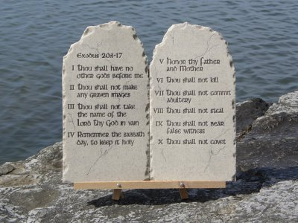
What was taken away?
“But if the ministration of death, written and engraven in stones, was glorious, so that the children of Israel could not steadfastly behold the face of Moses for the glory of his countenance; which glory was to be done away:…” verse 7

Slide 4
10 Commandments Done Away?
The passage, on the surface, says that the 10 commandments were done away. They are no longer binding. Is this the same man who said, “Do we then make void the law through faith? God forbid: yea, we establish the law.” Romans 3:31
There appears to be a contradiction between the two verses. On the one hand, it appears that Paul is saying the 10 commandments are gone; on the other, that the 10 commandments should be followed. So, which one is it?

Slide 5
Look Again
“But if the ministration of death, written and engraven in stones, was glorious, so that the children of Israel could not steadfastly behold the face of Moses for the glory of his countenance; which glory was to be done away:…” verse 7
What made the ten commandments glorious? The ten commandments, by themselves, as the verse says, are a ministration of death. That is, they condemn us to death. The ten commandments reveal our lost condition before God.

Slide 6
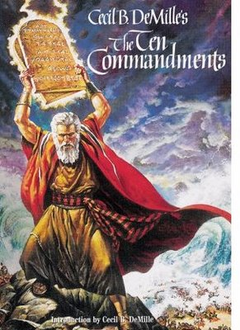
Life isn’t found here
“Whosoever committeth sin transgresseth also the law: for sin is the transgression of the law.” 1 John 3:4 “What shall we say then? Is the law sin? God forbid. Nay, I had not known sin, but by the law: for I had not known lust, except the law had said, Thou shalt not covet. But sin, taking occasion by the commandment, wrought in me all manner of concupiscence. For without the law sin was dead.” Romans 7:7,8

Slide 7
The Glorious Law
It condemns us to death; it reveals my absolutely lost condition. What is glorious about this? It doesn’t give me life; it only gives me death.
“Is the law then against the promises of God? God forbid: for if there had been a law given which could have given life, verily righteousness should have been by the law. But the scripture hath concluded all under sin, that the promise by faith of Jesus Christ might be given to them that believe.” Galatians 3:21,22 Where is hope?

Slide 8
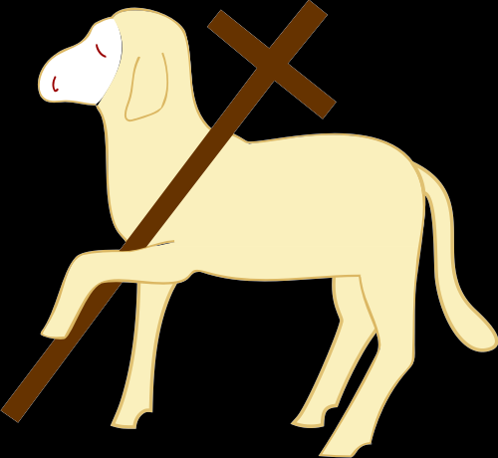
What made the Law Glorious?
Moses face shown with the brightness of a 1,000 suns. What did he see in those tables of stone that was so awesome.? He saw Christ in the law. He saw that a way was provided whereby guilty man could be forgiven for his sins.

Slide 9
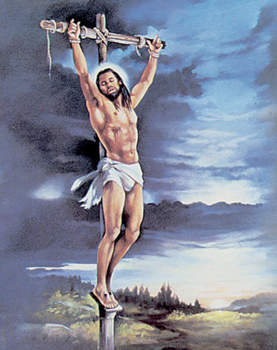
Christ Makes the Ten Commandments Glorious
It was seeing Jesus Christ, through the ceremonial law of sacrifice, dying for our sins against the 10 commandments, that made the system glorious. Without Christ, the 10 commandments would only bring us death.

Slide 10
Ceremonial System Revealed Christ
“For if the ministration of condemnation be glory, much more doth the ministration of righteousness exceed in glory.
For even that which was made glorious had no glory in this respect, by reason of the glory that excelleth.
For if that which is done away was glorious, much more that which remaineth is glorious.
Seeing then that we have such hope, we use great plainness of speech:” 2 Corinthians 3:9-12

Slide 11
Sacrifices/Ceremonies
The system of sacrifices, that revealed Christ, made Moses’ face shine. The ten commandments, the ministration of death, brought only condemnation and death. When Moses saw Christ revealed in the sacrificial offerings, he was enraptured by the thought and it was this that made his face shine. There was/is life/hope in Jesus Christ; there is death in the law of ten commandments.

Slide 12
Life in Christ
“Is the law then against the promises of God? God forbid: for if there had been a law given which could have given life, verily righteousness should have been by the law. But the scripture hath concluded all under sin, that the promise by faith of Jesus Christ might be given to them that believe. But before faith came, we were kept under the law, shut up unto the faith which should afterwards be revealed. Wherefore the law was our schoolmaster to bring us unto Christ, that we might be justified by faith. But after that faith is come, we are no longer under a schoolmaster.” Galatians 3:21-25
“For what the law could not do, in that it was weak through the flesh, God sending his own Son in the likeness of sinful flesh, and for sin, condemned sin in the flesh: That the righteousness of the law might be fulfilled in us, who walk not after the flesh, but after the Spirit.” Romans 8:3,4

Slide 13
No more need for Sacrifices
“For even that which was made glorious had no glory in this respect, by reason of the glory that excelleth. For if that which is done away was glorious, much more that which remaineth is glorious. Seeing then that we have such hope, we use great plainness of speech: And not as Moses, which put a vail over his face, that the children of Israel could not steadfastly look to the end of that which is abolished: But their minds were blinded: for until this day remaineth the same vail untaken away in the reading of the old testament; which vail is done away in Christ.” 2 Corinthians 3:10-14
After Christ came, there was no more need for sacrifices. This was a glorious system of ceremonies/sacrifices, but Christ was infinitely greater. In Paul’s day, the Jews couldn’t see that the ceremonial system was no longer binding. It was removed by Christ.

Slide 14
The Vail of Moses
“And it came to pass, when Moses came down from mount Sinai with the two tables of testimony in Moses' hand, when he came down from the mount, that Moses wist not that the skin of his face shone while he talked with him. And when Aaron and all the children of Israel saw Moses, behold, the skin of his face shone; and they were afraid to come nigh him.
And Moses called unto them; and Aaron and all the rulers of the congregation returned unto him: and Moses talked with them. And afterward all the children of Israel came nigh: and he gave them in commandment all that the LORD had spoken with him in mount Sinai.
And till Moses had done speaking with them, he put a vail on his face. But when Moses went in before the LORD to speak with him, he took the vail off, until he came out. And he came out, and spake unto the children of Israel that which he was commanded. And the children of Israel saw the face of Moses, that the skin of Moses' face shone: and Moses put the vail upon his face again, until he went in to speak with him.” Exodus 34:29-35

Slide 15
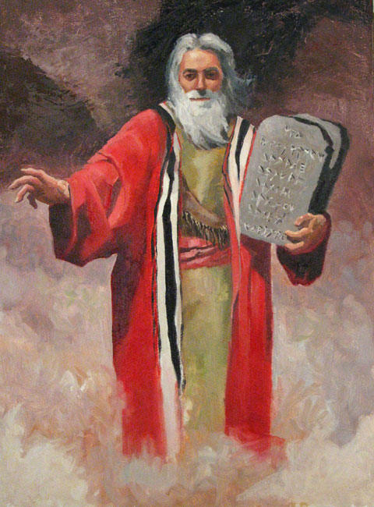
The Glory
“The greatest difficulty Paul had to meet arose from the influence of Judaizing teachers. These made him much trouble by causing dissension in the church at Corinth. They were continually presenting the virtues of the ceremonies of the law, exalting these ceremonies above the gospel of Christ, and condemning Paul because he did not urge them upon the new converts. Paul met them on their own ground. "If the ministration of death, written and engraven in stones, was glorious," he said, "so that the children of Israel could not steadfastly behold the face of Moses for the glory of his countenance; which glory was to be done away: how shall not the ministration of the spirit be rather glorious? For if the ministration of condemnation be glory, much more doth the ministration of righteousness exceed in glory" (2 Cor. 3:7-9). The law of God, spoken in awful grandeur from Sinai, is the utterance of condemnation to the sinner. It is the province of the law to condemn, but there is in it no power to pardon or to redeem. It is ordained to life; those who walk in harmony with its precepts will receive the reward of obedience. But it brings bondage and death to those who remain under its condemnation. “ 1SM 236,237

Slide 16
The glory
“The glory that shone on the face of Moses was a reflection of the righteousness of Christ in the law. The law itself would have no glory, only that in it Christ is embodied. It has no power to save. It is lusterless only as in it Christ is represented as full of righteousness and truth. The types and shadows of the sacrificial service, with the prophecies, gave the Israelites a veiled, indistinct view of the mercy and grace to be brought to the world by the revelation of Christ. To Moses was unfolded the significance of the types and shadows pointing to Christ. He saw to the end of that which was to be done away when, at the death of Christ, type met antitype. He saw that only through Christ can man keep the moral law. By transgression of this law man brought sin into the world, and with sin came death. Christ became the propitiation for man's sin. He proffered His perfection of character in the place of man's sinfulness. He took upon Himself the curse of disobedience. The sacrifices and offerings pointed forward to the sacrifice He was to make. The slain lamb typified the Lamb that was to take away the sin of the world. It was seeing the object of that which was to be done away, seeing Christ as revealed in the law, that illumined the face of Moses. The ministration of the law, written and engraved in stone, was a ministration of death. Without Christ, the transgressor was left under its curse, with no hope of pardon. The ministration had of itself no glory, but the promised Saviour, revealed in the types and shadows of the ceremonial law, made the moral law glorious.” 1SM 237

Slide 17
Again
“The pardon of sin through Christ, the promised Messiah, whom their offerings typified, was but dimly understood. Paul declared, "Seeing then that we have such hope, we use great plainness of speech: and not as Moses, which put a vail over his face, that the children of Israel could not steadfastly look to the end of that which is abolished: but their minds were blinded: for until this day remaineth the same vail untaken away in the reading of the old testament; which vail is done away in Christ. But even unto this day, when Moses is read, the vail is upon their heart. Nevertheless when it shall turn to the Lord, the vail shall be taken away" (2 Cor. 3:12-16). The Jews refused to accept Christ as the Messiah, and they cannot see that their ceremonies are meaningless, that the sacrifices and offerings have lost their significance. The veil drawn by themselves in stubborn unbelief is still before their minds. It would be removed if they would accept Christ, the righteousness of the law. Many in the Christian world also have a veil before their eyes and heart. They do not see to the end of that which was done away. They do not see that it was only the ceremonial law which was abrogated at the death of Christ. They claim that the moral law was nailed to the cross. Heavy is the veil that darkens their understanding. The hearts of many are at war with God. They are not subject to His law. Only as they shall come into harmony with the rule of His government, can Christ be of any avail to them. They may talk of Christ as their Saviour; but He will finally say to them, I know you not. You have not exercised genuine repentance toward God for the transgression of His holy law, and you cannot have genuine faith in Me, for it was My mission to exalt God's law.” 1SM 238,239

Slide 18
Paul’s Struggle
“And certain men which came down from Judaea taught the brethren, and said, Except ye be circumcised after the manner of Moses, ye cannot be saved. When therefore Paul and Barnabas had no small dissension and disputation with them, they determined that Paul and Barnabas, and certain other of them, should go up to Jerusalem unto the apostles and elders about this question.” “But there rose up certain of the sect of the Pharisees which believed, saying, That it was needful to circumcise them, and to command them to keep the law of Moses. And the apostles and elders came together for to consider of this matter.” Acts 15:12; 5,6
“The greatest difficulty Paul had to meet arose from the influence of Judaizing teachers. These made him much trouble by causing dissension in the church at Corinth. They were continually presenting the virtues of the ceremonies of the law, exalting these ceremonies above the gospel of Christ, and condemning Paul because he did not urge them upon the new converts. Paul met them on their own ground.”

Slide 19
The Issue in the First Century
There were Jewish believers who wanted to maintain the ceremonies of the Jews and teach them to the new converts. The Jews wanted them circumcised, to keep the feast days, and to reverence the services and temple in Jerusalem. Paul said absolutely not!
“One man esteemeth one day above another: another esteemeth every day alike. Let every man be fully persuaded in his own mind. He that regardeth the day, regardeth it unto the Lord; and he that regardeth not the day, to the Lord he doth not regard it.’ Romans 14:5,6
“But now, after that ye have known God, or rather are known of God, how turn ye again to the weak and beggarly elements, whereunto ye desire again to be in bondage? Ye observe days, and months, and times, and years.” Galatians 4:9,10

Slide 20
Ceremonial Sabbath Feast Days
“Blotting out the handwriting of ordinances that was against us, which was contrary to us, and took it out of the way, nailing it to his cross; And having spoiled principalities and powers, he made a shew of them openly, triumphing over them in it. Let no man therefore judge you in meat, or in drink, or in respect of an holyday, or of the new moon, or of the sabbath days: Which are a shadow of things to come; but the body is of Christ.” Colossians 2:14-17 What did the Jews have that contained meat, drink, holyday, (sabbath days) and new moons?

Slide 21
Continued
“And in the beginnings of your months (New Moons)ye shall offer a burnt offering unto the LORD; two young bullocks, and one ram, seven lambs of the first year without spot; And three tenth deals of flour for a meat offering, (Meat)mingled with oil, for one bullock; and two tenth deals of flour for a meat offering, mingled with oil, for one ram; And a several tenth deal of flour mingled with oil for a meat offering unto one lamb; for a burnt offering of a sweet savour, a sacrifice made by fire unto the LORD. And their drink offerings (Drink)shall be half an hin of wine unto a bullock, and the third part of an hin unto a ram, and a fourth part of an hin unto a lamb: this is the burnt offering of every month throughout the months of the year. And one kid of the goats for a sin offering unto the LORD shall be offered, beside the continual burnt offering, and his drink offering. And in the fourteenth day of the first month is the passover of the LORD. And in the fifteenth day of this month is the feast: seven days shall unleavened bread be eaten.; In the first day shall be an holy convocation (: Holyday)ye shall do no manner of servile work therein:(sabbath day).” Numbers 28:11-17 All five pieces that Paul was talking about were found in the feast days. Paul said they were no longer binding; they pointed forward to Christ and some work He would do on behalf of man.

Slide 22
Notice
1. Passover- “For even Christ our passover is sacrificed for us.” 1 Corinthians 5:7
2. Pentecost- Christ’s first act as High Priest; it was the early rain. “And they were all filled with the Holy Ghost, and began to speak with other tongues, as the Spirit gave them utterance.” Acts 2:4
3. Trumpets- The warning blast (Leviticus 23:24) told the Israelites that judgment was approaching. William Miller and others were trumpet call of Christ, warning of judgment near.

Slide 23
The Shadows
4. Day of Atonement- pointed forward to Christ’s final work in the Most Holy Place of the heavenly sanctuary. This began in 1844. “Also on the tenth day of this seventh month there shall be a day of atonement: it shall be an holy convocation unto you; and ye shall afflict your souls, and offer an offering made by fire unto the LORD.” Leviticus 23:27
5. Tabernacles- points forward to the Second Coming when the souls of earth will be harvested. “when ye have gathered in the fruit of the land, ye shall keep a feast unto the LORD seven days…” Leviticus 23:39

Slide 24
The Ceremonial Laws and Feast
As glorious as these were, these were shadows of the great works that Christ would perform on our behalf. Had the Jews received Christ, they would have seen that they were abolished. Because they didn’t receive Christ, “… that the children of Israel could not steadfastly look to the end of that which is abolished: But their minds were blinded: for until this day remaineth the same vail untaken away in the reading of the old testament; which vail is done away in Christ.” 2 Corinthians 3:13,14

Slide 25
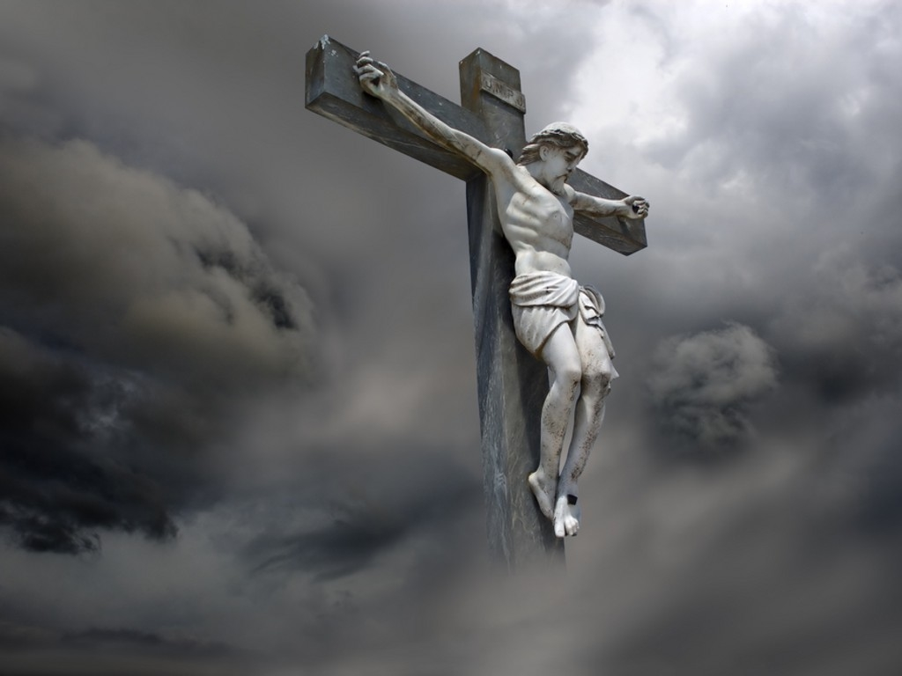
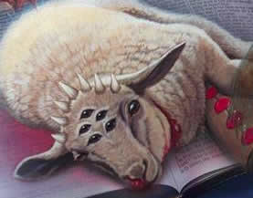
The Glorious System

