Slide 1
Daniel, Ch. 10 ‘The War Room’

Slide 2
The Prophecies are Clear!
The 2300 year prophecy is now clear. Jerusalem will be restored after the 70 years of Babylonian captivity.
“And this whole land shall be a desolation, and an astonishment; and these nations shall serve the king of Babylon seventy years. And it shall come to pass, when seventy years are accomplished, that I will punish the king of Babylon, and that nation, saith the LORD, for their iniquity, and the land of the Chaldeans, and will make it perpetual desolations.” Jeremiah 25:11,12

Slide 3
Trouble is Brewing!
“In the third year of Cyrus king of Persia a thing was revealed unto Daniel, whose name was called Belteshazzar; and the thing was true, but the time appointed was long: and he understood the thing, and had understanding of the vision. In those days I Daniel was mourning three full weeks. I ate no pleasant bread, neither came flesh nor wine in my mouth, neither did I anoint myself at all, till three whole weeks were fulfilled.” Daniel 10:1-3

Slide 4
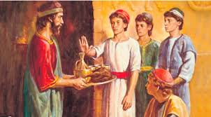
Pleasant Bread, Flesh, or Wine
“Daniel and his associates had been trained by their parents to habits of strict temperance. They had been taught that God would hold them accountable for their capabilities, and that they must never dwarf or enfeeble their powers. This education was to Daniel and his companions the means of their preservation amidst the demoralizing influences of the court of Babylon. Strong were the temptations surrounding them in that corrupt and luxurious court, but they remained uncontaminated. No power, no influence, could sway them from the principles they had learned in early life by a study of the word and works of God.” PK, pgs. 481,482

Slide 5
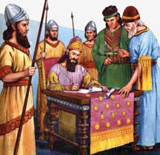
Captivity Over! What Now?
Cyrus’ 3rd year would be right at 536 BC, so the 70 years of Babylonian captivity was over. The Jews were not going anywhere. What was wrong? Daniel fell ill. What was wrong? Jehovah still reigned in the Heavens and in the earth. Daniel finds out!

Slide 6
Daniel’s Vision
And in the four and twentieth day of the first month, as I was by the side of the great river, which is Hiddekel; Then I lifted up mine eyes, and looked, and behold a certain man clothed in linen, whose loins were girded with fine gold of Uphaz: His body also was like the beryl, and his face as the appearance of lightning, and his eyes as lamps of fire, and his arms and his feet like in colour to polished brass, and the voice of his words like the voice of a multitude. And I Daniel alone saw the vision: for the men that were with me saw not the vision; but a great quaking fell upon them, so that they fled to hide themselves. Therefore I was left alone, and saw this great vision, and there remained no strength in me: for my comeliness was turned in me into corruption, and I retained no strength.” Daniel 10:4-8

Slide 7
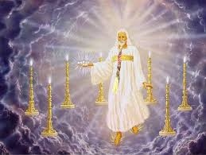
Just Like John
“And in the midst of the seven candlesticks one like unto the Son of man, clothed with a garment down to the foot, and girt about the paps with a golden girdle. His head and his hairs were white like wool, as white as snow; and his eyes were as a flame of fire; And his feet like unto fine brass, as if they burned in a furnace; and his voice as the sound of many waters. And he had in his right hand seven stars: and out of his mouth went a sharp two-edged sword: and his countenance was as the sun shineth in his strength.” Rev. 1:13-16

Slide 8
Fell at His feet as dead!
“This description is similar to that given by John when Christ was revealed to him upon the Isle of Patmos. No less a personage than the Son of God appeared to Daniel… All who are truly sanctified will have a similar experience. The clearer their views of the greatness, glory, and perfection of Christ, the more vividly will they see their own weakness and imperfection. They will have no disposition to claim a sinless character; that which has appeared right and comely in themselves will, in contrast with Christ's purity and glory, appear only as unworthy and corruptible. It is when men are separated from God, when they have
very indistinct views of Christ, that they say, "I am sinless; I am sanctified.“ SL, pgs. 49-51

Slide 9
Not I, but Christ!
“He who beholds Christ in His self-denial, His lowliness of heart, will be constrained to say, as did Daniel, when he beheld One like the sons of men, "My comeliness was turned in me into corruption." Daniel 10:8. The independence and self-supremacy in which we glory are seen in their true vileness as tokens of servitude to Satan. Human nature is ever struggling for expression, ready for contest; but he who learns of Christ is emptied of self, of pride, of love of supremacy, and there is silence in the soul. Self is yielded to the disposal of the Holy Spirit. Then we are not anxious to have the highest place. We have no ambition to crowd and elbow ourselves into notice; but we feel that our highest place is at the feet of our Saviour. We look to Jesus, waiting for His hand to lead, listening for His voice to guide. The apostle Paul had this experience, and he said, "I am crucified with Christ: nevertheless I live; yet not I, but Christ liveth in me: and the life which I now live in the flesh I live by the faith of the Son of God, who loved me, and gave Himself for me." Galatians 2:20. When we receive Christ as an abiding guest in the soul, the peace of God, which passeth all understanding, will keep our hearts and minds through Christ Jesus. The Saviour's life on earth, though lived in the midst of conflict, was a life of peace. While angry enemies were constantly pursuing Him, He said, "He that sent Me is with Me: the Father hath not left Me alone; for I do always those things that please Him." John 8:29. No storm of human or satanic wrath could disturb the calm of that perfect communion with God. And He says to us, "Peace I leave with you, My peace I give unto you." "Take My yoke upon you, and learn of Me; for I am meek and lowly in heart: and ye shall find rest." John 14:27; Matthew 11:29.” MB, pgs. 15,16

Slide 10
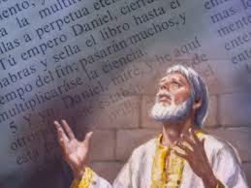
Greatly Loved!
“Yet heard I the voice of his words: and when I heard the voice of his words, then was I in a deep sleep on my face, and my face toward the ground. And, behold, an hand touched me, which set me upon my knees and upon the palms of my hands. And he said unto me, O Daniel, a man greatly beloved, understand the words that I speak unto thee, and stand upright: for unto thee am I now sent. And when he had spoken this word unto me, I stood trembling. Then said he unto me, Fear not, Daniel: for from the first day that thou didst set thine heart to understand, and to chasten thyself before thy God, thy words were heard, and I am come for thy words.” Daniel 10:9-12
https://encrypted-tbn2.gstatic.com/images?q=tbn:ANd9GcRtEXm3TD97sIHxrQy3GeceOhttps://encrypted-tbn2.gstatic.com/images?q=tbn:ANd9GcRtEXm3TD97sIHxrQy3GeceO5AZcdIk0m555UeJpdcGuDeIDIvEEg5AZcdIk0m555UeJpdcGuDeIDIvEEg

Slide 11
War Raged!
“But the prince of the kingdom of Persia withstood me one and twenty days: but, lo, Michael, one of the chief princes, came to help me; and I remained there with the kings of Persia. Now I am come to make thee understand what shall befall thy people in the latter days: for yet the vision is for many days. And when he had spoken such words unto me, I set my face toward the ground, and I became dumb.” Daniel 10:13-15

Slide 12
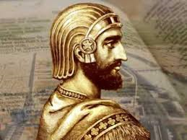
The Time Had Come!
The time had come for God’s people to return to Palestine. The 70 years were over. Daniel had been delivered from the lions den. Cyrus had seen the passages from Isaiah foretelling Heaven’s purpose for Cyrus to send God’s children home. The devil had other plans. A war raged!

Slide 13
“ By this we see that heavenly agencies have to contend with hindrances before the purpose of God is fulfilled in its time. The king of Persia was controlled by the highest of all evil angels. He refused, as did Pharaoh, to obey the word of the Lord. Gabriel declared, He withstood me twenty-one days by his representations against the Jews. But Michael came to his help, and then he remained with the kings of Persia, holding the powers in check, giving right counsel against evil counsel. Good and evil angels are taking a part in the planning of God in His earthly kingdom. It is God's purpose to carry forward His work in correct lines, in ways that will advance His glory. But Satan is ever trying to counterwork God's purpose. Only by humbling themselves before God can God's servants advance His work. Never are they to depend on their own efforts or on outward display for success (Letter 201, 1899).
13. An Invisible Struggle—We have before us in the Word of God instances of heavenly agencies working on the minds of kings and rulers, while at the same time satanic agencies were also at work on their minds. No human eloquence, in strongly set forth human opinions, can change the working of satanic agencies. Satan seeks continually to block the way, so that the truth shall be bound about by human devising; and those who have light and knowledge are in the greatest danger unless they constantly consecrate themselves to God, humiliating self, and realizing the peril of the times.

Slide 14
“Heavenly beings are appointed to answer the prayers of those who are working unselfishly for the interests of the cause of God. The very highest angels in the heavenly courts are appointed to work out the prayers which ascend to God for the advancement of the cause of God. Each angel has his particular post of duty, which he is not permitted to leave for any other place. If he should leave, the powers of darkness would gain an advantage.... Day by day the conflict between good and evil is going on. Why is it that those who have had many opportunities and advantages do not realize the intensity of this work? They should be intelligent in regard to this. God is the Ruler. By His supreme power He holds in check and controls earthly potentates. Through His agencies He does the work which was ordained before the foundation of the world. As a people we do not understand as we should the great conflict going on between invisible agencies, the controversy between loyal and disloyal angels. Evil angels are constantly at work, planning their line of attack, controlling as commanders, kings, and rulers, the disloyal human forces.” 4BC. Pg. 1173

Slide 15
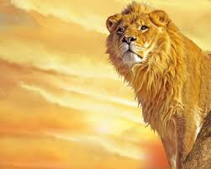
Who is Michael?
Only Michael could prevail over the mind of Cyrus. No other Heavenly being was able. The Bible gives us enough about Michael to determine who He is. For starters, the very name itself means, ‘the one who is like God’.

Slide 16
Michael
“And there was war in heaven: Michael and his angels fought against the dragon; and the dragon fought and his angels, And prevailed not; neither was their place found any more in heaven. And the great dragon was cast out, that old serpent, called the Devil, and Satan, which deceiveth the whole world: he was cast out into the earth, and his angels were cast out with him.” Rev. 12:7-9
“Yet Michael the archangel, when contending with the devil he disputed about the body of Moses, durst not bring against him a railing accusation, but said, The Lord rebuke thee.” Jude 9

Slide 17
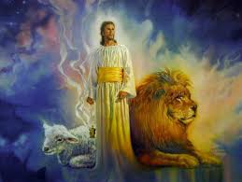
“And at that time shall Michael stand up, the great prince which standeth for the children of thy people: and there shall be a time of trouble, such as never was since there was a nation even to that same time: and at that time thy people shall be delivered, every one that shall be found written in the book.” Dan. 12:1

Slide 18
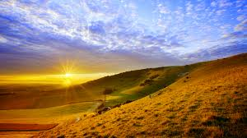
Conclusion
1. Only Michael can overcome the evil angel who controls Cyrus.
2. Michael leads the angels in the battle to drive the devil out of heaven.
3. Michael is the chief of the angels and has the power to resurrect Moses.
4. Michael is Christ Himself!

