Slide 1
Church and State, pt. 5
Our Forefathers????
Or Impaled Between Two Horns!!!

Slide 2
Think for a Minute!!!
The European continent was reeling. The papacy is collapsing; the Reformation of Luther has begun and kind of stopped; and as a result, there is the rise of the Anabaptist- Sabbatarians.
It is being proclaimed that the papacy is the antichrist. The papacy is saying that they changed the day of worship and the reformers realize there is no place for Sunday keeping in Scripture. The despised Anabaptist Sabbatarians are espousing the 7th day Sabbath, but the Lutheran/ Zwinglian reformers can’t stand them, nor embrace what they believe because the Luther/Zwingli people are sacralists and it is impossible for them to see believer’s baptism and the separation of church and state. How do they deal with the dilemma of the 7th day Sabbath?

Slide 3
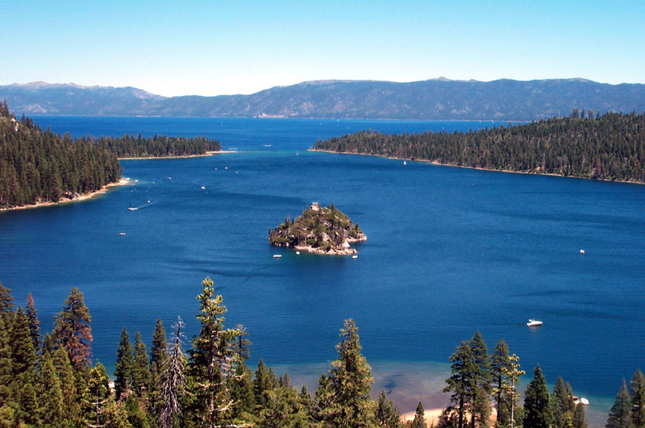
The Groups
1. Papists- claim authority for changing the day of worship from Sabbath to Sunday.
2. Luther/Zwingli- want nothing to do with Rome and only want the Bible.
3. Anabaptist Sabbatarians- pushing for the 7th day Sabbath but are despised by the ‘reformers’.

Slide 4
The Reformers Respond?!?!?!?!
They couldn’t embrace the papacy and their ‘Sunday’.
They couldn’t embrace the Anabaptists and their ‘Sabbath/Saturday’.
They created their own idea called it the Sunday-Sabbath.
“they developed the thesis that the Sabbath had been changed by apostolic or even divine authority to Sunday in commemoration of the ‘second creation’ of Christ’s resurrection.” Emmerson, The Reformation and the Advent Movement, pg. 123
THIS IS STILL WITH US TODAY!!!!!!

Slide 5
Spreading the Light
The Anabaptists were persecuted throughout Europe. Their refusal to accept infant baptism and their refusal to submit to a church-state union brought the ire of sacralists throughout Europe. As a result, the Anabaptists made their way to England. There, they initially met a king who, himself, was breaking free from the Catholic church. However, he was doing it for all the wrong reasons. The church would not annul his marriage to Catherine of Aragon in order for him to marry Anne Boleyn. The kings name was Henry VIII.

Slide 6
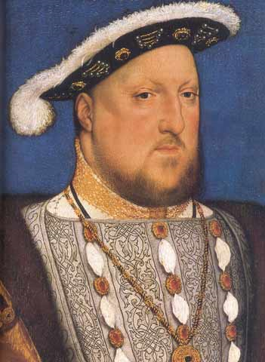
Sacral England
While Henry VIII broke free from the Vatican, he was still a papist at heart. He became the new pope of England. His successors were ‘popes’ as well. Edward VI, Bloody Mary, Elizabeth, and even James, of King James fame, kept the church and state together. Anyone who didn’t agree with these kings and queens suffered for their faith; whether Catholic or Protestant!

Slide 7
The English Ping-pong Ball
“In England the establishment of Protestantism as the national religion diminished, but did not wholly stop, persecution. While many of the doctrines of Rome had been renounced, not a few of its forms were retained. The supremacy of the pope was rejected, but in his place the monarch was enthroned as the head of the church. In the service of the church there was still a wide departure from the purity and simplicity of the gospel. The great principle of religious liberty was not yet understood. Though the horrible cruelties which Rome employed against heresy were resorted to but rarely by Protestant rulers, yet the right of every man to worship God according to the dictates of his own conscience was not acknowledged. All were required to accept the doctrines and observe the forms of worship prescribed by the established church. Dissenters suffered persecution, to a greater or less extent, for hundreds of years.
In the seventeenth century thousands of pastors were expelled from their positions. The people were forbidden, on pain of heavy fines, imprisonment, and banishment, to attend any religious meetings except such as were sanctioned by the church. Those faithful souls who could not refrain from gathering to worship God were compelled to meet in dark alleys, in obscure garrets, and at some seasons in the woods at midnight.” GC, pgs. 251,252

Slide 8
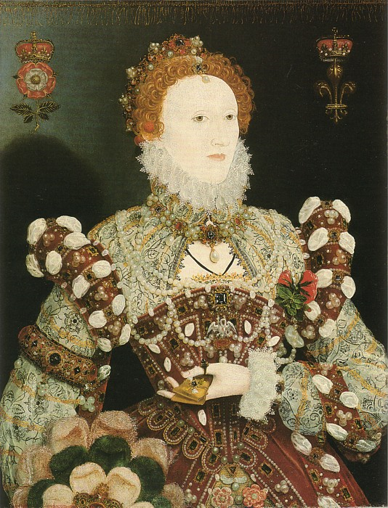
Elizabeth
Queen Elizabeth, along with all the other kings and queens in England, failed to separate the church and the state. Those who wanted changes, who wanted to see more purity in the faith of the church of England, began separating themselves from the state church. They became known as Puritans and Separatists. “In spite of the noble witness of the Puritans, who separated from the national church in the earlier years of Elizabeth’s reign, it was not until the 1580’s that evangelical separation became a major force in England.” Emmerson, pg. 127

Slide 9
Puritans were Calvinists
“England had become a Protestant kingdom and her church a Protestant church ; yet among the Protestants were those who were not satisfied with Elizabeth's moderation, and wished that all, even the slightest vestiges of popery might be removed" from the church and from the mind. These people, at first called Evangelics," had been obliged to flee from England during Mary's reign and to take refuge in certain cities of Germany, Geneva, Zurich, Strasburg, Frankfort, and Basel. There they had established churches, and during the years 1554-1558 had fought out among themselves many of the issues afterward to be raised in England. When in 1554 they had submitted to Calvin the question as to whether or not the prayer book of Edward VI should be adopted, the latter decided against it, on the ground that the prayer book lacked the purity that was desirable. This decision gave the victory to the more extreme or Calvinistic party among them and suggested the name, Puritan, which was afterward given to this party in England.” http://britain.library4history.org/Andrews-Henry-III-Stuarts/THE-TUDORS-AND-THE-REFORMATION
While it is true that the Puritans were Protestants, they were also sacralists like John Calvin. They also kept the church and state together and were ready to use the sword to kill opponents. This is why the Puritans, when they came to America, persecuted anyone who didn’t agree with them. They were sacralists.

Slide 10
Puritan-Calvin Connection
The preceding quote is very clear that the Puritans were very closely tied to the reforms of John Calvin. This becomes very significant in the light of early American history.
Calvin, as we have already seen, was a sacralist, believing that everyone had to conform to the beliefs in the area where they lived. He believed in infant baptism, the unification of church and state, and the use of the sword against those who didn’t agree with the majority. Calvin had many burned who didn’t agree with him.
While the Puritans, who came early to America from Holland, had separated from the established church in England, they still held the same ideas; namely, the church and state must be together and anyone who doesn’t comply must die.
“Associated exclusively with no single theology or definition of the church (although many were Calvinists), the English Puritans were known at first for their extremely critical attitude regarding the religious compromises made during the reign of Elizabeth I…These Puritans insisted that they, as God's elect, had the duty to direct national affairs according to God's will as revealed in the Bible. This union of church and state to form a holy commonwealth gave Puritanism direct and exclusive control over most colonial activity.” http://mb-soft.com/believe/txc/puritani.htm

Slide 11
The Separatists Leave England
William Brewster, born in 1567 in England, as an adult became a Puritan. The beliefs and views of the Puritans did not conform to those of the Church of England, creating a dangerous situation for those Englishmen and women who called themselves Puritans. In his village of Scrooby in Nottinghamshire, Brewster and others formed their own church, called a Separatist church. Secretly this group met for devotions in the Brewster manor house. But even from within the privacy of the Brewster home the group was spied upon, found out, and persecuted.
Although Brewster had been educated at Cambridge University, his Puritan beliefs and the seeking of religious freedom would in time bring him considerable trouble. They would also send him on an unbelievable adventure, first to Holland and then to America.
Previous to this adventure Brewster had been in the service of William Davison, England's ambassador to Holland. Brewster made numerous trips to that country and in time grew to know the country well.

Slide 12
On the Move
“Some at last determined to seek refuge in Holland. Difficulties, losses, and imprisonment were encountered. Their purposes were thwarted, and they were betrayed into the hands of their enemies. But steadfast perseverance finally conquered, and they found shelter on the friendly shores of the Dutch Republic.
In their flight they had left their houses, their goods, and their means of livelihood. They were strangers in a strange land, among a people of different language and customs. They were forced to resort to new and untried occupations to earn their bread. Middle-aged men, who had spent their lives in tilling the soil, had now to learn mechanical trades. But they cheerfully accepted the situation and lost no time in idleness or repining. Though often pinched with poverty, they thanked God for the blessings which were still granted them and found their joy in unmolested spiritual communion. "They knew they were pilgrims, and looked not much on those things, but lifted up their eyes to heaven, their dearest country, and quieted their spirits."--Bancroft, pt. 1, ch. 12, par. 15.
In the midst of exile and hardship their love and faith waxed strong. They trusted the Lord's promises, and He did not fail them in time of need. His angels were by their side, to encourage and support them. And when God's hand seemed pointing them across the sea, to a land where they might found for themselves a state, and leave to their children the precious heritage of religious liberty, they went forward, without shrinking, in the path of providence.” GC, pgs. 290, 291

Slide 13
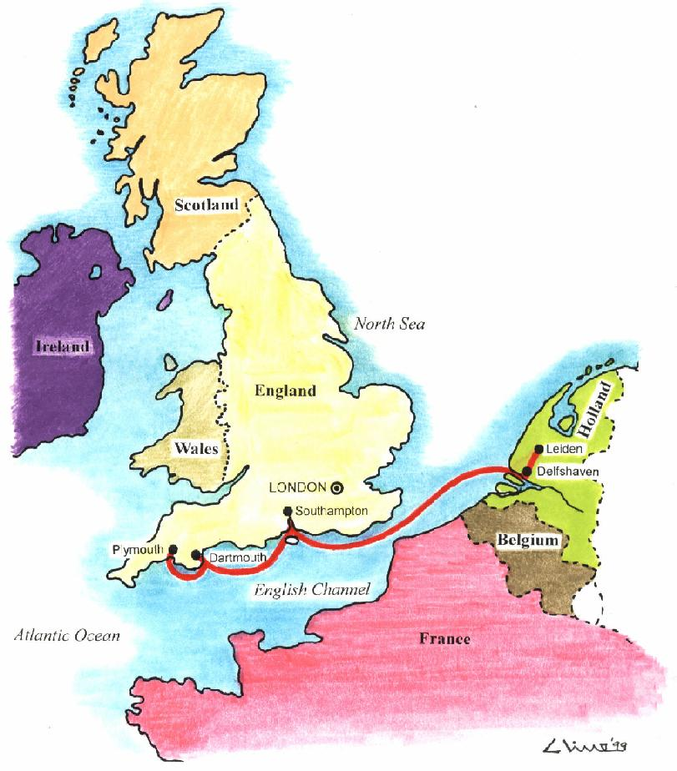
Puritans Meet the Anabaptists
John Smyth, an early Puritan leader in England, had gone to Holland. While there, he affirmed that believer’s baptism was the only way to go. He wrote, “We must either go back to the church of England, or go forward to true baptism.” The English Separatist Movement, B.R. White , pg. 46
True baptism would sever the tie of church and state and make the church ‘a called out body’ in the midst of a corrupt society. Smyth understood this, but the other Puritans in Holland took exception with this and felt that Smyth was unstable and fallen subject to some errors.
The Puritans would meet the Anabaptists again!

Slide 14
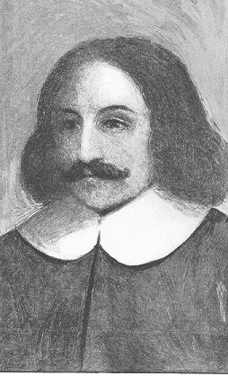
Famous Puritans who left England
The man to the right is William Bradford. He was very famous because he became the governor of the Boston settlement. Others included William Brewster and John Robinson. Robinson didn’t cross the sea, but left them some valuable advice that was NOT heeded. “But whether the Lord hath appointed it or not, I charge you before God and His blessed angels to follow me no farther than I have followed Christ. If God should reveal anything to you by any other instrument of His, be as ready to receive it as ever you were to receive any truth of my ministry; for I am very confident the Lord hath more truth and light yet to break forth out of His holy word."--Martyn, vol. 5, p. 70. "For my part, I cannot sufficiently bewail the condition of the reformed churches, who are come to a period in religion, and will go at present no farther than the instruments of their reformation. The Lutherans cannot be drawn to go beyond what Luther saw; . . . and the Calvinists, you see, stick fast where they were left by that great man of God, who yet saw not all things. This is a misery much to be lamented; "--D. Neal, History of the Puritans, vol. 1, p. 269.” GC, pg. 291,292

Slide 15
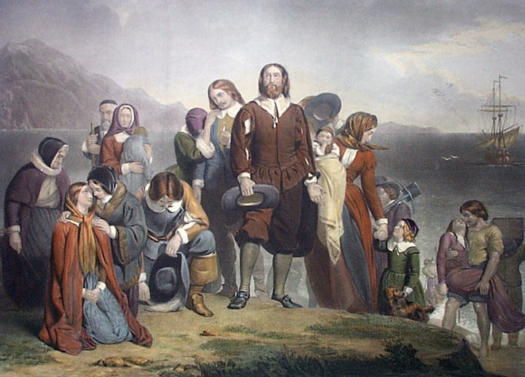
A Way was Opened
”And to the woman were given two wings of a great eagle, that she might fly into the wilderness, into her place, where she is nourished for a time, and times, and half a time, from the face of the serpent. And the serpent cast out of his mouth water as a flood after the woman, that he might cause her to be carried away of the flood. And the earth helped the woman, and the earth opened her mouth, and swallowed up the flood which the dragon cast out of his mouth.” Revelation 12:14-16

Slide 16
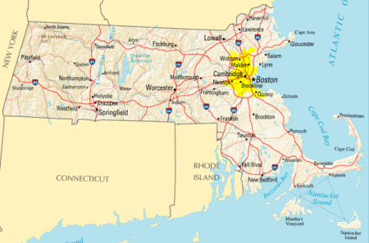
The Place
They came to a new land. They came with
a desire for religious freedom. They had lived and breathed the state/church together. They had already met the Anti-baptists and had resisted them. What would happen in this
new land? What principles would win now?

Slide 17
Too Bad-They were Sacralists!
“The Puritans brought strong religious impulses to bear in all colonies north of Virginia, but New England was their stronghold, and the Congregationalist churches established there were able to perpetuate their viewpoint about a Christian society for more than 200 years…These Puritans insisted that they, as God's elect, had the duty to direct national affairs according to God's will as revealed in the Bible. This union of church and state to form a holy commonwealth gave Puritanism direct and exclusive control over most colonial activity until commercial and political changes forced them to relinquish it at the end of the 17th century.” http://mb-soft.com/believe/txc/puritani.htm

Slide 18
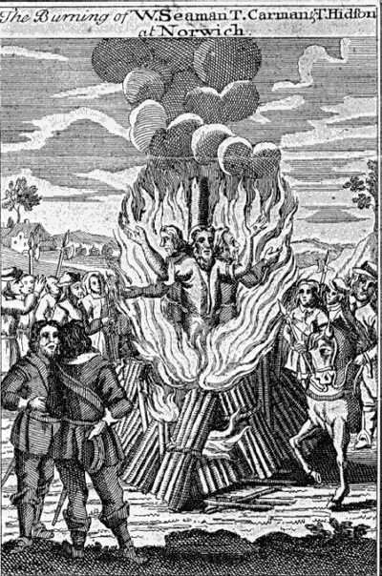
The Anabaptists come to America
Some Baptists emigrated to America, settling in Plymouth colony. The doctrine of believer’s baptism was not new to Governor Bradford, the Pilgrims having already met and resisted John Smyth’s “Anabaptist” church in Holland. Now, in the New World, Bradford had to decide whether to permit the spread of the Baptist deviation. Unfortunately, he chose to turn his back on the principle of freedom of conscience that had led to his original separation from the Established Church in England. He decided that the teaching of believer’s baptism was not to be tolerated, and he sought to exclude Baptists from the colony.” Emmerson, The Reformation and the Advent Movement, pg. 162
The ugly head of persecution had arisen AGAIN. This time in America!!!

Slide 19
Would it Ever End?
“It was the desire for liberty of conscience that inspired the Pilgrims to brave the perils of the long journey across the sea, to endure the hardships and dangers of the wilderness, and with God's blessing to lay, on the shores of America, the foundation of a mighty nation. Yet honest and God-fearing as they were, the Pilgrims did not yet comprehend the great principle of religious liberty. The freedom which they sacrificed so much to secure for themselves, they were not equally ready to grant to others. "Very few, even of the foremost thinkers and moralists of the seventeenth century, had any just conception of that grand principle, the outgrowth of the New Testament, which acknowledges God as the sole judge of human faith."--Ibid., vol. 5, p. 297. The doctrine that God has committed to the church the right to control the conscience, and to define and punish heresy, is one of the most deeply rooted of papal errors. While the Reformers rejected the creed of Rome, they were not entirely free from her spirit of intolerance. The dense darkness in which, through the long ages of her rule, popery had enveloped all Christendom, had not even yet been wholly dissipated. Said one of the leading ministers in the colony of Massachusetts Bay: "It was toleration that made the world antichristian; and the church never took harm by the punishment of heretics."--Ibid., vol. 5, p. 335. The regulation was adopted by the colonists that only church members should have a voice in the civil government. A kind of state church was formed, all the people being required to contribute to the support of the clergy, and the magistrates being authorized to suppress heresy. Thus the secular power was in the hands of the church. It was not long before these measures led to the inevitable result --persecution.” GC, pgs. 292, 293

Slide 20
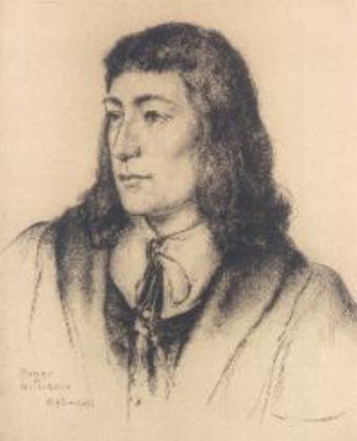
Land of the Free/ Two Horns like a Lamb?????????????
The Puritans and the Pilgrims were sacralists; they believed in forming a ‘Christian’ society where everyone from birth, having been baptized, would be part of this ‘Christian’ utopia. No one could not be part of it. If anyone wasn’t, then, well, they ceased to be!!! But what about the land of the free and two horns like a lamb??? From where did they come? Why the 1st amendment?
“Congress shall make no law respecting an establishment of religion, or prohibiting the free exercise thereof; or abridging the freedom of speech, or of the press; or the right of the people peaceably to assemble, and to petition the Government for a redress of grievances.” It came not from the mindset of a sacralist Puritan!! Never!!
God sent a man!!!

