Slide 1

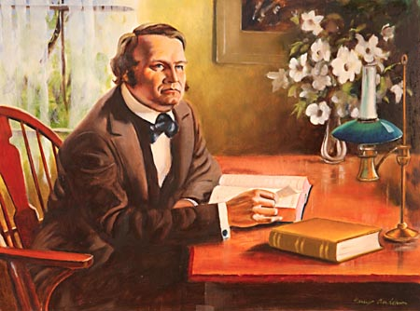
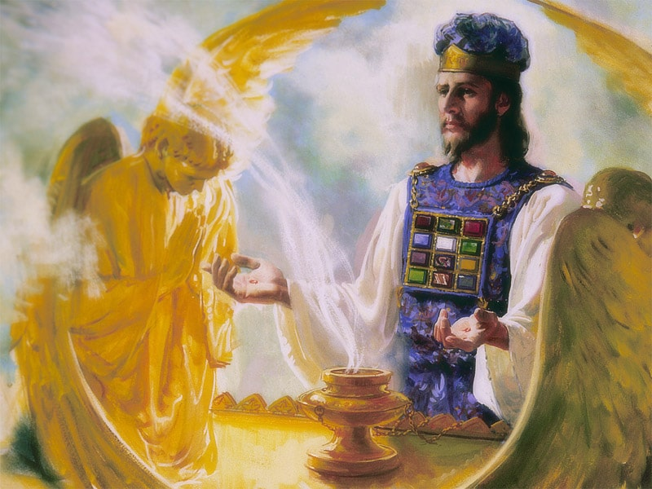
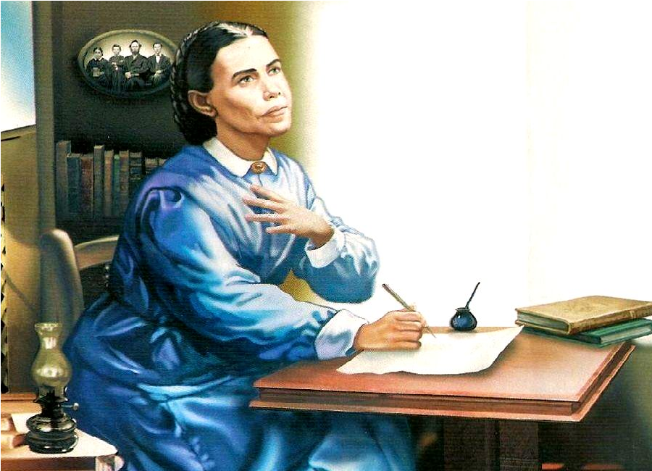
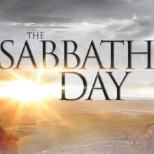
The 2300 Days

Slide 2
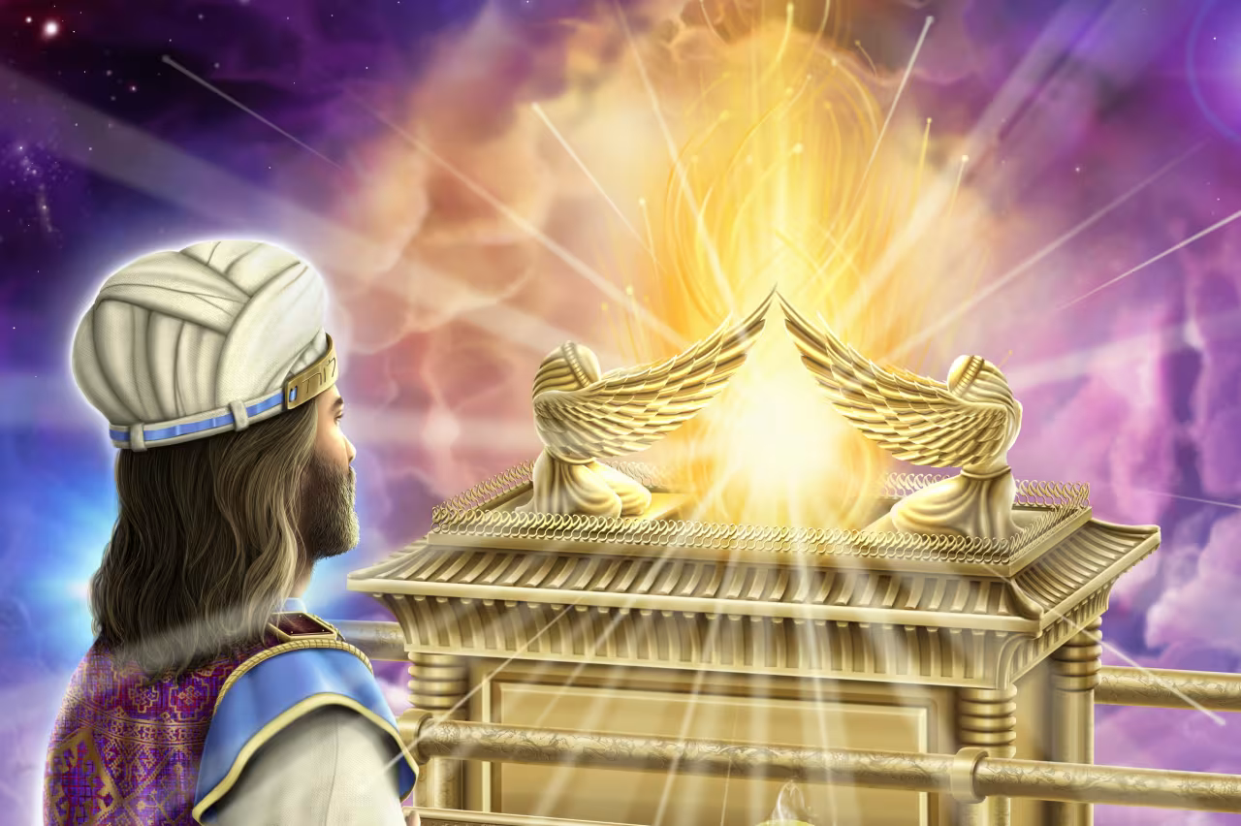
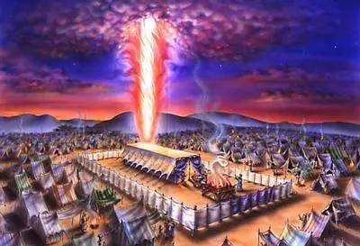
Recap…
So far we have found that the Millerite Movement of 1844 was ordained of God to:
Complete the work of the Reformation in “restoring” the Sanctuary
Fulfills to the day the prophetic time periods of Daniel 8, from 457BC-1844
Fulfills the event to take place, which was the cleansing of the Sanctuary (Day of Atonement)
Fulfills the time period of the “blessed” in Daniel 12, from 508AD-1843
Fulfills the prophetic events of the Midnight Cry from the Parable of the Ten Virgins
Is the only movement to share in the identical experience of the Disciples Great Disappointment
Fulfills the prophetic experience from Revelation 10
But Let’s take a deeper look at the prophecies of Revelation and the Millerite experience

Slide 3
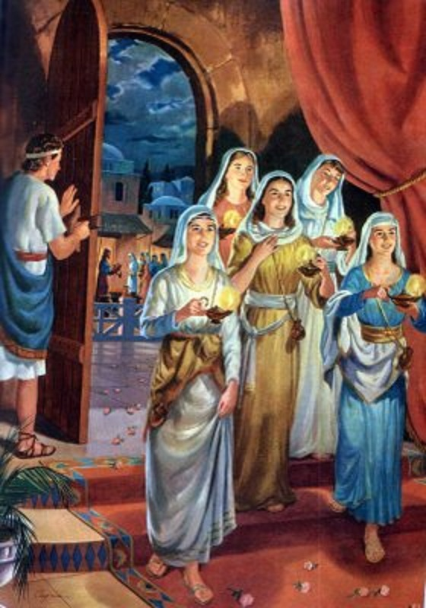
The Midnight Cry – Parable of the 10 Virgins
Matt. 25:5-13 “While the bridegroom tarried, they all slumbered and slept. And at midnight there was a cry made, Behold, the bridegroom cometh; go ye out to meet him. Then all those virgins arose, and trimmed their lamps. And the foolish said unto the wise, Give us of your oil; for our lamps are gone out. But the wise answered, saying, Not so; lest there be not enough for us and you: but go ye rather to them that sell, and buy for yourselves. And while they went to buy, the bridegroom came; and they that were ready went in with him to the marriage: and the door was shut. Afterward came also the other virgins, saying, Lord, Lord, open to us. But he answered and said, Verily I say unto you, I know you not. Watch therefore, for ye know neither the day nor the hour wherein the Son of man cometh.”

Slide 4
Tried, Tested, Tempted, Refined
“True, there had been a failure as to the expected event, but even this could not shake their faith in the word of God. When Jonah proclaimed in the streets of Nineveh that within forty days the city would be overthrown, the Lord accepted the humiliation of the Ninevites and extended their period of probation; yet the message of Jonah was sent of God, and Nineveh was tested according to His will. Adventists believed that in like manner God had led them to give the warning of the judgment. "It has," they declared, "tested the hearts of all who heard it, and awakened a love for the Lord's appearing; or it has called forth a hatred, more or less perceivable, but known to God, of His coming. It has drawn a line, . . . so that those who will examine their own hearts, may know on which side of it they would have been found, had the Lord then come—whether they would have exclaimed, 'Lo! this is our God, we have waited for Him, and He will save us;' or whether they would have called to the rocks and mountains to fall on them to hide them from the face of Him that sitteth on the throne, and from the wrath of the Lamb. God thus, as we believe, has tested His people, has tried their faith, has proved them, and seen whether they would shrink, in the hour of trial, from the position in which He might see fit to place them; and whether they would relinquish this world and rely with implicit confidence in the word of God."—The Advent Herald and Signs of the Times Reporter, vol. 8, No. 14 (Nov 13, 1844).”—GC, p. 406

Slide 5


Christ’s Object Lessons Explains
“The two classes of watchers represent the two classes who profess to be waiting for their Lord. They are called virgins because they profess a pure faith. By the lamps is represented the word of God. The psalmist says, "Thy word is a lamp unto my feet, and a light unto may path." Ps. 119:105. The oil is a symbol of the Holy Spirit. Thus the Spirit is represented in the prophecy of Zechariah. "The angel that talked with me came again," he says, "and waked me, as a man that is wakened out of his sleep, and said unto me, What seest thou? And I said, I have looked, and behold a candlestick all of gold, with a bowl upon the top of it, and his seven lamps thereon, and seven pipes to the seven lamps, which are upon the top thereof; and two olive trees by it, one upon the right side of the bowl, and the other upon the left side thereof. So I answered and spake to the angel that talked with me, saying, What are these, my lord? . . . Then he answered and spake unto me, saying, This is the word of the Lord unto Zerubbabel, saying, Not by might, nor by power, but by My Spirit, saith the Lord of hosts. . . . And I answered again, and said unto him, What be these two olive branches which through the two golden pipes empty the golden oil out of themselves? . . . Then said he, These are the two anointed ones, that stand by the Lord of the whole earth." Zech. 4:1-14.” COL, 407-408

Slide 6
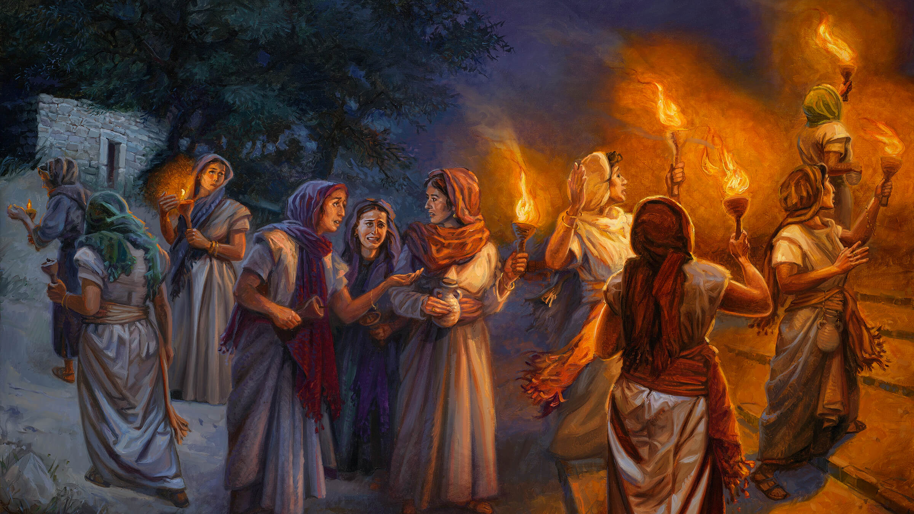
Rom. 8:9 “Now if any man have not the Spirit of Christ, he is none of his.”

Slide 7
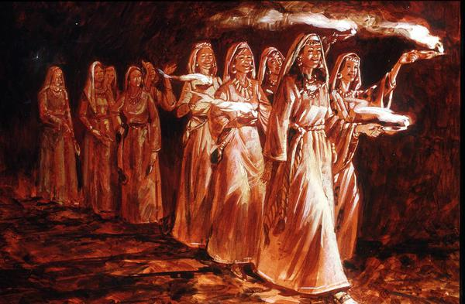
Christ’s Object Lessons Continues…
“In the parable, all the ten virgins went out to meet the bridegroom. All had lamps and vessels for oil. For a time there was seen no difference between them. So with the church that lives just before Christ's second coming. All have a knowledge of the Scriptures. All have heard the message of Christ's near approach, and confidently expect His appearing. But as in the parable, so it is now. A time of waiting intervenes, faith is tried; and when the cry is heard, "Behold, the Bridegroom cometh; go ye out to meet Him," many are unready. They have no oil in their vessels with their lamps. They are destitute of the Holy Spirit.” COL, 408

Slide 8
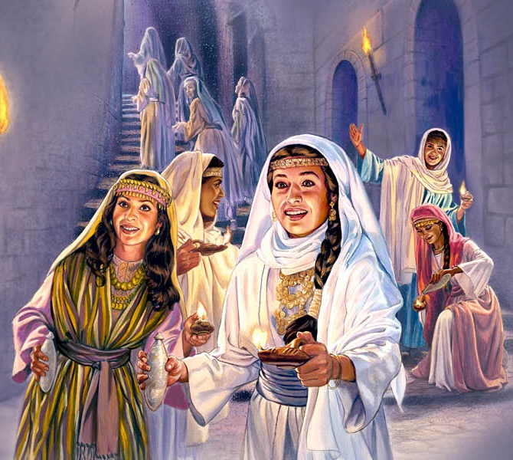
They Are Not Hypocrites!
“The class represented by the foolish virgins are not hypocrites. They have a regard for the truth, they have advocated the truth, they are attracted to those who believe the truth; but they have not yielded themselves to the Holy Spirit's working. They have not fallen upon the Rock, Christ Jesus, and permitted their old nature to be broken up. This class are represented also by the stony-ground hearers. They receive the word with readiness, but they fail of assimilating its principles. Its influence is not abiding. The Spirit works upon man's heart, according to his desire and consent implanting in him a new nature; but the class represented the foolish virgins have been content with a superficial work. They do not know God. They have not studied His character; they have not held communion with Him; therefore they do not know how to trust, how to look and live.” COL, 411

Slide 9
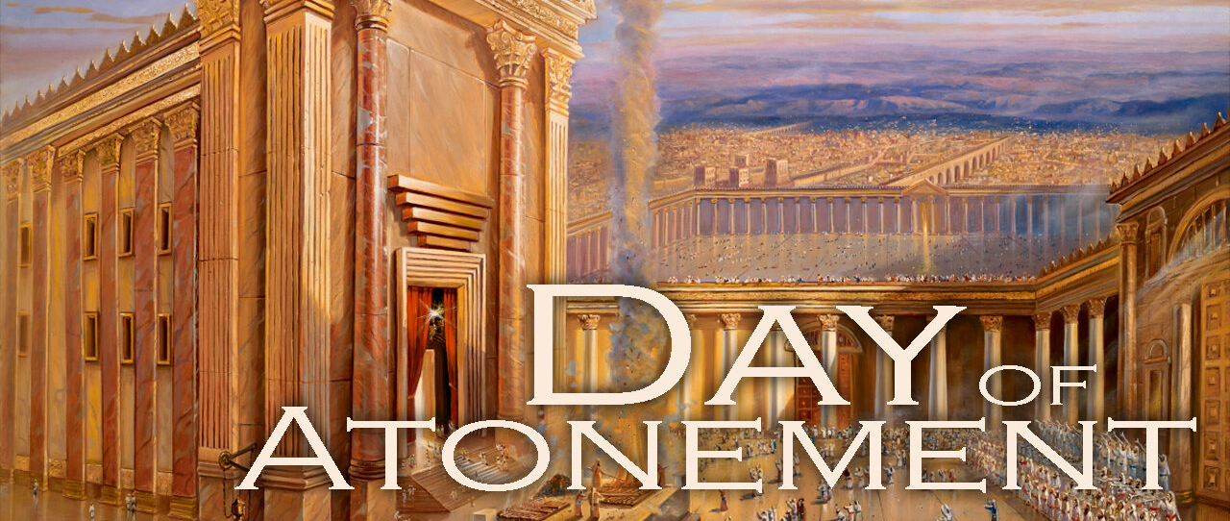
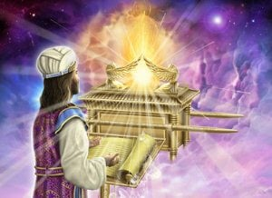
The Hour of His Judgment
Dan. 8:14 “And he said unto me, Unto two thousand and three hundred days; then shall the sanctuary be cleansed.”---ended in 1844
Lev. 16:15-16 “Then shall he kill the goat of the sin offering, that is for the people, and bring his blood within the vail, and do with that blood as he did with the blood of the bullock, and sprinkle it upon the mercy seat, and before the mercy seat: And he shall make an atonement for the holy place, because of the uncleanness of the children of Israel, and because of their transgressions in all their sins: and so shall he do for the tabernacle of the congregation, that remaineth among them in the midst of their uncleanness.”

Slide 10
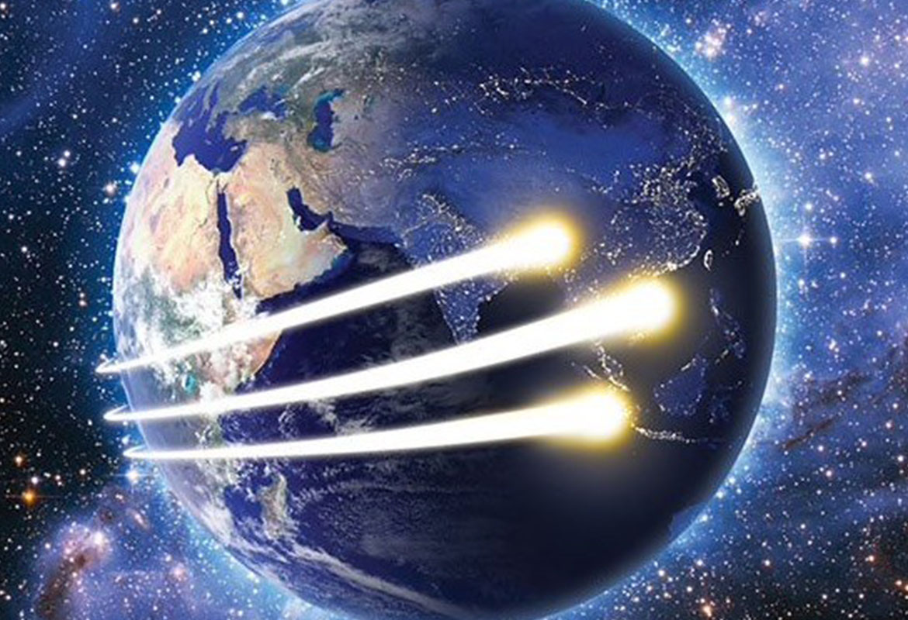
What Are the Three Angel’s Messages?
FIRST: Rev. 14:6-7 “And I saw another angel fly in the midst of heaven, having the everlasting gospel to preach unto them that dwell on the earth, and to every nation, and kindred, and tongue, and people, Saying with a loud voice, Fear God, and give glory to him; for the hour of his judgment is come: and worship him that made heaven, and earth, and the sea, and the fountains of waters.”

Slide 11
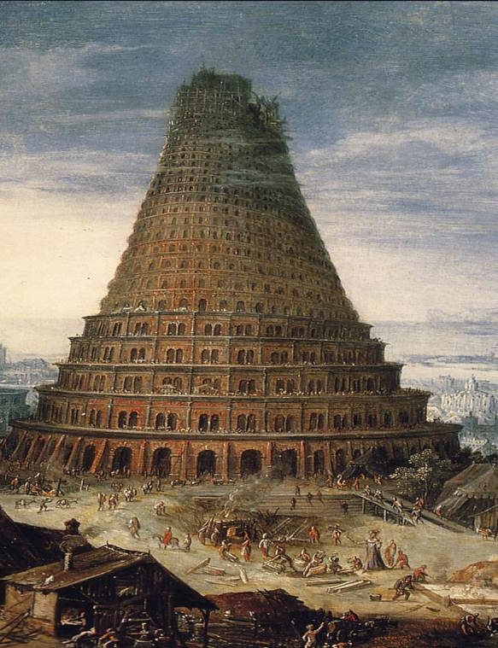
The Second Angel’s Message…
Rev. 14:8 “And there followed another angel, saying, Babylon is fallen, is fallen, that great city, because she made all nations drink of the wine of the wrath of her fornication.”

Slide 12
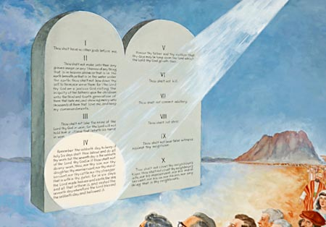

The Third Angel’s Message!!!
Rev. 14:9-12 “And the third angel followed them, saying with a loud voice, If any man worship the beast and his image, and receive his mark in his forehead, or in his hand, The same shall drink of the wine of the wrath of God, which is poured out without mixture into the cup of his indignation; and he shall be tormented with fire and brimstone in the presence of the holy angels, and in the presence of the Lamb: And the smoke of their torment ascendeth up for ever and ever: and they have no rest day nor night, who worship the beast and his image, and whosoever receiveth the mark of his name. Here is the patience of the saints: here are they that keep the commandments of God, and the faith of Jesus.”

Slide 13
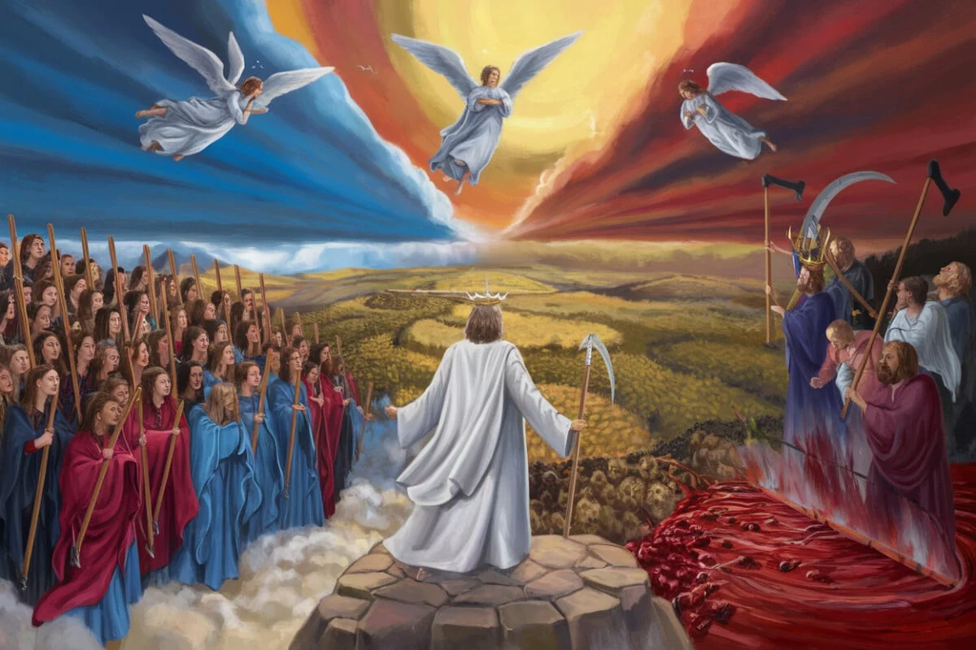
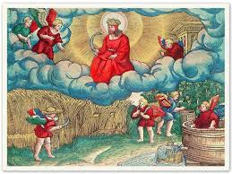
What Happens After These Messages?
Rev. 14:13-20 “And I heard a voice from heaven saying unto me, Write, Blessed are the dead which die in the Lord from henceforth: Yea, saith the Spirit, that they may rest from their labours; and their works do follow them. And I looked, and behold a white cloud, and upon the cloud one sat like unto the Son of man, having on his head a golden crown, and in his hand a sharp sickle. And another angel came out of the temple, crying with a loud voice to him that sat on the cloud, Thrust in thy sickle, and reap: for the time is come for thee to reap; for the harvest of the earth is ripe. And he that sat on the cloud thrust in his sickle on the earth; and the earth was reaped. And another angel came out of the temple which is in heaven, he also having a sharp sickle. And another angel came out from the altar, which had power over fire; and cried with a loud cry to him that had the sharp sickle, saying, Thrust in thy sharp sickle, and gather the clusters of the vine of the earth; for her grapes are fully ripe. And the angel thrust in his sickle into the earth, and gathered the vine of the earth, and cast it into the great winepress of the wrath of God. And the winepress was trodden without the city, and blood came out of the winepress, even unto the horse bridles, by the space of a thousand and six hundred furlongs.”

Slide 14
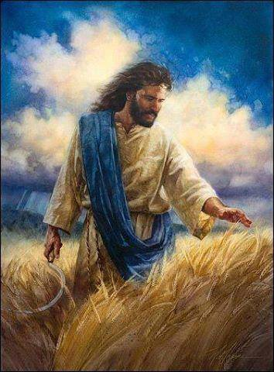
What is the Harvest?
Matt. 13:36-43 “Then Jesus sent the multitude away, and went into the house: and his disciples came unto him, saying, Declare unto us the parable of the tares of the field. He answered and said unto them, He that soweth the good seed is the Son of man; The field is the world; the good seed are the children of the kingdom; but the tares are the children of the wicked one; The enemy that sowed them is the devil; the harvest is the end of the world; and the reapers are the angels. As therefore the tares are gathered and burned in the fire; so shall it be in the end of this world. The Son of man shall send forth his angels, and they shall gather out of his kingdom all things that offend, and them which do iniquity; And shall cast them into a furnace of fire: there shall be wailing and gnashing of teeth. Then shall the righteous shine forth as the sun in the kingdom of their Father. Who hath ears to hear, let him hear.

Slide 15
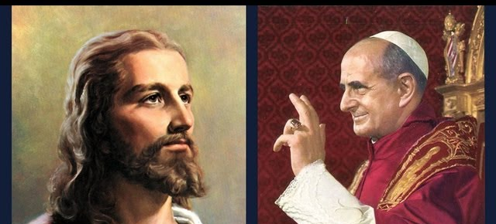
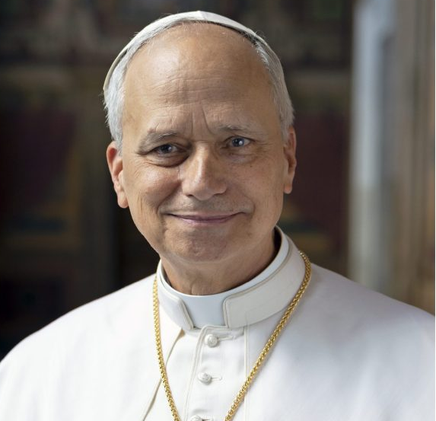
What Will We Choose?

Slide 16
Explain the time of the end and the Reformation, restoring the Sanctuary
Elijah and the restoration of the altar
Explain the Millerite movement and the 2300 days as the only ones who understood the significance of this passage
Walk through the events and the errors, highlight the importance of the sanctuary throughout
Loughborough’s account, etc.
3 Angel’s Messages—the worldwide message, the Second Great Awakening, Great Disappointment of the disciples

