Slide 1
Romans, part 13
Someone Needs to Die

Slide 2
Summary of Romans 6
1. Baptism represents the death of the old man of sin and rising to new life in Jesus Christ.
2. When the old man dies, the New Man, Christ Jesus, takes over and victory is the result.
3. When Christ is at the helm, the law no longer condemns because we are under His grace.

Slide 3
Paul Illustrates his point
Romans 7:1-4 “Know ye not, brethren, (for I speak to them that know the law,) how that the law hath dominion over a man as long as he liveth? For the woman which hath an husband is bound by the law to her husband so long as he liveth; but if the husband be dead, she is loosed from the law of her husband. So then if, while her husband liveth, she be married to another man, she shall be called an adulteress: but if her husband be dead, she is free from that law; so that she is no adulteress, though she be married to another man. Wherefore, my brethren, ye also are become dead to the law by the body of Christ; that ye should be married to another, even to him who is raised from the dead, that we should bring forth fruit unto God.“

Slide 4
The Illustration Defined
1. The woman represents the Christian; the husband represents the old man of sin.
2. While the husband/old man of sin is alive, the woman/Christian is bound to him.
3. If the husband/old man dies, then the woman/Christian can be married to another man/Christ.
4. The woman/Christian cannot be married to both at the same time; that would be adultery.

Slide 5
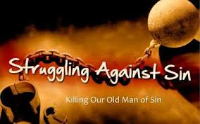
The Cruel Old Man
As long as the old man of sin is in the ascendancy, and we are responding to him, the law condemns us. We under the law’s condemnation and we have no peace. The law does not give life; it gives death! “Therefore by the deeds of the law shall no flesh be justified in His sight: for by the law is the knowledge of sin.” Romans 3:20

Slide 6

Our Identity
We have become identified with the old man of sin. He is our life and we obey him. We follow his dictates and can do nothing but follow them. We are slaves to do wrong.
“Can the Ethiopian change his skin or the leopard his spots? Can you do good that are accustomed to do evil?’ Jer. 13:23 “Who can bring a clean thing out of an unclean? Not one.” Job 14:4

Slide 7

God Helps Those Who………………………..
The proverb says, “God helps those who help themselves.” This could not be further from the truth. God helps those who realize they can’t help themselves. Married to the old man of sin, dwelling with him, we can do nothing but obey him as long as he lives. Will we let him die?

Slide 8

Obviously an illustration here!
The context of this letter declares that Paul is illustrating what he said in chapter 6. The SDA Reform group teaches that Paul’s point here is that a person cannot remarry unless the first partner is dead. Paul is illustrating the deep spiritual truths of death to sin and new life in Jesus Christ!

Slide 9

Hope on the Horizon
Wherefore, my brethren, ye are become dead to the law by the body of Christ, that ye should be married to another, even to Him who is raised from the dead.” verse 4
We can be married to One who lived in our flesh, ‘was tempted in all points as we are ,yet without sin.” Hebrews 4:15
Notice Hebrews 2:14-18 and Romans 8:3,4
“

Slide 10
Romans 7:5,6
“For when we were in the flesh, the motions of sins, which were by the law, did work in our members to bring forth fruit unto death. But now we are delivered from the law, that being dead wherein we were held; that we should serve in newness of spirit, and not in the oldness of the letter.”
While we follow the impulses of the carnal nature, the law condemns us as a transgressor. The result is eternal death, separation from God forever. Through the life of Christ now dwelling in us by faith, we are set free from the power of sin and the law’s condemnation.

Slide 11

Newness of Spirit or oldness of the letter
With the power of Christ in the life by faith, that life can produce victory, vitality, and glory. That life saves us from the drudgery of trying to live the Christian life apart from Christ which is impossible!!
“Then said Jesus unto his disciples, If any man will come after me, let him deny himself, and take up his cross, and follow me. For whosoever will save his life shall lose it: and whosoever will lose his life for my sake shall find it.” Matthew 16:24, 25

Slide 12

Romans 7:7,8
“What shall we say then? Is the law sin? God forbid. Nay, I had not known sin, but by the law: for I had not known lust, except the law had said, Thou shalt not covet. But sin, taking occasion by the commandment, wrought in me all manner of concupiscence. For without the law sin was dead.”

Slide 13

The Laws Function
The law of God reveals sin; it functions to condemn the guilty sinner. The law of God has no power to give life or to redeem. It points out defects; it reveals the places where sinful man falls short. It can’t produce life.
“Whosoever committeth sin transgresseth also the law: for sin is the transgression of the law.” 1 John 3:4

Slide 14

The Lifeless Wonder
“Because the law worketh wrath: for where no law is, there is no transgression.” Romans 4:15
“For until the law sin was in the world: but sin is not imputed when there is no law.” Romans 5:13
“Do we then make void the law through faith? God forbid: yea, we establish the law.” Romans :31

Slide 15

The Hunter/Stalker
“Is the law then against the promises of God? God forbid: for if there had been a law given which could have given life, verily righteousness should have been by the law. But the scripture hath concluded all under sin, that the promise by faith of Jesus Christ might be given to them that believe. But before faith came, we were kept under the law, shut up unto the faith which should afterwards be revealed. Wherefore the law was our schoolmaster to bring us unto Christ, that we might be justified by faith. But after that faith is come, we are no longer under a schoolmaster.” Gal. 3:21-25

Slide 16

Christ and the Law seek our good
The law of God condemns that Christ might heal. The law of God brings death that we might find life in Jesus Christ. The law of God shreds that Christ might make us whole. The law of God and Christ Jesus work hand in hand to save lost humanity from sin and self!

Slide 17

Romans 7:9,10
“For I was alive without the law once: but when the commandment came, sin revived, and I died. And the commandment, which was ordained to life, I found to be unto death.”
As long as Paul applied the law solely to his outer life, he thought he was good and everyone else did too. But, when he applied it to his inner life, he saw what a sinner he truly was and his cry was:
“Create in me a clean heart, O God; and renew a right spirit within me. Cast me not away from thy presence; and take not thy holy spirit from me. Restore unto me the joy of thy salvation; and uphold me with thy free spirit.” Psalm 51:10-12

Slide 18

Path to Freedom and Peace
The law of God was not meant to be the hammer of condemnation. It was ordained to life and as long as man walks in harmony with its precepts thru faith in the righteousness of Jesus Christ, the law is glorious. The law, as accepted thru faith in Christ, is glorious freedom, joy, and happiness. When men step outside of the law, then it is sheer misery!
“And I will walk at liberty: for I seek thy precepts.” Ps. 119:45

Slide 19

Applying the Law Within? Or Without?
Applying the law only to our outward acts and then comparing ourselves with others, is Pharisaical righteousness. We become puffed up, confident in our Adventism; this doesn’t cut it at all!
“For I say unto you, That except your righteousness shall exceed the righteousness of the scribes and Pharisees, ye shall in no case enter into the kingdom of heaven.” Matthew 5:20

Slide 20
Romans 7:11,12
“For sin, taking occasion by the commandment, deceived me, and by it slew me. Wherefore the law is holy, and the commandment holy, and just, and good.”
Paul was tricked by the law. This was not the law’s fault. Paul thought that it only applied to outward acts of behavior; it had nothing to do with the anger, lust, jealousy, or other fruits of the carnal heart. Paul felt he could harbor these thoughts and get away with it. When Paul realized and admitted that the law applied to his inward thoughts and that harboring sin was actually carrying it out, he was shredded by the law.
Paul realized the law was spiritual and applied within just as Christ had said. “Ye have heard that it was said by them of old time, Thou shalt not kill; and whosoever shall kill shall be in danger of the judgment: But I say unto you, That whosoever is angry with his brother without a cause shall be in danger of the judgment: and whosoever shall say to his brother, Raca, shall be in danger of the council: but whosoever shall say, Thou fool, shall be in danger of hell fire. Therefore if thou bring thy gift to the altar, and there rememberest that thy brother hath ought against thee; Leave there thy gift before the altar, and go thy way; first be reconciled to thy brother, and then come and offer thy gift. Agree with thine adversary quickly, whiles thou art in the way with him.” Matthew 5:21-25

Slide 21
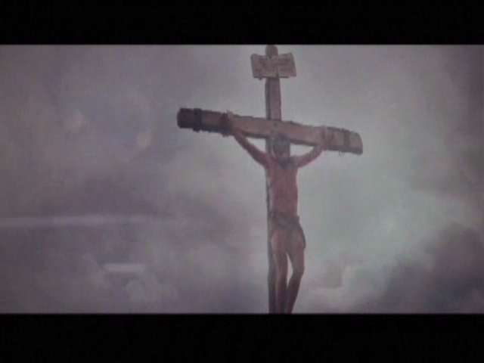
The Law Wasn’t at Fault
There is nothing faulty with the law of God. It does what it does; it reveals sin.
“For until the law sin was in the world: but sin is not imputed when there is no law.” Rom. 5:13
It can do nothing more and nothing less. The only faulty element is found in the sinful heart of man and there is but one remedy…….

Slide 22
Just Like the pregnant deer found out!

