Slide 1
Rom. Pt. 12
Under the Law?
Or Under Grace?

Slide 2
Romans 6:12-23
Paul’s continued statement of the death of the old man and the living of the new man is found in this portion of Scripture. Probably one of Paul’s most misunderstood statements is found in this passage. Are we under the law or under grace? What does this mean and what does it mean to me personally in my life will be the subject of this meeting.

Slide 3
Romans 6:12,13
To reign is to rule and control. Paul’s lofty challenge to the follower of Christ is to not allow sin to rule the life. The only way this can be accomplished is by yielding to Christ instead of to the old man of sin.
“He that committeth sin is of the devil; for the devil sinneth from the beginning. For this purpose the Son of God was manifested, that he might destroy the works of the devil. Whosoever is born of God doth not commit sin; for his seed remaineth in him: and he cannot sin, because he is born of God.” 1John 3: 8,9
“Let not sin therefore reign in your mortal body, that ye should obey it in the lusts thereof. Neither yield ye your members as instruments of unrighteousness unto sin: but yield yourselves unto God, as those that are alive from the dead, and your members as instruments of righteousness unto God.”

Slide 4
What is sin?
“Whosoever committeth sin transgresseth also the law: for sin is the transgression of the law.” 1John 3:4
“Because the law worketh wrath: for where no law is, there is no transgression.” Rom. 4:15
Slice it however you like, the only absolute that defines sin is the 10 commandments. If we are living in disobedience to any of them and yielding to sin, we are crucifying the new man who wants to reign in our lives, even Jesus Christ.

Slide 5
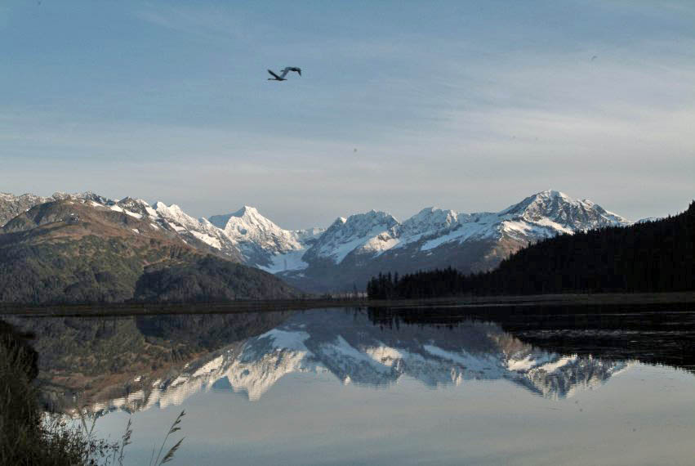
Under the law or under grace?
“For sin shall not have dominion over you: for ye are not under the law, but under grace. What then? shall we sin, because we are not under the law, but under grace? God forbid.” Romans 6:14,15

Slide 6
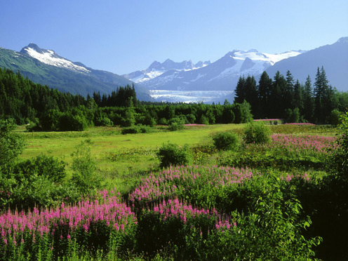
Under condemnation or under Christ?
If sin has dominion over us, then we are under the law. If we are choosing wrong, then the law condemns us as a sinner and shows us our desperate need for Christ. If we are yielding to Christ, then we are under His grace and are not condemned by the law of God. “But if ye be led of the Spirit, ye are not under the law.” Galatians 5:18

Slide 7
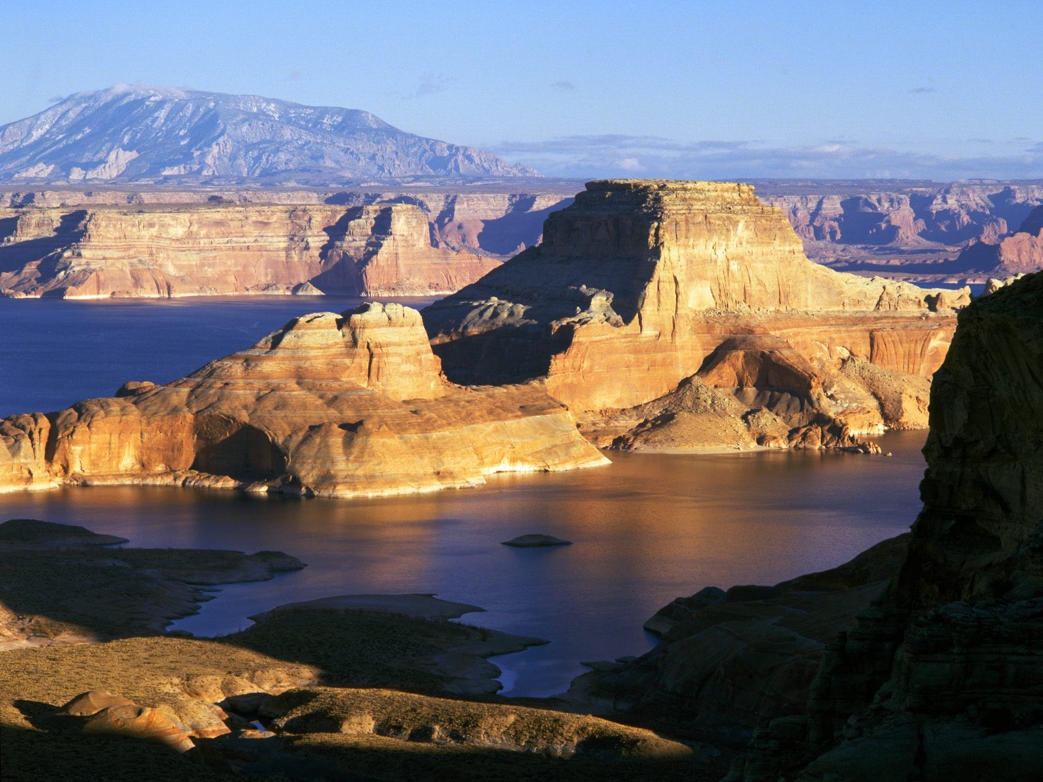
The law leads us to Christ!
“Is the law then against the promises of God? God forbid: for if there had been a law given which could have given life, verily righteousness should have been by the law. But the scripture hath concluded all under sin, that the promise by faith of Jesus Christ might be given to them that believe. But before faith came, we were kept under the law, shut up unto the faith which should afterwards be revealed. Wherefore the law was our schoolmaster to bring us unto Christ, that we might be justified by faith. But after that faith is come, we are no longer under a schoolmaster.” Gal. 3:21-25

Slide 8
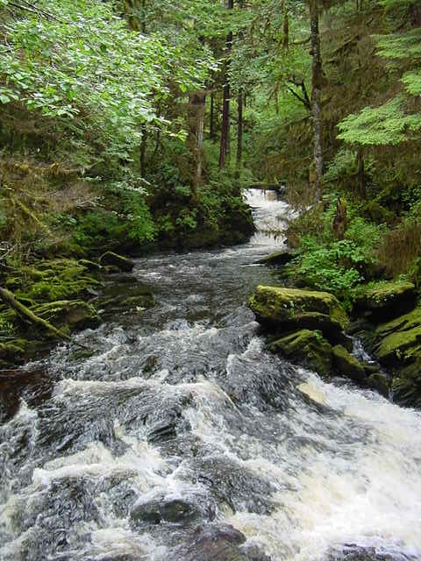
Nothing
Because we are under Christ’s gracious and merciful ruler ship, will we choose to come under the devil’s hell? The grace of Christ, His merciful compassion, is not an excuse for sin. When we walk away from Christ, we are not His!

Slide 9
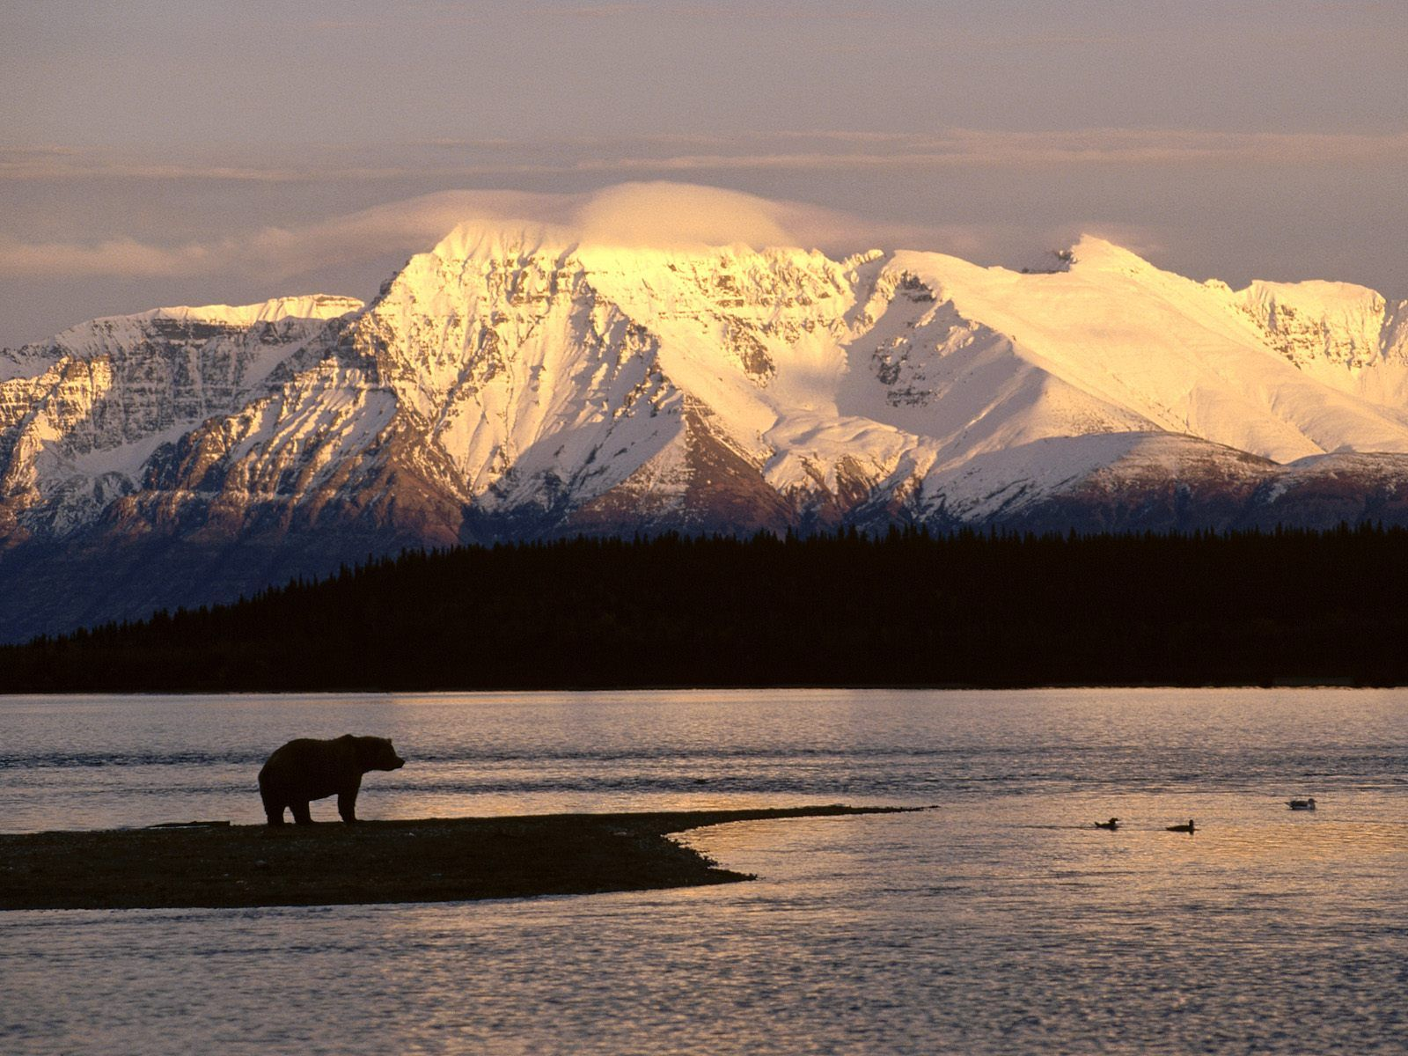
nghty
To not be under the law is to be walking in disobedience to God’s law. If I’m walking in disobedience to Christ and breaking His commands, then I’m under the law! If I’m in Christ and yielding to Him, then I’m under grace.

Slide 10
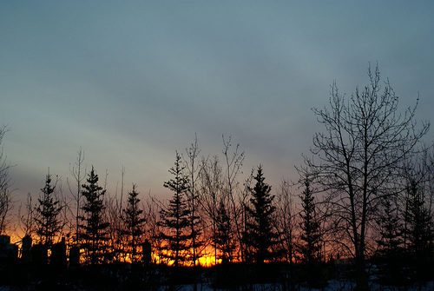
Romans 6:16-18
“Know ye not, that to whom ye yield yourselves servants to obey, his servants ye are to whom ye obey; whether of sin unto death, or of obedience unto righteousness? But God be thanked, that ye were the servants of sin, but ye have obeyed from the heart that form of doctrine which was delivered you. Being then made free from sin, ye became the servants of righteousness.”

Slide 11
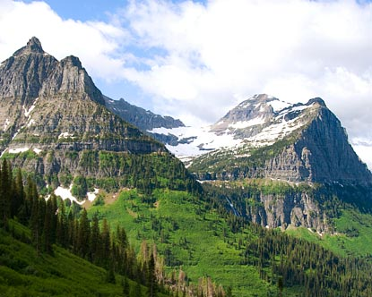
Paul’s message is so plain. We yield to sin, we become servants of it. “Jesus answered them, Verily, verily, I say unto you, Whosoever committeth sin is the servant of sin.” John 8:34
We try to confuse it so that we can excuse our sins and still consider ourselves to be Christians. If we sin, we can turn back to Christ. He doesn’t cast us off.

Slide 12

Freedom
Christ’s ultimate for His children is freedom from the controlling power of sin. “If ye continue in my word, then are ye my disciples indeed; And ye shall know the truth, and the truth shall make you free.” John 8:31,32

Slide 13
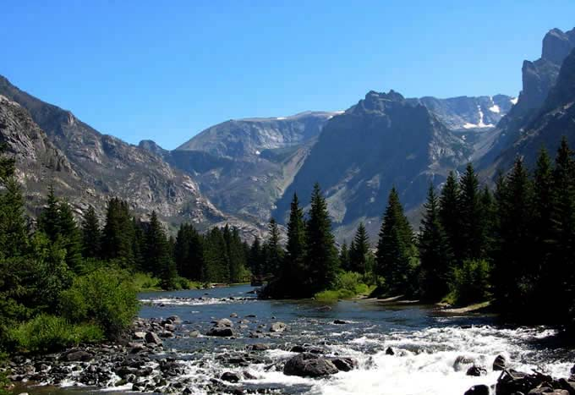
The devil’s lie
Freedom is only found in obeisance to God’s commands. The devil’s lie is that freedom comes in rebellion against God’s commands. The devil says that good comes in rebellion against God, that God doesn’t want our best and is withholding something good from us. His good is disease, sorrow, and broken dreams.

Slide 14
Real Freedom
“These words offended the Pharisees. The nation's long subjection to a foreign yoke, they disregarded, and angrily exclaimed, "We be Abraham's seed, and were never in bondage to any man: how sayest Thou, Ye shall be made free?" Jesus looked upon these men, the slaves of malice, whose thoughts were bent upon revenge, and sadly answered, "Verily, verily, I say unto you, Whosoever committeth sin is the servant of sin." They were in the worst kind of bondage,--ruled by the spirit of evil.
Every soul that refuses to give himself to God is under the control of another power. He is not his own. He may talk of freedom, but he is in the most abject slavery. He is not allowed to see the beauty of truth, for his mind is under the control of Satan. While he flatters himself that he is following the dictates of his own judgment, he obeys the will of the prince of darkness. Christ came to break the shackles of sin-slavery from the soul. "If the Son therefore shall make you free, ye shall be free indeed." "The law of the Spirit of life in Christ Jesus" sets us "free from the law of sin and death." Rom. 8:2.

Slide 15
In the work of redemption there is no compulsion. No external force is employed. Under the influence of the Spirit of God, man is left free to choose whom he will serve. In the change that takes place when the soul surrenders to Christ, there is the highest sense of freedom. The expulsion of sin is the act of the soul itself. True, we have no power to free ourselves from Satan's control; but when we desire to be set free from sin, and in our great need cry out for a power out of and above ourselves, the powers of the soul are imbued with the divine energy of the Holy Spirit, and they obey the dictates of the will in fulfilling the will of God.
The only condition upon which the freedom of man is possible is that of becoming one with Christ. "The truth shall make you free;" and Christ is the truth. Sin can triumph only by enfeebling the mind, and destroying the liberty of the soul. Subjection to God is restoration to one's self,--to the true glory and dignity of man. The divine law, to which we are brought into subjection, is "the law of liberty." James 2:12.” DA, pg. 466

Slide 16
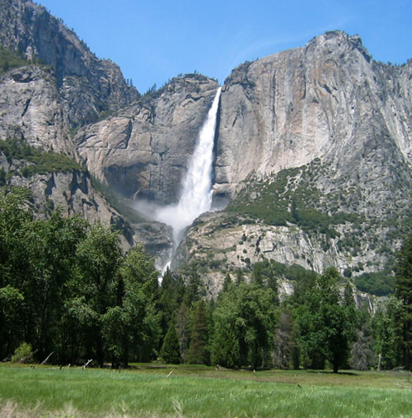
Romans 6:19-21
“I speak after the manner of men because of the infirmity of your flesh: for as ye have yielded your members servants to uncleanness and to iniquity unto iniquity; even so now yield your members servants to righteousness unto holiness. For when ye were the servants of sin, ye were free from righteousness. What fruit had ye then in those things whereof ye are now ashamed? for the end of those things is death. “ Romans 6:19-21

Slide 17
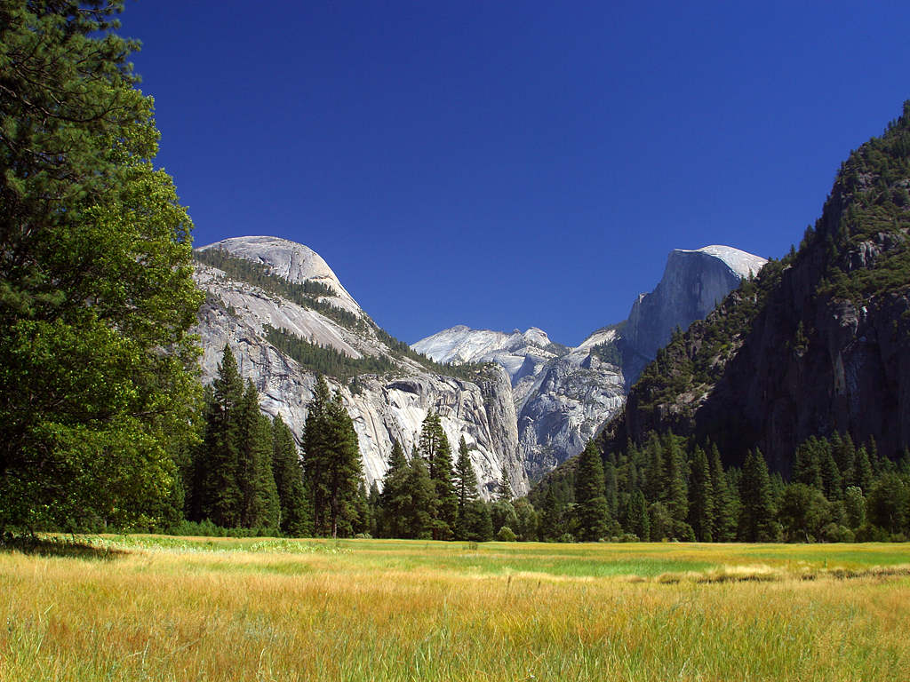
When we are walking in sin, we are void of righteousness. We justify our sin, excuse our sin, or blame someone else for our sin. We look for people who will support us in our sin. We do everything we can to convince ourselves that our sins are ok!
Praise God; He doesn’t leave us there. The Holy Spirit makes us feel utterly uncomfortable with our choices. He sends us cutting messages to bring us to confession and repentance.

Slide 18
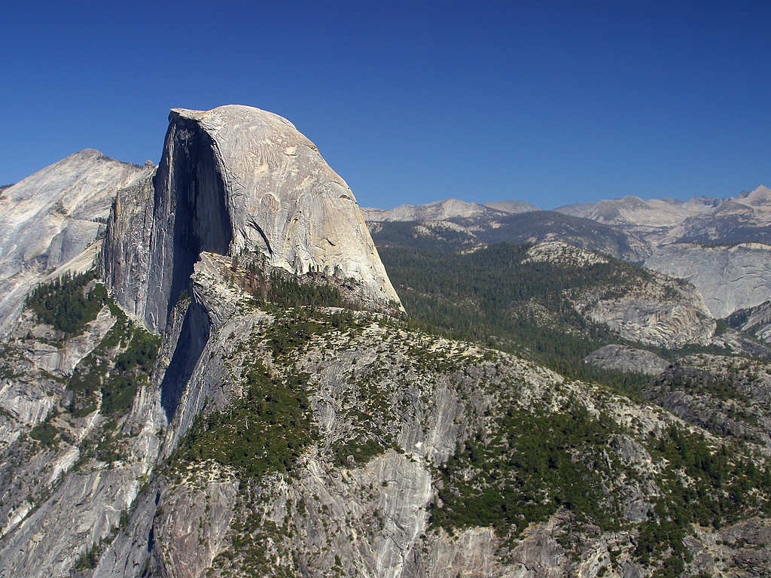
Convicts of sin, righteousness, and judgment!
The Holy Spirit shows us how abominable our sins are. He knows that the only way for healing and freedom to open is in admitting our stupidity, guilt, and shame. The Holy Spirit is not in to self esteem while living in rebellion to God’s law within and without.

Slide 19
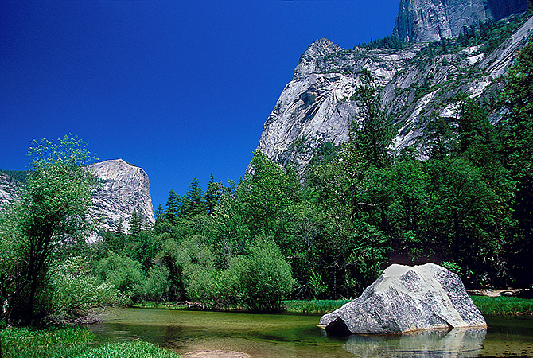
A Choice to Make
“But now being made free from sin, and become servants to God, ye have your fruit unto holiness, and the end everlasting life. For the wages of sin is death; but the gift of God is eternal life through Jesus Christ our Lord.” Romans 6:22,23

Slide 20
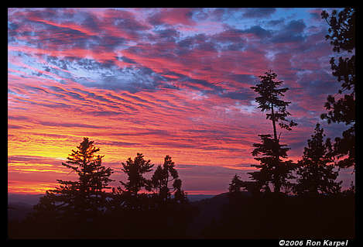
The choice is Ours
We can choose to follow Christ and live in submission to His gracious authority. We can choose to play the religious game and live for self and call ourselves Christians, but Christ knows better. We can choose to live in sin and die forever. The history of planet earth is nearing sunset!

