Slide 1
Bible Translations: Good, Better, or Best?
A Smorgasbord of Possibilities

Slide 2

As You Like?
The Bibles available today are innumerable. There are so many from which to choose that it staggers the mind. The Revised Standard Version, the Good News, the New International Version, Moffatt’s Translation, the Jerusalem Bible, etc.

Slide 3

Private Use
What Bible a person chooses to use in his/her private devotions is up to them. Knowing all the facts about the history of the Bibles would hopefully lead one to use only one translation. However, for one’s private devotions, the decision is yours!

Slide 4

The Problem
When we come together as a group for Bible study and everyone has a different translation, then we have a problem. It becomes quite confusing to hear someone reading a different translation from our own and trying to follow. CONFUSION! Or, as the Bible calls it in Revelation---BABYLON!
A new Tower has been built!

Slide 5
A Safe Path
The only real safety is to find out the origins of the Bible translations. Bible translations didn’t pop up in a corner somewhere. They all came at specific times, from specific sources so that there is really no cause for confusion. After this study, it will be very clear and simple as to which Bible translation should be used by every individual and by every Christian Church. History eliminates all confusion, all second guessing, and if we are willing, can eliminate all confusion in churches over Bible translations!

Slide 6

Two Streams Have Flowed
Two streams of Bible translations have flowed since the early Christian church began.
One stream flowed from where the believers were first called Christians. “And when he had found him, he brought him unto Antioch. And it came to pass, that a whole year they assembled themselves with the church, and taught much people. And the disciples were called Christians first in Antioch.”
This is Antioch in Syria. The Biblical stream of translation that flowed from here was sound Biblical scholarship.

Slide 7
Here We Are!
“There are actually only two types of Bibles, those based on the majority of the Greek manuscripts, and those based on texts from Egypt and Rome. The early Syrian Church had the Bible translated into Syrian about A.D. 150. This version is known as the Peshitto (meaning "correct," or "simple"). Even today, it generally follows the Received Text. Early Latin translations of the Bible were used in the British Isles, northern Italy, and southern France, long before these primitive Christians came into contact with the Church of Rome. Called the "Italic" or Old Latin version, the Waldenses in particular resisted the Vulgate as being spurious. Until at least the late thirteenth century, the Waldensian version held out strongly against the Vulgate. The fourth century scholar Helvidius, of northern Italy, accused Jerome of using corrupt Greek manuscripts. Waldensians in the Alps claimed their church began about A.D. 120, and their Italic Bible was said to be translated directly from the Greek no later than A.D. 157.” www.biblestudy.org/basicart/does-it-matter-which-bible-is-used-for-bible-study.html

Slide 8
Dr. Benjamin Wilkinson
“Anyone who is interested enough to read the vast volume of literature on this subject, will agree that down through the centuries there were only two streams of manuscripts. The first stream which carried the Received Text in Hebrew and Greek, began with the apostolic churches, and reappearing at intervals down the Christian Era among enlightened believers, was protected by the wisdom and scholarship of the pure church in her different phases; by such as the church at Pella in Palestine where Christians fled, when in 70 A. D. the Romans destroyed Jerusalem; by the Syrian Church of Antioch which produced eminent scholarship; by the Italic Church in northern Italy; and also at the same time by the Gallic Church in southern France and by the Celtic Church in Great Britain; by the pre-Waldensian, the Waldensian, and the churches of the Reformation…

Slide 9
Continued
…This first stream appears, with very little change, in the Protestant Bibles of many languages, and in English, in that Bible known as the King James Version, the one which has been in use for three hundred years in the English speaking world. These MSS. have in agreement with them, by far the vast majority of numbers. So vast is this majority that the enemies of the received Text admit that nineteen-twentieths and some ninety-nine one-hundredths of all Greek MSS. are of this class; while one hundred per cent of the Hebrew MSS. are for the Received Text.” OUR AUTHORIZED BIBLE VINDICATED, BENJAMIN G. WILKINSON, PH.D., DEAN OF THEOLOGY, WASHINGTON MISSIONARY COLLEGE TAKOMA PARK, D.C. WASHINGTON D.C, JUNE, 1930

Slide 10
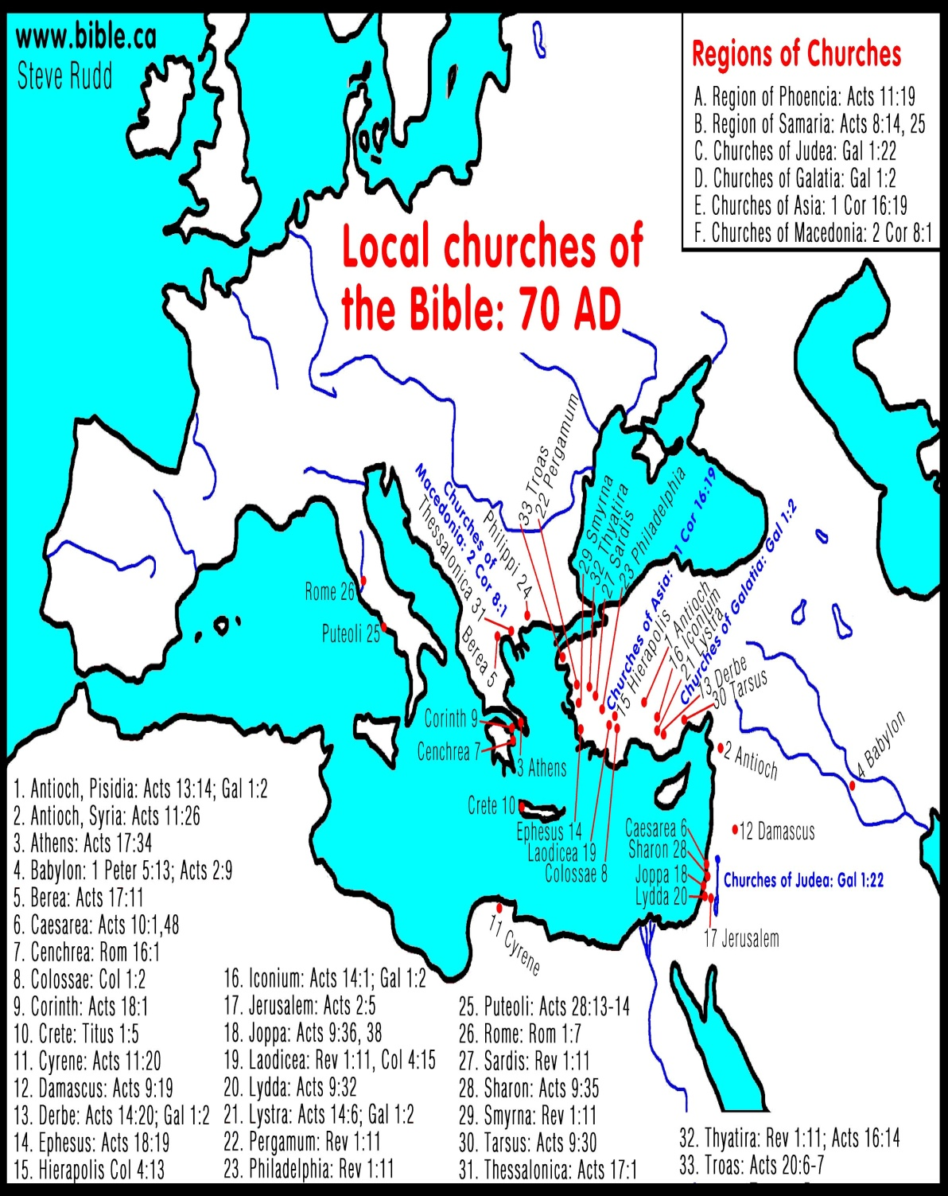
What We Know So Far!
The First Stream of Bible translations came to us from the earliest Greek and Hebrew manuscripts. These are known as the Received Text. These were used by the early Christians in Syria, France, England, and the Waldensians of the Alps. It was from this stream that came the King James Version of the Bible.
We will say more on the King James Bible later.

Slide 11
The Second Stream
“Around A.D. 200, Clement of Alexandria (a Church Father, c. 150-215) taught that just as God gave the Law to the Jews, so he gave philosophy to the Greeks--as an instrument to lead them to Christ. God’s eternal Word (Logos) was the source of both. Clement believed the truth was to be found in Scripture, but sometimes it was hidden, and could only be discovered through allegorical interpretation…His teaching and theological work was given to the young scholar Origen (185-254), who presided over the Alexandrian school for the next thirty years. Origen’s father was martyred under Severus, and his mother hid the youth’s clothes to keep him from joining the martyrs. Origen’s writings were some of the most influential in the early church…

Slide 12
From Clement to Origen
…He developed more fully Clement’s ideas of allegorical interpretation, understanding three levels of interpretation within a text that corresponded to three aspects of the human being. Literal, moral, and spiritual meanings corresponded to the body, soul, and spirit, in ascending order of importance. The literal meaning of the historical events was the least important for the Christian, just as the body was less important than the soul or spirit (two different things, psyche and pneuma, in Greek). More important were the underlying meanings which could only be perceived allegorically. Even Jesus was less important as a historical figure than as the mystery of Christ present to believers in the church and the sacraments…

Slide 13
Origen’s allegorical Translation
“To get the most accurate translation of the Old Testament, he consulted extensively with Jewish scholars. In the process, he produced the Hexapla, an estimated 6,500-page parallel version of the Old Testament with two Hebrew versions and four Greek translations in columns side-by-side, including the Septuagint (SEP-too-a-jint)…” *An excerpt from The Bible the Book the Bridges the Millennia by Maxine Clarke Beach Copyright © 1998 Maxine Clarke Beach.

Slide 14
From Origen to Jerome
“When we come to Origen, we speak the name of him who did the most of all to create and give direction to the forces of apostasy down through the centuries. It was he who mightily influenced Jerome, the editor of the Latin Bible known as the Vulgate. Eusebius worshiped at the altar of Origen’s teachings. He claims to have collected eight hundred of Origen’s letters, to have used Origen’s six-column Bible, the Hexapla, in his Biblical labors. Assisted by Pamphilus, he restored and preserved Origen’s library. Origen’s corrupted MSS. of the Scriptures were well arranged and balanced with subtlety. The last one hundred years have seen much of the so-called scholarship of European and English Christianity dominated by the subtle and powerful influence of Origen. Origen had so surrendered himself to the furor of turning all Bible events into allegories that he, himself, says, “The Scriptures are of little use to those who understand them as they are written.” Ben Wilkinson, pg.12

Slide 15
From Jerome to Rome!
“It is evident that the so-called Christian Emperor gave to the Papacy his endorsement of the Eusebio-Origen Bible. It was from this type of manuscript that Jerome translated the Latin Vulgate which became the authorized Catholic Bible for all time. The Latin Vulgate, the Sinaiticus, the Vaticanus, the Hexapla, Jerome, Eusebius, and Origen, are terms for ideas that are inseparable in the minds of those who know. The
type of Bible selected by Constantine has held the dominating influence at all times in the history of the Catholic Church. This Bible was different from the Bible of the Waldenses, and, as a result of this difference, the Waldenses were the object of hatred and cruel
persecution, as we shall now show.” Wilkinson, pg. 22

Slide 16

The second Stream
The second stream that has flowed came from Clement to Origen to Eusebius/Constantine to Jerome and onto Rome. This stream of translations have been muddied by allegorical/Greek/ pagan philosophy.

Slide 17

Whence Came the KJV?
Two noteworthy influences in this stream of translation would be the restoration of the Received Text in the translation into Greek of the New Testament by Erasmus of Rotterdam in 1516. His work paved the way for the English Bible of William Tyndale in the 1530’s and then the King James Bible of 1611. The King James Version came from the pure stream of translation that was from the original Greek and Hebrew texts.

Slide 18

Whence Came all the Modern Translations?
One other noteworthy Bible translation in the muddy stream was the Douay translation of the Jesuits in 1582. This translation came from the Bible stream of Clement-Origen-Eusebius-Jerome and Rome!!

Slide 19
The Pure Stream
NOTE: The two great families of Greek Bibles are well illustrated in the work of that outstanding scholar, Erasmus. Before he gave to the Reformation the New Testament in Greek, he divided all Greek MSS. into two classes: those which agreed with the
Received Text and those which agreed with the Vaticanus MS.f55
THE TWO PARALLEL STREAMS OF BIBLES
Apostles (Original).
Received Text (Greek).
Waldensian Bible (Italic).
Erasmus (Received Text Restored).
Luther’s Bible, Dutch, French, Spanish,
Italian, French, Italian, etc.,
Tyndale, (English) 1535 Rheims (English)
from (from Received Text).
King James, 1611 Oxford Movement.

Slide 20
Muddied Waters
(from Received Text).
Apostates (Corrupted Originals). (Clement, Origen,)
Sinaiticus and Vaticanus Bible (Greek).
Vulgate (Latin). Church of Rome’s Bible. , (Jerome)
Vaticanus (Greek).
Westcott and Hort (B and Aleph). English
Revised 1881.
Dr. Philip Schaff (B and Aleph). American
Revised 1901.
The King James from the Received Text has been the Bible of the English speaking world for 300 years. This has given the Received Text, and the Bibles translated from it into other tongues, standing and authority. At the same time, it neutralized the dangers of the Catholic manuscripts and the Bibles in other tongues translated from them.

