Slide 1
War in the Ukraine, pt. 2

Slide 2
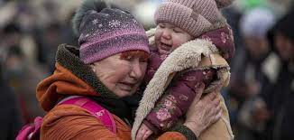
Suffering in Ukraine
Ukraine’s Latin Rite Catholic bishops asked Pope Francis earlier this month to consecrate Ukraine and Russia to the Immaculate Heart of Mary. In a letter to the pope, the Ukrainian bishops said that they were writing “in these hours of immeasurable pain and terrible ordeal for our people” in response to many requests for the consecration. “Responding to this prayer, we humbly ask Your Holiness to publicly perform the act of consecration to the Immaculate Heart of Mary of Ukraine and Russia, as requested by the Blessed Virgin in Fatima.”

Slide 3
Russia and the Virgin!
The Fatima Prophecy says:
“I shall come to ask for the Consecration of Russia to My Immaculate Heart … If people attend to My requests, Russia will be converted and the world will have peace.” https://fatima.org/the-consecration-of-russia/ This is said to be the message delivered by the Virgin Mary to three young shepherd children in Fatima, Portugal, in 1917.
Pope Francis will consecrate Russia and Ukraine to the Immaculate Heart of Mary on Friday, March 25, 2022, and many today believe that this will finally fulfill the Virgin Mary’s command to consecrate Russia, ushering in a period of peace and prosperity for the entire world.

Slide 4
Consecrated The War to Mary
“Pope Francis prayed for peace in Ukraine in a ceremony Friday that harked back to a century-old apocalyptic prophecy about peace and Russia that was sparked by purported visions of the Virgin Mary to three peasant children in Fatima, Portugal, in 1917. Francis invited bishops, priests and ordinary faithful around the world to join him in the consecration prayer, which opened with Francis entering St. Peter’s Basilica before an estimated 3,500 people and concluded with Francis sitting alone before a statue of the Madonna. There, he solemnly asked forgiveness that humanity had “forgotten the lessons learned from the tragedies of the last century, the sacrifice of the millions who fell in two World Wars.”
“Free us from war, protect our world from the menace of nuclear weapons,” he prayed. The service was Francis’ latest effort to rally prayers for an end to the war while keeping open options for dialogue with the Russian Orthodox Church and its influential leader, Patriarch Kirill. Francis has yet to publicly condemn Russia by name for its invasion, though his denunciations of the war in Ukraine have grown increasingly outraged.” CBS News

Slide 5
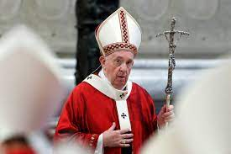
With Cross in Hand!
He prays to end war when he is the catalyst for it!!!
“And in her was found the blood of prophets, and of saints, and of all that were slain upon the earth.” Rev. 18:24
With cross in hand, the symbol of sacrifice, Francis prays for peace while he s the igniter of war!!!

Slide 6
Fatima and the Consecration of Russia
The Fatima story dates to 1917, when according to tradition, Portuguese siblings Francisco and Jacinta Marto and their cousin Lucia said the Virgin Mary appeared to them six times and confided to them three secrets. The first two described an apocalyptic image of hell, foretold the end of World War I and the start of World War II, and portended the rise and fall of Soviet communism. The children were between 7 and 10 years old at the time…. According to later writings by Lucia, who became a nun and died in 2005, Russia would be converted and peace would reign if the pope and all the bishops of the world consecrated Russia to the “Immaculate Heart of Mary.” Lucia later claimed that John Paul fulfilled that prophecy during a Mass on March 25, 1984, exactly 38 years ago Friday, even though he never specified Russia in the prayer.
The text of Francis’ prayer corrected that 1984 omission. It reads: “Therefore, Mother of God and our Mother, to your Immaculate Heart we solemnly entrust and consecrate ourselves, the Church and all humanity, especially Russia and Ukraine.” It adds: “Grant that war may end and peace spread throughout the world.”

Slide 7
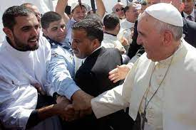
Francis’ Desperate Move!
Pope Francis directly addressed Russian President Vladimir Putin, pleading Sunday for an end to the invasion of Ukraine that has devastated several cities in the European nation. At the conclusion of Sunday’s Angelus prayers, the pontiff implored Mr. Putin: “In the name of God, I ask you: stop this massacre!” Francis noted the devastation wreaked by Russian forces in the Ukrainian city of Mairupol, named for the Virgin Mary to whom his congregation had just petitioned in the Angelus prayers.

Slide 8
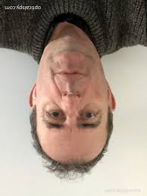
Warmonger Proclaims himself Peacemaker
He portrays himself as crying for peace when he instigated the war!!
He portrays himself as a Christian brother when the Bible says he is Babylon the Great, the Mother of Harlots!! (Rev. 17)
He portrays himself as the upholder of law and virtue while the Bible declares him the man of lawlessness and wickedness! (2Thessalonians 2)
He portrays himself as a holy god, while the Bible declares the great apostle Paul “This is a faithful saying, and worthy of all acceptation, that Christ Jesus came into the world to save sinners; of whom I am chief.” 1 Tim. 1:15

Slide 9
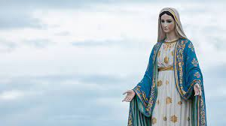
To Mary????
Goddess worship has existed since the Tower of Babel and Semiramis. This goddess worship culminates in the devotion that all false religions give to the apparitions of Mary. Pope Francis is the leader of the pack in his adoration of the Virgin! While the world’s churches venerate her, the Bible paints a very different picture.

Slide 10
The Bible on the State of the Dead
“For the living know that they shall die: but the dead know not any thing, neither have they any more a reward; for the memory of them is forgotten. Also their love, and their hatred, and their envy, is now perished; neither have they any more a portion for ever in any thing that is done under the sun.” Eccl. 9:5,6
“Whatsoever thy hand findeth to do, do it with thy might; for there is no work, nor device, nor knowledge, nor wisdom, in the grave, whither thou goest.” Eccl. 9:10
If we had no other Scriptures, these few passages are so blatantly obvious. The dead know nothing. When a person dies, there is nothing but an eternal sleep.

Slide 11
The Immortal Soul
The Orphics considered the human soul immortal and divine. They believed it to be a part of Dionysus, who in their mythology was dismembered and devoured by the Titans. As retribution, the Titans were destroyed by Zeus, and humanity was created from their ashes. What was left of the partially-consumed Dionysus was then used to make the immortal human soul.” Ancient Greek Theories Of The Human Soul, Mar. 13, 2021 • By Danielle Mackay, BA Classical Studies and Linguistics, MA Classical Studies
The Greeks held man to be immortal. The Bible says, “Now unto the King eternal, immortal, invisible, the only wise God, be honor and glory for ever and ever. Amen.” 1 Tim. 1:17
“Which in his times he shall shew, who is the blessed and only Potentate, the King of kings, and Lord of lords; Who only hath immortality, dwelling in the light which no man can approach unto; whom no man hath seen, nor can see: to whom be honor and power everlasting. Amen.” 1 Timothy 6:16

Slide 12
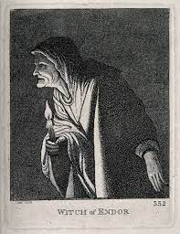
If Mary Knows NOTHING, then….
The Bible clearly teaches that when a person dies, they do not know anything anymore. So, who then is this being that Pope Francis is praying to and asking for her intervention in the Ukraine-Russia conflict? Well, the being is not from God, so where is this being’s origin? The one place in the Bible of someone clearly calling up someone who was dead was the case of Samuel and the witch of Endor.

Slide 13
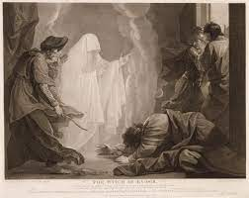
The Bible Leaves NO Doubt!
“Saul died for his transgression which he committed against the Lord, even against the word of the Lord, which he kept not, and also for asking counsel of one that had a familiar spirit, to inquire of it; and inquired not of the Lord: therefore He slew him, and turned the kingdom unto David the son of Jesse.” 1 Chronicles 10:13, 14.

Slide 14
Who Came up from the Witch’s Request?
“The Scripture account of Saul's visit to the woman of Endor has been a source of perplexity to many students of the Bible. There are some who take the position that Samuel was actually present at the interview with Saul, but the Bible itself furnishes sufficient ground for a contrary conclusion. If, as claimed by some, Samuel was in heaven, he must have been summoned thence, either by the power of God or by that of Satan. None can believe for a moment that Satan had power to call the holy prophet of God from heaven to honor the incantations of an abandoned woman. Nor can we conclude that God summoned him to the witch's cave; for the Lord had already refused to communicate with Saul, by dreams, by Urim, or by prophets. 1 Samuel 28:6. These were God's own appointed mediums of communication, and He did not pass them by to deliver the message through the agent of Satan.
The message itself is sufficient evidence of its origin. Its object was not to lead Saul to repentance, but to urge him on to ruin; and this is not the work of God, but of Satan. Furthermore, the act of Saul in consulting a sorceress is cited in Scripture as one reason why he was rejected by God and abandoned to destruction: “Saul died for his transgression which he committed against the Lord, even against the word of the Lord, which he kept not, and also for asking counsel of one that had a familiar spirit, to inquire of it; and inquired not of the Lord: therefore He slew him, and turned the kingdom unto David the son of Jesse.” 1 Chronicles 10:13, 14. Here it is distinctly stated that Saul inquired of the familiar spirit, not of the Lord. He did not communicate with Samuel, the prophet of God; but through the sorceress he held intercourse with Satan. Satan could not present the real Samuel, but he did present a counterfeit, that served his purpose of deception.” PP, pg. 683

Slide 15
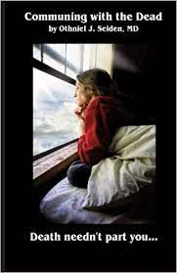
“Modern spiritualism and the forms of ancient witchcraft and idol worship—all having communion with the dead as their vital principle—are founded upon that first lie by which Satan beguiled Eve in Eden: “Ye shall not surely die: for God doth know that in the day ye eat thereof, ... ye shall be as gods.” Genesis 3:4, 5. Alike based upon falsehood and perpetuating the same, they are alike from the father of lies.” PP, pg. 685

Slide 16
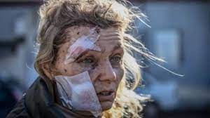
The Bible and Ellen White declared that holding communication with the dead will be revived in the days before Jesus comes. Pope Francis has now invoked the demon, masquerading as Mary, to intervene in the conflict! What a hot mess! A conflict instigated by the devil and his girlfriend and now, the girlfriend is invoking demons to stop a war they started!

Slide 17
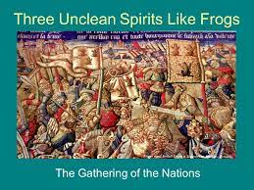
3 Unclean Spirits
“And I saw three unclean spirits like frogs come out of the mouth of the dragon, and out of the mouth of the beast, and out of the mouth of the false prophet. For they are the spirits of devils, working miracles, which go forth unto the kings of the earth and of the whole world, to gather them to the battle of that great day of God Almighty.” Revelation 16:13,14

Slide 18
“Through the two great errors, the immortality of the soul and Sunday sacredness, Satan will bring the people under his deceptions. While the former lays the foundation of spiritualism, the latter creates a bond of sympathy with Rome. The Protestants of the United States will be foremost in stretching their hands across the gulf to grasp the hand of spiritualism; they will reach over the abyss to clasp hands with the Roman power; and under the influence of this threefold union, this country will follow in the steps of Rome in trampling on the rights of conscience.... Papists, Protestants, and worldlings will alike accept the form of godliness without the power, and they will see in this union a grand movement for the conversion of the world and the ushering in of the long-expected millennium.” The Great Controversy, 588, 589.

