Slide 1
Erton Kohler:Bought and Sold

Slide 2

Crisis Rocks the World
No area of the world was left unaffected by this time!! Nations, churches, and our individual lives all were hit by this terrible illness! Something about this time remains locked in our minds and will actually never go away!! And, in Seventh day Adventism, this certainly is the case! Many Adventists died, many lost their health, and many lost their homes over their refusal to participate in the government’s remedy for this crisis!!

Slide 3

For Some Strange Reason!!
Some SDA’s couldn’t conscientiously participate in the government’s solution for Covid 19. Because of their religious convictions regarding their body as the temple of God, they couldn’t follow government mandates. As a result, many lost their jobs!! When these conscientious Adventists appealed to their local church or to the General Conference for religious exemption letters, they were refused. For some reason, the denomination would not protect its members!! But why??

Slide 4
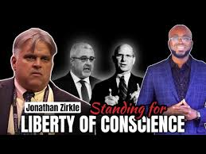
GC Session, June 6-11, 2022
The 61st General Conference Session of the Seventh-day Adventist Church was held in St. Louis, Missouri, from June 6-11, 2022. During this session, Johnathan Zirkle, an SDA lawyer, made a motion that the GC’s position on Covid 19 and their response to members be discussed. Zirkle declared that he had a petition signed by 25,000 SDA’s all over the world, 1,900 delegates/pastors, and over 4,000 health care providers all wanting to know why the church took the stand it did and refused to help the members. His motion was seconded!!!

Slide 5
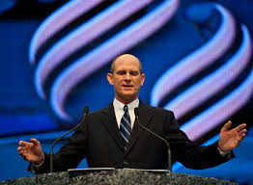
Ted Wilson Speaks
This issue was deeply troubling to many thousands of Adventists. They wanted to know why their church, that they loved and had financed for many years had failed to come to the aid of fellow Adventists in a time of crisis! They wanted and needed answers to this most perplexing situation. Ted Wilson acknowledged the motion and that it had been seconded. He then proceeded to tell everyone present that he would strongly urge this issue to NOT be discussed. The hope of resolution for many Adventists died. However, the church’s position did not!!!

Slide 6
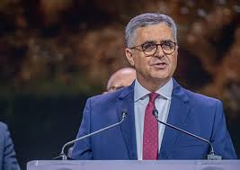
Confirmation for Ted Wilson
In confirming his decision to table the discussion of the church’s stand during Covid 19, and their refusal to assist SDA’s who, for conscientious reasons, could not honor govt. mandates, Ted Wilson mentioned 2 names that were in total agreement with the church’s stand not to give Adventist’s letters of exemption on the grounds of religious liberty and who totally agreed with Ted Wilson not to discuss the issue. The two men were treasurer, Paul Douglass, and the other, then vice president, Erton Kohler, who is now the GC president!!

Slide 7
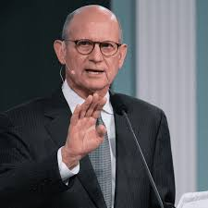
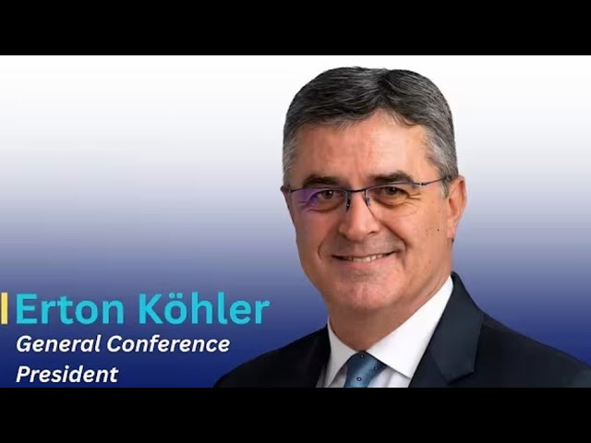
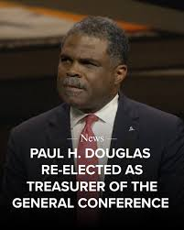
Why, Erton Kohler??
These 3 men agreed NOT to defend SDA’s religious liberty in time of crisis. These 3 men agreed that there was something far more important than protecting the conscientious SDA’s who couldn’t follow govt. mandates for religious-health reasons. Instead of standing with SDA’s, these 3 men decided that something else superseded hurting Adventists. For a people who have prized liberty of conscience and the stories of the faithful through the ages who would rather die than surrender their beliefs, what these 3 men did was un-Adventist, unconscionable, and a down right betrayal!!!!

Slide 8
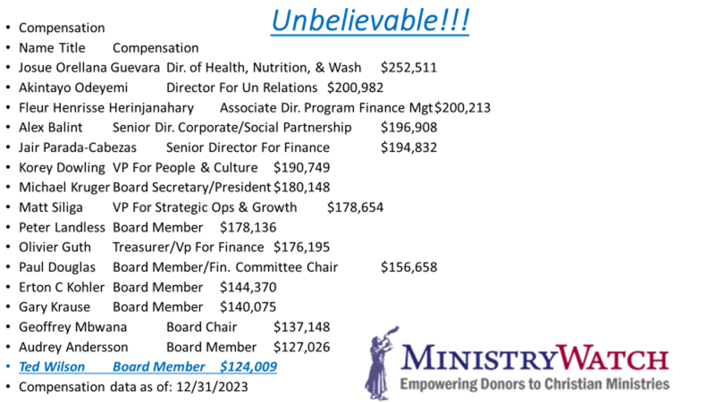
Did This Have anything to do with it?

Slide 9
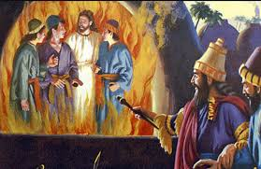
They Wouldn’t Bow
For SDA’s who know that down toward the end of this earth’s history, their would be a crisis and religious liberty would be trampled under foot. People’s convictions would no longer matter. Conform or else!! What could possibly have led these 3 men to trample on the conscience’s of fellow Adventists and allow them to lose their home, their health, and some their lives? The decision by Wilson, Douglass and Kohler is stunning!!
Why????
Why????
To this day, the question has never been answered!!

Slide 10
Affiliations, Money Flow, etc.???
The Adventist Health Systems; from Advent Health in Florida, to Kettering in Ohio, to Adventist Health in Northern California to Loma Linda in Southern California and a few other entities combine to make MANY billions of dollars per year. Of those funds, the great bulk of the revenues come from Medicare, Medicaid, and private insurance companies.
Besides these funds taking care of the Adventist Health Systems, funds are given to subsidize Adventist schools, and are also used to pay healthy sums of money to church leaders that sit on the boards of these medical institutions. Funds are also allocated to pay leaders for family trips to Europe, boats in the Pacific, and weekend getaways!!!
When Covid hit and Medicare/Medicaid were in support of the shots offered, Adventist hospitals and health systems and church leaders knew that if they didn’t go along with government programs, they would be cut off from receiving Medicare and Medicaid funding and the Adventist Health systems would disappear. Besides these, the Adventist school system would disappear as well!!

Slide 11
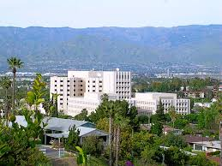
So, what would the church do?
Would the church protect its members who were being forced to accept govt. mandates or would they go along with the government program to ensure the flow of money into the coffers of Adventist Health? Would they come to the defense of members whose consciences were being trampled on or would they protect their free trips and their boats in the Pacific?
Adventists liberty of conscience was sacrificed in the name of keeping the money flowing!!! The church leaders refuse to admit this but those are the facts!!!

Slide 12
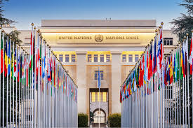
Adventism and the UN
Since the 1980’s, Adventism has joined the UN as an NGO or non- governmental organization. In this role, the denomination has consultive status; they can sit in on meetings. However, in this role, they must go along with the UN agenda for the world. If they don’t, millions of dollars would cease to flow via ADRA into the church!! The UN agenda is known as the 2030 agenda. While there are elements of this agenda with which we can agree, there are areas with which we can’t.

Slide 13
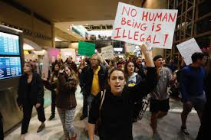
The UN wants to help end poverty by 2030. Of course, we can agree with this!
However, the UN is pushing the illegal immigration of masses of people into other countries. ADRA was/is part of this. ADRA receives millions of dollars from the UN for this purpose!
ADRA supports the UN/former pope Francis climate change agenda. The heart of this climate change agenda is Sunday. Just as GC, pgs. 589,590 says! In order to keep the money flowing, Adventist leaders WOULD NOT discuss the Covid issue and the church’s responses to members!! Kohler, Wilson, and Douglass would see to that!!

Slide 14
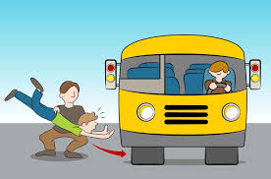
Kohler’s Election
Kohler’s election guaranteed that:
1. the denomination would remain tied to the money coffers of the UN and Medicare/Medicaid!
2. when another crisis comes; whether health or morally related; like a Sunday law; Kohler and his cronies will throw Adventists under the bus again to keep the money flowing!!
3. whenever moral questions are answered by money, morality becomes a relic in the rear view mirror!!

Slide 15
First Sermon on Boldness
On Women’s Ordination and Human Sexuality
“I will be open to talk with everyone, but I will be faithful to the Bible. All those conversations will be related to our message and our identity, in our trust in the Word of God. All of those who are available to align their lives with the Bible, I will be open to talk with them. The church belongs to all. I understand that we are diverse. We represent cultures, languages, genders, and many other things, and I believe that I need to be the leader of all of them, not only a portion of the church, but the entire church. But as the leader of God’s church, I need to be faithful to His revelation, and I would like to guide my leadership based on the Bible and always [be] open to dialogue.”
The Church’s Place in ICE Raids and Immigration Barriers
“This is a very sensitive issue, and we can’t deal with this issue openly. As a church, we are looking for the best ways to be close to our brothers and sisters who are facing challenges. We need to respect the laws, but at the same time, we have brothers and sisters that we need to protect, and we are looking for the best ways to do that.” Taken from Spectrum, July 7, 2025

Slide 16
Why? Why? Why?
“The Lord has a controversy with his professed people in these last days. In this controversy men in responsible positions will take a course directly opposite to that pursued by Nehemiah. They will not only ignore and despise the Sabbath themselves, but they will try to keep it from others by burying it beneath the rubbish of custom and tradition. In churches and in large gatherings in the open air, ministers will urge upon the people the necessity of keeping the first day of the week. There are calamities on sea and land: and these calamities will increase, one disaster following close upon another; and the little band of conscientious Sabbath-keepers will be pointed out as the ones who are bringing the wrath of God upon the world by their disregard of Sunday.” RH, March 18,1884
“The enemy of souls has sought to bring in the supposition that a great reformation was to take place among Seventh-day Adventists, and that this reformation would consist in giving up the doctrines which stand as the pillars of our faith, and engaging in a process of reorganization. Were this reformation to take place, what would result? The principles of truth that God in His wisdom has given to the remnant church, would be discarded. Our religion would be changed. The fundamental principles that have sustained the work for the last fifty years would be accounted as error. A new organization would be established. Books of a new order would be written. A system of intellectual philosophy would be introduced. The founders of this system would go into the cities, and do a wonderful work. The Sabbath of course, would be lightly regarded, as also the God who created it. Nothing would be allowed to stand in the way of the new movement. The leaders would teach that virtue is better than vice, but God being removed, they would place their dependence on human power, which, without God, is worthless. Their foundation would be built on the sand, and storm and tempest would sweep away the structure.” 1 SM, pgs. 204,205

