Slide 1
Papacy, CIA, Drugs, pt. 2
‘Making it Practical’
Prophecy Arise, pt. 7

Slide 2
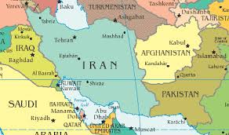
No Other Place

Slide 3
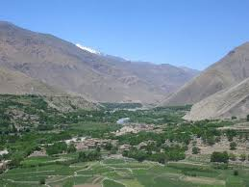
Helmand Valley of Afghanistan
1975 saw the fall of Saigon in Vietnam. It was also at this time that the fertile poppy growing regions in Burma were facing a severe drought and the Papacy/CIA would need a new area to produce heroin to continue their push for an Old World Order! The Helmand Valley of Afghanistan was perfect!

Slide 4
Already Been Used
This area, in the Golden Crescent, where the highlands of Afghanistan, Pakistan, and Iran converged, had wonderfully rich soil. Poppies for heroin had grown there successfully, but not on the scale needed by the Papacy and the CIA. In the mid 70’s, it was an area of vineyards, wheat, and cotton. But, that was about to change big time!

Slide 5
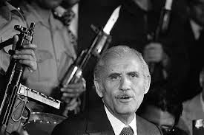
The Problem
Nur Mohammed Taraki was the leader of Afghanistan and he wanted to get rid of the production of all heroin growing in the region. Moslems in the area where the heroin was grown wanted to maintain their old beliefs; Taraki wanted to get rid of the old beliefs and the Moslems in the area!

Slide 6
Enter the Papacy/CIA
A group was formed in Afghanistan called Hezb-e-Islami; a group dedicated to creating a pure Islamic state. Does that sound familiar? (ISIS) Backed by the Papacy/CIA, the militant Moslems clashed with Taraki’s government. During this time in 1978, the production of heroin rose to 1,200 tons. Taraki was assassinated in September of 1979 and a pro-west, papacy, and CIA man, Hafizullah Amin, was put into power. In Dec. 1979, Russia invaded Afghanistan. They didn’t want a western Moslem at their backdoor!!

Slide 7
Stop the Soviets at all Cost
The stage was now set for a clash between the Soviet Union and the CIA led forces that could be trained in Afghanistan. One of the groups of men trained by the Catholic Intelligence Agency in Afghanistan was called Al-Qaeda and an offshoot of Al-Qaeda that was later formed by the CIA was called ISIS. One of the major leaders of the CIA led forces in Afghanistan was Osama bin Laden. The conflict with the Soviets began in early 1980. Many of the Muslim fighters were trained in the Middle East. Many were trained in America and because the need for fighters became paramount, many black Americans were recruited by the CIA!

Slide 8
Just What The Doctor Ordered!
“The CIA got what it wanted. The holy war had begun. For the next decade, black aid,-amounting to more than 3 billion dollars-would be poured into Afghanistan to support the holy warriors, making it the most expensive covert operation in US history.” Williams, Operation Gladio, pg. 169
“Operation Cyclone was created in this frame to create 100s of Islamic terror organizations throughout the central Asian republics. Included in these groups would be Al-Qaeda(ISIS is an offshoot of Al-Qaeda), and a host of other groups!” pg. 170

Slide 9
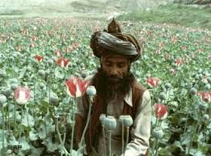
Heroin Flowed Like Oil!
In order to support this jihad against the Soviets, the Papacy/CIA needed huge supplies of heroin. The heroin flowing thru this region in the early 1980’s would be about 3 million dollars of heroin per hour! “
And the light of a candle shall shine no more at all in thee; and the voice of the bridegroom and of the bride shall be heard no more at all in thee: for thy merchants were the great men of the earth; for by thy sorceries were all nations deceived.” Rev. 18:23

Slide 10
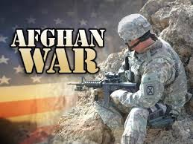
Jihad Thru the 1980’s
The Holy War between the Papacy, CIA, and the Moslem militants versus the Soviets went throughout the 1980’s. Thru dirty money, the papacy/CIA were arming the militants with big money, sophisticated weaponry, including Stinger missiles, and aiding them to drive out the Soviets!

Slide 11
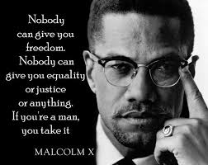
The Manpower
“In an effort to supply recruits to the jihad, the CIA (Papacy) once again focused its attention on America’s black community…. The Agency realized that millions of Black Americans, who felt forsaken by America, had converted to Islam, which they saw as the ‘black man’s religion’. This movement promoted by Timothy Drew, Malcolm X,etc. called on young black men to take up arms in the holy war to liberate their Muslim brothers!” Williams, pg. 257

Slide 12
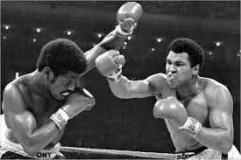
Even He Was Involved!

Slide 13
Cassius Clay/ Lew Alcindor
Some of America’s most famous and world-class athletes converted to Islam and changed their names. Cassius Clay became Mohammed Ali and basketball giant Lew Alcindor became Kareem Abdul Jabaar. Because of their influence, thousands of men worldwide looked more seriously at Islam as their religion. Once converted to Islam, there young and primarily black men could be encouraged thru big money and heavenly rewards to enlist in the Islamic jihad against the Soviets. This war continued on for nearly 10 years. It was financed by the CIA thru drug money coming out of the Helmand Valley of Afghanistan.

Slide 14
Training Facilities in America!!
“Though primarily based in Lahore, Pakistan, Jamaat ul-Fuqra has operational headquarters in New York and openly recruits through various social service organizations in the U.S., including the prison system. Members live in hamaats or compounds, such as Islamberg, where they agree to abide by the laws of Jamaat ul-Fuqra, which are considered to be above local, state and federal authority. Additional hamaats have been established in Hyattsville, Maryland; Red House, Virginia; Falls Church, Virginia; Macon, Georgia; York, South Carolina; Dover, Tennessee; Buena Vista, Colorado; Talihina, Oklahoma; Tulane Country, California; Commerce, California; and Onalaska, Washington. Others are being built, including an expansive facility in Sherman, Pennsylvania.” pg. 258 These are Catholic/CIA operated camps in America!

Slide 15
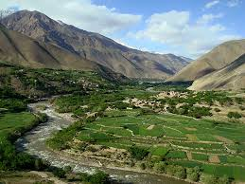
$100,000,000,000.00 annual income!
Afghanistan became the narcocapital of the world. The Helmand Valley was a gold mine, producing 3,000 to 4,000 tons of heroin per year during the 1990’s. From producing mega different kinds of crops, this area made opium production the first mono crop!

Slide 16
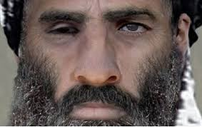
Trouble Arises!
The leader of Afghanistan, Mullah Omar, from 1995-2001, decided in Jan. 27, 2000 (notice the date!) to halt the production of opium poppies in Afghanistan!!! This sent shock waves thru the Vatican, the CIA, the US, and the Mafia drug cartel! Guess who the enemy was now? Mullah Omar! What could be done to stop him?

Slide 17
Let the Figures speak!
Thanks to the Mullah halting opium production, the harvest for the heroin fell from 4,600 tons in 1999 to 81 tons in 2001. What would the Vatican, the CIA, the US, and the Mafia do? The Mullah had to be removed in a forceful, violent manner or else! So, what would these groups do to create support for a US invasion of Afghanistan to get their much loved heroin back in full swing? Now think before you answer!

Slide 18
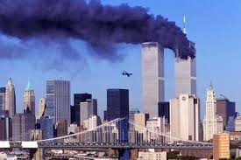
Do You Remember?

Slide 19
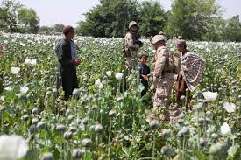
Motive for A Tragedy!
The Catholic Church, The Catholic Intelligence Agency, the drug lords of the world, and the Mafia wanted a reason for America’s military to invade Afghanistan in order to secure the poppy production. 9-11 was the answer, regardless of how many lives were lost! Regardless of how many destroyed!!

Slide 20
What 9-11 Gained for the Papacy?
1. destruction of American freedom thru the New Patriot Act.
2. restoration of the poppy growing, heroin producing region of the Helmand Valley in Afghanistan.
3. billions of dollars of drug money is being used by the Catholic Intelligence Agency to create war and terror to bring about the restoration of Romanism one final time.

Slide 21
TODAY!
With Al-Qaeda operatives being trained by the Catholic Intelligence Agency right here on American soil, the Jesuits will use them to create distraction and terror right here in American cities. When God allows them to do something awful in America, then Americans will look for a solution for this papal-induced problem, and the papacy/apostate protestants will come forward with their answer- SUNDAY! With the Supreme Court soon to vote on same sex marriages and their likely allowing it, this could call down upon America Heaven’s partial judgments! Al-Qaeda will be blamed and the papacy will shine bright while they are responsible!

