Slide 1
Prophecy Update 1-27-24

Slide 2
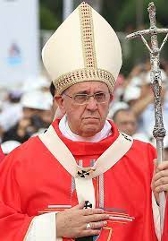
Unity in Catholic Teaching
On January 6, 2024, Pope Francis celebrated the Mass on the Solemnity of the Epiphany in St. Peter’s Basilica. In his homily, Pope Francis spoke about the lack of unity that exists within the church. He spoke about love and stated that we need to abandon “ecclesiastical ideologies” that are dividing us. Instead, we are to find our true meaning of “ecclesial vocation” within the “Holy Mother Church.”

Slide 3
Let Go of our Ideologies and Follow him!
“We need to set out on this journey, so that our faith will not be reduced to an assemblage of religious devotions or mere outward appearance, but will instead become a fire burning within us, making us passionate seekers of the Lord’s face and witnesses to his Gospel. We need this in the Church, where, instead of splitting into groups based on our own ideas, we are called to put God back at the centre. We need to let go of ecclesiastical ideologies so that we can discover the meaning of Holy Mother Church, the ecclesial habitus. Ecclesiastical ideologies, no; ecclesial vocation, yes. The Lord, not our own ideas or our own projects, must be at the center. Let us set out anew from God; let us seek from him the courage not to lose heart in the face of difficulties, the strength to surmount all obstacles, the joy to live in harmonious communion.”
https://press.vatican.va/content/salastampa/en/bollettino/pubblico/2024/01/06/240106a.html

Slide 4
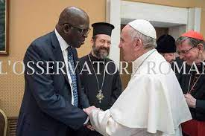
Diop Calls for the Same!
“This unique yearly gathering is a space where distinguished leaders of Christian world communions engage in bilateral and multilateral dialogues, each communion sharing on their own terms about their ecclesiastical life, and work as witnesses to the sovereignty of the triune God and His ultimate purpose to gather the whole world, oikumene, under the lordship of Christ.” https://www.oikoumene.org/news/wcc-hosts-conference-of-secretaries-of-christian-world-communions

Slide 5
Consciousness in Death!!
“On December 15, 2023, Time Magazine published a special edition called “Heaven and the Afterlife,” in which it asserted that there is scientific evidence to support the idea of a “continuing consciousness” beyond death. This view is identical to the doctrine of the immortal soul, which holds that the soul lives on eternally even after death. This philosophy is the same lie that Satan spoke in the Garden of Eden when he said, “Ye shall not surely die” (Genesis 3:4). Time magazine is helping prepare people to welcome the spirits of the dead by promoting the idea that the dead don’t really die. Once again, the great deceiver seeks to take control of our minds, and it is unfortunate that this generation listens to everything else except God and His truths. In order to enhance his deceptions, Satan’s fallen angels will pose as our deceased friends wearing “robes of light” and mimic the robes that the faithful will receive in the life to come (Revelation 6:11; 7:9, 17; 19:8).” Advent Messenger

Slide 6
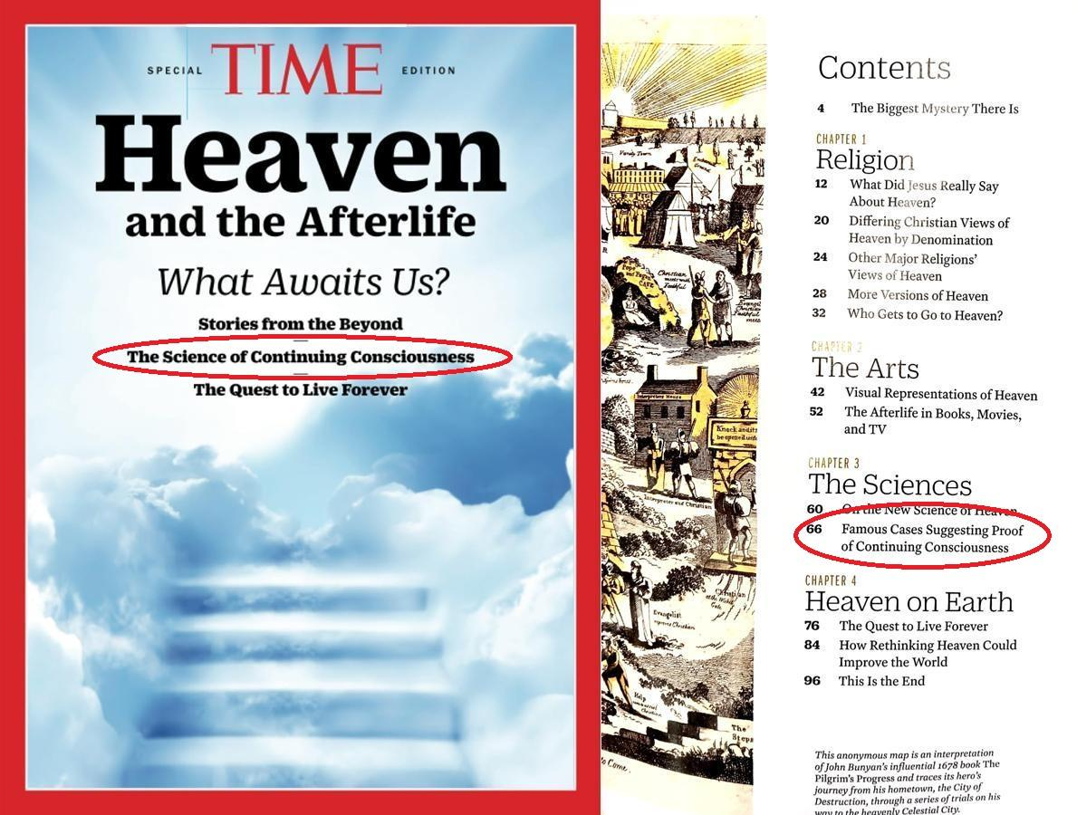
The Prophet Saw this!
“If the dead are admitted to the presence of God and holy angels, and privileged with knowledge far exceeding what they before possessed, why should they not return to the earth to enlighten and instruct the living? If, as taught by popular theologians, spirits of the dead are hovering about their friends on earth, why should they not be permitted to communicate with them, to warn them against evil, or to comfort them in sorrow? How can those who believe in man's consciousness in death reject what comes to them as divine light communicated by glorified spirits? Here is a channel regarded as sacred, through which Satan works for the accomplishment of his purposes. The fallen angels who do his bidding appear as messengers from the spirit world. While professing to bring the living into communication with the dead, the prince of evil exercises his bewitching influence upon their minds.” GC, pg. 551

Slide 7
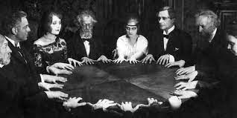
What Ellen White Foretold!!!
She said that communion with the dead would be one of the last great deceptions and anyone who understood that dead people sleep, without consciousness, would be protected from that horrific deception!!! Now, Time magazine is telling the world the devils lie and preparing the world for visitants from demons in the form of departed loved ones!! Praise God for the wonderful gift of prophecy!!!

Slide 8
Pope Francis Aims to Bring the World Together Politically, Socially, and Religiously at the World Economic Forum 2024
Vatican News published the following on January 17, 2024:
“To remind world leaders of their duty toward all of humanity, Pope Francis sent a message to the 2024 World Economic Forum, which was read out on Tuesday by Cardinal Peter Turkson and released on Wednesday. “ In his message, the Pope said the greatest challenge facing humanity is to ensure peaceful coexistence and integral development for everyone.” The Forum, he added, offers the chance for world leaders to explore innovative ways to build a better world, and he urged them to find ways to foster ‘social cohesion, fraternity, and reconciliation’ among all people.” Globalization has a profoundly moral dimension, said Pope Francis, adding that development requires a moral compass to guide discussions that shape the future of the international community.” He invited businesses and states to work together to promote ‘far-sighted and ethically sound models of globalization‘.” Authentic development must be global, shared by all nations, and in every part of the world, or it will regress even in areas marked hitherto by constant progress.” https://www.vaticannews.va/en/pope/news/2024-01/pope-francis-message-davos-world-economic-forum.html

Slide 9
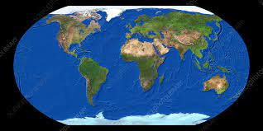
Everyone is in his Mirror
“And all that dwell upon the earth shall worship him, whose names are not written in the book of life of the Lamb slain from the foundation of the world. If any man have an ear, let him hear.” Revelation 13:8,9

Slide 10
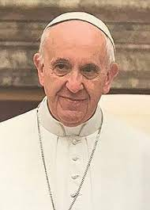
Yuck!!
Francis’ vision is a world under his authority and dominion. This world would be returned to another dark age; a world where the papacy would dominate every facet of our existence. The Bible tells us that Rome will be allowed this dominion for a short time. “And the ten horns which thou sawest are ten kings, which have received no kingdom as yet; but receive power as kings one hour with the beast. These have one mind, and shall give their power and strength unto the beast.” Rev. 17:12,13

Slide 11
Confrontation with the Lamb and Rain
“These shall make war with the Lamb, and the Lamb shall overcome them: for he is Lord of lords, and King of kings: and they that are with him are called, and chosen, and faithful.” Rev. 17:14
There will be a universal bond of union, one great harmony, a confederacy of Satan's forces. “And shall give their power and strength unto the beast.” Thus is manifested the same arbitrary, oppressive power against religious liberty, freedom to worship God according to the dictates of conscience, as was manifested by the papacy, when in the past it persecuted those who dared to refuse to conform with the religious rites and ceremonies of Romanism.
In the warfare to be waged in the last days there will be united, in opposition to God's people, all the corrupt powers that have apostatized from allegiance to the law of Jehovah. In this warfare the Sabbath of the fourth commandment will be the great point at issue; for in the Sabbath commandment the great Lawgiver identifies Himself as the Creator of the heavens and the earth (Manuscript 24, 1891).
Christ Glorified in the Last Crisis—”As Christ was glorified on the day of Pentecost, so will He again be glorified in the closing work of the gospel, when He shall prepare a people to stand the final test, in the closing conflict of the great controversy.”

Slide 12

Do you want a Fight?
“And after these things I saw another angel come down from heaven, having great power; and the earth was lightened with his glory. And he cried mightily with a strong voice, saying, Babylon the great is fallen, is fallen, and is become the habitation of devils, and the hold of every foul spirit, and a cage of every unclean and hateful bird. For all nations have drunk of the wine of the wrath of her fornication, and the kings of the earth have committed fornication with her, and the merchants of the earth are waxed rich through the abundance of her delicacies. And I heard another voice from heaven, saying, Come out of her, my people, that ye be not partakers of her sins, and that ye receive not of her plagues.” Rev. 18:1-4

Slide 13
Sunday Movement!
Fox News: “In a New Year, Pastor Reveals How to Get Back to Church Every Sunday: A prayerful decision” [1]
Lutherans: “Sabbath for this Year and Beyond” [2]
Catholic News Agency: “The Sabbath or the Lord’s Day” [3]
Reformed Churches: “Why You Should Attend Church in Person This Sunday” (4)
Evangelicals: “Sabbath for All Creation” [5]
ChurchLeaders.com: “Finding Sabbath in the Storm” [6]
MSN News: “Why Rest Should Be a Professional Priority” [7]
Yahoo News: “The Dying American Rest Ethic” [8]
https://www.foxnews.com/lifestyle/new-year-pastor-how-get-back-church-every-sunday-prayerful-decision.amp
[2] https://www.boldcafe.org/sabbath-for-this-year-and-beyond/
[3] https://www.catholicnewsagency.com/resource/55994/the-sabbath-or-the-lords-day
[4] https://www.thegospelcoalition.org/article/attend-church-sunday/
( 5] https://saltandlight.sg/devotional/sabbath-for-all-creation/
[6] https://churchleaders.com/wellness/465315-finding-pastoral-sabbath-in-the-storm.html
[7] https://www.msn.com/en-us/money/other/why-rest-should-be-a-professional-priority/ar-AA1mPvNd
[8] https://news.yahoo.com/grace-day-dying-american-rest-032000573.html
The Sunday movement is gaining momentum. Presently, efforts are underway to portray Sunday, the counterfeit Sabbath, as an essential good in our world. This will lead people away from the truth that God has for this time.
Advent Messenger

Slide 14
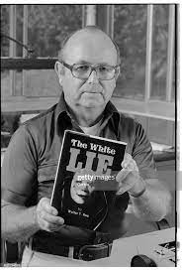
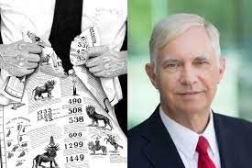
Ellen White Classic End time Scenario

Slide 15
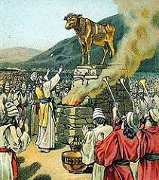
Prophetic and Pathetic People
Idols are made of scholarship and higher education that throw away the Heavenly gift of prophecy!! Shame on Adventism today!!
Praise God for the awesome gift of prophecy!!
What she wrote over 100 years ago is happening before our eyes!!

