Slide 1
One Project and Emerging Church

Slide 2
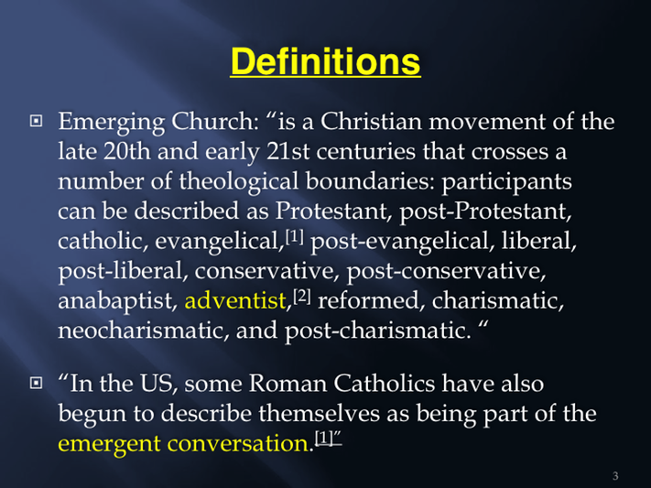
Emerging Church and Project One!

Slide 3
From Whence Have you Come?
In order to rightly understand this current movement within SDAdventism, we must understand the movement’s origins. From where did it come? Who originated these very nice sounding ideas? Who is involved with it, and who are the key pushers of this One Project and Emerging Church?

Slide 4
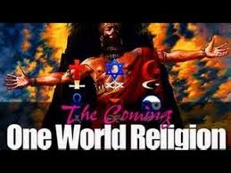
The Proponents
The main thing that the One Project and emerging Church proponents say is that ‘this is all about making Jesus supreme.’ This sounds great. However, when one begins to study into this just a little, it becomes clear that it isn’t about Christ at all, but rather about spiritualism, ecumenism, and a one world church!

Slide 5
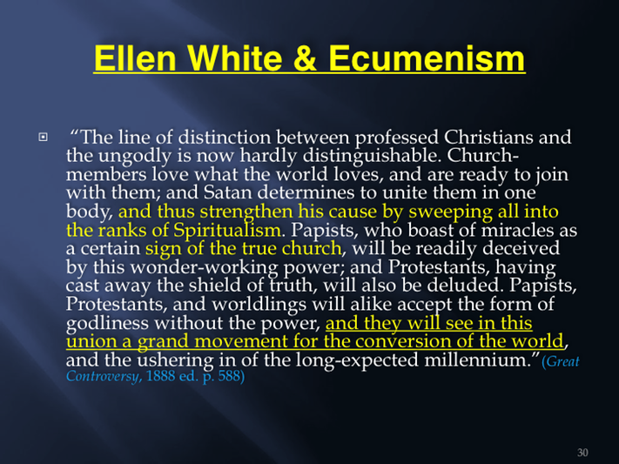

Slide 6
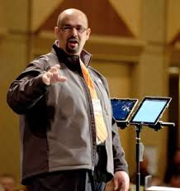
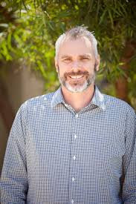
Japhet de Oliveira/ Tim Gillespie

Slide 7
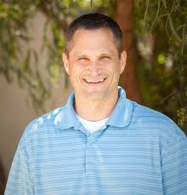
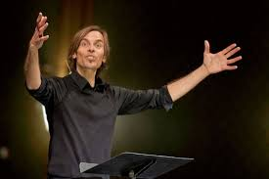
Alex Bryan/ Sam Lenore

Slide 8
George Fox University Backing!
“I am a month late to the discussion, but ran across this forum while doing a research paper on "The One Project." Certainly a worthy sounding cause, but what is behind it? For starters I have found that 4 of the 5 leaders have received (or will soon receive) post graduate degrees at George Fox University under the professorship of Leonard Sweet. If that doesn't say something.... Sweet's book Jesus Manifesto is quoted in the booklet given out at the Seattle gathering, promoted on one of the leaders Blogs as one of his suggested "books to read" and used as a title for a week-of-prayer type meeting presented by another of the five leaders. The book is clearly supported by the Project leadership.” R. Duff, The One Project.

Slide 9
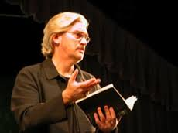
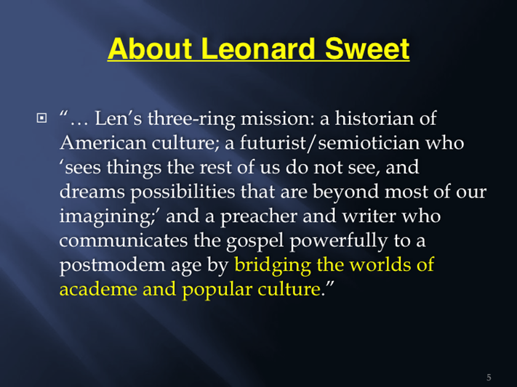
Its Distinguished, Visiting Professor!

Slide 10
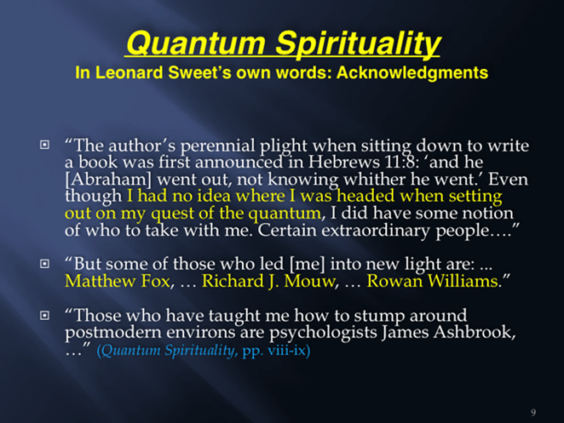
The people that have been foremost in leading Mr. Sweet Matthew Fox, Richard Mouw, and Rowan Williams. There is something strange about Mr. Sweet and maybe his friends can help!

Slide 11
Matthew Fox
Matthew Fox: is an American priest and theologian.[1] Formerly a member of the Dominican Order within the Roman Catholic Church, he is now a member of the Episcopal Church. Fox was an early and influential exponent of a movement that came to be known as Creation Spirituality. The movement draws inspiration from the mystical philosophies of such medieval Catholic visionaries as Hildegard of Bingen, Thomas Aquinas, Saint Francis of Assisi, Julian of Norwich, Dante Alighieri, and Meister Eckhart.

Slide 12
Richard Mouw, and Rowan Williams
Richard J. Mouw: is an American theologian and philosopher. He is currently President at Fuller Theological Seminary, where he also holds the post of Professor of Christian Philosophy. Dialogue with Catholics: In 2009, he signed a public statement encouraging all Christians to "read, wrestle with, and respond to Caritas in Veritate", the social encyclical by Pope Benedict XVI.
Rowan Williams: Rowan Williams is an Anglican bishop, poet and theologian. He was the 104th and current Archbishop of Canterbury. He is anti-creationist, pro-evolutionist, pro-homosexuality. He has written on Saint Teresa of Avila, a Spanish Roman Catholic mystic. He is active in the ecumenical movement and seeking reunion of the Church of England and Rome.

Slide 13
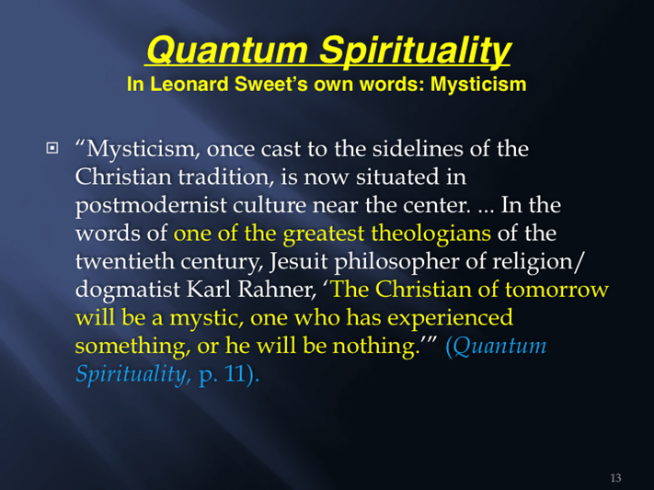
One of The Greatest Theologians

Slide 14
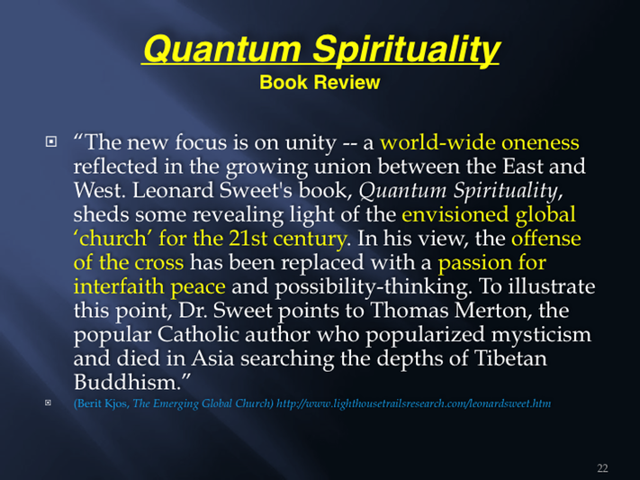

Slide 15
Summary
The Leaders of the One Project/Emerging movement in SDAdventism were predominantly educated at George Fox University in Oregon and their chief mentor is Leonard Sweet.
Sweet has written many books and his inspiration has come from Catholic priests and mystics and evangelicals who are strongly pushing the ecumenical movement! What are Adventists doing getting involved with this?

Slide 16
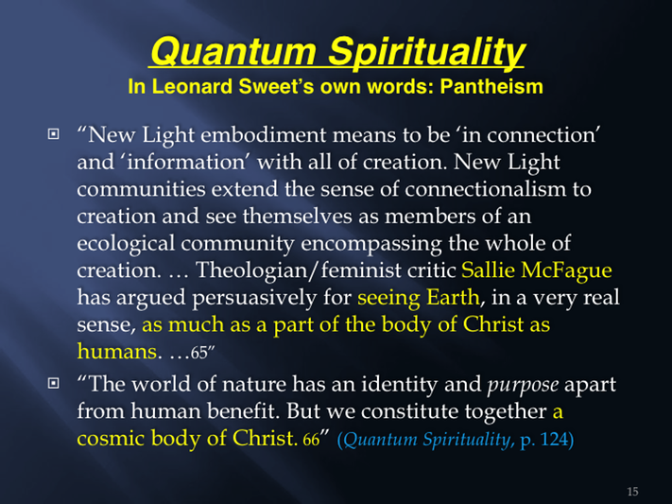
Sweet’s Great Thrust!

Slide 17
Warning
“I am instructed to say to you that it is not best to dwell upon the spiritualistic sentiments, the strange, misleading theories, which have for years been coming in among us…
(It is not best to preach on the subject of Pantheism or to read quotations from authors who write on this subject, and the specious, deceptive errors that lead to it. The statements made in Testimonies, volume 8, are sufficient to warn our people to avoid these errors. These statements will do more to enlighten minds than all the explanations or theories that our ministers and teachers may put forth concerning these matters.)
“If you try to handle these subjects, you will be led to repeat the sophistries of Satan, and thus you will help Satan to present his false theories to the people.” (Evangelism, p. 63)[Specific context was in regard to Kellogg crisis]

Slide 18
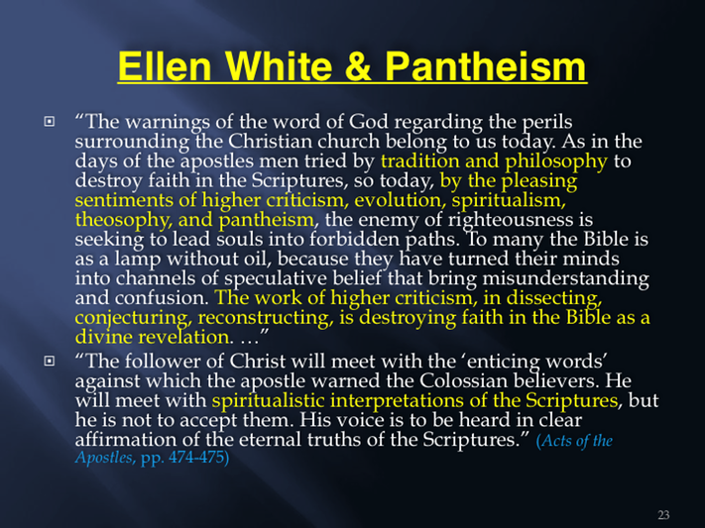

Slide 19
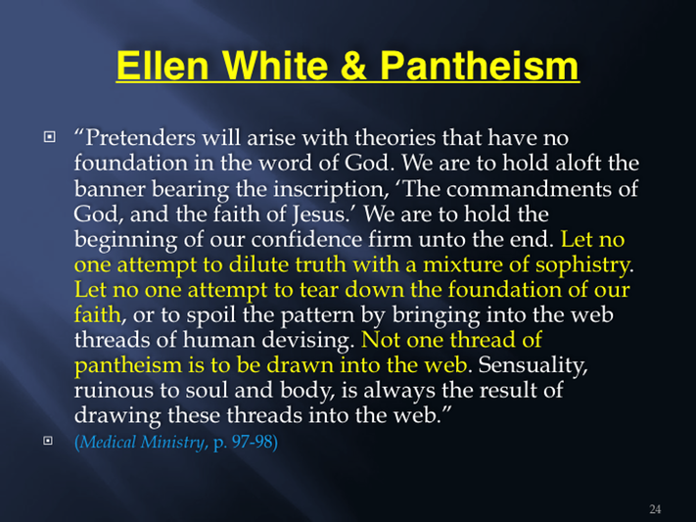

Slide 20
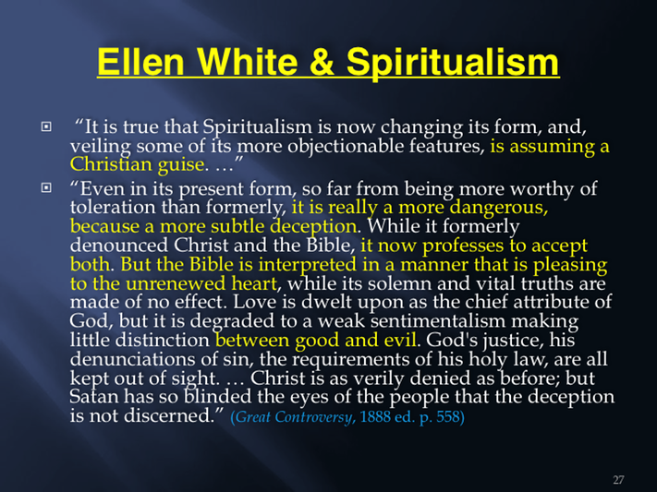

Slide 21

Unity Among churches with Spiritualism
“ And I saw three unclean spirits like frogs come out of the mouth of the dragon, and out of the mouth of the beast, and out of the mouth of the false prophet. For they are the spirits of devils, working miracles, which go forth unto the kings of the earth and of the whole world, to gather them to the battle of that great day of God Almighty.” Rev. 16:13, 14

