Slide 1
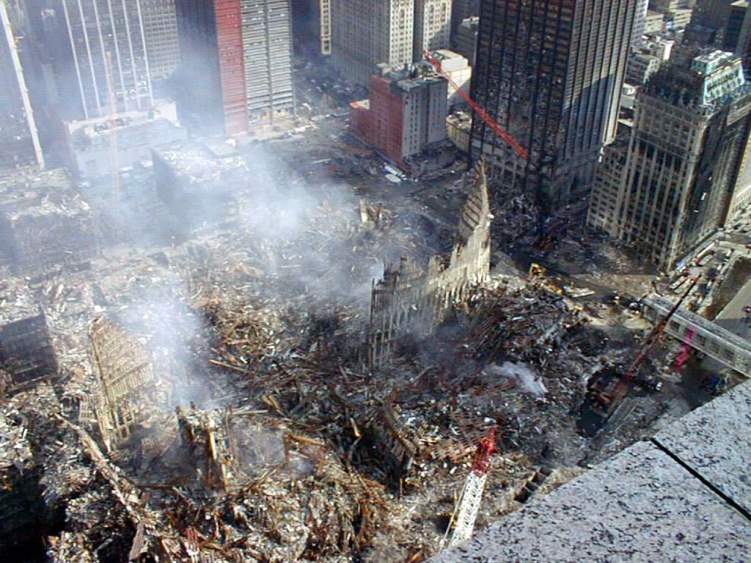

Slide 2
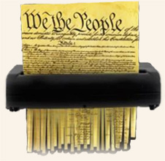

Slide 3
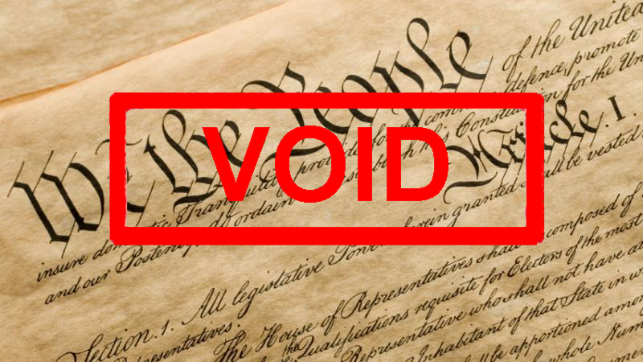

Slide 4
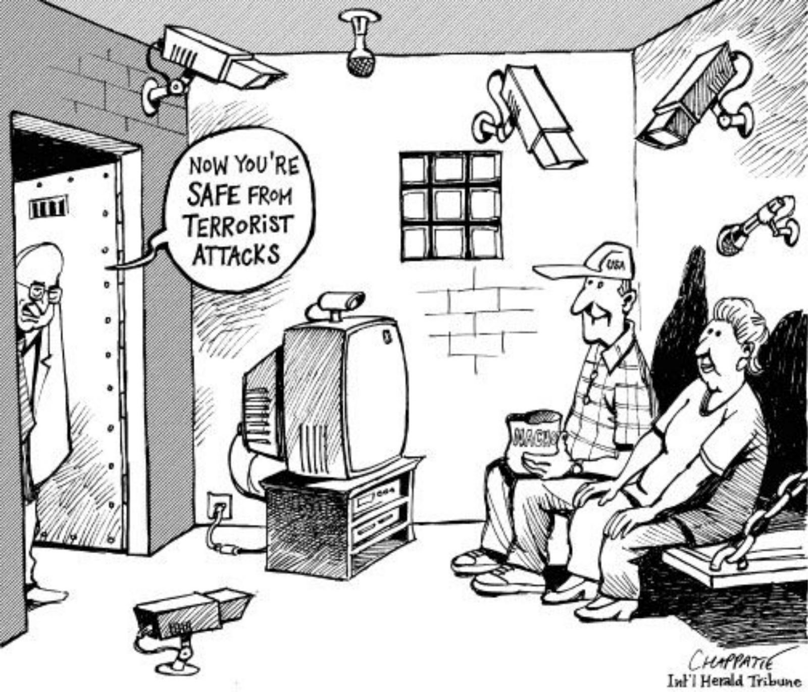

Slide 5
The Final Outcome? The Sunday Law (Mark of the Beast) and a One-World Government under the control of Rome. God will respond! Plagues and the Second Coming of Christ! Come out of Babylon before it’s too late!

Slide 6
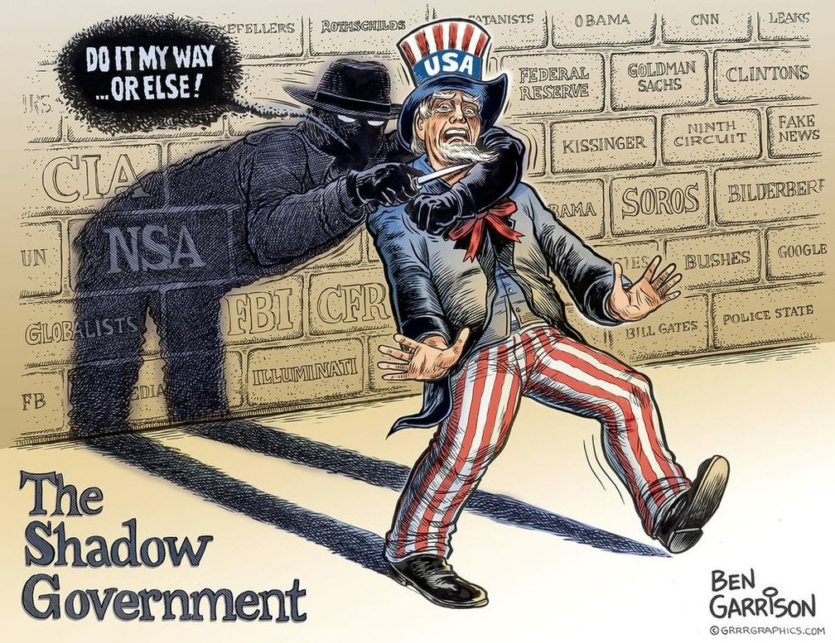

Slide 7
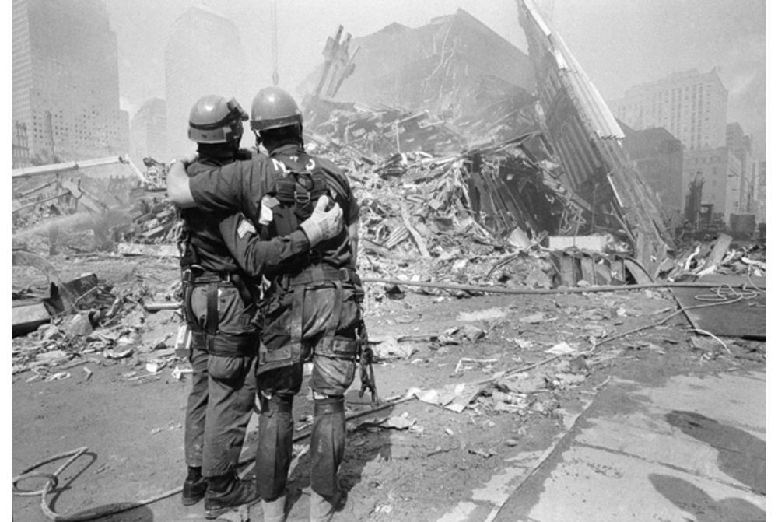
There is a way which seemeth right unto a man, but the end
thereof are the
ways of death.
—Proverbs 14:12
Understandable as it may seem, an emotional response to tragedy is never a wise path. One may think themselves doing right to relinquish
freedom for the greater good, but
if we continue in this path we will
find ourselves to be enslaved by
the government that we trusted
to protect us, due to our desire to help our country…

Slide 11
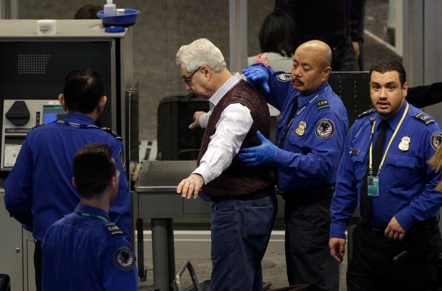
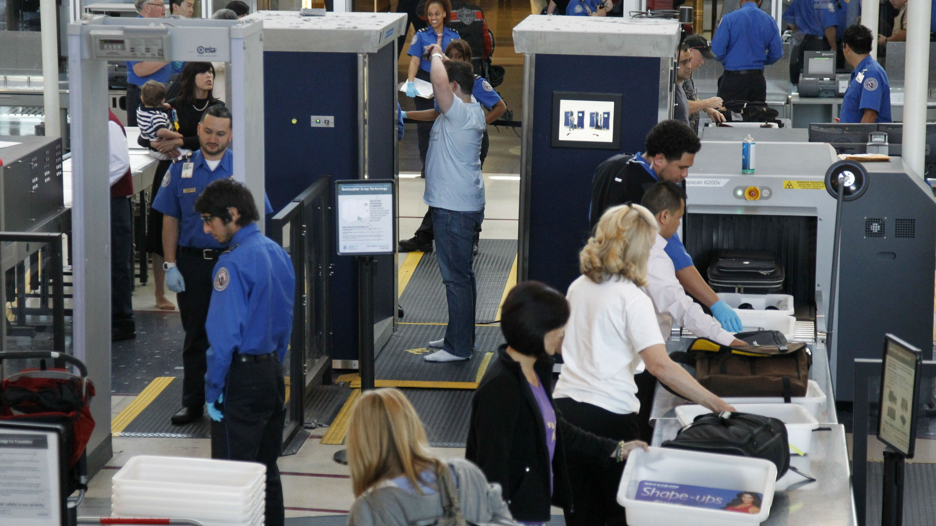

Slide 12
SILENT??? WHY??? Are they really concerned with our Civil Liberties? Or just another corrupt front organization? By their fruits, you shall know them

Slide 14
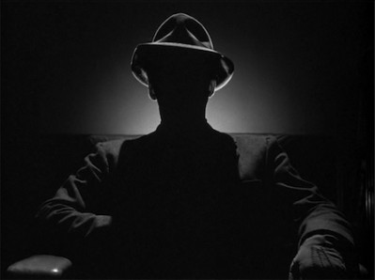
Who is the Enemy?

Slide 15
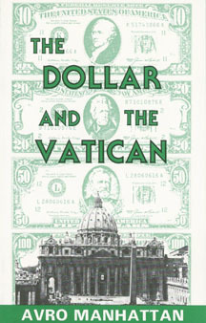
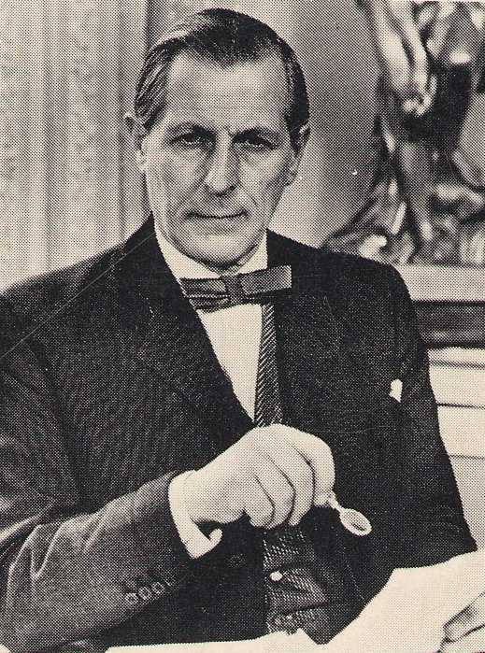

Slide 16
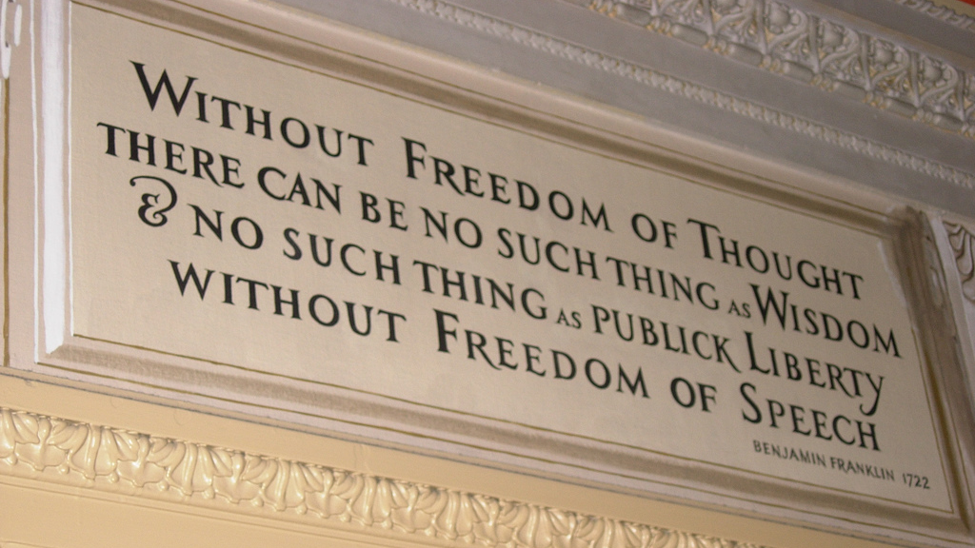

Slide 17
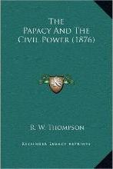
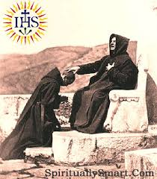

Slide 18
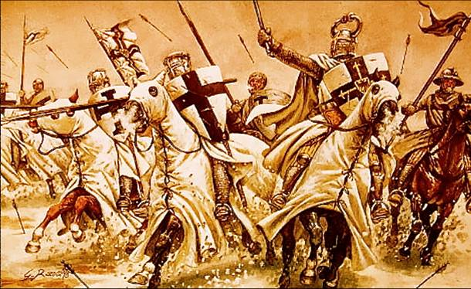
This is Catholic Religious freedom, and this will be the outcome of a return to Catholic unity of Church and State to those that choose to follow Christ according to the dictates of their own consciences

Slide 19
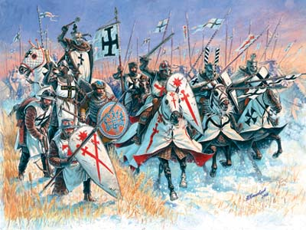
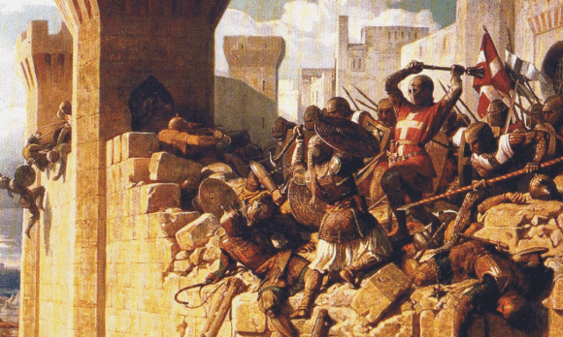
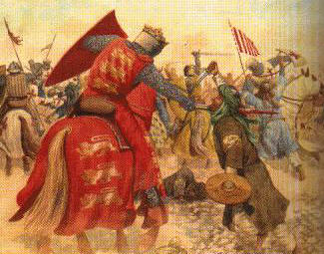
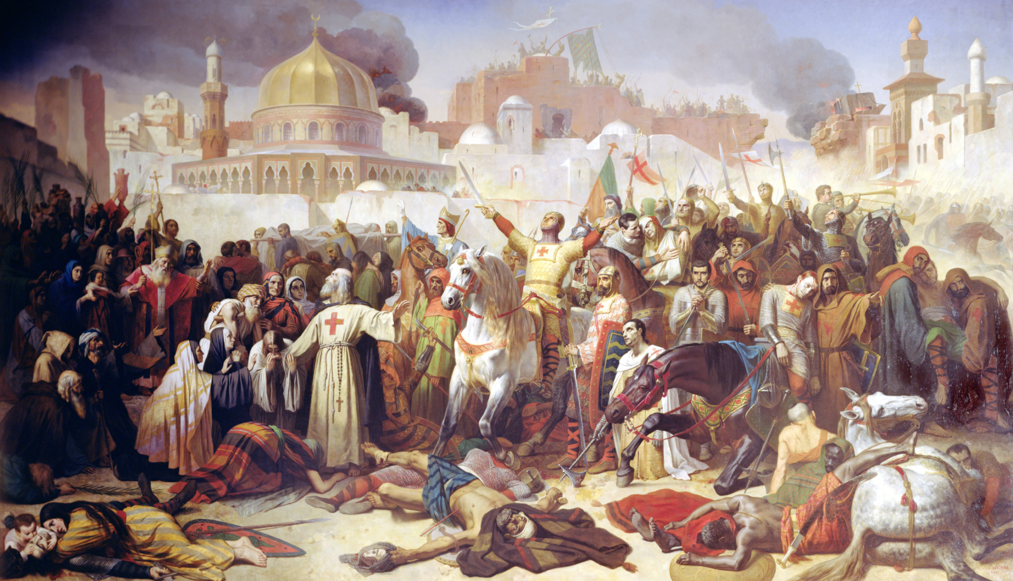

Slide 20
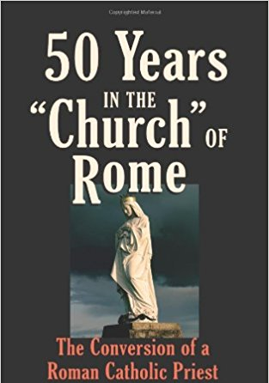

Slide 21
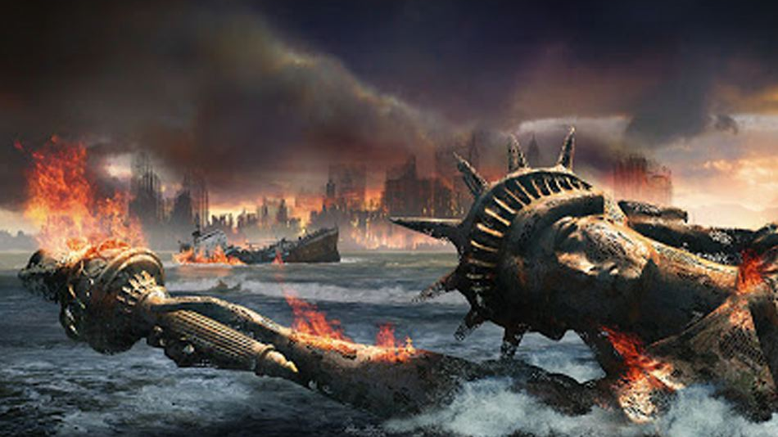

Slide 23
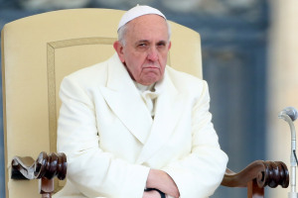

Slide 24
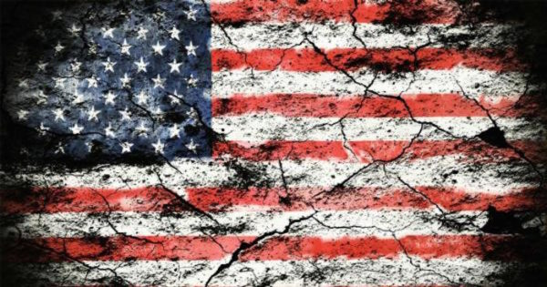

Slide 25
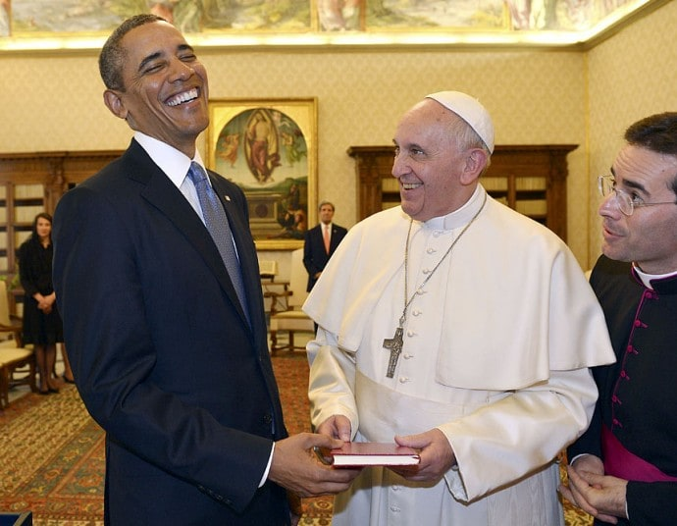
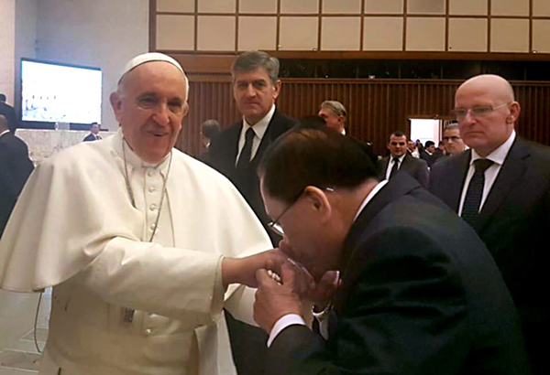
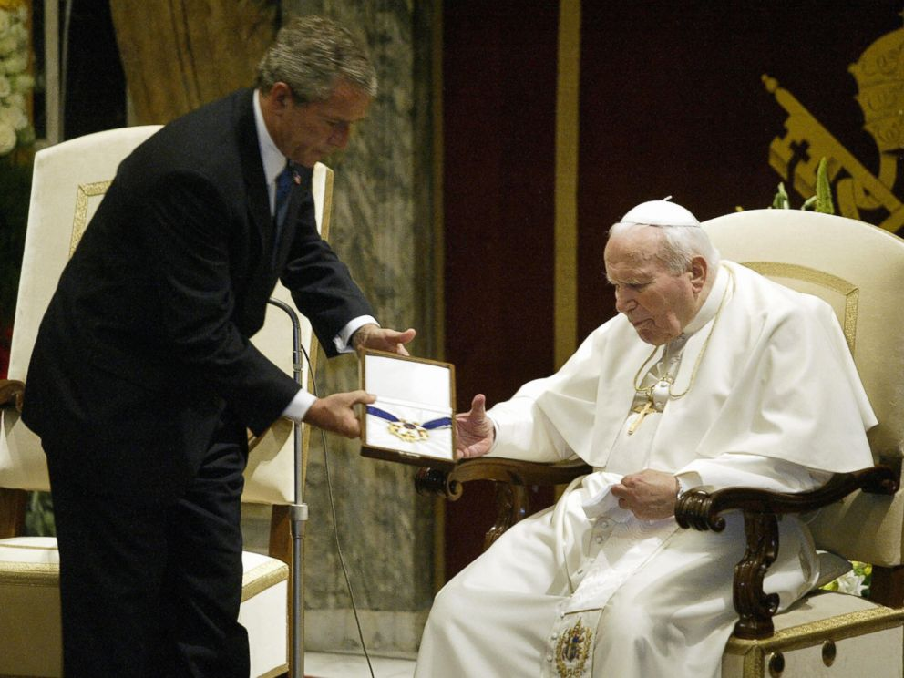

Slide 26
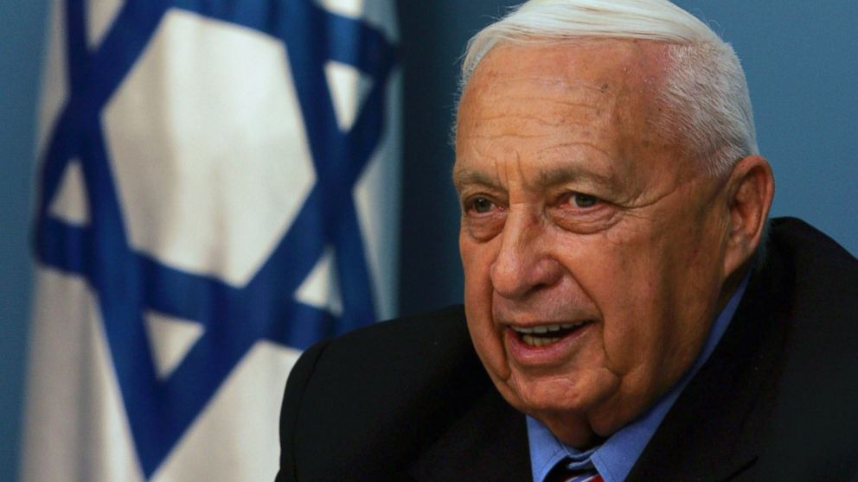

Slide 27
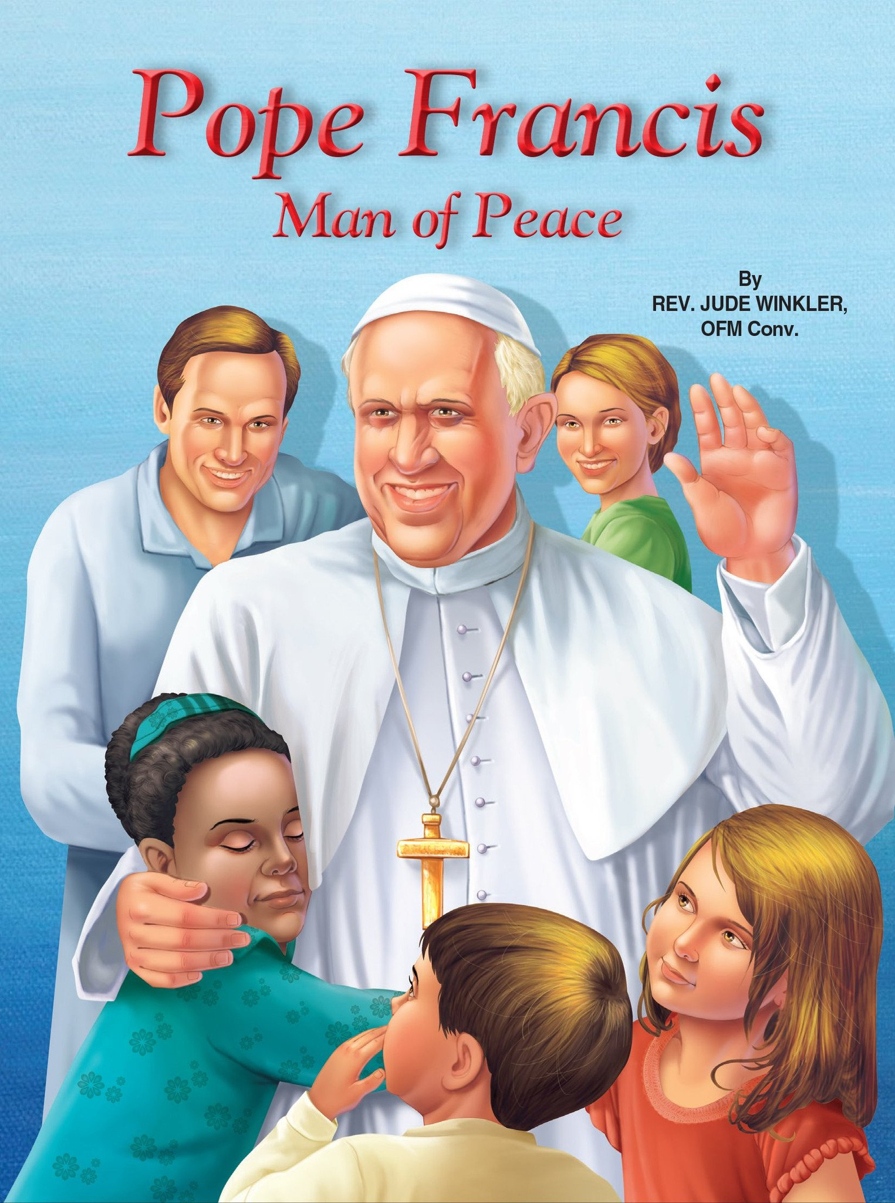
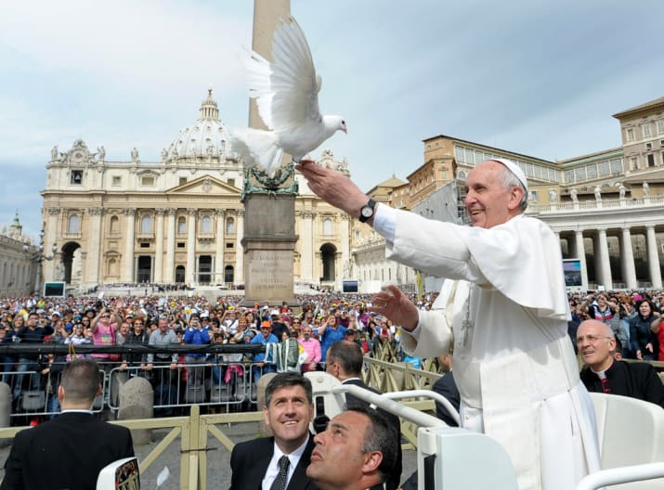
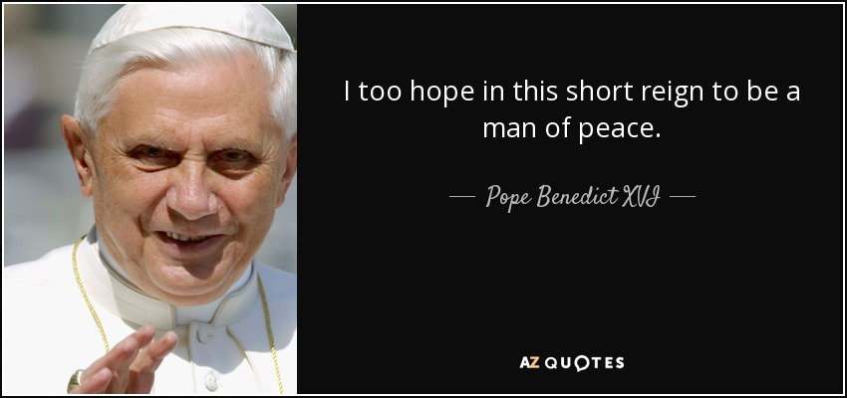

Slide 28
