Slide 1
Jesus Life,pt. 11 ‘Cleansing the Temple’

Slide 2
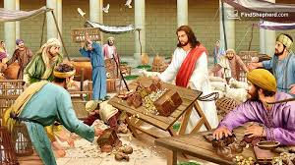
Many Distractions-One Truth
This could be a one slide sermon. Real simple. We can devise all the plans we can imagine, but there is still only one truth. Jesus came to cleanse the world from the defilement of sin. End of discussion. Only through faith in the power of Christ can this be accomplished. The story from John 2 makes clear the entire theme of Jesus life.

Slide 3
“In the cleansing of the temple, Jesus was announcing His mission as the Messiah, and entering upon His work. That temple, erected for the abode of the divine Presence, was designed to be an object lesson for Israel and for the world. From eternal ages it was God's purpose that every created being, from the bright and holy seraph to man, should be a temple for the indwelling of the Creator. Because of sin, humanity ceased to be a temple for God. Darkened and defiled by evil, the heart of man no longer revealed the glory of the Divine One. But by the incarnation of the Son of God, the purpose of Heaven is fulfilled. God dwells in humanity, and through saving grace the heart of man becomes again His temple.” DA, pg. 161

Slide 4
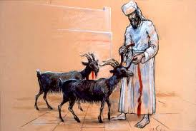
Past, Present, and Future!
“For on that day shall the priest make an atonement for you, to cleanse you, that ye may be clean from all your sins before the LORD.” Leviticus 16:30
“Saying with a loud voice, Fear God, and give glory to him; for the hour of his judgment is come: and worship him that made heaven, and earth, and the sea, and the fountains of waters.” Rev. 14:7

Slide 5
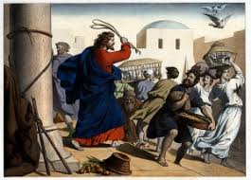
Uncomfortable Process
Jesus got a lot of people upset in this story. For many, it was very painful. Cleansing the heart from sin is a very painful process for us too! Something that desperately wants to stay alive has to be starved and ultimately slain. Paul said, “I protest by your rejoicing which I have in Christ Jesus our Lord, I die daily.” 1 Corinthians 15:31
“And he said to them all, If any man will come after me, let him deny himself, and take up his cross daily, and follow me. For whosoever will save his life shall lose it: but whosoever will lose his life for my sake, the same shall save it.” Luke 9:23,24

Slide 6
Painful!!!
“As He beholds the scene, indignation, authority, and power are expressed in His countenance. The attention of the people is attracted to Him. The eyes of those engaged in their unholy traffic are riveted upon His face. They cannot withdraw their gaze. They feel that this Man reads their inmost thoughts, and discovers their hidden motives. Some attempt to conceal their faces, as if their evil deeds were written upon their countenances, to be scanned by those searching eyes. The confusion is hushed. The sound of traffic and bargaining has ceased. The silence becomes painful. A sense of awe overpowers the assembly. It is as if they were arraigned before the tribunal of God to answer for their deeds. Looking upon Christ, they behold divinity flash through the garb of humanity. The Majesty of heaven stands as the Judge will stand at the last day,—not now encircled with the glory that will then attend Him, but with the same power to read the soul. His eye sweeps over the multitude, taking in every individual. His form seems to rise above them in commanding dignity, and a divine light illuminates His countenance. He speaks, and His clear, ringing voice—the same that upon Mount Sinai proclaimed the law that priests and rulers are transgressing—is heard echoing through the arches of the temple: “Take these things hence; make not My Father's house an house of merchandise.” DA, pg. 157, 158

Slide 7
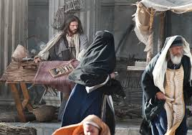
Does Your Jesus Ever Get Mad?
Does your impression of Jesus ever get mad? Does He ever stand for anything? Or, is He the nicest, sweetest, weakest Person you ever saw? Moses and Jesus were both meek, the meekest men of their generation. However, meek does not mean weak!! Meek gets tough; meek gets angry when the truth of God is being trampled upon!

Slide 8
Righteous Indignation No Excuse for Temper Tantrums
“Slowly descending the steps, and raising the scourge of cords gathered up on entering the enclosure, He bids the bargaining company depart from the precincts of the temple. With a zeal and severity He has never before manifested, He overthrows the tables of the money-changers. The coin falls, ringing sharply upon the marble pavement. None presume to question His authority. None dare stop to gather up their ill-gotten gain. Jesus does not smite them with the whip of cords, but in His hand that simple scourge seems terrible as a flaming sword. Officers of the temple, speculating priests, brokers and cattle traders, with their sheep and oxen, rush from the place, with the one thought of escaping from the condemnation of His presence. A panic sweeps over the multitude, who feel the overshadowing of His divinity. Cries of terror escape from hundreds of blanched lips. Even the disciples tremble. They are awestruck by the words and manner of Jesus, so unlike His usual demeanor.” Da, pg. 158

Slide 9
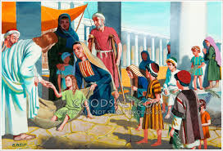
When the truth of God is being kicked to the curb, then it is justified to speak strongly in rebuke!
When the SOP is being attacked, then it is justified to stand up and let your voice be heard!
When someone is making a dumb prediction like Jeff Pipinger on July 18, then one is justified to rebuke such a deluded man.
However, to lose ones patience, to lose ones temper and lambast another, this is unjustifiable and wrong! This is not righteous indignation, but a temper tantrum!

Slide 10
What it is All About!
“But what a change had taken place during their absence! When they fled, the poor remained behind; and these were now looking to Jesus, whose countenance expressed His love and sympathy. With tears in His eyes, He said to the trembling ones around Him: Fear not; I will deliver thee, and thou shalt glorify Me. For this cause came I into the world. The people pressed into Christ's presence with urgent, pitiful appeals: Master, bless me. His ear heard every cry. With pity exceeding that of a tender mother He bent over the suffering little ones. All received attention. Everyone was healed of whatever disease he had. The dumb opened their lips in praise; the blind beheld the face of their Restorer. The hearts of the sufferers were made glad. As the priests and temple officials witnessed this great work, what a revelation to them were the sounds that fell on their ears! The people were relating the story of the pain they had suffered, of their disappointed hopes, of painful days and sleepless nights. When the last spark of hope seemed to be dead, Christ had healed them. The burden was so heavy, one said; but I have found a helper. He is the Christ of God, and I will devote my life to His service. Parents said to their children, He has saved your life; lift up your voice and praise Him. The voices of children and youth, fathers and mothers, friends and spectators, blended in thanksgiving and praise. Hope and gladness filled their hearts. Peace came to their minds. They were restored soul and body, and they returned home, proclaiming everywhere the matchless love of Jesus.” DA, pgs. 162, 163

Slide 11
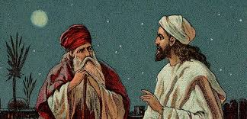
Someone Was Watching and was Honest
“Since hearing Jesus, Nicodemus had anxiously studied the prophecies relating to the Messiah; and the more he searched, the stronger was his conviction that this was the One who was to come. With many others in Israel he had been greatly distressed by the profanation of the temple. He was a witness of the scene when Jesus drove out the buyers and the sellers; he beheld the wonderful manifestation of divine power; he saw the Saviour receiving the poor and healing the sick; he saw their looks of joy, and heard their words of praise; and he could not doubt that Jesus of Nazareth was the Sent of God.” DA, pg. 168

Slide 12
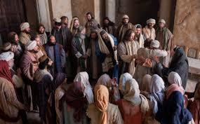
Showdown!
“Then answered the Jews and said unto him, What sign shewest thou unto us, seeing that thou doest these things? Jesus answered and said unto them, Destroy this temple, and in three days I will raise it up.” John 2:18,19

Slide 13
Nothing Would Convince Them
“Above all others the priests and rulers should have seen in Jesus the anointed of the Lord; for in their hands were the sacred scrolls that described His mission, and they knew that the cleansing of the temple was a manifestation of more than human power. Much as they hated Jesus, they could not free themselves from the thought that He might be a prophet sent by God to restore the sanctity of the temple. With a deference born of this fear, they went to Him with the inquiry, “What sign showest Thou unto us, seeing that Thou doest these things?” Jesus had shown them a sign. In flashing light into their hearts, and in doing before them the works which the Messiah was to do, He had given convincing evidence of His character. Now when they asked for a sign, He answered them by a parable, showing that He read their malice, and saw to what lengths it would lead them. “Destroy this temple,” He said, “and in three days I will raise it up.” DA, pg. 164

Slide 14
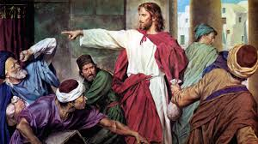
He Gave Them A Sign!
There was no doubt as to who Jesus was. He had showed them by His works that He was the Son of God. No sign would convince these Adventists as to who He was! “Abraham saith unto him, They have Moses and the prophets; let them hear them. And he said, Nay, father Abraham: but if one went unto them from the dead, they will repent. And he said unto him, If they hear not Moses and the prophets, neither will they be persuaded, though one rose from the dead.” Luke 16:29-31

Slide 15
Ready to Kill Him!
“In these words His meaning was twofold. He referred not only to the destruction of the Jewish temple and worship, but to His own death,—the destruction of the temple of His body. This the Jews were already plotting. As the priests and rulers returned to the temple, they had proposed to kill Jesus, and thus rid themselves of the troubler. Yet when He set before them their purpose, they did not understand Him. They took His words as applying only to the temple at Jerusalem, and with indignation exclaimed, “Forty and six years was this temple in building, and wilt Thou rear it up in three days?” Now they felt that Jesus had justified their unbelief, and they were confirmed in their rejection of Him.” DA, pg. 164

Slide 16
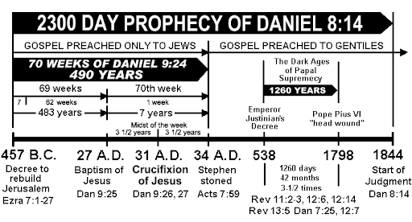
Passover, Number 1- AD 28, Springtime
“After this he went down to Capernaum, he, and his mother, and his brethren, and his disciples: and they continued there not many days. And the Jews' Passover was at hand, and Jesus went up to Jerusalem,…” John 2:12,13

