Slide 1
Celebration Turned Sour!!!
The Final Scenes, pt.2

Slide 2
A Thoughtful Hour
“It would be well for us to spend a thoughtful hour each day in contemplation of the life of Christ. We should take it point by point, and let the imagination grasp each scene, especially the closing ones. As we thus dwell upon His great sacrifice for us, our confidence in Him will be more constant, our love will be quickened, and we shall be more deeply imbued with His spirit. If we would be saved at last, we must learn the lesson of penitence and humiliation at the foot of the cross.” Desire of Ages, pg. 83

Slide 3
From Bethany to Jerusalem
After spending the Sabbath in Bethany at Simon’s house, Christ headed toward Jerusalem. It was only about 1.5 miles from Bethany to the city. Bethany was on the southeastern slope of the Mt. of Olives. Christ gave two disciples some directives. “And when they drew nigh unto Jerusalem, and were come to Bethphage, unto the mount of Olives, then sent Jesus two disciples, Saying unto them, Go into the village over against you, and straightway ye shall find an ass tied, and a colt with her: loose them, and bring them unto me. And if any man say ought unto you, ye shall say, The Lord hath need of them; and straightway he will send them.” Mt. 21:1-3

Slide 4
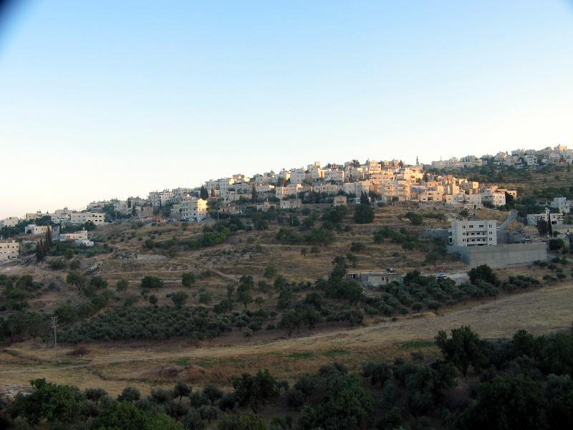
Bethany

Slide 5
Jesus Would Ride
“All this was done, that it might be fulfilled which was spoken by the prophet, saying, Tell ye the daughter of Sion, Behold, thy King cometh unto thee, meek, and sitting upon an ass, and a colt the foal of an ass. And the disciples went, and did as Jesus commanded them, And brought the ass, and the colt, and put on them their clothes, and they set him thereon. And a very great multitude spread their garments in the way; others cut down branches from the trees, and strawed them in the way. And the multitudes that went before, and that followed, cried, saying, Hosanna to the Son of David: Blessed is he that cometh in the name of the Lord; Hosanna in the highest.” Mt. 21:4-9

Slide 6
Foretold in Prophecy
“ Five hundred years before the birth of Christ, the prophet Zechariah thus foretold the coming of the King to Israel. This prophecy is now to be fulfilled. He who has so long refused royal honors now comes to Jerusalem as the promised heir to David's throne.
It was on the first day of the week that Christ made His triumphal entry into Jerusalem. Multitudes who had flocked to see Him at Bethany now accompanied Him, eager to witness His reception. Many people were on their way to the city to keep the Passover, and these joined the multitude attending Jesus. All nature seemed to rejoice. The trees were clothed with verdure, and their blossoms shed a delicate fragrance on the air. A new life and joy animated the people. The hope of the new kingdom was again springing up.” DA 569

Slide 7
‘Christ will be King!’
“ Christ was following the Jewish custom for a royal entry. The animal on which He rode was that ridden by the kings of Israel,... No sooner was He seated upon the colt than a loud shout of triumph rent the air. The multitude hailed Him as Messiah, their King. Jesus now accepted the homage which He had never before permitted, and the disciples received this as proof that their glad hopes were to be realized by seeing Him established on the throne. The multitude were convinced that the hour of their emancipation was at hand. In imagination they saw the Roman armies driven from Jerusalem, and Israel once more an independent nation. All were happy and excited; the people vied with one another in paying Him homage. They could not display outward pomp and splendor, but they gave Him the worship of happy hearts… they spread their outer garments as a carpet in His path, and they also strewed the leafy branches of the olive and the palm in the way. They could lead the triumphal procession with no royal standards, but they cut down the spreading palm boughs, Nature's emblem of victory, and waved them aloft with loud acclamations and hosannas.” DA, pg. 570

Slide 8
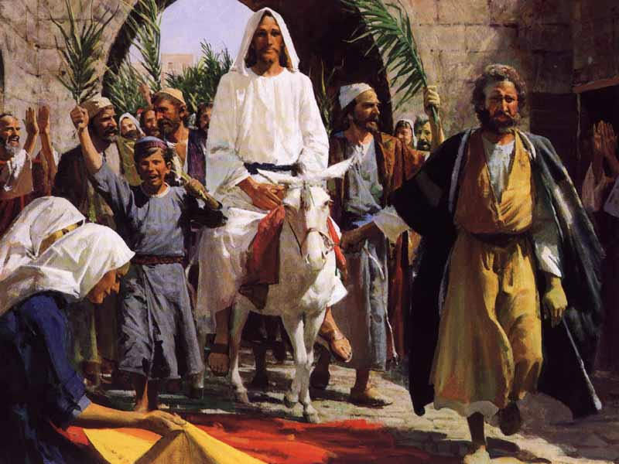
O, Happy Day!
Almost everyone was swallowed up in the moment. This meant one thing; earthly glory and triumph. No matter that Christ had declared the purpose for going to Jerusalem! No matter that He had talked of death and betrayal. This very event, the triumphal entry, sealed Christ’s doom. Of the huge throng, only One Man understood this!!

Slide 9
The Display
”Never before in His earthly life had Jesus permitted such a demonstration. He clearly foresaw the result. It would bring Him to the cross. But it was His purpose thus publicly to present Himself as the Redeemer. He desired to call attention to the sacrifice that was to crown His mission to a fallen world. While the people were assembling at Jerusalem to celebrate the Passover, He, the antitypical Lamb, by a voluntary act set Himself apart as an oblation. It would be needful for His church in all succeeding ages to make His death for the sins of the world a subject of deep thought and study. Every fact connected with it should be verified beyond a doubt. It was necessary, then, that the eyes of all people should now be directed to Him; the events which preceded His great sacrifice must be such as to call attention to the sacrifice itself. After such a demonstration as that attending His entry into Jerusalem, all eyes would follow His rapid progress to the final scene.” DA 571

Slide 10
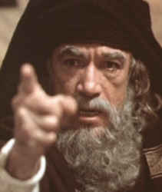
Unhappy Campers
“Saying, Blessed be the King that cometh in the name of the Lord: peace in heaven, and glory in the highest. And some of the Pharisees from among the multitude said unto him, Master, rebuke thy disciples. And he answered and said unto them, I tell you that, if these should hold their peace, the stones would immediately cry out.” Luke 19:38-40

Slide 11
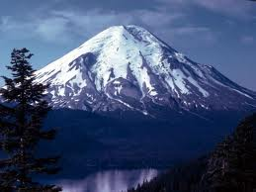
Immortal Truth
“That scene of triumph was of God's own appointing. It had been foretold by the prophet, and man was powerless to turn aside God's purpose. Had men failed to carry out His plan, He would have given a voice to the inanimate stones, and they would have hailed His Son with acclamations of praise.” DA, pg. 574

Slide 12
Purpose of Heaven
Nothing in earth or hell could have stopped the praising of Christ. If the people didn’t do it, the rocks would have cried out.
“For if thou altogether holdest thy peace at this time, then shall there enlargement and deliverance arise to the Jews from another place; but thou and thy father's house shall be destroyed: and who knoweth whether thou art come to the kingdom for such a time as this?” Esther 4:14
God’s people were to be delivered with Esther or without her!

Slide 13
How about us?
“For the earth shall be filled with the knowledge of the glory of the LORD, as the waters cover the sea.” Habb. 2:14
“And after these things I saw another angel come down from heaven, having great power; and the earth was lightened with his glory.” Rev. 18:1
“Men of faith and prayer will be constrained to go forth with holy zeal, declaring the words which God gives them. The sins of Babylon will be laid open. The fearful results of enforcing the observances of the church by civil authority, the inroads of spiritualism, the stealthy but rapid progress of the papal power--all will be unmasked. By these solemn warnings the people will be stirred. Thousands upon thousands will listen who have never heard words like these. ” GC, pg. 606

Slide 14
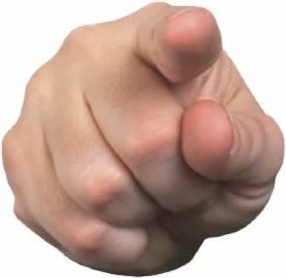
More pointed than John!
“In this fearful time, just before Christ is to come the second time, God’s faithful preachers will have to bear a still more pointed testimony than was borne by John the Baptist. A responsible, important work is before them; and those who speak smooth things, God will not acknowledge as His shepherds. A fearful woe is upon them.” – 1T321

Slide 15
Party is Over!
“And when he was come near, he beheld the city, and wept over it, Saying, If thou hadst known, even thou, at least in this thy day, the things which belong unto thy peace! but now they are hid from thine eyes. For the days shall come upon thee, that thine enemies shall cast a trench about thee, and compass thee round, and keep thee in on every side, And shall lay thee even with the ground, and thy children within thee; and they shall not leave in thee one stone upon another; because thou knewest not the time of thy visitation.” Luke 19:41-44

Slide 16
Apostasy has a Price!
“Jesus had come to the fig tree hungry, to find food. So He had come to Israel, hungering to find in them the fruits of righteousness. He had lavished on them His gifts, that they might bear fruit for the blessing of the world. Every opportunity and privilege had been granted them, and in return He sought their sympathy and co-operation in His work of grace. He longed to see in them self-sacrifice and compassion, zeal for God, and a deep yearning of soul for the salvation of their fellow men. Had they kept the law of God, they would have done the same unselfish work that Christ did. But love to God and man was eclipsed by pride and self-sufficiency. They brought ruin upon themselves by refusing to minister to others. The treasures of truth which God had committed to them, they did not give to the world. In the barren tree they might read both their sin and its punishment.” DA, pg. 583

Slide 17
Refused to Minister to others
“The message of salvation is communicated to men through human agencies. But the Jews had sought to make a monopoly of the truth which is eternal life. They had hoarded the living manna, and it had turned to corruption. The religion which they tried to shut up to themselves became an offense. They robbed God of His glory, and defrauded the world by a counterfeit of the gospel. They had refused to surrender themselves to God for the salvation of the world, and they became agents of Satan for its destruction.
The people whom God had called to be the pillar and ground of the truth had become representatives of Satan. They were doing the work that he desired them to do, taking a course to misrepresent the character of God, and cause the world to look upon Him as a tyrant. The very priests who ministered in the temple had lost sight of the significance of the service they performed. They had ceased to look beyond the symbol to the thing signified. In presenting the sacrificial offerings they were as actors in a play. The ordinances which God Himself had appointed were made the means of blinding the mind and hardening the heart. God could do no more for man through these channels. The whole system must be swept away.” DA, pg. 36

Slide 18
What About Us?
“The enemy of souls has sought to bring in the supposition that a great reformation was to take place among Seventh-day Adventists, and that this reformation would consist in giving up the doctrines which stand as the pillars of our faith, and engaging in a process of reorganization. Were this reformation to take place, what would result? The principles of truth that God in His wisdom has given to the remnant church, would be discarded. Our religion would be changed. The fundamental principles that have sustained the work for the last fifty years would be accounted as error. A new organization would be established. Books of a new order would be written. A system of intellectual philosophy would be introduced. The founders of this system would go into the cities, and do a wonderful work. The Sabbath of course, would be lightly regarded, as also the God who created it. Nothing would be allowed to stand in the way of the new movement. The leaders would teach that virtue is better than vice, but God being removed, they would place their dependence on human power, which, without God, is worthless. Their foundation would be built on the sand, and storm and tempest would sweep away the structure.” 1SM 204,205

Slide 19
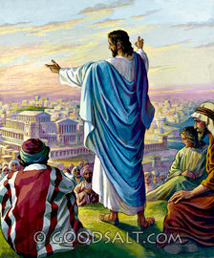
Christ Wept
What is Christ doing today? He is weeping for His professed people who are only thinking about themselves, who refuse to minister to others. He weeps for those who merely put in their time on Sabbath and the rest of the week live for themselves! How grievously sad!! May we resolve to live for Christ and others everyday!

