Slide 1
Romans, pt. 17
Children of Promise

Slide 2
Summary of Romans 8:15-39
1. While in submission to the Holy Spirit, we have no fear.
2. We have been adopted into the family of God.
3. God has predestined all to be saved, but so few will choose to accept it.
4. The only thing that separates us from Christ is………………..our miserable choices.

Slide 3
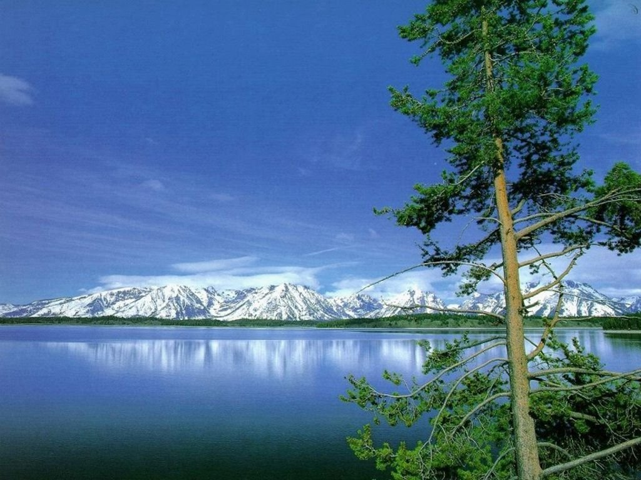
Romans 9:1-5
“I say the truth in Christ, I lie not, my conscience also bearing me witness in the Holy Ghost, That I have great heaviness and continual sorrow in my heart. For I could wish that myself were accursed from Christ for my brethren, my kinsmen according to the flesh: Who are Israelites; to whom [pertaineth] the adoption, and the glory, and the covenants, and the giving of the law, and the service [of God], and the promises; Whose [are] the fathers, and of whom as concerning the flesh Christ [came], who is over all, God blessed for ever. Amen.”

Slide 4
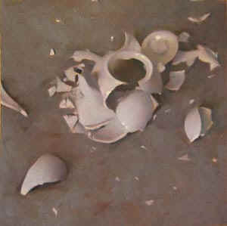
Paul’s Broken Heart
Paul was sick because the SDA’s of the first century were utterly miserable because of their rejection of Christ. Because of their horrible choices to walk apart from God and yet claim to be God’s children, it was well nigh impossible for them to turn around. Paul declared that he would die for them if that might help!

Slide 5
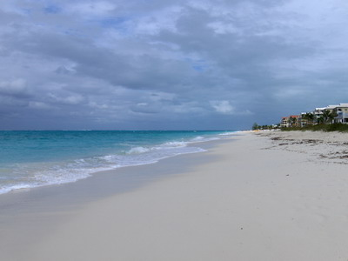
What more?
“What advantage then hath the Jew? or what profit is there of circumcision? Much every way: chiefly, because that unto them were committed the oracles of God.” Romans 3:1,2
Paul is repeating what he said in chapter 3. The Jews had so many advantages, but no corresponding works. They were given it all. They had:
1. the sanctuary message
2. the voice of prophecy
3. the law of God
4. the adoption as God’s children

Slide 6
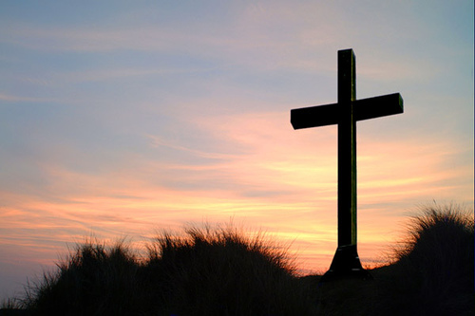
What will we Give?
“He was in the world, and the world was made by him, and the world knew him not. He came unto his own, and his own received him not.” John 1:10,11
“For he shall grow up before him as a tender plant, and as a root out of a dry ground: he hath no form nor comeliness; and when we shall see him, there is no beauty that we should desire him. He is despised and rejected of men; a man of sorrows, and acquainted with grief: and we hid as it were our faces from him; he was despised, and we esteemed him not. Surely he hath borne our grief's, and carried our sorrows: yet we did esteem him stricken, smitten of God, and afflicted. “ Isaiah 53:2-4

Slide 7
Abraham’s Two Boys
“Not as though the word of God hath taken none effect. For they are not all Israel, which are of Israel: Neither, because they are the seed of Abraham, are they all children: but, In Isaac shall thy seed be called. That is, They which are the children of the flesh, these are not the children of God: but the children of the promise are counted for the seed. For this is the word of promise, At this time will I come, and Sara shall have a son. “ Romans 9:6-9
Just because someone claims to be Abraham’s son doesn’t make him or her an heir to the kingdom of heaven. Isaac was a child of promise; he was given in response to faith in God’s word.
Ishmael was the result of Abraham and Sarah’s mistrust/disbelief. Any Israelites/SDA’s who are depending on anything but Christ to save them will be accounted a child of the flesh and lost! These are the two covenants. This is the message of Romans and of Christ!

Slide 8
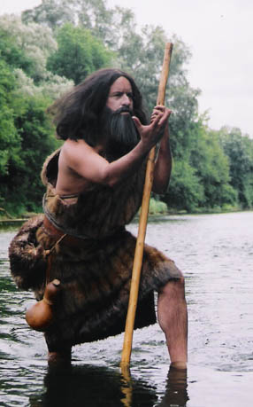
John’s Warning
“But when he saw many of the Pharisees and Sadducees come to his baptism, he said unto them, O generation of vipers, who hath warned you to flee from the wrath to come? Bring forth therefore fruits meet for repentance: And think not to say within yourselves, We have Abraham to our father: for I say unto you, that God is able of these stones to raise up children unto Abraham.” Matthew 3:7-9

Slide 9
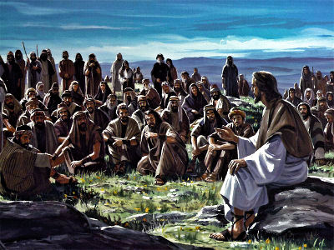
Christ Too
“They answered him, We be Abraham's seed, and were never in bondage to any man: how sayest thou, Ye shall be made free? Jesus answered them, Verily, verily, I say unto you, Whosoever committeth sin is the servant of sin. And the servant abideth not in the house for ever: but the Son abideth ever. If the Son therefore shall make you free, ye shall be free indeed. I know that ye are Abraham's seed; but ye seek to kill me, because my word hath no place in you. I speak that which I have seen with my Father: and ye do that which ye have seen with your father. They answered and said unto him, Abraham is our father. Jesus saith unto them, If ye were Abraham's children, ye would do the works of Abraham.” John 8:35-39

Slide 10
Spirit of Prophecy Quote
“The Jews regarded their natural descent from Abraham as giving them a claim to this promise. But they overlooked the conditions which God had specified. Before giving the promise, He had said, "I will put My law in their inward parts, and write it in their hearts; and will be their God, and they shall be My people. . . . For I will forgive their iniquity, and I will remember their sin no more." Jer. 31:33, 34.
To a people in whose hearts His law is written, the favor of God is assured. They are one with Him. But the Jews had separated themselves from God. Because of their sins they were suffering under His judgments. This was the cause of their bondage to a heathen nation. Their minds were darkened by transgression, and because in times past the Lord had shown them so great favor, they excused their sins. They flattered themselves that they were better than other men, and entitled to His blessings.
These things "are written for our admonition, upon whom the ends of the world are come." 1 Cor. 10:11….

Slide 11
Continued
How often we misinterpret God's blessings, and flatter ourselves that we are favored on account of some goodness in us! God cannot do for us that which He longs to do. His gifts are used to increase our self-satisfaction, and to harden our hearts in unbelief and sin. John declared to the teachers of Israel that their pride, selfishness, and cruelty showed them to be a generation of vipers, a deadly curse to the people, rather than the children of just and obedient Abraham. In view of the light they had received from God, they were even worse than the heathen, to whom they felt so much superior. They had forgotten the rock whence they were hewn, and the hole of the pit from which they had been digged. God was not dependent upon them for the fulfilling of His purpose. As He had called Abraham out from a heathen people, so He could call others to His service. Their hearts might now appear as lifeless as the stones of the desert, but His Spirit could quicken them to do His will, and receive the fulfillment of His promise. "And now also," said the prophet, "the ax is laid unto the root of the trees: therefore every tree which bringeth not forth good fruit is hewn down, and cast into the fire." Not by its name, but by its fruit, is the value of a tree determined. If the fruit is worthless, the name cannot save the tree from destruction. John declared to the Jews that their standing before God was to be decided by their character and life. Profession was worthless. If their life and character were not in harmony with God's law, they were not His people.” DA, pg. 106,107

Slide 12
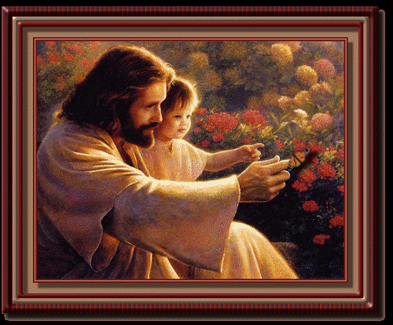
Children of Christ!
Jesus, Paul, and John the Baptist all were very clear that mere natural connection does not make one a child of Abraham. It was solely dependent upon manifesting the same faith and trust in God that made one His child like Abraham!
“And said, Verily I say unto you, Except ye be converted, and become as little children, ye shall not enter into the kingdom of heaven. Whosoever therefore shall humble himself as this little child, the same is greatest in the kingdom of heaven. “ Matthew 18:3.4

Slide 13
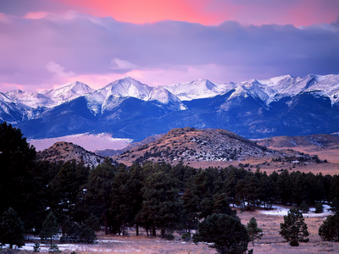
Faith that destroys mountains
Childlike faith declares a dependence upon what God says and believes that God will do what He says. Even when mountains of difficulty appear before us, faith believes that God will knock those mountains down and do just as He says.

Slide 14
“Throughout the history of God's people great mountains of difficulty, apparently insurmountable, have loomed up before those who were trying to carry out the purposes of Heaven. Such obstacles are permitted by the Lord as a test of faith. When we are hedged about on every side, this is the time above all others to trust in God and in the power of His Spirit. The exercise of a living faith means an increase of spiritual strength and the development of an unfaltering trust. It is thus that the soul becomes a conquering power. Before the demand of faith, the obstacles placed by Satan across the pathway of the Christian will disappear; for the powers of heaven will come to his aid. "Nothing shall be impossible unto you." Matthew 17:20. The way of the world is to begin with pomp and boasting. God's way is to make the day of small things the beginning of the glorious triumph of truth and righteousness. Sometimes He trains His workers by bringing to them disappointment and apparent failure. It is His purpose that they shall learn to master difficulties.
Often men are tempted to falter before the perplexities and obstacles that confront them. But if they will hold the beginning of their confidence steadfast unto the end, God will make the way clear. Success will come to them as they struggle against difficulties. Before the intrepid spirit and unwavering faith of a Zerubbabel, great mountains of difficulty will become a plain; “ PK, pgs. 594,595

Slide 15
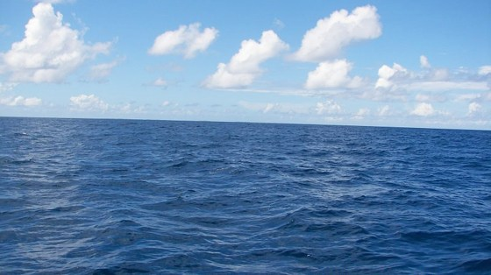
Strong Words/Emotions
“And not only this; but when Rebecca also had conceived by one, even by our father Isaac; (For the children being not yet born, neither having done any good or evil, that the purpose of God according to election might stand, not of works, but of him that calleth;) It was said unto her, The elder shall serve the younger. As it is written, Jacob have I loved, but Esau have I hated. What shall we say then? Is there unrighteousness with God? God forbid.” Romans 9:10-14

Slide 16
God’s Choice Based on our Choice
God’s ‘hatred’ of Esau.
1. Given the right to the birthright as the firstborn. Could have been the seed thru whom the Messiah would come. High priest of the family.
2. Born into material wealth; his dad was Isaac and his grandfather was Abraham.
3. He had it made. God provided every possible help for Esau to be a great man. Is that how you treat someone you hate?
4. Esau abused all the privileges. He rebelled against God and sold his birthright. God hated Esau’s choices.

Slide 17
Heaven’s Foreknowledge
Before Rebecca gave birth to the boys, Esau and Jacob, she was told that the younger, Jacob, would be given the birthright. (Gen. 25:23) Because Heaven knew the choices the boy’s would make, God could declare this. He didn’t arbitrarily cast off Esau; God knew.
“And Esau said to Jacob, Feed me, I pray thee, with that same red pottage; for I am faint: therefore was his name called Edom. And Jacob said, Sell me this day thy birthright. And Esau said, Behold, I am at the point to die: and what profit shall this birthright do to me? And Jacob said, Swear to me this day; and he sware unto him: and he sold his birthright unto Jacob. Then Jacob gave Esau bread and pottage of lentiles; and he did eat and drink, and rose up, and went his way: thus Esau despised his birthright.” Gen. 25:30-34

Slide 18

Choices
“For he saith to Moses, I will have mercy on whom I will have mercy, and I will have compassion on whom I will have compassion. So then it is not of him that willeth, nor of him that runneth, but of God that sheweth mercy.” Romans 9:15,16

Slide 19
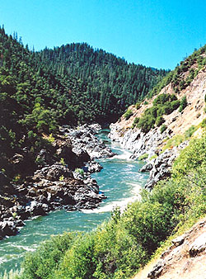
The Arbitrary God?
As we have seen, God isn’t arbitrary in the least. Many interpret Paul to be saying this. God provides abundant evidence and blessing to every human being that He is the kind benefactor of humanity. “That ye may be the children of your Father which is in heaven: for he maketh his sun to rise on the evil and on the good, and sendeth rain on the just and on the unjust.” Matthew 5:45
People must make choices based upon this evidence. God knows the decisions we will make and based on that foreknowledge can predict with assurance what will happen. God forces no one.

Slide 20
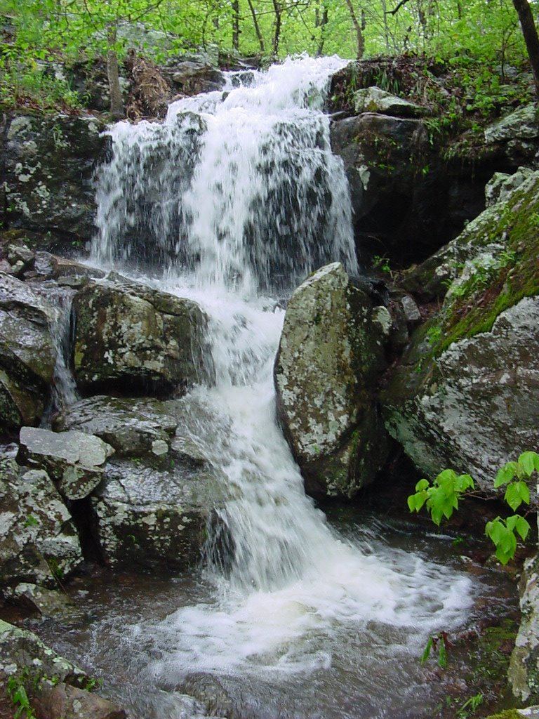
The Children of Israel, Esau, and Jacob
“O give thanks unto the LORD; for he is good: for his mercy endureth for ever.” Ps. 118:29
Throughout the history of humanity, most have chosen to reject the mercy of God in Christ. So, it is today. To choose Christ involves the submission of our carnal heart to Christ and most don’t want to surrender. May God help us to submit to His sovereign plan for our lives, whatever He chooses!!

