Slide 1
Health predictions… How did she know which ones???
1864: “Tobacco is a poison” (Spiritual Gifts, vol 4a, p. 128----1957 that the American Cancer Society concluded that smoking was a factor in lung cancer)

Slide 2
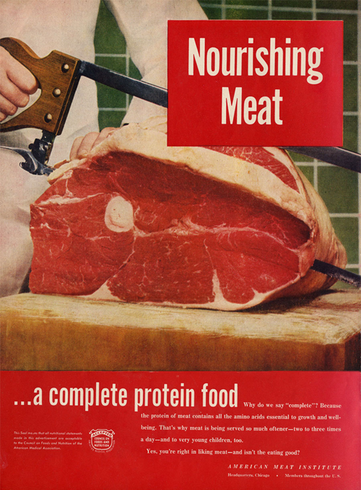
1863: “There are those who ought to be awake to the danger of meat eating, who are still eating the flesh of animals, thus endangering the physical, mental, and spiritual health” (R & H, May 27, 1902-----World Health Organization classifies Meat as a carcinogen in 2014)

Slide 3
1905: “Tea and coffee do not nourish the system. Their effect is produced before there has been time for digestion and assimilation, and what seems to be strength is only nervous excitement” (Ministry of Healing, p. 326)--------1967 "Illness otherwise unexplained may be caused by excessive ingestion of xantine cocoa alkaloids, including those in coffee, tea, cocoa, and those in some popular beverages.“--H. A. Riemann, Journal of the American Medical Associator

Slide 4
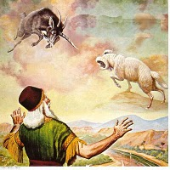
The Biblical Physical Signs
Dan. 10:8, 16-18 “Therefore I was left alone, and saw this great vision, and there remained no strength in me: for my comeliness was turned in me into corruption, and I retained no strength. And, behold, one like the similitude of the sons of men touched my lips: then I opened my mouth, and spake . . . straightway there remained no strength in me, neither is there breath left in me. Then there came again and touched me one like the appearance of a man, and he strengthened me,”
Num. 24:4 “He hath said, which heard the words of God, which saw the vision of the Almighty, falling into a trance, but having his eyes open”
9. No strength 10. speaks but has no breath 11. strengthened 12. Eyes remain open entire time

Slide 5
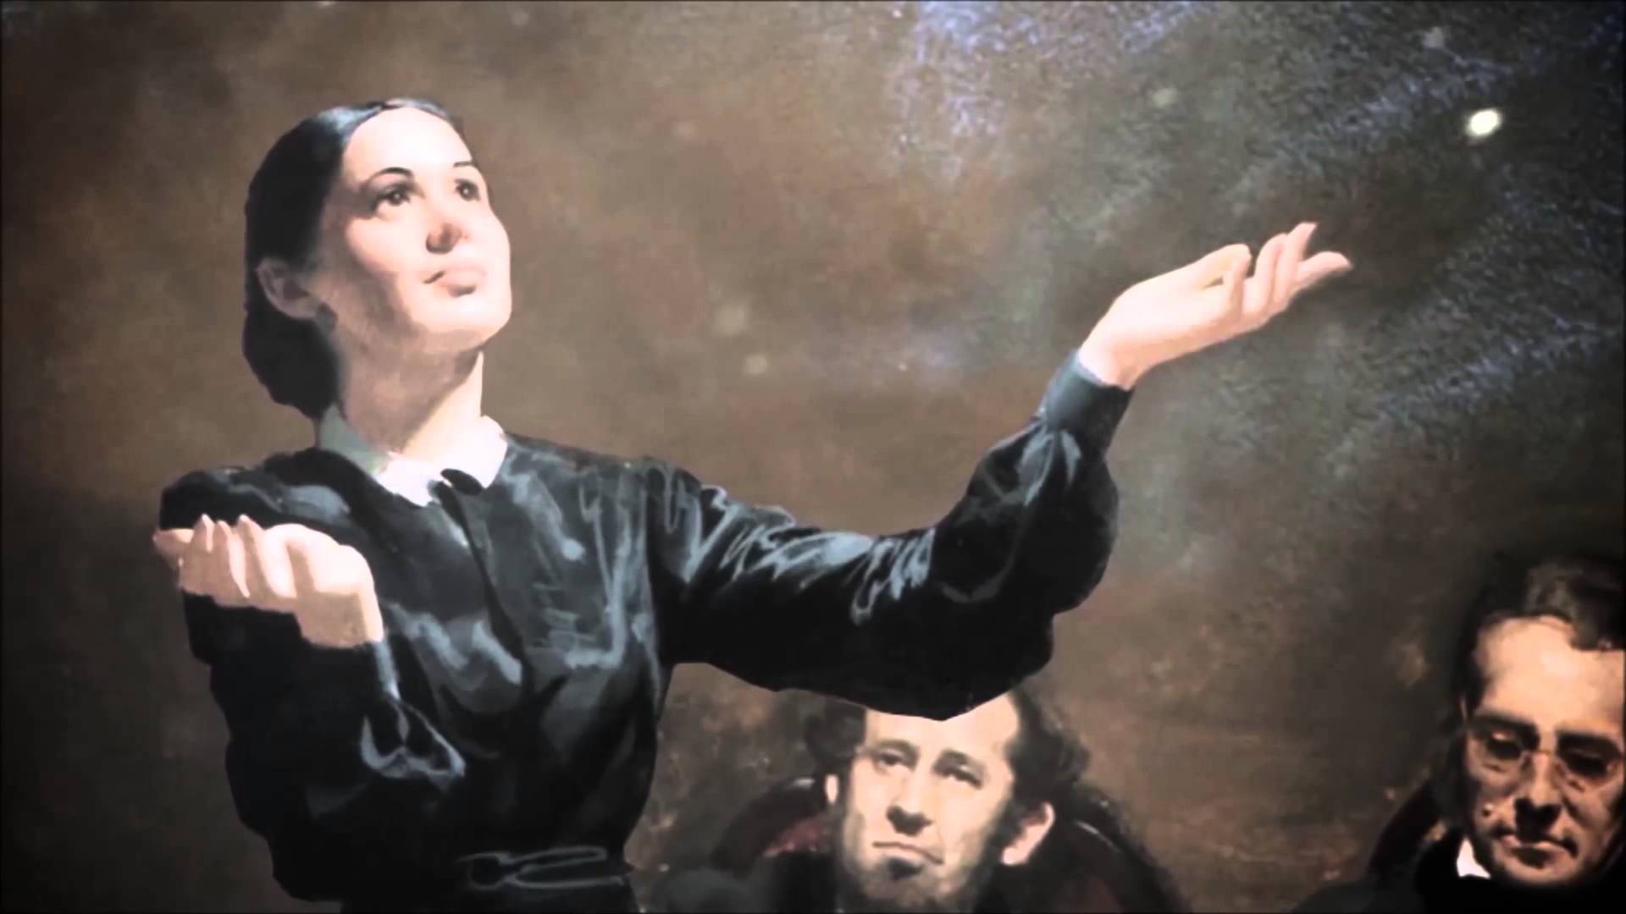
The Physical Tests Fulfilled:
“In vision her eyes were open. There was no breath, but there were graceful movements of the shoulders, arms and hands expressive of what she saw. It was impossible for anyone else to move her hands or arms. . . When the vision ended . . . She was then limp and strengthless.”—Martha Amadon, Notebook Leaflets

Slide 6
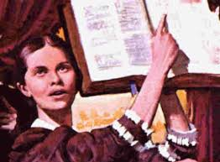
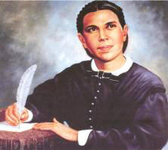
“June 28, 1857, I saw Sister Ellen G. White in vision for the first time. I was an unbeliever in the visions; but one circumstance among others that I might mention convinced me that her visions were of God. To satisfy my mind as to whether she breathed or not, I first put my hand on her chest sufficiently long to know that there was no more heavings of the lungs than there would have been had she been a corpse. I then took my hand and placed it over her mouth, pinching her nostrils between my thumb and forefinger, so that it was impossible for her to exhale or inhale air, even if she had desired to do so. I held her thus with my hand about ten minutes, long enough for her to suffocate under ordinary circumstances; she was not in the least affected by this ordeal. Since witnessing this wonderful phenomenon, I have not once been inclined to doubt the divine origin of her visions.”—Statement by D.T. Bourdeau, Battle Creek, Michigan, given Feb. 4, 1891

Slide 7
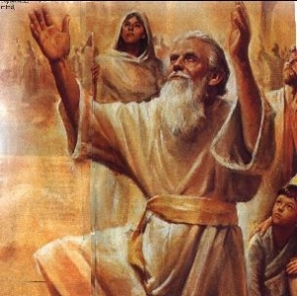
The Prophetic Pattern…
1. Proclaiming Prophet-----2. Time Prophecy of Judgment---3. Gathering Prophet with same message---4. Remnant Saved---5. (Dietary Counsel Given)---6. (If event is misunderstood, another prophet is sent to explain the event)

Slide 8
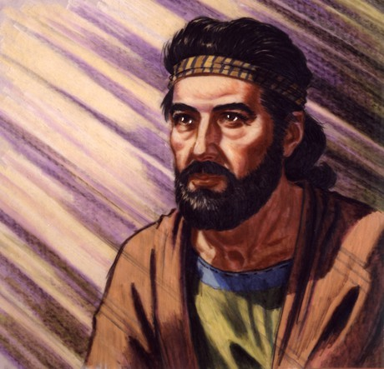
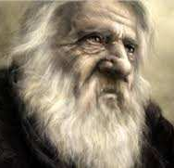
Example #1 The Flood
Enoch Proclaiming Prophet (Jude)----Methuselah is the Time Prophecy----Noah is the gathering prophet---8 people saved as Remnant---Diet of animals sanctioned
Jude 14, 15 “And Enoch also, the seventh from Adam, prophesied of these, saying, Behold, the Lord cometh with ten thousands of his saints, To execute judgment upon all, and to convince all that are ungodly among them of all their ungodly deeds which they have ungodly committed, and of all their hard speeches which ungodly sinners have spoken against him.”
2 Pet. 2:5 “And spared not the old world, but saved Noah the eighth person, a preacher of righteousness, bringing in the flood upon the world of the ungodly”
Methuselah- ”Man of the Dart” or broken down to its root words “when he dies, it shall be sent”--Jones' Dictionary of Old Testament Proper Names

Slide 9
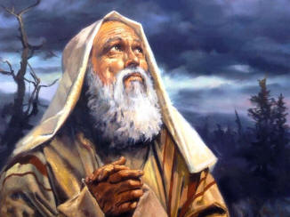
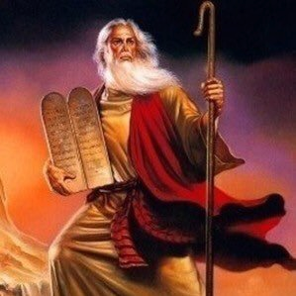
Example #2 The Exodus
Abraham receives prophecy about Israel enslavement (Gen. 15:13)---400 year time prophecy---Moses is gathering prophet---Israel saved---Levitical Diet Reform (Lev. 8)
Gen. 15:13 “And he said unto Abram, Know of a surety that thy seed shall be a stranger in a land that is not theirs, and shall serve them; and they shall afflict them four hundred years”
Deut. 34:10 “And there arose not a prophet since in Israel like unto Moses, whom the Lord knew face to face”

Slide 10
Example #3 Christ’s Ministry and Death as Messiah
Daniel is the Proclaiming Prophet (Dan. 8-9)---time prophecy of 490 years unto the Messiah to be cut off (Dan. 9:24-27)---John the Baptist is the gathering prophet---Dietary reform (no wine or strong drink Luke 1:15)---After Crucifixion only remnant remain----(Prophecy event is misunderstood, therefore another prophet comes to instruct)
-Dan. 8:14 “And he said unto me, Unto two thousand and three hundred days; then shall the sanctuary be cleansed.”
-Dan. 9:24-27 “Seventy weeks are determined upon thy people and upon thy holy city, to finish the transgression, and to make an end of sins, and to make reconciliation for iniquity, and to bring in everlasting righteousness, and to seal up the vision and prophecy, and to anoint the most Holy. Know therefore and understand, that from the going forth of the commandment to restore and to build Jerusalem unto the Messiah the Prince shall be seven weeks, and threescore and two weeks: the street shall be built again, and the wall, even in troublous times. And after threescore and two weeks shall Messiah be cut off, but not for himself: and the people of the prince that shall come shall destroy the city and the sanctuary; and the end thereof shall be with a flood, and unto the end of the war desolations are determined. And he shall confirm the covenant with many for one week: and in the midst of the week he shall cause the sacrifice and the oblation to cease, and for the overspreading of abominations he shall make it desolate, even until the consummation, and that determined shall be poured upon the desolate.”

Slide 11
Example #3 Christ’s Ministry and Death as Messiah
Daniel is the Proclaiming Prophet (Dan. 8-9)---time prophecy of 490 years unto the Messiah to be cut off (Dan. 9:24-27)---John the Baptist is the gathering prophet---Dietary reform (no wine or strong drink Luke 1:15)---After Crucifixion only remnant remain----(Prophecy event is misunderstood, therefore another prophet comes to instruct)
-John 1:20 “And he confessed, and denied not; but confessed, I am not the Christ. And they asked him, What then? Art thou Elias? And he saith, I am not. Art thou that prophet? And he answered, No. Then said they unto him, Who art thou? that we may give an answer to them that sent us. What sayest thou of thyself? He said, I am the voice of one crying in the wilderness, Make straight the way of the Lord, as said the prophet Esaias.”
-Luke 1:15 “ For he shall be great in the sight of the Lord, and shall drink neither wine nor strong drink; and he shall be filled with the Holy Ghost, even from his mother's womb.

Slide 12
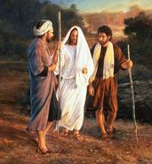
Example #3 Christ’s Ministry and Death as Messiah
Daniel is the Proclaiming Prophet (Dan. 8-9)---time prophecy of 490 years unto the Messiah to be cut off (Dan. 9:24-27)---John the Baptist is the gathering prophet---Dietary reform (no wine or strong drink Luke 1:15)---After Crucifixion only remnant remain----(Prophecy event is misunderstood, therefore another prophet comes to instruct)
Luke 24:21, 25-27 “But we trusted that it had been he which should have redeemed Israel: and beside all this, to day is the third day since these things were done. . . . Then he said unto them, O fools, and slow of heart to believe all that the prophets have spoken: Ought not Christ to have suffered these things, and to enter into his glory? And beginning at Moses and all the prophets, he expounded unto them in all the scriptures the things concerning himself.”

Slide 13
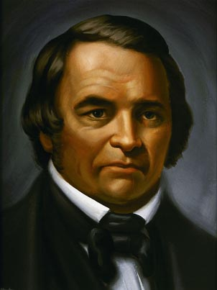
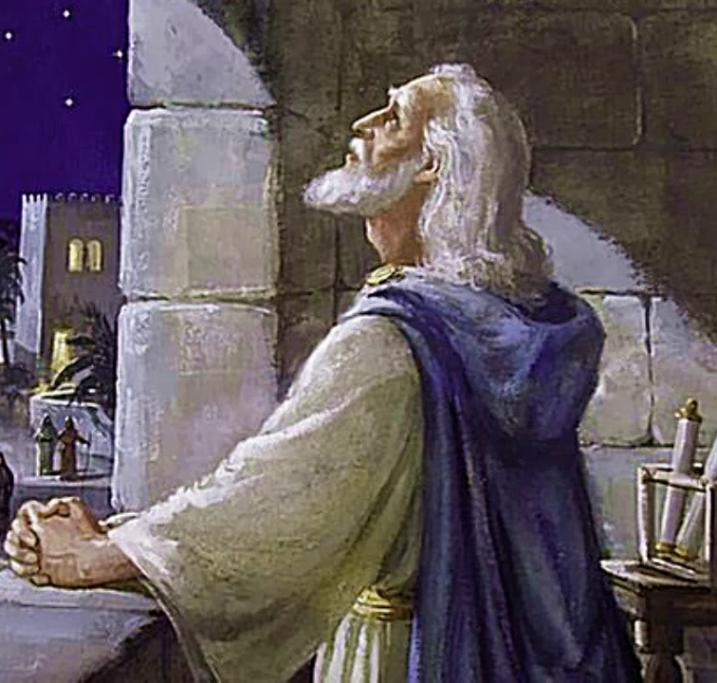
Example #4 1844
Proclaiming Prophet Daniel (Dan. 8:14)---time prophecy of 2300 years---William Miller is the Gathering Prophet---Great Disappointment leaves only 50 of the 50,000 Millerites---(Event misunderstood, God calls Ellen White to explain 2300 day prophecy)---Dietary Reform
-Dan. 8:14 “And he said unto me, Unto two thousand and three hundred days; then shall the sanctuary be cleansed.”
Earth to be cleansed by fire in 1844

Slide 14
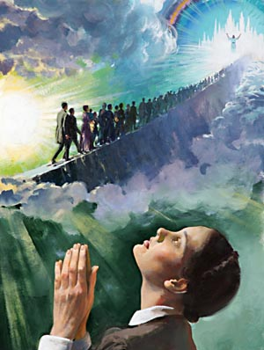
Ellen White’s First Vision Confirmed the Remnant
“While I was praying at the family altar, the Holy Ghost fell upon me, and I seemed to be rising higher and higher, far above the dark world. I turned to look for the Advent people in the world, but could not find them, when a voice said to me, "Look again, and look a little higher." At this I raised my eyes, and saw a straight and narrow path, cast up high above the world. On this path the Advent people were traveling to the city, which was at the farther end of the path.—EW, 14 (see also: Great Controversy, ch. 18-22 For a full synopsis on the Millerite movement and the true meaning of the events)

Slide 15
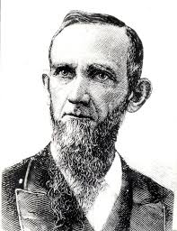
What About the Critics???
BEFORE:
“One thing I have remarked, and that is, that the most bitter opponents of the visions of Sister White admit that she is a Christian. How they can make this admission is more than I know. They try to fix it up by saying that she is deceived. They are not able to put their finger upon a single stain in all her life, nor an immoral sentence in all her writings. They have to admit that much of her writings are excellent, and whoever would live out all she says would be a good Christian, sure of Heaven. This is passing strange if she is a tool of the devil, inspired by Satan, or if her writings are immoral or the vagaries of her own mind.”—R&H, April 26, 1877.
Dudley M. Canright (1840-1919)

Slide 16
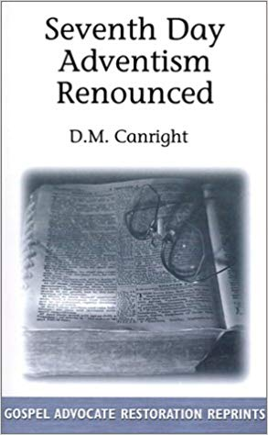
AFTER:
“That she is not inspired is plainly shown by many facts. She has never wrought a single miracle. The old prophets and the apostles wrought miracles freely, to prove that God had sent them. In all these seventy years, in all her forty volumes, not a single prediction has she ever made that has come to pass. This is astonishing, considering that she dwells almost wholly in predictions. It seems as though she ought to have blundered into many things which could afterward be construed into a fulfilled prophecy. But not one can be found. This shows how wild and utterly wrong her theories have been.”—Dudley Canright, Seventh-day Adventism Renounced, p. 138

Slide 17
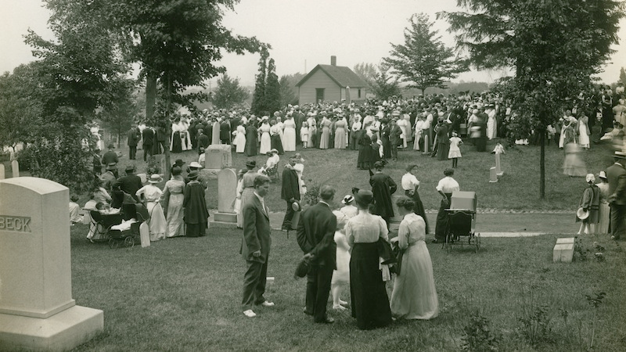
“My brother [Dudley M. Canright] rested his hand upon the side of the casket, and with tears rolling down his cheeks, he said brokenly ‘There is a noble Christian woman gone.’”—WA Spicer, The Spirit of Prophecy in the Advent Movement, p. 127

Slide 18
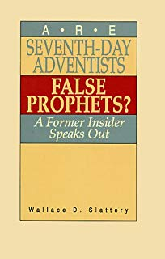
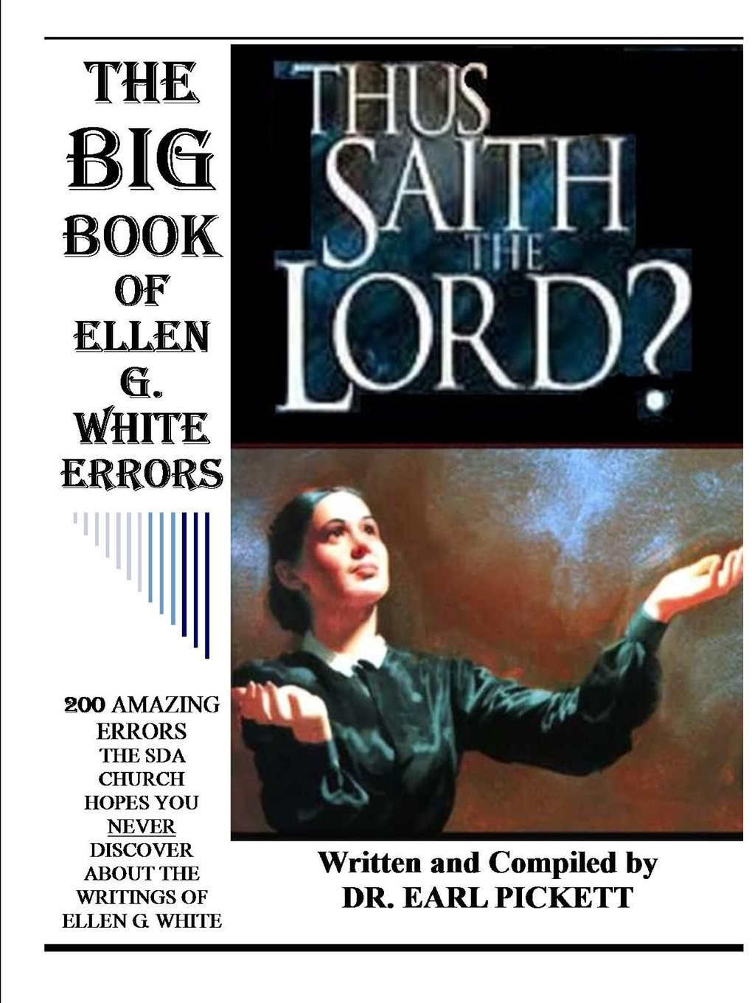
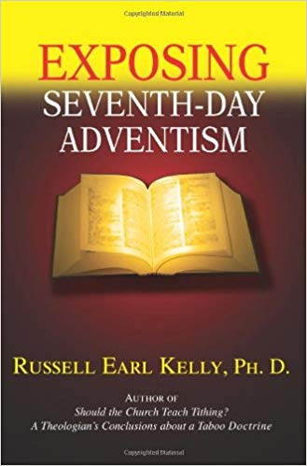
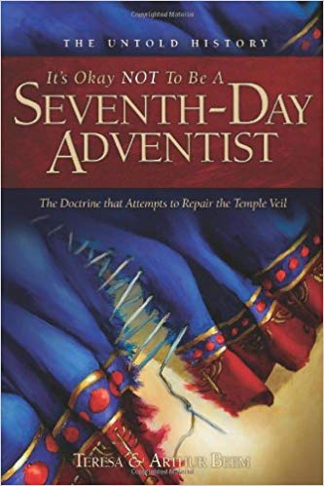
For The Others…
John 15:18-20 “If the world hate you, ye know that it hated me before it hated you. If ye were of the world, the world would love his own: but because ye are not of the world, but I have chosen you out of the world, therefore the world hateth you. Remember the word that I said unto you, The servant is not greater than his lord. If they have persecuted me, they will also persecute you; if they have kept my saying, they will keep yours also.”
How were the other prophets treated? Jesus? What about women’s suffrage?

Slide 19
Will We Listen to God’s Last Day Council?
“How many have read carefully Patriarchs and Prophets, The Great Controversy, and The Desire of Ages? I wish all to understand that my confidence in the light that God has given stands firm, because I know that the Holy Spirit's power magnified the truth, and made it honorable, saying: “This is the way, walk ye in it.” In my books, the truth is stated, barricaded by a “Thus saith the Lord.” The Holy Spirit traced these truths upon my heart and mind as indelibly as the law was traced by the finger of God, upon the tables of stone, which are now in the ark, to be brought forth in that great day when sentence will be pronounced against every evil, seducing science produced by the father of lies.”—Letter 90, 1906

