Slide 1
Behind the Door pt 25
The Merchants of the Earth

Slide 2
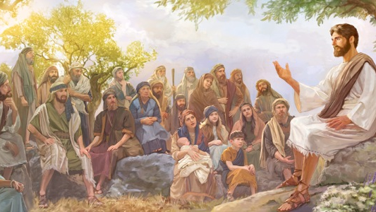

Slide 3
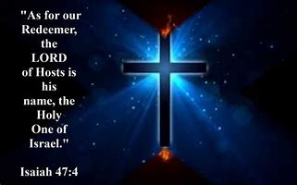

Slide 4
May God Be Glorified!

Slide 5
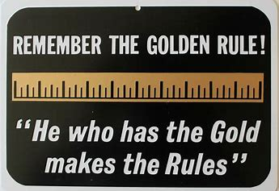
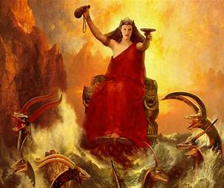
Rev. 18:3 “For all nations have drunk of the wine of the wrath of her fornication, and the kings of the earth have committed fornication with her, and the merchants of the earth are waxed rich through the abundance of her delicacies.”

Slide 6
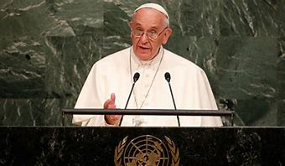
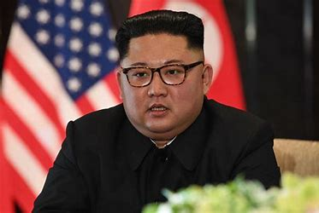
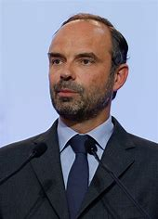
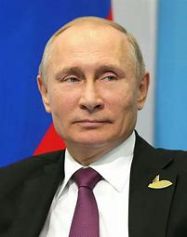
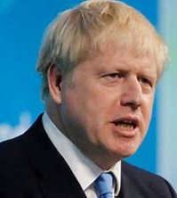
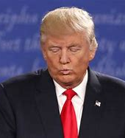
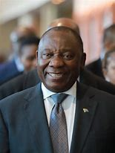
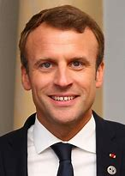
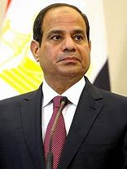
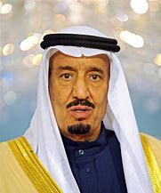
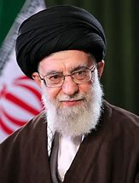
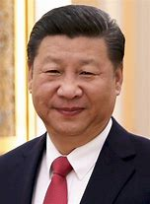
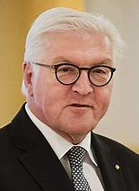
Regardless of their modern titles—the Bible is clear in the book of Revelation that the kings (leaders) of the world are working for the “Whore of Babylon” (the Papacy), and that even
though they at times appear to be enemies, they are all in the end working to accomplish the same end—setting up the Babylonian Image (Mark) of the Beast (Sunday Law) and enforcing it
throughout the world, ensuring a world-united front against God and His Law. They are doing this because they want to remain in power, and know full well what happens to those who resist the influence of the Roman Church and the Jesuit Order…
We Must Understand that in spite appearance—The Leaders are working together WITH the Papacy

Slide 7
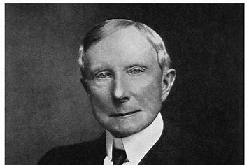
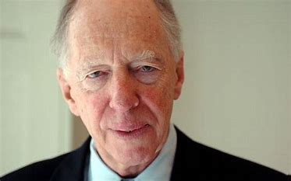
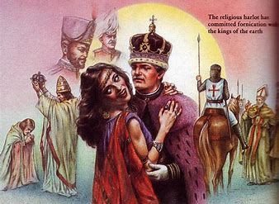
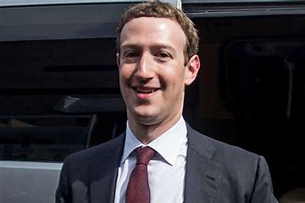
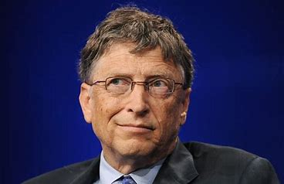
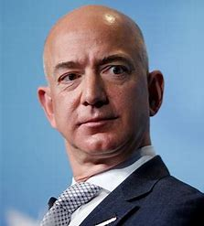
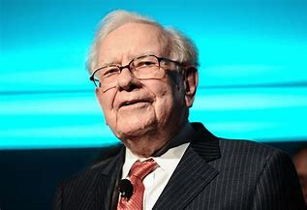
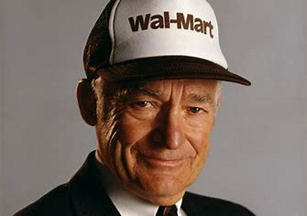
Not the “kings” only, but also the “merchants” of the earth get extremely wealthy through their obedience to the will of the Roman Church. That means not only the leaders of the earth, but the great businessmen, bankers, builders, and major sellers and financiers of all sorts are working for Rome to undermine Protestant ideals, and implement the Mark of the Beast (Sunday Law). For the same reasons they do this: wealth, power, position, and fear of the lengths the Jesuits and Papacy will go to remove merchants who will not do their bidding… This is an AMAZING foresight to the future—given in the late 1st Century!

Slide 8
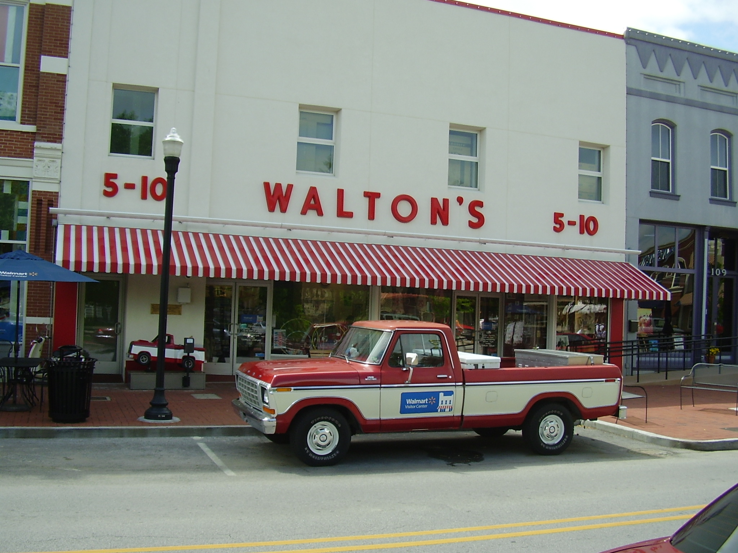
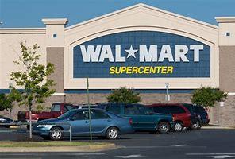
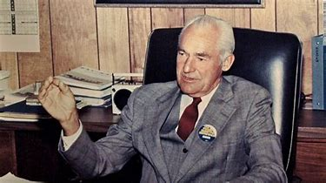
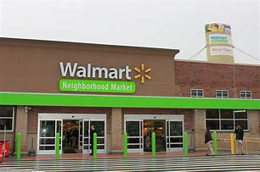
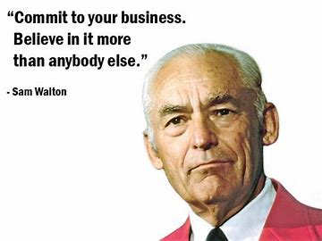
Modern Business 101: How to Get Rich Fast—How Did Sam Walton Do It? Who Helped Him Succeed!?
Original “Walmart” Walton’s in Bentonville, AK

Slide 9
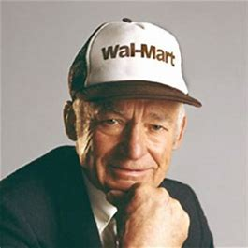
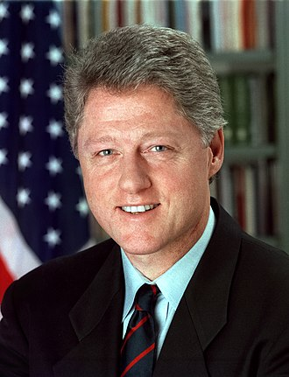
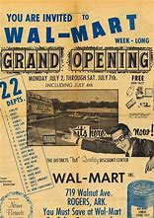
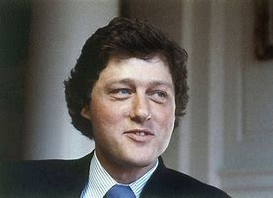
Is There a Connection???
Sam Walton’s tiny store soared to exceeding heights in almost no time at all. In 1977 Sam Walton had an 190 Wal-Marts, by 1985, he had 800+
How did he manage to gain such incredible success in so little time???
Bill Clinton was the governor of Arkansas from 1983-1992, went to a Jesuit College Georgetown University

Slide 10
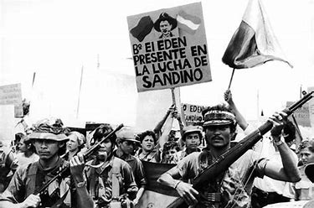
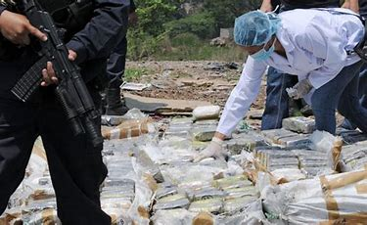
Conspiracy??? No, this was a true Court Affair with the ICJ! Only the Clintons were not implicated directly in the court proceedings…
Thousands upon thousands of lives were lost during the Nicaraguan Revolution, spanning from 1972-1992, aided directly by the United States!
“The Republic of Nicaragua v. The United States of America (1986) ICJ 1 is a public international law case decided by the International Court of Justice (ICJ). The ICJ ruled in favor of Nicaragua and against the United States and awarded reparations to Nicaragua. The ICJ held that the U.S. had violated international law by supporting the Contras in their rebellion against the Nicaraguan government and by mining Nicaragua's harbors. The United States refused to participate in the proceedings after the Court rejected its argument that the ICJ lacked jurisdiction to hear the case. The U.S. also blocked enforcement of the judgment by the United Nations Security Council and thereby prevented Nicaragua from obtaining any compensation.”—Wikipedia; Morrison, Fred L. (January 1987). "Legal Issues in The Nicaragua Opinion“. American Journal of International Law. 81 (1): 160–166.

Slide 11
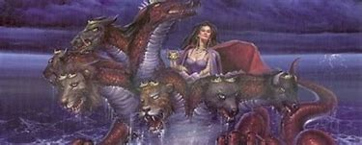
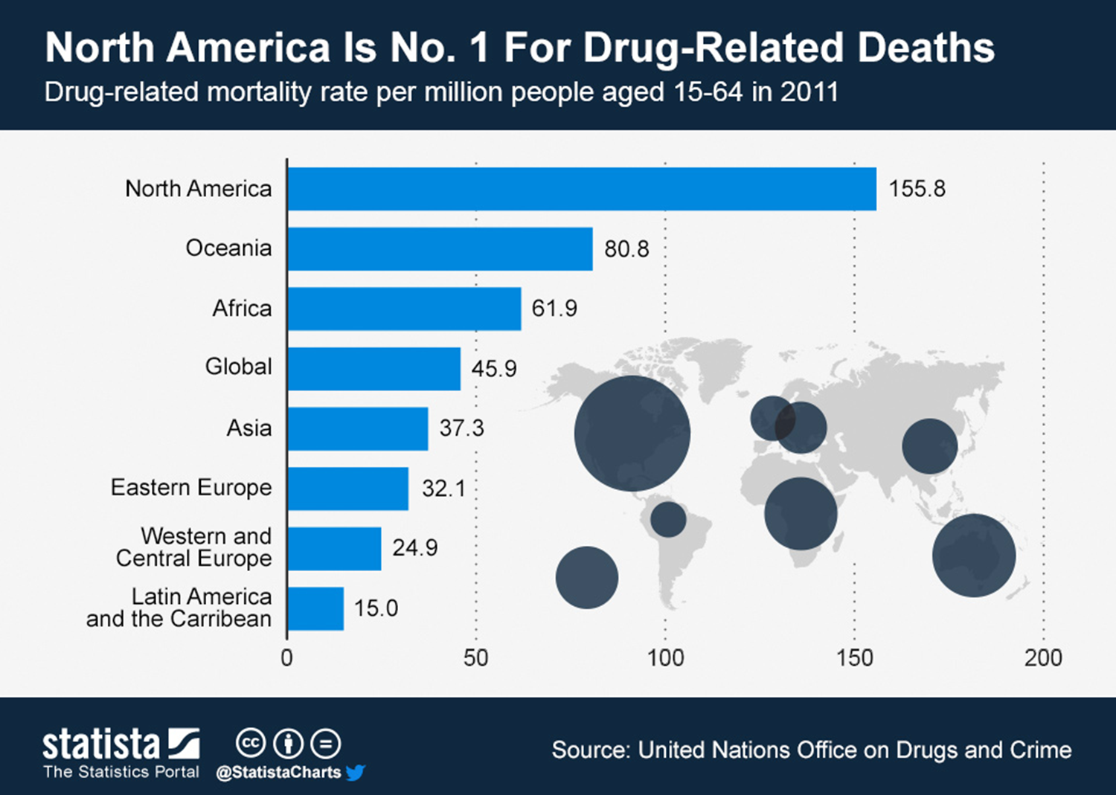
Rev. 18:3, 15 “ . . . the merchants of the earth are waxed rich through the abundance of her delicacies . . . The merchants of these things, which were made rich by her”
By promoting war in Nicaragua, and selling drugs in the United States, the Roman Masters, using their American puppet politicians, made money on both sides of the weapon-drug exchange. How much Nicaraguan blood can be laid at the feet of the Jesuit-controlled United States and how many American lives have been absolutely destroyed by the drug-trade in America??? Countless lives ruined, killed, violence and revenge, drug-gang wars, families broken, children lost, raped and beaten… All because of the Roman greed for wealth and power—using their Jesuit-trained political slaves…

Slide 12
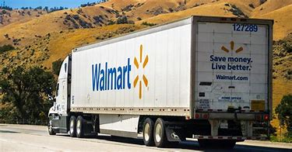
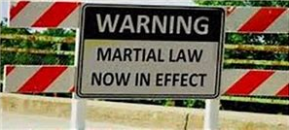
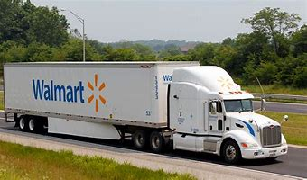
Same Tactics are employed as in the Nicaraguan Revolution—secretive dealings and exchanging products for money, except hidden before our very eyes….

Slide 13
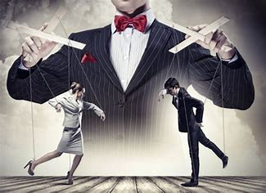
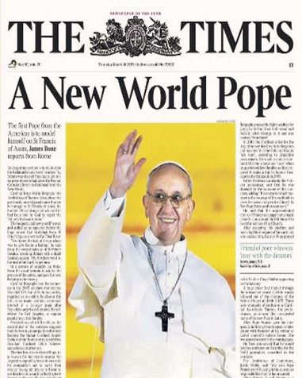
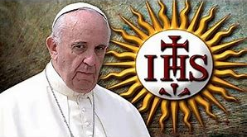
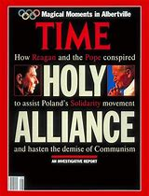
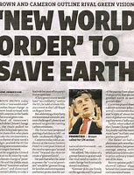
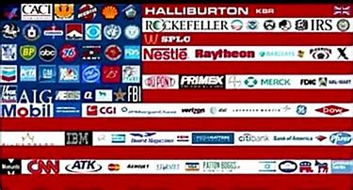
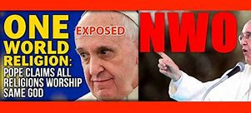

Slide 14
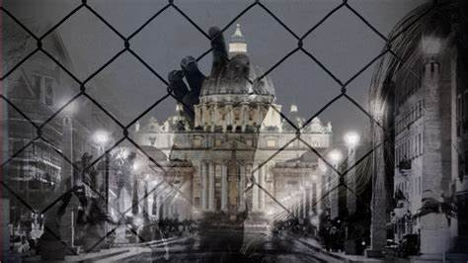
Rev. 13:16-17 “And he causeth all, both small and great, rich and poor, free and bond, to receive a mark in their right hand, or in their foreheads: And that no man might buy or sell, save he that had the mark, or the name of the beast, or the number of his name.”
According to the Bible, the Whore of Babylon wields absolute power over the various businesses of earth, else she could not control the buying and/or selling

Slide 15
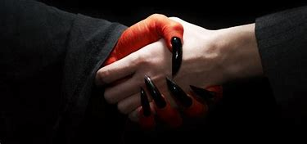
Satan working through Rome
Merchants of the Earth
Fear not during the time of no buying or selling, the same God that fed Elijah by ravens in the wilderness will tend to you!
Is. 33:16 “He shall dwell on high: his place of defence shall be the munitions of rocks: bread shall be given him; his waters shall be sure.”

Slide 16
Regardless of What Happens… God Will Provide! Trust in Him and NOT yourself, a man, false god, or ANYTHING else. Keep the Faith!

Slide 17
Fear not any man, demon, army, or the Devil himself! Fear not to boldly preach the truth in the face of persecution and even death! Submit fully to God and His will and He will supply your every need! Instead, we carry our work to completion by preaching the Gospel to everyone on earth, then the end shall come and we can go home to be with God forever!
1 John 4:4 “Ye are of God, little children, and have overcome them: because greater is he that is in you, than he that is in the world.”
James 4:7 “Submit yourselves therefore to God. Resist the devil, and he will flee from you.”
Isaiah 41:13 “For I the Lord thy God will hold thy right hand, saying unto thee, Fear not; I will help thee.”

Slide 18
“Aware that the Rothschilds are an important Jewish family, I looked them up in Encyclopedia Judaica and discovered that they [the Rothschilds] bear the title ‘Guardians of the Vatican Treasury’ . . . The appointment of Rothschild gave the black papacy absolute financial privacy and secrecy. Who would ever search a family of orthodox Jews for the key to the wealth of the Roman Catholic Church?”—F. Tupper Saussy, Rulers of Evil, p. 160-161

Slide 19
“We do not know the extent of the founder’s fortune at the time of his death in 1812, nor do we know the present magnitude of it, but apparently it represents about one-half of the wealth of the world.”—George Armstrong, Rothschild Money Trust, Preface dated September 12, 1940
HOW MUCH MORE NOW 80 Years LATER!?

Slide 20
The Secret of Financial Worldly Success and the Undermining of Capitalism
The Rockefellers, like so many business super-moguls were aided greatly by the Rothschilds Bankers. Standard Oil was a monopoly, as was JP Morgan’s General Electric, and Carnegie Steel (later bought out by JP Morgan), Vanderbilt’s, Harriman’s, and others. These persons may be brilliant in their own right, but their genius would never have been enough to take them to the next level of success. The price for their mega-corporate glory would be their very souls. Today, the name Rockefeller is synonymous with conspiracy, anti-American plots, and tyrannical control of the United States’ policies and people. These men have sold out their own countries! Why? For Money, fame, power, greed
Rockefeller
Morgan
Carnegie
Harriman
Vanderbilt

Slide 21
“the family that preys together, stays together”—Des Griffin, Descent Into Slavery?, p. 25
Where do you stack up?
The Pope and Black Pope
Jesuit Order and Secret Societies
Rothschild Banking Dynasty and their agents: (Schiffs, Warburgs, Rockefellers, other bankers)
Governments, Religious Leaders and Politicians, Powerful Gangs, Cartels, and Warlords
Other Merchants, News outlets famous people, educators and their institutions, and various individuals who have risen to power, have been intercepted and made allies…
Police Force and Military Personnel who unquestioningly obey their leaders
World citizens indoctrinated and/or distracted by the News, Politicians, Hollywood, Propaganda via Television, movies, music, the education structure, drugs and alcohol, and false religious leaders
Honest people in all walks of life, whistle blowers, true followers of Christ, conspiracy theorists who do follow the Popish NWO plan (to be destroyed)

Slide 22
“the family that preys together, stays together”—Des Griffin, Descent Into Slavery?, p. 25
Where do you stack up?
The Pope and Black Pope
Jesuit Order and Secret Societies
Rothschild Banking Dynasty and their agents: (Schiffs, Warburgs, Rockefellers, other bankers)
Governments, Religious Leaders and Politicians, Powerful Gangs, Cartels, and Warlords
Other Merchants, News outlets famous people, educators and their institutions, and various individuals who have risen to power, have been intercepted and made allies…
Police Force and Military Personnel who unquestioningly obey their leaders
World citizens indoctrinated and/or distracted by the News, Politicians, Hollywood, Propaganda via Television, movies, music, the education structure, drugs and alcohol, and false religious leaders
Honest people in all walks of life, whistle blowers, true followers of Christ, conspiracy theorists who do follow the Popish NWO plan (to be destroyed)

Slide 23
Battle of Waterloo June 18, 1815
Napoleon vs Duke of Wellington and his allied forces of Europe
“There were vast fortunes to be made—and lost—on the outcome of the Battle of Waterloo. The Stock Exchange in London was at fever pitch as traders awaited news of the outcome of this battle of giants. If Britain lost, English consols [money/funds] would plummet to unprecedented depths. If Britain was victorious, the value of the consul would leap to new dizzying heights”—Des Griffin, Descent Into Slavery?, p. 27

Slide 24
“As the two huge armies closed in for their battle to the death, Nathan Rothschild had his agents working feverishly on both sides of the line to gather the most accurate possible information as the battle proceeded. Additional Rothschild agents were on hand to carry the intelligence bulletins to a Rothschild command post strategically located nearby. Late on the afternoon of June 19, 1815”—Des Griffin, Descent Into Slavery?, p. 27
Nathan Mayer Rothschild (1777-1836)

Slide 25
“a Rothschild representative jumped on board a specially chartered boat and headed out into the channel [English Channel] in a hurried dash for the English coast. In his possession was a top secret report from Rothschild’s secret service agents on the progress of the crucial battle. This intelligence data would prove indispensable to Nathan [Rothschild] in making some vital decisions [at the London Stock Exchange]. The special agent was met a Folkestone the following morning at dawn by Nathan Rothschild himself. After quickly scanning the highlights of the report Rothschild was on his way again, speeding towards London and the Stock Exchange.”—Des Griffin, Descent Into Slavery?, p. 27

Slide 26
“Arriving at the [London Stock] Exchange, amid frantic speculation on the outcome of the battle, Nathan took up his usual position beside the famous ‘Rothschild Pillar’. Without a sign of emotion, without the slightest change of facial expression the stony-faced, flint eyed chief of the House of Rothschild gave a predetermined signal to his agents who were stationed nearby.”—Des Griffin, Descent Into Slavery?, p. 28

Slide 27
“Rothschild agents immediately began to dump consols [stock] on the market. As hundreds of thousands of dollars worth of consols [stock] poured onto the market their value started to slide. Then they began to plummet. Nathan continued to lean against ‘his’ pillar, emotionless, expressionless. He continued to sell, and sell, and sell. Consols kept falling. Word began to sweep through the Stock Exchange: ‘Rothschild knows.’ ‘Rothschild knows.’ ‘Wellington has lost at Waterloo!’”—Des Griffin, Descent Into Slavery?, p. 28

Slide 28
“The selling [at the London Stock Exchange] turned into a panic as people rushed to unload their ‘worthless’ consols [stocks] . . . in the hope of retaining at least part of their wealth. . . After several hours of feverish trading the consul lay in ruins. It was selling for about five cents on the dollar. Nathan Rothschild, emotionless and expressionless as ever, still leaned against his pillar. He continued to give subtle signals. But these signals were different. They were so subtly different that only the highly trained Rothschild agents could detect the change.”—Des Griffin, Descent Into Slavery?, p. 28

Slide 29
“On the cue from their boss dozens of Rothschild agents made their way to the order desks around the Exchange and bought every consol [stock] in sight for just a ‘song!’”—Des Griffin, Descent Into Slavery?, p. 28

Slide 30
The Economic Power Shifts in England, though glorious in battle, they were more than defeated in the financial arena—now Rothschilds virtually owned England’s economy…

Slide 31
Who decides the elections in England???

Slide 32
“When people think of England such terms as ‘Great Britain,’ ‘The Queen,’ ‘The Crown,’ ‘Crown Colonies,’ ‘London,’ ‘The City of London’ and ‘British Empire’ [and so on] . . . When we speak of ‘The City’ we are in fact refeering to a privately owned Corporation—or Sovereign State—occupying an irregular rectangle of 677 acres”—Des Griffin, Descent Into Slavery?, p. 41
The Central Banking systems set up in all countries is how the Rothschilds ensure that they control the money supply… England’s “Bank of England” is no exception…

Slide 33
Who Owns “The City”???
“and located right in the heart of the ‘Greater London Area’ . . . The ‘Crown’ is a committee of twelve to fourteen men who rule the independent sovereign state known as London or ‘The City.’ ‘The City’ is not part of England. It is not subject to the Sovereign [of England]. . . The City, which is often called ‘the wealthiest square mile on earth”, is ruled by a Lord Mayor.”—Des Griffin, Descent Into Slavery?, p. 41-42
Lord Mayor of England is Peter Estlin (2018)

Slide 34
Who’s in charge? And Who is dressed more luxuriously during this meeting? Who really rules London?
“Here are grouped together Britain’s great financial and commercial institutions: wealthy banks, dominated by the privately-owned (Rothschild controlled) Bank of England, Lloyd’s of London, the London Stock Exchange, and offices of most of the leading international trading concerns. . . When the Queen of England goes to visit The City she is met by the Lord Mayor at Temple Bar, the symbolic gate of the City. She bows and asks permission to enter in his private sovereign State.”—Des Griffin, Descent Into Slavery?, p. 42

Slide 35
Outdressed and Outshined in Authority and Glory, the inferior Queen follows her superior Lord Mayor of London as he leads her into his personal city… Just a ceremony??? Highly doubtful, seeing that it belittles the authority of the Monarch of England in the eyes of all onlookers and clearly depicts the Monarch of England submissive to the Lord Mayor of London
“He grants permission to enter by hander he the sword of State. During such State visits “the Lord Mayor in his robes and chain, and his entourage in medieval costume, outshines the royal party, which can dress up no further than service uniforms.” The Lord Mayor leads the queen into his city.”—Des Griffin, Descent Into Slavery?, p. 42

Slide 36
Another Ruling System in America????
Alan Greenspan (13th Chair of the Federal Reserve 1987-2006)

Slide 37
“The Bank was organized by Robert Morris”—G. Edward Griffin, The Creature From Jekyll Island, p. 325

Slide 38
“a member of Congress, who was a leader of a group of politicians and merchants who wanted the new nation to imitate the mercantilism of England [in 1781]. . . He was a wealthy Philadelphia merchant who had profited greatly from war contracts during the Revolution.”—G. Edward Griffin, The Creature From Jekyll Island, p. 325
Robert Morris (Senator Pennsylvania 1789-1795; Superintendent of Finance 1781-1784)

Slide 39
The Banking Wars of early United States!
VS
“A national debt, if it is not excessive, will be to us a national blessing. It will be a powerful cement of our Union.”—Alexander Hamilton, Letter to James Duane, September 3, 1781
“We must not let our rulers load us with perpetual debt”—The Basic Writings of Thomas Jefferson, p. 749

Slide 40
“A private central bank issuing the public currency is a greater menace to the liberties of the people than a standing army”—Thomas Jefferson quoted in G. Edward Griffin, The Creature From Jekyll Island, p. 329; The Writings of Thomas Jefferson (Putnam and Sons, 1899), Vol. X, p. 31
Since it’s creation in 1913, the Federal Reserve has undermined freedoms and liberty in the United States, while simultaneously pushing America further into debt and massively expanding the Government.
Restriction of Liberties: Income tax (1914), destruction of the middle class, Great Depression (Stock Market Crash and deficit spending)
Expansion of Government: War finance (more debt also), New Deal (expansion of socialism to solve a problem they started [Great Depression]), welfare and other ‘safety nets’ (which need more government overseeing, regulation, and less individual American self-reliance)

Slide 41
The Rothschild’s were behind the Central Bank system in the United States from the very start!!!! The Federal Reserve is their creation also!
“The blunt reality is that the Rothschild banking dynasty in Europe was the dominant force, both financially and politically, in the formation of the Bank of the United States.”—G. Edward Griffin, The Creature From Jekyll Island, p. 331

Slide 42
“Biographer, Derek Wilson, explains: ‘Nathan … had made loans to various states of the Union, had been, for a time, the official European banker for the US government and was a pledged supporter of the Bank of the United States.’ . . . The Rothschilds, therefore, were not merely investors nor just an important power. The were the power behind the Bank of the United States! The significance of the Rothschild power in American finance and politics was the subject of extensive comment in a previous section [of this book].”—G. Edward Griffin, The Creature From Jekyll Island, p. 331; Wilson quote from: Derek Wilson, Rothschild: The Wealth and Power of a Dynasty, 1988, p. 178

Slide 43
The Fall of Morality in the American Political Arena…
Truly a titan of a figure, Daniel Webster served the government of the United States for the majority of his life. Early in his career he seemed to be a very loyal patriot to the United States and the principles of Protestantism. However, for some unknown reason, he seems to have defected in some way from his morals. By his fruits we can see this: he was a put into office as Secretary of State following the Jesuit assassination Zachary Taylor, and he was an active member (partnered with Henry Clay) in the “Compromise of 1850” which effectively postponed (yet again) and protected the slave-state issue in the Union—a problem, which if dealt with without compromise may ended the slave-state/free-state issue, rather than postponing it until it came to a boiling point, resulting in the gruesome Civil War.
Daniel Webster (Political Career 1813-1852-various titles)

Slide 44
American? In Name Only!
Nicholas Biddle was the mover and shaker of the 1816 Second Central Bank of the United States, which had a 20 year charter. He sought, purposely to renew the bank charter 4 years early because Andrew Jackson was going to be in his second term of Presidency in 1836. He thought that Jackson would not dare to threaten the security of his second running for President by opposing the Central Bank, but he was sorely mistaken. President Andrew Jackson vetoed the renewal for the Central Bank (a veto worth reading today) and laid it all on the line!
Nicholas Biddle (Political career 1813-1836)

Slide 45
In an effort to “punish” Jackson and the American people. Biddle caused a fabricated Recession in the United States, so that the people would think that it was because the Central Bank was gone, and that the only way to turn around the economy would be to reinstitute the Central Bank in the United States. Classic Hegelian Dialectic at work! They cause the problem so they can give you their calculated solution!

Slide 46
Risking Life, career and reputation, Jackson vetoed the Bank charter, ended the Central Bank in the United States, and PAID OFF THE NATIONAL DEBT completely! The ONLY President ever to do that!

Slide 49
American Traitors!
The Merchant of the Earth, in subjection to Rome, with aim to gain unmatchable political power and authority in every country, plunged the nation into debt by starting the Federal Reserve act. How did they do it? They used their puppet politicians like President Wilson, closely handled by their agent Colonel House, shortly thereafter, the people of the United States incurred income tax in 1914, starting the spiral down and shift of power from the people to the bankers and their agents…

Slide 51
The Morgan’s were From England and Rothschild Allies!!
“The Morgan’s were friendly competitors with the Rothschilds and became socially close to them”—G. Edward Griffin, The Creature From Jekyll Island, p. 208

Slide 52
In return for saving Morgan’s financial empire, he became a Rothschild Agent! And aimed to be as ‘American’ as possible
“Morgan’s London-based firm was saved from financial ruin in 1857 by the Bank of England over which the Rothschilds held great influence. Thereafter, Morgan appears to have served as a Rothschild financial agent and went to great length to appear totally American”—G. Edward Griffin, The Creature From Jekyll Island, p. 208

Slide 53
The Jesuit-Rothschild Merchant-Politician Puppet Show
The Wealthy merchants and politicians who did not go along with this initiative were dispatched when the Titanic sank on its maiden voyage…

Slide 55
These Things Just… Happened? A Master Captain Loses all common sense on a routine voyage???
Captain Smith, a master of the seas became an imbecile when he boarded the Titanic.
Visited just before setting off by Jesuit Priest (The Jesuit got off the ship just before setting off—JP Morgan was also supposed to board but canceled)
Was travelling too fast in known iceberg infested waters…
Ignored 8 telegraph warnings from other ships to slow down
When in trouble, the Titanic shot white flares into the sky instead of red (signifying a party)

Slide 56
How many innocent lives died horrific deaths, just so Edward Smith could kill a few wealthy political opponents to the Federal Reserve? How many men, women, and children drowned, froze, or worse because Captain Smith obeyed his wicked Jesuit masters?
Captain Edward Smith

Slide 57
Just like JFK and Jackson, the Jesuits and their agents, the Rothschilds, will murder anyone who stands in the way of their domination-control-machine, which is the Federal Reserve Bank. They killed JFK, and almost killed Jackson; they killed Astor, Guggenheim, and Straus and thousands of other people including their own, just to ensure that their Federal Reserve monster was protected. And they will do the same today to protect it be “the means justify the ends”
But Take Heart, the Lord is our protection!
Nehemiah 4:14 “And I looked, and rose up, and said unto the nobles, and to the rulers, and to the rest of the people”

Slide 58
Nehemiah 4:14 “Be not ye afraid of them: remember the Lord, which is great and terrible, and fight for your brethren, your sons, and your daughters, your wives, and your houses.

Slide 65
By promoting war in Nicaragua, and selling drugs in the United States, the Roman Masters, using their American puppet politicians, made money on both sides of the weapon-drug exchange. How much Nicaraguan blood can be laid at the feet of the Jesuit-controlled United States and how many American lives have been absolutely destroyed by the drug-trade in America??? Countless lives ruined, killed, violence and revenge, drug-gang wars, families broken, children lost, raped and beaten… All because of the Roman greed for wealth and power—using their Jesuit-trained political slaves…

