Slide 1
Oh, Dan!
He had it All

Slide 2
One Big, ‘Happy’ Family
The family of Jacob was very big. Including all in his immediate family, there were at least 18 that we know of for sure. This included 4 wives, 12 boys, and at least, one girl, Dinah.
But, not all was happy. Far from it. Polygamy, with its accompanying anger, jealousy, unhappiness, and sexual perversion were there. The byproducts of this were incest, prostitution, rape, mass murder, betrayal, lying, cunning, deception, and treachery. All of this could have easily annihilated this family, but the Lord used it to mold the family. The family members learned in the ‘school of hard knocks’.
“I will make mention of Rahab and Babylon to them that know me: behold Philistia, and Tyre, with Ethiopia; this man was born there. And of Zion it shall be said, This and that man was born in her: and the highest himself shall establish her. The LORD shall count, when he writeth up the people, that this man was born there. Selah.” Psalm 87:4-6
The Lord took into account the problems in this home and provided the grace that saved it from utter ruin.

Slide 3
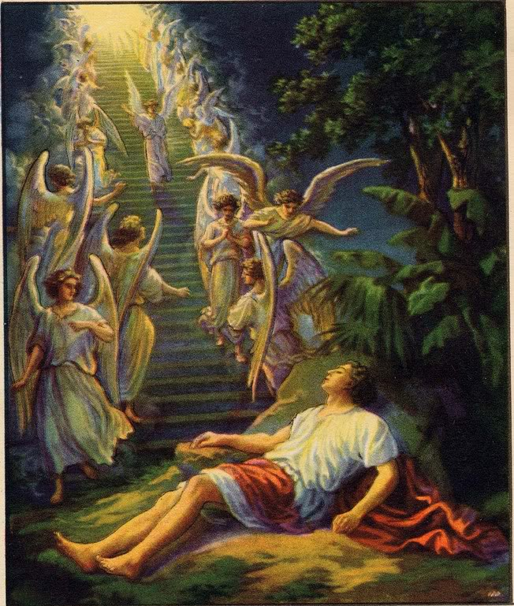
Jacob’s Ladder
Jacob’s early life had been marked by deception and cunning. He had stolen the birthright from his brother, Esau, and had cunningly connived with his mother to deceive his dad, Isaac. He had to flee from his home because his brother had some hired assassins ready to kill him. He was around 75 years old when he left, single, and heading toward his mother’s relatives in Haran to stay until his brother should calm down.
Jacob was alone, guilt ridden, and in desperate need of companionship, forgiveness, and hope. The Lord understood all and provided it all in the ladder, which represented Christ Jesus!! Seeing Christ, Jacob could go forward!

Slide 4
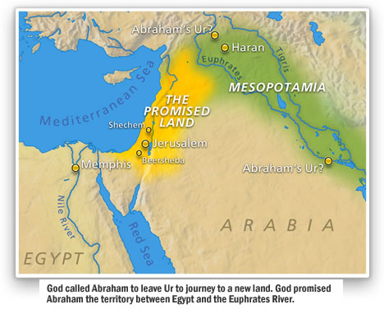
It was here, in the land of Haran, Padanaram, that Jacob sojourned for 20 years. Here was where the family of Jacob began. What a destiny was to be theirs!
From this family would come the chosen people. From this family would come the Messiah of the world. From this family would come the spiritual giants called the 144,000. (Rev. 7:4-8) From this family would come the sons whose names would adorn the gates of the New Jerusalem. (Rev. 21:12)
All of these awesome privileges would come because of the abounding grace of Christ that could take one big, ‘happy’ family and make it into His likeness. Christ would do this because He recognized that ‘this man was born there.’ Ps. 87:6

Slide 5
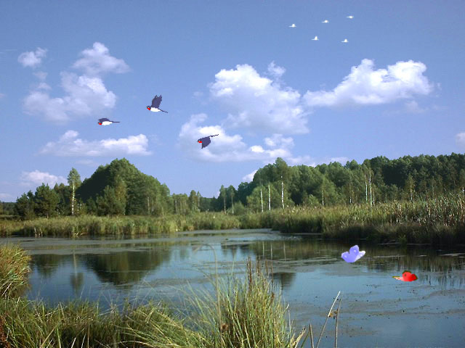
The Boys
It is absolutely shocking that from the family of Jacob came the heads of the 144,000 and their names are inscribed on the walls of the Heavenly Jerusalem!
The boys engaged in so much garbage! Incest, mass murder , rape, deception, cruelty, and lies!
How could God allow their names there? God will never allow this into heaven. The boys of Jacob didn’t remain this way.

Slide 6
They Became Overcomers
“Joseph was satisfied. He had seen in his brothers the fruits of true repentance.” PP, pg. 230
“Men whom God favored, and to whom He entrusted great responsibilities, were sometimes overcome by temptation and committed sin, even as we at the present day strive, waver, and frequently fall into error. Their lives, with all their faults and follies, are open before us, both for our encouragement and warning. If they had been represented as without fault, we, with our sinful nature, might despair at our own mistakes and failures. But seeing where others struggled through discouragements like our own, where they fell under temptations as we have done, and yet took heart again and conquered through the grace of God, we are encouraged in our striving after righteousness. As they, though sometimes beaten back, recovered their ground, and were blessed of God, so we too may be overcomers in the strength of Jesus. ” PP, pg. 238

Slide 7
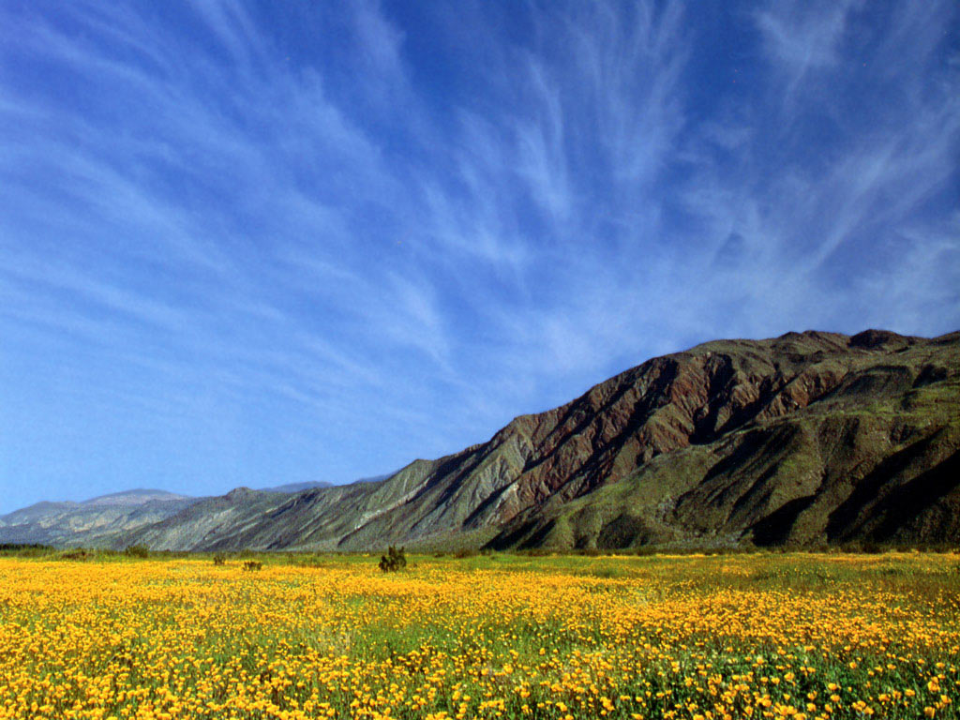
All But One!
“And I heard the number of them which were sealed: and there were sealed an hundred and forty and four thousand of all the tribes of the children of Israel. Of the tribe of Juda were sealed twelve thousand. Of the tribe of Reuben were sealed twelve thousand. Of the tribe of Gad were sealed twelve thousand. Of the tribe of Aser were sealed twelve thousand. Of the tribe of Nepthalim were sealed twelve thousand. Of the tribe of Manasses were sealed twelve thousand. Of the tribe of Simeon were sealed twelve thousand. Of the tribe of Levi were sealed twelve thousand. Of the tribe of Issachar were sealed twelve thousand. Of the tribe of Zabulon were sealed twelve thousand. Of the tribe of Joseph were sealed twelve thousand. Of the tribe of Benjamin were sealed twelve thousand.” Rev. 7:4-8

Slide 8
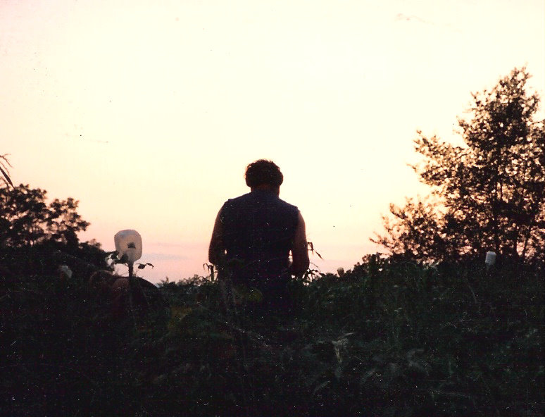
One Lost Tribe
In the final roll call found in Revelation 7, the tribe of Ephraim was missing. However, the saved from this family will fall under the tribe of his father, Joseph. One tribe is left out. This tribe truly failed and will be left out of the kingdom of heaven. This was the tribe of Dan! In the light of everything done by his brothers, what could Dan have possibly done that would keep him outside the pearly gates? This question demands an answer and will be the focus of our study.

Slide 9
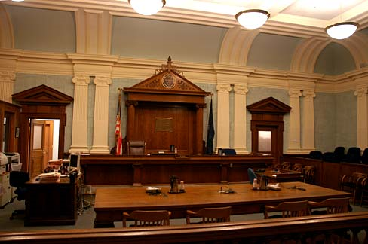
The Heritage of Dan
“And Bilhah conceived, and bare Jacob a son. And Rachel said, God hath judged me, and hath also heard my voice, and hath given me a son: therefore called she his name Dan.” Genesis 30:5,6
“Dan shall judge his people, as one of the tribes of Israel. Dan shall be a serpent by the way, an adder in the path, that biteth the horse heels, so that his rider shall fall backward. I have waited for thy salvation, O LORD.” Genesis 49:14-16

Slide 10
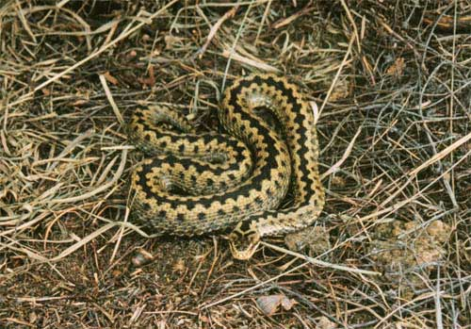
The Judge Becomes a Snake
As one of God’s chosen, an ancient SDA, Dan was called to pre-eminence and a position of responsibility. Able to judge character with keen insight, Dan was exalted. However, he dropped so low as to become a back- biter; the proverbial snake-in-the-grass! Like the snake, he would lay in wait for the horse to pass , bite its heel, and throw the rider to the ground. The gossiper does the same, always feasting on others characters, waiting for the right time to devour the unsuspecting prey, and throw everyone to the ground!

Slide 11
Dr. Hardinge’s Book, The Conquerors
“Dan was like a serpent! The word kerastes used here refers to the horned adder, about two feet long and the color of the sand in which it lies. This reptile waits in the dust of the road, watching for opportunity to sink its venomed fangs into the unwary prey that comes too close. Jacob portrayed this wily serpent biting the heels of a passing horse and causing it to rear up in terror, thus throwing the rider, and perhaps injuring or killing him.
Here is a perfect picture of the backbiter. There is nothing about his appearance to indicate his nature or even that he is there! What he does behind your back with his sudden, cunningly contrived, poison-laden bite, startles you and throws you off your guard.” The Conqueror's, pg. 50

Slide 12
God Can Restore Back-biter’s!/Anyone
“Both these disciples had the same opportunities to study and follow the divine Pattern. Both were closely associated with Jesus and were privileged to listen to His teaching. Each possessed serious defects of character; and each had access to the divine grace that transforms character. But while one in humility was learning of Jesus, the other revealed that he was not a doer of the word, but a hearer only. One, daily dying to self and overcoming sin, was sanctified through the truth; the other, resisting the transforming power of grace and indulging selfish desires, was brought into bondage to Satan.
Such transformation of character as is seen in the life of John is ever the result of communion with Christ. There may be marked defects in the character of an individual, yet when he becomes a true disciple of Christ, the power of divine grace transforms and sanctifies him. Beholding as in a glass the glory of the Lord, he is changed from glory to glory, until he is like Him whom he adores.” AA, pgs. 558,559

Slide 13

The Development of Dan
“Why abodest thou among the sheepfolds, to hear the bleatings of the flocks? For the divisions of Reuben there were great searchings of heart. Gilead abode beyond Jordan: and why did Dan remain in ships?” Judges 5:16,17 During one of the great crisis in Israel, when Sisera’s armies came to trounce the Israelites, the tribe of Dan was nowhere to be found. In fact, in the crisis, Dan was out having a wonderful time in the water or seeking to advance his economic standing.
What are we doing today for God in this time of crisis when the messages of God are being trampled in the dust? Do we even know what we believe if someone were to ask us? Or, are we just having a good time, living for ourselves?

Slide 14
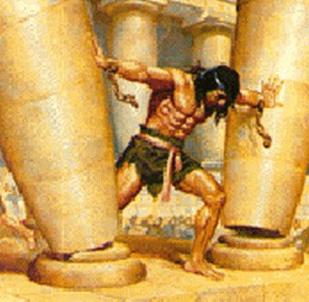
Samson- The Great Danite Judge
“And there was a certain man of Zorah, of the family of the Danites, whose name was Manoah; and his wife was barren, and bare not. And the angel of the LORD appeared unto the woman, and said unto her, Behold now, thou art barren, and bearest not: but thou shalt conceive, and bear a son. Now therefore beware, I pray thee, and drink not wine nor strong drink, and eat not any unclean thing: For, lo, thou shalt conceive, and bear a son; and no rasor shall come on his head: for the child shall be a Nazarite unto God from the womb: and he shall begin to deliver Israel out of the hand of the Philistines…And the woman bare a son, and called his name Samson:” Judges 13:2-5,24

Slide 15

Restored by the Grace of God
Samson struggled with women. Delilah almost destroyed him completely, but the grace of God restored him. Through repentance , prayer, and claiming the power of Christ, Samson gained the victory over lust and sensual pleasure.
Everything we have seen from the Danites so far couldn’t have kept them out of the kingdom of God. Back biting, indolence, and lust were not worse than the other sins of his brothers. All of these horribly rebellious traits could be changed by the grace of God in a repentant human heart. Why was Dan left out of the final roll call in Revelation 7?

Slide 16
Dan’s Downfall
“And the children of Dan sent of their family five men from their coasts, men of valour, from Zorah, and from Eshtaol, to spy out the land, and to search it; and they said unto them, Go, search the land: who when they came to mount Ephraim, to the house of Micah, they lodged there. When they were by the house of Micah, they knew the voice of the young man the Levite: and they turned in thither, and said unto him, Who brought thee hither? and what makest thou in this place? and what hast thou here? And he said unto them, Thus and thus dealeth Micah with me, and hath hired me, and I am his priest. And they said unto him, Ask counsel, we pray thee, of God, that we may know whether our way which we go shall be prosperous. And the priest said unto them, Go in peace: before the LORD is your way wherein ye go. Then the five men departed,” Judges 18:1-7

Slide 17
“It Was Always Their Way”
“And the six hundred men appointed with their weapons of war, which were of the children of Dan, stood by the entering of the gate. And the five men that went to spy out the land went up, and came in thither, and took the graven image, and the ephod, and the teraphim, and the molten image: and the priest stood in the entering of the gate with the six hundred men that were appointed with weapons of war. And these went into Micah's house, and fetched the carved image, the ephod, and the teraphim, and the molten image. Then said the priest unto them, What do ye? And they said unto him, Hold thy peace, lay thine hand upon thy mouth, and go with us, and be to us a father and a priest: is it better for thee to be a priest unto the house of one man, or that thou be a priest unto a tribe and a family in Israel? …And when they were a good way from the house of Micah, the men that were in the houses near to Micah's house were gathered together, and overtook the children of Dan. And they cried unto the children of Dan. And they turned their faces, and said unto Micah, What aileth thee, that thou comest with such a company? And he said, Ye have taken away my gods which I made, and the priest, and ye are gone away: and what have I more? and what is this that ye say unto me, What aileth thee? And the children of Dan said unto him, Let not thy voice be heard among us, lest angry fellows run upon thee, and thou lose thy life, with the lives of thy household. And the children of Dan went their way:” Judges 18:17-26

Slide 18
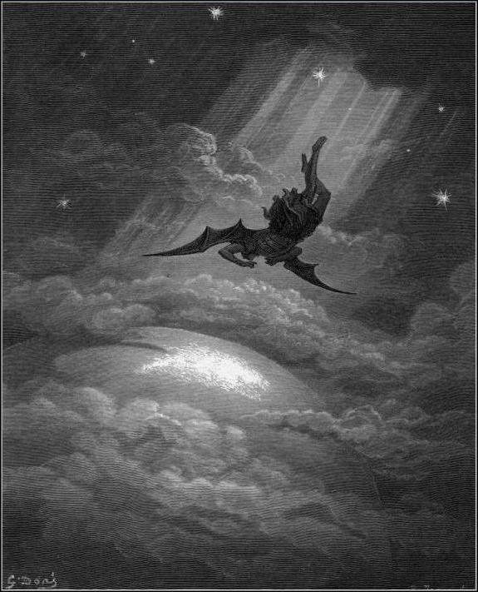
The Unpardonable Sin That Killed Dan
Dan could:
1. basely steal
2. steal a priest to worship God?
3. JUSTIFY HIS SINS AND REFUSE TO REPENT OF HIS WRONGS!
4. NOONE COULD TELL HIM ANYTHING!
“the children of Dan went their way.”

Slide 19
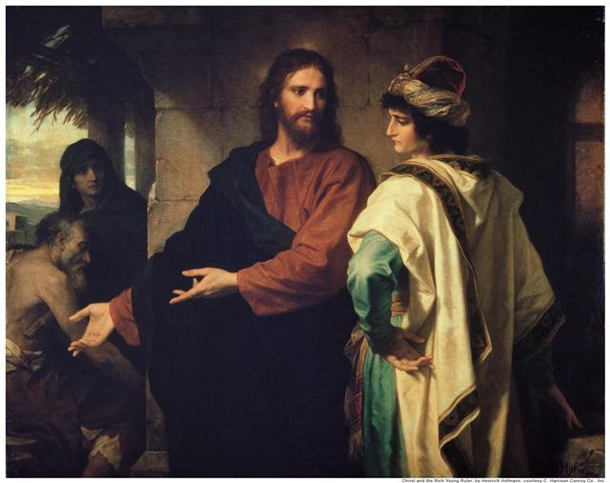
Laodicea
“I know thy works, that thou art neither cold nor hot: I would thou wert cold or hot. So then because thou art lukewarm, and neither cold nor hot, I will spue thee out of my mouth. Because thou sayest, I am rich, and increased with goods, and have need of nothing; and knowest not that thou art wretched, and miserable, and poor, and blind, and naked: I counsel thee to buy of me gold tried in the fire, that thou mayest be rich; and white raiment, that thou mayest be clothed, and that the shame of thy nakedness do not appear; and anoint thine eyes with eyesalve, that thou mayest see.” Rev. 3:15-18 Laodicea ‘thinks’ it is all good. Laodicea:
1. goes to church on Sabbath
2. pays their money to the church
3. follows some health habits
4. follows some dress standards
5. claims to be God’s people on the way to the kingdom
Christ warns us “BEWARE” lest the fatal self righteousness that destroyed Dan destroy us!

