Slide 1
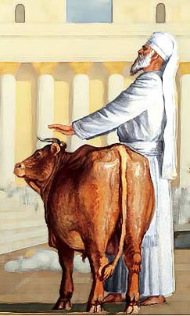
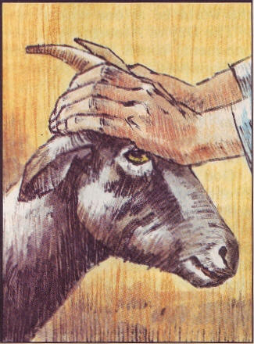
The Sin Problem and Answer

Slide 2
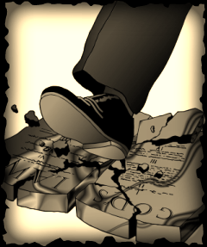
What is “Sin”???
1 John 3:4 “Whosoever committeth sin transgresseth also the law: for sin is the transgression of the law.”
266 harmatia- 1) to be without a share in, to miss the mark, to err/be mistaken, to miss or wander from the path of uprightness and honour to do or go wrong, to wander from the law of God
2) That which is done wrong, sin, an offence, a violation of the divine law in thought or in act

Slide 3
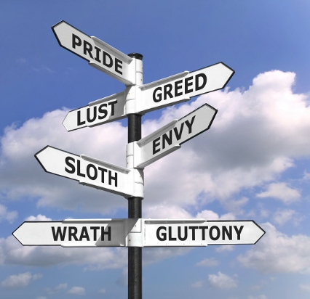
What is Iniquity?
93 adikia-unrighteousness, unjust, wrong; 1) injustice of a judge 2) unrighteousness of heart and life 3) a deed of violating law and justice, act of unrighteousness
458 anomia- set about [4060] to transgress the law 1) condition of without law (ignorant or violating it) 2) contempt and violation of law, iniquity, wickedness

Slide 4
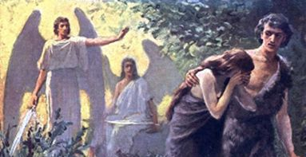
The First Sin-Offering
Gen. 3:21 “Unto Adam also and to his wife did the LORD God make coats of skins, and clothed them.”

Slide 5
Institution of Sin-Offerings
The sacrificial offerings were ordained by God to be to man a perpetual reminder and a penitential acknowledgment of his sin and a confession of his faith in the promised Redeemer. They were intended to impress upon the fallen race the solemn truth that it was sin that caused death. To Adam, the offering of the first sacrifice was a most painful ceremony. His hand must be raised to take life, which only God could give. It was the first time he had ever witnessed death, and he knew that had he been obedient to God, there would have been no death of man or beast. As he slew the innocent victim, he trembled at the thought that his sin must shed the blood of the spotless Lamb of God. This scene gave him a deeper and more vivid sense of the greatness of his transgression, which nothing but the death of God’s dear Son could expiate. And he marveled at the infinite goodness that would give such a ransom to save the guilty. A star of hope illumined the dark and terrible future and relieved it of its utter desolation. PP, 68

Slide 6
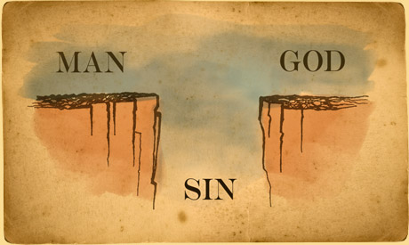
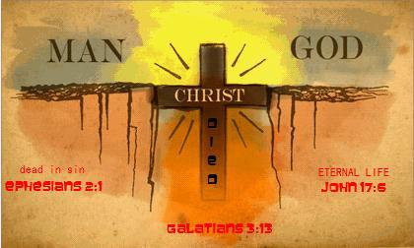
Who has Sinned?
Psalm 53:1-3 “The fool hath said in his heart, There is no God. Corrupt are they, and have done abominable iniquity: there is none that doeth good. God looked down from heaven upon the children of men, to see if there were any that did understand, that did seek God. Every one of them is gone back: they are altogether become filthy; there is none that doeth good, no, not one.
Romans 3:23 “For all have sinned, and come short of the glory of God”

Slide 7
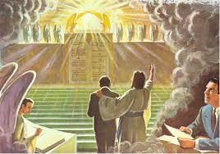
How is Sin Recorded?
Rev. 20:12 “And I saw the dead, small and great, stand before God; and the books were opened: and another book was opened, which is the book of life: and the dead were judged out of those things which were written in the books, according to their works.”
Dan. 7:10 “A fiery stream issued and came forth from before him: thousand thousands ministered unto him, and ten thousand times ten thousand stood before him: the judgment was set, and the books were opened.”

Slide 8
Sin without Works is Dead
2 Cor. 5:10 “For we must all appear before the judgment seat of Christ; that every one may receive the things done in his body, according to that he hath done, whether it be good or bad.”
Ecc. 12:13-14 “Let us hear the conclusion of the whole matter: Fear God, and keep his commandments: for this is the whole duty of man. For God shall bring every work into judgment, with every secret thing, whether it be good, or whether it be evil.
Matt. 12:36-37 “But I say unto you, That every idle word that men shall speak, they shall give account thereof in the day of judgment. For by thy words thou shalt be justified, and by thy words thou shalt be condemned.

Slide 9
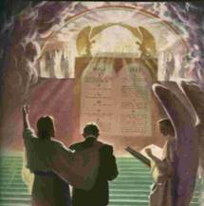
Sin is our works, words, thoughts, motives, hopes, core values, and beliefs
Every man's work passes in review before God, and is registered for faithfulness or unfaithfulness. Opposite each name in the books of heaven is entered, with terrible exactness, every wrong word, every selfish act, every unfulfilled duty, and every secret sin, with every artful dissembling. Heaven-sent warnings or reproofs neglected, wasted moments, unimproved opportunities, the influence exerted for good or for evil, with its far-reaching results, all are chronicled by the recording angel. The law of God is the standard by which the characters and the lives of men will be tested in the judgment. GC, 482

Slide 10
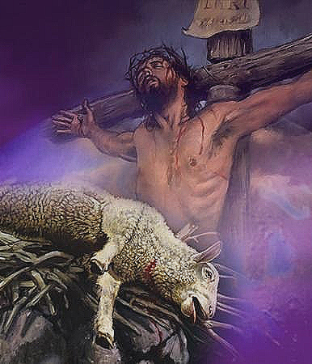
What is the Answer to Sin and Iniquity?
Lev. 17:11 “For the life of the flesh is in the blood: and I have given it to you upon the altar to make an atonement for your souls: for it is the blood that maketh an atonement for the soul.”
Heb. 9:22 “And almost all things are by the law purged with blood; and without shedding of blood is no remission.”
Is. 53:4-5 “Surely he hath borne our griefs, and carried our sorrows: yet we did esteem him stricken, smitten of God, and afflicted. But he was wounded for our transgressions, he was bruised for our iniquities: the chastisement of our peace was upon him; and with his stripes we are healed.”

Slide 11
Christ: the Only Hope of Mankind
Through the long centuries of "trouble and darkness" and "dimness of anguish" (Isaiah 8:22) marking the history of mankind from the day our first parents lost their Eden home, to the time the Son of God appeared as the Saviour of sinners, the hope of the fallen race was centered in the coming of a Deliverer to free men and women from the bondage of sin and the grave. . . Though they must suffer from the power of their adversary because they had fallen under his seductive influence and had chosen to disobey the plain command of Jehovah, yet they need not yield to utter despair. The Son of God was offering to atone with His own lifeblood for their transgression. To them was to be granted a period of probation, during which, through faith in the power of Christ to save, they might become once more the children of God. PK, 681, 682

Slide 12
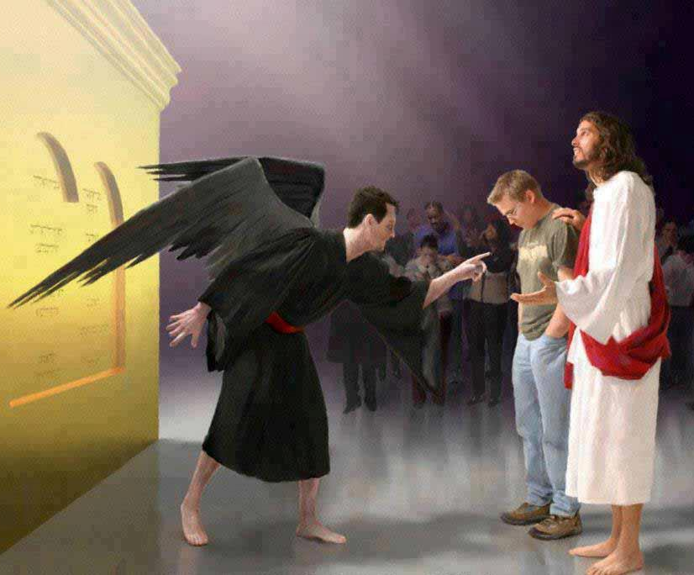
God’s Answer to Sin… Requires Our Response
1 John 2:1-6 “My little children, these things write I unto you, that ye sin not. And if any man sin, we have an advocate with the Father, Jesus Christ the righteous: And he is the propitiation for our sins: and not for ours only, but also for the sins of the whole world. And hereby we do know that we know him, if we keep his commandments. He that saith, I know him, and keepeth not his commandments, is a liar, and the truth is not in him. But whoso keepeth his word, in him verily is the love of God perfected: hereby know we that we are in him. He that saith he abideth in him ought himself also so to walk, even as he walked.

Slide 13
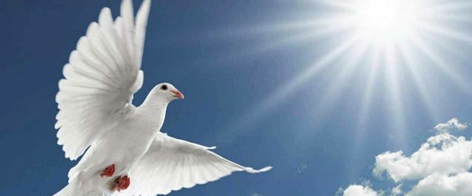
The New Man
Rom. 8:1-6 “There is therefore now no condemnation to them which are in Christ Jesus, who walk not after the flesh, but after the Spirit. For the law of the Spirit of life in Christ Jesus hath made me free from the law of sin and death. For what the law could not do, in that it was weak through the flesh, God sending his own Son in the likeness of sinful flesh, and for sin, condemned sin in the flesh: That the righteousness of the law might be fulfilled in us, who walk not after the flesh, but after the Spirit. For they that are after the flesh do mind the things of the flesh; but they that are after the Spirit the things of the Spirit. For to be carnally minded is death; but to be spiritually minded is life and peace.”

Slide 14
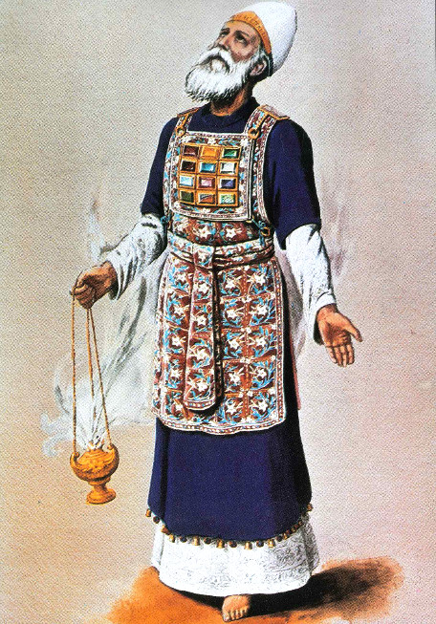
Where Does the Sin Go?
The Priest:
Ex. 28:38 “And it shall be upon Aaron's forehead, that Aaron may bear the iniquity of the holy things, which the children of Israel shall hallow in all their holy gifts; and it shall be always upon his forehead, that they may be accepted before the LORD.”
Lev. 6:26 “Speak unto Aaron and to his sons, saying, This is the law of the sin offering: In the place where the burnt offering is killed shall the sin offering be killed before the Lord: it is most holy. The priest that offereth it for sin shall eat it: in the holy place shall it be eaten, in the court of the tabernacle of the congregation.

Slide 15
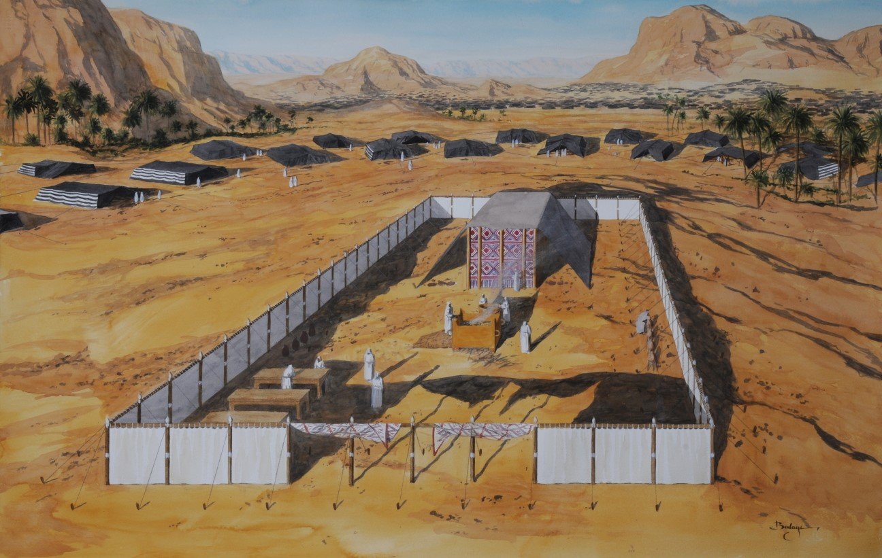
Lev. 10:17 “Wherefore have ye not eaten the sin offering in the holy place, seeing it is most holy, and God hath given it you to bear the iniquity of the congregation, to make atonement for them before the Lord?”
2. The Sanctuary and altars
Lev. 16:16 “And he shall make an atonement for the holy place, because of the uncleanness of the children of Israel, and because of their transgressions in all their sins: and so shall he do for the tabernacle of the congregation, that remaineth among them in the midst of their uncleanness.
Lev. 16:33 “And he shall make an atonement for the holy sanctuary, and he shall make an atonement for the tabernacle of the congregation, and for the altar, and he shall make an atonement for the priests, and for all the people of the congregation.”

Slide 16
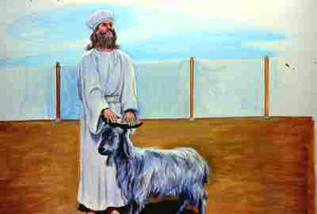
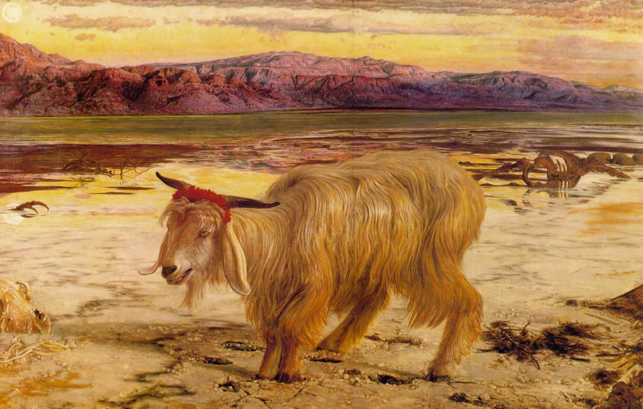
3. Azazel/Satan:
Lev. 16:10 “But the goat, on which the lot fell to be the scapegoat, shall be presented alive before the Lord, to make an atonement with him, and to let him go for a scapegoat into the wilderness. . . And when he hath made an end of reconciling the holy place, and the tabernacle of the congregation, and the altar, he shall bring the live goat: And Aaron shall lay both his hands upon the head of the live goat, and confess over him all the iniquities of the children of Israel, and all their transgressions in all their sins, putting them upon the head of the goat, and shall send him away by the hand of a fit man into the wilderness: And the goat shall bear upon him all their iniquities unto a land not inhabited: and he shall let go the goat in the wilderness.

Slide 17
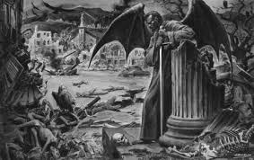
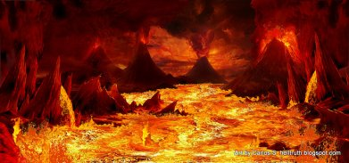
In the typical service the high priest, having made the atonement for Israel, came forth and blessed the congregation. So Christ, at the close of His work as mediator, will appear, "without sin unto salvation" (Hebrews 9:28), to bless His waiting people with eternal life. As the priest, in removing the sins from the sanctuary, confessed them upon the head of the scapegoat, so Christ will place all these sins upon Satan, the originator and instigator of sin. The scapegoat, bearing the sins of Israel, was sent away "unto a land not inhabited" (Leviticus 16:22); so Satan, bearing the guilt of all the sins which he has caused God's people to commit, will be for a thousand years confined to the earth, which will then be desolate, without inhabitant, and he will at last suffer the full penalty of sin in the fires that shall destroy all the wicked. Thus the great plan of redemption will reach its accomplishment in the final eradication of sin and the deliverance of all who have been willing to renounce evil. GC, 485, 486

Slide 18
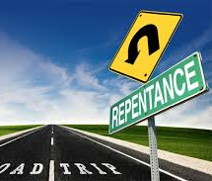
Repent:
1. Sorrow for any thing done or said; the pain or grief which a person experiences in consequence of the injury or inconvenience produced by his own conduct.
3. Real penitence; sorrow or deep contrition for sin, as an offense and dishonor to God, a violation of his holy law, and the basest ingratitude towards a Being of infinite benevolence. This is called evangelical repentance, and is accompanied and followed by amendment of life.

Slide 19
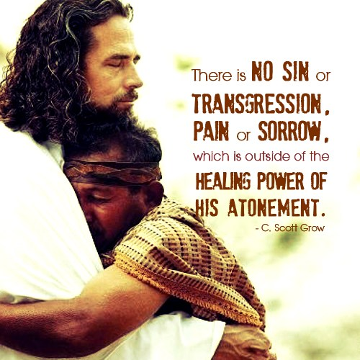
Luke 5:32 “I came not to call the righteous, but sinners to repentance.”
3341 metanoia-a change of mind
Acts 3:19 “Repent ye therefore, and be converted, that your sins may be blotted out, when the times of refreshing shall come from the presence of the Lord.”

Slide 20
2. Confession:
1 John 1:9 “If we confess our sins, he is faithful and just to forgive us our sins, and to cleanse us from all unrighteousness.”
Jer. 3:13 “Only acknowledge thine iniquity, that thou hast transgressed against the LORD thy God, and hast scattered thy ways to the strangers under every green tree, and ye have not obeyed my voice, saith the LORD.”
Psalm 32:1-6 “Blessed is he whose transgression is forgiven, whose sin is covered. Blessed is the man unto whom the Lord imputeth not iniquity, and in whose spirit there is no guile. When I kept silence, my bones waxed old through my roaring all the day long. For day and night thy hand was heavy upon me: my moisture is turned into the drought of summer. Selah. I acknowledge my sin unto thee, and mine iniquity have I not hid. I said, I will confess my transgressions unto the Lord; and thou forgavest the iniquity of my sin. Selah. For this shall every one that is godly pray unto thee in a time when thou mayest be found: surely in the floods of great waters they shall not come nigh unto him.”

Slide 21
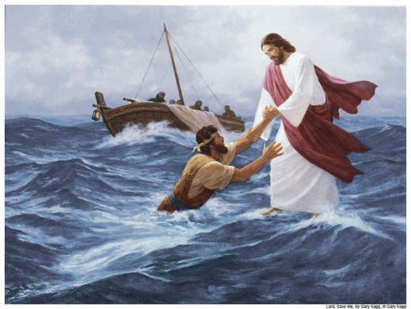
3. Faith in Substitute Sacrifice:
John 3:16 “For God so loved the world, that he gave his only begotten Son, that whosoever believeth in him should not perish, but have everlasting life.”
Rom. 3:25 “Whom God hath set forth to be a propitiation through faith in his blood, to declare his righteousness for the remission of sins that are past, through the forbearance of God”

Slide 22
The Faith Dilemma
As your conscience has been quickened by the Holy Spirit, you have seen something of the evil of sin, of its power, its guilt, its woe; and you look upon it with abhorrence. You feel that sin has separated you from God, that you are in bondage to the power of evil. The more you struggle to escape, the more you realize your helplessness. Your motives are impure; your heart is unclean. You see that your life has been filled with selfishness and sin. You long to be forgiven, to be cleansed, to be set free. Harmony with God, likeness to Him--what can you do to obtain it? It is peace that you need--Heaven's forgiveness and peace and love in the soul. Money cannot buy it, intellect cannot procure it, wisdom cannot attain to it; you can never hope, by your own efforts, to secure it. But God offers it to you as a gift, "without money and without price." Isaiah 55:1. It is yours if you will but reach out your hand and grasp it. The Lord says, "Though your sins be as scarlet, they shall be as white as snow; though they be red like crimson, they shall be as wool." Isaiah 1:18. "A new heart also will I give you, and a new spirit will I put within you." Ezekiel 36:26. You have confessed your sins, and in heart put them away. You have resolved to give yourself to God. Now go to Him, and ask that He will wash away your sins and give you a new heart. Then believe that He does this because He has promised.--Steps to Christ, 49-50

Slide 23
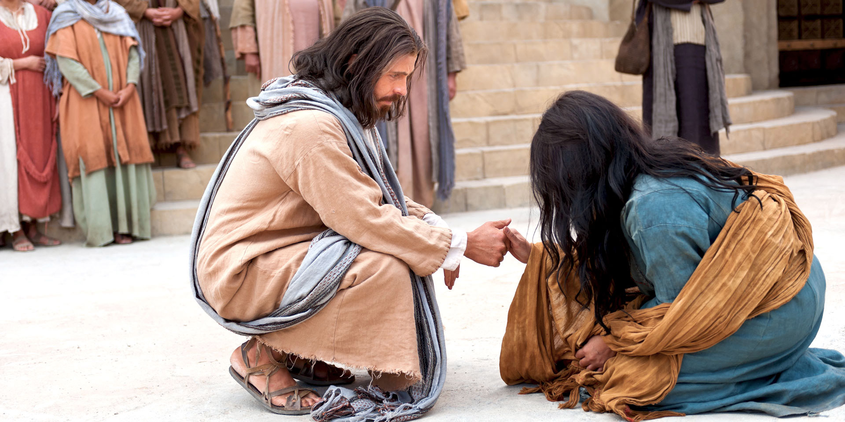
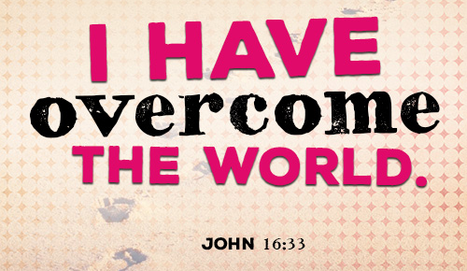
4. Die to Self, and Live According to God’s Will:
1 John 5:2-4 “By this we know that we love the children of God, when we love God, and keep his commandments. For this is the love of God, that we keep his commandments: and his commandments are not grievous. For whatsoever is born of God overcometh the world: and this is the victory that overcometh the world, even our faith.
John 8:10-11 “When Jesus had lifted up himself, and saw none but the woman, he said unto her, Woman, where are those thine accusers? hath no man condemned thee? She said, No man, Lord. And Jesus said unto her, Neither do I condemn thee: go, and sin no more.

Slide 24
Our Role in Summation…
Psalm 51:1-17 “Have mercy upon me, O God, according to thy lovingkindness: according unto the multitude of thy tender mercies blot out my transgressions. Wash me throughly from mine iniquity, and cleanse me from my sin. For I acknowledge my transgressions: and my sin is ever before me. Against thee, thee only, have I sinned, and done this evil in thy sight: that thou mightest be justified when thou speakest, and be clear when thou judgest. Behold, I was shapen in iniquity; and in sin did my mother conceive me. Behold, thou desirest truth in the inward parts: and in the hidden part thou shalt make me to know wisdom. Purge me with hyssop, and I shall be clean: wash me, and I shall be whiter than snow. Make me to hear joy and gladness; that the bones which thou hast broken may rejoice. Hide thy face from my sins, and blot out all mine iniquities. Create in me a clean heart, O God; and renew a right spirit within me. Cast me not away from thy presence; and take not thy holy spirit from me. Restore unto me the joy of thy salvation; and uphold me with thy free spirit. Then will I teach transgressors thy ways; and sinners shall be converted unto thee. Deliver me from bloodguiltiness, O God, thou God of my salvation: and my tongue shall sing aloud of thy righteousness. O Lord, open thou my lips; and my mouth shall shew forth thy praise. For thou desirest not sacrifice; else would I give it: thou delightest not in burnt offering. The sacrifices of God are a broken spirit: a broken and a contrite heart, O God, thou wilt not despise.”

Slide 25
At the time appointed for the judgment--the close of the 2300 days, in 1844--began the work of investigation and blotting out of sins. All who have ever taken upon themselves the name of Christ must pass its searching scrutiny. Both the living and the dead are to be judged "out of those things which were written in the books, according to their works.“ Sins that have not been repented of and forsaken will not be pardoned and blotted out of the books of record, but will stand to witness against the sinner in the day of God. He may have committed his evil deeds in the light of day or in the darkness of night; but they were open and manifest before Him with whom we have to do. Angels of God witnessed each sin and registered it in the unerring records. Sin may be concealed, denied, covered up from father, mother, wife, children, and associates; no one but the guilty actors may cherish the least suspicion of the wrong; but it is laid bare before the intelligences of heaven. The darkness of the darkest night, the secrecy of all deceptive arts, is not sufficient to veil one thought from the knowledge of the Eternal. God has an exact record of every unjust account and every unfair dealing. He is not deceived by appearances of piety. He makes no mistakes in His estimation of character. Men may be deceived by those who are corrupt in heart, but God pierces all disguises and reads the inner life.--GC, 486

