Slide 1
The Past Speaks in the Present
Pyramids of Mexico

Slide 2
Long Time in Process
“Through the two great errors, the immortality of the soul and Sunday sacredness, Satan will bring the people under his deceptions. While the former lays the foundation of spiritualism, the latter creates a bond of sympathy with Rome. The Protestants of the United States will be foremost in stretching their hands across the gulf to grasp the hand of spiritualism; they will reach over the abyss to clasp hands with the Roman power; and under the influence of this threefold union, this country will follow in the steps of Rome in trampling on the rights of conscience.” GC, pg. 588

Slide 3
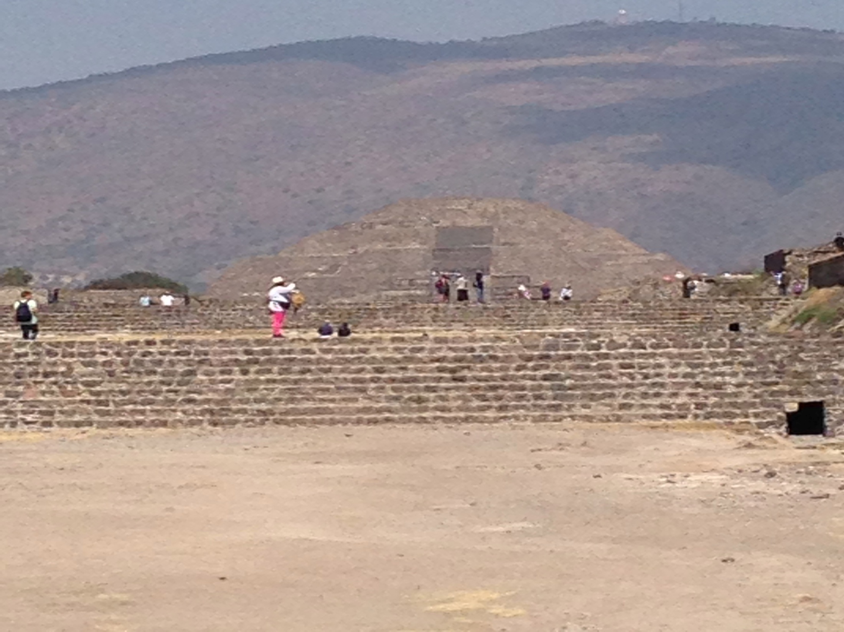

Slide 4
From Where Did they Come?

Slide 5
Moving Away
“And it came to pass, as they journeyed from the east, that they found a plain in the land of Shinar; and they dwelt there. And they said one to another, Go to, let us make brick, and burn them thoroughly. And they had brick for stone, and slime had they for mortar. And they said, Go to, let us build us a city and a tower, whose top may reach unto heaven; and let us make us a name, lest we be scattered abroad upon the face of the whole earth.” Gen. 11:1-4

Slide 6
“For a time the descendants of Noah continued to dwell among the mountains where the ark had rested. As their numbers increased, apostasy soon led to division. Those who desired to forget their Creator and to cast off the restraint of His law felt a constant annoyance from the teaching and example of their God-fearing associates, and after a time they decided to separate from the worshipers of God. Accordingly they journeyed to the plain of Shinar, on the banks of the river Euphrates. They were attracted by the beauty of the situation and the fertility of the soil, and upon this plain they determined to make their home.” PP, pg. 118

Slide 7
Devil Worshippers
“But while they murmured against God as arbitrary and severe, they were accepting the rule of the cruelest of tyrants. Satan was seeking to bring contempt upon the sacrificial offerings that prefigured the death of Christ; and as the minds of the people were darkened by idolatry, he led them to counterfeit these offerings and sacrifice their own children upon the altars of their gods. As men turned away from God, the divine attributes--justice, purity, and love--were supplanted by oppression, violence, and brutality.” PP, pgs. 122,123

Slide 8
Scattered Abroad
Following the fiasco at the Tower of Babel, the idolatrous people were scattered throughout the earth. They took with them a knowledge of architecture and the seeds of rebellious worship inspired by the devil. Should it surprise us to see similar structures and similar ideas around the earth?

Slide 9
Seeds of Evil
1. Structures would be used as burial grounds for rulers. Their goods were buried with them for the afterlife. They believed in the immortality of the soul.
2. They believed in human sacrifices.
3. They worshipped the sun.
4. This was all inspired by the devil.

Slide 10
Immortality
Purpose of The Pyramids of Egypt
Ancient Egypt History The Old Kingdom
Their purpose was not architectural but religious; the Pyramids of Egypt were tombs, lineally descended from the most primitive of burial mounds. Apparently the Pharaoh believed, like any commoner among his people, that every living body was inhabited by a double, or ka, which need not die with the breath; and that the ka would survive all the more completely if the flesh were preserved against hunger, violence and decay.

Slide 12
Human Sacrifices
“Human sacrifice was a religious practice characteristic of pre-Columbian Aztec civilization,…Human sacrifice was in this sense the highest level of an entire panoply of offerings through which the Aztecs sought to repay their debt to the gods.”

Slide 13
Started way back
“Satan was seeking to bring contempt upon the sacrificial offerings that prefigured the death of Christ; and as the minds of the people were darkened by idolatry, he led them to counterfeit these offerings and sacrifice their own children upon the altars of their gods.” PP, pg. 122,123

Slide 15
Sun Worship
Not only are the immortality of the soul and human sacrifice so prevalent at the pyramids of old, but also sun worship. This medallion was purchased at the site of the pyramids of Mexico. Sun worship originated with early peoples and will be a part of the final crisis!

Slide 16
.

Slide 17
“And he brought me into the inner court of the LORD'S house, and, behold, at the door of the temple of the LORD, between the porch and the altar, were about five and twenty men, with their backs toward the temple of the LORD, and their faces toward the east; and they worshipped the sun toward the east.” Ezek. 8:16

Slide 18
The one behind it All!

Slide 19
Ugly Monster
This ugly creature greeted us at Teotihuacan. One of the guides informed us that that was the serpent. How fitting that immortality, human sacrifice, sun worship, and a site dedicated to the serpent was all provided in one package! “And the great dragon was cast out, that old serpent, called the Devil, and Satan, which deceiveth the whole world: he was cast out into the earth, and his angels were cast out with him.” Rev. 12:9

Slide 20
How Fitting!
As we left Teotihuacan, we saw this mangled snake laying in pieces on the road. How fitting and comforting to know that everything we saw at the pyramids of Teotihuacan; one day it would be destroyed! “And I will put enmity between thee and the woman, and between thy seed and her seed; it shall bruise thy head, and thou shalt bruise his heel.” Gen. 3:15

