Slide 1
Behind the Door pt 23
The Tale of 2 Kings

Slide 3
Rev. 17:1,2 “And there came one of the seven angels which had the seven vials, and talked with me, saying unto me, Come hither; I will shew unto thee the judgment of the great whore that sitteth upon many waters: With whom the kings of the earth have committed fornication, and the inhabitants of the earth have been made drunk with the wine of her fornication.”

Slide 4
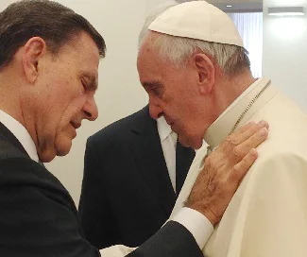
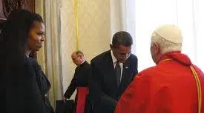
THE “BENEFITS” OF ALLYING WITH ROME
All “kings” of the earth, regardless of their preferred title, “all kings” means all presidents, chancellors, prime ministers, supreme leaders, dictatorships and… worldwide religious leaders who exercise their kingly authority over many nations—essentially all the “leaders” of the earth are in unholy union with the papal power, according the Revelation 17. Some anti-Roman dissenters, throughout history, have existed and are possible, but they would be the exception and NOT the rule. Revelation is clear eventually all will be in submission to the will of Rome.

Slide 5
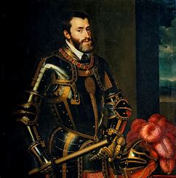
Charles V (Reign 1519-1556), Holy Roman Emperor and King of Spain:
-Was a member of the ruling Habsburg family
-only 19 years old when he became Holy Roman Emperor
-Was a major opponent to Protestantism and Martin Luther
-Present at the Diet of Worms in 1521 (age 21)
-Declared Luther an outlaw after his refusal to recant
-waged war against Protestantism in Germany

Slide 6
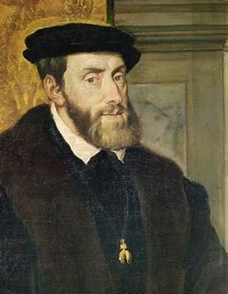
Born 1500—Death 1558
-Coincided with the creation of the Counter-Reformation Catholic Church Order of the Jesuits (1540-commissioned by Pope Paul III)
-Coincided with the time of the Counter-Reformation Council of Trent (1546-1563), which renounced Protestant claims of justification by faith alone, through grace alone, and reaffirmed Catholic extrabiblical claims, such as: grace by works, Mary worship, transubstantiation/mass, apocryphal writings, councils, traditions, and papacy equal with Scripture, veneration of saints, salvation in the Roman Church alone, sacraments and others—declaring that all who did not accept these canonical laws to be anathema (damned to hell)
-coincided with many individuals fleeing of persecution to the “New World”—Huguenots left France for Brazil in 1555, other Protestants throughout Europe began leaving around this time also

Slide 7
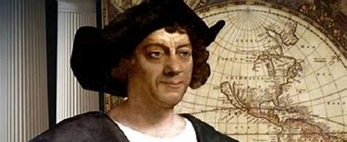
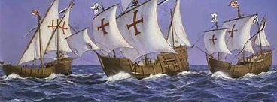
Columbus (1451-1506) sailed to the New World in 1492
Queen Isabella I “of Castile” (reign 1474-1504)
King Ferdinand II “of Aragon” called “the Catholic” (reign 1475-1504)
Columbus’ ships: Santa Maria, Pinta, Nina (Santa Clara)

Slide 8
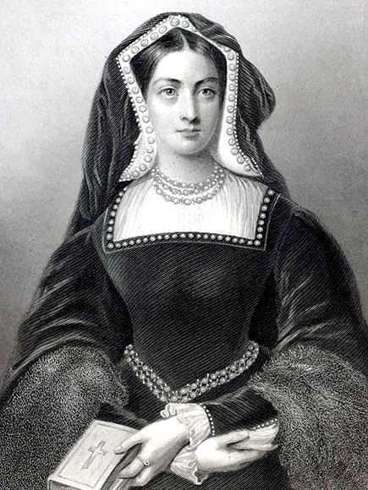
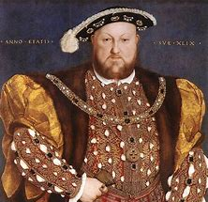
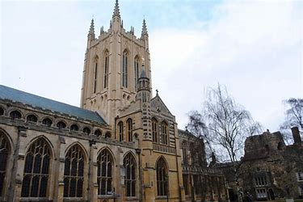
Charles V’s Aunt: Catherine of Aragon (Henry VIII’s wife 1509-1533)
Henry VIII (reign 1509-1547) sought to annul marriage to Catherine, which was not granted, so for selfish reasons Henry VIII adopted Protestantism
Divorce to Catherine-1533
Establishment of Church of England (Anglican Church)-1534

Slide 9
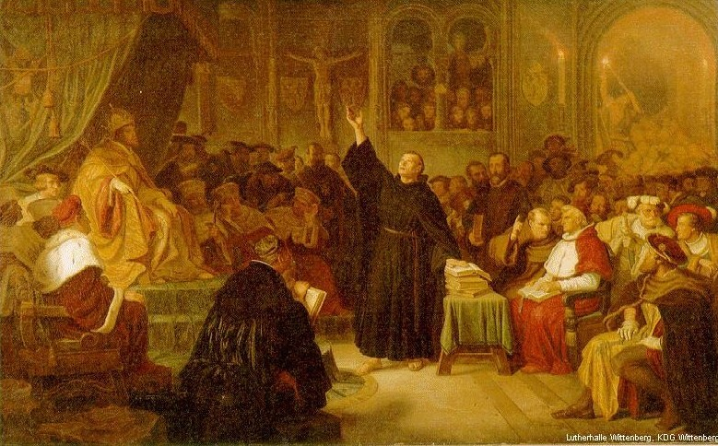

Slide 10
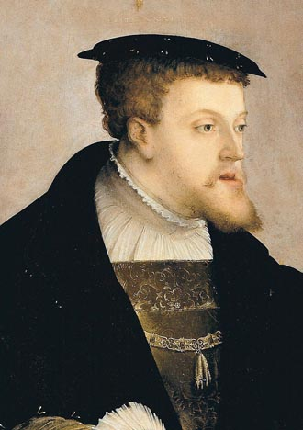
“His [Luther’s] words were not without effect. On the day following Luther’s answer, Charles Fifth caused a message to be presented to the Diet [in Worms], announcing his determination to carry out the policy of his predecessors to maintain and protect the Catholic religion. Since Luther had refused to renounce his errors, the most vigorous measures should be employed against him and the heresies he taught. . . . ‘A single monk, misled by his own folly, has risen against the faith of Christendom. . . .’”—Great Controversy, Ellen White, p. 162

Slide 11
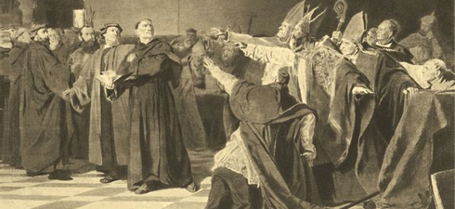
“To stay such impiety, I will sacrifice my kingdoms, my treasures, my friends, my body, my blood, my soul, and my life. I am about to dismiss the Augustine Luther, forbidding him to cause the least disorder among the people; I shall then proceed against him and his adherents as contumacious heretics, by excommunication, by interdict, and by every means calculated to destroy them. I call on the members of the states to behave like faithful Christians.“—Great Controversy, Ellen White, p. 163

Slide 12
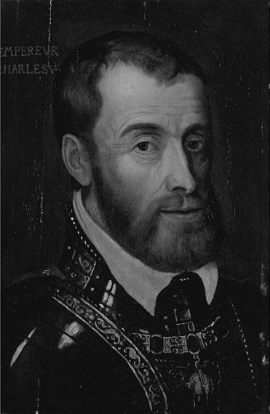
“I call on the members of the states to behave like faithful Christians [Catholics]. [quoted in: D'Aubigne, History of the Reformation of the Sixteenth Century, b. 7 ch. 9]. Nevertheless the emperor declared that Luther's safe-conduct must be respected, and that before proceedings against him could be instituted, he must be allowed to reach his home in safety.”—Great Controversy, Ellen White, p. 163

Slide 13
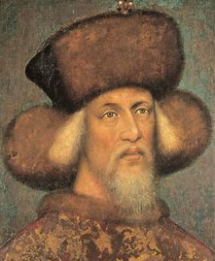
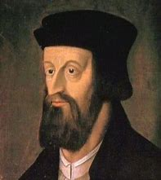
Only About a generation prior, another “Holy Roman Emperor” (though not Emperor during Huss’ trial) named Sigismund, lied to Jan Huss, while under Catholic pressure, about his “safe conduct”—instead Jan Huss was burned at the stake in violation of the Emperors assurance of his safety. Charles V, remembering this fiasco and taking council with Germany’s princes was persuaded not to repeat the error of Sigismund. (see Great Controversy ch. 8; Jacques Lenfant, History of the Council of Constance vol. 1; D’Aubigne History of the Protestant Reformation in the 16th Century b. 7)
Sigismund King of Hungary (1387-1437) (left) Holy Roman Emperor (reign 1433-1437)
Jan Huss (right), killed as a heretic in 1415 at ‘Council of Constance’

Slide 14
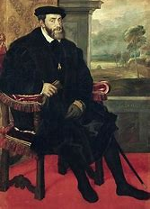
Rejected the Light!!!
“’I am firmly resolved to imitate the example of my ancestors’ [D’aubigne, b. 7 ch. 9] . . . He had decided that he would not step out of the path of custom, even to walk in the ways of truth and righteousness. Because his fathers did, he would uphold the papacy, with all its cruelty and corruption. Thus he took his position, refusing to accept any light in advance of what his fathers had received, or to perform any duty that they had not performed. ”—Great Controversy, Ellen White, p. 163-164

Slide 15
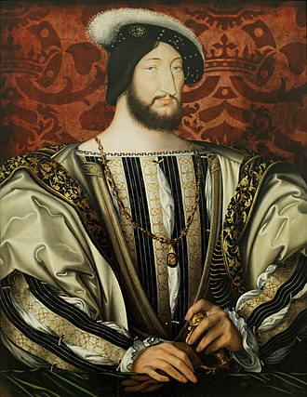
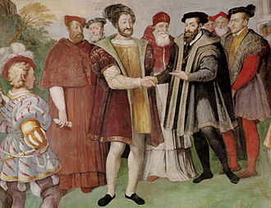
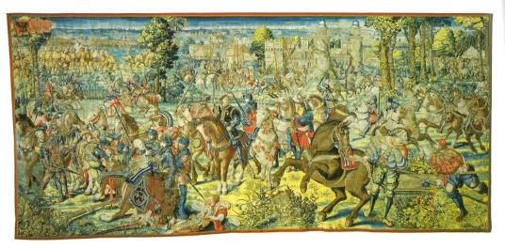
A Life of Constant War!!!
Francis I of France (reign 1515-1547) tried and failed to become Holy Roman Emperor in 1519, and dragged out the Italian Wars (bottom left) of his predecessors (1494-1559), finally signed a treaty at the Truce of Nice (bottom right) in 1538, but the war eventually continued again.

Slide 16
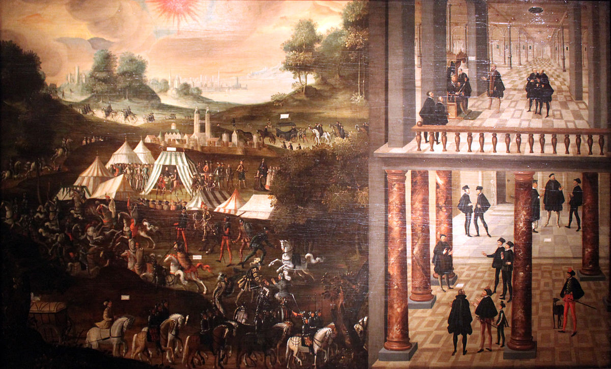
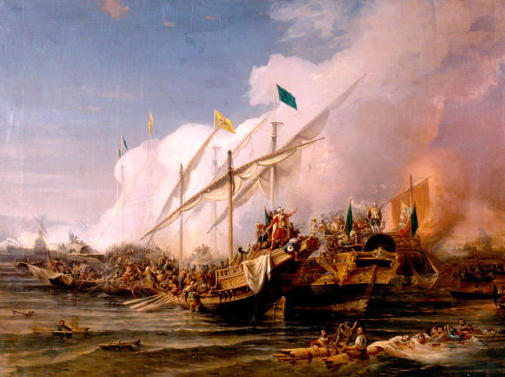
By God’s Providence, Charles V was NEVER able to wipe out the Protestant Reformation
The Ottoman (Muslim) Turks, constantly provoked wars before, during, and after Charles V’s reign. During his reign he was continually called away from his compaigns against Protestantism to deal with conflicts with the Turks, including: the Battle of Mahacs (1526), Conquest of Tunis (1534 and 1535), Siege of Vienna (1529), Preveza (1538)—sometimes the Ottomans even allied with the French against Charles V, such as an alliance in 1536 and the Franco-Ottoman Alliance of 1542.

Slide 17
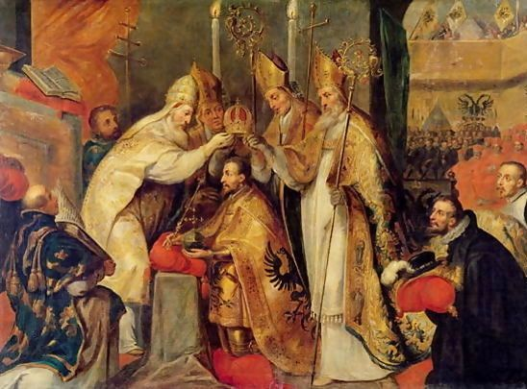
Beneficial Alliance????
Reflecting on the Diet of Spires, Ellen White, Great Controversy, p. 197 writes:
“A dark and threatening day had come for the Reformation. . .”

Slide 18
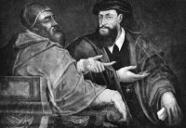
“Notwithstanding the Edict of Worms, declaring Luther to be an outlaw and forbidding the teaching or belief of his doctrines, religious toleration had thus far prevailed in the empire. God's providence had held in check the forces that opposed the truth. Charles V was bent on crushing the Reformation, but often as he raised his hand to strike he had been forced to turn aside the blow. Again and again the immediate destruction of all who dared to oppose themselves to Rome appeared inevitable; but at the critical moment the armies of the Turk appeared on the eastern frontier, or the king of France, or even the pope himself, jealous of the increasing greatness of the emperor, made war upon him; and thus, amid the strife and tumult of nations, the Reformation had been left to strengthen and extend.”—Great Controversy, Ellen White, p. 197
Unwise Alliance!

Slide 19
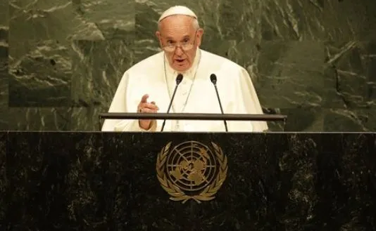
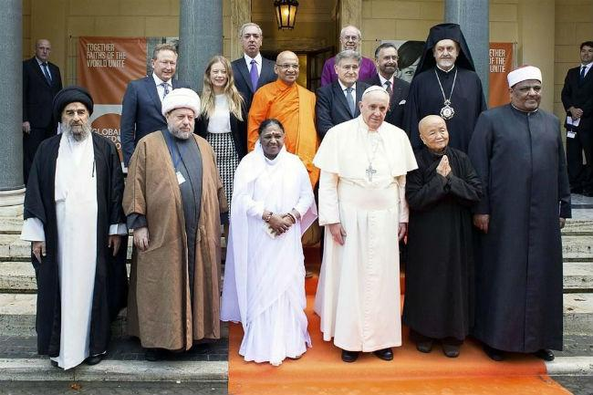
“and thus, amid the strife and tumult of nations, the Reformation had been left to strengthen and extend.”—Great Controversy, Ellen White, p. 197
Do NOT be Deceived! What may appear as world peace and community may actually be compromising Christ and all He and His Apostles stood for! Like the Tower of Babel, NOT “all” cooperative world movements are good!
Undoubtedly, the kings of the earth will unite as did Charles V, to finally stamp out Protestantism from the face of the earth. Now, as then, alliance with this wicked institution will backfire into misery, strife, weakness, and ultimately destruction as the Lord returns to vindicate His message, His people, His law, and His Name to show a difference between the unholy and the holy.

Slide 20
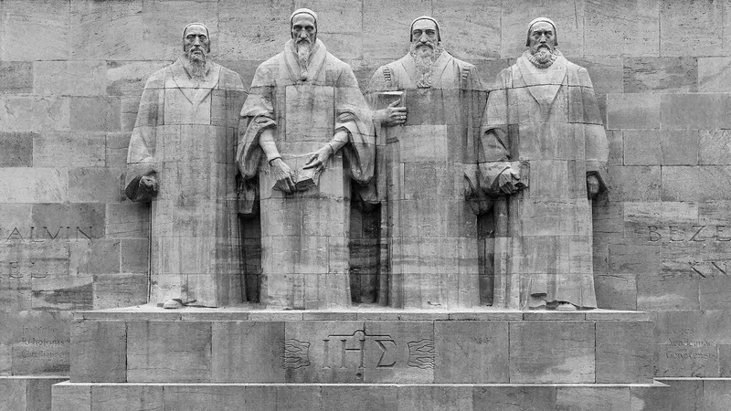
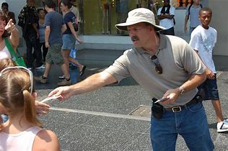
We are called to Finish the Reformation
Columbia Encyclopedia 6th ed. “In Germany, at the Diet of Worms in 1521, Charles secured a compromise regarding certain issues at the Diet, but he unyieldingly opposed the doctrines of Martin Luther. In his written opinion, Charles declared himself ready to stake his dominions, friends, blood, life, and soul on the extinction of heresy”
What are God’s People Doing to Finish the Reformation???

Slide 21
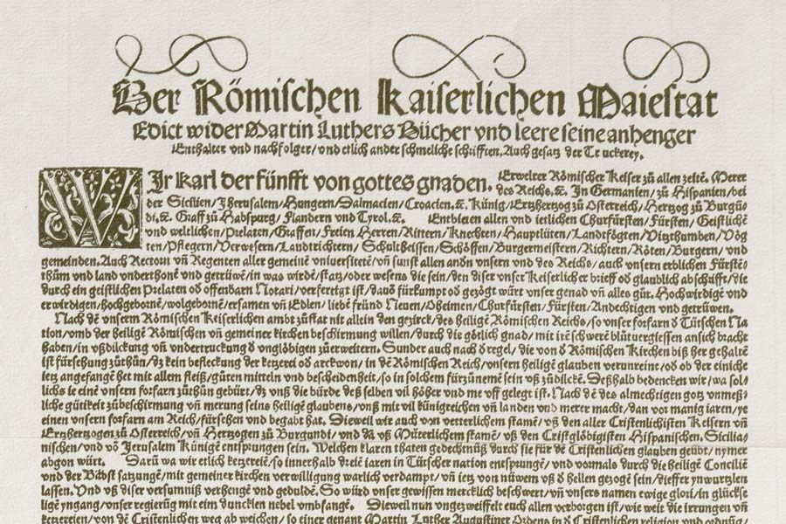
“Late in May 1521 he signed the Edict of Worms, outlawing Luther and his followers. However, Charles’ preoccupation with the war with France prevented him from checking the spread of Luther’s doctrines. Charles was not always supported by the popes, who were concerned with the threat to their temporal power and independence posed by imperial domination of Italy.”
Outlawed for believing and teaching the Bible???

Slide 22
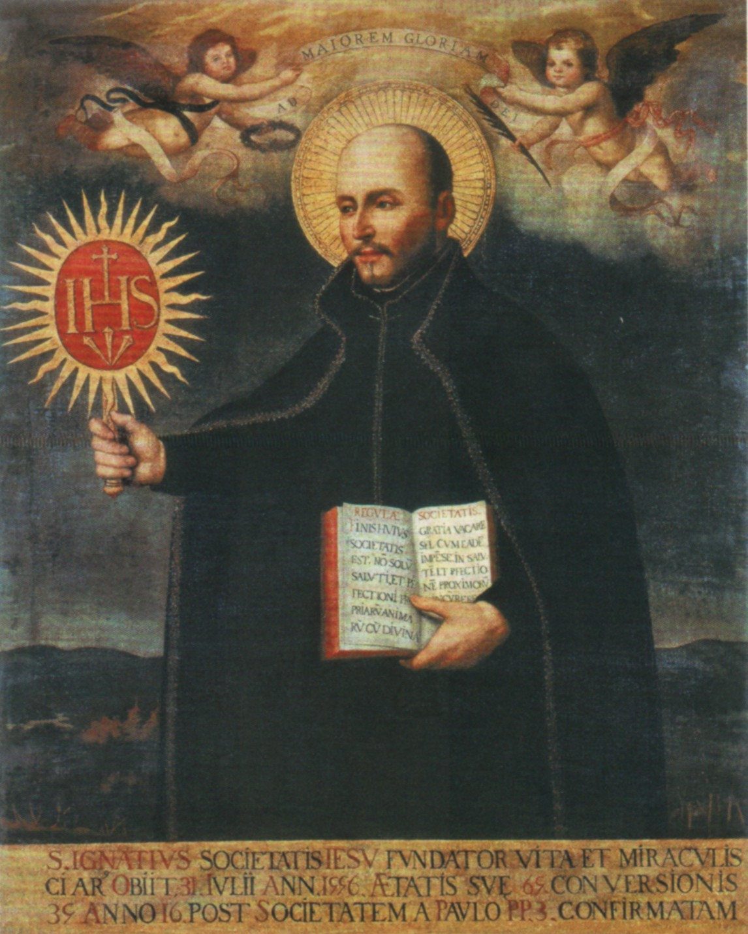
Columbia Encyclopedia 6th Ed. On Charles V: He had a truce with the Turks, which gave Charles some rest from his wars with them. At last, the way opened for the Counter-Reformation ardently desired by Charles and forwarded by St. Ignatius of Loyola. Turning on the Protestant princes of Germany, Charles split their ranks, attacked their league in 1546, defeated certain German princes in 1547, made a compromised profession of doctrine that he then tried to impose on the Protestants with the help of Spanish troops.

Slide 23
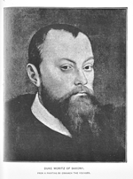
In 1552, Maurice of Saxony changed sides again and called in France to help, and even attempted to capture Charles at Innsbruck. . .
Yet Charles failed in his purpose to turn the Protestants to the Roman Catholic Church. And the human and financial cost of constant warfare drained Spanish resources. . .
NOT ALL PROTESTANTS ARE TRUE: Maurice of Saxony was not Protestant for religious reasons, and he proved a powerful foe and ally as he switched sides—originally allied with the Lutheran League and League of Confessors of the Protestant faith, later to betray them in favor of siding with Catholic Charles V in the hopes of gaining more lands and power, to later switch sides again. He was a battle-hardened, intelligent general whom both sides could hardly afford to lose.
Maurice of Saxony (Elector of Saxony 1547-1553)-killed in battle of Sievershausen

Slide 24
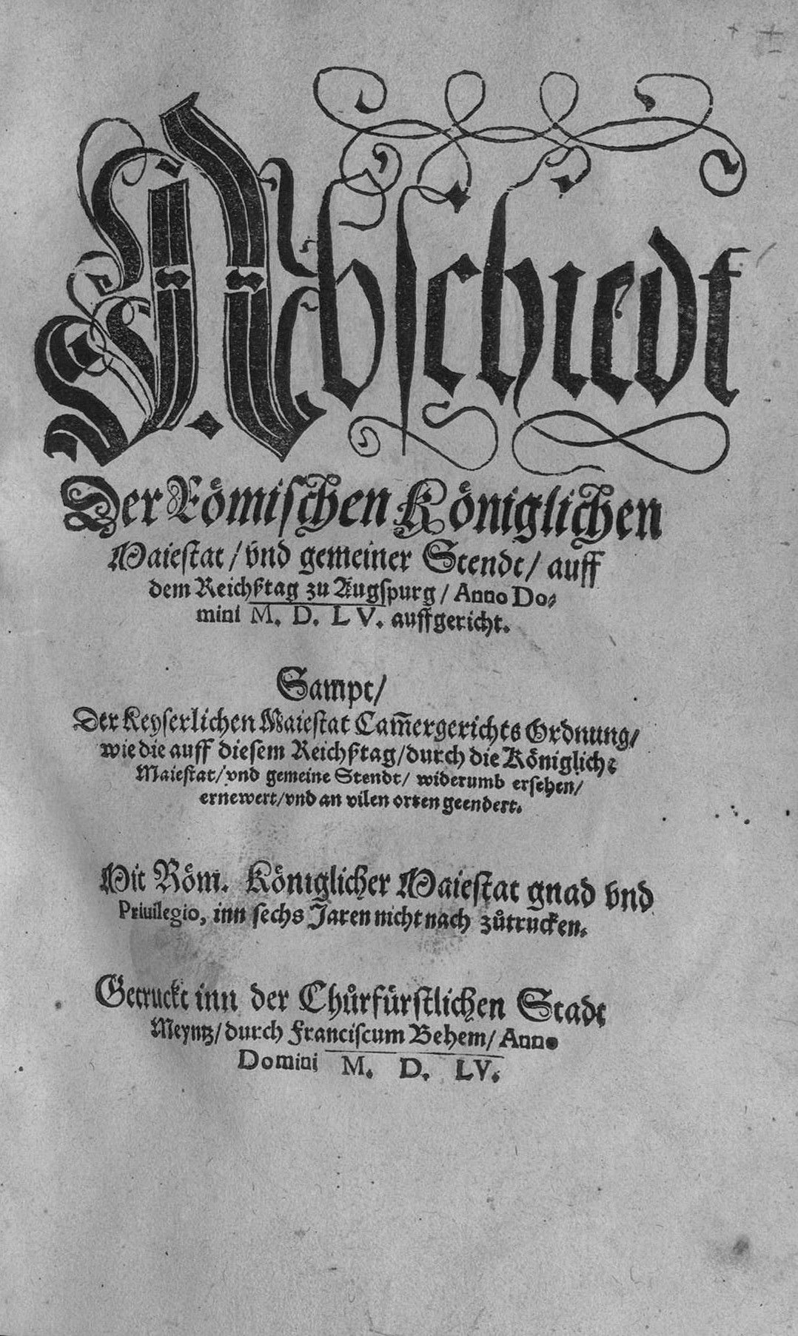
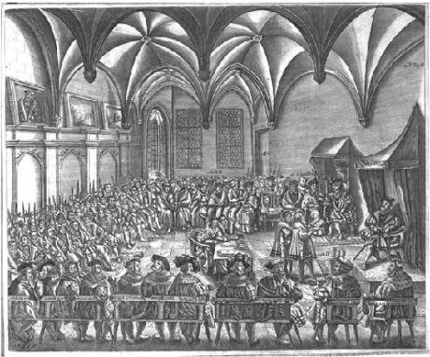
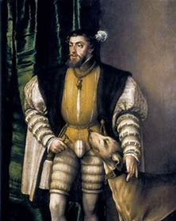
Moreover, Charles’ hopes for a universal empire were thwarted by the political realities of western Europe.
Finally Peace was forced by the depletion of Charles V’s resources to resume against the Protestants, at the famous Peace of Augsburg, when the princes presented their confession of faith to Charles V

Slide 25
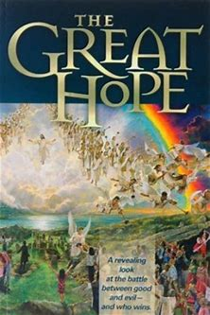
Destined to Be Destroyed???
Church manual (tradition) over Bible?
“The Protest of Spires [1529] and the Confession at Augsburg [1530], which marked the triumph of the Reformation in Germany, were followed by years of conflict and darkness. Weakened by divisions among its supporters, and assailed by powerful foes, Protestantism seemed destined to be utterly destroyed”—Great Controversy, Ellen White, p. 211
Watered-down message
Church authority out of control
Ellen White irrelevant?
Ecumenism? Spiritual Formation?
Atonement finished at cross?
3 Angel’s Messages?
Women’s ordination
Saved in sin?
Sanctuary not taught?
About to Fall?
LGBT

Slide 26
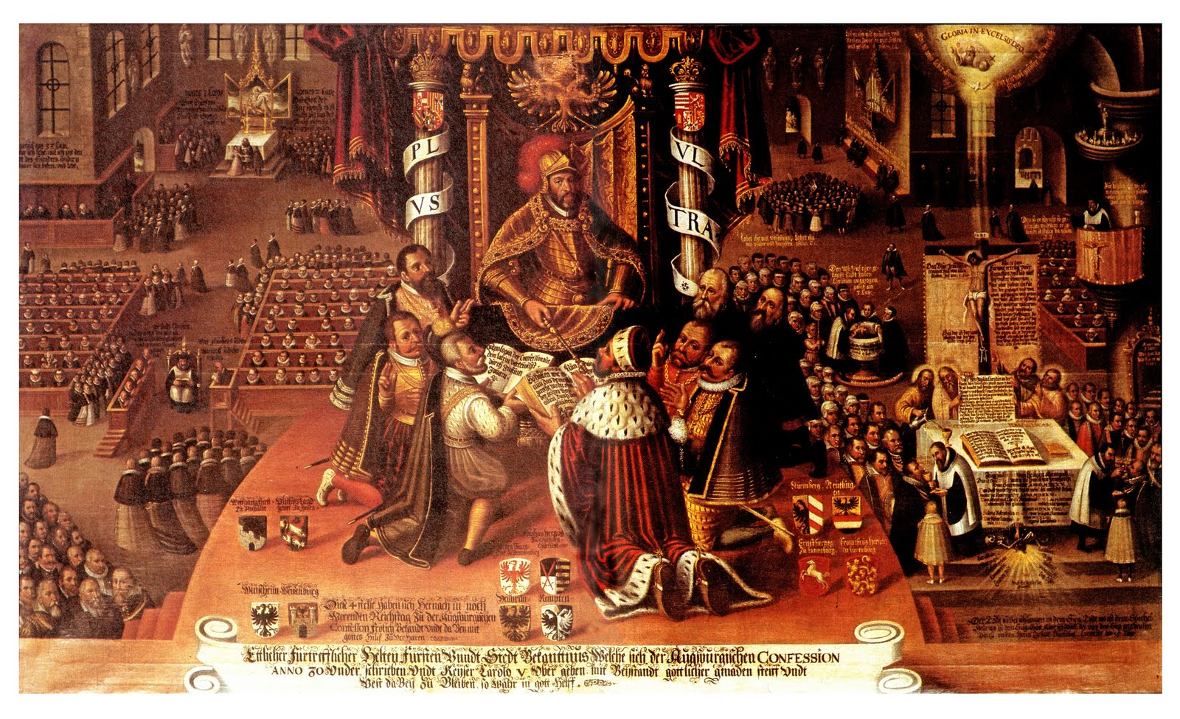
“Thousands sealed their testimony with their blood. Civil war broke out; the Protestant cause was betrayed by one of its leading adherents; the noblest of the reformed princes fell into the hands of the emperor and were dragged as captives from town to town. But in the moment of his apparent triumph, the emperor was smitten with defeat. He saw the prey wrested from his grasp, and he was forced at last to grant toleration to the doctrines which it had been the ambition of his life to destroy.”—Great Controversy, Ellen White, p. 211

Slide 27
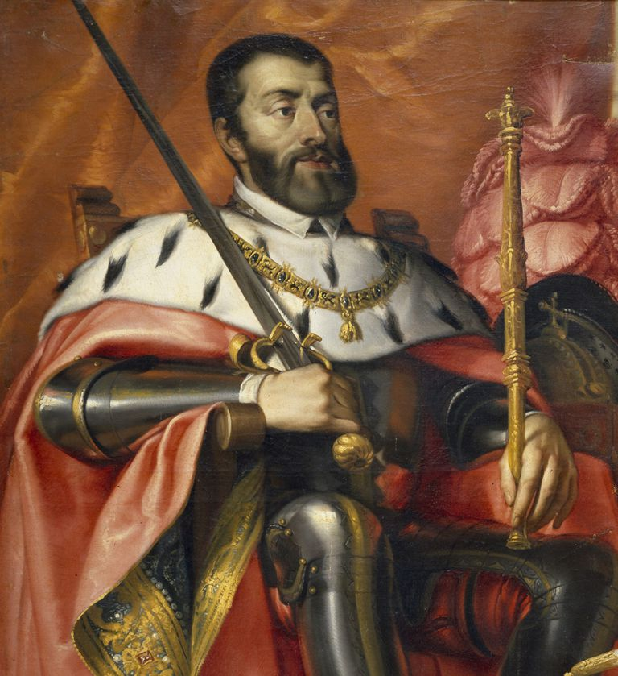
“. . . forced at last to grant toleration to the doctrines which it had been the ambition of his life to destroy. He had staked his kingdom, his treasures, and life itself upon the crushing out of the heresy. Now he saw his armies wasted by battle, his treasuries drained, his many kingdoms threatened by revolt, while everywhere the faith which he had vainly endeavored to suppress, was extending. Charles V had been battling against omnipotent power. God had said, "Let there be light," but the emperor had sought to keep the darkness unbroken. His purposes had failed; and in premature old age, worn out with the long struggle, he abdicated the throne and buried himself in a cloister. ”—Great Controversy, Ellen White, p. 211

Slide 28
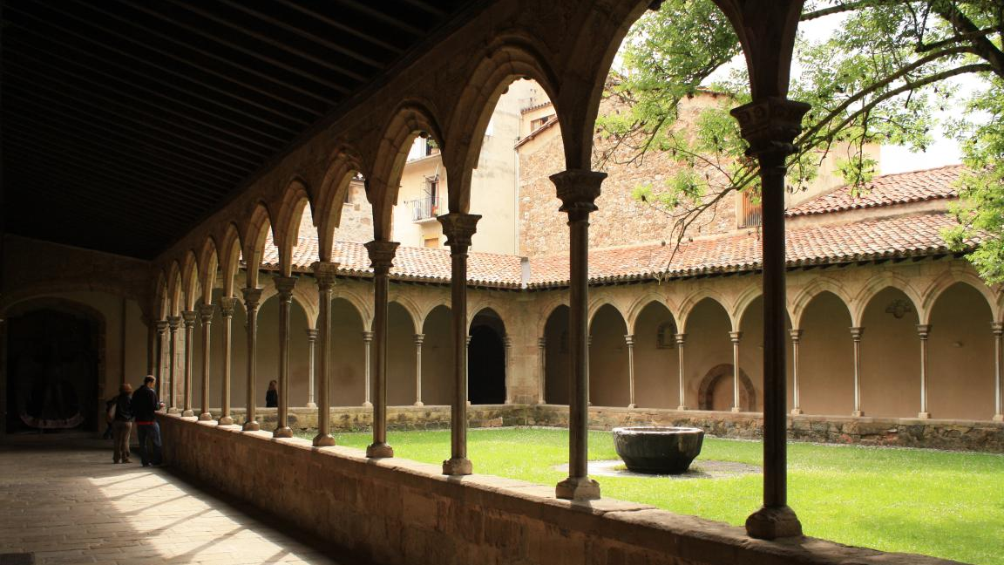
AFTER A WASTED LIFE AND RULE< CHARLES V SPENT HIS LAST YEARS IN SELF-EXHILE VIA A CLOISTER (remote convent of sorts)

Slide 29
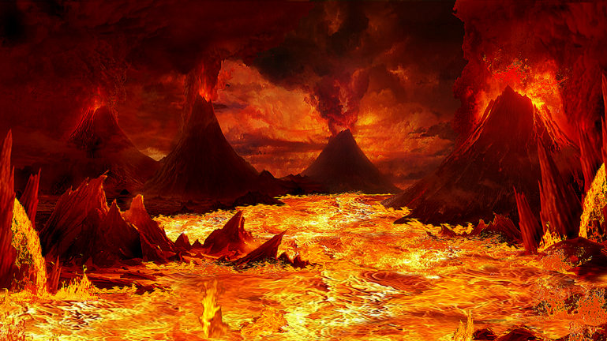
Don’t Be Deceived! This is where Catholicism leads souls! We must follow God’s Word, which is to be our only authority! God calls us into His truth: “Come out of her, my people, that ye be not partakers of her sins, and that ye receive not of her plagues” (Rev. 18:4)—those who do not reject the light are lost! “And with all deceivableness of unrighteousness in them that perish; because they received not the love of the truth, that they might be saved.” (2 Thess. 2:10)

Slide 30
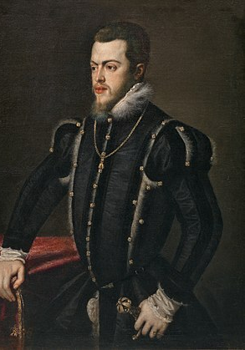
Phillip II of Spain (reign 1556-1598):
-son of Charles V
-Devout Catholic, opposed to Protestant Reformation
-Member of Catholic League
-inherited debt of Charles V, due to relentless wars waged by father
“Charles V had left his son Philip with a debt of about 36 million ducats and an annual deficit of 1 million ducats.”—Wikipedia.com, “Phillip II of Spain”

Slide 31
SOME “ALLY”!!!
Urged on by Catholics, Charles V was crushed by Debts (Apparently, the Roman Catholic way of maintaining control over powerful allies…)

Slide 32
The Reformation had lit up the Darkness through God’s power! It would never be put out! Though apparently ‘defeated’ and backslidden today, the Protestant Reformation will triumph to the end by Christ’s strength and guiding! We must take an active role in finishing the Reformation!!

Slide 33
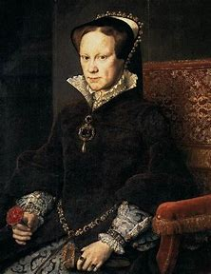
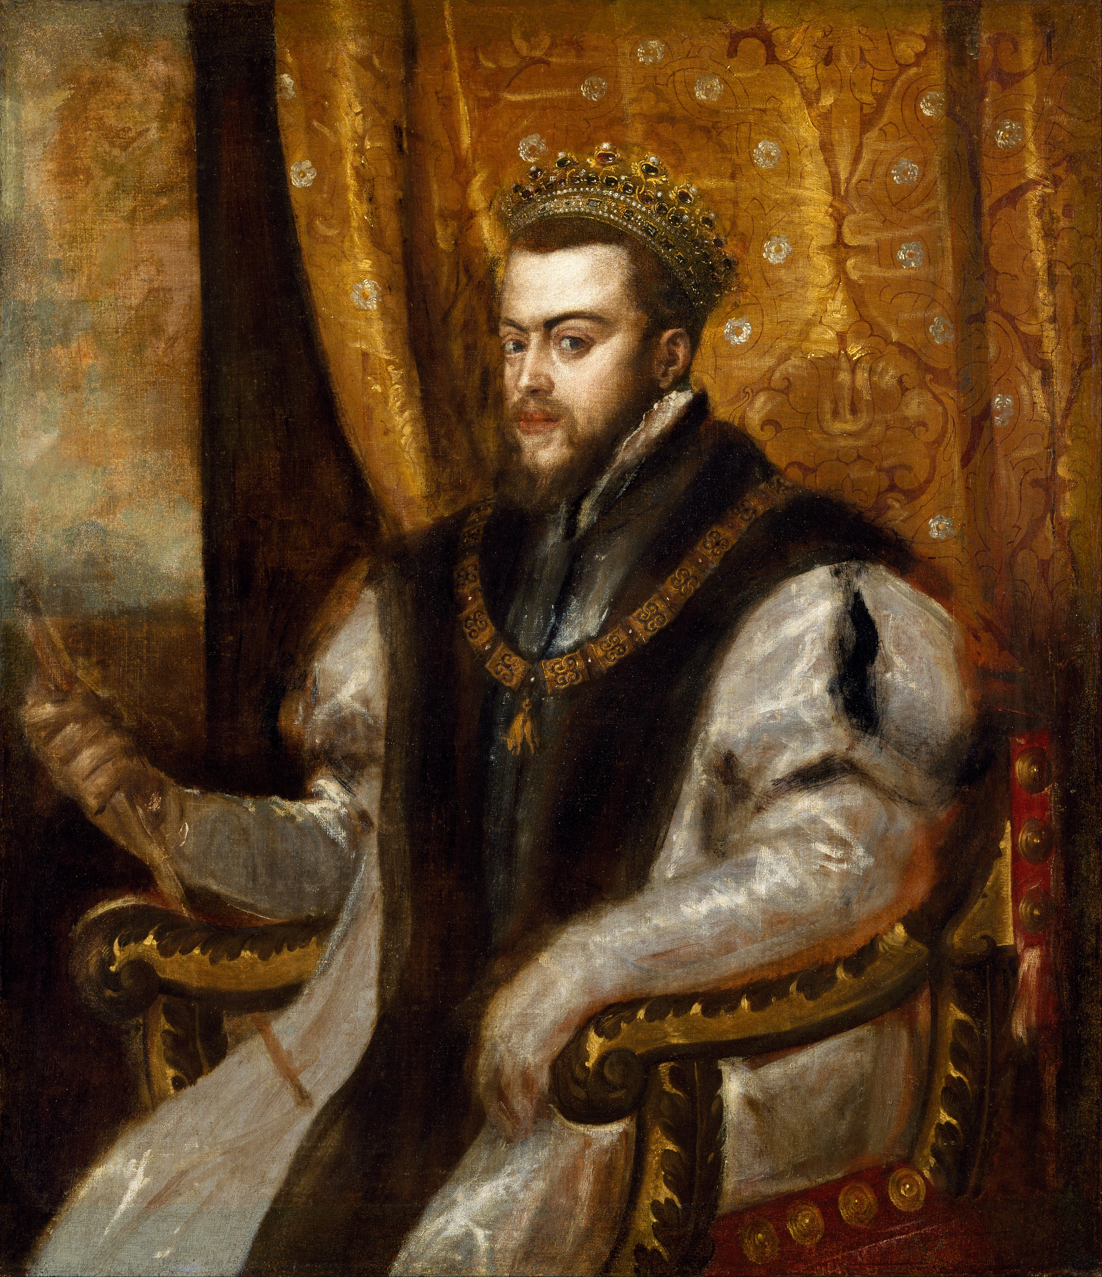
Mary I “Tudor” of England (Catholic), daughter of Catherine, became Queen after Edward VI’s (Protestant) early death

Slide 34
Mary I (reign 1553-1558):
-Persecuted and murdered Protestants, giving her the nickname ‘Bloody Mary’
-sought to return England to the Roman Catholic faith
-Opponent of Reformer John Knox
-Died of uterine cancer in 1558
-Failed to stamp out Protestantism in England, failed to return England to Rome, failed to birth an heir, thus her throne was succeeded by Elizabeth I (Protestant)

Slide 35
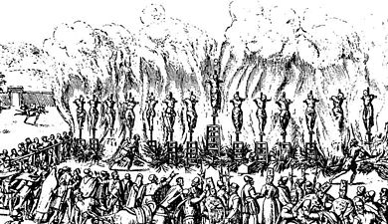
Protestant Persecution in Full Effect under Philip II and Mary I, the picture below is 1559 Auto-da-fe of Valladolid, Spain where 14 Protestants were burned at the stake!

Slide 36
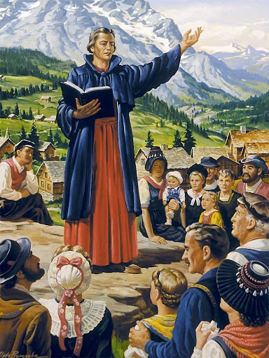
Illegal to preach, teach, read the Bible???
“No one shall print, write, copy, keep, conceal, sell, buy or give in churches, streets, or other places, any book or writing made by Martin Luther, John Calvin, or other heretics reprobated by the Holy Church . . . nor in house hold illegal gatherings . . . Moreover, we forbid all lay persons to converse or dispute concerning the Holy Scriptures, openly or secretly, or to read, teach or expound the Scriptures”—Vatican Assassins, Eric Jon Phelps, p. 106, quoted from: The Rise of the Dutch Republic vol. 1, John Lothrop Motley, 1879, p. 261, 262

Slide 37
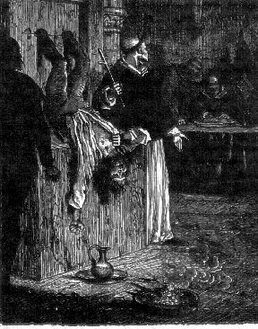
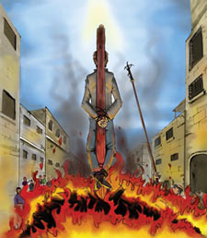
Killed For Believing God’s Word…
“or to preach secretly or openly . . . on pain . . . to be punished in the following manner. That such . . . are to be executed, to wit: the men with the sword and the women to be buried alive, if they do not persist in their errors; if they do persist in them, then they are to be executed with fire; all their property in both cases being confiscated to the crown.”—Vatican Assassins, Eric Jon Phelps, p. 106, quoted from: The Rise of the Dutch Republic vol. 1, John Lothrop Motley, 1879, p. 261, 262
“In the Second half of the sixteenth century the Spanish armies occupied Holland and Flanders and the glare of the Inquisition’s auto-da-fe lit up the market squares of the cities great and small.”—Vatican Assassins, Eric Jon Phelps, p. 106, quoted from: Days of Our Years, Pierre van Paassen, 1939, p. 389

Slide 38
Roman Catholic Logic:
Murdering People for Believing God’s Word Over Tradition = “Act of Faith” (Auto-de-fe)
“After a long vigil in prayer, the silent man with the cruel eyes in the Escorial [Philip II of Spain] he decreed the extermination of the new religion in the Netherlands. In less than a decade there perished by his will in the torture chambers, on the gallows and on the pyres two hundred and fifty thousand men and women of the Dutch race. Nobles and burglars, old and young, rich and poor, all were dragged from their homes, frequently on secret denunciation, to face the Grand Inquisitor—the monk Titelman—and his helpers, who knew no mercy”—Vatican Assassins, Eric Jon Phelps, p. 106, quoted from: Days of Our Years, Pierre van Paassen, 1939, p. 389

Slide 39
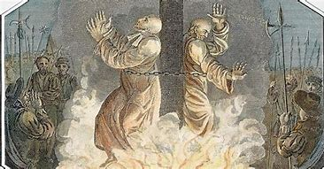
Do Not Forget Our Fallen Brethren! Remember that in the Last Days, many again will be called to lay down their lives for what they believe! We must use the time we have to prepare for that immanent reality!

Slide 40
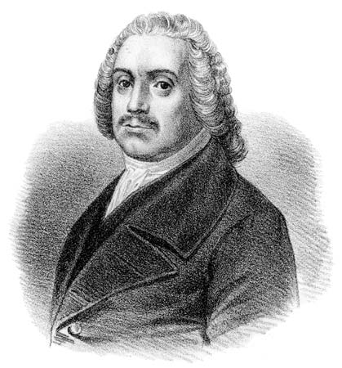
Roger Williams (1603-1683):
-Became a Puritan Minister, being a major critic of the Church of England’s persistence in holding onto Catholic ceremony and doctrines
-Taught liberty of conscience, separation of church and state, and separatism (to separate from Church of England which he believed was irredeemably corrupt)
-Was banned from the Massachusetts Bay Colony for his doctrines and being critical of English leadership and royalty
-Founding father of the Rhode Island Colony, and thus a founding father of the later United States

Slide 41
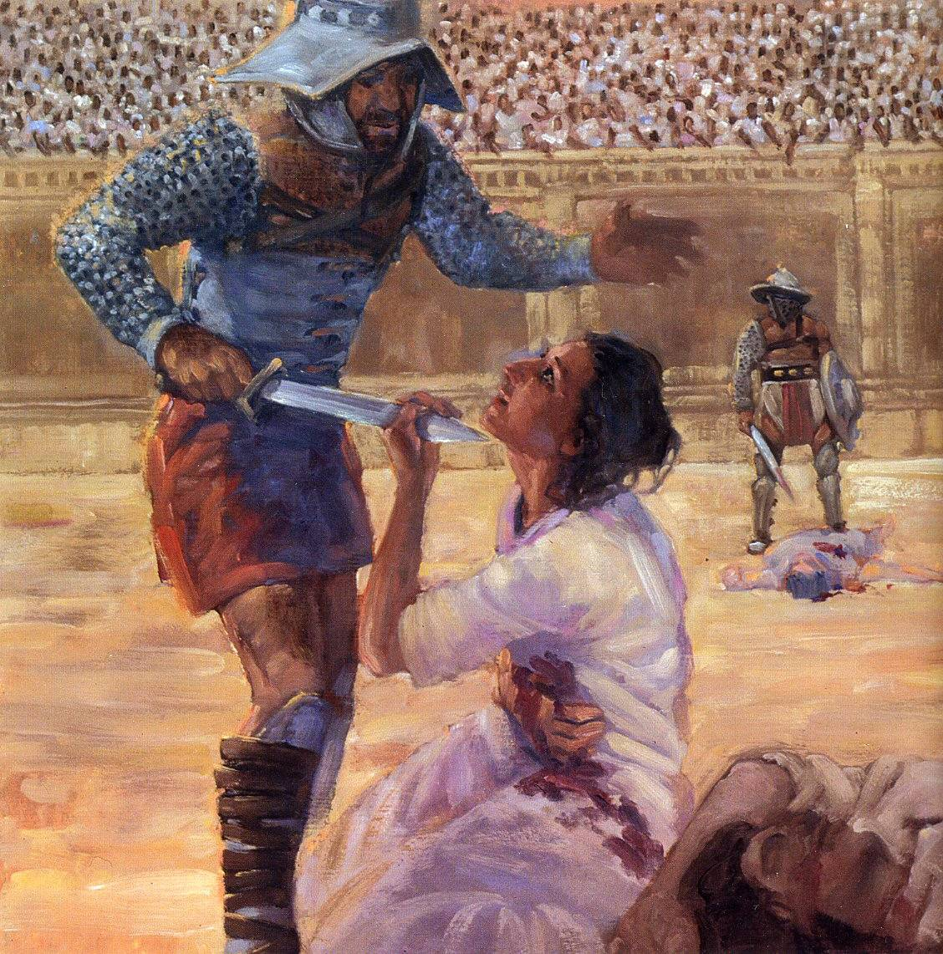
Don’t Forget the Martyrs, Let their courage be your strength! God can give us this strength also! Their Deaths Have Saved Souls!!
And fear not them which kill the body, but are not able to kill the soul: but rather fear him which is able to destroy both soul and body in hell (Matthew 10:28)

Slide 43
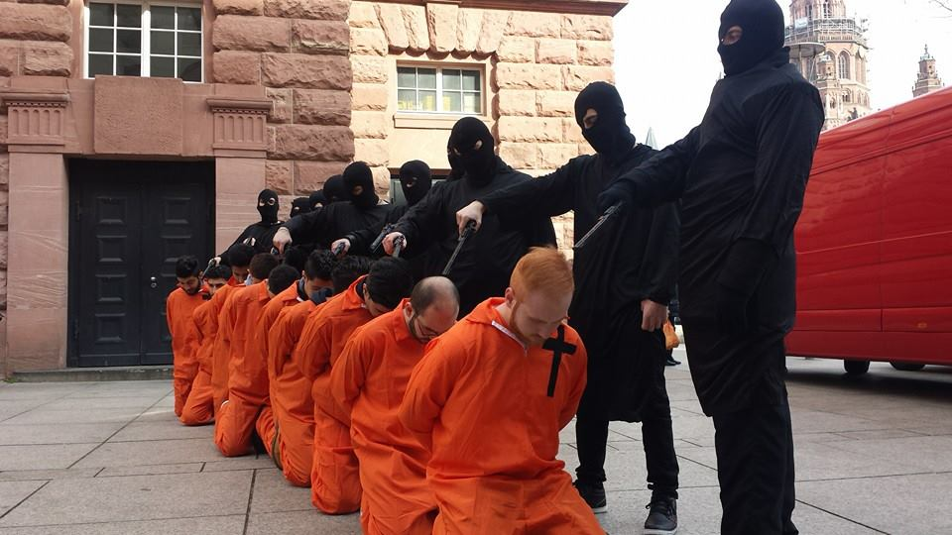
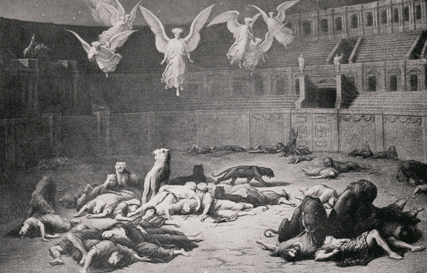
God grant us the courage to be willing, in the face of torture and death, to lay down our lives, if necessary, for the glory of your kingdom and name!
“Then shall they deliver you up to be afflicted, and shall kill you: and ye shall be hated of all nations for my name's sake.” (Matthew 245:9)

Slide 44
History is clear, everywhere the Spanish went, they desolated the natives, enslaved them, stole their valuables, and dismantled their societies… De Soto in Florida, Columbus in West Indies, Cortez in Central America—simply put: they became rich via theft!

Slide 47
Most of the Spanish Armada was destroyed by a massive freak storm which desolated over 1/3 of the Armada, damaging many more. The remaining ships which could
do battle, were outmaneuvered by Francis Drake’s smaller schooners, which won the conflict.
Sir Francis Drake (1540-1596)
Catholic Spain’s Armada defeated by Protestant England’s fleet in 1588

Slide 49
Through God’s Providence, the Spanish Armada was defeated even before engaging the English Fleet!
“He delivereth me from mine enemies: yea, thou liftest me up above those that rise up against me: thou hast delivered me from the violent man” (Psalm 18:48)

Slide 50
The Annals of History may have been written much differently had not Protestant England defeated Catholic Spain in 1588! Causing the decline of Spanish Colonial Expansion and the consequential rise of English Colonial Expansion…
As Protestant England expanded after the decline of Spain, it paved the way for Protestant settlers to settle in the New World, far from the persecutions of Europe; guiding principles like Protestantism, liberty of conscience, freedom of religion, separation of church and state, liberties, property ownership, etc. became hallmark identifiers of American Colonial life—ideas which laid the foundation for the creation of the Declaration of Independence, Constitution, with it’s Bill of Rights

Slide 51
“Thou preparest a table before me in the presence of mine enemies: thou anointest my head with oil; my cup runneth over.” (Psalm 23:5)

Slide 52
“In that vast throng are multitudes of the long-lived race that existed before the Flood; men of lofty stature and giant intellect, who, yielding to the control of fallen angels, devoted all their skill and knowledge to the exaltation of themselves . . . There are kings and generals who conquered nations, valiant men who never lost a battle, proud, ambitious warriors whose approach made kingdoms tremble. In death these experienced no change. As they come up from the grave, they resume the current of their thoughts just where it ceased.”—Great Controversy, Ellen White, p. 664

Slide 53
“Satan consults with his angels, and then with these kings and conquerors and mighty men. They look upon the strength and numbers on their side, and declare that the army within the city is small in comparison with theirs, and that it can be overcome. They lay their plans to take possession of the riches and glory of the New Jerusalem. . . Kings and warriors are in his train, and the multitudes follow in vast companies, each under its appointed leader. With military precision the serried ranks advance over the earth's broken and uneven surface to the City of God.”—Great Controversy, Ellen White, p. 664

Slide 54
No Middle Ground!
Will We Side With God or Will We Be a Part of the Attack Force on the New Jerusalem???

Slide 55
“Seek ye the Lord while he may be found, call ye upon him while he is near” (Isaiah 55:6)

Slide 56
“Seek ye the Lord while he may be found, call ye upon him while he is near” (Isaiah 55:6)

