Slide 1
‘Woman of Ill Repute’
Amazing Grace, pt. 9

Slide 2

Hall of Fame or Hall of Shame?
She definitely came from the wrong side of the tracks. She definitely would not be considered to be in the high classes of society. However, because of God’s amazing grace, this woman went from the Hall of Shame to the Hall of Fame!

Slide 3

Elevated By God’s Amazing Grace!
In the genealogy of Christ, recorded in Matthew 1, she is one of 5 women mentioned. In the great Hall of Faith, recorded in Hebrews chapter 11, she is one of two women mentioned among the giants of Scripture!

Slide 4
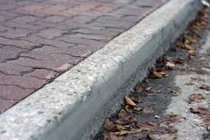
Lowly, Filthy Beginnings
Her life was a dead-end street. She was going deeply into a pit fast, feeling more and more everyday that she was worth nothing and that life was solely about getting what one wanted regardless of who you had to knock over to get there. She was in a dog eat dog world!

Slide 5

Her introduction into Scripture
“And Joshua the son of Nun sent out of Shittim two men to spy secretly, saying, Go view the land, even Jericho. And they went, and came into an harlot's house, named Rahab, and lodged there.” Josh. 2:1
If the spies had a chance of not being detected, it would be at a whore house where men would be going to and fro!

Slide 6
She Had Heard Strange News!
Unbeknownst to the spies, Rahab had heard stories as a little girl, 40 years before, of the Amazing God of the Hebrews who had dried the water of the Red Sea! That came back to her mind when she heard of the slaughter of Sihon and Og, who were just recently wiped out by the same mysterious God of the Universe! These 2 kings were powerful chieftains; unstoppable to everyone but the Hebrews God! The story of long ago rekindled hope again!

Slide 7
Her Response to the King of Jericho
She would protest the followers of the Hebrew’s God at all costs to herself! “And it was told the king of Jericho, saying, Behold, there came men in hither to night of the children of Israel to search out the country. And the king of Jericho sent unto Rahab, saying, Bring forth the men that are come to thee, which are entered into thine house: for they be come to search out all the country. And the woman took the two men, and hid them, and said thus, There came men unto me, but I wist not whence they were: And it came to pass about the time of shutting of the gate, when it was dark, that the men went out: whither the men went I wot not: pursue after them quickly; for ye shall overtake them. But she had brought them up to the roof of the house, and hid them with the stalks of flax, which she had laid in order upon the roof. And the men pursued after them the way to Jordan unto the fords: and as soon as they which pursued after them were gone out, they shut the gate.” Joshua 2: 2-7

Slide 8

She Lied to Protect Them!
Growing up in gross heathenism, Rahab knew no other law than to lie to protect herself or her family/friends. God doesn’t hold us accountable to a standard we don’t know,; only to a standard we do know! “Forasmuch then as we are the offspring of God, we ought not to think that the Godhead is like unto gold, or silver, or stone, graven by art and man's device.
And the times of this ignorance God winked at; but now commandeth all men every where to repent: Because he hath appointed a day, in the which he will judge the world in righteousness by that man whom he hath ordained;” Acts 17:29-31

Slide 9
Confesses Her Faith
“And she said unto the men, I know that the LORD hath given you the land, and that your terror is fallen upon us, and that all the inhabitants of the land faint because of you. For we have heard how the LORD dried up the water of the Red sea for you, when ye came out of Egypt; and what ye did unto the two kings of the Amorites, that were on the other side Jordan, Sihon and Og, whom ye utterly destroyed. And as soon as we had heard these things, our hearts did melt, neither did there remain any more courage in any man, because of you: for the LORD your God, he is God in heaven above, and in earth beneath.” Joshua 2:9-11

Slide 10
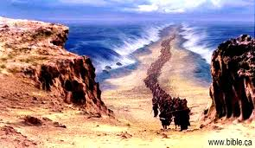
She Remembered the Story 40 Years Before!
She still remembered! An event 40 years before , that was rekindled by the defeat of Sihon and Og, brought Rahab to this great testimony of faith! There is no God like the God of Heaven and earth! I want to walk with Him too!

Slide 11

The Israelites were….Terrorists
With the Lord leading the way, the Israelites were terrorizing the people of the land. The inhabitants were beside themselves with fear to deal with the Hebrew God! Oh, that we would walk so near the Lord today that people would fear our God and us!

Slide 12
Mercy Pleads
“The inhabitants of Canaan had been granted ample opportunity for repentance. Forty years before, the opening of the Red Sea and the judgments upon Egypt had testified to the supreme power of the God of Israel. And now the overthrow of the kings of Midian, of Gilead and Bashan, had further shown that Jehovah was above all gods. The holiness of His character and His abhorrence of impurity had been evinced in the judgments visited upon Israel for their participation in the abominable rites of Baalpeor. All these events were known to the inhabitants of Jericho, and there were many who shared Rahab's conviction, though they refused to obey it, that Jehovah, the God of Israel, "is God in heaven above, and upon the earth beneath." Like the men before the Flood, the Canaanites lived only to blaspheme Heaven and defile the earth. And both love and justice demanded the prompt execution of these rebels against God and foes to man.” PP, pg. 492

Slide 13
The Agreement
“ Now therefore, I pray you, swear unto me by the LORD, since I have shewed you kindness, that ye will also shew kindness unto my father's house, and give me a true token: And that ye will save alive my father, and my mother, and my brethren, and my sisters, and all that they have, and deliver our lives from death. And the men answered her, Our life for yours, if ye utter not this our business. And it shall be, when the LORD hath given us the land, that we will deal kindly and truly with thee. Then she let them down by a cord through the window: for her house was upon the town wall, and she dwelt upon the wall. And she said unto them, Get you to the mountain, lest the pursuers meet you; and hide yourselves there three days, until the pursuers be returned: and afterward may ye go your way.” Joshua 2:12-16

Slide 14
Compact
“ And the men said unto her, We will be blameless of this thine oath which thou hast made us swear. Behold, when we come into the land, thou shalt bind this line of scarlet thread in the window which thou didst let us down by: and thou shalt bring thy father, and thy mother, and thy brethren, and all thy father's household, home unto thee. And it shall be, that whosoever shall go out of the doors of thy house into the street, his blood shall be upon his head, and we will be guiltless: and whosoever shall be with thee in the house, his blood shall be on our head, if any hand be upon him. And if thou utter this our business, then we will be quit of thine oath which thou hast made us to swear. And she said, According unto your words, so be it. And she sent them away, and they departed: and she bound the scarlet line in the window.” Joshua 2:17-21

Slide 15
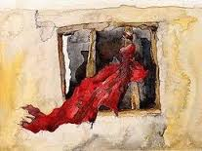
Scarlet Sign!
The scarlet cord was the silent testimony of a woman of faith that lived in Jericho. This would be a mute testimony that the living God reigned in her heart and that she was His! This was the blood on the doorpost; this was Samson’s long hair; this is the 4th commandment sign of ownership!

Slide 16
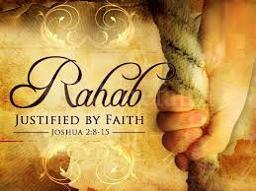
Woman of Honor
Rahab’s shining faith in the Hebrew God; the Lord’s amazing grace that reached out to her and transformed her, shone throughout Bible history. She married into the tribe of Judah, and the Bible declares, “And Salmon begat Booz of Rachab; and Booz begat Obed of Ruth; and Obed begat Jesse;” Matthew 1:5

Slide 17

Amazing Grace!
Rahab is part of the lineage of the Messiah of Israel! She is the mother of Boaz; the great, great Grandmother of David, and one of five wise women mentioned in Matthew 1! From whore to wholesome; from prostitute to purity; the results of God’s Amazing Grace!

Slide 18
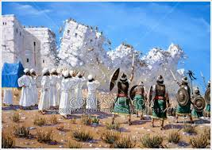
The Great Hall of Faith
“By faith the walls of Jericho fell down, after they were compassed about seven days. By faith the harlot Rahab perished not with them that believed not, when she had received the spies with peace.” Hebrews 11:30,31

Slide 19
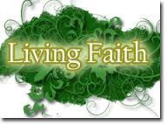
Justified by Amazing Grace!
“Ye see then how that by works a man is justified, and not by faith only. Likewise also was not Rahab the harlot justified by works, when she had received the messengers, and had sent them out another way? For as the body without the spirit is dead, so faith without works is dead also.” James 2:24-26 Rahab’s faith was seen in her actions!

