Slide 1
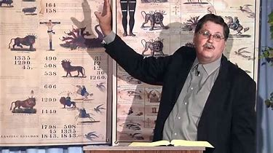
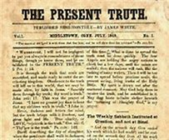
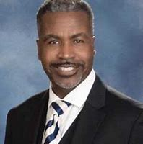
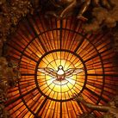
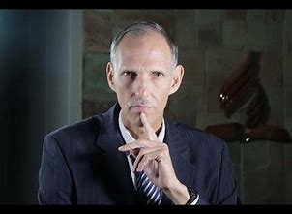
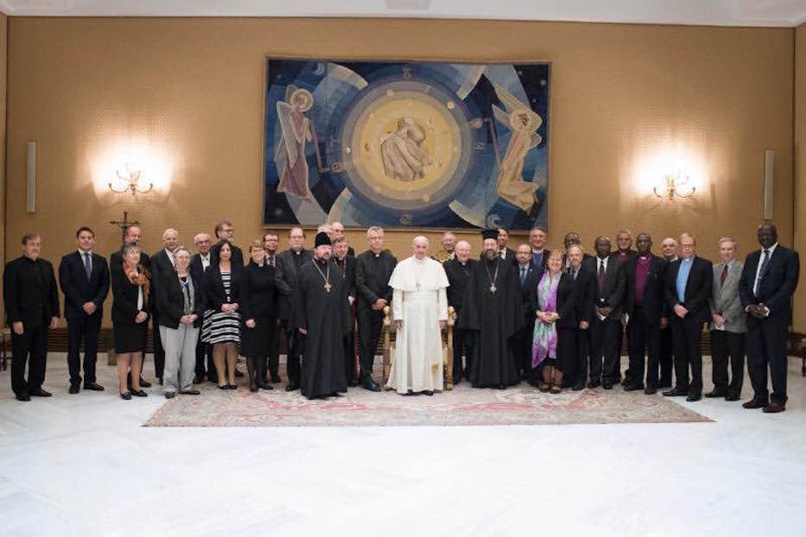
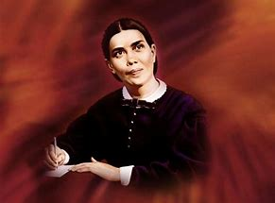
“Present Truth”
What is it Really?

Slide 2
Who’s Right???
Arthur Branner and David Gates: “understanding the sequence of events” (Arthur Branner, Part 3. Prophecy Science and the New World Order 14-15:20)---prophetic time-setting revealed to himself and few select others alone and not seen in plain Scripture or SOP
Jeff Pippenger: “We never saw the significance of these charts until after 2001. . . I never saw the 2520…” promoting the 2520 and association of the seals with September 11 (Jeff Pippenger, Waynesboro Va Dec 9 2017 pt 5 20-20:45)
Ted Wilson and the Conference majority: Go to sleep…. Everything is just fine…
Ellen White: ???

Slide 3
Ted Wilson Speaks About Sunday Laws
President Wilson Statement Sabah Adventist News & network (SANN)

Slide 4
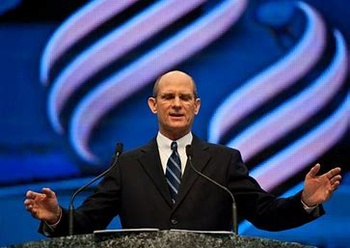
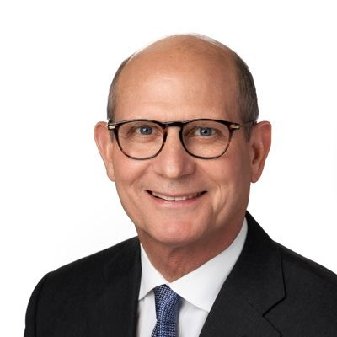
By Their Words Ye Shall Know Them?
Ted Wilson’s Words: study the Bible and SOP, spread the 3 angel’s messages, trust in the righteousness of Christ…
“A Message from Ted Wilson, Present Truth”
7Lamps Ministries

Slide 5
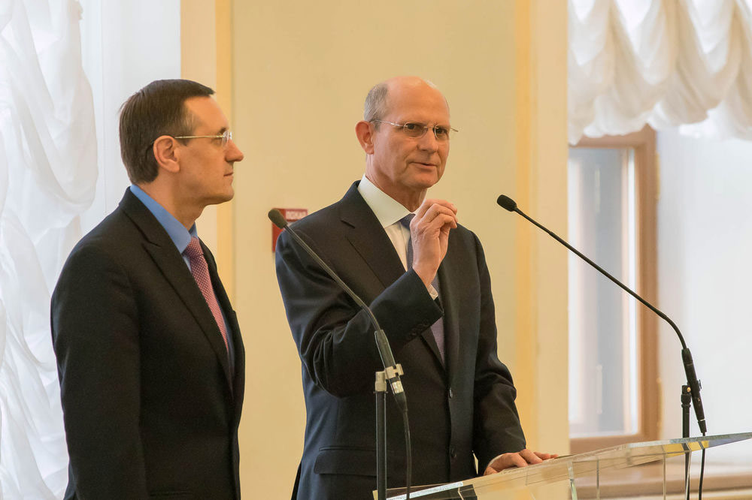
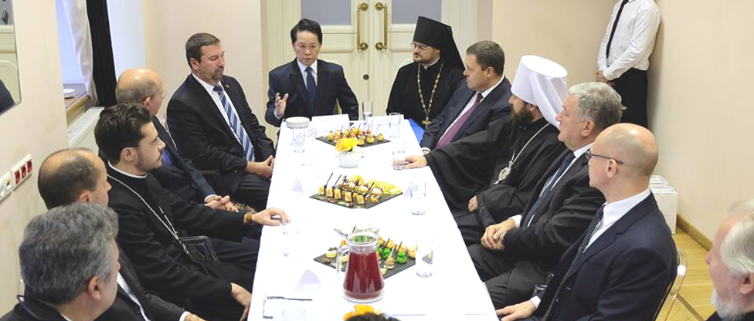
Ted Wilsons actions: Attended Ecumenical Meetings in Moscow, Tells the church members to not look for Sunday Laws, Creates the “Great Hope”—an ecumenical Great Controversy for an ecumenical church

Slide 6
“Be ye not unequally yoked together with unbelievers: for what fellowship hath righteousness with unrighteousness? and what communion hath light with darkness?” 2 Cor. 6:14
Is. 29:13 “Wherefore the Lord said, Forasmuch as this people draw near me with their mouth, and with their lips do honour me, but have removed their heart far from me, and their fear toward me is taught by the precept of men”
Guard Against Those Who Claim Sole Possession of “Present Truth”

Slide 7
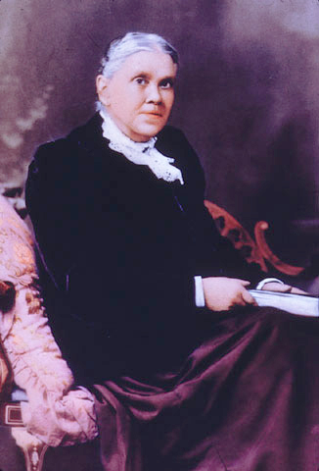
Let the Prophetess Speak!
"God has a church. It is not the great cathedral, neither is it the national establishment, neither is it the various denominations; it is the people who love God and keep His commandments. "Where two or three are gathered together in my name, there am I in the midst of them" (Matthew 18:20). Where Christ is even among the humble few, this is Christ's church, for the presence of the High and Holy One who inhabiteth eternity can alone constitute a church. “--Upward Look 315

Slide 8
Ok then, What is Present Truth?
3T, p. 448 “I was shown that the only safe position for Brother B is to sit at the feet of Jesus and learn the way of life more perfectly. His doctrine shall drop as the rain, and His speech shall distill as the dew, upon the heart of the humble and teachable. Brother B must obtain a teachable disposition. He is not to sit as a judge, but as a learner; not to cavil, but to believe; not to question and find fault and oppose, but to listen. Pride must give way to humility, and prejudice must be exchanged for candor, or the gracious words of Christ will be in vain to him. My brother, you may reason with your blind judgment and unsanctified mind until the day of God and not advance a step toward heaven; you may debate and investigate and search learned authors, and even the Scriptures, and yet grow more and more self-deceived, and become darker and darker, as did the Jews in reference to Christ. What was their fault? They rejected the light which God had already given them and were seeking for some new light by which they might so interpret the Scriptures as to sustain their actions.

Slide 9
You are doing the same; you pass over the light that God has seen fit to give you in the publications upon present truth and in His word, and are seeking doctrines of your own, theories which cannot be sustained by the word of God. When you become as a little child, willing to be led, and when your understanding is sanctified and your will and prejudices surrendered, such a light will be shed abroad in your heart as will illumine the Scriptures and show you present truth in its beautiful harmony. It will appear like a golden chain, link joined to link in a perfect whole. “Except ye be converted, and become as little children, ye shall not enter into the kingdom of heaven.” “Learn of Me,” says Christ; “for I am meek and lowly in heart: and ye shall find rest unto your souls.” If you have indeed entered the school of Christ, He expects you to manifest in your character and deportment the lowliness which is so beautifully exemplified in His character. Christ will not undertake to teach the self-righteous, self-conceited, and self-willed. If such come to Him with the inquiry, What is truth? He gives them no answer. It is only the meek that He will guide in judgment; the meek will He teach His way.”

Slide 10
In Other Words…
STAY AWAY FROM “NEW LIGHT” PREACHERS!!!
AND FROM THOSE WHO SEEK TO BRUSH THE “OLD PATHS” TO THE SIDE!!!

Slide 11
Don’t Make the Same Mistakes as Ancient Israel
Jer. 8:3-9 “And death shall be chosen rather than life by all the residue of them that remain of this evil family, which remain in all the places whither I have driven them, saith the LORD of hosts. Moreover thou shalt say unto them, Thus saith the LORD; Shall they fall, and not arise? shall he turn away, and not return? Why then is this people of Jerusalem slidden back by a perpetual backsliding? they hold fast deceit, they refuse to return. I hearkened and heard, but they spake not aright: no man repented him of his wickedness, saying, What have I done? every one turned to his course, as the horse rusheth into the battle. Yea, the stork in the heaven knoweth her appointed times; and the turtle and the crane and the swallow observe the time of their coming; but my people know not the judgment of the LORD. How do ye say, We are wise, and the law of the LORD is with us? Lo, certainly in vain made he it; the pen of the scribes is in vain. The wise men are ashamed, they are dismayed and taken: lo, they have rejected the word of the LORD; and what wisdom is in them?"

Slide 12
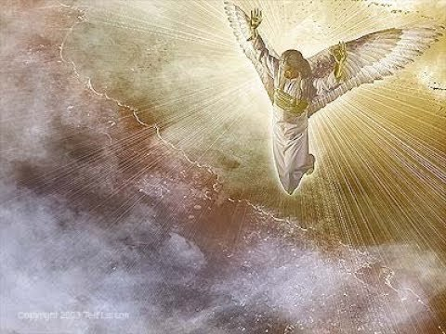
Getting Closer…
“I inquire of those in responsible positions in Battle Creek, What are you doing? You have turned your back, and not your face, to the Lord. There needs to be a cleansing of the heart, the feelings, the sympathies, the words, in reference to the most momentous subjects--the Lord God, eternity, truth. What is the message to be given at this time? It is the third angel's message. But that light which is to fill the whole earth with its glory has been despised by some who claim to believe the present truth. Be careful how you treat it. Take off the shoes off your feet; for you are on holy ground. Beware how you indulge the attributes of Satan, and pour contempt upon the manifestation of the Holy Spirit. I know not but some have even now gone too far to return and to repent.” Testimonies to Ministers and Gospel Workers 89

Slide 13
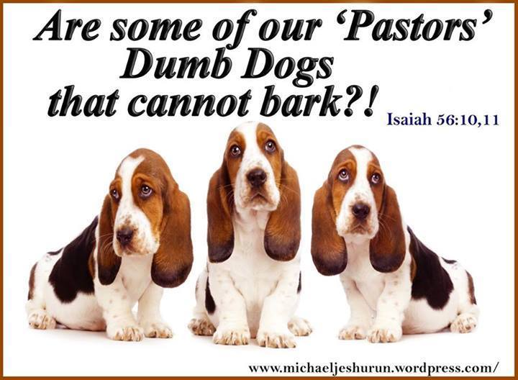
Rev. 18:1-4 “And after these things I saw another angel come down from heaven, having great power; and the earth was lightened with his glory. And he cried mightily with a strong voice, saying, Babylon the great is fallen, is fallen, and is become the habitation of devils, and the hold of every foul spirit, and a cage of every unclean and hateful bird. For all nations have drunk of the wine of the wrath of her fornication, and the kings of the earth have committed fornication with her, and the merchants of the earth are waxed rich through the abundance of her delicacies. And I heard another voice from heaven, saying, Come out of her, my people, that ye be not partakers of her sins, and that ye receive not of her plagues.”

Slide 14
The 3rd Angel’s Message is Present Truth, and is Our ONLY Job!
Rev. 14:9-12 “And the third angel followed them, saying with a loud voice, If any man worship the beast and his image, and receive his mark in his forehead, or in his hand, The same shall drink of the wine of the wrath of God, which is poured out without mixture into the cup of his indignation; and he shall be tormented with fire and brimstone in the presence of the holy angels, and in the presence of the Lamb: And the smoke of their torment ascendeth up for ever and ever: and they have no rest day nor night, who worship the beast and his image, and whosoever receiveth the mark of his name. Here is the patience of the saints: here are they that keep the commandments of God, and the faith of Jesus.”

Slide 15
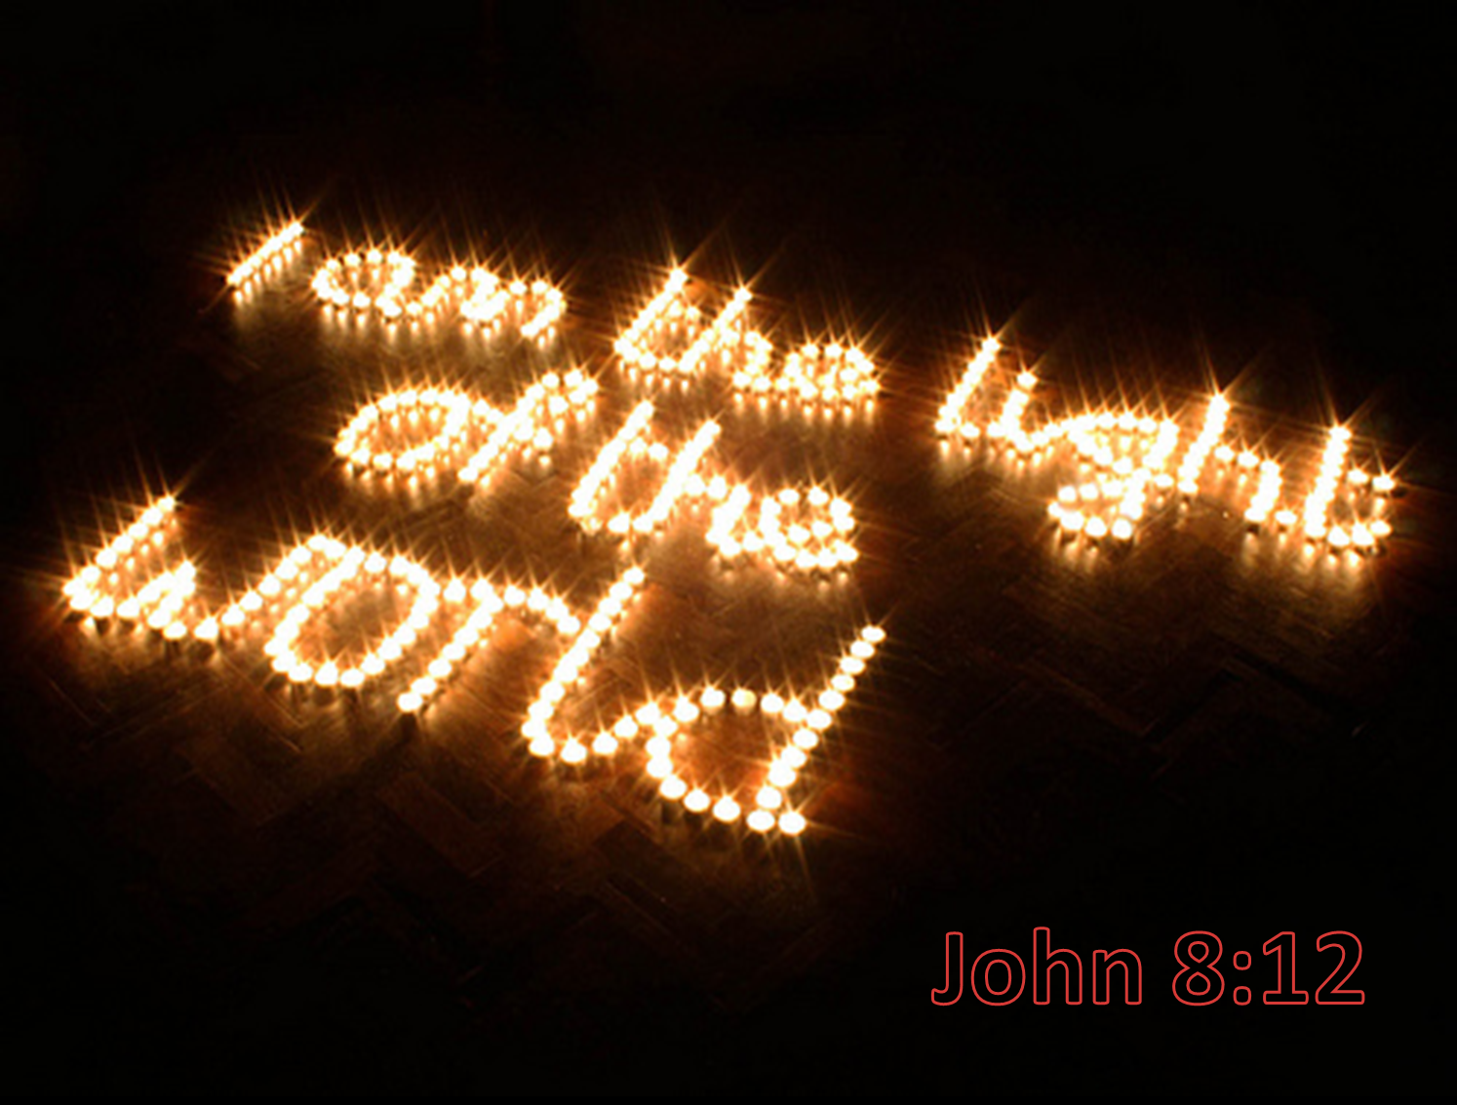
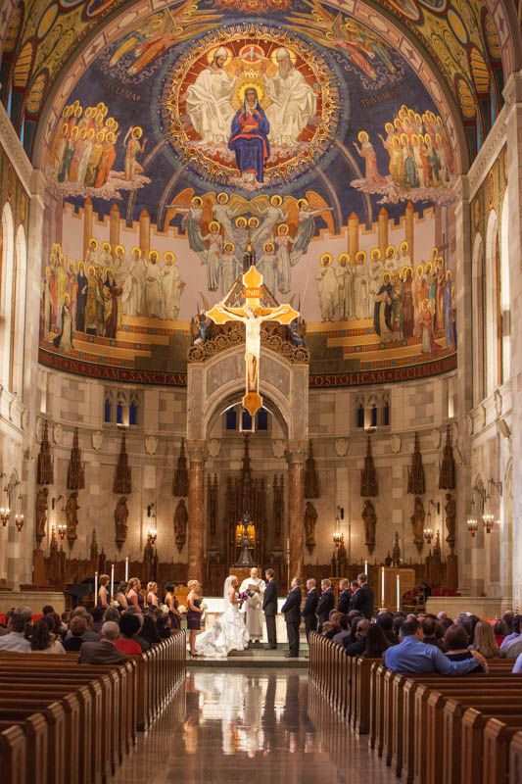
"Not by seeking a holy mountain or a sacred temple are men brought into communion with heaven. Religion is not to be confined to external forms and ceremonies. The religion that comes from God is the only religion that will lead to God. In order to serve Him aright, we must be born of the divine Spirit. This will purify the heart and renew the mind, giving us a new capacity for knowing and loving God. It will give us a willing obedience to all His requirements. This is true worship. It is the fruit of the working of the Holy Spirit. By the Spirit every sincere prayer is indited, and such prayer is acceptable to God. Wherever a soul reaches out after God, there the Spirit's working is manifest, and God will reveal Himself to that soul. For such worshipers He is seeking. He waits to receive them, and to make them His sons and daughters.“—DA, 189

Slide 16
Early Writings Explains…
Not all who proclaimed the first and the second angel's message are to give the third, even after they fully embrace it, for some have been in so many errors and delusions that they can but just save their own souls, and if they undertake to guide others, they will be the means of overthrowing them. But I saw that some who have formerly run deep into fanaticism would be the first now to run before God sends them, before they are purified from their past errors; having error mixed with the truth, they would feed the flock of God with it, and if they were suffered to go on, the flock would become sickly, and distraction and death would follow. I saw that they would have to be sifted and sifted, until they were freed from all their errors, or they could never enter the kingdom. The messengers could not have that confidence in the judgment and discernment of those who have been in errors and fanaticism that they could have in those who have been in the truth and not in extravagant errors.

Slide 17
Many, also, are too apt to urge out into the field some who have but just professed the present truth, who have much to learn and much to do before they can be right in the sight of God themselves, much less point out the way to others. I saw the necessity of the messengers, especially, watching and checking all fanaticism wherever they might see it rise. Satan is pressing in on every side, and unless we watch for him, and have our eyes open to his devices and snares, and have on the whole armor of God, the fiery darts of the wicked will hit us. There are many precious truths contained in the Word of God, but it is “present truth” that the flock needs now. I have seen the danger of the messengers running off from the important points of present truth, to dwell upon subjects that are not calculated to unite the flock and sanctify the soul. Satan will here take every possible advantage to injure the cause. But such subjects as the sanctuary, in connection with the 2300 days, the commandments of God and the faith of Jesus, are perfectly calculated to explain the past Advent movement and show what our present position is, establish the faith of the doubting, and give certainty to the glorious future. These, I have frequently seen, were the principal subjects on which the messengers should dwell.”—EW, 62,63

Slide 18
The work of keeping before the people the common things transpiring around us, the news of the day, is not the work of present truth. Our work is to fill every page of printed matter with spiritual food. What is the chaff to the wheat? All these common things are very cheap, and often are but stale food to those who are starving for the heavenly manna. We are living in an important period of this world's history. A great work is to be done in a short time. I feel an overwhelming sense of the condition of our world.... We are standing in a time that is of the greatest consequence to the whole world. We see the necessity of understanding the instruction given in the Scriptures. The religious life is not to be represented from the pulpit or in our papers as a romance. It pains my soul to see in the papers coming from our press, the most important truth placed before the people in the form of a romance. Let the articles in our papers at this time, when the eternal interests of souls are at stake, be of a character to arouse souls to a sense of their peril. At this time Bible truth is to make a solemn impression upon hearts. The genuine facts of truth are to be presented as they came from the lips of the greatest teacher the world has ever known—Counsels to Writers and Editors, 21

Slide 19
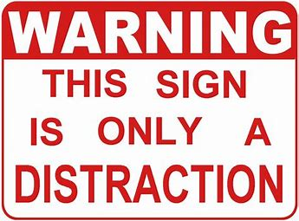
Lastly, Beware of All Distractions!
“To the second chapter of second Timothy we may refer those who are desirous of originating some new and strange thing, which is the product of the human imagination, and as much below the grand and noble sentiments of Holy Writ as the common is below the sacred. We may answer foolish questions by saying, Wait, and we shall all know what is essential for us to know. Our salvation does not depend on side issues”—(Letter 58, 1900)

Slide 20
Present Truth is:
1. Old Truths still important today
2. The 3 Angel’s Messages and Spreading them to the world
3. The Law of God, Judgment, and Faith of Jesus
4. Presenting the world the truth about the Antichrist and calling others out of Babylon! (Dan. and Rev.)
5. The Sanctuary Message in Prophesy, 2300 days, and 1844
Present Truth is NOT:
1. New ‘truths’ or light, or removing old truths
2. Talking about spreading the Gospel but not doing it, or teaching side issues
3. Saying the Law is not binding, all are saved, or that you cannot stop sinning!
4. Not joining the Beast power in ecumenical counsels
5. Never teaching the Heavenly Sanctuary, or 1844 message

