Slide 1
What is the Difference Between Mormons, Jehovah’s Witnesses, and Seventh-day Adventists? pt 23

Slide 2
A Warning From Ellen White
“As the storm approaches, a large class who have professed faith in the third angel's message, but have not been sanctified through obedience to the truth, abandon their position and join the ranks of the opposition. By uniting with the world and partaking of its spirit, they have come to view matters in nearly the same light; and when the test is brought, they are prepared to choose the easy, popular side. Men of talent and pleasing address, who once rejoiced in the truth, employ their powers to deceive and mislead souls. They become the most bitter enemies of their former brethren. When Sabbathkeepers are brought before the courts to answer for their faith, these apostates are the most efficient agents of Satan to misrepresent and accuse them, and by false reports and insinuations to stir up the rulers against them” GC, 608

Slide 3
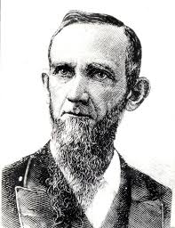
Dudley Canright vs the World
Before we can get into some shared points of concern with Ellen White and her testimonies from God, we have to stop a moment and study the man who was once one of her dearest friends…. Dudley Canright was an Adventist Powerhouse! He is likely the best public speaker, debater, and one of the best evangelists of the pioneer era of Adventism. However, he also became its fiercest opponent. Like Lucifer who was superior in many ways from his brethren angels, Canright was self-deceived by the talents God had entrusted to him. Sadly, his arguments given in “Seventh-day Adventism Renounced” are the same arguments still used today against the prophetic office of Ellen White. We must first examine his meteoric rise and fall to help us understand his argumentation and its merits
Dudley M. Canright (1840-1919)

Slide 4
Synopsis
“Mr. Canright was a Seventh-day Adventist for twenty-eight years and an ordained minister of the church for twenty-two years, serving largely as an evangelist, but filling executive and other positions as well. From the time the 1867 diary jottings reveal in his experience periods of victory and confidence and then recurring periods of doubt bordering on atheism,… The Adventists found him to be a man of strength, but plagued with recurring periods of questioning and discouragement, at times resulting in his laying down his ministerial duties and resorting for a time to agricultural activities.” Carrie Johnson, ‘I Was Canright’s Secretary’, Foreword, p. 5

Slide 5
Dudley Marvin, was born soon after their arrival at Kinderhook, Michigan. The date, September 22, 1840. Father Hiram rejoiced, visualizing a muscular youth helping him in the fields and at some future date taking over the farm. Describing his conversion, Canright wrote that he "heard Bro. White's sermon on first-day [Sunday]Note 2I there came to the conclusion to keep the Sabbath of the Lord; and by his grace assisting me, I have been enabled to do so."-Ibid., Jan. 26, 1860, p. 78. Some years later, in recounting his experience, he told Cottrell how he listened to the preaching, devoured Adventist books, and studied his Bible day and night. He was an enthusiastic believer, and longed to convert others to his new found faith. An item appearing in the issue of December 30, 1862, three years after his conversion, revealed his studiousness, his earnestness, and his hopeful spirit: "I have heard most of the objections that infidels and worldly professors can raise against the truth, yet these have only increased my faith in the message, by showing the spirit of its adversary, and the utter foolishness of their arguments. O, how good the truth is now, when we see the signs predicted by our Lord as the harbingers of his return to gather his people, fulfilling in quick succession, and know that the hope of God's children is so soon to be realized . . . "I deeply feel the need of a pure heart. . . . How little we generally realize the importance of keeping ourselves pure and unspotted from the world. May God help the remnant to seek meekness, that they may be hid in the day of the Lord's anger, is the prayer of your unworthy brother."

Slide 6
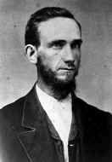
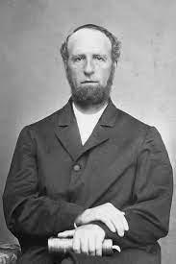
Canright and James White
"He [Canright] came from Coldwater to talk with me on the subject of his preaching. I spent about an hour with him. I said to him, 'Do not content yourself with being a small preacher, but be somebody, or die, trying. Do not go out to be a pet, but go out into the field, with the weight of the work upon you, with steady principles, and stand your ground. The last thing I did, was to present him with one of our English Bibles, and a pair of charts, saying, as I did so, 'Here Dudley, take these, go out and try it.’” Carrie Johnson, I Was Canright’s Secretary, p. 14

Slide 7
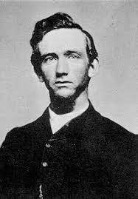
The Depressed Doubting Debater
“For lengthening periods of time he would be deeply discouraged. Doubt would sweep over his mind. He belief in God would waver and on at least one occasion he veered toward atheism. Then, with success in his work and encouragement from his brethren, he would rise from the gloomy depths of depression. In a small handwritten diary kept during 1867, he described how at times he almost doubted "present truth.“ He wrote of his temptation toward exhibitions of pride, self-exaltation, and a spirit of harshness toward others. He once declared that he was spiritually sick; he feared that God had forsaken him, and was tortured with the thought that he would be eternally lost. He suffered from frequent headaches and often mentioned that he was ill. But on the last day of that year he wrote that God had saved him from falling and that he still trusted in Him. The year, he said, had been a mingling of deep sorrow and great joy. The happiest event of that year was his marriage. In late March, 1867, Canright wrote with keen anticipation, "I now go home to spend a few weeks in Michigan“ Ibid., p. 17

Slide 8
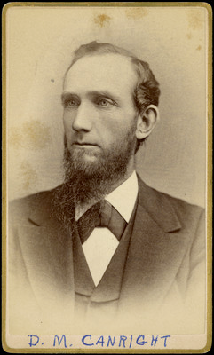
Almost Gives Up the Faith
“In December, 1869, Canright, not yet in his thirties, again demonstrated marked weaknesses of character. At Monroe, Iowa, forty had taken their stand after evangelistic meetings he had held. On Tuesday, December 28, he participated in a debate, the sixth of a series, with an Elder Johnson of the Presbyterian church. The subject was "Life and Death." Mr. Johnson frankly admitted that he could not meet Canright's arguments, and yielded. This had a far-reaching effect in the community. Several more joined the Seventh-day Adventists. Elder Butler attended this debate. Since the house Elder Canright was building was unfinished, the two men shared a room, probably in a hotel. Butler reported that Canright was not in good spirits the night of his success. Butler was astounded to learn that the young man was under the powerful temptation to give up religion, renounce his belief in the Scriptures, and become an out-and-out infidel. All night long the two men talked and prayed. Neither slept. Butler reported that in the morning Canright seemed more calm and self-possessed, and a few weeks later, at the General Conference session in Battle Creek, he "made some confessions," seemed very much relieved, and again threw himself zealously into the evangelistic field.” Ibid., p. 25-26

Slide 9
Canright’s Character
“Writing some years later Elder Butler gives us a glimpse behind the scenes in Elder Canright's life: "He was never noted for patience, forbearance, or special regard for the opinions of others. He was a person who formed his conclusions remarkably quick, and was inclined to be rash; and though in the main a genial, pleasant, frank companion, yet his desire to have his own way sometimes got him into trouble "He never could bear reproof with patience, or feel composed when his way was crossed. When he came to mingle in important matters with brethren in prominent positions, these and other traits naturally got him into trouble. . . Elder C. had little respect for any one's opinion unless it coincided with his own. The reader can readily see that very naturally there would be friction. He always hated reproof, hence bore it like a fractious child. So he had some unpleasant experiences, as we well remember. "On such occasions the Elder was immediately greatly troubled with doubts. When everything went pleasantly, he could usually see things with clearness. When he was 'abused,' as he always thought he was when things did not go to suit him, the evidences of our faith began immediately to grow dim. Dark clouds of unbelief floated over his mental sky, and he felt that everything was going by the board. Here was the Elder's special weakness. He is a strong man in certain directions when all goes smoothly, but very weak in adversity. He failed to 'endure hardness as a good soldier of Jesus Christ. -Review and Herald Extra, December, 1887.” Ibid., p. 34-35

Slide 10
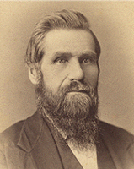
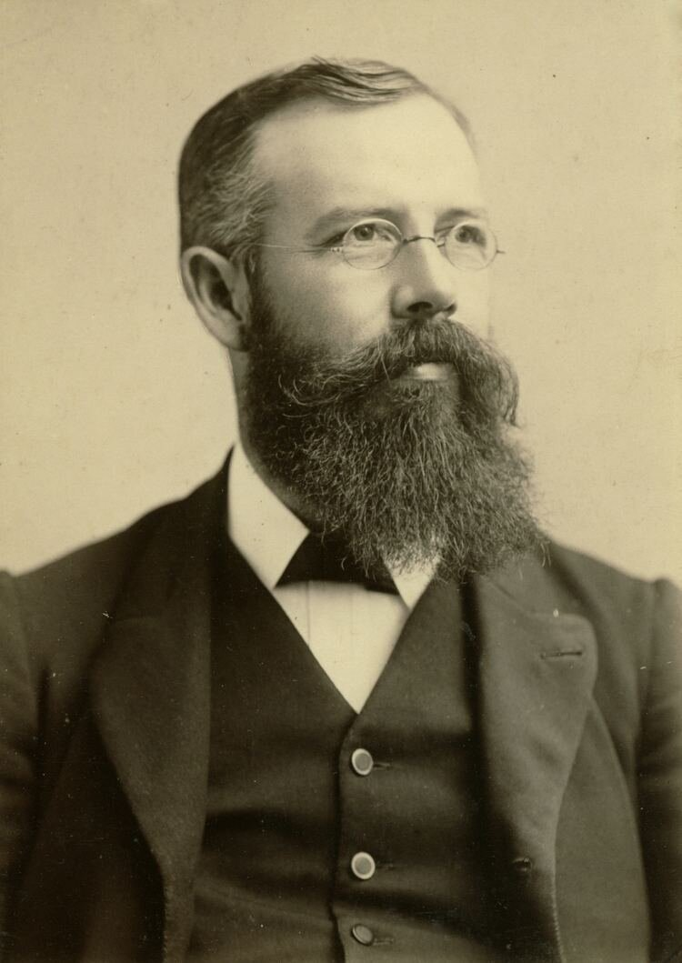
Canright and the GC President
“Elder Canright was in Battle Creek to be near his wife, who was dying with consumption. Suddenly he decided to go to Colorado with Father, for his health. And he went, contrary to the pleadings of the friends of his wife, and spent several weeks in the mountains near Black Hawk, with us. At that time my father was President of the General Conference of Seventh-day Adventists. His associates on the Committee were S. N. Haskell and D. M. Canright. Father's health was uncertain, and it was expected that one of these associates would be the next President. My wife and I were surprised and shocked to observe the diligence and enthusiasm with which Mr. Canright improved every opportunity to exalt himself, and to discredit Eld. Haskell in my father's estimation. In the good providence of God my father's health improved, and he was re-elected, and there was no contest over the office of President.-W. C. White letter to E. W. Barr, July 27, 1920.” Ibid., p. 51

Slide 11
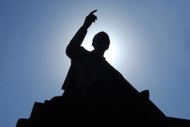
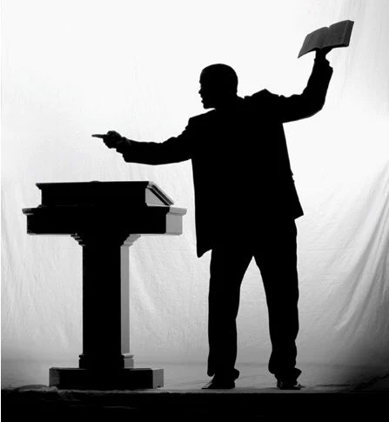
President of Ohio Conference
“As president of the Ohio Conference, Canright planned and executed a strong program. One who witnessed to this was Drury W. Reavis, a student of Battle Creek College, called by Canright to come to Ohio to carry on special Sabbath school promotion. Reavis, longtime employee of the Review and Herald publishing house, recalls in his book I Remember that as a president, Canright "was a fine general" (page 114, and stated: "I found Elder D. M. Canright, who was then regarded as one of our most efficient ministers, to be a most congenial man, fair, honest, ready to help everybody in every way possible. He was a wonderful help to me, and I shall always feel greatly indebted to him."-Ibid., p. 116. Continuing, Reavis writes: "Elder Canright talked freely with me about everything in which he was interested, about his personal difficulties, about his past trials and sorrows, and of his future hopes and plans. He seemed to find consolation in going over these things with me. He evidently felt that while I sympathetically listened, I would not repeat. . . "The elder was remarkably bright, and grew rapidly from his humble beginning, through the blessing of God, and the power of the message he proclaimed with Heaven-bestowed ability. He was so greatly admired and openly praised by our workers and the laity, that he finally reached the conclusion he had inherent ability-that the message he was proclaiming was a hindrance to him rather than the exclusive source of his power."-Ibid., p. 117” Ibid., p. 55-56

Slide 12
Canright Consummed…
Reavis: “One Sunday night, in the largest church of the West Side, he spoke on "The Saint's Inheritance" to more than 3,000 people, and I took a seat in the gallery directly in front of him, to see every gesture and to hear every tone, form of voice, emphasis, stress, and pitch, and all the rest. But that was as far as I got in my part of the service, for he so quickly and eloquently launched into this, his favorite theme, that I, with the entire congregation, became entirely absorbed in the Biblical facts he was so convincingly presenting. I never thought of anything else until he had finished. After the benediction I could not get to him for more than half an hour, because of the many people crowding around him, complimenting and thanking him for his masterly discourse. On all sides I could hear people saying it was the most wonderful sermon they had ever heard. I knew it was not the oratorical manner of the delivery, but the Bible truth clearly and feelingly presented, that had appealed to the people—it was the power in that timely message. It made a deep, lasting impression upon my mind. I saw that the power was all in the truth, and not in the speaker. After a long time we were alone, and we went into a beautiful city park just across the street, which was almost deserted because of the late hour of the night, and sat down to talk the occasion over and for me to deliver my criticisms. But I had none for the elder. I frankly confessed that I became so completely carried away with that soul—inspiring Biblical subject I did not think once of the oratorical rules he was applying in its presentation. Then we sat in silence for some time. Suddenly the elder sprang to his feet and said, "D. W., I believe I could become a great man were it not for our unpopular message.“ Ibid., p. 57-58

Slide 13
Wanted to be Great!
“I made no immediate reply, for I was shocked to hear a great preacher make such a statement; to think of the message, for which I had given up the world, in the estimation of its leading minister, being inferior to, and in the way of, the progress of men, was almost paralyzing. Then I got up and stepped in front of the elder and said with much feeling, "D. M., the message made you all you are, and the day you leave it, you will retrace your steps back to where it found you.“ But in his mind the die was evidently cast. The decision had doubtless been secretly made in his mind for some time, but had not before been expressed in words. From that night the elder was not quite the same toward our people and the work at large.-I Remember pp. 118, 119. Reavis then makes reference to Canright's later defection and presents some of his personal observations: "His estrangement began and developed through harboring that greatest seductive thing that finds its way into some human hearts, which I name an abnormal desire to be great, not great in the true meaning of the word, but great only in the estimation of people-to be popular."-Ibid., p. 117. "The feeling that being an Adventist was his principal hindrance increasing as time passed, he finally reached the conclusion that he could achieve his goal of fame through denouncing the unpopular doctrines of the denomination, and he finally worked himself out of the denomination."- Ibid., p. 119.” Ibid., p. 58

Slide 14
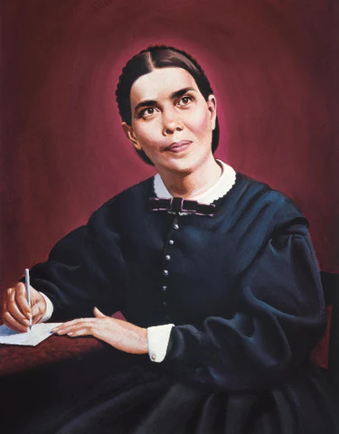
Ellen White called it!
“You have ever had a desire for power, for popularity, and this is one of the reasons for your present position. But I beg of you to keep your doubts, your questionings, your skepticism to yourself. The people have given you credit for more strength of purpose and stability of character than you possessed. They thought you were a strong man; and when you breathe out your dark thoughts and feelings, Satan stands ready to make these thoughts and feelings so intensely powerful in their deceptive character, that many souls will be deceived and lost through the influence of one soul who chose darkness rather than light, and presumptuously placed himself on Satan's side, in the ranks of the enemy. You have wanted to be too much, and make a show and noise in the work, and as the result your sun will surely set in obscurity. You have felt that there was a higher work for you, but, oh, if you would only take up the work lying directly in your path, and do it with fidelity, not seeking in any way to exalt self, then peace and joy would come to your soul, purer, richer, and more satisfying than the conquerors earthly warfare. To live and work for God and make the best use we can of all our time and faculties, is to grow in grace and knowledge. This we can do, because it is our work. You must needs put away your questioning doubts, and have full faith in the reality of your divine mission, to be indeed successful in labor.-Published in Selected Messages, book 2, pp. 162-168. (During the summer and fall of 1880)

Slide 15
Canright bitter towards egw
“DUDLEY M. CANRIGHT apparently had not learned the lesson he thought he had mastered. After a few months he again lapsed into doubt and darkness. In the fall of 1882 he gave up preaching and went to farming in Otsego, Michigan. For two years he tilled the soil. In a letter to a friend he wrote that he was busy and hard at work, doing what he loved to do "the best of anything." He declared that he had no intention of ever again engaging in ministerial work. He clearly stated that his reason for abandoning his ministry was his impaired confidence in the work of Ellen G. White. "I am thoroughly satisfied that the visions are not from God, but are wholly the fruit of her own imagination. "But," he continued, "you can not separate her visions and work from the third message as held by our people.“ He expressed high regard for "Elder Butler and all the other leading men. . . . I have no feelings against any of them, excepting Mrs. White. I dislike her very much indeed. . . . But they are good men for all that, and I never shall willingly oppose them. I am a member of the church still and do all I can to help it. But if I were situated differently, I would just as soon join some other church."- D. M. Canright letter, Dec. 8, 1883. (Italics supplied.)” Ibid., p. 65

Slide 16
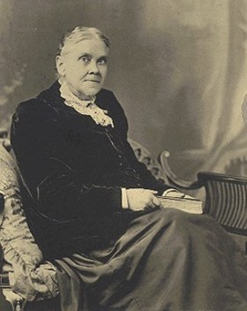
Back on track in 1884
“In response to the pleading of his friends, Canright attended a camp meeting at Jackson, Michigan, in September, 1884. After much prayer and counsel, with explanation of some matters he had viewed in an exaggerated light, he once again publicly took his stand with Seventh-day Adventists. A thousand people, many with tears in their eyes, heard his heartfelt confession. He spoke of the clouds of darkness that had enveloped his mind; but now, he declared, all was clear to him. He confessed freely that for years he had harbored in his heart bitter feelings toward Mrs. White because of the testimonies he had received from her. Then in the company of a select few he confessed this all to her and begged her forgiveness. "You then humbled your heart," wrote Ellen White to Canright of this experience, "and upon your knees asked me to forgive you for the things you had said about me and my work." And she reports, "I freely forgave you, for it was not against me. None of these things were against me: I was only a servant bearing the message God gave me."-Testimonies for the church, Vol. 5, p. 623. He seemed like a changed man as he went forth to work once more. All rejoiced that Elder Canright was again in the gospel field, preaching with power the message of the Sabbath and the soon return of Jesus. “ Ibid., p. 66

Slide 17
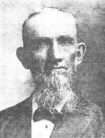
1886: Canright Passed Over
“Canright's name was widely known. This did not displease him. He was talented, highly esteemed, and greatly respected as a Seventh-day Adventist church leader. But those close to him understood well his weak points. Butler reported: When everything went pleasantly, he could usually see things with clearness. When he was "abused," as he always thought he was when things did not go to suit him, the evidences of our faith began immediately to grow dim. Dark clouds of unbelief floated over his mental sky, and he felt that everything was going by the board. Here was the Elder's special weakness. He is a strong man in certain directions when all goes smoothly, but very weak in adversity. When things apparently were against him, he seemed to have no staying, recuperative qualities.-Review and Herald Extra, December, 1887. It appears likely that these traits, observed by his brethren, constituted the reason why he was repeatedly passed by when choices were made for the president of the General Conference, or the presidents of State conferences, or the president of the Michigan Conference in the fall of 1886.” Ibid., p. 80

Slide 18
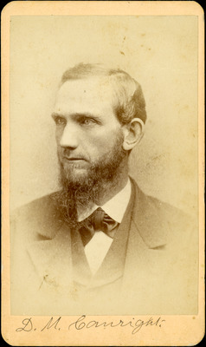
Do Not Leave the Message!
“I awoke, but it is this dream that leads me to write to you. I was feeling deeply over some of these things when a letter came, saying that you were “under great temptation and trial.” What is it, Brother M? Is Satan tempting you again? Is God permitting you to be brought to the same place where you have failed before? Will you now let unbelief take possession of your soul? Will you fail every time, as did the children of Israel? God help you to resist the devil and to come forth stronger from every trial of your faith! Be careful how you move. Make straight paths for your feet. Close the door to unbelief and make God your strength. If perplexed, hold still; make no move in the dark. I am deeply concerned for your soul. This may be the last trial that God will grant you. Advance not one step in the downward road to perdition. Wait, and God will help you. Be patient, and the clear light will appear. If you yield to impressions you will lose your soul, and the soul is of great value with God. I have been writing upon the first volume of Great Controversy, and it makes me feel very solemn as I review these important subjects—creation and the events from the fall of Satan to the fall of Adam. The Lord seems very near me as I write, and I am deeply moved as I contemplate this Controversy.” 5 Testimonies, pgs. 570, 571

Slide 19
The ultimatum
“About the year 1918 a cousin of Eld. D. M. Canright came to our home and spent a few days. I asked this cousin what he knew about D. M. Canright. He replied "I will tell you one thing. Just before he left the denomination Elder Canright came to the (1886)Michigan camp meeting with his team and I took care of his horses. On that occasion my cousin said, 'If I am not elected President of this Conference at this meeting I am not going to preach for them any more.'"-Statement concerning D. M. Canright by Ray Birmingham, Alma, Michigan, Sept. 7, 1947. George I. Butler, not D. M. Canright, was elected president of the Michigan conference.” Ibid., p. 80

Slide 20
January 1887, Canright Defects!
Feb. 17, 1887, Canright stated: “That he had come to a point where he no longer believed that the Ten Commandments were binding upon Christians and had given up the Law, the Sabbath, the Messages, the Sanctuary, our position upon [the] U.S. in prophecy, the Testimonies, health reform, the ordinances of humility. He also said that he did not believe that the papacy had changed the Sabbath. And though he did not directly state it, his language intimated that he would probably keep Sunday. He thinks that Seventh-day Adventists are too narrow in their ideas, and that in quoting so much as they do from the Old Testament are going back into the moonlight rather than experiencing the sunlight of the gospel of Christ. He thought we were exalting the law above Christ. Also has no faith in the missionary work as conducted by our people, feels as if it is not the way God designed to do the work. . . . Church clerk's record, Feb. 17, 1887, Otsego, Michigan, SDA church.” Ibid., p. 82

Slide 21
The love of the truth not cherished!
March 1887 Canright begins preaching for the Baptists.
1889 writes Seventh-Day Adventism Renounced
1898 dropped as a Baptist minster.
1898 begins selling books as a colporteur. This he did, unsuccessfully, for the rest of his life.

Slide 22
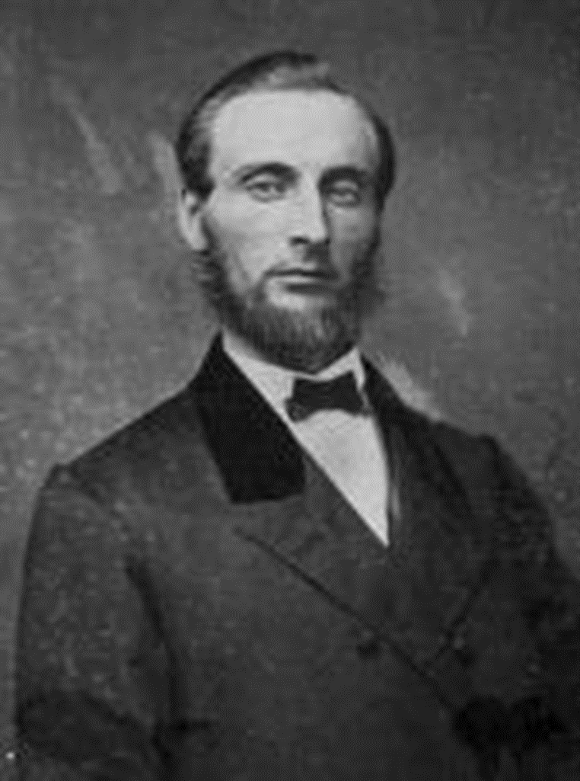
1903: DW Reavis tries to bring him back!
“I finally prevailed upon him to attend a general meeting of our workers in Battle Creek in 1903, with the view of meeting many of the old workers and having a heart-to-heart talk together. He was delighted with the reception given him by all the old workers, and greatly pleased with the cordiality of the new workers. All through the meetings he would laugh with his eyes full of tears. The poor man seemed to exist simultaneously in two distinct parts— uncontrollable joy and relentless grief. Finally when he came to the Review and Herald office, where I was then working. to bid me good-bye before returning to his home in Grand Rapids. Michigan, we went back in a dark storeroom alone to have a talk. and we spent a long time there in this last personal, heart-to-heart visit. I reminded him of what I had told him years before in Chicago. and he frankly admitted that what I predicted had come to pass, and that he wished the past could be blotted out and that he was back in our work just as he was at the beginning. before any ruinous thoughts of himself had entered his heart." Ibid., p. 100-101

Slide 23
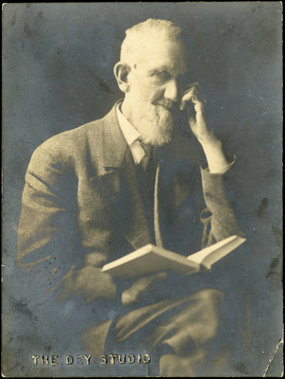
Couldn’t Come Back!
“I tried to get him to say to the workers there assembled just what he had said to me, assuring him that they would be glad to forgive all and to take him back in full confidence. I never heard anyone weep and moan in such deep contrition as did that once leading light in our message. It was heartbreaking even to hear him. He said he wished he could come back to the fold as I suggested. but after long. heartbreaking moans and weeping, he said: "I would be glad to come back, but I can't! It's too late! I am forever gone! Gone!" As he wept on my shoulder, he thanked me for all I had tried to do to save him from that sad hour. He said. "D. W.. Whatever you do. don't ever fight the message.“ This is a brief statement of the downfall of one of the leading men in our denominational work, brought about through the gradual development of a germ of self-exaltation. —From the book "/ Remember, p. 119-120 —by D. W. Reavis.” Ibid., p. 101

Slide 24
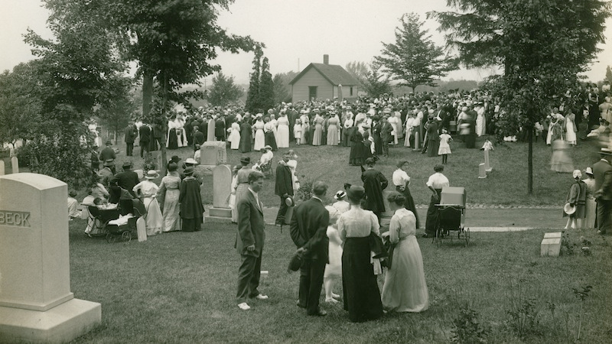
“My brother [Dudley M. Canright] rested his hand upon the side of the casket, and with tears rolling down his cheeks, he said brokenly ‘There is a noble Christian woman gone.’”—WA Spicer, The Spirit of Prophecy in the Advent Movement, p. 127

Slide 25
Do Not Let the truth go
“The late Elder K. F. Ambs, of Washington, D.C., recalled the following incident that occurred when he was a boy growing up in Otsego: ‘One afternoon, while father and I were away at work, mother answered the door and admitted an elderly man who was selling a small book. When she looked at the title it read, Gospel Primer, by J.E. White. ‘Surprised, she said, ‘This is a Seventh-day Adventist book, isn’t it?’ to which the old gentleman replied, ‘Yes, ma’am it is.’ ‘And are you a Seventh-day Adventist?’ she asked. To this he replied. ‘Well, I was a Seventh day Adventist.’ ‘Upon asking him his name, he replied that his name was Canright. ‘Are you D.M. Canright?’ she asked. ‘Yes, sister, I’m D.M. Canright.’ ‘Are you that man who had so much light and who turned his back on it?’ mother asked. ‘His response was significant. Said he, ‘Yes, sister, I am that man, and how often have I sought to find my way back but have been unable to do so.’ As he was leaving he shook mother’s hand saying, as tears filled his eyes, ‘Sister, you have the truth, hold fast to it, never let it go. It is the very truth.’—Letter from K.F. Ambs to D.A. Delafield, dated December 4, 1964.” Ibid., 103

Slide 26
Blessed By God or Slave of the Devil?
“In March 1916, Canright accompanied an old Adventist friend, J.H. Morrison, to a church workers' meeting in Battle Creek. Afterward, they went to Morrison's house. Following that visit, Canright walked to the local Baptist church, where he had a key to the basement. Unaware that extensive remodeling had taken place, and arriving at the church after dark, Canright fell through an open hole into the basement, broke his leg, and remained there for two days. He was taken to the local hospital, and then to the Battle Creek Sanitarium, where his leg was amputated. He spent the last 3 years of his life with his daughter Genevieve, who had converted to Christian Science.” DM Canright, Wikipedia

Slide 27
His Final Legacy….
“Canright died on May 12, 1919. Two months later, his final book, The Life of Mrs. E.G. White, was published. In it he criticised White heavily and maintained, among other charges:
that the early doctrines held in 1844 and up to 1851 failed utterly
that in some cases her prophecies were wrong, and then suppressed afterwards
that she rebuked and controlled peoples' conduct, purportedly by spiritual knowledge, but factually by informings that often attacked an innocent party
that she plagiarized many of her purportedly God-inspired texts from other authors, and had to revise one of her books at an expense of $3,000” DM Canright, Wikipedia

Slide 28
Those Who Seek Power and Position…
The following message that Ellen White related in Loma Linda back in 1908 in the presence of her secretary, (Sr. Mclnterfer) and Elder D. E. Robinson (the husband of her granddaughter Ella White) and W. E. Ross, should be of profound interest to all concerned, knowing that it is applicable to the time we are living in at the present time. Here is the message as related by W. E. Ross: “About 1908, with Sr. Mclnterfer (her Secretary and Brother D. E. Robinson (her granddaughter’s husband) present, and myself Sister White told us that a terrible storm of persecution was coming, like a windstorm that would blow down every standing object. Not one Seventh-day Adventist was to be seen. They, like the disciples, all forsook Christ and fled. All who had sought positions were never seen anymore. After the storm there was a great calm. Then the Seventh-day Adventist’s arose like a flock of sheep, but without shepherds. They all united in earnest prayer to God who answered by helping them choose leaders of their number who had never sought positions. They prayed most earnestly again for God’s Holy Spirit, which was poured upon them, making them fully ready for service. They then unitedly went forth ‘as an army with banners’ fearlessly and fully to give the message to all the world.’ “—Related by W. E. Ross. The brother who related this testimony said, “I was surprised and asked, whether this refers to Loma Linda. Her answer that this vision refers to the entire denominational Adventist people in all the world. “This startled me,” he said, “So that I did not dare ask further questions.”

