Slide 1
Judges, pt. 8 Jephthah

Slide 2
Jephthah-the man
“Now Jephthah the Gileadite was a mighty man of valour, and he was the son of an harlot: and Gilead begat Jephthah. And Gilead's wife bare him sons; and his wife's sons grew up, and they thrust out Jephthah, and said unto him, Thou shalt not inherit in our father's house; for thou art the son of a strange woman. Then Jephthah fled from his brethren, and dwelt in the land of Tob: and there were gathered vain men to Jephthah, and went out with him. And it came to pass in process of time, that the children of Ammon made war against Israel. And it was so, that when the children of Ammon made war against Israel, the elders of Gilead went to fetch Jephthah out of the land of Tob: And they said unto Jephthah, Come, and be our captain, that we may fight with the children of Ammon. And Jephthah said unto the elders of Gilead, Did not ye hate me, and expel me out of my father's house? and why are ye come unto me now when ye are in distress?...

Slide 3
Who Was He?
…And the elders of Gilead said unto Jephthah, Therefore we turn again to thee now, that thou mayest go with us, and fight against the children of Ammon, and be our head over all the inhabitants of Gilead. And Jephthah said unto the elders of Gilead, If ye bring me home again to fight against the children of Ammon, and the LORD deliver them before me, shall I be your head? And the elders of Gilead said unto Jephthah, The LORD be witness between us, if we do not so according to thy words. Then Jephthah went with the elders of Gilead, and the people made him head and captain over them: and Jephthah uttered all his words before the LORD in Mizpeh.” Judges 11:1-11

Slide 4
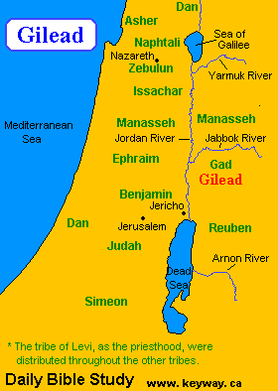
His ancestry
Jephthah’s origins were from the land of Gad, east of the Jordan. It was from this area where the prophet Elijah came as well. Besides Jephthah and Elijah, about the only other famous thing that came from Gilead was the medicinal balm that came from there. The Balm of Gilead was a rare perfume used medicinally, that was mentioned in the Bible, and named for the region of Gilead, where it was produced. Jeremiah referred to it when he said, “Is there no balm in Gilead; is there no physician there? why then is not the health of the daughter of my people recovered?” Jeremiah 8:22

Slide 5
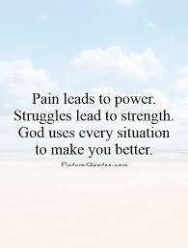
His Pain!
Jephthah was cast out of his home because his mother was a prostitute. He was disowned by his step brothers and sisters, and even the townsfolk sided with the family in kicking him out of the house and cutting off his inheritance. In the midst of his sorrow, Jephthah learned to rely on the Lord. We know this because later on we read, “Then the Spirit of the LORD came upon Jephthah, and he passed over Gilead, and Manasseh, and passed over Mizpeh of Gilead, and from Mizpeh of Gilead he passed over unto the children of Ammon.” Judges 11:29

Slide 6
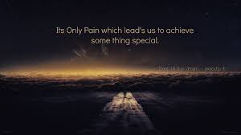
“My brethren, count it all joy when ye fall into divers temptations; Knowing this, that the trying of your faith worketh patience. But let patience have her perfect work, that ye may be perfect and entire, wanting nothing.” James 1:2-4
“For the LORD shall comfort Zion: he will comfort all her waste places; and he will make her wilderness like Eden, and her desert like the garden of the LORD; joy and gladness shall be found therein, thanksgiving, and the voice of melody.” Isaiah 51:3

Slide 7


Slide 8
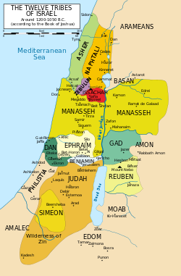
Ammonites Want Land Back
During the Israelites invasion of the Promised Land, they had taken over land that belonged to the Moabites, the Ammonites, and the Edomite's. Now, with Israel in apostasy and the Lord stepping away from them, the Ammonites came boldly forward demanding their land back. Jephthah boldly declared that Israel had asked for peaceful passage through their land, but the Ammonites chose to attack them and Israel took over their land. “Wilt not thou possess that which Chemosh thy god giveth thee to possess? So whomsoever the LORD our God shall drive out from before us, them will we possess.” Judges 11:24

Slide 9
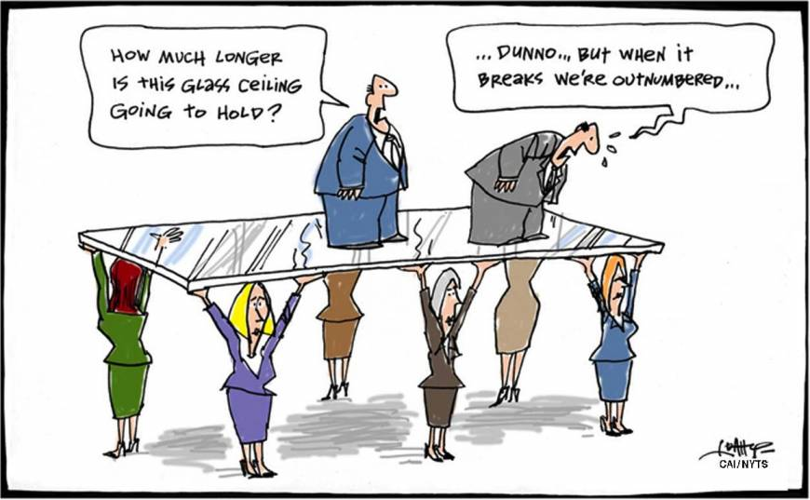
Jephthah Tries Peaceful Means, Diplomacy
“And now art thou any thing better than Balak the son of Zippor, king of Moab? did he ever strive against Israel, or did he ever fight against them, While Israel dwelt in Heshbon and her towns, and in Aroer and her towns, and in all the cities that be along by the coasts of Arnon, three hundred years? why therefore did ye not recover them within that time? Wherefore I have not sinned against thee, but thou doest me wrong to war against me: the LORD the Judge be judge this day between the children of Israel and the children of Ammon. Howbeit the king of the children of Ammon hearkened not unto the words of Jephthah which he sent him.” Judges 11:25-28

Slide 10
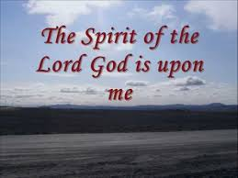
Jephthah’s Strength
“Then the Spirit of the LORD came upon Jephthah, and he passed over Gilead, and Manasseh, and passed over Mizpeh of Gilead, and from Mizpeh of Gilead he passed over unto the children of Ammon.” Judges 11:29
“even Othniel the son of Kenaz, Caleb's younger brother. And the Spirit of the LORD came upon him, and he judged Israel, and went out to war: and the LORD delivered Chushanrishathaim king of Mesopotamia.” Judges 3:9,10
“But the Spirit of the LORD came upon Gideon, and he blew a trumpet; and Abiezer was gathered after him.

Slide 11
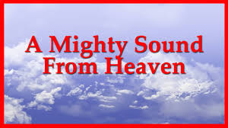
I Hear the Sound!
Jephthah had learned in his own life of pain and suffering to depend on the Holy Spirit. He had learned to trust in the Spirit’s power to overcome and to comfort him in times of pain and suffering. When a huge crisis hit in his life, Jephthah turned to the One who had always been faithful and the Holy Spirit answered the call. “So shall they fear the name of the LORD from the west, and his glory from the rising of the sun. When the enemy shall come in like a flood, the Spirit of the LORD shall lift up a standard against him.” Isaiah 59:19

Slide 12
For Us Too!
“The promise of the Holy Spirit is not limited to any age or to any race. Christ declared that the divine influence of His Spirit was to be with His followers unto the end. From the Day of Pentecost to the present time, the Comforter has been sent to all who have yielded themselves fully to the Lord and to His service. To all who have accepted Christ as a personal Savior, the Holy Spirit has come as a counselor, sanctifier, guide, and witness. The more closely believers have walked with God, the more clearly and powerfully have they testified of their Redeemer's love and of His saving grace. The men and women who through the long centuries of persecution and trial enjoyed a large measure of the presence of the Spirit in their lives, have stood as signs and wonders in the world. Before angels and men they have revealed the transforming power of redeeming love.” AA, pg. 49

Slide 13
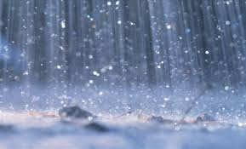
“And after these things I saw another angel come down from heaven, having great power; and the earth was lightened with his glory. And he cried mightily with a strong voice, saying, Babylon the great is fallen, is fallen, and is become the habitation of devils, and the hold of every foul spirit, and a cage of every unclean and hateful bird. For all nations have drunk of the wine of the wrath of her fornication, and the kings of the earth have committed fornication with her, and the merchants of the earth are waxed rich through the abundance of her delicacies.” Rev. 18:1-3

Slide 14
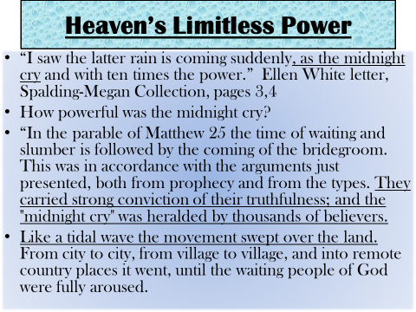

Slide 15
Jephthah’s Vow!
“And Jephthah vowed a vow unto the LORD, and said, If thou shalt without fail deliver the children of Ammon into mine hands, Then it shall be, that whatsoever cometh forth of the doors of my house to meet me, when I return in peace from the children of Ammon, shall surely be the LORD'S, and I will offer it up for a burnt offering….(Judges 11:30,31) And Jephthah came to Mizpeh unto his house, and, behold, his daughter came out to meet him with timbrels and with dances: and she was his only child; beside her he had neither son nor daughter. And it came to pass, when he saw her, that he rent his clothes, and said, Alas, my daughter! thou hast brought me very low, and thou art one of them that trouble me: for I have opened my mouth unto the LORD, and I cannot go back. And she said unto him, My father, if thou hast opened thy mouth unto the LORD, do to me according to that which hath proceeded out of thy mouth; forasmuch as the LORD hath taken vengeance for thee of thine enemies, even of the children of Ammon.” Judges 11:34-36

Slide 16
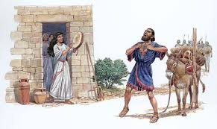
Jephthah’s Sorrow
“And she said unto her father, Let this thing be done for me: let me alone two months, that I may go up and down upon the mountains, and bewail my virginity, I and my fellows. And he said, Go. And he sent her away for two months: and she went with her companions, and bewailed her virginity upon the mountains. And it came to pass at the end of two months, that she returned unto her father, who did with her according to his vow which he had vowed: and she knew no man. And it was a custom in Israel, That the daughters of Israel went yearly to lament the daughter of Jephthah the Gileadite four days in a year.” Judges 11:37-40

Slide 17
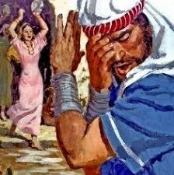
The majority opinion among commentators is that Jephthah killed his daughter as an act of human sacrifice. There is, however, a minority opinion that Jephthah's daughter spent the rest of her life in seclusion. This is based on considerations such as weeping for her virginity would make no sense if she were about to die (although it would be sensible in light of the Biblical commandment to "be fruitful and multiply", which she would now no longer be able to fulfill).

Slide 18
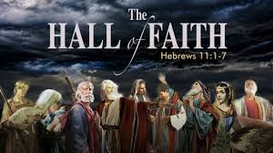
Hall of Faith
“By faith the harlot Rahab perished not with them that believed not, when she had received the spies with peace. And what shall I more say? for the time would fail me to tell of Gedeon, and of Barak, and of Samson, and of Jephthah; of David also, and Samuel, and of the prophets: Who through faith subdued kingdoms, wrought righteousness, obtained promises, stopped the mouths of lions, Quenched the violence of fire, escaped the edge of the sword, out of weakness were made strong, waxed valiant in fight, turned to flight the armies of the aliens.” Hebrews 11:31-34

