Slide 1
The Golden Rule, pt. 2 “War, Biddle, and Jackson”

Slide 2
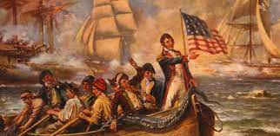
Charter Collapses
The bank charter of Alexander Hamilton was to expire in 1811. Attempts were made to renew the charter prior to this, but they all failed. The Rothschilds/papacy were furious! They would use the arms of Britain to teach America a lesson. Thus, the War of 1812 was fought. Ultimately, the War of 1812 ended in a draw on the battlefield, and the peace treaty reflected this. The Treaty of Ghent was signed in modern-day Belgium on December 24, 1814, and went into effect on February 17, 1815, after both sides had ratified it.

Slide 3
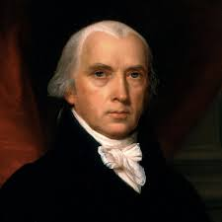
Guess What Happened after the WAR?
The War of 1812 was a draw or was it? The attempt at renewing the charter for a Central Bank had not passed in Congress in 1811. Congress feared the power of a central bank that was predominantly owned by foreign investors; the Rothschild/ Papal consortium. The war of 1812 was fought to an apparent draw. Now, guess what happened after the war ended?
The charter for a new central bank was signed into law by James Madison on April 10, 1816. The Rothschilds won the war of 1812!!! Note: people died over a central bank and this is the beginning!

Slide 4
Notice the Dominance
In 1816, the third Bank of the United States was established in order to bring stability to the national economy, serve as the depository for national funds, and provide the government with the means of floating loans and transferring money across the country. In reality, the central bank was set up to help the Rothschild’s/papacy control the money, the economy, and the government of the United States!! This was at the time William Miller started studying the Bible!!
“Biddle had one powerful advantage over his adversary. For all practical
purposes, Congress was is his pocket. Or, more accurately, the product of his
generosity was in the pockets of Congressmen. Following the Rothschild
Formula, Biddle had been careful to reward compliant politicians with success in
the business world. Few of them would bite the hand that fed them. Even the
great Senator, Daniel Webster, found himself kneeling at Biddle’s throne.-- G.
Edward Griffin, The Creature from Jekyll Island, American Opinion, p. 351.

Slide 5
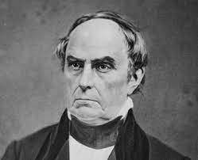
The One with the Gold!!
“Daniel Webster was, at various times, a director of the Bank and on retainer as its counsel. "I believe my retainer has not been renewed or refreshed as usual. If it be wished that my relation to the Bank be continued, it may be well to send me the usual retainers." Numerous other men of distinction had been accommodated, including members of the press. -- John Kenneth Galbraith, Money: Whence it Came, Where it Went, Houghton Mifflin, page 80.
Webster's record in Congress had previously been in behalf of sound money. When Biddle bought Webster with money and other enticements, he succumbed and became a supporter of the corrupt banking objectives of Biddle. Webster became one of the central banks most avid supporters. How tragic that Daniel Webster did not have the moral courage to withstand Biddle's bribes!

Slide 6
Waterloo!
“To illustrate how the Jesuits and the Rothschilds have used countries and events to gain domination over nations and financial markets, we must look at the battle of Waterloo between France and England on June 19, 1815. There were vast fortunes to be made, and lost, on the outcome of the Battle of Waterloo. The Stock Exchange in London was at fever pitch as traders awaited news of the outcome of this battle of the giants. If Britain lost, English consuls would plummet to unprecedented depths. If Britain was victorious, the value of the consul would leap to new dizzying heights. As the two huge armies closed in for the battle to the death, Nathan Rothschild had his agents working feverishly on both sides of the line to gather the most accurate possible information as the battle proceeded. Additional Rothschild agents were on hand to carry the intelligence bulletins to a Rothschild command post strategically located nearby….

Slide 7
Blood thirsty!
“…Late on the afternoon of June 19, 1815, a Rothschild representative jumped on board a specially chartered boat and headed out into the channel in a hurried dash for the English coast. In his possession was a top secret report from Rothschilds secret service agents on the progress of the crucial battle. This intelligence data would prove indispensable to Nathan in making some vital decisions. The special agent was met at Folkstone the following morning at dawn by Nathan Rothschild himself. After quickly scanning the highlights of the report Rothschild was on his way again, speeding towards London and the Stock Exchange. Arriving at the Exchange amid frantic speculation on the outcome of the battle, Nathan took up his usual position beside the famous ‘Rothschild Pillar’. Without a sign of emotion, without the slightest change of facial expression the stony-faced, flint eyed chief of the House of Rothschild gave a predetermined signal to his agents who were stationed nearby…

Slide 8
“…Rothschild agents immediately began to dump consuls on the market. As hundreds of thousands of dollars worth of consuls poured onto the market their value started to slide. Then they began to plummet. Nathan continued to lean against ‘his’ pillar, emotionless, expressionless. He continued to sell, and sell and sell. Consuls kept on falling. Word began to sweep through the Stock Exchange: ‘Rothschild knows.’ ‘Rothschild knows.’ ‘Wellington has lost at Waterloo.’ The selling turned into a panic as people rushed to unload their ‘worthless’ consuls or paper money for gold and silver in the hope of retaining at least part of their wealth. Consuls continued their nosedive towards oblivion. After several hours of feverish trading the consul lay in ruins. It was selling for about five cents on the dollar. Nathan Rothschild, emotionless and expressionless as ever, still leaned against his pillar. He continued to give subtle signals. But these signals were different. They were so subtly different that only the highly trained Rothschild agents could detect the change. On the cue from their boss dozens of Rothschild agents made their way to the order desks around the Exchange and bought every consul in sight for just a ‘song’. A short time later the ‘official’ news arrived in the British capital. England was now the master of the European scene. Within seconds the consul skyrocketed to above its original value. As the significance of the British victory began to sink into the public consciousness, the value of the consuls rose ever higher. Napoleon had ‘met his Waterloo.’ Nathan had bought control of the British economy. Overnight his already vast fortune was multiplied twenty times over. --
Des Griffin, Descent into Slavery, Emissary Publications, pp. 27, 28.

Slide 9
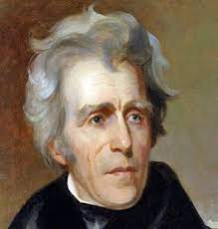
Would Someone Oppose Them?
The central bank charter was set to expire in 1836. Andrew Jackson won the election in 1828 and was seeking reelection in 1832. (At this time, Ellen Harmon was 5 years old. William Miller started public preaching). Rothschild/papal agent Nicholas Biddle decided to renew the charter prior to the 1832 election, thinking that Jackson would not oppose it because of his reelection bid! He was wrong!

Slide 10
Jackson’s Opposition
Andrew Jackson understood the dangers of the central bank and vetoed the bill to renew the bank’s charter. Jackson’s argument was simple. “Is there no danger to our liberty and independence in a bank that in its nature has so little to bind it to our country?...[Is there not] cause to tremble for the purity of our elections in peace and for the independence of our country in war?...Of the course which would be pursued by a bank almost wholly owned by the subjects of a foreign power, and managed by those whose interests, if not affections, would run in the same direction there can be no doubt...Controlling our currency, receiving our public monies, and holding thousands of our citizens in dependence, it would be more formidable and dangerous than a naval and military power of the enemy. -- Herman E. Kross, Documentary History of Banking and Currency in the United States, Chelsea House, pp. 26, 27.

Slide 11
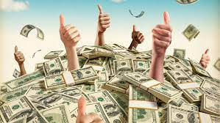
Jackson understood the power wielded by the Rothschild’s/papacy and that their stranglehold over the American financial system was worse than a foreign army on US soil!! He put his reelection bid on the line to veto the renewal of the charter! The central bank was not renewed and Jackson won the3 election! How did the Rothschild’s/Jesuits feel about this? They had to have a central bank in America to gain total control. It was simple; when diplomacy failed, try MURDER!

Slide 12
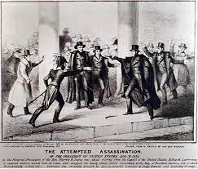
Jackson Won and Almost Lost!!
“With these accomplishments close on the heels of his victory over the Bank, the President had earned the undying hatred of monetary scientists, both in America and abroad. It is not surprising, therefore. that on January 30, 1835, an assassination attempt was made against him. Miraculously, both pistols of the assailant misfired, and Jackson was spared by a quirk of fate. It was the first such attempt to be made against the life of a President of the United States. The would-be assassin was Richard Lawrence who either was truly insane or who pretended to be insane to escape harsh punishment. At any rate, Lawrence was found not guilty due to insanity. Later, he boasted to friends that he had been in touch with powerful people in Europe who had promised to protect him from punishment should he be caught. -- G. Edward Griffin, The Creature from Jekyll Island, American Opinion, p. 357.

Slide 13
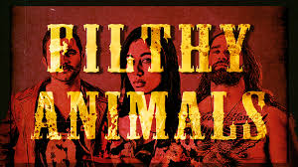
War and Murder!!
Richard Lawrence tried to shoot Jackson, but his pistols misfired. Lawrence was promised by powerful people in Europe ??? that if he were caught, they would get him off!! Just like John Surratt 30 years later!!
Who might the powerful people in Europe be who hated Jackson for stopping their plans?
HMMM… Rothschilds/Jesuits/Papacy!!

Slide 14
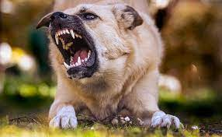
The goal was simple. Take over the American banking system so that “And he causeth all, both small and great, rich and poor, free and bond, to receive a mark in their right hand, or in their foreheads: And that no man might buy or sell, save he that had the mark, or the name of the beast, or the number of his name.” Revelation 13:16,17
William Miller had started preaching. The final time prophecy in the Bible was about to be fulfilled. It was time for Jesus to come. The animals of Rome were deadly serious about their plan!

Slide 15
Are You Clothed?
“Behold, I come as a thief. Blessed is he that watcheth, and keepeth his garments, lest he walk naked, and they see his shame.” Rev. 16:15
“And when the king came in to see the guests, he saw there a man which had not on a wedding garment: And he saith unto him, Friend, how camest thou in hither not having a wedding garment? And he was speechless. Then said the king to the servants, Bind him hand and foot, and take him away, and cast him into outer darkness; there shall be weeping and gnashing of teeth. For many are called, but few are chosen.” Matthew 22:11-14
“By His perfect obedience He has made it possible for every human being to obey God's commandments. When we submit ourselves to Christ, the heart is united with His heart, the will is merged in His will, the mind becomes one with His mind, the thoughts are brought into captivity to Him; we live His life. This is what it means to be clothed with the garment of His righteousness. Then as the Lord looks upon us He sees, not the fig-leaf garment, not the nakedness and deformity of sin, but His own robe of righteousness, which is perfect obedience to the law of Jehovah.” COL, pg. 311

