Slide 1
Revelation 17, 18
The Loud Cry, pt. 3

Slide 2
A Final Warning
“And after these things I saw another angel come down from heaven, having great power; and the earth was lightened with his glory. And he cried mightily with a strong voice, saying, Babylon the great is fallen, is fallen, and is become the habitation of devils, and the hold of every foul spirit, and a cage of every unclean and hateful bird. For all nations have drunk of the wine of the wrath of her fornication, and the kings of the earth have committed fornication with her, and the merchants of the earth are waxed rich through the abundance of her delicacies. And I heard another voice from heaven, saying, Come out of her, my people, that ye be not partakers of her sins, and that ye receive not of her plagues. For her sins have reached unto heaven, and God hath remembered her iniquities.” Revelation 18:1-5

Slide 3
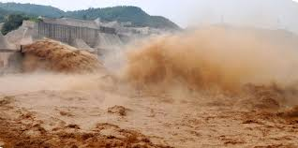
Great Power
“I saw the latter rain is coming suddenly, as the midnight cry and with ten times the power.” Ellen White letter, Spalding-Megan Collection, pages 3,4

Slide 4
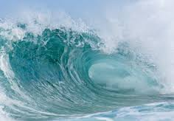
Tidal Wave
“In the parable of Matthew 25 the time of waiting and slumber is followed by the coming of the bridegroom. This was in accordance with the arguments just presented, both from prophecy and from the types. They carried strong conviction of their truthfulness; and the "midnight cry" was heralded by thousands of believers.
Like a tidal wave the movement swept over the land. From city to city, from village to village, and into remote country places it went, until the waiting people of God were fully aroused.” GC, pg. 400

Slide 5
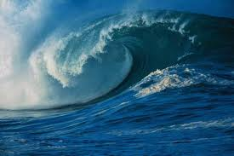

Slide 6
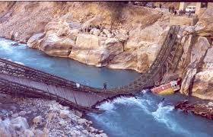
Babylon is Fallen
“And he cried mightily with a strong voice, saying, Babylon the great is fallen, is fallen, and is become the habitation of devils, and the hold of every foul spirit, and a cage of every unclean and hateful bird.”

Slide 7
Our Day!
“This scripture points forward to a time when the announcement of the fall of Babylon, as made by the second angel of Revelation 14 (verse 8), is to be repeated, with the additional mention of the corruptions which have been entering the various organizations that constitute Babylon, since that message was first given, in the summer of 1844. A terrible condition of the religious world is here described. With every rejection of truth the minds of the people will become darker, their hearts more stubborn, until they are entrenched in an infidel hardihood. In defiance of the warnings which God has given, they will continue to trample upon one of the precepts of the Decalogue, until they are led to persecute those who hold it sacred. Christ is set at nought in the contempt placed upon His word and His people. As the teachings of spiritualism are accepted by the churches, the restraint imposed upon the carnal heart is removed, and the profession of religion will become a cloak to conceal the basest iniquity. A belief in spiritual manifestations opens the door to seducing spirits and doctrines of devils, and thus the influence of evil angels will be felt in the churches.” GC, pgs. 603,604

Slide 8
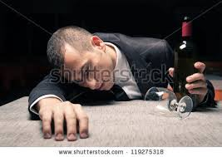
Drunk on Wine
“We are not to think that the chosen ones of God who are trying to walk in the light, compose Babylon. The fallen denominational churches are Babylon. Babylon has been fostering poisonous doctrines, the wine of error. This wine of error is made up of false doctrines, such as the natural immortality of the soul, the eternal torment of the wicked, the denial of the pre-existence of Christ prior to His birth in Bethlehem, and advocating and exalting the first day of the week above God’s holy, sanctified day. These and kindred errors are presented to the world by the various churches.” EV, pg. 365

Slide 9
“For all nations have drunk of the wine of the wrath of her fornication, and the kings of the earth have committed fornication with her, and the merchants of the earth are waxed rich through the abundance of her delicacies.” Rev. 18:3
The papal power, the political powers of earth, and the merchants of the earth have united together to oppose the people of God! The Holy Spirit will bowl over this conglomerate and smash it to bits! In infinite love, the Lord will call for His children to forsake these apostate communions and to exalt the Lord Jesus and Him alone!

Slide 10
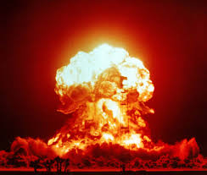
Man made Institutions
“For if a man think himself to be something, when he is nothing, he deceiveth himself… But God forbid that I should glory, save in the cross of our Lord Jesus Christ, by whom the world is crucified unto me, and I unto the world.” Galatians 6:3,14

Slide 11
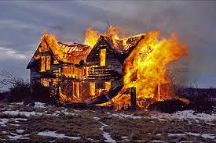
Come Out of Her
“And I heard another voice from heaven, saying, Come out of her, my people, that ye be not partakers of her sins, and that ye receive not of her plagues. For her sins have reached unto heaven, and God hath remembered her iniquities.” Rev. 18:4,5

Slide 12
Decision Time
“But not one is made to suffer the wrath of God until the truth has been brought home to his mind and conscience, and has been rejected. There are many who have never had an opportunity to hear the special truths for this time. The obligation of the fourth commandment has never been set before them in its true light. He who reads every heart and tries every motive will leave none who desire a knowledge of the truth, to be deceived as to the issues of the controversy. The decree is not to be urged upon the people blindly. Everyone is to have sufficient light to make his decision intelligently.
The Sabbath will be the great test of loyalty, for it is the point of truth especially controverted. When the final test shall be brought to bear upon men, then the line of distinction will be drawn between those who serve God and those who serve Him not. While the observance of the false Sabbath in compliance with the law of the state, contrary to the fourth commandment, will be an avowal of allegiance to a power that is in opposition to God, the keeping of the true Sabbath, in obedience to God's law, is an evidence of loyalty to the Creator. While one class, by accepting the sign of submission to earthly powers, receive the mark of the beast, the other choosing the token of allegiance to divine authority, receive the seal of God.” GC, pg. 605

Slide 13
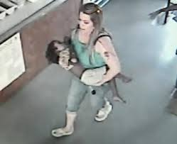
Saved Barely
“The Lord is not slack concerning his promise, as some men count slackness; but is longsuffering to us-ward, not willing that any should perish, but that all should come to repentance.” 2 Peter 3:9

Slide 14
“It is true that there are real Christians in the Roman Catholic communion. Thousands in that church are serving God according to the best light they have. They are not allowed access to His word, and therefore they do not discern the truth. [PUBLISHED IN 1888 AND 1911. SEE APPENDIX.] They have never seen the contrast between a living heart service and a round of mere forms and ceremonies. God looks with pitying tenderness upon these souls, educated as they are in a faith that is delusive and unsatisfying. He will cause rays of light to penetrate the dense darkness that surrounds them. He will reveal to them the truth as it is in Jesus, and many will yet take their position with His people.” GC, pg 565

Slide 15
Seed Has Been Sown
“The message will be carried not so much by argument as by the deep conviction of the Spirit of God. The arguments have been presented. The seed has been sown, and now it will spring up and bear fruit. The publications distributed by missionary workers have exerted their influence, yet many whose minds were impressed have been prevented from fully comprehending the truth or from yielding obedience. Now the rays of light penetrate everywhere, the truth is seen in its clearness, and the honest children of God sever the bands which have held them. Family connections, church relations, are powerless to stay them now. Truth is more precious than all besides. Notwithstanding the agencies combined against the truth, a large number take their stand upon the Lord's side.” GC, pg. 612

Slide 16
It Is All About ME!
“How much she hath glorified herself, and lived deliciously, so much torment and sorrow give her: for she saith in her heart, I sit a queen, and am no widow, and shall see no sorrow. Therefore shall her plagues come in one day, death, and mourning, and famine; and she shall be utterly burned with fire: for strong is the Lord God who judgeth her.” Rev. 18:7,8

Slide 17
God’s Professed People
“As the storm approaches, a large class who have professed faith in the third angel's message, but have not been sanctified through obedience to the truth, abandon their position and join the ranks of the opposition. By uniting with the world and partaking of its spirit, they have come to view matters in nearly the same light; and when the test is brought, they are prepared to choose the easy, popular side. Men of talent and pleasing address, who once rejoiced in the truth, employ their powers to deceive and mislead souls. They become the most bitter enemies of their former brethren. When Sabbath keepers are brought before the courts to answer for their faith, these apostates are the most efficient agents of Satan to misrepresent and accuse them, and by false reports and insinuations to stir up the rulers against them. “ GC, pg. 608

Slide 18
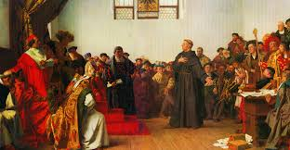
Luther!
“But before all these, they shall lay their hands on you, and persecute you, delivering you up to the synagogues, and into prisons, being brought before kings and rulers for my name's sake. And it shall turn to you for a testimony. Settle it therefore in your hearts, not to meditate before what ye shall answer: For I will give you a mouth and wisdom, which all your adversaries shall not be able to gainsay nor resist. And ye shall be betrayed both by parents, and brethren, and kinfolks, and friends; and some of you shall they cause to be put to death.” Luke 21:12-16

Slide 19
“In this time of persecution the faith of the Lord's servants will be tried. They have faithfully given the warning, looking to God and to His word alone. God's Spirit, moving upon their hearts, has constrained them to speak. Stimulated with holy zeal, and with the divine impulse strong upon them, they entered upon the performance of their duties without coldly calculating the consequences of speaking to the people the word which the Lord had given them. They have not consulted their temporal interests, nor sought to preserve their reputation or their lives. Yet when the storm of opposition and reproach bursts upon them, some, overwhelmed with consternation, will be ready to exclaim: "Had we foreseen the consequences of our words, we would have held our peace." They are hedged in with difficulties. Satan assails them with fierce temptations. The work which they have undertaken seems far beyond their ability to accomplish. They are threatened with destruction. The enthusiasm which animated them is gone; yet they cannot turn back. Then, feeling their utter helplessness, they flee to the Mighty One for strength. They remember that the words which they have spoken were not theirs, but His who bade them give the warning. God put the truth into their hearts, and they could not forbear to proclaim it.” GC, pg. 608, 609

