Slide 1
Mr. Wilson Goes to Moscow

Slide 2
Sigh and Cry!!!
“And the LORD said unto him, Go through the midst of the city, through the midst of Jerusalem, and set a mark upon the foreheads of the men that sigh and that cry for all the abominations that be done in the midst thereof. And to the others he said in mine hearing, Go ye after him through the city, and smite: let not your eye spare, neither have ye pity: Slay utterly old and young, both maids, and little children, and women: but come not near any man upon whom is the mark; and begin at my sanctuary. Then they began at the ancient men which were before the house.” Ezekiel 9:4-6

Slide 3
No Cloak!
“In the time when His wrath shall go forth in judgments, these humble, devoted followers of Christ will be distinguished from the rest of the world by their soul anguish, which is expressed in lamentation and weeping, reproofs and warnings. While others try to throw a cloak over the existing evil, and excuse the great wickedness everywhere prevalent, those who have a zeal for God's honor and a love for souls will not hold their peace to obtain favor of any. Their righteous souls are vexed day by day with the unholy works and conversation of the unrighteous. They are powerless to stop the rushing torrent of iniquity, and hence they are filled with grief and alarm. They mourn before God to see religion despised in the very homes of those who have had great light. They lament and afflict their souls because pride, avarice, selfishness, and deception of almost every kind are in the church. The Spirit of God, which prompts to reproof, is trampled underfoot, while the servants of Satan triumph. God is dishonored, the truth made of none effect.” 5 Testimonies, pg. 210

Slide 4
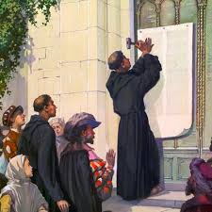
500 years ago, on October 31, 1517, German monk Martin Luther nailed the 95 theses or protests on the church door in Wittenberg, Germany. The world has never been the same sense. Luther’s Reformation brought the great principles of:
1. civil and religious freedom for everyone.
2. the middle class.
3. the right of all men to worship God according to the dictates of his/her own conscience.
500 years later, October 31,2017 saw a reformation too……….just not like Luther’s!!!

Slide 5
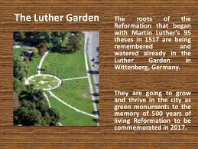
The Lutheran World Federation had a Luther Garden planted for the 500th anniversary. They said it was in honor of Luther’s Reformation. In reality, the Lutheran Federation website said, “For the Lutheran World Foundation, the worldwide dimension of the project supports its fundamental notion of the church, as it has been phrased in its constitution: "The Lutheran World Foundation confesses the one, holy, catholic and apostolic church and wants to serve the unity of Christianity." On this basis, the Lutheran World Foundation wants to underline the ecumenical significance of the Reformation anniversary and its importance for the ecumenical relationships.” WOW!

Slide 6
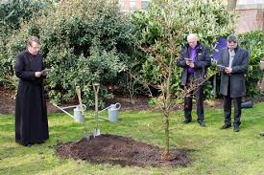
Churches Involved in the Luther Garden Ecumenism
Many, if not all major denominations around the globe planted a tree in the Garden, demonstrating their part in being a part of the ecumenical community of churches!

Slide 7
Even the 7th day Adventists
On March 3rd, 2015 a tree was planted for the Seventh-Day Adventist Church in Lower Saxony. The symbolical plantation of the Red Maple tree (Acer rubrum ‘October Glory’ was done by Rev. Ralf Schönfeld (president) and Rev. Detlef Bendig (deputy chairman)… On March 3rd, 2015 Johannes Scheel and Thomas Groß planted a Red Maple Tree (Acer rubrum ‚October Glory’) for the Seventh-Day Adventist in Berlin-Central Germany, which is a federation of churches from Berlin, Brandenburg, Saxony, Saxony-Anhalt and Thuringia.

Slide 8
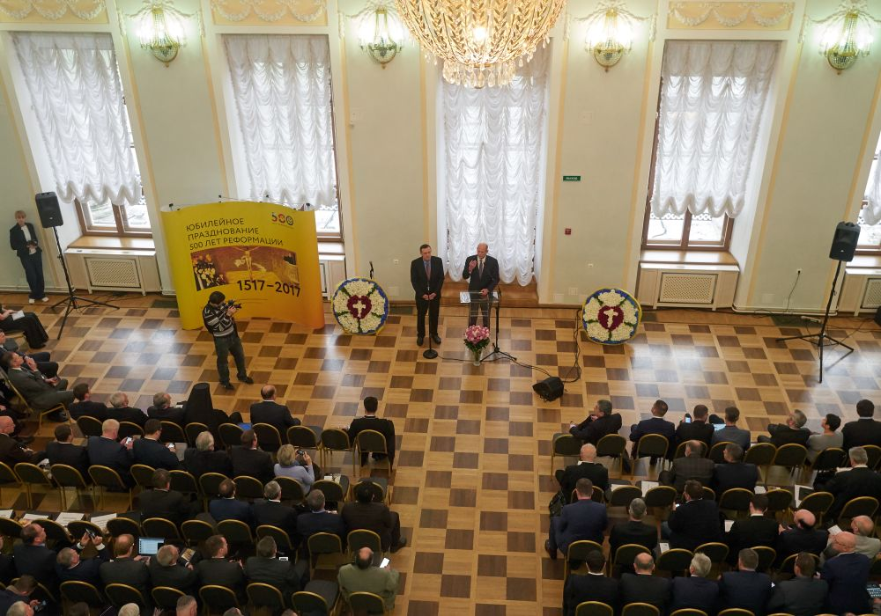
Where Was Ted Wilson on Reformation Day???
“It is a great privilege on this day 500 years after the Reformation began, when there seem to be so much instability and challenges in the world, to continue the reformation in our own hearts,” Wilson said in a brief speech to 200 leaders gathered for the “Reformation: 500 Years” event on Oct. 31. ANN, Nov. 1, 2107
Adventist Church president Ted N.C. Wilson, right, speaking at a Reformation forum in Pashkov House in Moscow, Russia, on Oct. 31, 2017. Euro-Asia Division president Michael Kaminski is interpreting.

Slide 9
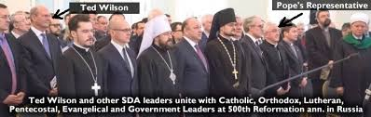
Mikhail Kaminsky (far left), president of the Euro-Asian Division of the Seventh-day Adventist Church stands next to Ted Wilson (second from left), President of the General Conference. Together they are standing shoulder to shoulder with Apostolic, Communist, Evangelical, Lutheran, Muslim, Orthodox, Pentecostal with the Pope’s representative—Vatican Ambassador and Roman Catholic, Archbishop Celestino Migliore (red arrow).

Slide 10
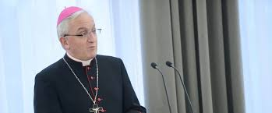
Francis’ representative Speaks
Archbishop Celestino Migliore, the Vatican Ambassador for this ecumenical event, brought greetings from Pope Francis. In his speech to the different religious and political leaders he told them the Roman Catholic Church was not only proud to participate in this celebration but they felt it was their “duty.” He also said it was not Rome’s intention to focus on the divisions brought about by the Protestant Reformation which he characterized as a “disease of conflict,” but instead to look forward to a new “joint future” based upon overcoming the “prejudices about the Reformation.” Surprisingly, Archbishop Celestino Migliore also praised the important understanding that we must maintain the “centrality” of the Word of God.

Slide 11
Wake Up!!!
“The Roman Church now presents a fair front to the world, covering with apologies her record of horrible cruelties. She has clothed herself in Christ like garments; but she is unchanged. Every principle of the papacy that existed in past ages exists today. The doctrines devised in the darkest ages are still held. Let none deceive themselves. The papacy that Protestants are now so ready to honor is the same that ruled the world in the days of the Reformation, when men of God stood up, at the peril of their lives, to expose her iniquity. She possesses the same pride and arrogant assumption that lorded it over kings and princes, and claimed the prerogatives of God. Her spirit is no less cruel and despotic now than when she crushed out human liberty and slew the saints of the Most High.” Great Controversy, pg. 571

Slide 12
Disease of Conflict
“As the Christian princes advanced to sign the Confession, Melanchthon interposed, saying: "It is for the theologians and ministers to propose these things; let us reserve for other matters the authority of the mighty ones of the earth." "God forbid," replied John of Saxony, "that you should exclude me. I am resolved to do what is right, without troubling myself about my crown. I desire to confess the Lord. My electoral hat and my ermine are not so precious to me as the cross of Jesus Christ." Having thus spoken, he wrote down his name. Said another of the princes as he took the pen: "If the honor of my Lord Jesus Christ requires it, I am ready . . . to leave my goods and life behind." "I would rather renounce my subjects and my states, rather quit the country of my fathers staff in hand," he continued, "than receive any other doctrine than that which is contained in this Confession." Such was the faith and daring of those men of God. The appointed time came to appear before the emperor. Charles V, seated upon his throne, surrounded by the electors and the princes, gave audience to the Protestant Reformers. The confession of their faith was read. In that august assembly the truths of the gospel were clearly set forth, and the errors of the papal church were pointed out. Well has that day been pronounced "the greatest day of the Reformation, and one of the most glorious in the history of Christianity and of mankind.“ Great Controversy, pg. 207

Slide 13
Open Your Eyes!!!!
Michael Kaminisky, president of the Adventist Church’s Moscow-based Euro-Asia Division, who interpreted Wilson’s remarks, marveled that senior clergy from the Russian Orthodox Church, the Roman Catholic Church, and the Islamic faith joined their Protestant counterparts in supporting the Bible.
“It was interesting to see people from various walks of life find something in common,” he said in an interview. “Everyone spoke about the importance of the Word of God.”

Slide 14
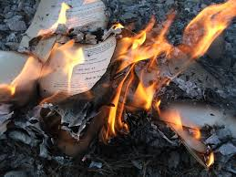
Centrality of Scripture??????
“The bishop of Durham at one time bought of a bookseller who was a friend of Tyndale his whole stock of Bibles, for the purpose of destroying them, supposing that this would greatly hinder the work. But, on the contrary, the money thus furnished, purchased material for a new and better edition, which, but for this, could not have been published. When Tyndale was afterward made a prisoner, his liberty was offered him on condition that he would reveal the names of those who had helped him meet the expense of printing his Bibles. He replied that the bishop of Durham had done more than any other person; for by paying a large price for the books left on hand, he had enabled him to go on with good courage.” GC, pg. 247

Slide 15
Rome Hates the Bible and Never Changes
“The war against the Bible, carried forward for so many centuries in France, culminated in the scenes of the Revolution. That terrible out breaking was but the legitimate result of Rome's suppression of the Scriptures. (See Appendix.) It presented the most striking illustration which the world has ever witnessed of the working out of the papal policy-- an illustration of the results to which for more than a thousand years the teaching of the Roman Church had been tending. The suppression of the Scriptures during the period of papal supremacy was foretold by the prophets; and the Revelator points also to the terrible results that were to accrue especially to France from the domination of the "man of sin.“ GC, pgs. 265,266

Slide 16
Spiritualism Embraces the Bible!!!!!
“It is true that spiritualism is now changing its form and, veiling some of its more objectionable features, is assuming a Christian guise. But its utterances from the platform and the press have been before the public for many years, and in these its real character stands revealed. These teachings cannot be denied or hidden. Even in its present form, so far from being more worthy of toleration than formerly, it is really a more dangerous, because a more subtle, deception. While it formerly denounced Christ and the Bible, it now professes to accept both. But the Bible is interpreted in a manner that is pleasing to the unrenewed heart, while its solemn and vital truths are made of no effect. Love is dwelt upon as the chief attribute of God, but it is degraded to a weak sentimentalism, making little distinction between good and evil. God's justice, His denunciations of sin, the requirements of His holy law, are all kept out of sight. The people are taught to regard the Decalogue as a dead letter. Pleasing, bewitching fables captivate the senses and lead men to reject the Bible as the foundation of their faith. Christ is as verily denied as before; but Satan has so blinded the eyes of the people that the deception is not discerned.” GC, pgs. 557,558

Slide 17
Wilson and the 3 Angel’s Messages
“He said the Seventh-day Adventist Church was grateful for the foundations of the Reformation, and he singled out several principles as especially important: only the Bible, salvation only by faith in Jesus, Christ is the only mediator, eternal life only through the grace of Jesus, and to God only be the glory.
Wilson said that those Reformation truths are proclaimed by sharing the three angels’ messages of Christ’s soon coming in Revelation 14.
“The very heart of the three angels’ messages is righteousness, the justification of Christ,” he said.
Pointing to Jesus’ words in Luke 4:18, Wilson added, “The Reformation must help make Christianity practical. Preach the gospel to the poor. Heal the broken hearted. Preach deliverance to the captives, recovery of sight to the blind, and set at liberty those who are bruised. As the Reformation continues, may these principles burn in our hearts and help us truly fulfill the Protestant Reformation.”
He also thanked the Russian government for protecting religious freedom in a part of the world where it can be difficult for Protestants to spread the gospel.” ANN, Nov. 1, 2107

Slide 18
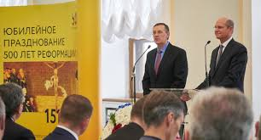
Salvation only by faith in Jesus
Just believe in Jesus??? Who in that room, of all those denominations, could not feel content with that comment??? “Thou believest that there is one God; thou doest well: the devils also believe, and tremble. But wilt thou know, O vain man, that faith without works is dead?” James 2:19,20
“While it formerly denounced Christ and the Bible, it now professes to accept both. But the Bible is interpreted in a manner that is pleasing to the unrenewed heart, while its solemn and vital truths are made of no effect. Love is dwelt upon as the chief attribute of God, but it is degraded to a weak sentimentalism, making little distinction between good and evil. God's justice, His denunciations of sin, the requirements of His holy law, are all kept out of sight.” GC, pg. 558

Slide 19
Sermons and Articles
In nearly 8 years, Ted Wilson has repeatedly declared the importance of preaching the three angel’s messages to the world. In all the messages and articles that I have read, he has never actually discussed and pinpointed who Babylon fallen is in the 2nd angel’s message, nor has he discussed the beast and his image in the 3rd angel’s message. When asked at ASI, in August 2014, Wilson declared the mark of the beast is any other day of the week than the 7th day Sabbath! What is this??? He gives lip service to the message, but never speaks on the parts that would make his ecumenical friends unhappy!!! Even his comments in Moscow left the ecumenical audience smiling as he spoke!! Everyone felt good about the 3 angel’s messages as simply believing in Jesus!

Slide 20
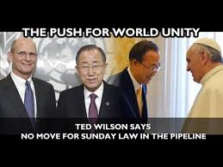
Track Record
1. General Conference 2010, Ted Wilson opposes Spiritual Formation. Actually had pushed for it in 2001!
2). Promotes 3 angels messages, but never publicly proclaims with clarity the second or the third angel’s message.
3). Promotes Great Controversy, but gives us ‘The Great Hope’ with NO clarity on the 2nd or 3rd angel’s message.
4). Goes to Russia, mentions like always, 3 angel’s messages, but says nothing of 2nd or 3rd angel’s message.
5). States publicly on 3ABN that Mark of The Beast is any other day than Saturday. He must know better than this?
Until Ted Wilson states publicly his position on The Mark of the Beast, Who Babylon fallen is, and the entire 3 angel’s messages, there will surely always be doubts as to where he stands on these important issues.

Slide 21
Long Time Coming
For decades, the Seventh day Adventist leaders have been imbibing the ecumenical spirit of Rome!
1. Froom and Anderson rewrote Adventist doctrine to go along with Rome in the 1950’s!
2. Arthur Maxwell, BB Beach and others sung the praises of Rome at Vatican II.
3. Neal Wilson, in 1975, said our belief in the papacy as the antichrist was in the garbage.
4. George Vandemann, Mervyn Maxwell, and Myron Widmer said that Rome was now a Christian Church and preaches the gospel straight from the Bible.
5. We changed our logo from 3 angel’s to 3 wavy lines to harmonize with the ecumenical council of 1982 in Lima, Peru.
6. Jan Paulsen and Ted Wilson have bent over backwards to accommodate Rome!
When will the voice of protest be heard in Adventism again???

Slide 22
Uniting on Common Points!
“When the leading churches of the United States, uniting upon such points of doctrine as are held by them in common, shall influence the state to enforce their decrees and to sustain their institutions, then Protestant America will have formed an image of the Roman hierarchy, and the infliction of civil penalties upon dissenters will inevitably result.” GC, pg. 445

Slide 23
Will You be Part of This Work?
“In the closing work of God in the earth, the standard of His law will be again exalted. False religion may prevail,iniquity may abound, the love of many may wax cold, the cross of Calvary may be lost sight of, and darkness, like the pall of death, may spread over the world; the whole force of the popular current may be turned against the truth; plot after plot may be formed to overthrow the people of God; but in the hour of greatest peril the God of Elijah will raise up human instrumentalities to bear a message that will not be silenced. In the populous cities of the land, and in the places where men have gone to the greatest lengths in speaking against the Most High, the voice of stern rebuke will be heard. Boldly will men of God's appointment denounce the union of the church with the world. Earnestly will they call upon men and women to turn from the observance of a man-made institution to the observance of the true Sabbath. "Fear God, and give glory to Him," they will proclaim to every nation; "for the hour of His judgment is come: and worship Him that made heaven, and earth, and the sea, and the fountains of waters. . . . If any man worship the beast and his image, and receive his mark in his forehead, or in his hand, the same shall drink of the wine of the wrath of God, which is poured out without mixture into the cup of His indignation." Revelation 14:7-10.

