Slide 1
Francis Calls for Global Govt.

Slide 2
Heading Toward May 2020
At a meeting of the Pontifical Academy held recently, Pope Francis (shown in white) advocated a policy of decreased national sovereignty and increased global unity. A shift toward globalism is necessary, he said, in order to fight climate change and other worldwide “threats.”
"When a supranational common good is clearly identified, it is necessary to have a special authority legally and concordantly constituted capable of facilitating its implementation. We think of the great contemporary challenges of climate change, new forms of slavery and peace,” his holiness told those gathered to discuss “Nation, State, and Nation-State,” the conference theme.
Pope Francis put a pretty fine point on his message, claiming that planetary problems are exacerbated by “an excessive demand for sovereignty on the part of States.”
He moved on to immigration, declaring that nationalism is too easily twisted into a doctrine repugnant to the welcoming of immigrants. “The Church observes with concern the reemergence, in many parts of the world, of currents that are aggressive towards foreigners, especially immigrants, as well as a growing nationalism that neglects the common good,” Pope Francis said.” May , 2019

Slide 3
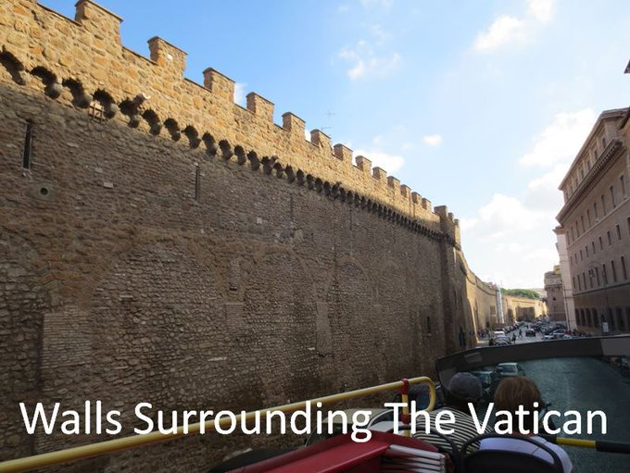
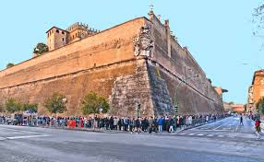
Wow!

Slide 4
Are You Going?
ROME - Pope Francis is inviting world leaders and young people to come together at the Vatican on May 14, 2020, for a an event called “Reinventing the Global Educational Alliance.” “Never before has there been such need to unite our efforts in a broad educational alliance, to form mature individuals capable of overcoming division and antagonism, and to restore the fabric of relationships for the sake of a more fraternal humanity,” Francis wrote in the message announcing the initiative, released by the Vatican’s press office on Thursday. According to Francis, education today clashes with a process of “rapidification” that traps human existence in a “whirlwind of high-speed technology and computerization, continually altering our points of reference.”

Slide 5
The Elite Are Invited!
As a result, human identity loses “its solidity,” he wrote. According to an African proverb, Francis wrote, “it takes a whole village to educate a child.” When it comes to education, that village still needs to be created, beginning by clearing the ground of “discrimination,” and fraternity “must be allowed to flourish.” According to the pope, this not only includes teachers, students and their families, but wider civil society, including science, sports, politics, and charitable organizations.

Slide 6
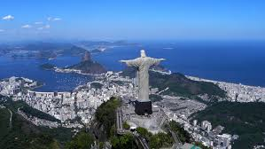
Fraternal Francis
Fraternal describes the relationship between brothers, but it is also used is to describe a club, society or fraternity, some brotherly group of people — usually men — with common interests.

Slide 7
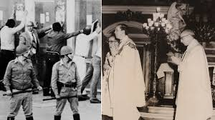
Rounding Up Dissidents!
“ the actions of the Roman Catholic Church during the Dirty War are still being called into question. In February - for the first time - the Argentine judiciary issued a ruling which stated that the Church was complicit in the abuses, and added that the Church was still refusing to investigate those believed responsible. Pope Francis was not part of the Catholic hierarchy at the time, but he was head of the Society of Jesus, or Jesuits, in Argentina.” BBC News, 15 March 2013

Slide 8
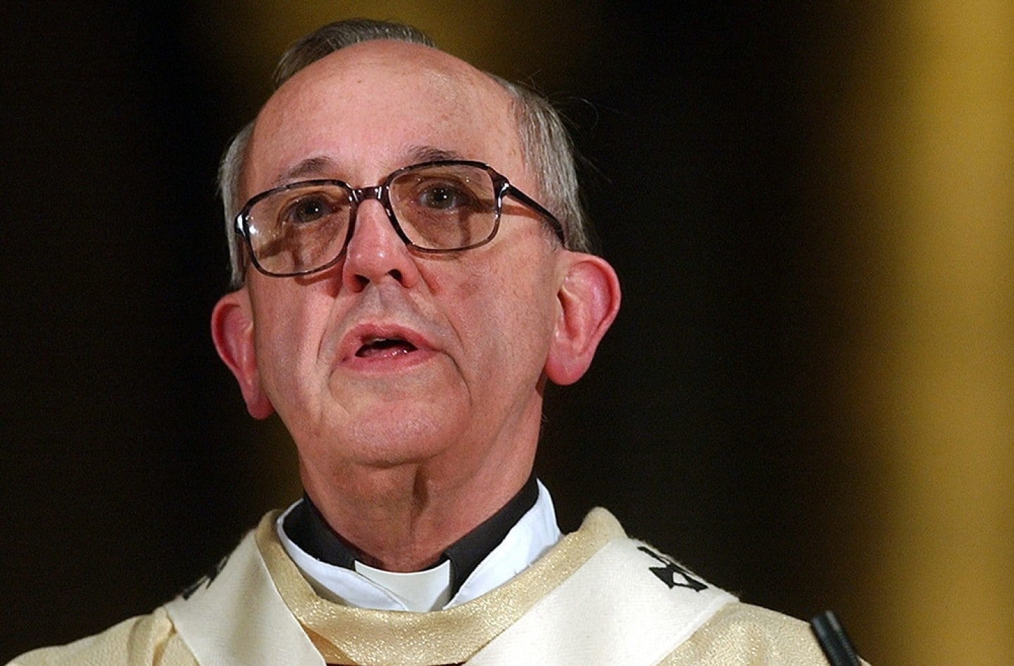
Only he Survived prison!
But for some Argentinians the pope pointedly remains Bergoglio rather than Francis. They still want to know what he did – or did not do – during Argentina’s Dirty War between the military dictatorship and its left-wing opponents during which the state murdered more than 10,000 people.
Such Argentinians include Estela de la Cuadra, whose family suffered more than most during the dictatorship: five of her family members were “disappeared”. Among those she never saw again were her husband, a brother-in-law and her sister Elena…. Former officials convicted in Argentina's 'dirty war' trial.
A court has sentenced 48 people to prison for crimes committed at a notorious torture center run by Argentina's junta. More than 30,000 people were kidnapped, tortured and killed in the 1976-83 "dirty war."

Slide 9
Laudato Si is on his Mind!
According to a statement from the Congregation for Catholic Education, the initiative is a response to a request that came during several meetings Francis had with different personalities of “various cultures and religious affiliations.” The statement said the fifth anniversary of the environmental encyclical Laudato Si’ was an “ideal platform” to launch the event. “The most significant personalities in the world are invited to take part in the proposed initiative, political, cultural and religious, and in particular the young people to whom the future belongs,” the Vatican statement says. “The goal is to arouse an awareness and a wave of responsibility for the common good of humanity, starting from the young and reaching all people of good will.”

Slide 10
Heal the Environment
The statement from the Congregation also said that the new educational pact will aim to heal three “fractures” affecting the world.
The first is that which separates reality from transcendence. According to the Vatican, children should be introduced to “total reality,” including openness to the transcendent, healing a “vertical rift between man and the Absolute.”
The second fracture the pact should heal is “horizontal,” between generations, cultures, and within the family, with people who bring different cultural visions and religions, and with those who face financial, social and moral difficulties.
The third fracture is that between humanity and the environment, with an urgent need to “create the conditions for ‘ecological citizenship’” that educates in “responsible austerity, grateful contemplation of the world, and care for the fragility of the poor and the environment.” Crux, Taking the Catholic Pulse

Slide 11
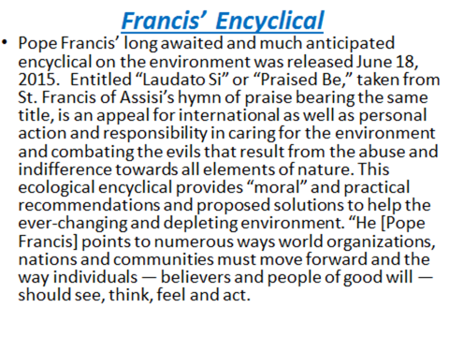

Slide 12
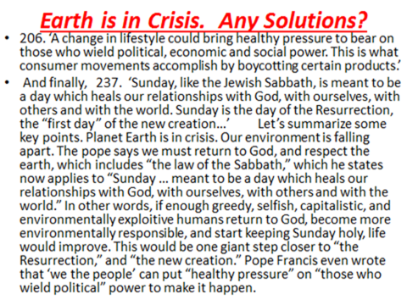

Slide 13
Connecting the Dots!
“While appearing to the children of men as a great physician who can heal all their maladies, he will bring disease and disaster, until populous cities are reduced to ruin and desolation. Even now he is at work. In accidents and calamities by sea and by land, in great conflagrations, in fierce tornadoes and terrific hailstorms, in tempests, floods, cyclones, tidal waves, and earthquakes, in every place and in a thousand forms, Satan is exercising his power. He sweeps away the ripening harvest, and famine and distress follow. He imparts to the air a deadly taint, and thousands perish by the pestilence. These visitations are to become more and more frequent and disastrous. Destruction will be upon both man and beast. “The earth mourneth and fadeth away,” “the haughty people ... do languish. The earth also is defiled under the inhabitants thereof; because they have transgressed the laws, changed the ordinance, broken the everlasting covenant.” Isaiah 24:4, 5. And then the great deceiver will persuade men that those who serve God are causing these evils. The class that have provoked the displeasure of Heaven will charge all their troubles upon those whose obedience to God's commandments is a perpetual reproof to transgressors. It will be declared that men are offending God by the violation of the Sunday sabbath; that this sin has brought calamities which will not cease until Sunday observance shall be strictly enforced; and that those who present the claims of the fourth commandment, thus destroying reverence for Sunday, are troublers of the people, preventing their restoration to divine favor and temporal prosperity.” GC, pgs. 589,590

Slide 14
Common Good, Sunday, and ?????
“An alliance, in other words, between the earth’s inhabitants and our ‘common home’, which we are bound to care for and respect,” Francis wrote. “An alliance that generates peace, justice and hospitality among all peoples of the human family, as well as dialogue between religions.” In addition to the May 14 meeting in the Vatican’s Paul VI Audience Hall, Francis said that a number of seminars on related topics will take place in other locations to prepare for the event. “I invite everyone to work for this alliance and to be committed, individually and within our communities, to nurturing the dream of a humanism rooted in solidarity and responsive both to humanity’s aspirations and to God’s plan,” Francis wrote.

Slide 15
Solidarity
Solidarity
Solidarity is about valuing our fellow human beings and respecting who they are as individuals. “The many situations of inequality, poverty and injustice, are signs not only of a profound lack of fraternity, but also of the absence of a culture of solidarity. New ideologies, characterized by rampant individualism, egocentrism and materialistic consumerism, weaken social bonds, fueling that “throw away” mentality which leads to contempt for, and the abandonment of, the weakest and those considered “useless”. In this way human coexistence increasingly tends to resemble a mere do ut des which is both pragmatic and selfish” Pope Francis
“We are all one family in the world. Building a community that empowers everyone to attain their full potential through each of us respecting each other’s dignity, rights and responsibilities makes the world a better place to live” Sollicitudo rei socialis – ‘On Social Concern’ (1987)

Slide 16
Francis’ Idea of Fraternity???????

Slide 17
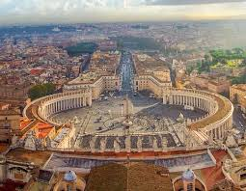
Common Good, Sunday, and No Individual Rights!
“And the beast that was, and is not, even he is the eighth, and is of the seven, and goeth into perdition. And the ten horns which thou sawest are ten kings, which have received no kingdom as yet; but receive power as kings one hour with the beast. These have one mind, and shall give their power and strength unto the beast. These shall make war with the Lamb, and the Lamb shall overcome them: for he is Lord of lords, and King of kings: and they that are with him are called, and chosen, and faithful.” Rev. 17:11-14

Slide 18
It will not be Silenced
“In the closing work of God in the earth, the standard of His law will be again exalted. False religion may prevail, [187] iniquity may abound, the love of many may wax cold, the cross of Calvary may be lost sight of, and darkness, like the pall of death, may spread over the world; the whole force of the popular current may be turned against the truth; plot after plot may be formed to overthrow the people of God; but in the hour of greatest peril the God of Elijah will raise up human instrumentalities to bear a message that will not be silenced. In the populous cities of the land, and in the places where men have gone to the greatest lengths in speaking against the Most High, the voice of stern rebuke will be heard. Boldly will men of God's appointment denounce the union of the church with the world. Earnestly will they call upon men and women to turn from the observance of a man-made institution to the observance of the true Sabbath. "Fear God, and give glory to Him," they will proclaim to every nation; "for the hour of His judgment is come: and worship Him that made heaven, and earth, and the sea, and the fountains of waters. . . . If any man worship the beast and his image, and receive his mark in his forehead, or in his hand, the same shall drink of the wine of the wrath of God, which is poured out without mixture into the cup of His indignation." Revelation 14:7-10.

