Slide 1
What is the Difference Between Mormons, Jehovah’s Witnesses, and Seventh-day Adventists? pt 13

Slide 2
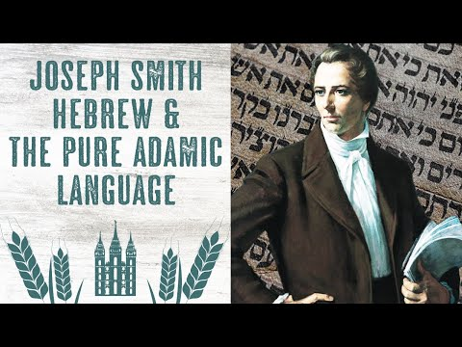
The Pure Adamic Language
In November 1830 Joseph Smith had already started his translation of the Bible. In the Book of Moses there is reference to a book created by Adam “in the language of Adam" and further states that Adam's children “were taught to read and write, having a language which was pure and undefiled.” (Moses 6:5-6). By March 20, 1832 Joseph Smith taught his followers a few samples of the “pure, Adamic language”. The following statement is from the Joseph Smith Papers, from Joseph’s own mouth:

Slide 3
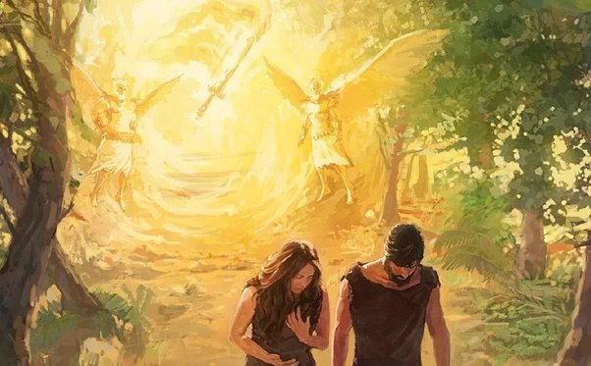
“A Sample of pure Language given by Joseph the Seer as copied by Br Johnson
Question: What is the name of God in pure Language
Answer: Awmen.
Q: The meaning of the pure word A[w]men
A: It is the being which made all things in all its parts.
Q: What is the name of the Son of God.
A: The Son Awmen.
Q: What is the Son Awmen.
A: It is the greatest of all the parts of Awmen which is the Godhead the first born.
Q: What is is man.
A: This signifies Sons Awmen. the human family the children of men the greatest parts of Awmen Sons the Son Awmen
Q: What are Angels called in pure language.
A: Awmen Angls-men
Q: What are the meaning of these words.
A: Awmen’s Ministerring servants Sanctified who are sent forth from heaven to minister for or to Sons Awmen the greatest part of Awmen Son. Sons Awmen Son Awmen Awmen”—josephsmithpapers.org, “Sample of Pure Language, between circa 4 and circa 20 March 1832”, https://www.josephsmithpapers.org/paper-summary/sample-of-pure-language-between-circa-4-and-circa-20-march-1832/1

Slide 4
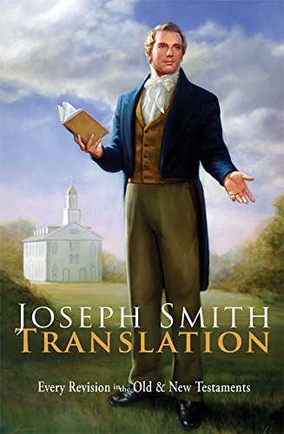
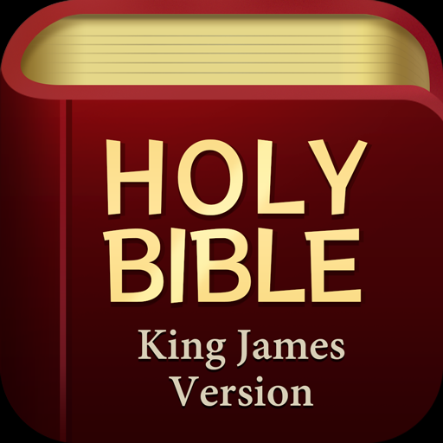
The Bible vs Joseph Smith
“The Joseph Smith Translation (JST), also called the Inspired Version of the Holy Scriptures (IV), is a revision of the Bible by Joseph Smith, the founder of the Latter Day Saint movement, who said that the JST/IV was intended to restore what he described as "many important points touching the salvation of men, [that] had been taken from the Bible, or lost before it was compiled".[Joseph Smith (Joseph Fielding Smith ed.), Teachings of the Prophet Joseph Smith, 16 February 1832, pp. 10–11] Smith died before he deemed it complete, though most of his work on it was performed about a decade beforehand. The work is the King James Version of the Bible (KJV) with some significant additions and revisions. It is considered a sacred text and is part of the canon of Community of Christ (CoC)”—Wikipedia, Joseph Smith Translation of the Bible

Slide 5
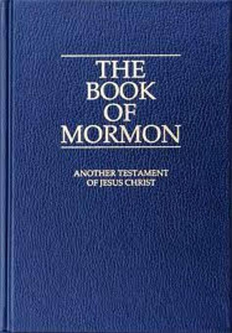
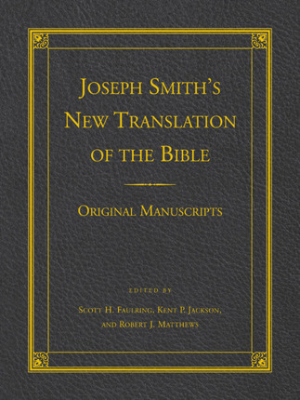
Another Gospel???
Gal. 1:6-9 “I marvel that ye are so soon removed from him that called you into the grace of Christ unto another gospel: Which is not another; but there be some that trouble you, and would pervert the gospel of Christ. But though we, or an angel from heaven, preach any other gospel unto you than that which we have preached unto you, let him be accursed. As we said before, so say I now again, if any man preach any other gospel unto you than that ye have received, let him be accursed.”

Slide 6
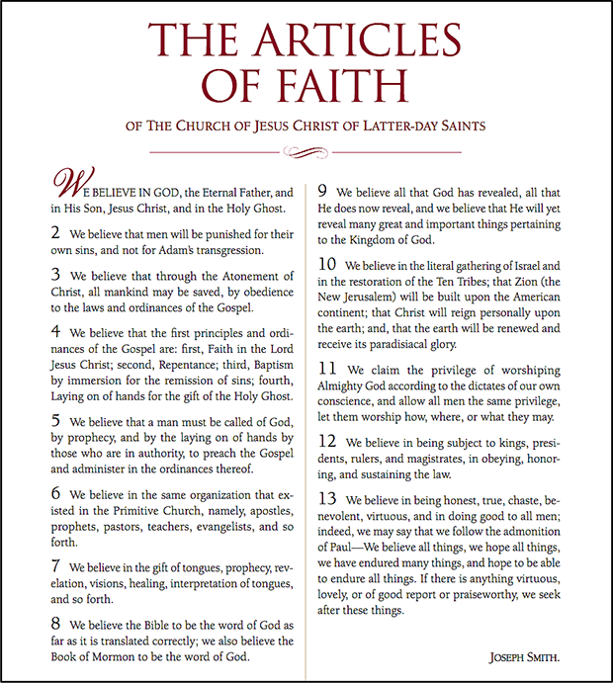
Articles of Faith: Article 8
Article 8: “We believe the Bible to be the word of God as far as it is translated correctly; we also believe the Book of Mormon to be the word of God.”

Slide 7
Bible Warnings About Tampering With Scripture
Deut. 4:2 “Ye shall not add unto the word which I command you, neither shall ye diminish ought from it, that ye may keep the commandments of the Lord your God which I command you.”
Rev. 22:18-19 “For I testify unto every man that heareth the words of the prophecy of this book, If any man shall add unto these things, God shall add unto him the plagues that are written in this book: And if any man shall take away from the words of the book of this prophecy, God shall take away his part out of the book of life, and out of the holy city, and from the things which are written in this book.”
Is. 40:8 “The grass withereth, the flower fadeth: but the word of our God shall stand for ever.”
Matt. 24:35 “Heaven and earth shall pass away, but my words shall not pass away.”

Slide 8
Why the Need to “Restore” the Bible???
“The restoration was necessary to gather Israel and to re-establish the true teachings and church of Jesus Christ in the world. By the end of the 19th century, LDS scholars and leaders had entered a new phase by turning to the findings of modern historians in an attempt to expand their understanding of the apostasy. Protestant historians, who focused on the failings of the Catholic tradition, provided seemingly endless evidences of apostasy in Christian history, justifying the Protestant reformation in the process. . . . Over the last century there has been an outpouring of rediscovered manuscripts, written during the first Christian centuries, that enable us to get a much clearer picture of what the Christian experience was like in those early times. And as our knowledge of these times grows, the apostasy is again pushed back further, even into the first century.”—Noel B. Reynolds, What Went Wrong for the Early Christians? Brigham Young University–Idaho Devotional, June 15, 2004 https://www2.byui.edu/Presentations/Transcripts/Devotionals/2004_06_15_Reynolds.htm

Slide 9
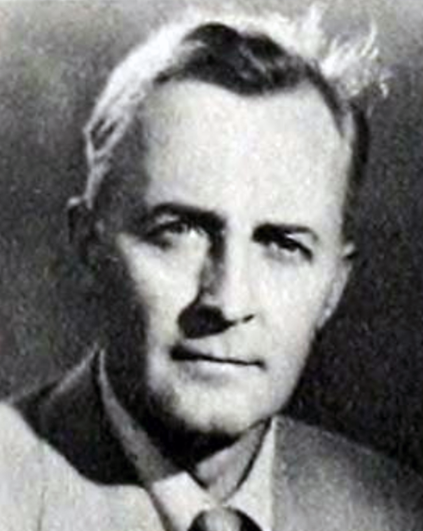
1st Century Apostasy???
“Hugh Nibley was the first LDS author to enter this third phase. He located the apostasy in the later decades of the very first century, from which almost no writings survived. Using a stage metaphor, he calls it the years “when the lights went out.” And when they came back on at the end of the century, he said, the furniture had all been moved around. But because there are no surviving documents from this period, we don’t know how that happened.”—Ibid.

Slide 10
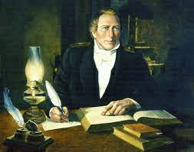
History of the Translation
“The JST/IV was a work in progress throughout Smith's ministry, the bulk between June 1830 and July 1833. Some parts of the revision (Genesis and the four Gospels) were completed from beginning to end, including unchanged verses from the KJV; some parts were revised more than once, and others revised one verse at a time”—Wikipedia, Joseph Smith Translation of the Bible

Slide 11
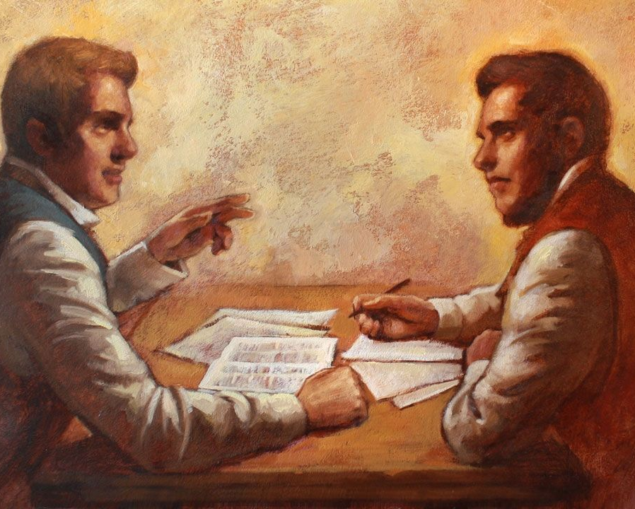
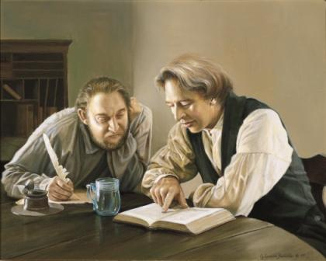
What Changes/Additions/Deletions Were Made?
Six Basic Types of Changes:
“Long additions that have little or no biblical parallel, such as the visions of Moses and Enoch, and the passage on Melchizedek
“Common-sense” changes (e.g., Genesis 6:6 “And it repented the Lord that he had made man” is revised in Moses 8:25 to read: “And it repented Noah, and his heart was pained that the Lord had made man”. God, being perfect, needs no repentance.)
“Interpretive additions”, often signaled by the phrase “or in other words,” appending to a passage to clarify
“Harmonization”, reconciled passages that seemed to conflict with other passages
"Not easily classifiable", frequently the meaning is changed, often idiosyncratically
Grammatical improvements, technical clarifications, and modernization of terms (by far the most common within the JST/IV)” Wikipedia, Joseph Smith Translation of the Bible

Slide 12
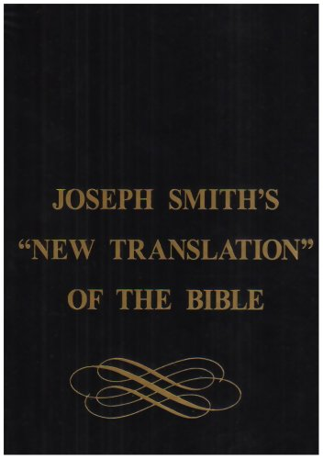
JST Introduction:
“Following are selected portions of the Joseph Smith Translation of the King James Version of the Bible (JST). The Lord inspired the Prophet Joseph Smith to restore truths to the King James Bible text that had become lost or changed since the original words were written. These restored truths clarified doctrine and improved scriptural understanding. Because the Lord revealed to Joseph certain truths that the original authors had once recorded, the Joseph Smith Translation is unlike any other Bible translation in the world. In this sense, the word translation is used in a broader and different way than usual, for Joseph’s translation was more revelation than literal translation from one language into another.”—Introduction to the JST, churchofjesuschrist.org https://www.churchofjesuschrist.org/study/scriptures/jst/introduction?lang=eng

Slide 13
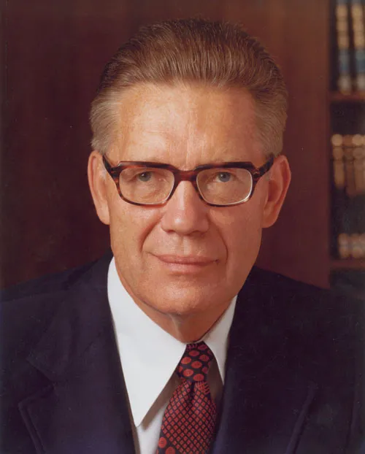
Bruce R. McConkie Chimes in
In 1984, Elder Bruce R. McConkie [Of the Quorum of the Twelve Apostles
Supplement, A Symposium on the New Testament, 1984 (1984), 1–7] stated: "The Joseph Smith Translation, or Inspired Version, is a thousand times over the best Bible now existing on earth. It contains all that the King James Version does, plus pages of additions and corrections and an occasional deletion. It was made by the spirit of revelation, and the changes and additions are the equivalent of the revealed word in the Book of Mormon and the Doctrine and Covenants... Reference to this section and to the footnotes themselves will give anyone who has spiritual insight a deep appreciation of this revelatory work of the Prophet Joseph Smith. It is one of the great evidences of his prophetic call." (The Bible, a Sealed Book, Key Nine, churchofjesuschrist.org)

Slide 14
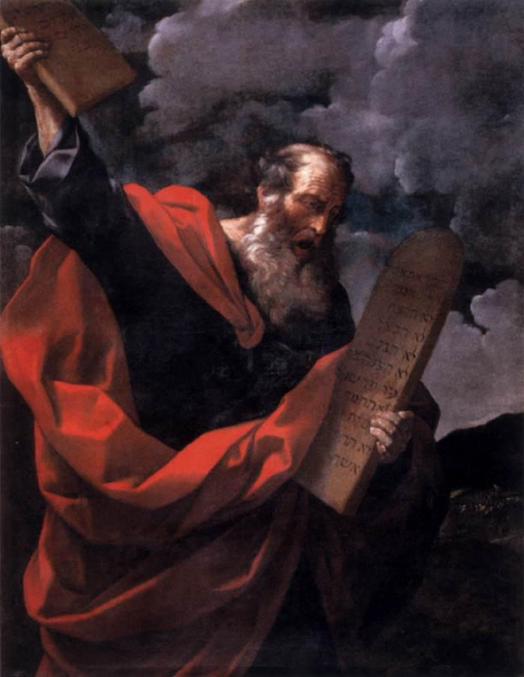
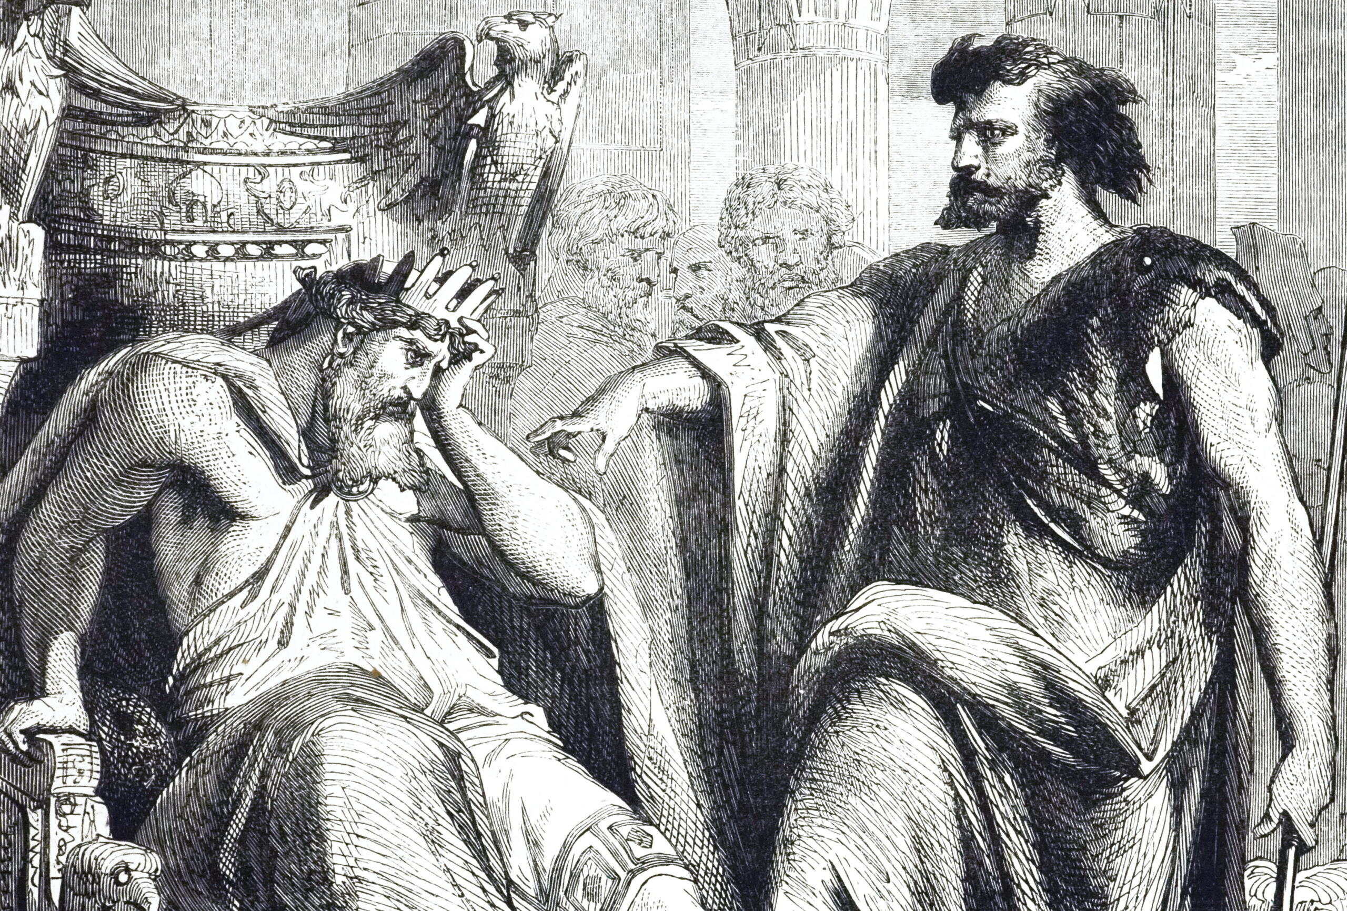
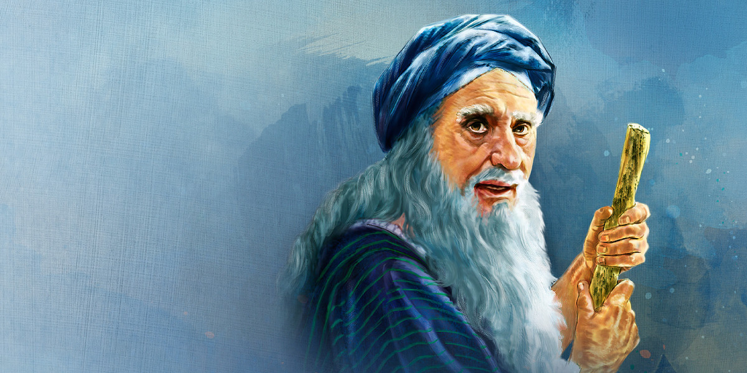
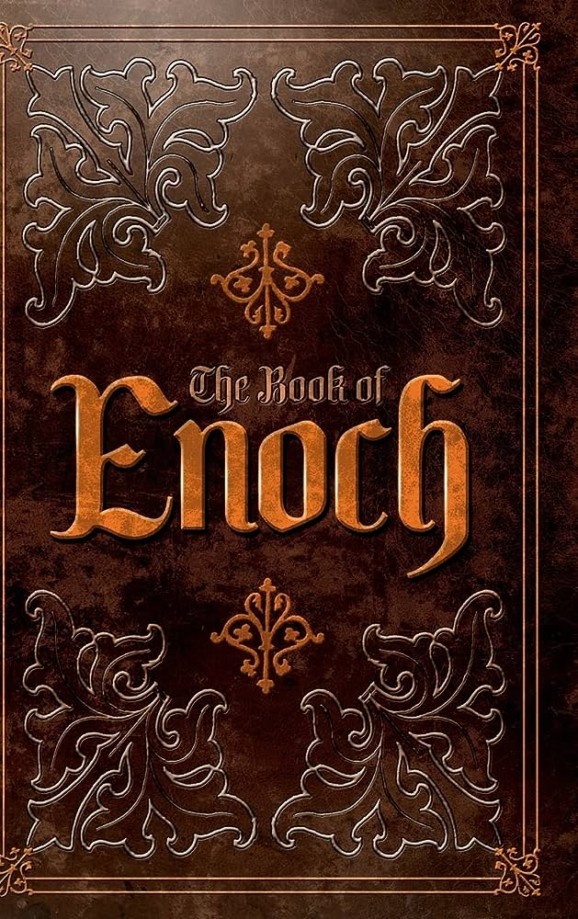
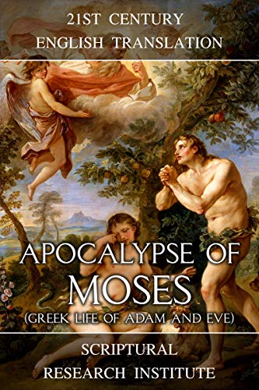
Joseph Smith a Psuedo-Author

Slide 15
Genesis Extended?
Genesis is the first book to be rewritten. Joseph Smith begins his “Book of Moses” not at Creation, but with ‘visions of Moses’. The book contains prophecies which are repeated in the ancient occult pseudepigraphal work called “the book of Enoch” with clear connections with the Apocalypse of Moses. Joseph later even adds a prophecy about himself in Genesis 50 (which has 38 verses, instead of 26 in the KJV):
Gen. 50:33 “And that seer will I bless, and they that seek to destroy him shall be confounded; for this promise I give unto you; for I will remember you from generation to generation; and his name shall be called Joseph, and it shall be after the name of his father; and he shall be like unto you; for the thing which the Lord shall bring forth by his hand shall bring my people unto salvation.”

Slide 16
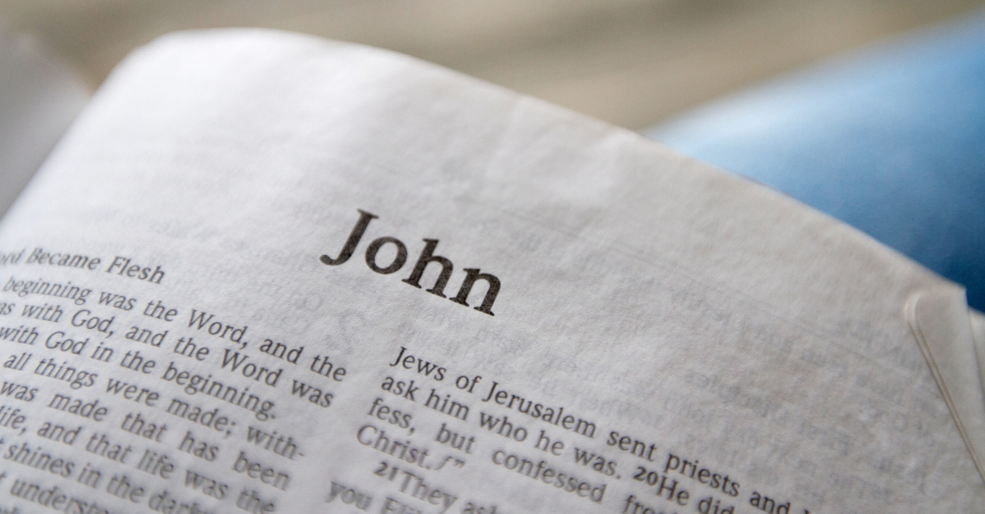
John 1
KJV
JST
John 1:1-3 “In the beginning was the Word, and the Word was with God, and the Word was God. The same was in the beginning with God. All things were made by him; and without him was not any thing made that was made.”
John 1:1-3 “In the beginning was the gospel preached through the Son. And the gospel was the word, and the word was with the Son, and the Son was with God, and the Son was of God. The same was in the beginning with God. All things were made by him; and without him was not anything made which was made.”
16 “For in the beginning was the Word, even the Son, who is made flesh, and sent unto us by the will of the Father. And as many as believe on his name shall receive of his fullness. And of his fullness have all we received, even immortality and eternal life, through his grace.”

Slide 17
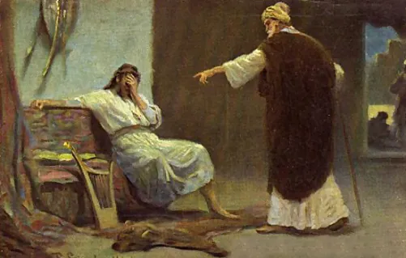
2 Samuel 12
KJV
JST
2 Sam. 12:13 “And David said unto Nathan, I have sinned against the Lord. And Nathan said unto David, The Lord also hath put away thy sin; thou shalt not die”
2 Sam. 12:13 “And David said unto Nathan, I have sinned against the Lord. And Nathan said unto David, The Lord also hath not put away thy sin that thou shalt not die”

Slide 18
Matthew 24
KJV
JST
Matt. 24:12-15 “And because iniquity shall abound, the love of many shall wax cold. But he that shall endure unto the end, the same shall be saved. And this gospel of the kingdom shall be preached in all the world for a witness unto all nations; and then shall the end come. When ye therefore shall see the abomination of desolation, spoken of by Daniel the prophet, stand in the holy place, (whoso readeth, let him understand:)”
Matt. 24:10-12 “And because iniquity shall abound, the love of many shall wax cold. But he that remaineth steadfast, and is not overcome, the same shall be saved. [?] When ye therefore, shall see
the abomination of desolation,
spoken of by Daniel the prophet,
concerning the destruction of Je-
rusalem, then ye shall stand in the
holy place. (Whoso readeth let
him understand.)”

Slide 19
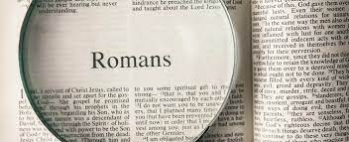
Romans 4
KJV
JST
Rom. 4:5 “But to him that worketh not, but believeth on him that justifieth the ungodly, his faith is counted for righteousness”
Rom. 4:5 “But to him that seeketh not to be justified by the law of works, but believeth on him who justifieth not the ungodly, his faith is counted for righteousness,”

Slide 20
Hebrews 6
KJV
JST
Hebrews 6:1 “Therefore leaving the principles of the doctrine of Christ, let us go on unto perfection; not laying again the foundation of repentance from dead works, and of faith toward God,”
Heb. 6:1 “Therefore not leaving the principles of the doctrine of Christ, let us go on unto perfection; not laying again the foundation of repentance from dead works, and of faith toward God,”

Slide 21
The Dead Sea Scrolls
Joseph Smith made over 100 “corrections” to the Book of Isaiah. However, in 1947, the Dead Scrolls were discovered. Of the Bible Manuscripts, they found what is now called “The Great Isaiah Scroll” which contained a complete copy of the Book of Isaiah. The Book of Isaiah matches the KJV translation and NOT the Joseph Smith Translation. The Dead Sea Scrolls date back to the 3rd Century BC, which means they are a lot older than the story of the “apostasy” given by the Mormon Church. Moreover, the Library of Congress stated this: “All of the books of the Bible are represented in the Dead Sea Scroll collection except Esther.” loc.gov, “Scrolls from the Dead Sea”, https://www.loc.gov/exhibits/scrolls/libr.html

Slide 22
Time-setting Again! 1975
"Choosing the Best Way of Life". The Watchtower. March 15, 1980. pp. 17–18. With the appearance of the book Life Everlasting—in Freedom of the Sons of God, ... considerable expectation was aroused regarding the year 1975. ... there were other statements published that implied that such realization of hopes by that year was more of a probability than a mere possibility. It is to be regretted that these latter statements apparently overshadowed the cautionary ones and contributed to a buildup of the expectation already initiated. ... persons having to do with the publication of the information ... contributed to the buildup of hopes centered on that date.
"What will the 1970's Bring?". Awake!. Watch Tower Society. October 8, 1968. p. 14. Does this mean that the above evidence positively points to 1975 as the complete end of this system of things? Since the Bible does not specifically state this, no man can say... If the 1970s should see intervention by Jehovah God to bring an end to a corrupt world drifting toward ultimate disintegration, that should surely not surprise us.
"How Are You Using Your Life?". Our Kingdom Ministry. May 1, 1974. p. 63. Reports are heard of brothers selling their homes and property and planning to finish out the rest of their days in this old system in the pioneer service. Certainly, this is a fine way to spend the short time remaining before the wicked world's end.

Slide 23
Decline of the Watch Tower After Death
Chicago Daily Tribune October 30, 1949 pg 18: "Pastor Russell died in 1916. In the 33 years since, the methods of this sect have deviated completely from those of Pastor Russell and his manner of teaching."

