Slide 1
The Feast of Atonement
The 4th Feast

Slide 2
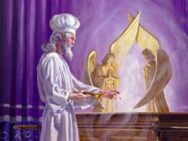
The Day
The fourth of five Jewish feasts was the Day of Atonement. It was coupled between the feast of trumpets and the feast of tabernacles. These three feasts made up the autumn feasts in the Jewish religious year.
The first of the three autumn feasts was the feast of trumpets. This one fell each year on the 7th month and the first day of the month. The day of Atonement fell 10 days later.

Slide 3
A Holy Convocation
“And the LORD spake unto Moses, saying, ‘Also on the tenth day of this seventh month there shall be a day of atonement; it shall be a holy convocation unto you; and ye shall afflict your souls, and offer an offering made by fire unto the LORD. And ye shall do no work in that same day: for it is a day of atonement, to make an atonement for you before the LORD your God. For whatsoever soul it be that shall not be afflicted in that same day, he shall be cut off from among his people. And whatsoever soul it be that doeth any work in that same day, the same soul will I destroy from among his people. Ye shall do no manner of work: it shall be a statute for ever throughout your generations in all your dwellings. It shall be unto you a sabbath of rest, and ye shall afflict your souls: in the ninth day of the month at even, from even unto even, shall ye celebrate your sabbath.” Leviticus 23:26-32

Slide 4
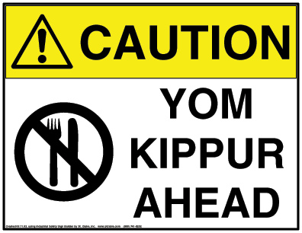
Yom Kippur
Yom Kippur , also known as the Day of Atonement, is the holiest day of the year for religious Jews. Its central themes are atonement and repentance. According to Jewish tradition, God inscribes each person's fate for the coming year into a book, the Book of Life, on Rosh Hashanah, and waits until Yom Kippur to "seal" the verdict. During the Days of Awe, a Jew tries to amend his or her behavior and seek forgiveness for wrongs done against God and against other human beings.

Slide 5
Day of Atonement=Day of Judgment
“For whatsoever soul it be that shall not be afflicted in that same day, he shall be cut off from among his people. And whatsoever soul it be that doeth any work in that same day, the same soul will I destroy from among his people.” Leviticus 23:29,30
Today, the ten days between Rosh Hashanah and Yom Kippur are days of repentance, when Jews express remorse for their sins through prayer and fasting. Yom Kippur is the final day of judgment, when each person's fate is sealed by God for the upcoming year.

Slide 6
The Uniqueness of ‘The Day’
1. The only day the high priest went into the Most Holy Place.
2. The only day the high priest only wore his linen clothes instead of his daily attire/regalia.
3. The only day that mediation was for cleansing and not for forgiveness.
4. The only day that sin was removed and not placed in the sanctuary.

Slide 7
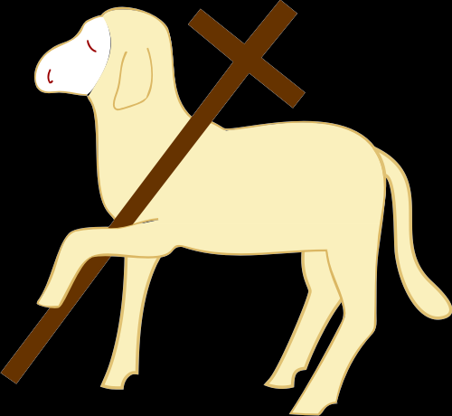
Why a Day of Atonement?
In the daily service, a person received forgiveness for their sins. Their sin was transferred to the sanctuary. They were forgiven; God’s entire government is built on this fact. When anyone comes to God thru the merits of Christ and asks for forgiveness, God’s character of justice must forgive. Why was it necessary for a Day of Atonement? Why was it necessary for a future day of Atonement/Judgment if a person had already been forgiven. The answer to this unlocks one of the most beautiful aspects of the entire salvation process/story!

Slide 8
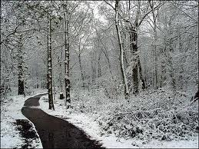
Some Wrong Answers
1. Legal forgiveness is all that matters.
2. Once you accept Christ, you are saved no matter what you may do.
3. Some are destined to be saved and others to be lost. If you are in the elect, don’t worry.
4. Because of Christ’s death, all mankind is saved.

Slide 9
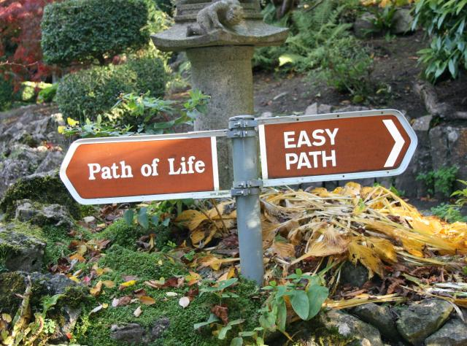
God Doesn’t Take away the power of Choice
Once we accept Christ’s forgiveness and are legally forgiven by God, we do not stop making choices. We do not become robots. We can choose to step away from the forgiveness of Christ and we can choose our own way. The Day of Atonement answers a simple question; is the person, who once embraced the forgiveness and love of God, still choosing to follow Christ when the Day of Atonement comes or at the end of his life? Am I still claiming Christ in my life when my name comes up in the judgment?

Slide 10
An Attorney Speaks
“But is that gift of life irrevocable, or is it contingent? To put it another way, by believing in Jesus does one thereby lose the freedom to change one’s mind? Evidently not; a great number of backsliders makes that point all too evident. The gift of life is bestowed with the condition of accepting Christ-with all that implies, including accepting Him as part of one’s own life. The relationship is more than a one-time contact; it is an ongoing connection, and to lose it brings tragic consequences…While belief in Christ calls into being the legal right to live forever, that gift cannot be granted irrevocably until there is no possibility that a person will change his mind and return to sin…God is confronted by persons stating a request that He cannot deny-eternal life in the name of Jesus. But He is also dealing with human beings, whose freedom of choice gives them the ability to change their minds.” Walton, Decision at the Jordan, pg. 67

Slide 11
Cleansing of the Sanctuary
“And he shall make an atonement for the holy place, because of the uncleanness of the children of Israel, and because of their transgressions in all their sins: and so shall he do for the tabernacle of the congregation, that remaineth among them in the midst of their uncleanness. And there shall be no man in the tabernacle of the congregation when he goeth in to make an atonement in the holy place, until he come out, and have made an atonement for himself, and for his household, and for all the congregation of Israel. And he shall go out unto the altar that is before the LORD, and make an atonement for it; and shall take of the blood of the bullock, and of the blood of the goat, and put it upon the horns of the altar round about. And he shall sprinkle of the blood upon it with his finger seven times, and cleanse it, and hallow it from the uncleanness of the children of Israel.” Leviticus 16:16-19

Slide 12

Cleansing of the People
“For on that day shall the priest make an atonement for you, to cleanse you, that ye may be clean from all your sins before the LORD.” Lev. 16:30
More than forgiveness, it meant the cleansing from sin through faith in Christ. “He that overcometh, the same shall be clothed in white raiment; and I will not blot out his name out of the book of life, but I will confess his name before my Father, and before his angels. “ Rev. 3:5

Slide 13
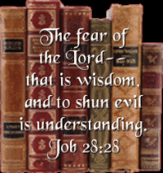
Sin Known
“Sin may be concealed, denied, covered up from father, mother, wife, children, and associates; no one but the guilty actors may cherish the least suspicion of the wrong; but it is laid bare before the intelligences of heaven. The darkness of the darkest night, the secrecy of all deceptive arts, is not sufficient to veil one thought from the knowledge of the Eternal. God has an exact record of every unjust account and every unfair dealing. He is not deceived by appearances of piety. He makes no mistakes in His estimation of character. Men may be deceived by those who are corrupt in heart, but God pierces all disguises and reads the inner life.” GC, pg. 486

Slide 14
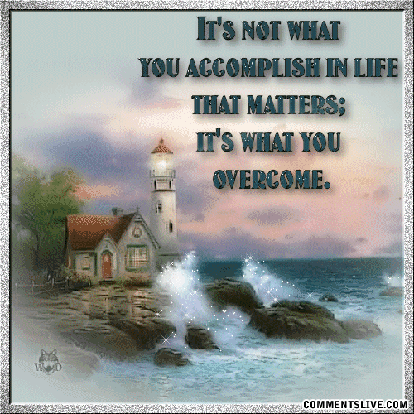
Overcoming
“If those who hide and excuse their faults could see how Satan exults over them, how he taunts Christ and holy angels with their course, they would make haste to confess their sins and to put them away. Through defects in the character, Satan works to gain control of the whole mind, and he knows that if these defects are cherished, he will succeed. Therefore he is constantly seeking to deceive the followers of Christ with his fatal sophistry that it is impossible for them to overcome. But Jesus pleads in their behalf His wounded hands, His bruised body; and He declares to all who would follow Him: "My grace is sufficient for thee." 2 Corinthians 12:9.

Slide 15
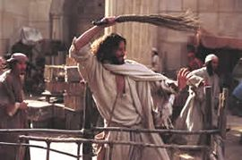
Christ’s Mission
“…the Jews had not understood the significance of the building they regarded with so much pride. They did not yield themselves as holy temples for the Divine Spirit. The courts of the temple at Jerusalem, filled with the tumult of unholy traffic, represented all too truly the temple of the heart, defiled by the presence of sensual passion and unholy thoughts. In cleansing the temple from the world's buyers and sellers, Jesus announced His mission to cleanse the heart from the defilement of sin,--from the earthly desires, the selfish lusts, the evil habits, that corrupt the soul.” DA, pg. 161

Slide 16
In Heaven Right Now!
“Jesus will appear as their advocate, to plead in their behalf before God. "If any man sin, we have an advocate with the Father, Jesus Christ the righteous." 1 John 2:1. "For Christ is not entered into the holy places made with hands, which are the figures of the true; but into heaven itself, now to appear in the presence of God for us." "Wherefore He is able also to save them to the uttermost that come unto God by Him, seeing He ever liveth to make intercession for them." Hebrews 9:24; 7:25. As the books of record are opened in the judgment, the lives of all who have believed on Jesus come in review before God. Beginning with those who first lived upon the earth, our Advocate presents the cases of each successive generation, and closes with the living. Every name is mentioned, every case closely investigated. Names are accepted, names rejected. When any have sins remaining upon the books of record, unrepented of and unforgiven, their names will be blotted out of the book of life, and the record of their good deeds will be erased from the book of God's remembrance. The Lord declared to Moses: "Whosoever hath sinned against Me, him will I blot out of My book." Exodus 32:33. And says the prophet Ezekiel: "When the righteous turneth away from his righteousness, and committeth iniquity, . . . all his righteousness that he hath done shall not be mentioned." Ezekiel 18:24. All who have truly repented of sin, and by faith claimed the blood of Christ as their atoning sacrifice, have had pardon entered against their names in the books of heaven; as they have become partakers of the righteousness of Christ, and their characters are found to be in harmony with the law of God, their sins will be blotted out, and they themselves will be accounted worthy of eternal life.” GC, pgs. 482,483

Slide 17
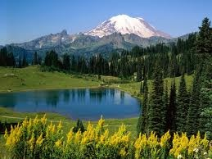
Atonement-Judgment-Cleansing
As Bible students studied the sanctuary and recognized that all 3 of these terms were identical, they realized that the time period of Daniel 8:14 “And he said unto me, Unto two thousand and three hundred days; then shall the sanctuary be cleansed,” pinpointed a prophecy revealing the time when judgment would begin in the heavenly sanctuary. This coupled with the message of Revelation 14:7 “Saying with a loud voice, Fear God, and give glory to him; for the hour of his judgment is come: and worship him that made heaven, and earth, and the sea, and the fountains of waters.” This Scriptures became the spring board to understanding the time frame for the 4th antitypical feast of the Jews!

Slide 18

1844!
By studying Daniel 8 and 9, Bible students realized that the 2,300 year prophecy ended in 1844 and then it was that judgment began in heaven. This feast pointed to Christ’s final work in the heavenly sanctuary in the Most Holy Place! They then realized that the message of William Miller and others were the fulfillment of the feast of trumpets, and that 1844 marked a key date in salvation history. Judgment had begun and that showed clearly how close mankind was to the end of time and this earth’s history!

Slide 19

One Feast Remains
Through the feasts, we have seen:
1. Christ’s death
2. Christ’s work as our High Priest in the Holy Place.
3. Christ’s warning that judgment was approaching.
4. Christ’s work in the Most Holy Place.
5. What could the final feast of Tabernacles represent?

