Slide 1
Daniel 3
‘Walking in Fire’

Slide 2
Remembering a dream
Nebuchadnezzar had seen a dream of a metal man in Daniel 2. Daniel had told him that his kingdom of Babylon was the head of gold. Daniel also told him that Babylon would pass away and other inferior kingdoms would arise, represented by the silver, brass, iron, and iron/clay mixture. Finally, the great stone – the kingdom of heaven- would put an end to all these kingdoms and IT would endure forever! Nebuchadnezzar didn’t like this; his kingdom would endure forever, and he would make sure everyone got the message!

Slide 3
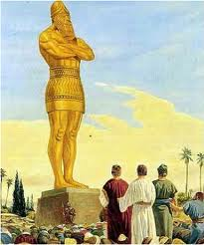
Out do the Creator
“Nebuchadnezzar the king made an image of gold, whose height was threescore cubits, and the breadth thereof six cubits: he set it up in the plain of Dura, in the province of Babylon.” Daniel 3:1

Slide 4
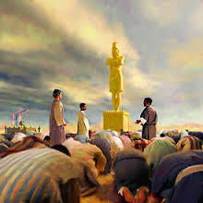
Assault on Heaven!
This was a direct assault on the Creator God of Heaven! The Lord had said one thing and Nebuchadnezzar, the arrogant, conceited, boastful monarch would do another! This was a direct affront to the Creator’s authority!

Slide 5
Needed Reinforcements
“Then Nebuchadnezzar the king sent to gather together the princes, the governors, and the captains, the judges, the treasurers, the counsellors, the sheriffs, and all the rulers of the provinces, to come to the dedication of the image which Nebuchadnezzar the king had set up. Then the princes, the governors, and captains, the judges, the treasurers, the counsellors, the sheriffs, and all the rulers of the provinces, were gathered together unto the dedication of the image that Nebuchadnezzar the king had set up; and they stood before the image that Nebuchadnezzar had set up…all the people, the nations, and the languages, fell down and worshipped the golden image that Nebuchadnezzar the king had set up.” Daniel 3:2,3,7

Slide 6
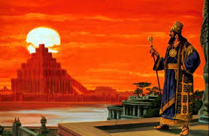
Unify the empire in Rebellion
Babylon the Great would be united in rebellion against the authority of the God of Heaven. Babylon the Great would bring the world together in rebellion against the God of Creation! The unity would be centered in this golden metal man. This unity and worship would be a direct assault on the Creator and a slap in His face!!!

Slide 7
Since he has been Pope, Francis has expressed a desire for unity with the Eastern Orthodox, the Anglicans, and many other major Protestant denominations. But more than a few eyebrows were raised when he recently sent a video message to Kenneth Copeland and his congregation. At the time that the video message was played to the congregation, one speaker declared that “Luther’s protest is over”…“The Catholic and Charismatic Renewal is the hope of the Church,” exclaims Anglican Episcopal Bishop Tony Palmer, before a group of cheering followers at the Kenneth Copeland Ministries. Palmer said those words are from the Vatican. Before playing the video message from Pope Francis to Kenneth Copeland, Palmer told the crowd, “When my wife saw that she could be Catholic, and Charismatic, and Evangelical, and Pentecostal, and it was absolutely accepted in the Catholic Church, she said that she would like to reconnect her roots with the Catholic culture. So she did.” The crowd cheered, as he continued, “Brothers and sisters, Luther’s protest is over. Is yours?” Even Kenneth Copeland finds this development incredible: Said Copeland, “Heaven is thrilled over this…You know what is so thrilling to me? When we went into the ministry 47 years ago, this was impossible. So is Luther’s protest really over?”

Slide 8
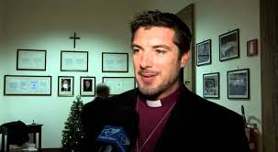
Modern Day Elijah
Pope Francis, a Jesuit, the head of Babylon the Great; Kenneth Copeland has been strongly identified with preaching a prosperity and abundance message, commonly referred to as a prosperity gospel; and Tony Palmer, Bishop of the Anglican Episcopal Communion, want to unite all the churches. Just like Nebuchadnezzar in Daniel 3!

Slide 9
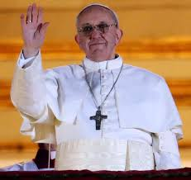
False worship is the issue
“That at what time ye hear the sound of the cornet, flute, harp, sackbut, psaltery, dulcimer, and all kinds of musick, ye fall down and worship the golden image that Nebuchadnezzar the king hath set up: And whoso falleth not down and worshippeth shall the same hour be cast into the midst of a burning fiery furnace.” Dan. 3:5,6

Slide 10
Unity in False Worship
That the issue here is unity in false worship is plain because Daniel 3 mentions worship more than any other chapter in Scripture. 11 times, worship or forms of the word are cited. ( Daniel 3:5,6,7,10,11,12,14,15 (2), 18, and 28) This worship could not be done by the 3 Hebrews because it would be going against the 2nd commandment. “⁴ Thou shalt not make unto thee any graven image, or any likeness of any thing that is in heaven above, or that is in the earth beneath, or that is in the water under the earth: Thou shalt not bow down thyself to them, nor serve them: for I the LORD thy God am a jealous God, visiting the iniquity of the fathers upon the children unto the third and fourth generation of them that hate me;” Ex. 20:4,5

Slide 11
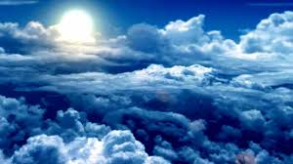
Daniel 3 and Revelation 13
While Daniel 3 refers to worship more than any other chapter in Scripture, the chapter in the Bible that is 2nd is………………………………………………………………………………………....Revelation 13. In that chapter, the word is used 5 times.

Slide 12
Jesus Nailed it!
“Why do thy disciples transgress the tradition of the elders? for they wash not their hands when they eat bread. But he answered and said unto them, Why do ye also transgress the commandment of God by your tradition? For God commanded, saying, Honour thy father and mother: and, He that curseth father or mother, let him die the death. But ye say, Whosoever shall say to his father or his mother, It is a gift, by whatsoever thou mightest be profited by me; And honour not his father or his mother, he shall be free. Thus have ye made the commandment of God of none effect by your tradition. Ye hypocrites, well did Esaias prophesy of you, saying, This people draweth nigh unto me with their mouth, and honoureth me with their lips; but their heart is far from me. But in vain they do worship me, teaching for doctrines the commandments of men.” Matthew 15:2-9

Slide 13
No Leader Has the Right!
“Every man has a right to worship God according to his own convictions; no one is called upon to obey laws that are opposed to the laws of God; and the only position the State can take, and have the approval of God, is to guard the rights of every individual, permitting no oppression to come upon any one because of religious belief.
As Nebuchadnezzar tried to force his subjects to obey his mandates, so men will try to force us to disregard the Word of God. They will endeavor to compel us to render homage to man-made statutes; but in God’s strength we are to refuse to dishonor him. The laws of earthly kingdoms are to be obeyed only when they do not conflict with the laws of God. When governments are tyrannical and overbearing, when they trample on God’s law, their laws are contemptible in his sight. And when they try to control the minds and consciences of those whom Christ died to make free, God’s children are to show their loyalty to him by refusing to disobey his commandments. {ST May 13, 1897, par. 8}

Slide 14
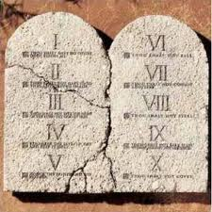
Which Command of God Goes Down?
In the times of Nebuchadnezzar, Babylon the Great went after the 2nd commandment. In their efforts to unify, which commandment will Francis, Copeland, Palmer and the world assault in an open affront to Heaven’s authority? The Bible and history are so clear!

Slide 15
Worship in Revelation
“Saying with a loud voice, Fear God, and give glory to him; for the hour of his judgment is come: and worship him that made heaven, and earth, and the sea, and the fountains of waters. And there followed another angel, saying, Babylon is fallen, is fallen, that great city, because she made all nations drink of the wine of the wrath of her fornication. And the third angel followed them, saying with a loud voice, If any man worship the beast and his image, and receive his mark in his forehead, or in his hand,”

Slide 16
Sabbath or Sunday?
“ Remember the sabbath day, to keep it holy. Six days shalt thou labour, and do all thy work: But the seventh day is the sabbath of the LORD thy God: in it thou shalt not do any work, thou, nor thy son, nor thy daughter, thy manservant, nor thy maidservant, nor thy cattle, nor thy stranger that is within thy gates: For in six days the LORD made heaven and earth, the sea, and all that in them is, and rested the seventh day: wherefore the LORD blessed the sabbath day, and hallowed it.” Ex. 20:8-11
“It is well to remind the Presbyterians, Baptists, Methodists, and all other Christians, that the Bible does not support them anywhere in their observance of Sunday. Sunday is an institution of the Roman Catholic Church, and those who observe the day observe a commandment of the Catholic Church. “— Priest Brady, in an address, reported in the Elizabeth, N.J. “News,” March 18, 1903.

Slide 17
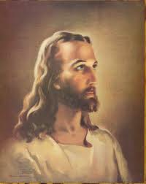
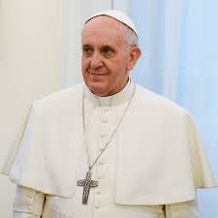
The Creator or the creature?

Slide 18
Foretold
Charles Beecher, in a sermon in the year 1846, declared that the ministry of "the evangelical Protestant denominations" is "not only formed all the way up under a tremendous pressure of merely human fear, but they live, and move, and breathe in a state of things radically corrupt, and appealing every hour to every baser element of their nature to hush up the truth, and bow the knee to the power of apostasy. Was not this the way things went with Rome? Are we not living her life over again? And what do we see just ahead? Another general council! A world's convention! Evangelical alliance, and universal creed!"--Sermon on "The Bible a Sufficient Creed," delivered at Fort Wayne, Indiana, Feb. 22, 1846. When this shall be gained, then, in the effort to secure complete uniformity, it will be only a step to the resort to force. When the leading churches of the United States, uniting upon such points of doctrine as are held by them in common, shall influence the state to enforce their decrees and to sustain their institutions, then Protestant America will have formed an image of the Roman hierarchy, and the infliction of civil penalties upon dissenters will inevitably result. “ GC, pgs. 444,445

Slide 19
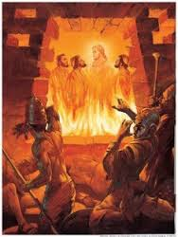
Where is Christ in the Drama?
And these three men, Shadrach, Meshach, and Abednego, fell down bound into the midst of the burning fiery furnace. Then Nebuchadnezzar the king was astonied, and rose up in haste, and spake, and said unto his counsellors, Did not we cast three men bound into the midst of the fire? They answered and said unto the king, True, O king. He answered and said, Lo, I see four men loose, walking in the midst of the fire, and they have no hurt; and the form of the fourth is like the Son of God.” Dan. 3:23-25

Slide 20
After 3 Chapters
God and His Faithful Children- 3
Babylon the Great-0

