Slide 1
Feast Days, pt.1
Shadows of Christ

Slide 2
Trouble in Jerusalem
“And certain men which came down from Judaea taught the brethren, and said, Except ye be circumcised after the manner of Moses, ye cannot be saved. When therefore Paul and Barnabas had no small dissension and disputation with them, they determined that Paul and Barnabas, and certain other of them, should go up to Jerusalem unto the apostles and elders about this question….
And when they were come to Jerusalem, they were received of the church, and of the apostles and elders, and they declared all things that God had done with them. But there rose up certain of the sect of the Pharisees which believed, saying, That it was needful to circumcise them, and to command them to keep the law of Moses. And the apostles and elders came together for to consider of this matter.” Acts 15:1-7

Slide 3
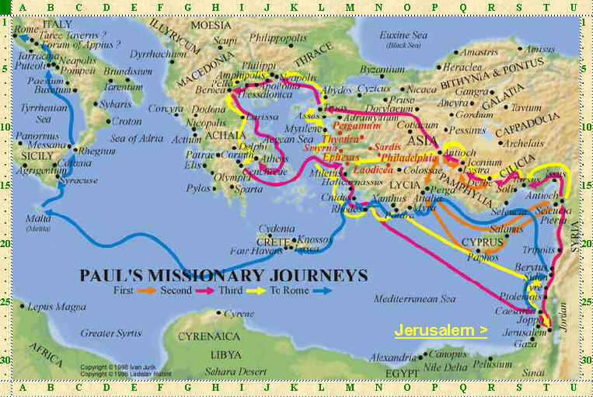
Never went Away
“I marvel that ye are so soon removed from him that called you into the grace of Christ unto another gospel: Which is not another; but there be some that trouble you, and would pervert the gospel of Christ. But though we, or an angel from heaven, preach any other gospel unto you than that which we have preached unto you, let him be accursed.” Galatians 1:6-8

Slide 4
The Other Gospel
“ But neither Titus, who was with me, being a Greek, was compelled to be circumcised: And that because of false brethren unawares brought in, who came in privily to spy out our liberty which we have in Christ Jesus, that they might bring us into bondage.” Gal. 2:2-4
“But now, after that ye have known God, or rather are known of God, how turn ye again to the weak and beggarly elements, whereunto ye desire again to be in bondage? Ye observe days, and months, and times, and years.” Gal. 4:9,10
“Through the influence of false teachers who had arisen among the believers in Jerusalem, division, heresy, and sensualism were rapidly gaining ground among the believers in Galatia. These false teachers were mingling Jewish traditions with the truths of the gospel. Ignoring the decision of the general council at Jerusalem, they urged upon the Gentile converts the observance of the ceremonial law. The situation was critical.” AA, pg. 383
a

Slide 5
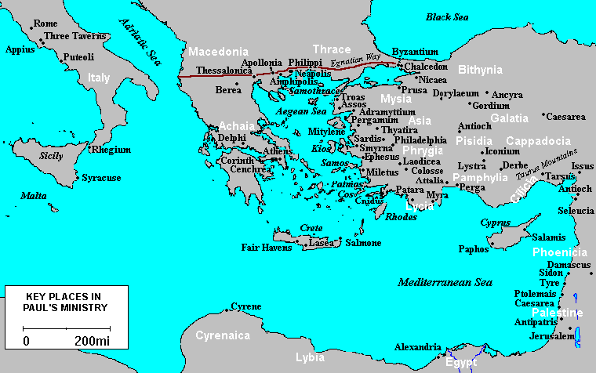
Colossae Too!

Slide 6
Circumcision and Feast Days
“In whom also ye are circumcised with the circumcision made without hands, in putting off the body of the sins of the flesh by the circumcision of Christ: Buried with him in baptism, wherein also ye are risen with him through the faith of the operation of God, who hath raised him from the dead. And you, being dead in your sins and the uncircumcision of your flesh, hath he quickened together with him, having forgiven you all trespasses; Blotting out the handwriting of ordinances that was against us, which was contrary to us, and took it out of the way, nailing it to his cross; And having spoiled principalities and powers, he made a shew of them openly, triumphing over them in it. Let no man therefore judge you in meat, or in drink, or in respect of an holyday, or of the new moon, or of the sabbath [days]: Which are a shadow of things to come; but the body [is] of Christ.” Colossians 2:11-17

Slide 7
Paul’s Argument
The commandments contained in ordinances were abolished. Ordinances are laws; they are also things whereby people participate or have a part. We call foot washing the ‘ordinance of humility’. In an ordinance, people have a part in the process. They were nailed to the cross because they all pointed forward to what Christ would do for man and in man! Paul, in this context, mentions the ordinances that were abolished: circumcision and the feast days.

Slide 8
Ceremonies No Longer Needed
Circumcision pointed to Christ cutting away sin from the life. “And the LORD thy God will circumcise thine heart, and the heart of thy seed, to love the LORD thy God with all thine heart, and with all thy soul, that thou mayest live.” Deut. 30:6
Each feast day pointed forward to something Christ would do for us. There were five feasts:
1. Passover /unleavened bread.
2. Pentecost/feast of weeks.
3. Trumpets
4. Atonement/Judgment
5. Tabernacles

Slide 9
Every Feast
“Let no man therefore judge you in meat, or in drink, or in respect of an holyday, or of the new moon, or of the sabbath [days]: Which are a shadow of things to come; but the body [is] of Christ.” Colossians 2:16,17
Every feast contained meat offerings, drink offerings, holy days, new moons, and sabbaths. Because these sabbaths were based on the new moons, they could fall on any day of the week. Whenever a feast day sabbath fell on the 7th day Sabbath, it was called ‘an high day’. Jn. 19:31 “The Jews therefore, because it was the preparation, that the bodies should not remain upon the cross on the sabbath day, (for that sabbath day was an high day,) besought Pilate that their legs might be broken, and [that] they might be taken away.”

Slide 10
All Components of Paul
“And in the fourteenth day of the first month [is] the passover of the LORD. And in the fifteenth day of this month [is] the feast: seven days shall unleavened bread be eaten. In the first day shall be an holy convocation; ye shall do no manner of servile work therein:”verses 16-18
“And their meat offering shall be of flour mingled with oil: three tenth deals shall ye offer for a bullock, and two tenth deals for a ram;” verse 20
“After this manner ye shall offer daily, throughout the seven days, the meat of the sacrifice made by fire, of a sweet savour unto the LORD: it shall be offered beside the continual burnt offering, and his drink offering.” verse 24 Numbers 28:16-24

Slide 11
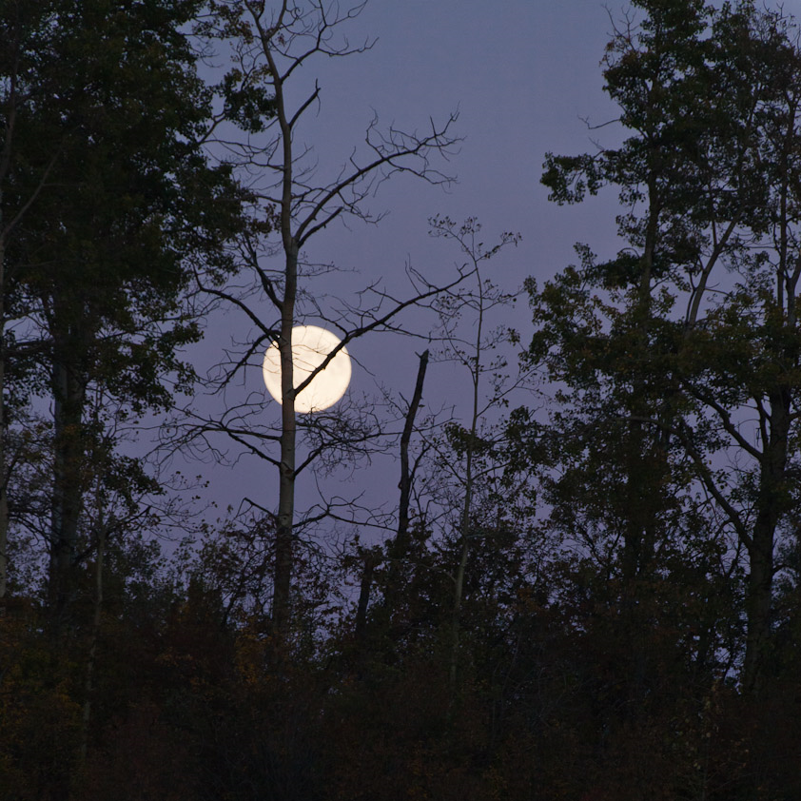
Jewish Feasts
All of the feasts were built around the new moon. The new moon determined when the feasts would be celebrated. Each feast had a holy convocation or a ceremonial sabbath feast day. At each feast, there were meat and drink offerings given. These are all the components that Paul described in Colossians 2:16,17.

Slide 12
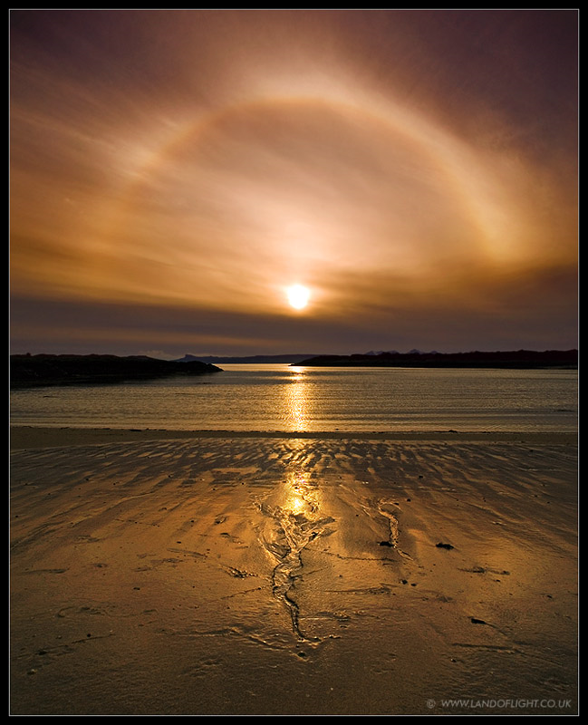
One Feast Based on the Weekly Cycle
“Speak unto the children of Israel, and say unto them, Concerning the feasts of the LORD, which ye shall proclaim to be holy convocations, even these are my feasts. Six days shall work be done: but the seventh day is the sabbath of rest, an holy convocation; ye shall do no work therein: it is the sabbath of the LORD in all your dwellings. These are the feasts of the LORD, even holy convocations, which ye shall proclaim in their seasons.”
Leviticus 23:2-4

Slide 13
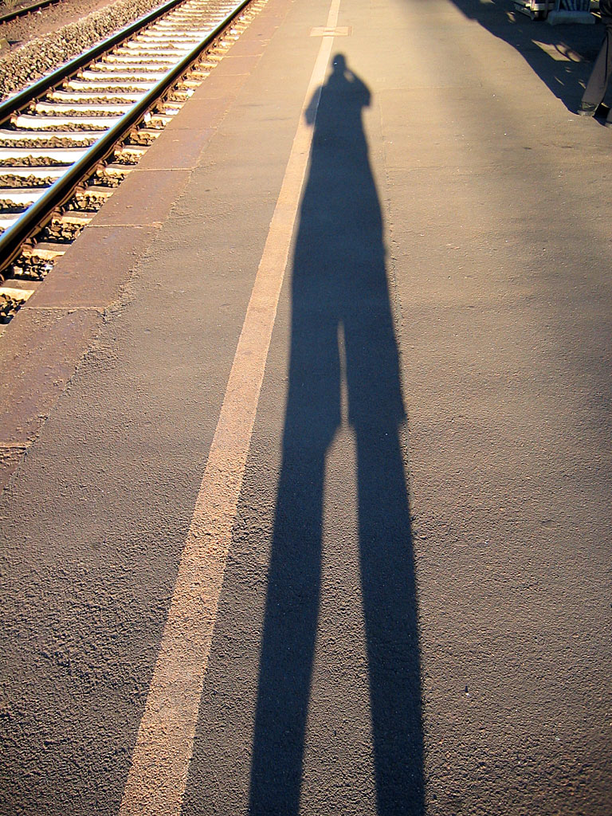
Trouble in Asia Minor
There were those in Paul’s day who were making a big issue about circumcision and the feast days. Paul says they were all shadows of things to come, but the body of Christ is the substance to which all the feasts pointed. Just as a shadow points to a body nearby, so the feasts point to Christ, the body!!

Slide 14
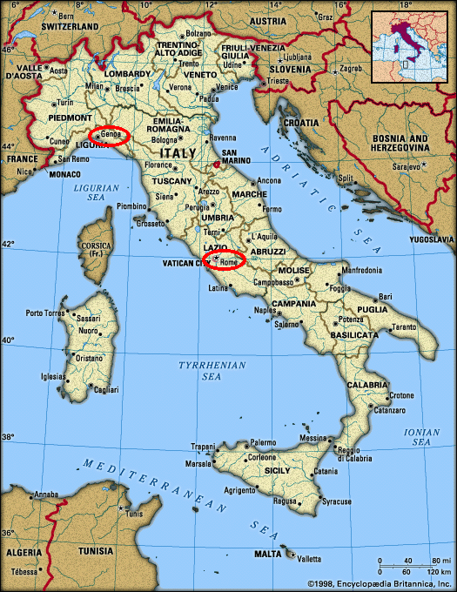
It Was in Rome Too!!
One man esteemeth one day above another: another esteemeth every day alike. Let every man be fully persuaded in his own mind.
⁶ He that regardeth the day, regardeth it unto the Lord; and he that regardeth not the day, to the Lord he doth not regard it. He that eateth, eateth to the Lord, for he giveth God thanks; and he that eateth not, to the Lord he eateth not, and giveth God thanks.” Romans 14:5,6

Slide 15
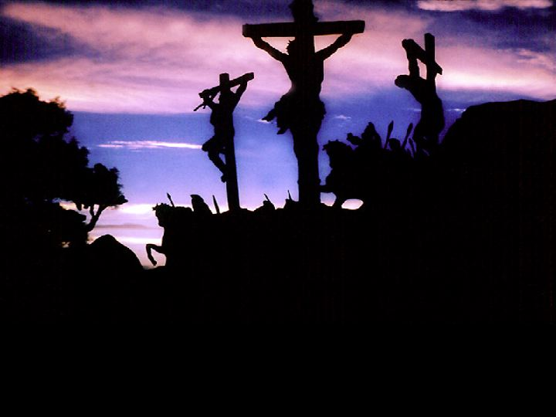
Forgetting the Cross
There were those in Rome who were pushing one feast day above another and making it critical for salvation. Paul struggled with these people throughout his ministry; it never stopped. He admonished, “Let every man be fully persuaded in his own mind.” “The ceremonial system was made up of symbols pointing to Christ, to His sacrifice and His priesthood. This ritual law, with its sacrifices and ordinances, was to be performed by the Hebrews until type met antitype in the death of Christ, the Lamb of God that taketh away the sin of the world. Then all the sacrificial offerings were to cease. It is this law that Christ "took . . . out of the way, nailing it to His cross." Colossians 2:14. PP, pg. 365

Slide 16
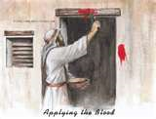
Each Feast Pointed to Christ
The Passover/Unleavened Bread. This feast is mentioned in Leviticus 23:5-14.
Paul makes it very clear that this feast pointed forward to “Purge out therefore the old leaven, that ye may be a new lump, as ye are unleavened. For even Christ our passover is sacrificed for us:” 1 Corinthians 5:8

Slide 17
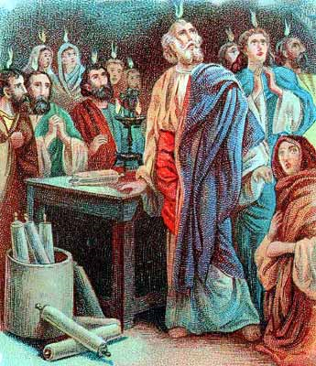
Pentecost
This feast is referenced in Leviticus 23:15-22 and centers around the harvest of the grain crops. The first fruits were dedicated to the Lord; this happened 50 days after the grain harvest was dedicated.
50 days after Christ’s resurrection, in Christ’s first act as our High Priest in the Holy Place in heaven, the Holy Spirit was poured out and the first fruits of Christ’s work received Him. 3,000 souls were converted that day!!!
“And when the day of Pentecost was fully come, they were all with one accord in one place. And suddenly there came a sound from heaven as of a rushing mighty wind, and it filled all the house where they were sitting.” Acts 2:1,2

Slide 18
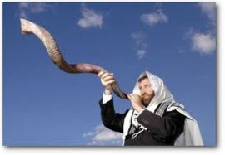
Feast of Trumpets
The Feast of Trumpets was 10 days before the Day of Atonement. It is mentioned in Leviticus 23:24,25. Due to the fact that this feast had end-time ramifications, like all the other feasts, this corresponds with the blowing trumpet of William Miller and others, calling the world to judgment in 1844. This feast of trumpets would correspond to the mid 1830’s and the warning message ‘to prepare to meet thy God.’

Slide 19
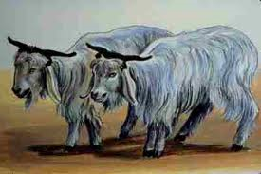
Atonement/Judgment
This feast is mentioned in Leviticus 23:26-32. This points forward to the work of Christ in the Most Holy Place of the sanctuary in heaven. This work began in 1844.
“Saying with a loud voice, Fear God, and give glory to him; for the hour of his judgment is come: and worship him that made heaven, and earth, and the sea, and the fountains of waters.

Slide 20
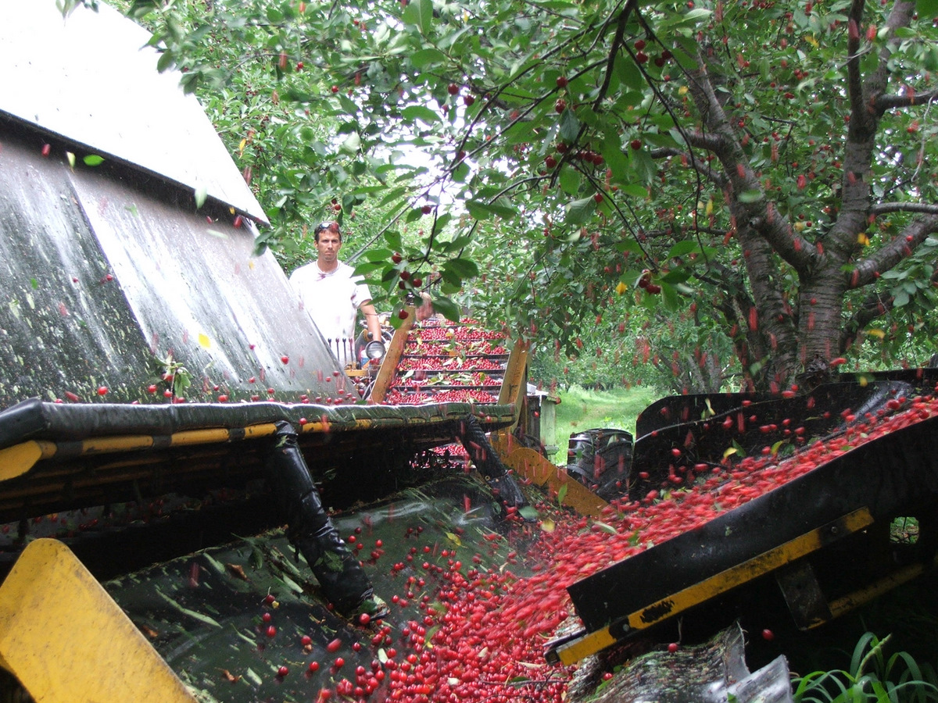
Feast of Tabernacles
After the Day of Atonement was over, the feast of Tabernacles began. The final harvest of the crops for the year was complete and the people rejoiced in this final ingathering. This is referred to in Leviticus 23:34-41. This points forward to the second coming of Jesus when the final harvest of souls will be gathered into heaven.
“And I looked, and behold a white cloud, and upon the cloud one sat like unto the Son of man, having on his head a golden crown, and in his hand a sharp sickle. And another angel came out of the temple, crying with a loud voice to him that sat on the cloud, Thrust in thy sickle, and reap: for the time is come for thee to reap; for the harvest of the earth is ripe. And he that sat on the cloud thrust in his sickle on the earth; and the earth was reaped.” Revelation 14

