Slide 1
Final Scenes, pt.5
Christ’s 95 Theses

Slide 2

Christ’s Final Sermon
“It was the last day of Christ's teaching in the temple. Of the vast throngs that were gathered at Jerusalem, the attention of all had been attracted to Him; the people had crowded the temple courts, watching the contest that had been in progress, and they eagerly caught every word that fell from His lips. Never before had such a scene been witnessed. There stood the young Galilean, bearing no earthly honor or royal badge. Surrounding Him were priests in their rich apparel, rulers with robes and badges significant of their exalted station, and scribes with scrolls in their hands, to which they made frequent reference. Jesus stood calmly before them, with the dignity of a king.” DA, pg. 610

Slide 3
Summary
Sabbath-Christ went a feast at Simon’s house where Mary anointed His feet.
1st day/Sunday-Christ made His triumphal entry into Jerusalem.
2nd day/Monday-Christ cursed the fig tree and cleansed the temple.
3rd day/Tuesday-Christ was met with many questions to try and entrap Him.
4th day/Wednesday-Christ gave His final sermon, pronouncing woes on the Pharisees. This is our study today!

Slide 4
A Definite Reason
“Yet another work remained for Christ to do. Another purpose was still to be accomplished. The interest of the people in Christ and His work had steadily increased. They were charmed with His teaching, but they were also greatly perplexed. They had respected the priests and rabbis for their intelligence and apparent piety. In all religious matters they had ever yielded implicit obedience to their authority. Yet they now saw these men trying to cast discredit upon Jesus, a teacher whose virtue and knowledge shone forth the brighter from every assault. They looked upon the lowering countenances of the priests and elders, and there saw discomfiture and confusion. They marveled that the rulers would not believe on Jesus, when His teachings were so plain and simple. They themselves knew not what course to take. With eager anxiety they watched the movements of those whose counsel they had always followed.” DA, pgs. 610,611

Slide 5

Christ’s 95 Thesis
Christ final message was given to make crystal clear the evils of the leaders.
“In the parables which Christ had spoken, it was His purpose both to warn the rulers and to instruct the people who were willing to be taught. But there was need to speak yet more plainly. Through their reverence for tradition and their blind faith in a corrupt priesthood, the people were enslaved. These chains Christ must break. The character of the priests, rulers, and Pharisees must be more fully exposed. “ DA, pgs. 611,612

Slide 6
Abuses!
“All therefore whatsoever they bid you observe, that observe and do; but do not ye after their works: for they say, and do not. For they bind heavy burdens and grievous to be borne, and lay them on men's shoulders; but they themselves will not move them with one of their fingers. But all their works they do for to be seen of men: they make broad their phylacteries, and enlarge the borders of their garments, And love the uppermost rooms at feasts, and the chief seats in the synagogues, And greetings in the markets, and to be called of men, Rabbi, Rabbi. But be not ye called Rabbi: for one is your Master, even Christ; and all ye are brethren. And call no man your father upon the earth: for one is your Father, which is in heaven. Neither be ye called masters: for one is your Master, even Christ. But he that is greatest among you shall be your servant.” Matthew 23:3-11

Slide 7
Pharisaical Abuses
Christ condemned the leaders for many abuses.
1. They were hypocrites, claiming one thing and doing another.
2. They expected the people to do things they themselves wouldn’t do.
3. They felt themselves superior to the common people.
4. They demanded to be looked upon as a pope/god!

Slide 8
Arrogance!
“He also reproved the vanity shown in coveting the title of rabbi, or master. Such a title, He declared, belonged not to men, but to Christ. Priests, scribes, and rulers, expounders and administrators of the law, were all brethren, children of one Father. Jesus impressed upon the people that they were to give no man a title of honor indicating his control of their conscience or their faith.
If Christ were on earth today, surrounded by those who bear the title of "Reverend" or "Right Reverend," would He not repeat His saying, "Neither be ye called masters: for One is your Master, even Christ"? The Scripture declares of God, "Holy and reverend is His name." Ps. 111:9. To what human being is such a title befitting? How little does man reveal of the wisdom and righteousness it indicates! How many of those who assume this title are misrepresenting the name and character of God! Alas, how often have worldly ambition, despotism, and the basest sins been hidden under the broidered garments of a high and holy office!” DA, pg. 613

Slide 9
Not Pleased
”But woe unto you, scribes and Pharisees, hypocrites! for ye shut up the kingdom of heaven against men: for ye neither go in yourselves, neither suffer ye them that are entering to go in. Woe unto you, scribes and Pharisees, hypocrites! for ye devour widows' houses, and for a pretence make long prayer: therefore ye shall receive the greater damnation. Woe unto you, scribes and Pharisees, hypocrites! for ye compass sea and land to make one proselyte, and when he is made, ye make him twofold more the child of hell than yourselves. Woe unto you, ye blind guides, which say, Whosoever shall swear by the temple, it is nothing; but whosoever shall swear by the gold of the temple, he is a debtor! Ye fools and blind: for whether is greater, the gold, or the temple that sanctifieth the gold? And, Whosoever shall swear by the altar, it is nothing; but whosoever sweareth by the gift that is upon it, he is guilty. Ye fools and blind: for whether [is] greater, the gift, or the altar that sanctifieth the gift? Whoso therefore shall swear by the altar, sweareth by it, and by all things thereon. And whoso shall swear by the temple, sweareth by it, and by him that dwelleth therein.” Matthew 23:13-21

Slide 10
He Nailed it!
Jesus, humanly speaking, was on a roll; He was fired up! Next, He slammed……
5. By their horrible witness, others wanted no part of their religion.
6. Through an air of piety, they suckered widows into giving their money to them to be used for selfish purposes.
7. They converted people to Judaism; then made them worse than before their conversion by their hypocrisy.
8. They heavily condemned trivial offenses and passed off serious crimes as nothing for material gain.

Slide 11

Bristling Ears
The religious leaders ears were ticked off at Christ for clearly exposing them. ‘How dare He say; I’ve been a leader for many years’ ‘Why, I’m a fifth generation Adventist’
‘I do many nice things and besides I liberally support this temple; how dare He!’ This would indeed, be Christ’s final message; the leaders wouldn’t allow another!!

Slide 12
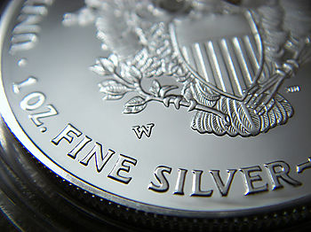
The One with the Silver!
“For a money consideration they excused persons from their vows. And for large sums of money they sometimes passed over aggravated crimes. At the same time these priests and rulers would in other cases pronounce severe judgment for trivial offenses.” DA, pg. 616

Slide 13
Clean Inside!
“Woe unto you, scribes and Pharisees, hypocrites! for ye pay tithe of mint and anise and cummin, and have omitted the weightier matters of the law, judgment, mercy, and faith: these ought ye to have done, and not to leave the other undone. Ye blind guides, which strain at a gnat, and swallow a camel. Woe unto you, scribes and Pharisees, hypocrites! for ye make clean the outside of the cup and of the platter, but within they are full of extortion and excess. Thou blind Pharisee, cleanse first that which is within the cup and platter, that the outside of them may be clean also. Woe unto you, scribes and Pharisees, hypocrites! for ye are like unto whited sepulchers, which indeed appear beautiful outward, but are within full of dead men's bones, and of all uncleanness. Even so ye also outwardly appear righteous unto men, but within ye are full of hypocrisy and iniquity.” Matthew 23:23-28

Slide 14
Jesus Was Just Warming Up!!
The next batch of disclosures were:
9. You are meticulous when it comes to tithing you crops, but when it comes to mercy and fairness, they could care less.
10. Outward cleanliness was so important, but inward purity was voided!
11. Their tombs were beautiful on the outside, but full of dead men’s bones; likewise, their outward lives looked holy and pious, but inside they were full of all manner of evil.
I’ll bet the skin on the back of their neck was getting red!!

Slide 15
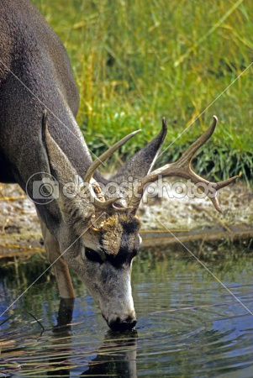
Deer Longs for Water, so……
Jesus had no trouble with communication. Like the prophets of old, He demanded a return on Heaven’s investment toward men. Lip service Christianity wasn’t enough. Our standing with God isn’t dependent on ancestry, but on a life that walks in the light of God’s 10 commandments!

Slide 16
Killing the Prophets
“Woe unto you, scribes and Pharisees, hypocrites! because ye build the tombs of the prophets, and garnish the sepulchres of the righteous, And say, If we had been in the days of our fathers, we would not have been partakers with them in the blood of the prophets. Wherefore ye be witnesses unto yourselves, that ye are the children of them which killed the prophets. Fill ye up then the measure of your fathers. Ye serpents, ye generation of vipers, how can ye escape the damnation of hell? Wherefore, behold, I send unto you prophets, and wise men, and scribes: and some of them ye shall kill and crucify; and some of them shall ye scourge in your synagogues, and persecute them from city to city: That upon you may come all the righteous blood shed upon the earth, from the blood of righteous Abel unto the blood of Zacharias son of Barachias, whom ye slew between the temple and the altar. Verily I say unto you, All these things shall come upon this generation.” Matthew 23:29-36

Slide 17
Slammed!
“The Pharisees built the tombs of the prophets, and adorned their sepulchers, and said one to another, If we had lived in the days of our fathers, we would not have united with them in shedding the blood of God's servants. At the same time they were planning to take the life of His Son. This should be a lesson to us. It should open our eyes to the power of Satan to deceive the mind that turns from the light of truth. Many follow in the track of the Pharisees. They revere those who have died for their faith. They wonder at the blindness of the Jews in rejecting Christ. Had we lived in His day, they declare, we would gladly have received His teaching; we would never have been partakers in the guilt of those who rejected the Saviour. But when obedience to God requires self-denial and humiliation, these very persons stifle their convictions, and refuse obedience. Thus they manifest the same spirit as did the Pharisees whom Christ condemned.” DA, pg. 618

Slide 18
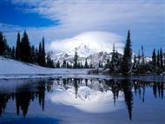
The Tears of a King
“ O Jerusalem, Jerusalem, thou that killest the prophets, and stonest them which are sent unto thee, how often would I have gathered thy children together, even as a hen gathereth her chickens under her wings, and ye would not! Behold, your house is left unto you desolate.” Matthew 23:37,38

Slide 19
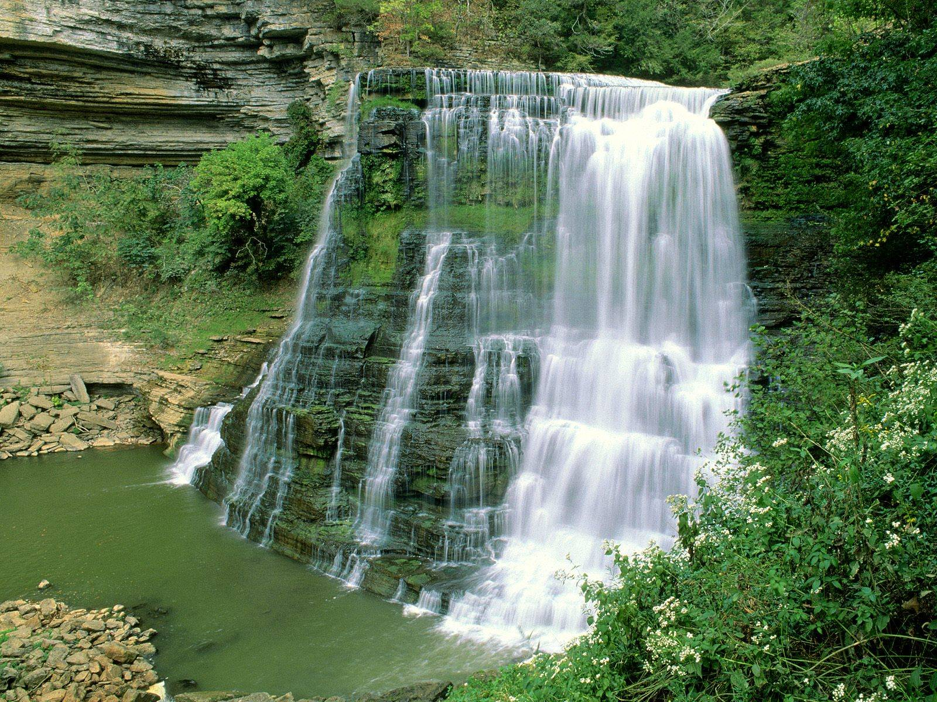
SAD, SAD, SAD
As a mother hen gathers her chicks under her wings to assure, comfort, and protect them, so Christ came to His people that He might be her Saviour, but selfish and self righteousness killed them. There was nothing more Christ could do. His patience was exhausted! Wednesday came to an end too quickly!

