Slide 1
The Book of Romans pt. 3
Romans chapter 2:1-16

Slide 2
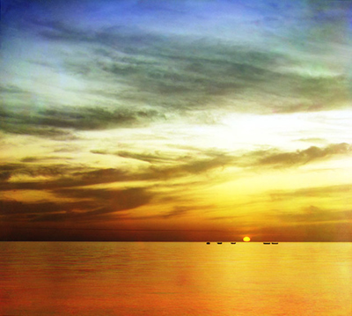
Summary of Chapter 1
1. Romans 1:1-7 Paul greets the Romans.
2. verses 8-15 Paul wants the best for the Roman Christians.
3. verses 16,17 Paul’s gospel crystallized.
4. verses 18-20 Through creation, all mankind can know of God’s power and goodness.
5. verses 21-32 Mankind has foolishly rejected their Maker.

Slide 3
Romans 2:1-4
“Therefore thou art inexcusable, O man, whosoever thou art that judgest: for wherein thou judgest another, thou condemnest thyself; for thou that judgest doest the same things. But we are sure that the judgment of God is according to truth against them which commit such things. And thinkest thou this, O man, that judgest them which do such things, and doest the same, that thou shalt escape the judgment of God? Or despisest thou the riches of his goodness and forbearance and longsuffering; not knowing that the goodness of God leadeth thee to repentance?”

Slide 4
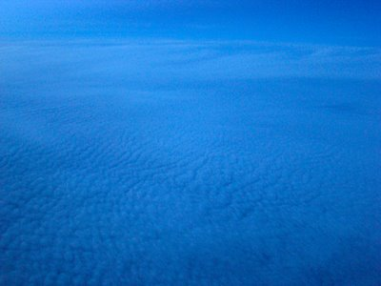
We are ALL Condemned
If we know enough to condemn the unrighteous deeds of the heathen, we by that very judgment acknowledge ourselves to be without excuse for our own misdeeds.
“The LORD looketh from heaven; he beholdeth all the sons of men. From the place of his habitation he looketh upon all the inhabitants of the earth. He fashioneth their hearts alike; he considereth all their works.” Ps. 33:13-15

Slide 5
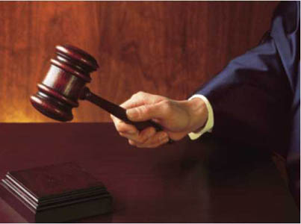
No one Escapes God’s Righteous Judgment
“Let us hear the conclusion of the whole matter: Fear God, and keep his commandments: for this is the whole duty of man. For God shall bring every work into judgment, with every secret thing, whether it be good, or whether it be evil.” Eccl. 12:13,14 Rich or poor, high or low; all meet Heaven’s judgment.

Slide 6
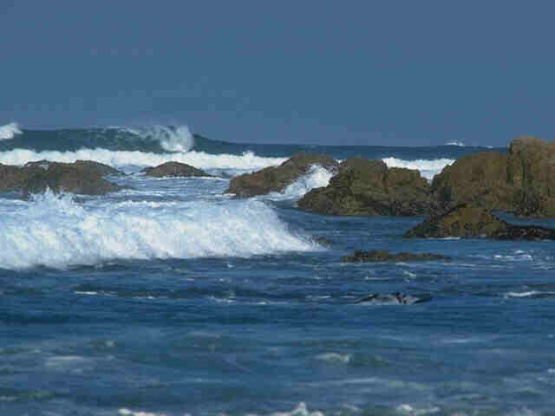
ALL Flesh Produces the Same
Since we all naturally produce the same thing, which is evil and wrong, we should be filled with humiliation, not contempt for others, for it is really what is in our own hearts. Instead of saying, “I’m glad I’m not like him’, we should say, “how can I help?” or “God, be merciful to me, a sinner.” Luke 18:13

Slide 7
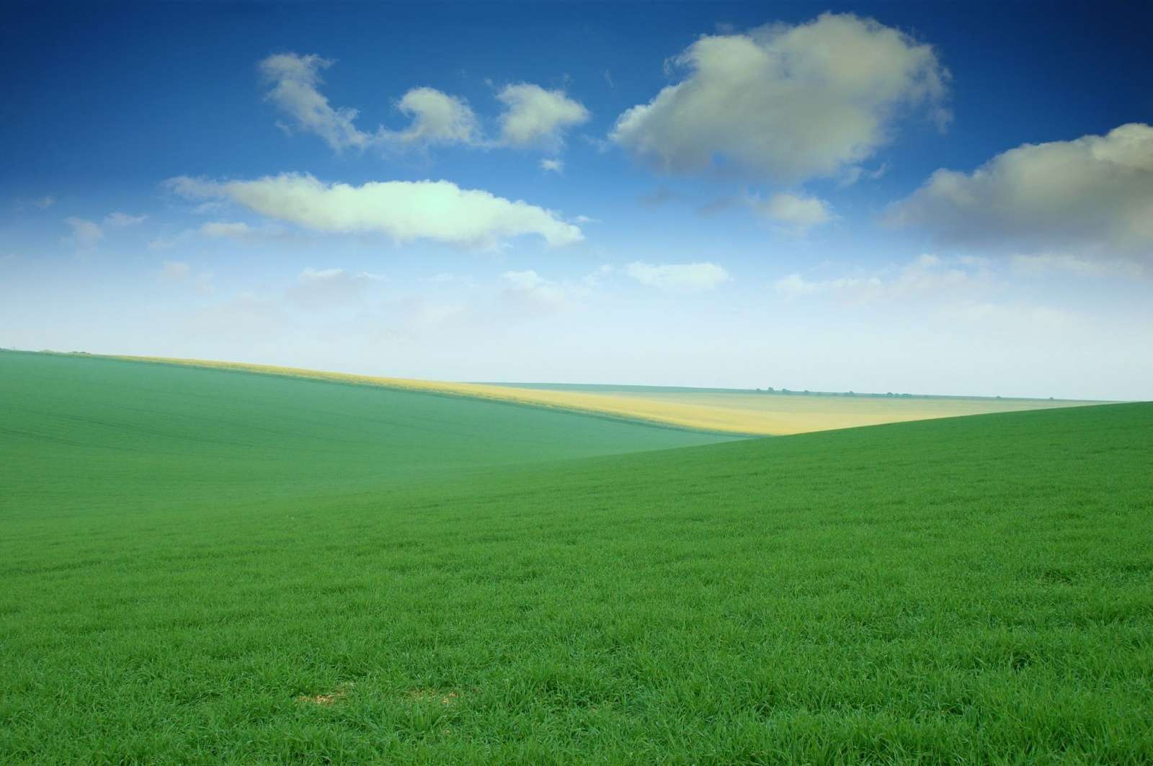
The Goodness of God leads us to Repent
“But God, who is rich in mercy, for his great love wherewith he loved us, Even when we were dead in sins, hath quickened us together with Christ, (by grace ye are saved;) And hath raised us up together, and made us sit together in heavenly places in Christ Jesus: That in the ages to come he might shew the exceeding riches of his grace in his kindness toward us through Christ Jesus. For by grace are ye saved through faith; and that not of yourselves: it is the gift of God: Not of works, lest any man should boast.” Eph. 2:4-8
Seeing what God has done for us, it is not possible for us to deal harshly towards our fellow man, no matter what background, culture, or color they may be.
“If a man say, I love God, and hateth his brother, he is a liar: for he that loveth not his brother whom he hath seen, how can he love God whom he hath not seen? 1John 4:20

Slide 8
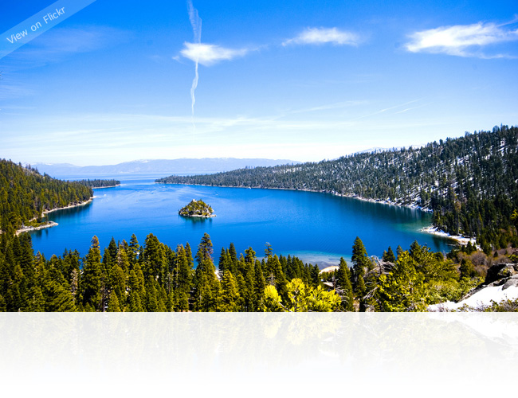
The Goodness of God
Since the goodness of God seeks to bring all men to repentance, and most people do not repent, shows us of the stubbornness and wickedness of guilty man. “The Lord is not slack concerning his promise, as some men count slackness; but is longsuffering to us-ward, not willing that any should perish, but that all should come to repentance.” 2Peter 3:9

Slide 9
Romans 2:5-11
“But after thy hardness and impenitent heart treasurest up unto thyself wrath against the day of wrath and revelation of the righteous judgment of God; Who will render to every man according to his deeds: To them who by patient continuance in well doing seek for glory and honour and immortality, eternal life: But unto them that are contentious, and do not obey the truth, but obey unrighteousness, indignation and wrath,
Tribulation and anguish, upon every soul of man that doeth evil, of the Jew first, and also of the Gentile; But glory, honour, and peace, to every man that worketh good, to the Jew first, and also to the Gentile: For there is no respect of persons with God.”

Slide 10
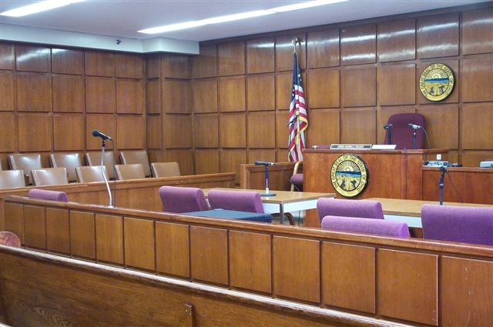
Judged by DEEDS or Beliefs
“For the Son of man shall come in the glory of his Father with his angels; and then he shall reward every man according to his works.” Matt.16:27 While we are judged by our deeds, what we believe has a strong bearing on what we do. “If any man will do his will, he shall know of the doctrine, whether it be of God, or whether I speak of myself.” John 7:17

Slide 11
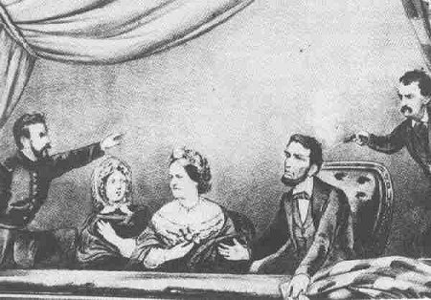
Beliefs Influence Actions
“In speaking of the assassination of the President (Lincoln) and others, Jacob Thompson said that it was only removing them from office, that the killing of a tyrant was no murder.” Internet, Bank of Wisdom, Louisville,KY.

Slide 12
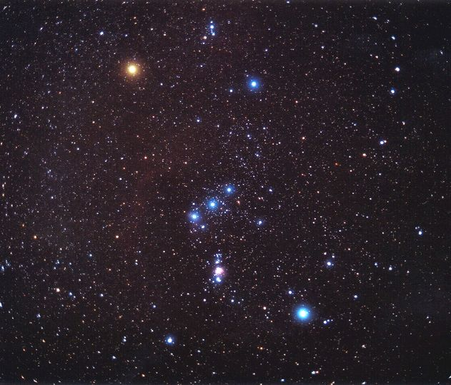
Seeking for immortality
If we are to seek for immortality, then we obviously don’t have it yet. Immortality will come at the Second Coming of Christ.
“Behold, I shew you a mystery; We shall not all sleep, but we shall all be changed, In a moment, in the twinkling of an eye, at the last trump: for the trumpet shall sound, and the dead shall be raised incorruptible, and we shall be changed. For this corruptible must put on incorruption, and this mortal must put on immortality. So when this corruptible shall have put on incorruption, and this mortal shall have put on immortality, then shall be brought to pass the saying that is written, Death is swallowed up in victory.” 1Cor. 15:51-54

Slide 13
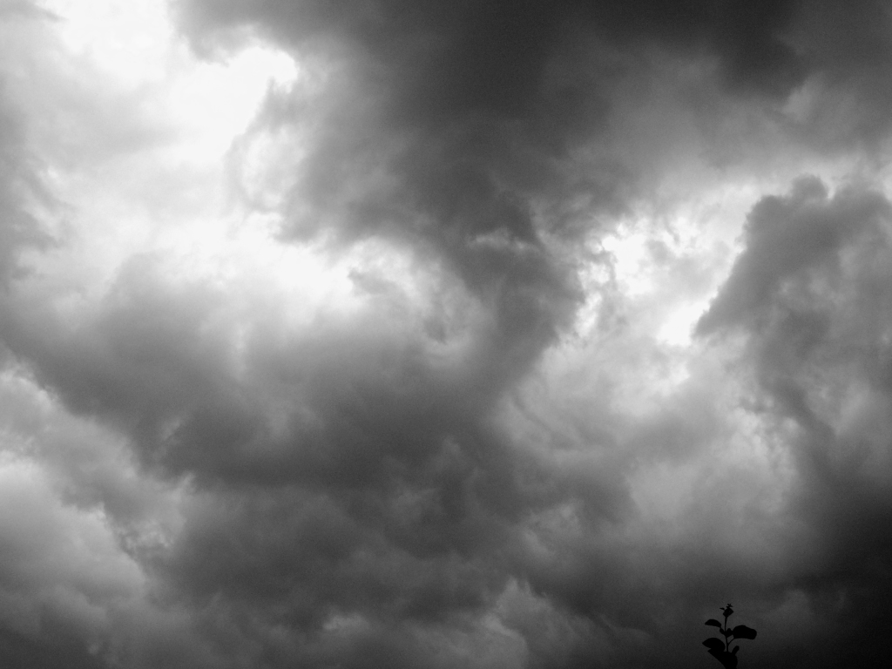
To the Jew first
Victory or judgment came to the Jew first, not in the sense of time, but because the revelation of God’s character came to them in a pre-eminent way, above and beyond others. The point here is that ‘God is no respecter of persons’.

Slide 14
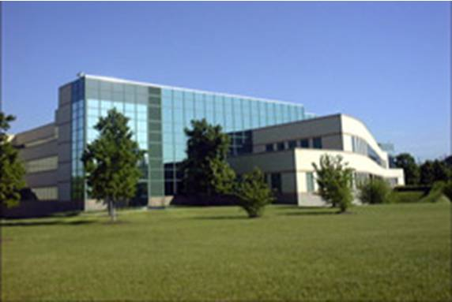
To Adventism
With SDAdventism, judgment will come first in respect of time. It will occur before the Latter Rain falls. “And the LORD said unto him, Go through the midst of the city, through the midst of Jerusalem, and set a mark upon the foreheads of the men that sigh and that cry for all the abominations that be done in the midst thereof. And to the others he said in mine hearing, Go ye after him through the city, and smite: let not your eye spare, neither have ye pity:
Slay utterly old and young, both maids, and little children, and women: but come not near any man upon whom is the mark; and begin at my sanctuary. Then they began at the ancient men which were before the house.” Ezekiel 9:4-6 “For the time is come that judgment must begin at the house of God: and if it first begin at us,” 1Peter 4:17

Slide 15
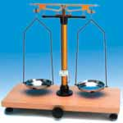
God is no respecter of People
No matter who we are, no matter what our station in life, and no matter what our background or culture or education, God will justly and fairly judge every human being. This judgment began in 1844.

Slide 16
Romans 2:12-16
“For as many as have sinned without law shall also perish without law: and as many as have sinned in the law shall be judged by the law; (For not the hearers of the law are just before God, but the doers of the law shall be justified. For when the Gentiles, which have not the law, do by nature the things contained in the law, these, having not the law, are a law unto themselves: Which shew the work of the law written in their hearts, their conscience also bearing witness, and their thoughts the mean while accusing or else excusing one another;) In the day when God shall judge the secrets of men by Jesus Christ according to my gospel.”

Slide 17
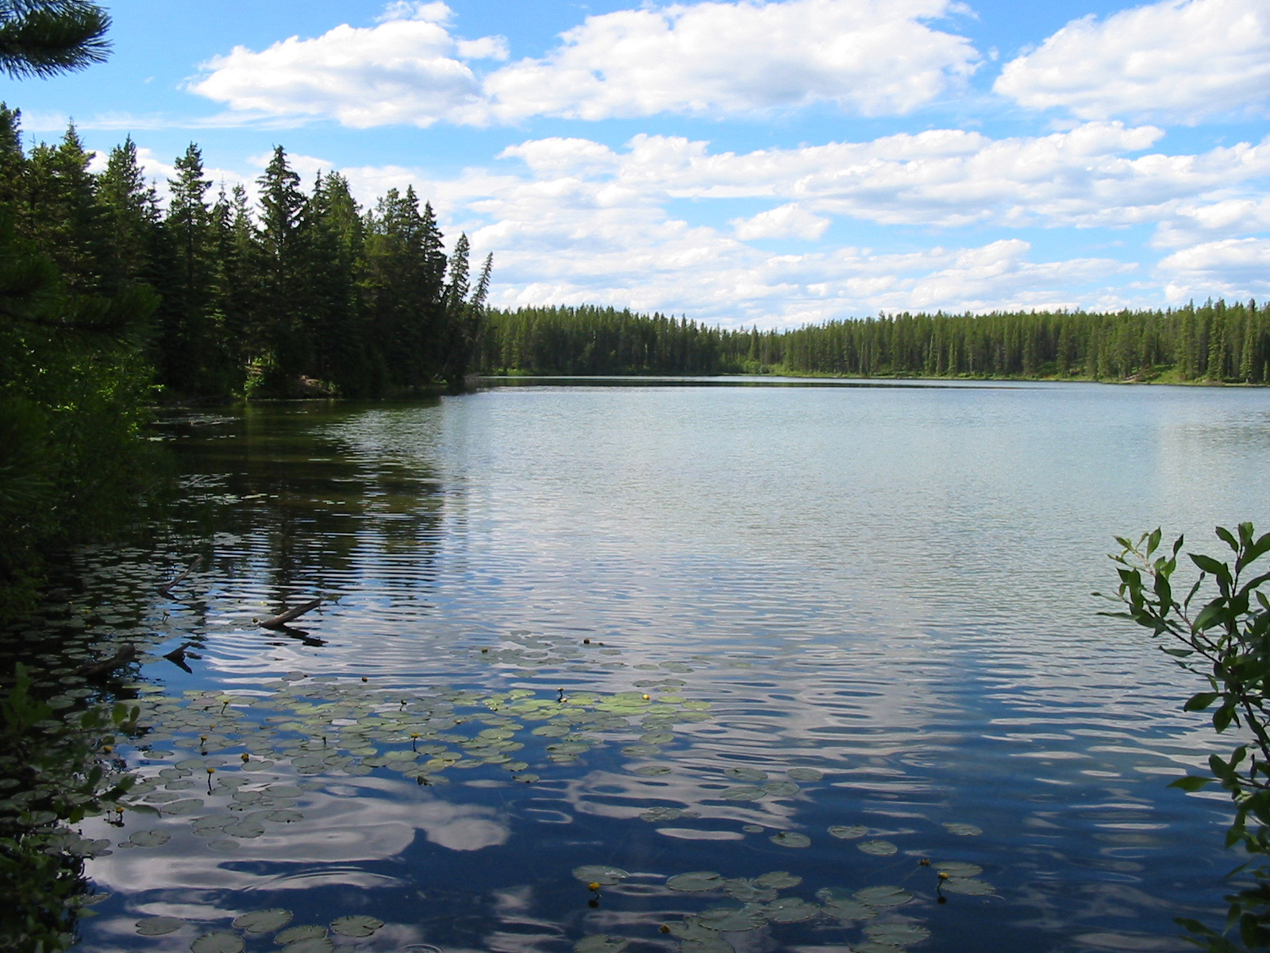
No excuses from anyone
Many have never heard of Christ or of the ten commandments, but nevertheless, they will be judged, because chapter 1 declared that through nature all mankind has a knowledge of God so that no one is without excuse.
“For the invisible things of him from the creation of the world are clearly seen, being understood by the things that are made, even his eternal power and Godhead; so that they are without excuse:” verse 20
“He was not that Light, but was sent to bear witness of that Light. That was the true Light, which lighteth every man that cometh into the world.” John 1:9

Slide 18
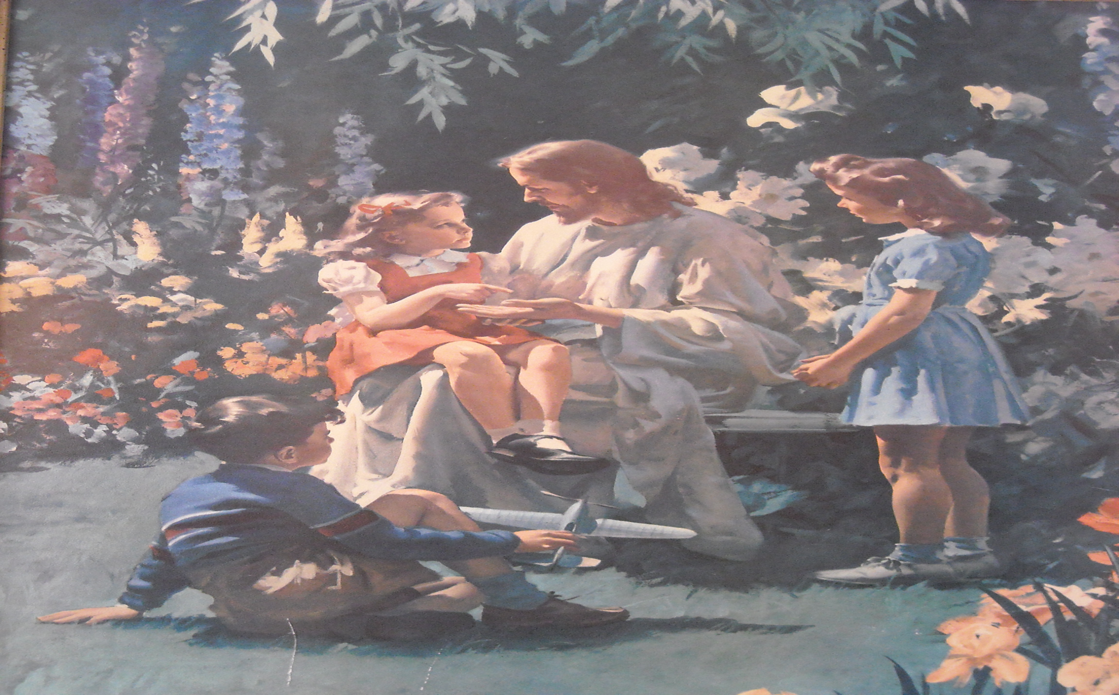
Never Heard
Some will be in heaven because they responded to all the light they had, and yet, never heard the name of Christ. “And one shall say unto him, What are these wounds in thine hands? Then he shall answer, Those with which I was wounded in the house of my friends.“ Zech. 13:6

Slide 19
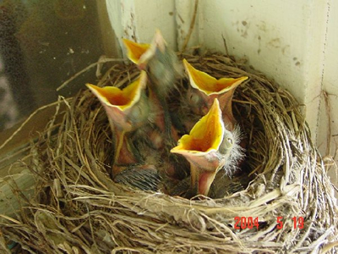
Fairness and Equity
We will not be judged according to what we haven’t heard, but according to what we have heard. Those who have received more light will be judged accordingly. Sin, wherever found, will be judged fairly. Two things are sure:
1. God will judge justly.
2. All will be judged according to the light they received.

Slide 20
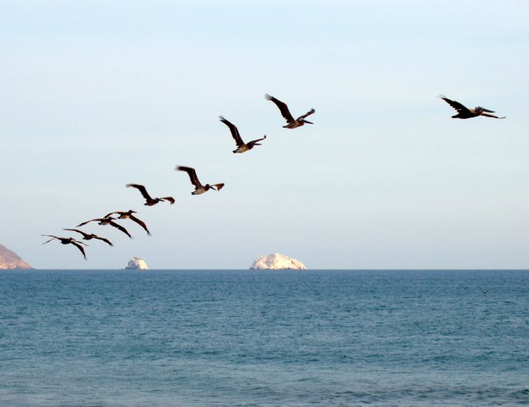
The Life Giver
“In him was life; and the life was the light of men. And the light shineth in darkness; and the darkness comprehended it not.” John 1:4,5 Christ gives life to all. Even if we have had little light, nevertheless, a rejection of that light is rejecting the very life of God and thereby cutting us off from Him. God is not arbitrary.

Slide 21
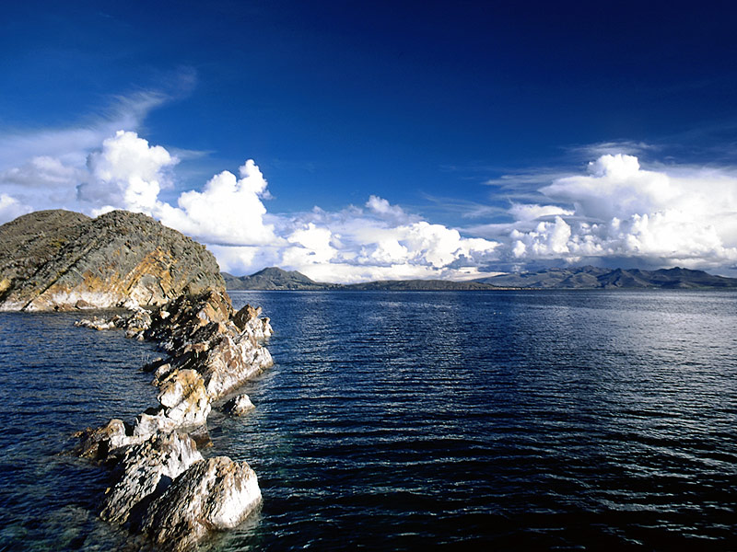
Summary of Romans 2:1-16
1. The very fact that we know when another does wrong reveals that God has given us an awareness of right and wrong. No one has an excuse.
2. When seeing others do wrong, it should humble us because, apart from Christ, we do the same things.
3. Since we are dependent upon Christ for all goodness, it should lead us to be gentle and, not harsh, toward our fellow man.
4. Since all men have received some awareness of God, all will be judged based on the light given.
5. God’s judgment will be utterly fair.
“And they sing the song of Moses the servant of God, and the song of the Lamb, saying, Great and marvellous are thy works, Lord God Almighty; just and true are thy ways, thou King of saints. Who shall not fear thee, O Lord, and glorify thy name? for thou only art holy: for all nations shall come and worship before thee; for thy judgments are made manifest.” Rev. 15:3,4

