Slide 1
Health is Wealth

Slide 2
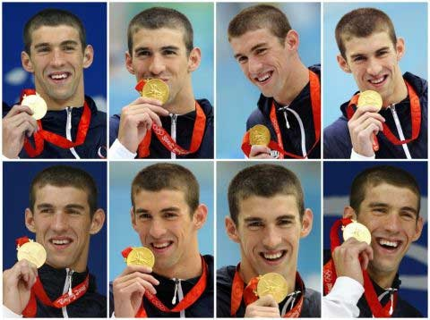
Michael Phelps- Olympic Gold

Slide 3
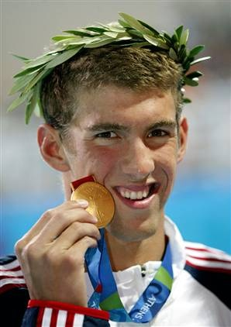
Gives his all
“Phelps trains for six hours a day, six days a week, without fail. Even if Christmas day falls on a training day, he does a full day of training. Total dedication to his training program has made him a world champion.
He swims approximately 50 miles (80km) each week, which is over 8 miles per training day. He has two massages everyday and also takes ice baths to help his body to recover.” Internet

Slide 4
A
Corruptible Crown
“Know ye not that they which run in a race run all, but one receiveth the prize? So run, that ye may obtain. And every man that striveth for the mastery is temperate in all things. Now they do it to obtain a corruptible crown; but we an incorruptible. I therefore so run, not as uncertainly; so fight I, not as one that beateth the air: But I keep under my body, and bring it into subjection: lest that by any means, when I have preached to others, I myself should be a castaway.” 1 Corinthians 9:24-27

Slide 5
How Important is it for us?
1. Is it important for us what we eat? When we eat?
2. Is it important that we exercise?
3. Is it important when we sleep? How much sleep we get? To be regular?
4. Is it important how much water we drink? To take baths?
5. Is it important to get sunshine everyday?

Slide 6
This is part of God’s final message to us!
“And I saw another angel fly in the midst of heaven, having the everlasting gospel to preach unto them that dwell on the earth, and to every nation, and kindred, and tongue, and people, ‘Saying with a loud voice, Fear God, and give glory to him; for the hour of his judgment is come: and worship him that made heaven, and earth, and the sea, and the fountains of waters.” Rev. 14:6,7
“Whether therefore ye eat, or drink, or whatsoever ye do, do all to the glory of God. “ 1 Corinthians 10:31
“What? know ye not that your body is the temple of the Holy Ghost which is in you, which ye have of God, and ye are not your own? For ye are bought with a price: therefore glorify God in your body, and in your spirit, which are God's.” 1 Corinthians 6:19,20

Slide 7
Give Glory to Him
To give glory to Him involves taking care of our bodies. To take care of ourselves makes it possible for us to have a clear mind. With a clear mind, we can discern between right and wrong, between truth and error. Without a clear mind, we will embrace deceptive error and will think that wrong is right. God help us to incorporate sound health habits into our lives immediately.

Slide 8
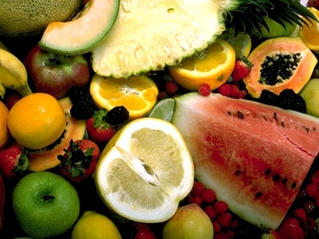
God’s Original Diet
“And God said, Behold, I have given you every herb bearing seed, which is upon the face of all the earth, and every tree, in the which is the fruit of a tree yielding seed; to you it shall be for meat.” Genesis 1:29
“Thorns also and thistles shall it bring forth to thee; and thou shalt eat the herb of the field.” Genesis 3:18

Slide 9
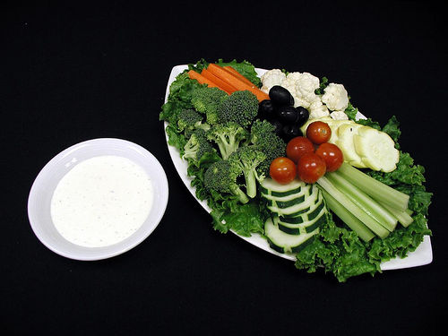
The Plan
God originally gave Adam and Eve a diet consisting of fruits, grains, and nuts. After sin, they were told to eat vegetables as well. This was the original diet God gave to man. Flesh food was added after the flood out of necessity, but was never to be a main staple for man.

Slide 10
Regularity
Space Between Meals
Not between meals
“In many cases the faintness that leads to a desire for food is felt because the digestive organs have been too severely taxed during the day. After disposing of one meal, the digestive organs need rest. At least five or six hours should
intervene between the meals; and most persons who give the plan a trial, will find that two meals a day are better than three.” {CD 173.4}
“Having no time for rest, the digestive organs become enfeebled, hence the sense of "goneness," and desire for frequent eating. The remedy such require, is to eat less frequently and less liberally, and be satisfied with plain, simple food, eating twice, or, at most, three times a day. The stomach must have its regular periods for labor and rest; hence eating irregularly and between meals, is a most pernicious violation of the laws of health. With regular habits, and proper food, the stomach will gradually recover.” {CD 175.2}

Slide 11
Eating Properly
Not Before Bed
Two meals or Three?
If a third meal be eaten at all, it should be light, and several hours before going to bed. But with many, the poor, tired stomach may complain of weariness in vain. More food is forced upon it, which sets the digestive organs in motion, again to perform the same round of labor through the sleeping hours. The sleep of such is generally disturbed with unpleasant dreams, and in the morning they awake unrefreshed. There is a sense of languor and loss of appetite. A lack of energy is felt through the entire system. In a short time the digestive organs are worn out, for they have had no time to rest. These become miserable dyspeptics, and wonder what has made them so. The cause has brought the sure result. If this practice be indulged in a great length of time, the health will become seriously impaired.” CD, pg. 174
“Most people enjoy better health while eating two meals a day than three; others, under their existing circumstances, may require something to eat at suppertime; but this meal should be very light. Let no one think himself a criterion for all,--that every one must do exactly as he does.
Never cheat the stomach out of that which health demands, and never abuse it by placing upon it a load which it should not bear. Cultivate self-control. Restrain appetite; keep it under the control of reason. Do not feel it necessary to load down your table with unhealthful food when you have visitors. The health of your family and the influence upon your children should be considered, as well as the habits and tastes of your guests. “ CD 176

Slide 12
The Ladder of Success
“And beside this, giving all diligence, add to your faith virtue; and to virtue knowledge;
And to knowledge temperance; and to temperance patience; and to patience godliness;
And to godliness brotherly kindness; and to brotherly kindness charity.
For if these things be in you, and abound, they make you that ye shall neither be barren nor unfruitful in the knowledge of our Lord Jesus Christ.” 2 Peter 1:5-8 Without temperance in our health habits, it is impossible for us to climb the ladder.

Slide 13
A Clear Mind
When we are eating healthy food, spacing our meals, not eating between meals, or late at night, our mind and body will be strong and clear to detect God’s voice and follow what is right. If our mind is weak from wrong health habits, we will think and do wrong!
“The brain is the organ and instrument of the mind, and controls the whole body. In order for the other parts of the system to be healthy, the brain must be healthy. And in order for the brain to be healthy, the blood must be pure. If by correct habits of eating and drinking the blood is kept pure, the brain will be properly nourished.--MS 24, 1900.

Slide 14

Exercise
For many of us, this has become a bad word. Our exercise relates to walking to walking to our car in the morning, or to the mailbox, or to get a snack at work. This is pathetic. In order to get maintain a strong, healthy mind and body, we must exercise 3-4 times per week!

Slide 15

Get out the Toxins
There are two ways that we eliminate toxins from our bodies:
1. through our waste organs/ bowels etc.
2. through our pores.
This only comes through sweating. How many of us sweated this past week? month? year?

Slide 16
Exercise is Crucial
“The exercise of one muscle, while others are left with nothing to do, will not strengthen the inactive ones, any more than the continual exercise of one of the organs of the mind will develop and
strengthen the organs not brought into use. Each faculty of the mind and each muscle has its distinctive office, and all require to be exercised in order to become properly developed and retain healthful vigor. Each organ and muscle has its work to do in the living organism. Every wheel in the machinery must be a living, active, working wheel. Nature's fine and wonderful works need to be kept in active motion in order to accomplish the object for which they were designed. Each faculty has a bearing upon the others, and all need to be exercised in order to be properly developed. If one muscle of the body is exercised more than another, the one used will become much the larger, and will destroy the harmony and beauty of the development of the system. A variety of exercise will call into use all the muscles of the body.-- {HL 127,128
Exercise isn’t an option. We will accomplish more, be happier and content if we make exercise part of our lives. “I beseech you therefore, brethren, by the mercies of God, that ye present your bodies a living sacrifice, holy, acceptable unto God, which is your reasonable service. And be not conformed to this world: but be ye transformed by the renewing of your mind, that ye may prove what is that good, and acceptable, and perfect, will of God.” Rom. 12:1,2

Slide 17

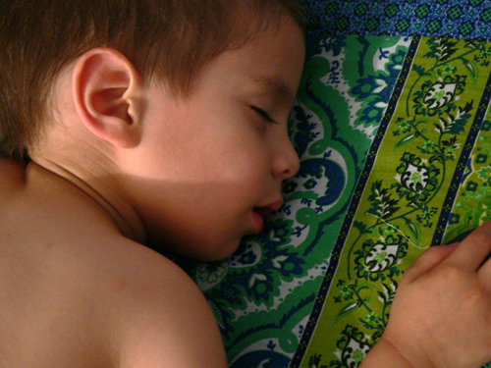
Sleep/Rest

Slide 18
Sleep Before Midnight
“I know from the testimonies given me from time to time for brain workers, that sleep is worth far more before than after midnight. Two hours' good sleep before twelve o'clock is worth more than four hours after twelve o'clock. . . . 7MR 224
How prevalent is the habit of turning day into night, and night into day. Many youth sleep soundly in the morning, when they should be up with the early singing birds and be stirring when all nature is awake. Some youth are much opposed to order and discipline. They do not respect the rules of the home by rising at a regular hour. They lie in bed some hours after daylight, when everyone should be astir. They burn the midnight oil, depending upon artificial light to supply the place of the light that nature has provided at seasonable hours. In so doing they not only waste precious opportunities, but cause additional expense. But in almost every case the plea is made, "I cannot get through my work; I have something to do; I cannot retire early." . . . The precious habits of order are broken, and the moments thus idled away in the early morning set things out of course for the whole day.” CG 111,112

Slide 19
Camp meeting/Always
“Strict order was observed on the ground. At nine or half past, the bell was rung for retiring, and after that no meeting or loud talking was allowed. At five, at the sound of the bell, the camp was astir, preparing for the morning meeting in the pavilion. I was gratified to see the full attendance at this early hour. The practice which prevails in camp-meetings held by some denominations, of continuing the meetings to a late hour, some even spending the night in praying and shouting is not conducive to the spiritual advancement of the worshipers. I have been told that in several instances persons have been taken from these meetings so excited that they were considered fit subjects for an insane asylum. This has caused many to decide never to attend a camp-meeting; but on attending those held by our people, they are forced to admit that they can see nothing objectionable in them. They say that the order is fully as good as that observed in houses of worship in the cities. Body and mind need rest, that the mind may not become unbalanced and excited from being subjected to a constant strain. In our camp-meetings great pains is taken in Bible-readings and sermons to make important points of truth so clear that none need to be in ignorance. And good and regular sleep should be secured, that the mind may be clear, and in the best condition possible to weigh the arguments presented and to decide between truth and error. “ (RH, November 25, 1884)

Slide 20
Sleep Summary
1. The best hours for sleep are the ones before midnight. Two before are worth four after.
2. Regularity in sleep is vital.
3. We should go to bed around 9-9:30p.m. and rise around 5-5:30 a.m.
4. Having a window open brings fresh, invigorating air in the room and helps with sleep.
5. This enables us to hear God’s voice and resist the enemy.

Slide 21


Water

Slide 22
Water
“Many make a mistake in drinking cold water with their meals. Taken with meals, water diminishes the flow of the salivary glands; and the colder the water, the greater the injury to the stomach. Ice water or iced lemonade, drunk with meals, will arrest digestion until the system has imparted sufficient warmth to the stomach to enable it to take up its work again. Hot drinks are debilitating; and besides those who indulge in their use become slaves to habit. . . . But if anything is needed to quench thirst, pure water, drunk some little time before or after a meal, is all that nature requires. Water is the best liquid possible to cleanse the tissues. . . . Drink some little time before or after the meal.” DF 151

Slide 23

How Much
Each day, we should drink, in ounces, half our body weight. If we weigh 180 pounds, then we should drink 90 ounces of water. This helps all our body organs and aids in elimination. One reason why so many have headaches is because of a lack of water.

Slide 24
Sunlight
“One of the most beautiful adornments our rooms can have, is the cheering sunlight, gilding and glorifying everything it rests upon. Our children can but have discontented, unhappy, and homesick feelings, shut in by walls, with windows darkened, excluding the glad sunshine. Some mothers are so anxious to exclude the sun and air from their rooms that they will not allow more than half a window exposed, free from shades, to let in the light and sun. They shut out these blessings as though they were enemies to health and life. Their rooms have a dismal, lonesome appearance that children feel, though they cannot explain why they feel discontented, languid, and irritable…. When God had made our world, and darkness was upon the face of the deep, he said, Let there be light, and there was light. And God saw the light that it was good. Shall we close our houses, and exclude from them the light which God has pronounced good? Many deprive themselves of light and air, because they fear their picture frames or expensive furniture will be tarnished, and their lovely carpets faded. We may arrange our houses tastefully, and yet with simplicity, and have no fears of welcoming in the purifying air and glad sunshine. We had better dispense with costly furniture and expensive carpets, rather than with the sunlight, and the invigorating air of heaven.” HR, April 1, 1871

Slide 25

Health and Happiness
“Beloved, I wish above all things that thou mayest prosper and be in health, even as thy soul prospereth. “ 3 John, verse 2

