Slide 1
The Fit Man and the Cleansing of the Sanctuary
Atonement, pt. 4

Slide 2
Cleansing of the Sanctuary
“And he shall make an atonement for the holy place, because of the uncleanness of the children of Israel, and because of their transgressions in all their sins: and so shall he do for the tabernacle of the congregation, that remaineth among them in the midst of their uncleanness. And there shall be no man in the tabernacle of the congregation when he goeth in to make an atonement in the holy place, until he come out, and have made an atonement for himself, and for his household, and for all the congregation of Israel. And he shall go out unto the altar that is before the LORD, and make an atonement for it; and shall take of the blood of the bullock, and of the blood of the goat, and put it upon the horns of the altar round about. And he shall sprinkle of the blood upon it with his finger seven times, and cleanse it, and hallow it from the uncleanness of the children of Israel.” Leviticus 16:16-19

Slide 3
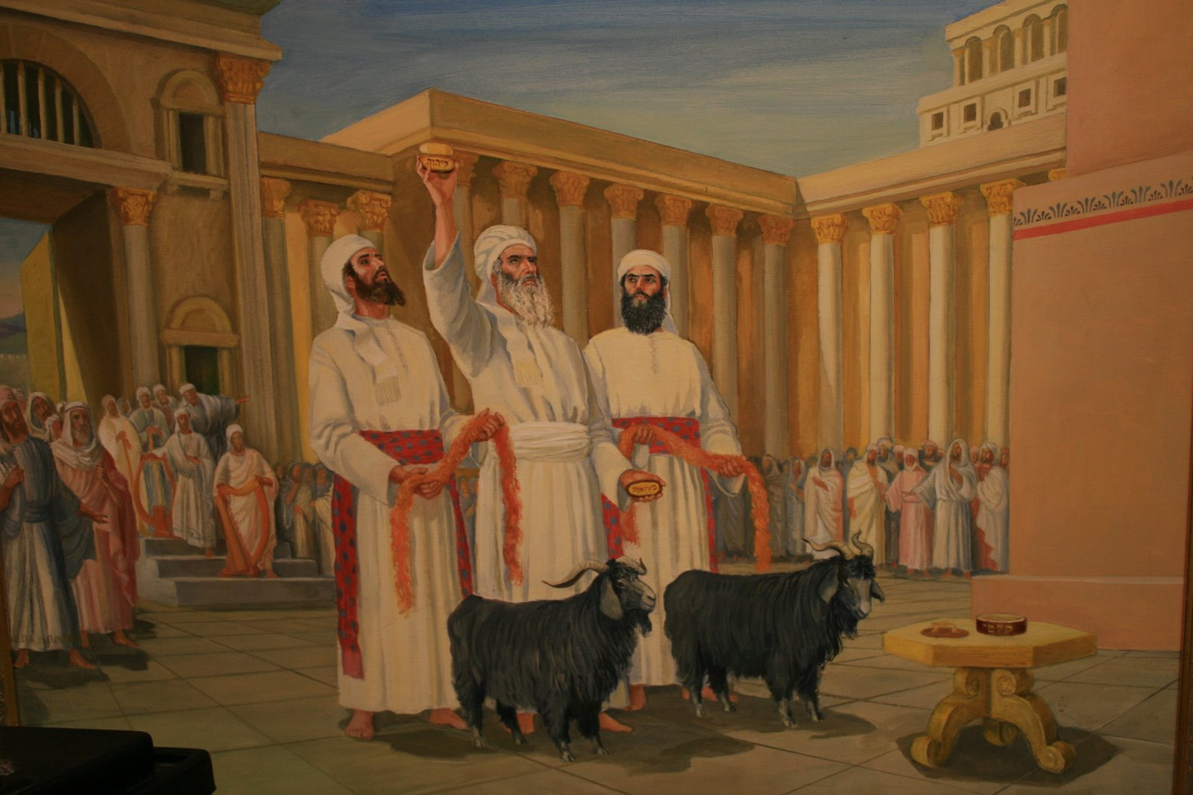
Day of Atonement
“Also on the tenth day of this seventh month there shall be a day of atonement: it shall be an holy convocation unto you; and ye shall afflict your souls, and offer an offering made by fire unto the LORD. And ye shall do no work in that same day: for it is a day of atonement, to make an atonement for you before the LORD your God.” Leviticus 23:27,28

Slide 4
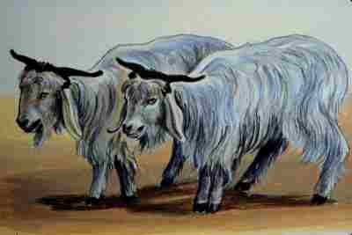
Also, a Day of Judgment
“For whatsoever soul it be that shall not be afflicted in that same day, he shall be cut off from among his people. And whatsoever soul it be that doeth any work in that same day, the same soul will I destroy from among his people.” Leviticus 16:29,30

Slide 5
They Go Together
1. Cleansing of the Sanctuary
a. Cleansing of the people’s lives from sin.
2. Day of Atonement
3. Day of Judgment
As Bible students of prophecy studied Daniel and Revelation, they saw these ideas mentioned in connection to time. They realized there connection and the importance of this message for God’s people in preparation for the judgment of the living and the end of time.

Slide 6
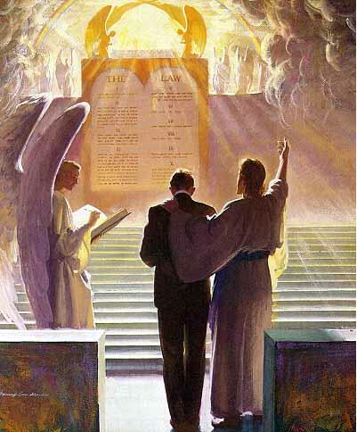
Connecting Prophecy
“And he said unto me, Unto two thousand and three hundred days; then shall the sanctuary be cleansed.” Daniel 8:14
“having the everlasting gospel to preach unto them that dwell on the earth, and to every nation, and kindred, and tongue, and people, Saying with a loud voice, Fear God, and give glory to him; for the hour of his judgment is come:” Rev. 14:7
They put Daniel 8:14, which talks about the cleansing of the sanctuary, and Rev. 14:7, which talks about the hour of His judgment and realized that the two verses are talking about the same event. Daniel 8 talks about the cleansing in the future; Rev. 14& declares that the judgment or cleansing time has arrived!

Slide 7
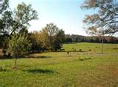
Afflicting Their Souls
“And this shall be a statute for ever unto you: that in the seventh month, on the tenth day of the month, ye shall afflict your souls, and do no work at all, whether it be one of your own country, or a stranger that sojourneth among you:” Lev. 16:29 “Also on the tenth day of this seventh month there shall be a day of atonement: it shall be an holy convocation unto you; and ye shall afflict your souls, and offer an offering made by fire unto the LORD.” Lev. 23:27

Slide 8
Afflicting Oursleves
Afflict-to humble oneself, to examine critically.

Slide 9

Cleansing of the People
“For on that day shall the priest make an atonement for you, to cleanse you, that ye may be clean from all your sins before the LORD.” Lev. 16:30
More than forgiveness, it meant the cleansing from sin through faith in Christ. “He that overcometh, the same shall be clothed in white raiment; and I will not blot out his name out of the book of life, but I will confess his name before my Father, and before his angels. “ Rev. 3:5

Slide 10
In Heaven Right Now!
“Jesus will appear as their advocate, to plead in their behalf before God. "If any man sin, we have an advocate with the Father, Jesus Christ the righteous." 1 John 2:1. "For Christ is not entered into the holy places made with hands, which are the figures of the true; but into heaven itself, now to appear in the presence of God for us." "Wherefore He is able also to save them to the uttermost that come unto God by Him, seeing He ever liveth to make intercession for them." Hebrews 9:24; 7:25. As the books of record are opened in the judgment, the lives of all who have believed on Jesus come in review before God. Beginning with those who first lived upon the earth, our Advocate presents the cases of each successive generation, and closes with the living. Every name is mentioned, every case closely investigated. Names are accepted, names rejected. When any have sins remaining upon the books of record, unrepented of and unforgiven, their names will be blotted out of the book of life, and the record of their good deeds will be erased from the book of God's remembrance. The Lord declared to Moses: "Whosoever hath sinned against Me, him will I blot out of My book." Exodus 32:33. And says the prophet Ezekiel: "When the righteous turneth away from his righteousness, and committeth iniquity, . . . all his righteousness that he hath done shall not be mentioned." Ezekiel 18:24. All who have truly repented of sin, and by faith claimed the blood of Christ as their atoning sacrifice, have had pardon entered against their names in the books of heaven; as they have become partakers of the righteousness of Christ, and their characters are found to be in harmony with the law of God, their sins will be blotted out, and they themselves will be accounted worthy of eternal life.” GC, pgs. 482,483

Slide 11
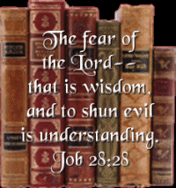
Sin Known
“Sin may be concealed, denied, covered up from father, mother, wife, children, and associates; no one but the guilty actors may cherish the least suspicion of the wrong; but it is laid bare before the intelligences of heaven. The darkness of the darkest night, the secrecy of all deceptive arts, is not sufficient to veil one thought from the knowledge of the Eternal. God has an exact record of every unjust account and every unfair dealing. He is not deceived by appearances of piety. He makes no mistakes in His estimation of character. Men may be deceived by those who are corrupt in heart, but God pierces all disguises and reads the inner life.” GC, pg. 486

Slide 12

Overcoming
“If those who hide and excuse their faults could see how Satan exults over them, how he taunts Christ and holy angels with their course, they would make haste to confess their sins and to put them away. Through defects in the character, Satan works to gain control of the whole mind, and he knows that if these defects are cherished, he will succeed. Therefore he is constantly seeking to deceive the followers of Christ with his fatal sophistry that it is impossible for them to overcome. But Jesus pleads in their behalf His wounded hands, His bruised body; and He declares to all who would follow Him: "My grace is sufficient for thee." 2 Corinthians 12:9.

Slide 13
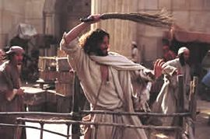
Christ’s Mission
“…the Jews had not understood the significance of the building they regarded with so much pride. They did not yield themselves as holy temples for the Divine Spirit. The courts of the temple at Jerusalem, filled with the tumult of unholy traffic, represented all too truly the temple of the heart, defiled by the presence of sensual passion and unholy thoughts. In cleansing the temple from the world's buyers and sellers, Jesus announced His mission to cleanse the heart from the defilement of sin,--from the earthly desires, the selfish lusts, the evil habits, that corrupt the soul.” DA, pg. 161

Slide 14

Enter the Fit Man
“And when he hath made an end of reconciling the holy place, and the tabernacle of the congregation, and the altar, he shall bring the live goat and Aaron shall lay both his hands upon the head of the live goat, and confess over him all the iniquities of the children of Israel, and all their transgressions in all their sins, putting them upon the head of the goat, and shall send him away by the hand of a fit man into the wilderness: and the goat shall bear upon him all their iniquities unto a land not inhabited: and he shall let go the goat in the wilderness.” Leviticus 16:20-22

Slide 15
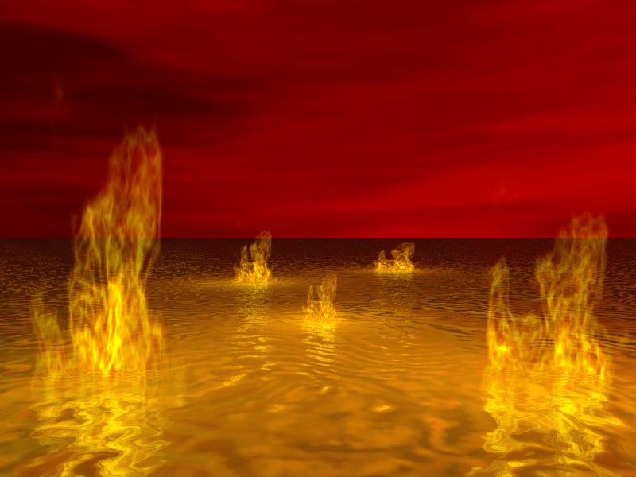
The Devil Banished
“The fit man takes the scapegoat into a land not inhabited and lets him go in the wilderness. The scapegoat is never to have contact with God’s people again. This typifies “As the priest, in removing the sins from the sanctuary, confessed them upon the head of the scapegoat, so Christ will place all these sins upon Satan, the originator and instigator of sin. The scapegoat, bearing the sins of Israel, was sent away "unto a land not inhabited" (Leviticus 16:22); so Satan, bearing the guilt of all the sins which he has caused God's people to commit, will be for a thousand years confined to the earth, which will then be desolate, without inhabitant, and he will at last suffer the full penalty of sin in the fires that shall destroy all the wicked. Thus the great plan of redemption will reach its accomplishment in the final eradication of sin and the deliverance of all who have been willing to renounce evil. “ GC, pgs. 485,486

Slide 16
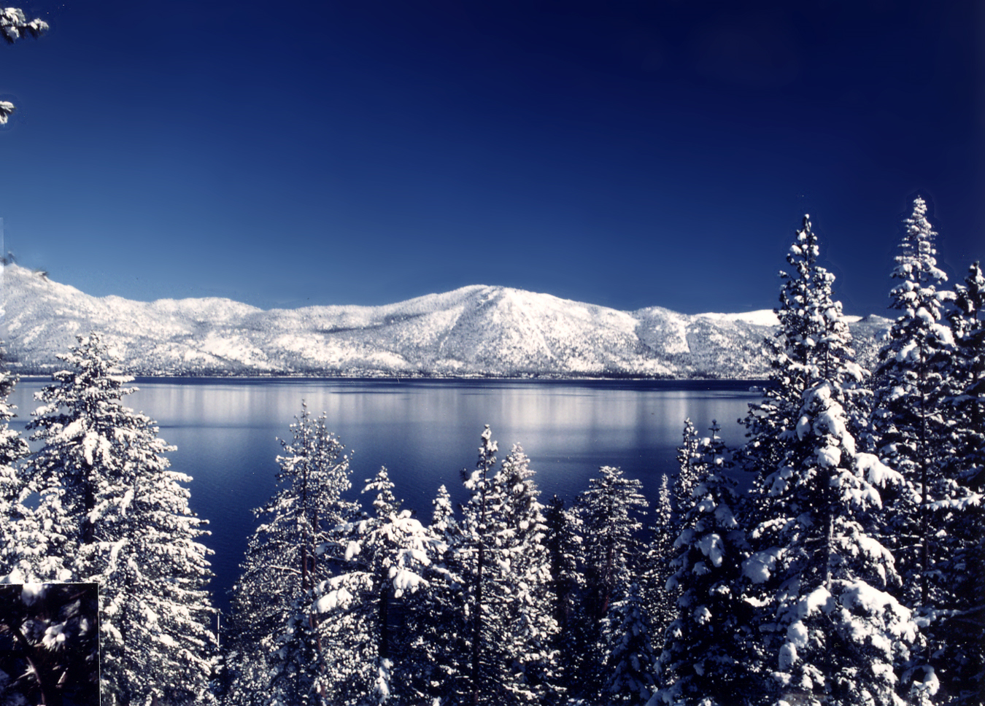
Who the Fit Man is Not
Some have declared that the fit man is representative of the 144,000. The fit man is one of God’s people; he is given a special job on the day of Atonement; however, there is nothing in Inspiration that declares the 144,000 having anything to do with the banishment of the Devil and his final destruction. That the fit man represents this group seems highly speculative to me.

