Slide 1
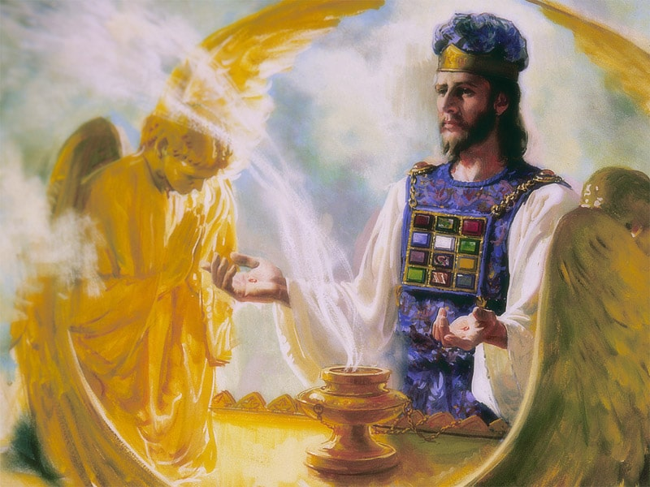
The Sanctuary pt 68: The Day of Atonement 15: The Shaking and the Second Coming

Slide 2
Where We Left Off…
In the last days of the Antitypical Day of Atonement, the Judgment began in 1844 after the 1st and 2nd Angel’s Messages were given; and it began with the Righteous Dead. The work of the Seventh-day Adventist faith has been to declare the 3rd Angel’s message to the entire world (and then shall the end come). The Judgment follows the typical service, (repentance and putting away of sin, a judgment between those who are “afflicting their souls” and those who are not who will be cut off). Names come up in the Judgment to see if the individual who has once trusted in Jesus Christ has indeed overcome every known sin by partaking of the divine nature by faith through love to gain the victory over every defect of character and hereditary and cultivated tendency to evil. The Christian is intensely examined in the Judgment by proxy via the perfect record of their characters in heaven. The Sunday Law marks the beginning of the Judgment of the Living and it begins in the house of God. The Pastors, Teachers and Preachers are called to address the sins within the church or they are false teachers and will be lost unless a work of repentance and reformation changes their faulty course. God’s response to Sunday Law will by the Latter Rain and the Loud Cry of the Third Angel. The Devil’s Response will be spiritualism and when Lucifer impersonates Jesus Christ’s Second Coming. God’s people will go through the final preparation of Jacob’s Time of Trouble (the true “afflicting of souls” application). Once the world is fully warned and every person has chosen between Sabbath and Sunday, probation closes, the plagues begin to fall and Christ is soon to Return!

Slide 3
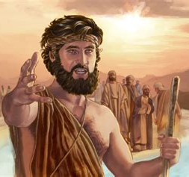
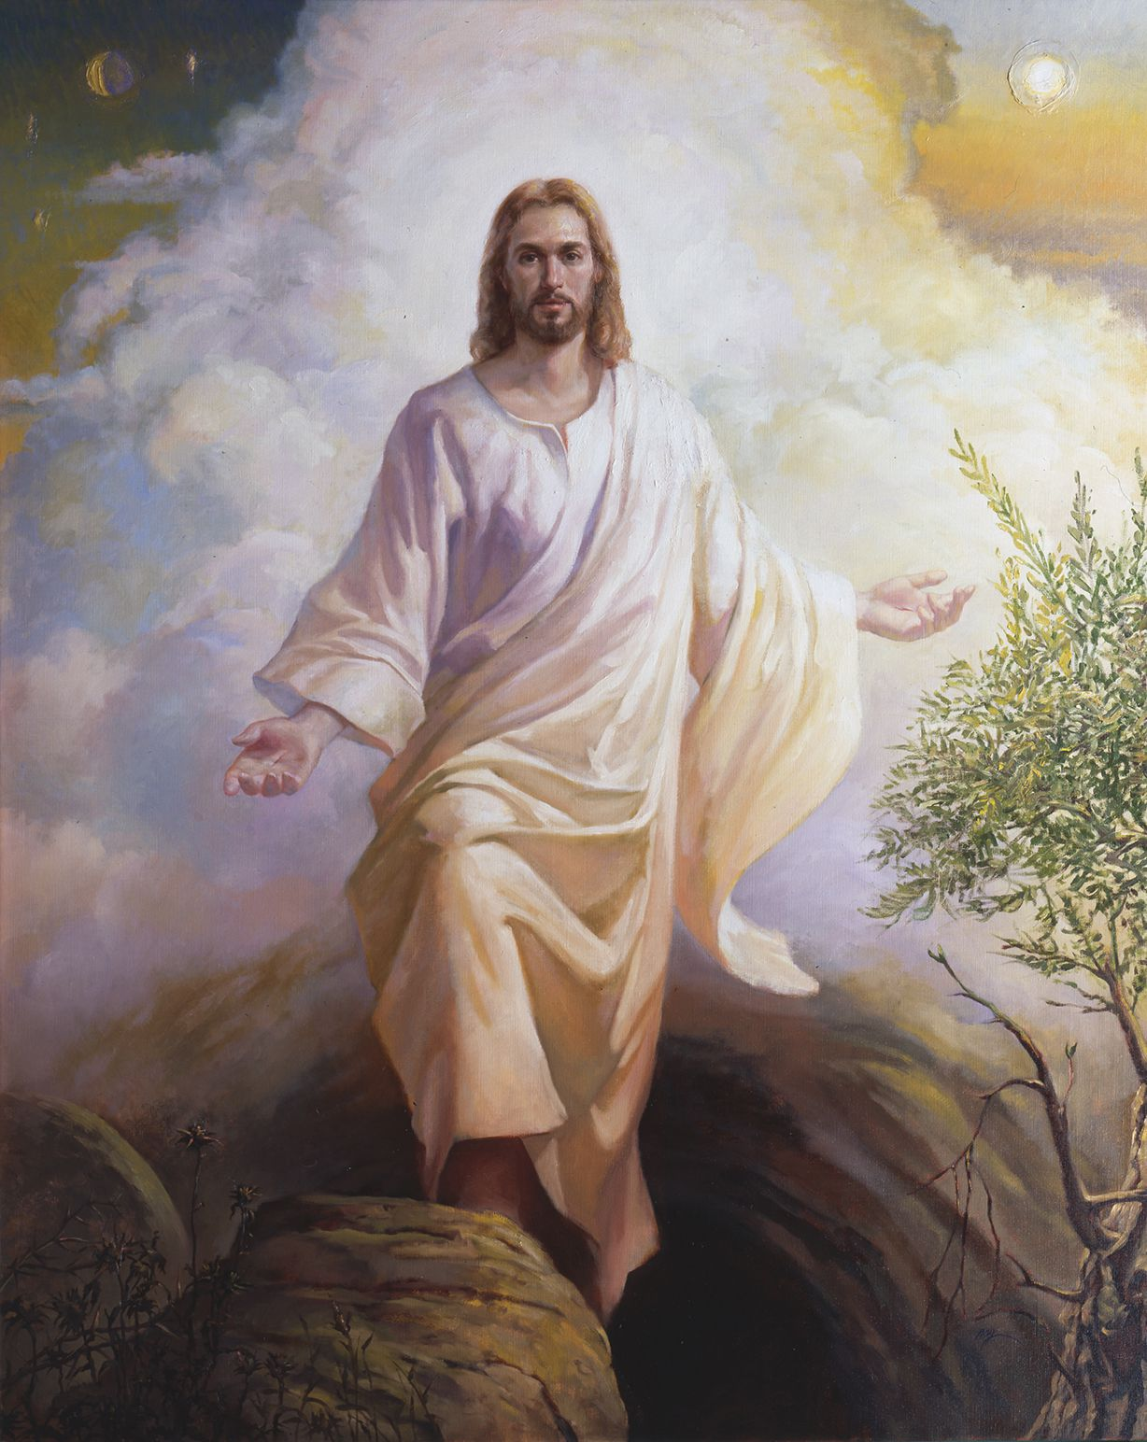
What is the True Church According to SOP?
“The church is God's fortress, His city of refuge, which He holds in a revolted world. Any betrayal of the church is treachery to Him who has bought mankind with the blood of His only-begotten Son. From the beginning, faithful souls have constituted the church on earth. In every age the Lord has had His watchmen, who have borne a faithful testimony to the generation in which they lived. These sentinels gave the message of warning; and when they were called to lay off their armor, others took up the work. God brought these witnesses into covenant relation with Himself, uniting the church on earth with the church in heaven. He has sent forth His angels to minister to His church, and the gates of hell have not been able to prevail against His people.” Acts of the Apostles, p. 11

Slide 4
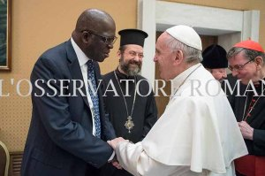
What’s the Storehouse? There Are 2!!!
“There are only two places in the world where we can deposit our treasures--in God's storehouse or in Satan’s, and all that is not devoted to Christ's service is counted on Satan's side and goes to strengthen his cause. The Lord designs that the means entrusted to us shall be used in building up His kingdom. His goods are committed to His stewards that they may be carefully traded upon and bring back a revenue to Him in the saving of souls unto eternal life.” 6T, 448
The Final Coffin Nail for Adventist Education: April 27, 2021 by Arnie Suntag

Slide 5
How Do We Make Sense of it All?
“The Lord does not set limits about His workers in some lines as men are wont to set. In their work, Brethren Megan and Sutherland have been hindered unnecessarily. Means have been withheld from them because in the organization and management of the Madison school, it was not placed under the control of the Conference. But the reasons why this school was not owned and controlled by the Conference has not been duly considered . . . The Lord does not require that the educational work at Madison shall be changed all about before it can receive hearty support of our people. The work that has been done there is approved of God, and He forbids that this line of work shall be broken up. The Lord will continue to bless and sustain the workers so long as they follow His counsel.”—EGW, June 18, 1907; Series B, No. 11, p. 32.
“God has a church upon the earth who are His chosen people, who keep His commandments. He is leading, not stray offshoots, not one here and one there, but a people. The truth is a sanctifying power; but the church militant is not the church triumphant. There are tares among the wheat.” TM, p. 61

Slide 6
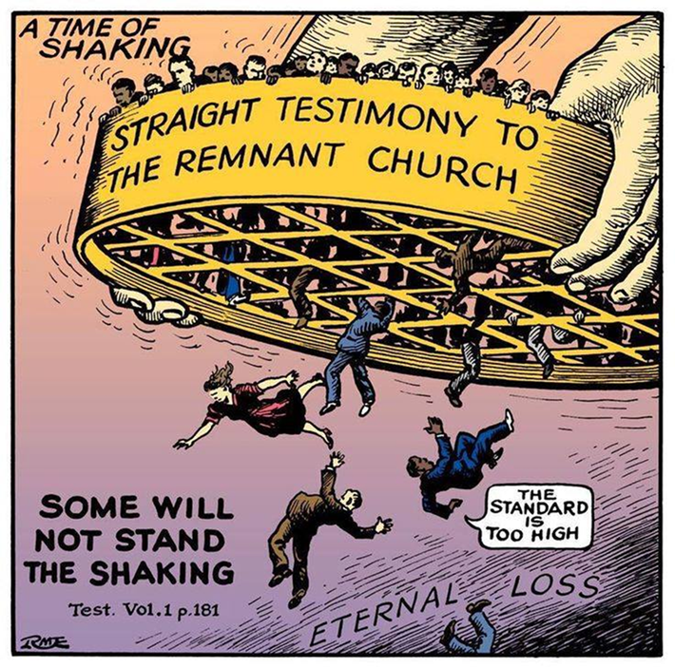
The Shaking…
“I asked the meaning of the shaking I had seen and was shown that it would be caused by the straight testimony called forth by the counsel of the True Witness to the Laodiceans. This will have its effect upon the heart of the receiver, and will lead him to exalt the standard and pour forth the straight truth. Some will not bear this straight testimony. They will rise up against it, and this is what will cause a shaking among God's people. I saw that the testimony of the True Witness has not been half heeded. The solemn testimony upon which the destiny of the church hangs has been lightly esteemed, if not entirely disregarded. This testimony must work deep repentance; all who truly receive it will obey it and be purified.”

Slide 7
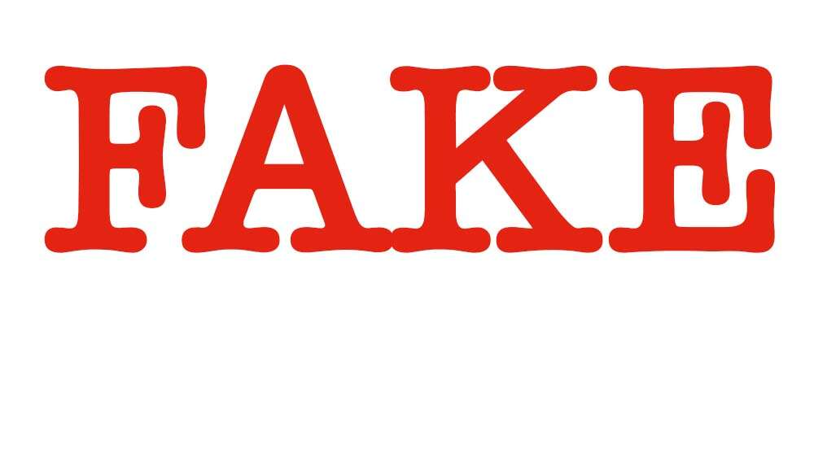
“The work which the church has failed to do in a time of peace and prosperity she will have to do in a terrible crisis under most discouraging, forbidding circumstances. The warnings that worldly conformity has silenced or withheld must be given under the fiercest opposition from enemies of the faith. And at that time the superficial, conservative class, whose influence has steadily retarded the progress of the work, will renounce the faith.”--5T 463; see also LDE, Ch. 12, The Shaking, p. 174

Slide 8
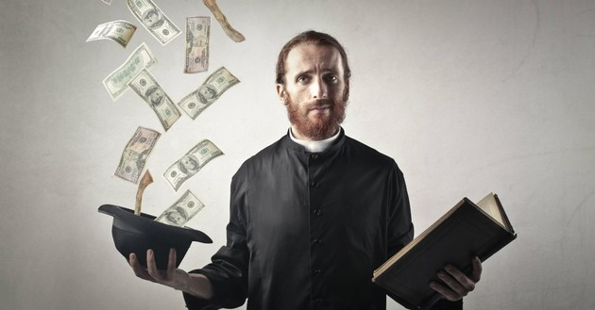
“The time is not far distant when the test will come to every soul. The observance of the false sabbath will be urged upon us. The contest will be between the commandments of God and the commandments of men. Those who have yielded step by step to worldly demands and conformed to worldly customs will then yield to the powers that be, rather than subject themselves to derision, insult, threatened imprisonment, and death. At that time the gold will be separated from the dross. True godliness will be clearly distinguished from the appearance and tinsel of it. Many a star that we have admired for its brilliance will then go out in darkness. Those who have assumed the ornaments of the sanctuary, but are not clothed with Christ's righteousness, will then appear in the shame of their own nakedness” PK, 188

Slide 9
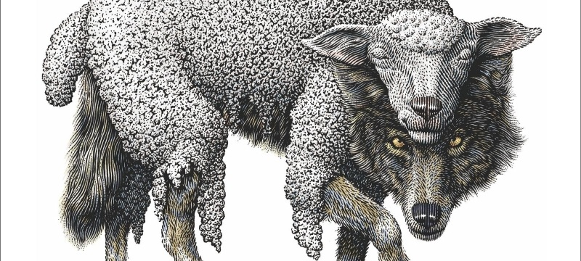
“As the storm approaches, a large class who have professed faith in the third angel's message, but have not been sanctified through obedience to the truth, abandon their position and join the ranks of the opposition. By uniting with the world and partaking of its spirit, they have come to view matters in nearly the same light; and when the test is brought, they are prepared to choose the easy, popular side. Men of talent and pleasing address, who once rejoiced in the truth, employ their powers to deceive and mislead souls. They become the most bitter enemies of their former brethren. When Sabbathkeepers are brought before the courts to answer for their faith, these apostates are the most efficient agents of Satan to misrepresent and accuse them, and by false reports and insinuations to stir up the rulers against them.” GC, p. 608

Slide 10
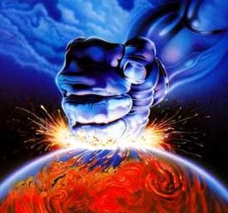
What it Will Be Like for the World
“In earnest, agonizing prayer they call for God to pass them not by. The kings, the mighty men, the lofty, the proud, the mean man, alike bow together under a pressure of woe, desolation, misery inexpressible; heart-anguished prayers are wrung from their lips. Mercy! mercy! Save us from the wrath of an offended God! A voice answers them with terrible distinctness, sternness, and majesty: "Because I have called, and ye refused; I have stretched out My hand, and no man regarded; but ye have set at nought all My counsel, and would none of My reproof: I also will laugh at your calamity; I will mock when your fear cometh.“ Then kings and nobles, the mighty man, and the poor man, and the mean man, alike, cry there most bitterly. They who in the days of their prosperity despised Christ and the humble ones who followed in His footsteps, men who would not humble their dignity to bow to Christ, who hated His despised cross, are now prostrate in the mire of the earth.” 2T, 41

Slide 11
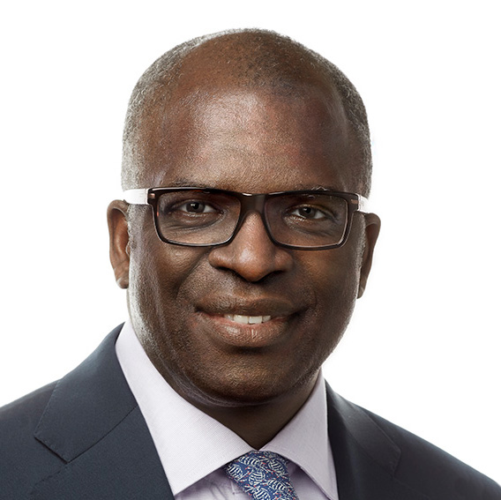
The Awful Consequences of Error
“Many of the wicked were greatly enraged as they suffered the effects of the plagues. It was a scene of fearful agony. Parents were bitterly reproaching their children, and children their parents, brothers their sisters, and sisters their brothers. Loud, wailing cries were heard in every direction, "It was you who kept me from receiving the truth which would have saved me from this awful hour." The people turned upon their ministers with bitter hate and reproached them, saying, "You have not warned us. You told us that all the world was to be converted, and cried, Peace, peace, to quiet every fear that was aroused. You have not told us of this hour; and those who warned us of it you declared to be fanatics and evil men, who would ruin us." But I saw that the ministers did not escape the wrath of God. Their suffering was tenfold greater than that of their people” EW, p. 282

Slide 12
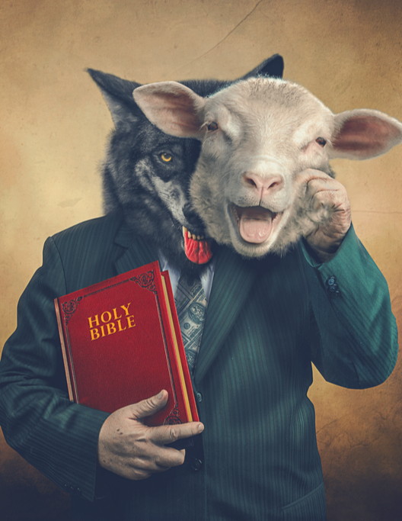
False Teachers Confronted By God!
“I saw that the priests who are leading on their flock to death are soon to be arrested in their dreadful career. The plagues of God are coming, but it will not be sufficient for the false shepherds to be tormented with one or two of these plagues. God's hand at that time will be stretched out still in wrath and justice and will not be brought to Himself again until His purposes are fully accomplished, and the hireling priests are led to worship at the feet of the saints, and to acknowledge that God has loved them because they held fast the truth and kept God's commandments, and until all the unrighteous ones are destroyed from the earth.” EW, p. 124

Slide 13
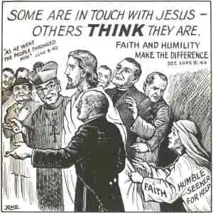
The Minister’s Office…
“The enemies of God's law, from the ministers down to the least among them, have a new conception of truth and duty. Too late they see that the Sabbath of the fourth commandment is the seal of the living God. Too late they see the true nature of their spurious sabbath and the sandy foundation upon which they have been building. They find that they have been fighting against God. Religious teachers have led souls to perdition while professing to guide them to the gates of Paradise. Not until the day of final accounts will it be known how great is the responsibility of men in holy office and how terrible are the results of their unfaithfulness. Only in eternity can we rightly estimate the loss of a single soul. Fearful will be the doom of him to whom God shall say: Depart, thou wicked servant.” GC, p. 640

Slide 14
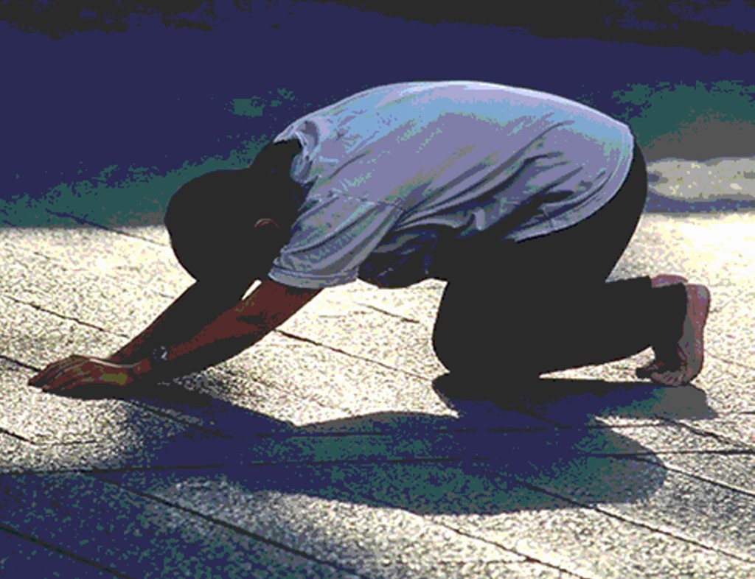
What is their Gain in the End?
“Their greatness has all at once left them, and they do not hesitate to bow to the earth at the feet of the saints. They then realize with terrible bitterness that they are eating the fruit of their own way, and are filled with their own devices. In their supposed wisdom they turned away from the high, eternal reward, rejected the heavenly inducement, for earthly gain. The glitter and tinsel of earth fascinated them, and in their supposed wisdom they became fools. They exulted in their worldly prosperity as though their worldly advantages were so great that they could through them be recommended to God, and thus secure heaven.” 2T, 42

Slide 15
Repentance Unto Death
1 Cor. 7:10 “For godly sorrow worketh repentance to salvation not to be repented of: but the sorrow of the world worketh death.”

Slide 16
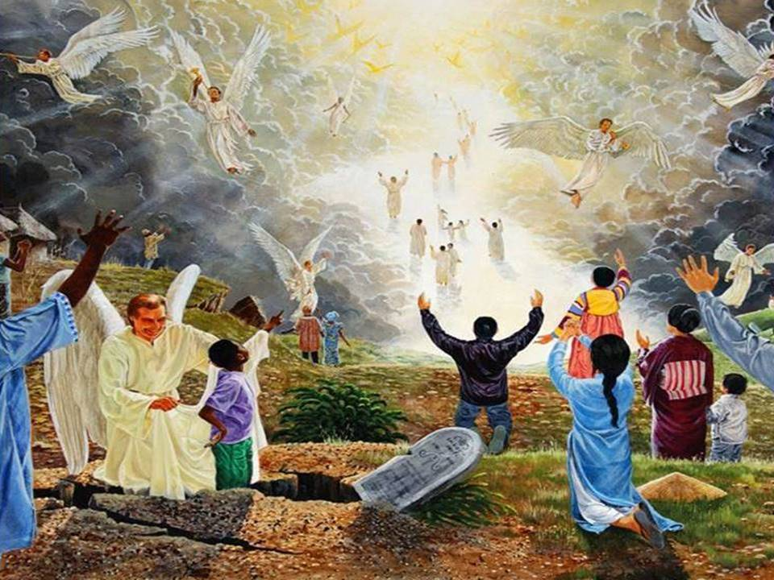
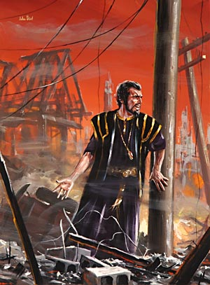
The Second Coming
“In the lives of all who reject truth there are moments when conscience awakens, when memory presents the torturing recollection of a life of hypocrisy and the soul is harassed with vain regrets. But what are these compared with the remorse of that day when "fear cometh as desolation," when "destruction cometh as a whirlwind"! Proverbs 1:27. Those who would have destroyed Christ and His faithful people now witness the glory which rests upon them. In the midst of their terror they hear the voices of the saints in joyful strains exclaiming: "Lo, this is our God; we have waited for Him, and He will save us." Isaiah 25:9. Amid the reeling of the earth, the flash of lightning, and the roar of thunder, the voice of the Son of God calls forth the sleeping saints. He looks upon the graves of the righteous, then, raising His hands to heaven, He cries: "Awake, awake, awake, ye that sleep in the dust, and arise!" Throughout the length and breadth of the earth the dead shall hear that voice, and they that hear shall live.” GC, 644

Slide 17
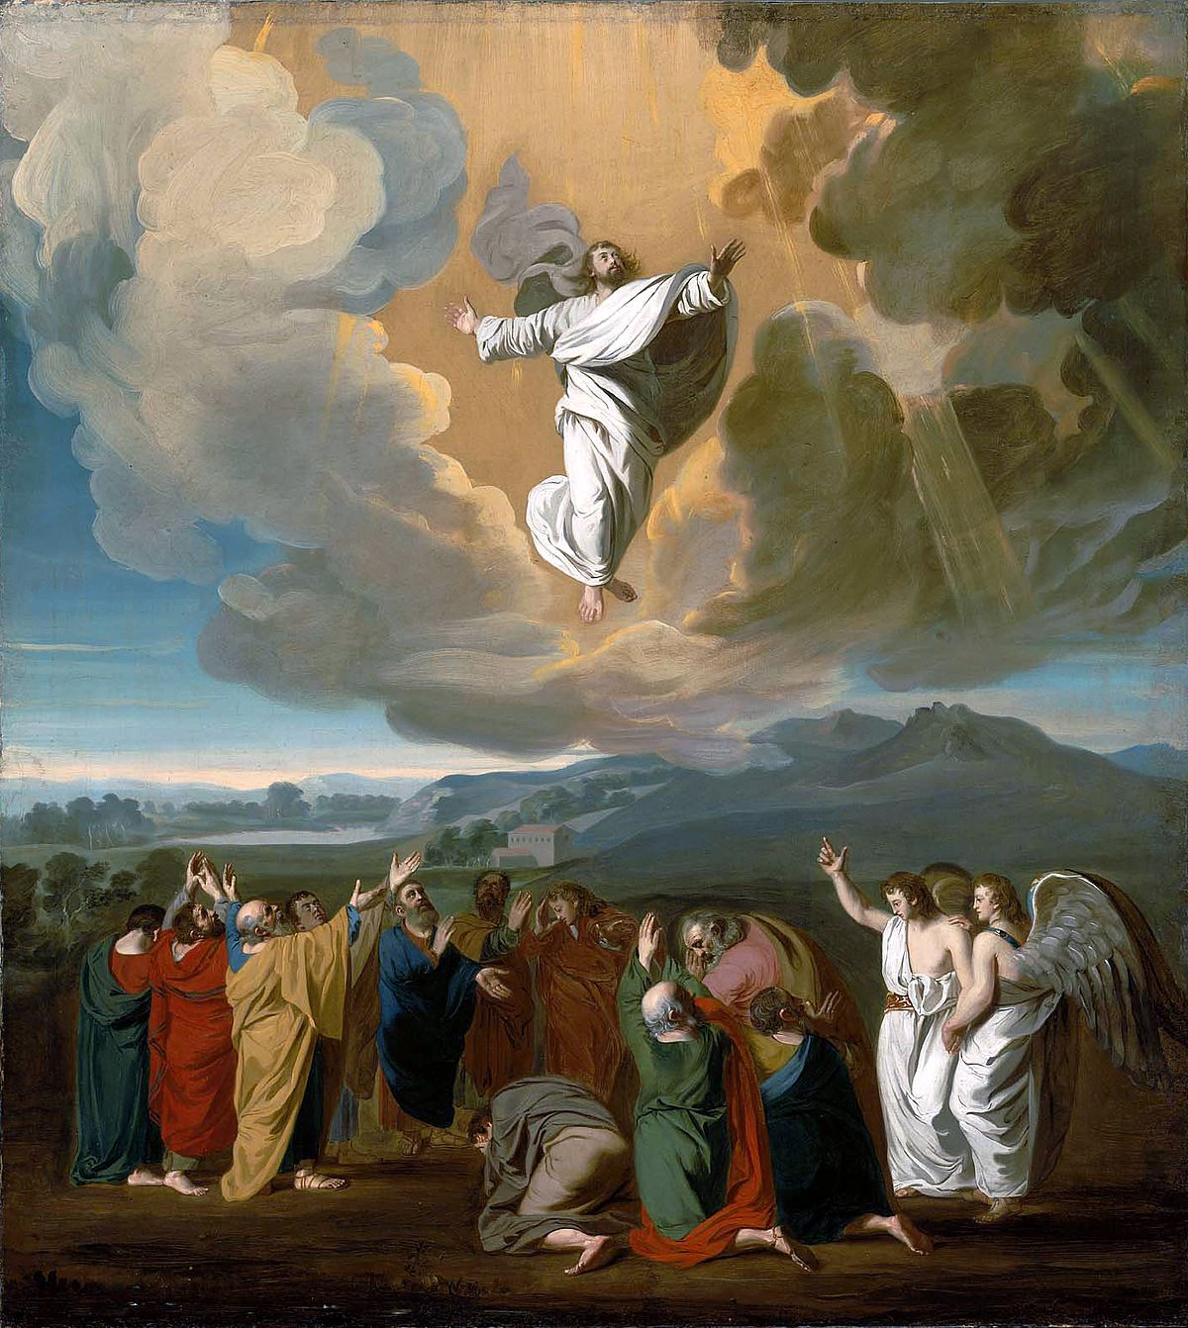
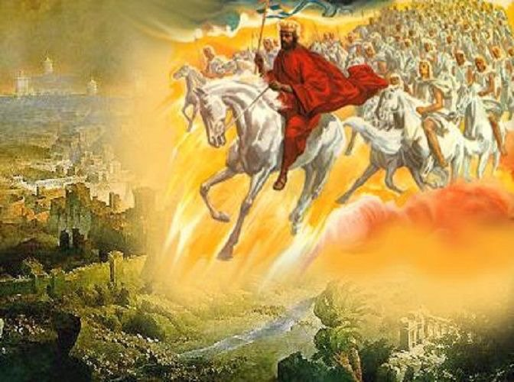
Destroyed At His Coming!
Rev. 19:11-18 “And I saw heaven opened, and behold a white horse; and he that sat upon him was called Faithful and True, and in righteousness he doth judge and make war. His eyes were as a flame of fire, and on his head were many crowns; and he had a name written, that no man knew, but he himself. And he was clothed with a vesture dipped in blood: and his name is called The Word of God. And the armies which were in heaven followed him upon white horses, clothed in fine linen, white and clean. And out of his mouth goeth a sharp sword, that with it he should smite the nations: and he shall rule them with a rod of iron: and he treadeth the winepress of the fierceness and wrath of Almighty God. And he hath on his vesture and on his thigh a name written, King Of Kings, And Lord Of Lords. And I saw an angel standing in the sun; and he cried with a loud voice, saying to all the fowls that fly in the midst of heaven, Come and gather yourselves together unto the supper of the great God; That ye may eat the flesh of kings, and the flesh of captains, and the flesh of mighty men, and the flesh of horses, and of them that sit on them, and the flesh of all men, both free and bond, both small and great.”

Slide 18
Positive for Saints, Negative for Wicked

Slide 19
The Wicked Judged By…
When the world's Redeemer walked among men, bearing insult, reproach, and scorn, the Father beheld each indignity. Every word of mockery, every sneer, every act of contumely and hate, was marked in the books of remembrance. The Jewish nation suffered terrible judgments, because they rejected the Lord from heaven; but their deeds were not fully requited. Those who mocked and crucified the Son of God will come forth from their graves, and the deeds done in secrecy and darkness, as well as those done in the light of day, will be presented before them as they appear before the infinite Father. Every transgression will receive its just recompense of reward in the day of final retribution. {RH, March 27, 1888 par. 11}

Slide 20
Jesus calls all, unbelief insult to God
Jesus alone has power to save from sin, to free from the power of evil; and to doubt him who has laid down his life for us, is to grieve and insult the Father, who has in one gift poured out all heaven to a lost world. "He that spared not his own Son, but delivered him up for us all, how shall he not with him also freely give us all things?" Unbelief is an offense to God. A plan has been provided so broad, so perfect, that every sinner may find forgiveness and redemption. However great may be the sin, the sinner has no excuse for remaining away from Christ; for Jesus draws every soul, and all may respond to the infinite love of God. The sinner may put his will on the side of God's will, and may become a laborer together with God. {RH, February 10, 1891

Slide 21
Wicked Judged Will Feel Every Wrong Act
Then those who pierced Christ will remember how they slighted His love and abused His compassion; how they chose in His stead Barabbas, a robber and murderer; how they crowned the Saviour with thorns, and caused Him to be scourged and crucified; how, in the agony of His death on the cross, they taunted Him, saying, "Let him now come down from the cross, and we will believe him." "He saved others; himself he cannot save." They will seem to hear again His voice of entreaty. Every tone of solicitude will vibrate as distinctly in their ears as when the Saviour spoke to them. Every act of insult and mockery done to Christ will be as fresh in their memory as when the satanic deeds were done. {6BC 1070.2}

Slide 22
