Slide 1
REPAIRERs of the Breach
It’s Time

Slide 2
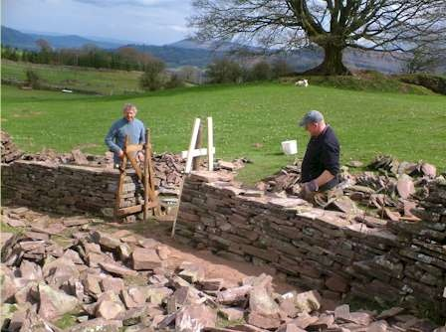
Repairers of the Breach
“And they that shall be of thee shall build the old waste places: thou shalt raise up the foundations of many generations; and thou shalt be called, The repairer of the breach, The restorer of paths to dwell in.” Isaiah 58:12

Slide 3
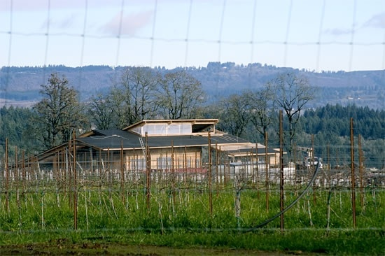
Wall of Protection
“Now will I sing to my well beloved a song of my beloved touching his vineyard. My well beloved hath a vineyard in a very fruitful hill: And he fenced it, and gathered out the stones thereof, and planted it with the choicest vine, and built a tower in the midst of it, and also made a winepress therein: and he looked that it should bring forth grapes, and it brought forth wild grapes…. And now go to; I will tell you what I will do to my vineyard: I will take away the hedge thereof, ” Isaiah 5:1-5

Slide 4
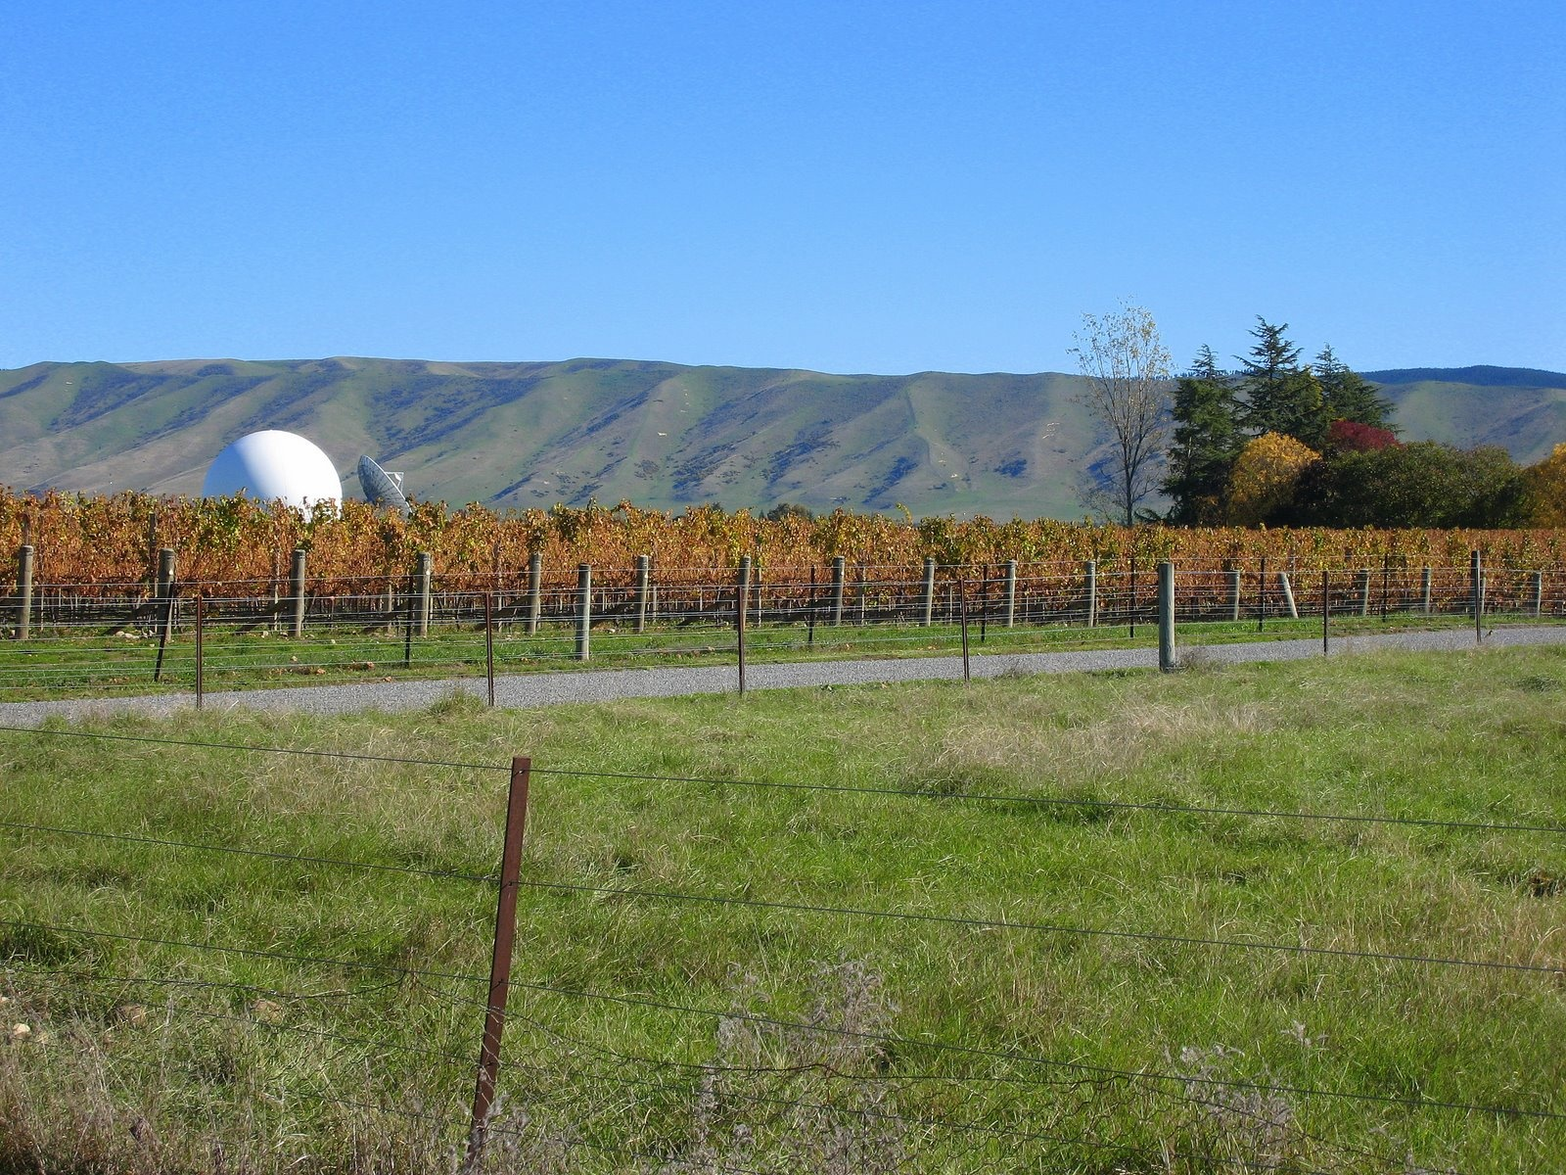
Christ’s Parable
“Hear another parable: There was a certain householder, which planted a vineyard, and hedged it round about, and digged a winepress in it, and built a tower, and let it out to husbandmen, and went into a far country: And when the time of the fruit drew near, he sent his servants to the husbandmen, that they might receive the fruits of it.” Matthew 21:33-39

Slide 5
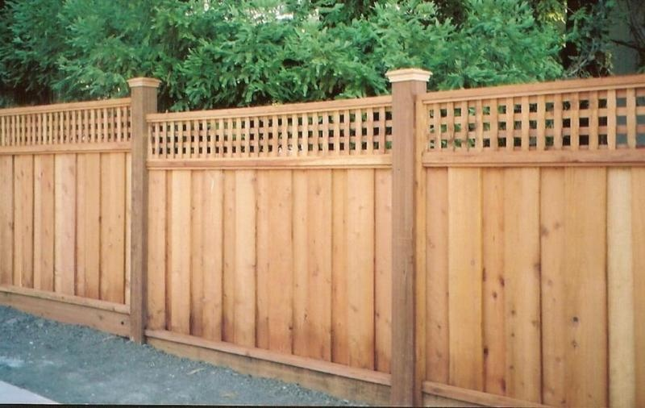
A Fence Protects
A fence protects people and animals from trouble. It protects a farmer’s crops from hungry animals and it protects domesticated animals from getting out and getting run over by cars or other vehicles.

Slide 6
Christ’s meaning
“The speakers had not at first perceived the application of the parable, but they now saw that they had pronounced their own condemnation. In the parable the householder represented God, the vineyard the Jewish nation, and the hedge the divine law which was their protection. The tower was a symbol of the temple. The lord of the vineyard had done everything needful for its prosperity. "What could have been done more to my vineyard," he says, "that I have not done in it." Isa. 5:4. Thus was represented God's unwearied care for Israel.” DA, pgs. 596

Slide 7
The Ten commandments
“ There is not a commandment of the law that is not for the good and happiness of man, both in this life and in the life to come. In obedience to God's law, man is surrounded as with a hedge and kept from the evil. He who breaks down this divinely erected barrier at one point has destroyed its power to protect him; for he has opened a way by which the enemy can enter to waste and ruin.” Reflecting Christ, pg. 69

Slide 8
Attempts to Destroy the Hedge
“Ye have not gone up into the gaps, neither made up the hedge for the house of Israel to stand in the battle in the day of the LORD…Because, even because they have seduced my people, saying, Peace; and there was no peace; and one built up a wall, and, lo, others daubed it with untempered morter: Say unto them which daub it with untempered morter, that it shall fall: there shall be an overflowing shower; and ye, O great hailstones, shall fall; and a stormy wind shall rend it. Lo, when the wall is fallen, shall it not be said unto you, Where is the daubing wherewith ye have daubed it?... So will I break down the wall that ye have daubed with untempered morter, and bring it down to the ground.” Ezekiel 13:5-16

Slide 9
"untempered mortar"
The wall "daubed with untempered mortar" of (Ezekiel 13:10) was perhaps a sort of cob-wall of mud or clay without lime, which would give way under heavy rain. Untempered mortar was the Hebrew equivalent for empty foolishness. It was a picture of someone who built a stone wall with water and sand as mortar and then covered it over with white wash. To them, there was nothing more foolish than a wall which couldn’t stand up against the elements or hold back the enemy armies that often laid siege against their cities.

Slide 10
Tampering with the Wall
The wall or hedge is the law of God. Ezekiel 13 tells us that the law of God is being tampered with and is trying to be destroyed. Does the Bible give any indication as to any specific commandment that is under attack?
“Her priests have violated my law, and have profaned mine holy things: they have put no difference between the holy and profane, neither have they shewed difference between the unclean and the clean, and have hid their eyes from my sabbaths, and I am profaned among them. Her princes in the midst thereof are like wolves ravening the prey, to shed blood, and to destroy souls, to get dishonest gain. And her prophets have daubed them with untempered morter, seeing vanity, and divining lies unto them, saying, Thus saith the Lord GOD, when the LORD hath not spoken.” Ezekiel 22:26-28

Slide 11
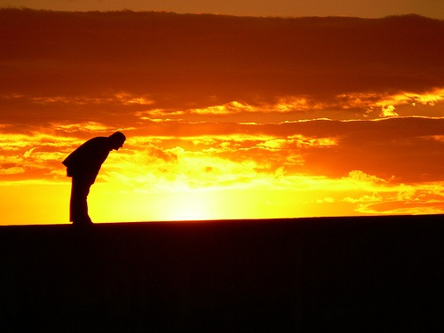
Sun Worshippers
“Then said he unto me, Hast thou seen this, O son of man? turn thee yet again, and thou shalt see greater abominations than these. And he brought me into the inner court of the LORD's house, and, behold, at the door of the temple of the LORD, between the porch and the altar, were about five and twenty men, with their backs toward the temple of the LORD, and their faces toward the east; and they worshipped the sun toward the east.” Ezekiel 8:15,16

Slide 12
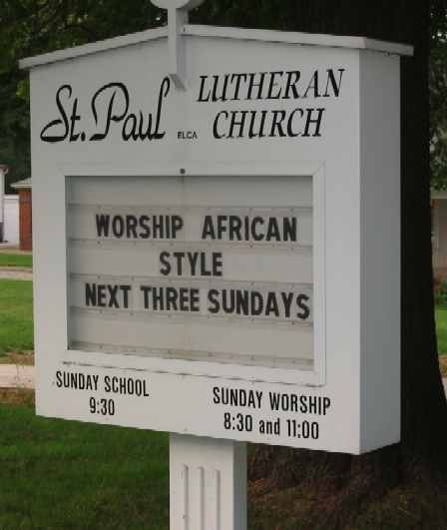
Untempered Mortar
A mixture of mortar has been added to the mix to solidify the law of God. This ‘untempered mortar’ is of human origin and has no place in God’s original law. People are led to believe that this mortar gives strength when it actually brings destruction. The mortar is sun worship.

Slide 13
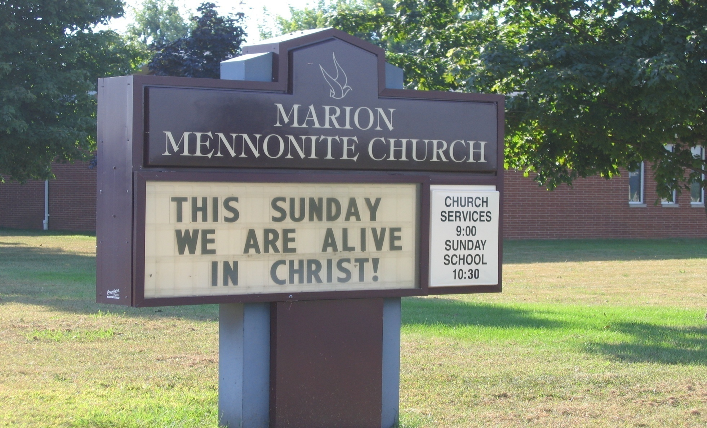

Slide 14
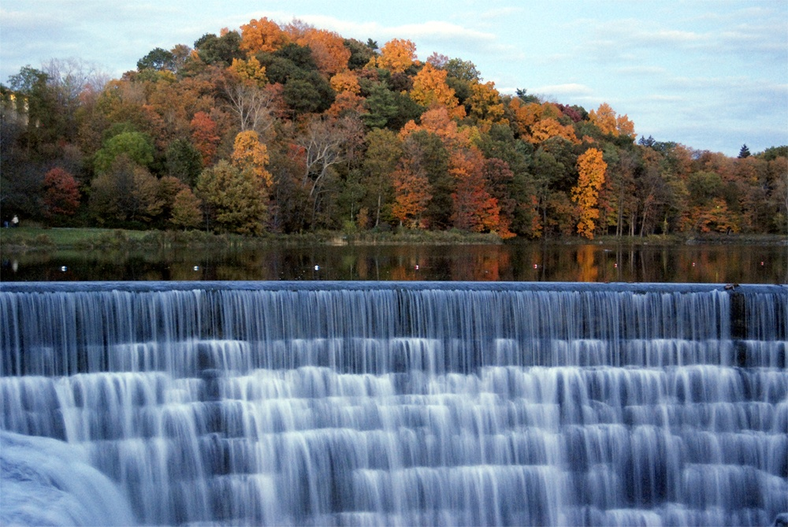
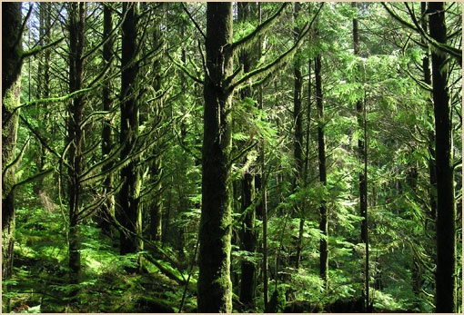
Destruction of the Sabbath

Slide 15
Prophecy Predicted it
“And he shall speak great words against the most High, and shall wear out the saints of the most High, and think to change times and laws: and they shall be given into his hand until a time and times and the dividing of time.” Daniel 7:25
“Let no man deceive you by any means: for that day shall not come, except there come a falling away first, and that man of sin be revealed, the son of perdition; Who opposeth and exalteth himself above all that is called God, or that is worshipped; so that he as God sitteth in the temple of God, shewing himself that he is God. Remember ye not, that, when I was yet with you, I told you these things?...” 2 Thessalonians 2: 3-8

Slide 16
The Papacy Admits it!
Prove to me from the Bible alone that I am bound to keep Sunday holy. There is no such law in the Bible. It is a law of the holy Catholic Church alone. The Bible says ‘Remember the Sabbath day to keep it holy.’ The Catholic Church says, No. By my divine power I abolish the Sabbath day and command you to keep holy the first day of the week. And lo! The entire civilized world bows down in reverent obedience to the command of the Holy Catholic Church. — Thomas Enright, CSSR, President, Redemptorist College (Roman Catholic), Kansas City, MO., February 18, 1884.
The observance of Sunday by the Protestants is an homage they pay, in spite of themselves, to the authority of the [Catholic] church. — Monsignor Louis Segur, Plain Talk About the Protestantism of Today (1868), p. 213.
The State, in passing laws for the due sanctification of Sunday, is unwittingly acknowledging the authority of the Catholic Church, and carrying out more or less faithfully its prescriptions.
The Sunday, as a day of the week set apart for the obligatory public worship of Almighty God, to be sanctified by a suspension of all servile labor, trade, and worldly avocations and by exercises of devotion, is purely a creation of the Catholic Church. — The American Catholic Quarterly Review, January, 1883, pp. 152, 139.

Slide 17
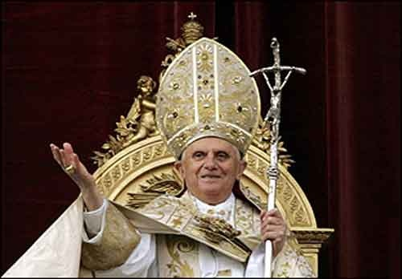
He has been pushing it-Now!
APOSTOLIC LETTER
DIES DOMINI ON KEEPING THE LORD'S DAY HOLY. This document was authored by Ratzinger himself! This was while he was the head of the Congregation for the Doctrine of the Faith-anciently known as the holy office of the inquisition

Slide 18
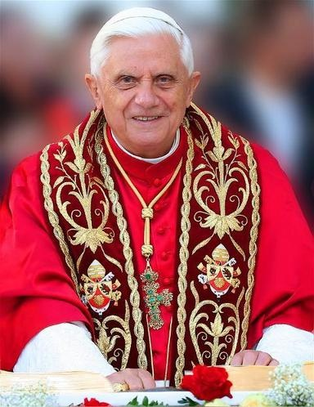
Now! The Destroyer of Man
The EU Must Keep Sunday, Says Catholic Church
November 18, 2008 | From theTrumpet.com
“The Catholic Church wants Sunday observance enshrined in EU law. The European Parliament is debating changes to its Working Time Directive. The Vatican wants a clause in this law that would force every citizen in the European Union to rest on Sunday.”

Slide 19
The Consequences
“Say unto them which daub it with untempered morter, that it shall fall: there shall be an overflowing shower; and ye, O great hailstones, shall fall; and a stormy wind shall rend it. Lo, when the wall is fallen, shall it not be said unto you, Where is the daubing wherewith ye have daubed it? Therefore thus saith the Lord GOD; I will even rend it with a stormy wind in my fury; and there shall be an overflowing shower in mine anger, and great hailstones in my fury to consume it. So will I break down the wall that ye have daubed with untempered morter, and bring it down to the ground,…” Ezekiel 13:11-15

Slide 20
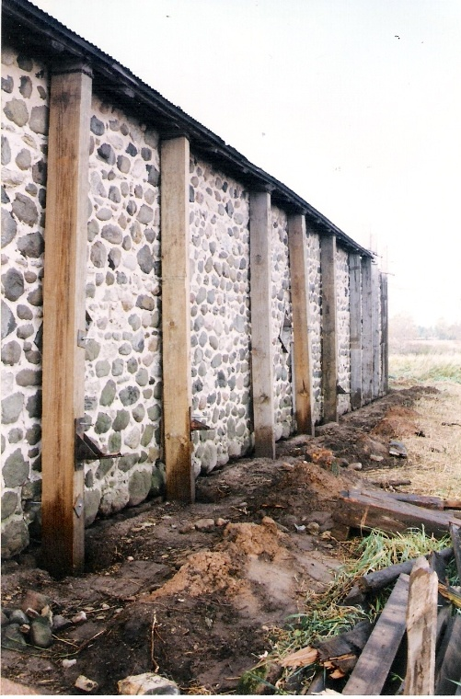
Building the Wall
“And they that shall be of thee shall build the old waste places: thou shalt raise up the foundations of many generations; and thou shalt be called, The repairer of the breach, The restorer of paths to dwell in. If thou turn away thy foot from the sabbath, from doing thy pleasure on my holy day; and call the sabbath a delight, the holy of the LORD, honourable; and shalt honour him, not doing thine own ways, nor finding thine own pleasure, nor speaking thine own words: Then shalt thou delight thyself in the LORD; and I will cause thee to ride upon the high places of the earth, and feed thee with the heritage of Jacob thy father: for the mouth of the LORD hath spoken it.” Isaiah 58:12-14

Slide 21
For Such a Time
“For if thou altogether holdest thy peace at this time, then shall deliverance arise to the Jews (Adventists) from another place, but thou and thy father’s house shall be destroyed; and who knoweth whether thou art come to the kingdom for such a time as this.” Esther 4:13,14

