Slide 1
Benjamin ‘Raving’ Wolf

Slide 2
The Grand Finale
Approaching 100 years old, Jacob was finally returning home after 20 turbulent years in Haran. He had left Canaan empty and now he returned with 4 wives, at least 12 children, and an abundance of cattle. Crowning it all off, his beloved wife Rachel was pregnant again with their 2nd child. Oh, how the couple longed for another little boy like their first, Joseph! It couldn’t get any better than this; going home and your dear wife having another child!!
Tragically, this beautiful dream would end in nightmare as Rachel gave birth to another boy, Benjamin and died in the process! At the pinnacle of earthly joy, everything to look forward to, and at the height of human joy, Rachel goes down for the count! The child in this sorrow was Benjamin!
Motherless, would lose his brother at 11; what became of this young man, almost unknown in the Bible?

Slide 3
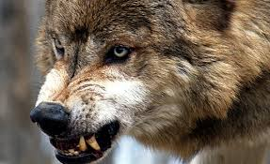
Raving Wolf
Jacob had a very graphic way of describing his children in terms that his listeners could understand. Naphtali was a hind let loose; Issachar is a strong donkey, and Dan was a serpent. All of these animals were well known to his listener’s Well, Benjamin was also portrayed by an animal. “Benjamin shall ravin as a wolf: in the morning he shall devour the prey, and at night he shall divide the spoil.” Genesis 49:27

Slide 4
Coward by itself; Vicious when in a Group
The wolf is rather larger than our largest dogs, and looks somewhat like them; but he seems more wild, savage and cruel. The wolves go in large companies, making a terrible howling noise; and though they are in general cowardly, yet when they are very hungry they attack large animals, and even men. They almost always go out by night, and the Bible refers to this when it says, "Their horses are more fierce than the evening wolves." Jacob, just before his death, said of one of his sons, "Benjamin shall raven as a wolf; in the morning he shall devour the prey, and at evening he shall divide the spoil."

Slide 5
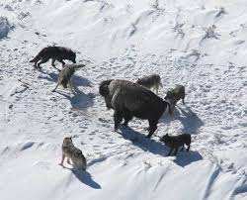
The Entitled!
The Benjamite Motto is:
1. I’m entitled to whatever I want.
2. I take what I see.
3. I destroy what I see.
4. I devour what I see.
5. I do not care about anything if it gets in my way!

Slide 6
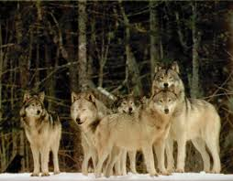
One wolf, OK; a wolf pack, big trouble
In the varying sources, a single wolf was described as a coward, remaining aloof; whereas a pack of wolves can be utterly tenacious and vicious. Wolves gain strength from being in a group and do things they would never dream of doing if alone!

Slide 7
Bad Marks!
Wolves are sometimes used as an analogy for certain forms of despicable human behavior, such as misfit politicians who usurp high government office through election fraud and then manipulate and mislead their too-trusting followers thereafter by endless lies and deception…
The Bible uses wolves as an analogy for those who prey upon God's "sheep.“ "Wolves In Sheep's Clothing.”
Jesus Christ warned Believers to watch out for "wolves" - a warning that included a warning to the wolves themselves of the fate that awaits them if they don't repent of their evil:

Slide 8
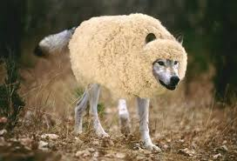
Wolves in Sheep’s clothing
“Beware of false prophets, which come to you in sheep's clothing, but inwardly they are ravening wolves. Ye shall know them by their fruits. Do men gather grapes of thorns, or figs of thistles? Even so every good tree bringeth forth good fruit; but a corrupt tree bringeth forth evil fruit. A good tree cannot bring forth evil fruit, neither can a corrupt tree bring forth good fruit.” Matthew 7:15-18

Slide 9
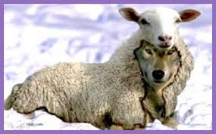
“Take heed therefore unto yourselves, and to all the flock, over the which the Holy Ghost hath made you overseers, to feed the church of God, which he hath purchased with his own blood. For I know this, that after my departing shall grievous wolves enter in among you, not sparing the flock. Also of your own selves shall men arise, speaking perverse things, to draw away disciples after them.” Acts 20:28-30

Slide 10

Most Difficult Task
It is quite difficult to find anything redemptive in Jacob’s illustration of Benjamin as a raving wolf! Yet, we read clearly in the final account of God’s 144,000 that Benjamin and those like him will be there!!! How can this be?
“Of the tribe of Zabulon were sealed twelve thousand. Of the tribe of Joseph were sealed twelve thousand. Of the tribe of Benjamin were sealed twelve thousand.” Rev. 7:8

Slide 11
Sick!
“And, behold, there came an old man from his work out of the field at even, which was also of mount Ephraim; and he sojourned in Gibeah: but the men of the place were Benjamites. And when he had lifted up his eyes, he saw a wayfaring man in the street of the city: and the old man said, Whither goest thou? and whence comest thou? And he said unto him, We are passing from Bethlehemjudah toward the side of mount Ephraim; from thence am I: and I went to Bethlehemjudah, but I am now going to the house of the LORD; and there is no man that receiveth me to house. Yet there is both straw and provender for our asses; and there is bread and wine also for me, and for thy handmaid, and for the young man which is with thy servants: there is no want of any thing. And the old man said, Peace be with thee; howsoever let all thy wants lie upon me; only lodge not in the street. So he brought him into his house, and gave provender unto the asses: and they washed their feet, and did eat and drink. Now as they were making their hearts merry, behold, the men of the city, certain sons of Belial, beset the house round about, and beat at the door, and spake to the master of the house, the old man, saying, Bring forth the man that came into thine house, that we may know him. And the man, the master of the house, went out unto them, and said unto them, Nay, my brethren, nay, I pray you, do not so wickedly; seeing that this man is come into mine house, do not this folly. Behold, here is my daughter a maiden, and his concubine; them I will bring out now, and humble ye them, and do with them what seemeth good unto you: but unto this man do not so vile a thing…

Slide 12
Heartbreaking!
But the men would not hearken to him: so the man took his concubine, and brought her forth unto them; and they knew her, and abused her all the night until the morning: and when the day began to spring, they let her go. Then came the woman in the dawning of the day, and fell down at the door of the man's house where her lord was, till it was light. And her lord rose up in the morning, and opened the doors of the house, and went out to go his way: and, behold, the woman his concubine was fallen down at the door of the house, and her hands were upon the threshold.” Judges 19:16-27
The rest of Israel was not pleased with this and requested the Benjamites to give up these wicked men to death for their crimes. The Benjamites refused and prepared to go to war against them. To a man, the Benjamites were almost wiped out as a result of this debacle!
“And said, O LORD God of Israel, why is this come to pass in Israel, that there should be to day one tribe lacking in Israel?” Judges 21:3

Slide 13
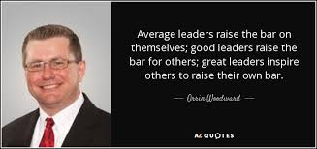
Barely Survived!
The Benjamites, in their lust and covetousness, almost destroyed themselves. This entitlement mentality is self-destructive in itself! Eventually, one entitled runs into someone who doesn’t agree with their estimation of things; a battle ensues and the entitled ones are destroyed!
Fortunately, Benjamin learned from this near massacre. This tribe produced some great leaders!

Slide 14
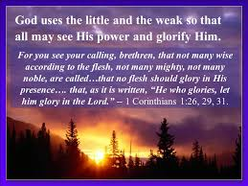
Ehud!
But when the children of Israel cried unto the LORD, the LORD raised them up a deliverer, Ehud the son of Gera, a Benjamite, a man left handed: and by him the children of Israel sent a present unto Eglon the king of Moab.” Judges 3:15 Ehud, unlike his kindred and tribe, learned that his ways were folly apart from the Lord! His glory was laid in the dust and Ehud allowed the Lord to work His way in his life. This made all the difference!

Slide 15
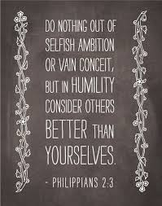
Wolf/Child in Battle
“Now in Shushan the palace there was a certain Jew, whose name was Mordecai, the son of Jair, the son of Shimei, the son of Kish, a Benjamite;” Esther 2:5
“Now there was a man of Benjamin, whose name was Kish, the son of Abiel, the son of Zeror, the son of Bechorath, the son of Aphiah, a Benjamite, a mighty man of power. And he had a son, whose name was Saul, a choice young man, and a goodly: and there was not among the children of Israel a goodlier person than he: from his shoulders and upward he was higher than any of the people.” 1 Samuel 9:1,2

Slide 16
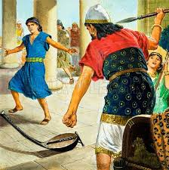
Wolf Ate Him Alive!!!
Mordecai knew where his strength lay. The wolf of Benjamin remained subdued in this man and God did great things through him. Saul, on the other hand, did great things when he was humble in his own eyes. When the wolf manifested himself in Saul, disaster struck! Tragically, in the end, the wolf in Saul devoured him. “But the Spirit of the LORD departed from Saul, and an evil spirit from the LORD troubled him. And Saul's servants said unto him, Behold now, an evil spirit from God troubleth thee.” 1 Samuel 16:14,15

Slide 17
Hope For Benjamites!
“Though I might also have confidence in the flesh. If any other man thinketh that he hath whereof he might trust in the flesh, I more: Circumcised the eighth day, of the stock of Israel, of the tribe of Benjamin, an Hebrew of the Hebrews; as touching the law, a Pharisee;” Philippians 3:4,5
“And Saul, yet breathing out threatenings and slaughter against the disciples of the Lord, went unto the high priest, And desired of him letters to Damascus to the synagogues, that if he found any of this way, whether they were men or women, he might bring them bound unto Jerusalem. And as he journeyed, he came near Damascus: and suddenly there shined round about him a light from heaven: And he fell to the earth, and heard a voice saying unto him, Saul, Saul, why persecutest thou me? And he said, Who art thou, Lord? And the Lord said, I am Jesus whom thou persecutest: it is hard for thee to kick against the pricks.” Acts 9:1-5

Slide 18
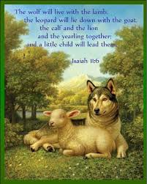
Wolf Beholds the Lamb!
Benjamin, the wolf, did not have a prayer to make it into the kingdom. He was a devourer, the one entitled to anything he saw. His only hope was in beholding the Lamb. This changed the greatest Benjamite in Saul of Tarsus! “What is justification by faith? It is the work of God in laying the glory of man in the dust, and doing for man that which it is not in his power to do for himself. When men see their own nothingness, they are prepared to be clothed with the righteousness of Christ.” TFILB, pg. 111

