Slide 1
Romans, pt.10
Romans 5:11-21

Slide 2
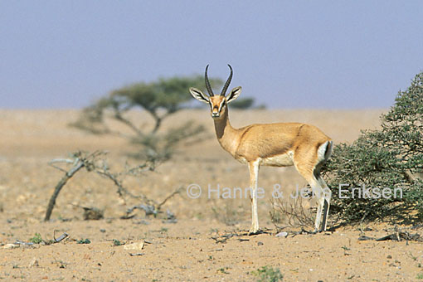
Romans 5:11
“And not only so, but we also joy in God through our Lord Jesus Christ, by whom we have now received the atonement.”

Slide 3
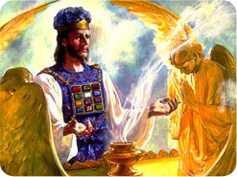
Atonement Not Over Yet
As great as the death of Christ was in the atonement process, Christ’s death did not complete the atonement. The Bible and SOP are very clear on this point.

Slide 4
Watch Carefully
“And if any one of the common people sin through ignorance, while he doeth somewhat against any of the commandments of the LORD concerning things which ought not to be done, and be guilty; Or if his sin, which he hath sinned, come to his knowledge: then he shall bring his offering, a kid of the goats, a female without blemish, for his sin which he hath sinned. And he shall lay his hand upon the head of the sin offering, and slay the sin offering in the place of the burnt offering. And the priest shall take of the blood thereof with his finger, and put it upon the horns of the altar of burnt offering, and shall pour out all the blood thereof at the bottom of the altar.
And he shall take away all the fat thereof, as the fat is taken away from off the sacrifice of peace offerings; and the priest shall burn it upon the altar for a sweet savour unto the LORD; and the priest shall make an atonement for him, and it shall be forgiven him.” Leviticus 4:27-31

Slide 5

Sacrifice and Priestly Mediation
“The intercession of Christ in man's behalf in the sanctuary above is as essential to the plan of salvation as was His death upon the cross. By His death He began that work which after His resurrection He ascended to complete in heaven. We must by faith enter within the veil, "whither the forerunner is for us entered." Hebrews 6:20. There the light from the cross of Calvary is reflected. There we may gain a clearer insight into the mysteries of redemption. The salvation of man is accomplished at an infinite expense to heaven; the sacrifice made is equal to the broadest demands of the broken law of God. Jesus has opened the way to the Father's throne, and through His mediation the sincere desire of all who come to Him in faith may be presented before God.” GC, pg. 489

Slide 6
Taking Care of the Sin problem
“Wherefore say, Behold, I give unto him my covenant of peace: And he shall have it, and his seed after him, even the covenant of an everlasting priesthood; because he was zealous for his God, and made an atonement for the children of Israel.” Numbers 25:12,13
“Then there was a famine in the days of David three years, year after year; and David inquired of the LORD. And the LORD answered, It is for Saul, and for his bloody house, because he slew the Gibeonites. And the king called the Gibeonites, and said unto them; (now the Gibeonites were not of the children of Israel, but of the remnant of the Amorites; and the children of Israel had sworn unto them: and Saul sought to slay them in his zeal to the children of Israel and Judah.) Wherefore David said unto the Gibeonites, What shall I do for you? and wherewith shall I make the atonement, that ye may bless the inheritance of the LORD?“ 2Samuel 21:1-3

Slide 7

Romans 5:12
“Wherefore, as by one man sin entered into the world, and death by sin; and so death passed upon all men, for that all have sinned:”
By Adam, sin entered the world and eternal death was the consequence. Every man, save ONE, has chosen to sin as well; therefore, all men, save ONE, deserve eternal death.

Slide 8
Romans 5:13-17
“(For until the law sin was in the world: but sin is not imputed when there is no law. Nevertheless death reigned from Adam to Moses, even over them that had not sinned after the similitude of Adam's transgression, who is the figure of him that was to come. But not as the offence, so also is the free gift. For if through the offence of one many be dead, much more the grace of God, and the gift by grace, which is by one man, Jesus Christ, hath abounded unto many. And not as it was by one that sinned, so is the gift: for the judgment was by one to condemnation, but the free gift is of many offences unto justification. For if by one man's offence death reigned by one; much more they which receive abundance of grace and of the gift of righteousness shall reign in life by one, Jesus Christ.)”

Slide 9
Adam and Christ
Adam gave us:
1. sinful nature
2. condemned to die in this world and eternally.
3. hopelessness
Christ gave us:
1. a new nature
2. eternal life
3. hope
With Adam’s failure, we were given things without choice. With Christ’s victory, we must choose to accept His provisions.

Slide 10
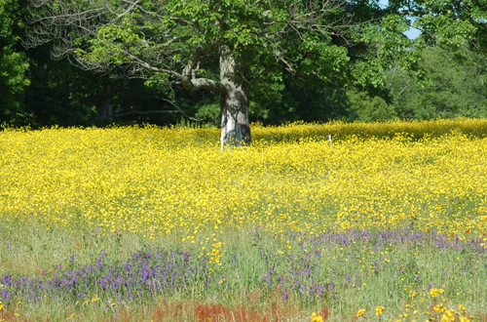
No Sin without the Law
Without law, there is no knowledge of sin. “Whosoever committeth sin transgresseth also the law: for sin is the transgression of the law.” Without law, there is no need for a Savior. Without law, everyone becomes their own absolute. The changeable, sinful heart becomes the authority and everything becomes subject to it. And, it can justify anything; murder, rape, stealing, anything!

Slide 11
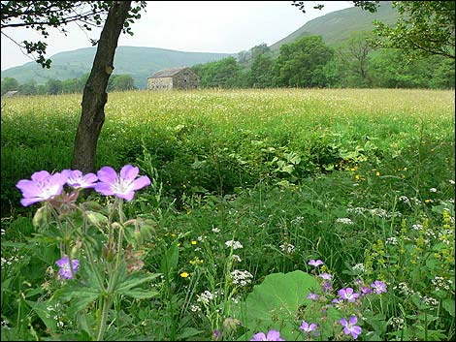
The Two Adam’s
Mankind’s sin was different from Adam’s because he sinned in a perfect nature, in perfect manhood, and in perfect health. We didn’t. Adam was like Christ in that his decision would effect the human race just as Christ’s decisions effected the human race. At different points in man’s history, each stood as man’s representative. Adam’s failure brought a carnal nature and death; Christ’s victory brought a new nature and eternal life.
“For since by man came death, by man came also the resurrection of the dead. For as in Adam all die, even so in Christ shall all be made alive.” 1 Corinthians 15:21,22

Slide 12
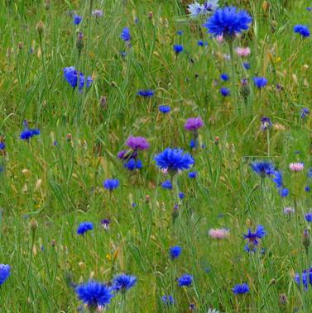
Let the New Man Live
We all have chosen to follow Adam’s example of rebellion against God. Because of our choice, we have become guilty. At birth, we are born with a carnal nature, but are not guilty for Adam’s sin. We become guilty when we sin. Christ offers us a new nature that can enable us to resist sin.
“Set your affection on things above, not on things on the earth. For ye are dead, and your life is hid with Christ in God. When Christ, who is our life, shall appear, then shall ye also appear with him in glory.” Col. 3:2-4

Slide 13
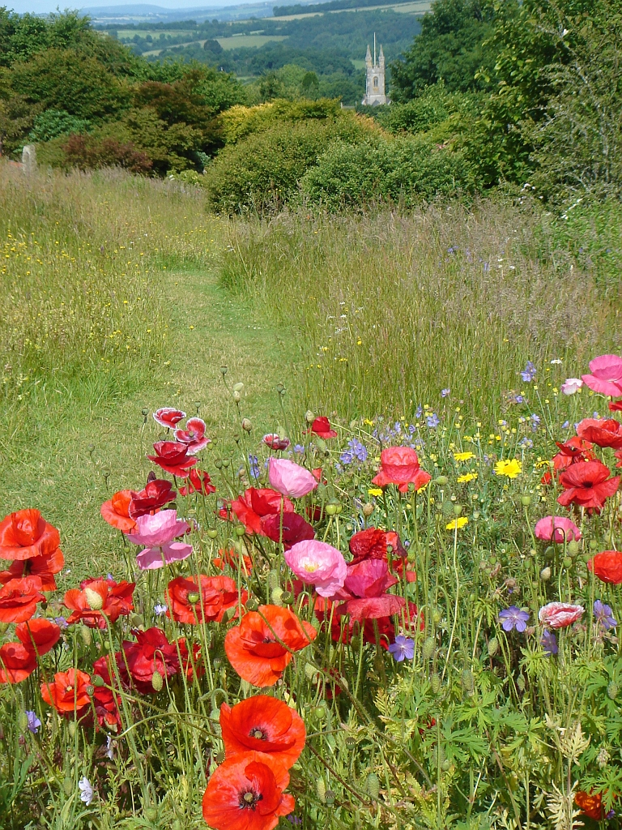
Ours for the taking
We have all been condemned to die by Adam and all deserve eternal death because of our own choices. Christ steps in, offers us a new nature and eternal life. We must individually receive it.
“Therefore if any man be in Christ, he is a new creature: old things are passed away; behold, all things are become new.
18: And all things are of God, who hath reconciled us to himself by Jesus Christ, and hath given to us the ministry of reconciliation;” 2Corinthians 5:17,18
“For he hath made him to be sin for us, who knew no sin; that we might be made the righteousness of God in him.’ 2 Corinthians 5:21

Slide 14
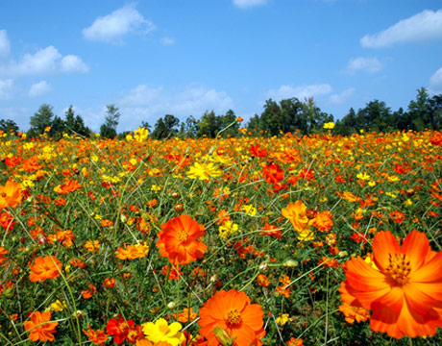
Romans 5:18
“Therefore as by the offence of one judgment came upon all men to condemnation; even so by the righteousness of one the free gift came upon all men unto justification of life.” The free gift was made available to every child of humanity. Christ’s death was sufficient to save the entire human family. Everyone could be saved because of Christ’s death. So few will be saved because so few will accept the gift.

Slide 15
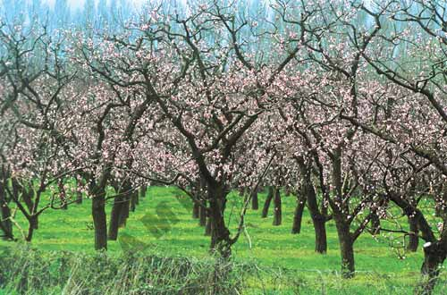
For Every Man
“ But we see Jesus, who was made a little lower than the angels for the suffering of death, crowned with glory and honour; that he by the grace of God should taste death for every man.” Heb. 2:9 Christ’s death did not guarantee that we would never die the first death; no, Christ’s death was sufficient to enable man not to die forever.

Slide 16
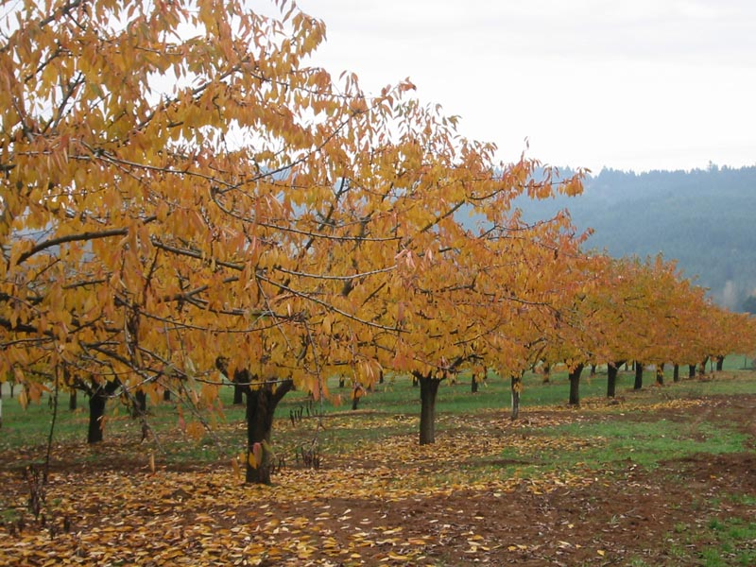
Romans 5:19
“For as by one man's disobedience many were made sinners, so by the obedience of one shall many be made righteous.”
Christ’s life and death made it possible for us to receive His life in our lives if we are willing to die to sin. Christ makes us righteous in our lives; it isn’t a mere declaration, but a reality. The New Theology says that Christ declares a man righteous when it isn’t reality in the life.
““For he hath made him to be sin for us, who knew no sin; that we might be made the righteousness of God in him.’ 2 Corinthians 5:21

Slide 17
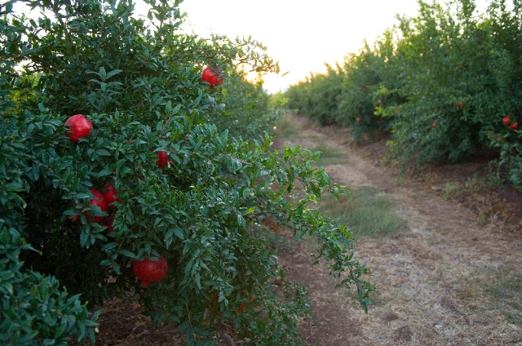
Christ’s Life
Christ’s life was lived so that He might show us how to live. Because He realizes how weak we are, He will give us His life by faith to enable us to do what we can’t; even to resist sin.
“The only defense against evil is the indwelling of Christ in the heart through faith in His righteousness. Unless we become vitally connected with God, we can never resist the unhallowed effects of self-love, self-indulgence, and temptation to sin. We may leave off many bad habits, for the time we may part company with Satan; but without a vital connection with God, through the surrender of ourselves to Him moment by moment, we shall be overcome. Without a personal acquaintance with Christ, and a continual communion, we are at the mercy of the enemy, and shall do his bidding in the end.” DA, pg. 324

Slide 18

How do we measure Disobedience?
What is the one thing that measures disobedience? What did Adam break that has brought untold misery into this world? Through his breaking God’s law has come sorrow and woe. Through Christ’s obedience to God’s law has come hope and life. “Sacrifice and offering thou didst not desire; mine ears hast thou opened: burnt offering and sin offering hast thou not required. Then said I, Lo, I come: in the volume of the book it is written of me, I delight to do thy will, O my God: yea, thy law is within my heart.” Ps. 40:6-8

Slide 19
Romans 5:20,21
“Moreover the law entered, that the offence might abound. But where sin abounded, grace did much more abound: That as sin hath reigned unto death, even so might grace reign through righteousness unto eternal life by Jesus Christ our Lord.”
The law entered at Mt. Sinai so that man would be without excuse as to what constitutes sin. Wherever you have sin, you have a mighty Savior there to counteract its authority. This has been true throughout time.

Slide 20
Grace Abounding
After Adam and Eve’s failure, all was lost. Sin abounded. Christ was there to bring hope and a remedy. “And I will put enmity between thee and the woman, and between thy seed and her seed; it shall bruise thy head, and thou shalt bruise his heel.” Genesis 3:15
“To man the first intimation of redemption was communicated in the sentence pronounced upon Satan in the garden. The Lord declared, "I will put enmity between thee and the woman, and between thy seed and her seed; it shall bruise thy head, and thou shalt bruise his heel." Genesis 3:15. This sentence, uttered in the hearing of our first parents, was to them a promise. While it foretold war between man and Satan, it declared that the power of the great adversary would finally be broken. Adam and Eve stood as criminals before the righteous Judge, awaiting the sentence which transgression had incurred; but before they heard of the life of toil and sorrow which must be their portion, or of the decree that they must return to dust, they listened to words that could not fail to give them hope. Though they must suffer from the power of their mighty foe, they could look forward to final victory. When Satan heard that enmity should exist between himself and the woman, and between his seed and her seed, he knew that his work of depraving human nature would be interrupted; that by some means man would be enabled to resist his power. Yet as the plan of salvation was more fully unfolded, Satan rejoiced with his angels that, having caused man's fall, he could bring down the Son of God from His exalted position. He declared that his plans had thus far been successful upon the earth, and that when Christ should take upon Himself human nature, He also might be overcome, and thus the redemption of the fallen race might be prevented.

Slide 21
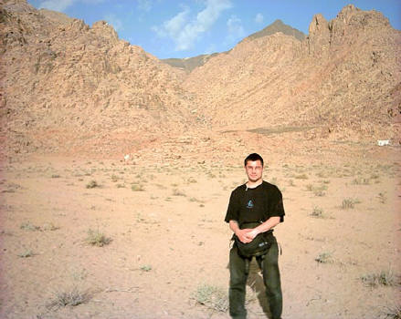
At Sinai
“And it came to pass, when Moses came down from mount Sinai with the two tables of testimony in Moses' hand, when he came down from the mount, that Moses wist not that the skin of his face shone while he talked with him.” Ex. 34:29 The light that shone from the face of Moses was the glory of Christ in the law. This was to give hope to the Israelites who had grievously broken God’s law. Where sin abounds, grace much more abounds!

