Slide 1
Jerusalem and the American Embassy

Slide 2
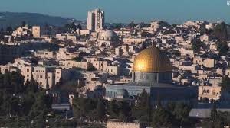

Slide 3
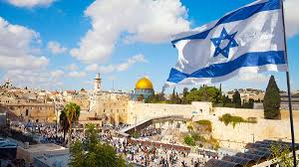
Many a battle has been fought over this coveted piece of real estate. Many lives have been lost; much blood has been shed within its walls! Jerusalem, David’s city,; the city of the Great King! “Great is the LORD, and greatly to be praised in the city of our God, in the mountain of his holiness. Beautiful for situation, the joy of the whole earth, is mount Zion, on the sides of the north, the city of the great King.” Ps. 48:1,2

Slide 4
A Point of Conflict Again!
Washington (CNN), December 6, 2017 “President Donald Trump recognized Jerusalem as Israel's capital on Wednesday and announced plans to relocate the US Embassy there, a move expected to inflame tensions in the region and unsettle the prospects for peace. "Today, we finally acknowledge the obvious: that Jerusalem is Israel's capital. This is nothing more or less than a recognition of reality. It is also the right thing to do," Trump said from the White House's Diplomatic Reception Room. "After more than two decades of waivers, we are no closer to a lasting peace agreement between Israel and the Palestinians. It would be folly to assume that repeating the exact same formula would now produce a different or better result," he added. Trump’s Jerusalem decision promises upheaval upending decades of foreign policy. Trump's decision upended seven decades of US foreign policy that has resisted a recognition of Jerusalem as Israel's capital before the Israeli-Palestinian conflict is resolved.

Slide 5
"Today, I am delivering," Trump said, referencing his campaign promise. But Trump's move on Wednesday signaled a willingness to prioritize the fulfillment of another campaign promise over warnings from US allies in the region. The decision could also stymie the peace process and increase security risks in a region that is already on edge. Acknowledging the concerns he fielded a day earlier from regional Arab leaders, Trump underscored his decision by reaffirming the United States' commitment to helping Israelis and Palestinians reach a peace agreement. He also stressed that his announcement did not mark a shift in US policy on the final boundaries of future Israeli and Palestinian states. "We are not taking a position on any of the final status issues including the final boundaries of the Israeli sovereignty in Jerusalem," Trump said. "Those questions are up to the parties involved. The United States remains deeply committed to helping facilitate a peace agreement that is acceptable to both sides."

