Slide 1
Final Scenes, pt. 14
Before Caiaphas, GC President

Slide 2
A Thoughtful Hour
“It would be well for us to spend a thoughtful hour each day in contemplation of the life of Christ. We should take it point by point, and let the imagination grasp each scene, especially the closing ones. As we thus dwell upon His great sacrifice for us, our confidence in Him will be more constant, our love will be quickened, and we shall be more deeply imbued with His spirit. If we would be saved at last, we must learn the lesson of penitence and humiliation at the foot of the cross.” Desire of Ages, pg. 83

Slide 3
Appointed by Rome!
“The first-century Jewish historian Josephus is considered the most reliable literary source for Caiaphas.^{[2]} His works contain information on the dates for Caiaphas's tenure of the high priesthood, along with reports on other high priests, and also help to establish a coherent description of the responsibilities of the high-priestly office. Josephus (Antiquities Judaic 18.33-35) relates that Caiaphas became a high priest during a turbulent period. He also states that the proconsul Vitellius deposed him (Antiquities Judaic 18.95-97).^{[3]} Josephus' account is based on an older source in which incumbents of the high priesthood were listed chronologically.^{[4]}
According to Josephus, Caiaphas was appointed in AD 18 by the Roman prefect who preceded Pilate,Valerius Grates.^{[1]}

Slide 4
At This Point
“The dead had been raised in the full light of day, and before a crowd of witnesses. No artifice could explain away such evidence. For this very reason the enmity of the priests grew deadlier. They were more than ever determined to put a stop to Christ's work. The Sadducees, though not favorable to Christ, had not been so full of malignity toward Him as were the Pharisees. Their hatred had not been so bitter. But they were now thoroughly alarmed. They did not believe in a resurrection of the dead. Producing so-called science, they had reasoned that it would be an impossibility for a dead body to be brought to life. But by a few words from Christ their theory had been overthrown. They were shown to be ignorant both of the Scriptures and of the power of God. They could see no possibility of removing the impression made on the people by the miracle. How could men be turned away from Him who had prevailed to rob the grave of its dead? Lying reports were put in circulation, but the miracle could not be denied, and how to counteract its effect they knew not. Thus far the Sadducees had not encouraged the plan of putting Christ to death. But after the resurrection of Lazarus they decided that only by His death could His fearless denunciations against them be stopped.” DA pgs. 537,538

Slide 5
Jn. 11:47-53
“Then gathered the chief priests and the Pharisees a council, and said, What do we? for this man doeth many miracles.
If we let him thus alone, all [men] will believe on him: and the Romans shall come and take away both our place and nation.
And one of them, [named] Caiaphas, being the high priest that same year, said unto them, Ye know nothing at all, Nor consider that it is expedient for us, that one man should die for the people, and that the whole nation perish not. And this spake he not of himself: but being high priest that year, he prophesied that Jesus should die for that nation; And not for that nation only, but that also he should gather together in one the children of God that were scattered abroad. Then from that day forth they took counsel together for to put him to death.”

Slide 6
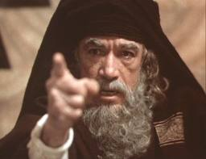
The man!
“Caiaphas was a proud and cruel man, overbearing and intolerant. Among his family connections were Sadducees, proud, bold, reckless, full of ambition and cruelty, which they hid under a cloak of pretended righteousness. Caiaphas had studied the prophecies, and although ignorant of their true meaning, he spoke with great authority and assurance: "Ye know nothing at all, nor consider that it is expedient for us, that one man should die for the people, and that the whole nation perish not.“ DA., pgs. 539,540

Slide 7
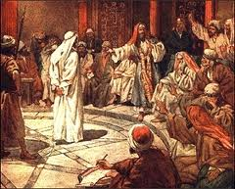
Heartless, Vicious
“Caiaphas belonged to the Sadducees, some of whom were now the most desperate enemies of Jesus. He himself, though wanting in force of character, was fully as severe, heartless, and unscrupulous as was Annas. He would leave no means untried to destroy Jesus. It was now early morning, and very dark; by the light of torches and lanterns the armed band with their prisoner proceeded to the high priest's palace. Here, while the members of the Sanhedrin were coming together, Annas and Caiaphas again questioned Jesus, but without success. When the council had assembled in the judgment hall, Caiaphas took his seat as presiding officer.”
DA, pg. 703

Slide 8
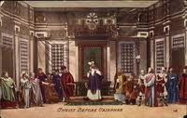
Furious and Hell Bent
“And they that had laid hold on Jesus led him away to Caiaphas the high priest, where the scribes and the elders were assembled. But Peter followed him afar off unto the high priest's palace, and went in, and sat with the servants, to see the end. Now the chief priests, and elders, and all the council, sought false witness against Jesus, to put him to death; But found none: yea, though many false witnesses came, yet found they none. At the last came two false witnesses, And said, This fellow said, I am able to destroy the temple of God, and to build it in three days. And the high priest arose, and said unto him, Answerest thou nothing? what is it which these witness against thee?” Matthew 26:57-62

Slide 9
Witnesses
Early in His ministry Christ had said, "Destroy this temple, and in three days I will raise it up." In the figurative language of prophecy, He had thus foretold His own death and resurrection. "He spake of the temple of His body." John 2:19, 21. These words the Jews had understood in a literal sense, as referring to the temple at Jerusalem. Of all that Christ had said, the priests could find nothing to use against Him save this. By misstating these words they hoped to gain an advantage. The Romans had engaged in rebuilding and embellishing the temple, and they took great pride in it; any contempt shown to it would be sure to excite their indignation. Here Romans and Jews, Pharisees and Sadducees, could meet; for all held the temple in great veneration. On this point two witnesses were found whose testimony was not so contradictory as that of the others had been. One of them, who had been bribed to accuse Jesus, declared, "This fellow said, I am able to destroy the temple of God, and to build it in three days." Thus Christ's words were misstated. If they had been reported exactly as He spoke them, they would not have secured His condemnation even by the Sanhedrin. Had Jesus been a mere man, as the Jews claimed, His declaration would only have indicated an unreasonable, boastful spirit, but could not have been construed into blasphemy. Even as misrepresented by the false witnesses, His words contained nothing which would be regarded by the Romans as a crime worthy of death.” DA, pgs. 705, 706

Slide 10
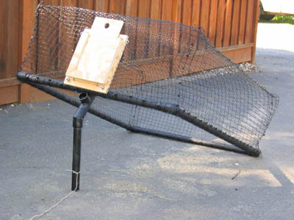
Trying to Trap Him
“Patiently Jesus listened to the conflicting testimonies. No word did He utter in self-defense. At last His accusers were entangled, confused, and maddened. The trial was making no headway; it seemed that their plottings were to fail. Caiaphas was desperate. One last resort remained; Christ must be forced to condemn Himself. The high priest started from the judgment seat, his face contorted with passion, his voice and demeanor plainly indicating that were it in his power he would strike down the prisoner before him. "Answerest Thou nothing?" he exclaimed; "what is it which these witness against Thee?"
Jesus held His peace. "He was oppressed, and He was afflicted, yet He opened not His mouth: He is brought as a lamb to the slaughter, and as a sheep before her shearers is dumb, so He openeth not His mouth." Isaiah 53:7.” DA, pg. 706

Slide 11
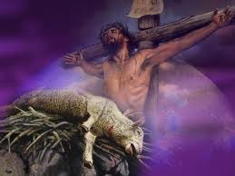
Christ the Lamb
Jesus didn’t defend Himself. He didn’t speak up in His own behalf. He listened patiently to the conflicting falsehoods thrown against Himself, but He didn’t retaliate. “For even hereunto were ye called: because Christ also suffered for us, leaving us an example, that ye should follow his steps: Who did no sin, neither was guile found in his mouth: Who, when he was reviled, reviled not again; when he suffered, he threatened not; but committed [himself] to him that judgeth righteously:” 1Peter 2:21-23

Slide 12
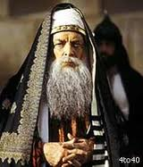
Christ must Condemn Himself
Caiaphas had no choice. The witnesses he had were in conflict. Christ had done nothing wrong. There was no reason for Christ to be on trial. Caiaphas had a terrible dilemma. He had to try and get Christ to say something that he could use to condemn Him.

Slide 13
Are You the Christ?
“At last, Caiaphas, raising his right hand toward heaven, addressed Jesus in the form of a solemn oath: "I adjure Thee by the living God, that Thou tell us whether Thou be the Christ, the Son of God.“ To this appeal Christ could not remain silent. There was a time to be silent, and a time to speak. He had not spoken until directly questioned. He knew that to answer now would make His death certain. But the appeal was made by the highest acknowledged authority of the nation, and in the name of the Most High. Christ would not fail to show proper respect for the law. More than this, His own relation to the Father was called in question… Jesus had said to His disciples, "Whosoever therefore shall confess Me before men, him will I confess also before My Father which is in heaven." Matt. 10:32. Now by His own example He repeated the lesson. Every ear was bent to listen, and every eye was fixed on His face as He answered, "Thou hast said." A heavenly light seemed to illuminate His pale countenance as He added, "Nevertheless I say unto you, Hereafter shall ye see the Son of man sitting on the right hand of power, and coming in the clouds of heaven.“ DA, pgs. 706,707

Slide 14
Caiaphas Was Shredded
Christ’s words pointed forward to a day when the scene would be reversed. Christ would come as Judge; Caiaphas would be judged for the crimes he was now committing. He had opportunity to confess then and there; he realized without doubt that Jesus was the Son of God. He would not repent. He had gone on too long and could not, would not, change. “Wherefore (as the Holy Ghost saith, To day if ye will hear his voice, Harden not your hearts” Heb. 3:7,8

Slide 15
Caiaphas Condemned himself
“The scene passed from the priest's vision. Christ's words cut him, the Sadducee, to the quick. Caiaphas had denied the doctrine of the resurrection, the judgment, and a future life. Now he was maddened by satanic fury. Was this man, a prisoner before him, to assail his most cherished theories? Rending his robe, that the people might see his pretended horror, he demanded that without further preliminaries the prisoner be condemned for blasphemy. "What further need have we of witnesses?" he said; "behold, now ye have heard His blasphemy. What think ye?" And they all condemned Him. Conviction mingled with passion led Caiaphas to do as he did. He was furious with himself for believing Christ's words, and instead of rending his heart under a deep sense of truth, and confessing that Jesus was the Messiah, he rent his priestly robes in determined resistance. This act was deeply significant. Little did Caiaphas realize its meaning. In this act, done to influence the judges and secure Christ's condemnation, the high priest had condemned himself. By the law of God he was disqualified for the priesthood. He had pronounced upon himself the death sentence. A high priest was not to rend his garments. By the Levitical law, this was prohibited under sentence of death. Under no circumstances, on no occasion, was the priest to rend his robe.” DA, pg. 708

Slide 16
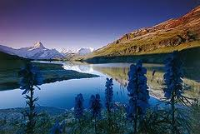
SDA’s at their finest
“What think ye? They answered and said, He is guilty of death. Then did they spit in his face, and buffeted him; and others smote him with the palms of their hands, Saying, Prophesy unto us, thou Christ, Who is he that smote thee?” Matt. 26:66-68

Slide 17
“… the Saviour was now treated as a condemned criminal, and given up to be abused by the lowest and vilest of humankind. The palace of the high priest surrounded an open court in which the soldiers and the multitude had gathered. Through this court, Jesus was taken to the guardroom, on every side meeting with mockery of His claim to be the Son of God. His own words, "sitting on the right hand of power," and, "coming in the clouds of heaven," were jeeringly repeated. While in the guardroom, awaiting His legal trial, He was not protected. The ignorant rabble had seen the cruelty with which He was treated before the council, and from this they took license to manifest all the satanic elements of their nature. Christ's very nobility and godlike bearing goaded them to madness. His meekness, His innocence, His majestic patience, filled them with hatred born of Satan. Mercy and justice were trampled upon. Never was criminal treated in so inhuman a manner as was the Son of God.” DA, pg. 710

Slide 18
It Will Happen Again
“That night I dreamed that I was in Battle Creek looking out from the side glass at the door and saw a company marching up to the house, two and two. They looked stern and determined. I knew them well and turned to open the parlor door to receive them, but thought I would look again. The scene was changed. The company now presented the appearance of a Catholic procession. One bore in his hand a cross, another a reed. And as they approached, the one carrying a reed made a circle around the house, saying three times: "This house is proscribed. The goods must be confiscated. They have spoken against our holy order." Terror seized me, and I ran through the house, out of the north door, and found myself in the midst of a company, some of whom I knew, but I dared not speak a word to them for fear of being betrayed. I tried to seek a retired spot where I might weep and pray without meeting eager, inquisitive eyes wherever I turned. I repeated frequently: "If I could only understand this! If they will tell me what I have said or what I have done!“ TEST. Vol. 1, pg. 578

Slide 19
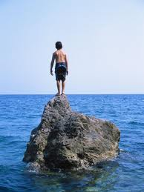
Stand
"Now is the time for God’s people to show themselves true to principle. When the religion of Christ is most held in contempt, when His law is most despised, then should our zeal be the warmest and our courage and firmness the most unflinching. To stand in defense of truth and righteousness when the majority forsake us, to fight the battles of the Lord when champions are few this will be our test." 5T 136.

