Slide 1
Feast Days, pt. 6
Feast of Tabernacles

Slide 2
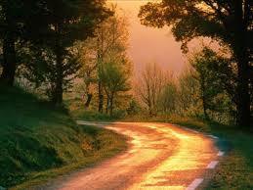
One Feast Remains
Through the feasts, we have seen:
1. Christ’s death
2. Christ’s work as our High Priest in the Holy Place.
3. Christ’s warning that judgment was approaching.
4. Christ’s work in the Most Holy Place.
5. What could the final feast of Tabernacles represent?

Slide 3
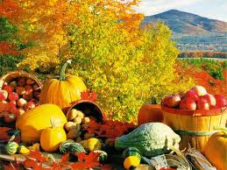
The Grand Finale
The final feast of the Jews was the Feast of Tabernacles. It took place five days after the feast of atonement. With the solemn events of the Day of Atonement past, with the scapegoat banished into the wilderness, and with everyone at peace with God and one another, and with the crops for the year all harvested, it was a time for rejoicing!

Slide 4
8 Day Feast
“ Speak unto the children of Israel, saying, The fifteenth day of this seventh month (1) shall be the feast of tabernacles for seven days unto the LORD. On the first day shall be an holy convocation(2): ye shall do no servile work therein(3). Seven days ye shall offer an offering made by fire unto the LORD: on the eighth day shall be an holy convocation unto you; and ye shall offer an offering made by fire unto the LORD: it is a solemn assembly; and ye shall do no servile work therein. These are the feasts of the LORD, which ye shall proclaim to be holy convocations, to offer an offering made by fire unto the LORD, a burnt offering, and a meat offering(4), a sacrifice, and drink offerings(5), every thing upon his day: Beside the sabbaths of the LORD, and beside your gifts, and beside all your vows, and beside all your freewill offerings, which ye give unto the LORD. Also in the fifteenth day of the seventh month, when ye have gathered in the fruit of the land, ye shall keep a feast unto the LORD seven days: on the first day [shall be] a sabbath, and on the eighth day [shall be] a sabbath. .” Leviticus 23:34-39

Slide 5
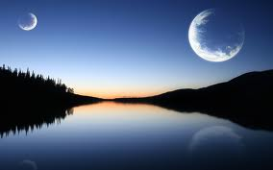
All that Paul mentioned in Colossians 2
As we have found repeatedly throughout the study of the feasts, every one of them had the components that Paul addressed in Colossians 2:16,17. “ Let no man therefore judge you in meat, or in drink, or in respect of an holyday, or of the new moon, or of the sabbath [days]: Which are a shadow of things to come; but the body [is] of Christ.” The feast days; this was Paul’s issue! This passage has nothing to do with the 7th day Sabbath!!

Slide 6
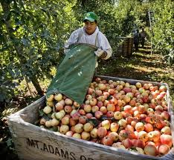
Yearly Harvest Complete
The grain harvest, having been taken care of in the spring of the year, left only the remainder of the field crops and the orchards to be harvested. Once everything had been harvested for the year, then came time for the feast of tabernacles. It was a time of rejoicing in God’s goodness and provision for His children.

Slide 7
Time of Rejoicing
“In the seventh month came the Feast of Tabernacles, or of ingathering. This feast acknowledged God's bounty in the products of the orchard, the olive grove, and the vineyard. It was the crowning festal gathering of the year. The land had yielded its increase, the harvests had been gathered into the granaries, the fruits, the oil, and the wine had been stored, the first fruits had been reserved, and now the people came with their tributes of thanksgiving to God, who had thus richly blessed them. This feast was to be pre-eminently an occasion of rejoicing. It occurred just after the great Day of Atonement, when the assurance had been given that their iniquity should be remembered no more. At peace with God, they now came before Him to acknowledge His goodness and to praise Him for His mercy. The labors of the harvest being ended, and the toils of the new year not yet begun, the people were free from care, and could give themselves up to the sacred, joyous influences of the hour. Though only the fathers and sons were commanded to appear at the feasts, yet, so far as possible, all the household were to attend them, and to their hospitality the servants, the Levites, the stranger, and the poor were made welcome.” PP, pg. 540

Slide 8
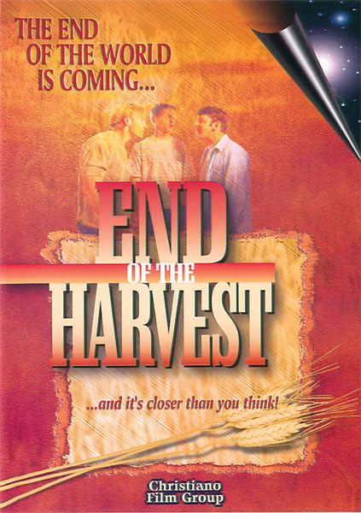
What does it Mean?
A final harvesting of the orchard and some field crops? Does the Bible talk about a final harvest?
“ The field is the world; the good seed are the children of the kingdom; but the tares are the children of the wicked [one]; The enemy that sowed them is the devil; the harvest is the end of the world; and the reapers are the angels.” Matthew 13:38-40
“ And I looked, and behold a white cloud, and upon the cloud [one] sat like unto the Son of man, having on his head a golden crown, and in his hand a sharp sickle. And another angel came out of the temple, crying with a loud voice to him that sat on the cloud, Thrust in thy sickle, and reap: for the time is come for thee to reap; for the harvest of the earth is ripe. And he that sat on the cloud thrust in his sickle on the earth; and the earth was reaped.” Revelation 14:14-16

Slide 9
The Second Coming
“The Feast of Tabernacles was not only commemorative but typical. It not only pointed back to the wilderness sojourn, but, as the feast of harvest, it celebrated the ingathering of the fruits of the earth, and pointed forward to the great day of final ingathering, when the Lord of the harvest shall send forth His reapers to gather the tares together in bundles for the fire, and to gather the wheat into His garner. At that time the wicked will all be destroyed. They will become "as though they had not been." Obadiah 16. And every voice in the whole universe will unite in joyful praise to God. Says the revelator, "Every creature which is in heaven, and on the earth, and under the earth, and such as are in the sea, and all that are in them, heard I saying, Blessing, and honor, and glory, and power, be unto Him that sitteth upon the throne, and unto the Lamb forever and ever." Revelation 5:13.” PP, pg. 541

Slide 10
Dwelling in Booths
“ And ye shall take you on the first day the boughs of goodly trees, branches of palm trees, and the boughs of thick trees, and willows of the brook; and ye shall rejoice before the LORD your God seven days. And ye shall keep it a feast unto the LORD seven days in the year. [It shall be] a statute for ever in your generations: ye shall celebrate it in the seventh month. Ye shall dwell in booths seven days; all that are Israelites born shall dwell in booths: That your generations may know that I made the children of Israel to dwell in booths, when I brought them out of the land of Egypt: I [am] the LORD your God. And Moses declared unto the children of Israel the feasts of the LORD.” Leviticus 23:40-44

Slide 11
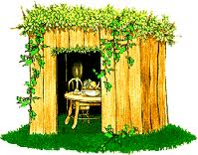
Remember Days of Old!
“Like the Passover, the Feast of Tabernacles was commemorative. In memory of their pilgrim life in the wilderness the people were now to leave their houses and dwell in booths, or arbors, formed from the green branches "of goodly trees, branches of palm trees, and the boughs of thick trees, and willows of the brook." Leviticus 23:40, 42, 43.
The first day was a holy convocation, and to the seven days of the feast an eighth day was added, which was observed in like manner.
At these yearly assemblies the hearts of old and young would be encouraged in the service of God, while the association of the people from the different quarters of the land would strengthen the ties that bound them to God and to one another.” PP, pg. 540

Slide 12
Never Forget
“Well would it be for the people of God at the present time to have a Feast of Tabernacles--a joyous commemoration of the blessings of God to them. As the children of Israel celebrated the deliverance that God had wrought for their fathers, and His miraculous preservation of them during their journeyings from Egypt, so should we gratefully call to mind the various ways He has devised for bringing us out from the world, and from the darkness of error, into the precious light of His grace and truth.” PP, pgs. 540,541

Slide 13
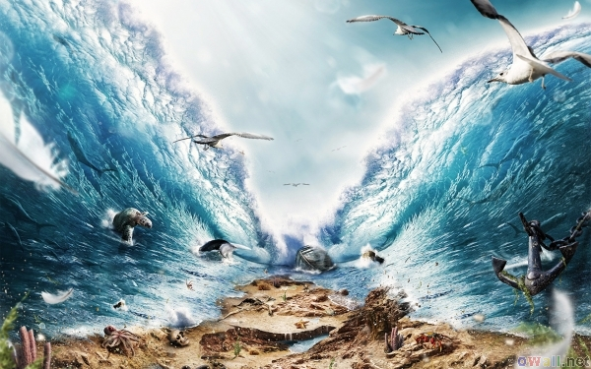
Miss Applied Today
Some take the preceding passage to mean that we should keep the feast day today. This isn’t what the SOP is saying at all. She has simply said that we should have times where we remember the abundant blessings/provisions of God on our behalf!
“We have nothing to fear for the future, except as we shall forget the way the Lord has led us, and his teaching in our past history.” Ellen G. White, Review and Herald, October
12, 1905

Slide 14
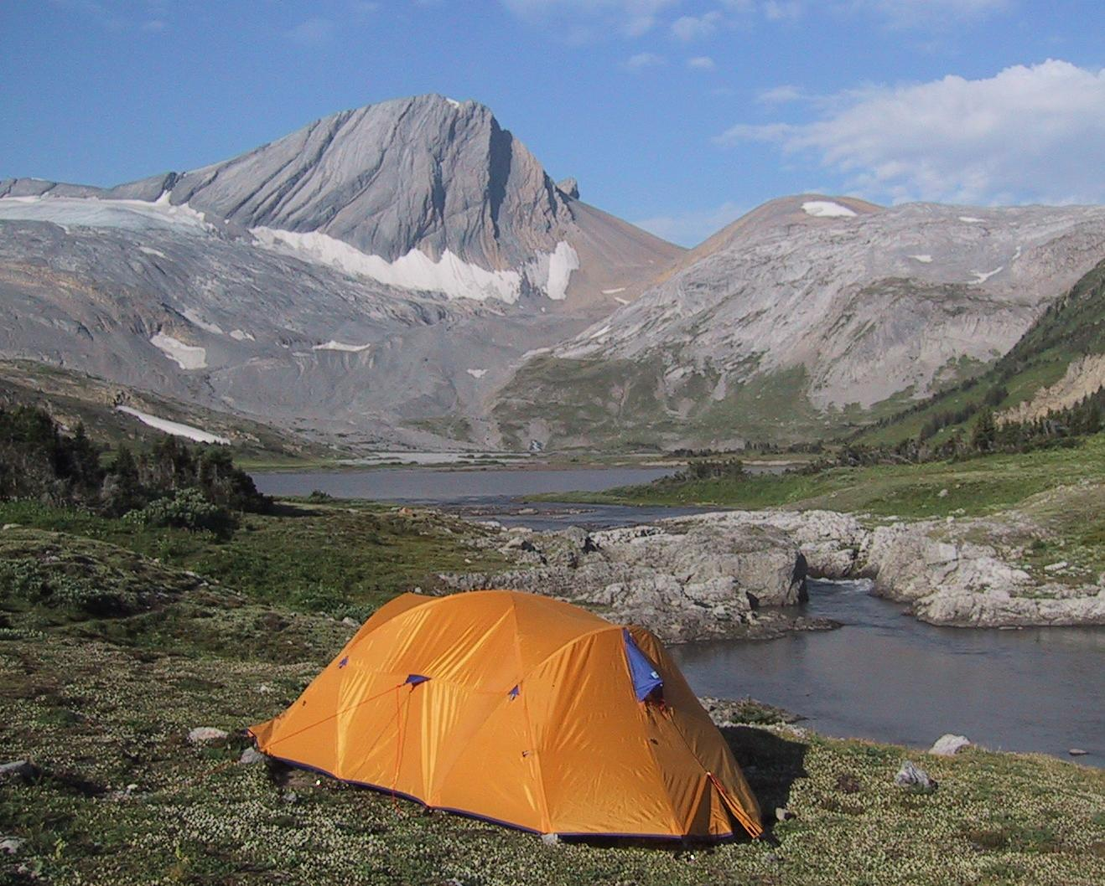
Three Feasts All males Required
“ Three times thou shalt keep a feast unto me in the year. Thou shalt keep the feast of unleavened bread: (thou shalt eat unleavened bread seven days, as I commanded thee, in the time appointed of the month Abib; for in it thou camest out from Egypt: and none shall appear before me empty:) And the feast of harvest, the firstfruits of thy labours, which thou hast sown in the field: and the feast of ingathering, [which is] in the end of the year, when thou hast gathered in thy labours out of the field. Three times in the year all thy males shall appear before the Lord GOD.” Ex. 23:14-17

Slide 15
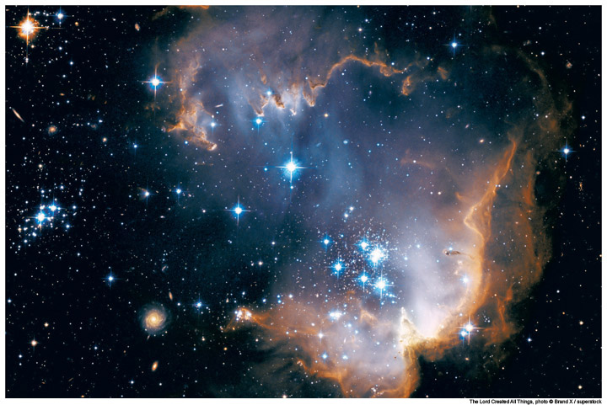
Christ as Sacrifice, Priest, and Coming King!
Passover- Christ’s death!
Pentecost- Christ our High Priest!
Tabernacles- Christ coming again!
These were the three feasts that all males were to attend every year. These three aspects of Christ’s work in our behalf are to be kept foremost in our minds!

Slide 16
Daniel’s Book
In the prophecies in the book of Daniel, we find three times where Christ is revealed. He is depicted in Daniel 2:44,45 as our Coming King. “And in the days of these kings shall the God of heaven set up a kingdom, which shall never be destroyed: and the kingdom shall not be left to other people, [but] it shall break in pieces and consume all these kingdoms, and it shall stand for ever. Forasmuch as thou sawest that the stone was cut out of the mountain without hands, and that it brake in pieces the iron, the brass, the clay, the silver, and the gold; the great God hath made known to the king what shall come to pass hereafter: and the dream [is] certain, and the interpretation thereof sure.”
In Daniel 7:13,14, He is revealed as our High Priest. “I saw in the night visions, and, behold, [one] like the Son of man came with the clouds of heaven, and came to the Ancient of days, and they brought him near before him. And there was given him dominion, and glory, and a kingdom, that all people, nations, and languages, should serve him: his dominion [is] an everlasting dominion, which shall not pass away, and his kingdom [that] which shall not be destroyed.”
In Daniel 9:27, Christ is revealed as the sacrifice for our sins. “And he shall confirm the covenant with many for one week: and in the midst of the week he shall cause the sacrifice and the oblation to cease, and for the overspreading of abominations he shall make [it] desolate, even until the consummation, and that determined shall be poured upon the desolate.”

Slide 17
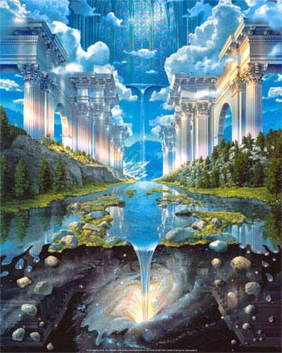
In Reverse Order
Daniel depicts Christ in His three works for man as sacrifice, priest, and coming king. These were the three required feasts of the Jews. Daniel refers to them in reverse order from when they occurred in the Jewish economy.

