Slide 1
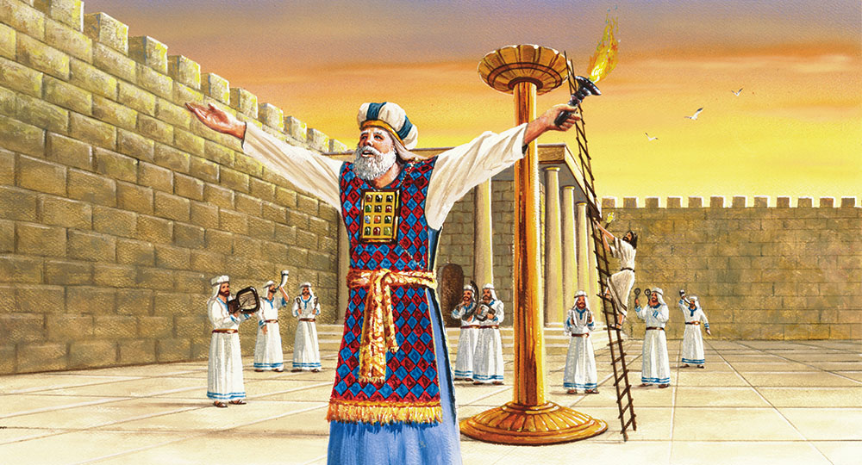
The Sanctuary pt 71: The Feast of Tabernacles

Slide 2
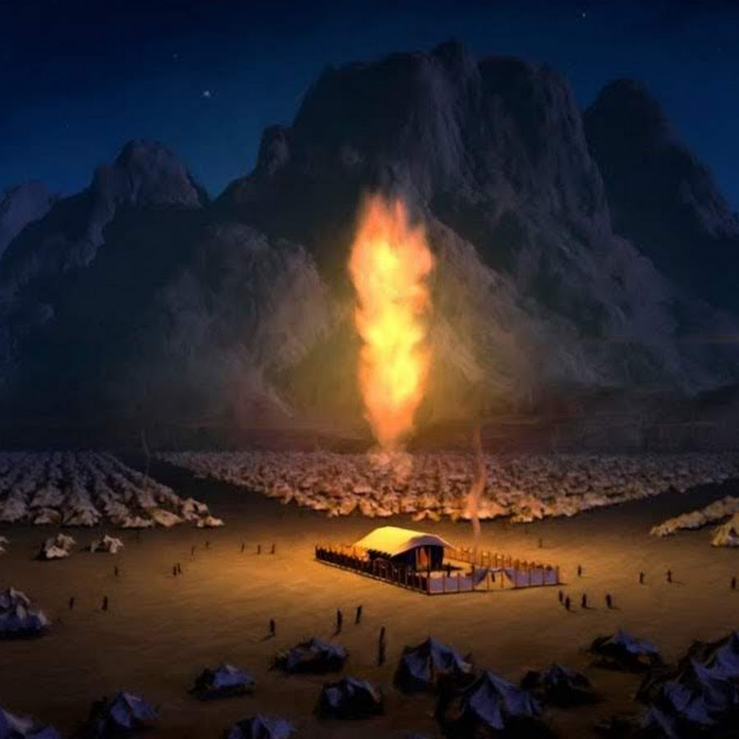
The Feast of Tabernacles…
Also Called Feast of Booths, or Feast of Ingathering
What We Will Study:
What it is and what it meant to Ancient Israel
What it means on a personal timeless level
The Prophetic fulfillment

Slide 3
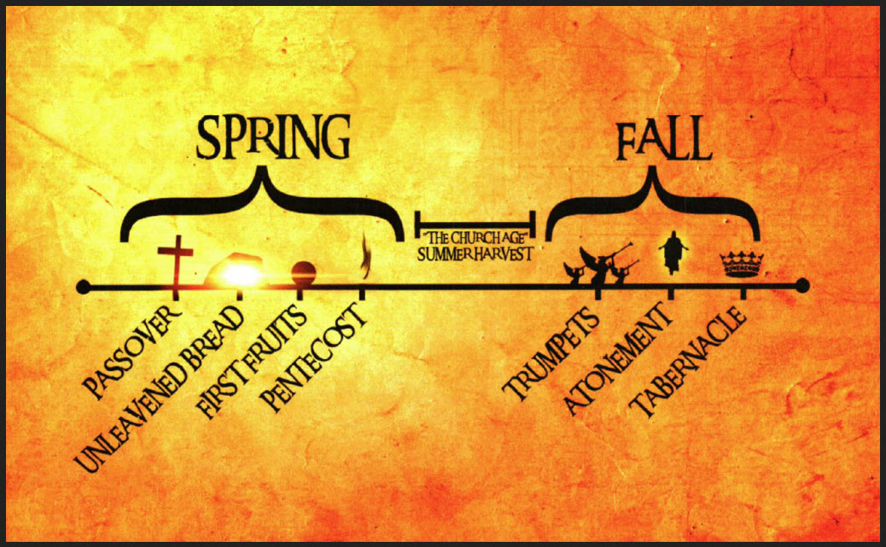

Slide 4
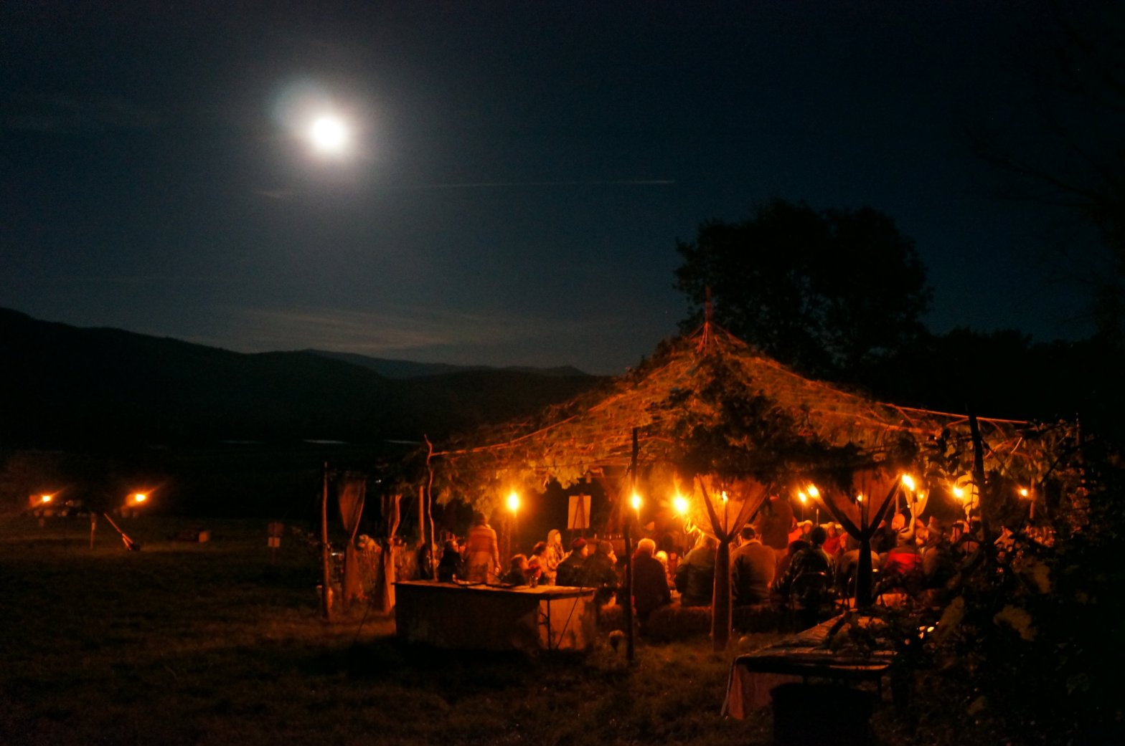
A Time of Rejoicing After the Harvest
Deut. 16:13-15 “Thou shalt observe the feast of tabernacles seven days, after that thou hast gathered in thy corn and thy wine: And thou shalt rejoice in thy feast, thou, and thy son, and thy daughter, and thy manservant, and thy maidservant, and the Levite, the stranger, and the fatherless, and the widow, that are within thy gates. Seven days shalt thou keep a solemn feast unto the Lord thy God in the place which the Lord shall choose: because the Lord thy God shall bless thee in all thine increase, and in all the works of thine hands, therefore thou shalt surely rejoice.”

Slide 5
One of the Three Highlighted Feasts
Ex. 23:14-17 “Three times thou shalt keep a feast unto me in the year. Thou shalt keep the feast of unleavened bread: (thou shalt eat unleavened bread seven days, as I commanded thee, in the time appointed of the month Abib; for in it thou camest out from Egypt: and none shall appear before me empty:) And the feast of harvest, the firstfruits of thy labours, which thou hast sown in the field: and the feast of ingathering, which is in the end of the year, when thou hast gathered in thy labours out of the field. Three times in the year all thy males shall appear before the Lord God.”

Slide 6
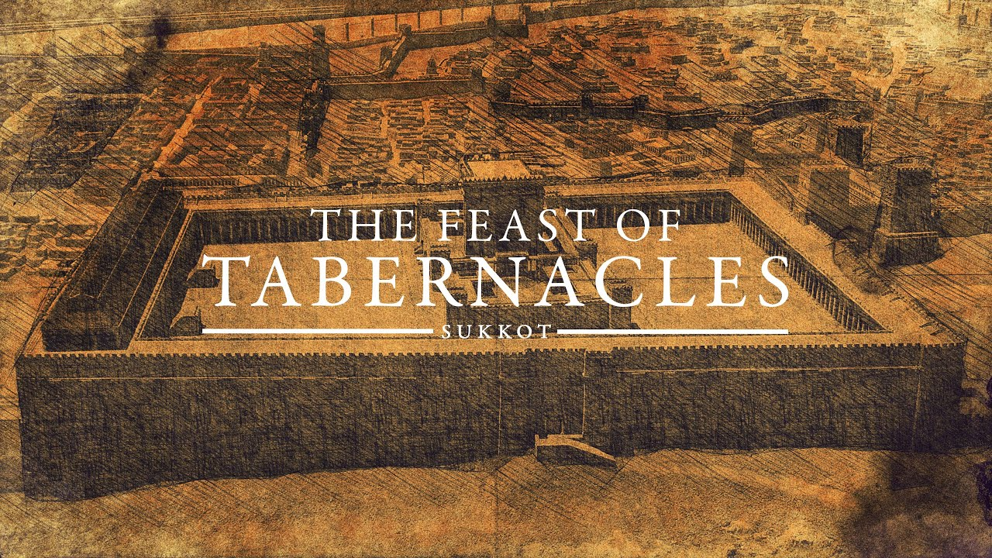
When Did it Occur?
Lev. 23:34-36 “Speak unto the children of Israel, saying, The fifteenth day of this seventh month shall be the feast of tabernacles for seven days unto the Lord. On the first day shall be an holy convocation: ye shall do no servile work therein. Seven days ye shall offer an offering made by fire unto the Lord: on the eighth day shall be an holy convocation unto you; and ye shall offer an offering made by fire unto the Lord: it is a solemn assembly; and ye shall do no servile work therein.”

Slide 7

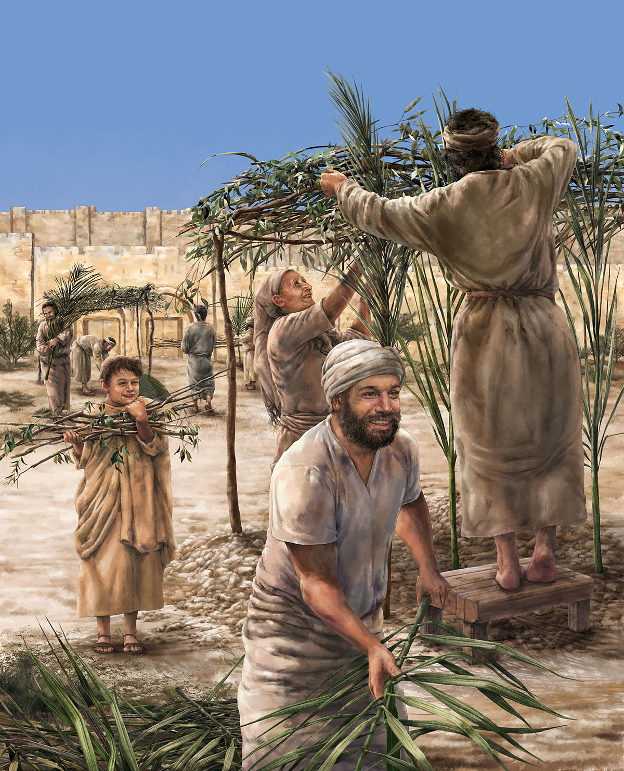
Mrs. White Explains
“In the seventh month came the Feast of Tabernacles, or of ingathering. This feast acknowledged God’s bounty in the products of the orchard, the olive grove, and the vineyard. It was the crowning festal gathering of the year. The land had yielded its increase, the harvests had been gathered into the granaries, the fruits, the oil, and the wine had been stored, the first fruits had been reserved, and now the people came with their tributes of thanksgiving to God, who had thus richly blessed them. This feast was to be pre-eminently an occasion of rejoicing. It occurred just after the great Day of Atonement, when the assurance had been given that their iniquity should be remembered no more. At peace with God, they now came before him to acknowledge his goodness and to praise him for his mercy. The labors of the harvest being ended, and the toils of the new year not yet begun, the people were free from care, and could give themselves up to the sacred, joyous influences of the hour. Though only the fathers and sons were commanded to appear at the feasts, yet, so far as possible, all the household were to attend them, and to their hospitality the servants, the Levites, the stranger, and the poor were made welcome.” PP, 540

Slide 8
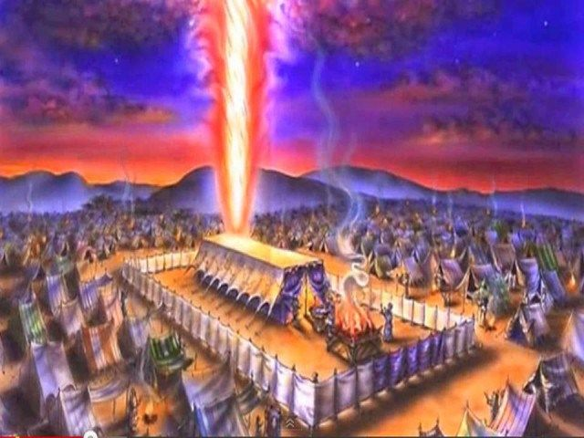
A Holiday of Rejoicing and Memorial
“The feast of tabernacles was the great holiday of the nation. This feast was preceded by a day of atonement, which occurred on the tenth day of the seventh month, when every one was to afflict his soul by confessing his sins, both to the Lord and to his brethren. This humiliation was to prepare the way for the celebration of the feast of tabernacles, which lasted seven days, and was a memorial of the protecting care of God when he led Israel through the wilderness.” R&H, July 7, 1896

Slide 9
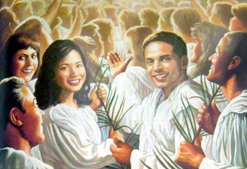
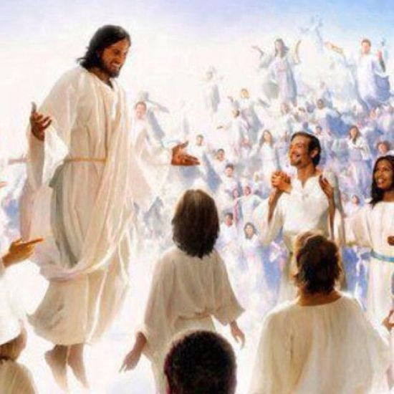
Don’t Disqualify Yourself!!!
“Jesus alone has power to save from sin, to free from the power of evil; and to doubt him who has laid down his life for us, is to grieve and insult the Father, who has in one gift poured out all heaven to a lost world. "He that spared not his own Son, but delivered him up for us all, how shall he not with him also freely give us all things?" Unbelief is an offense to God. A plan has been provided so broad, so perfect, that every sinner may find forgiveness and redemption. However great may be the sin, the sinner has no excuse for remaining away from Christ; for Jesus draws every soul, and all may respond to the infinite love of God. The sinner may put his will on the side of God's will, and may become a laborer together with God” {RH, February 10, 1891}
Rom. 3:26 “To declare, I say, at this time his righteousness: that he might be just, and the justifier of him which believeth in Jesus.”

Slide 10
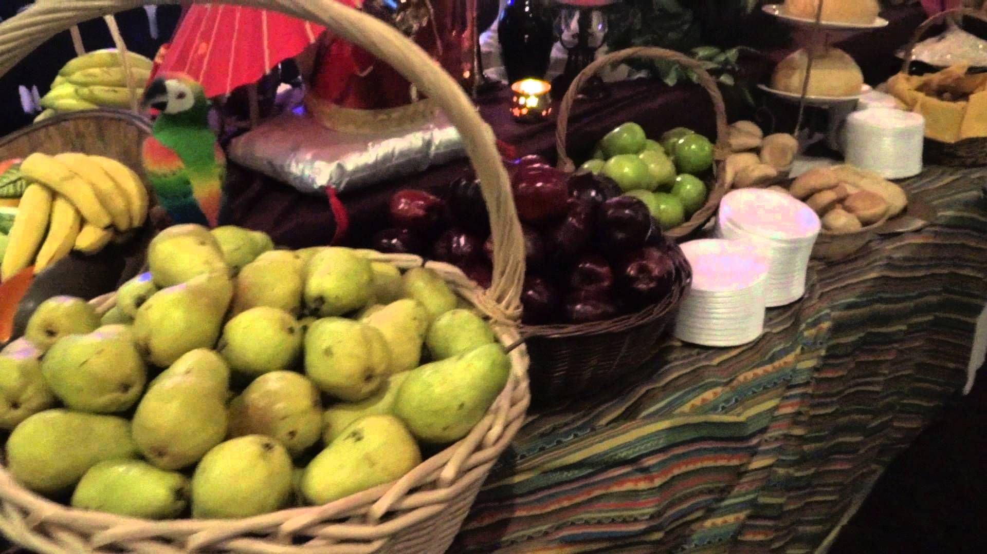
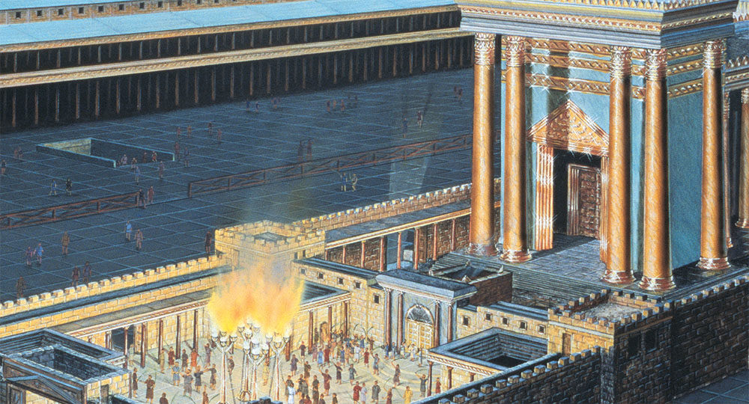
What Happened During this Feast?
Lev. 23:40-43 “Also in the fifteenth day of the seventh month, when ye have gathered in the fruit of the land, ye shall keep a feast unto the Lord seven days: on the first day shall be a sabbath, and on the eighth day shall be a sabbath. And ye shall take you on the first day the boughs of goodly trees, branches of palm trees, and the boughs of thick trees, and willows of the brook; and ye shall rejoice before the Lord your God seven days. And ye shall keep it a feast unto the Lord seven days in the year. It shall be a statute for ever in your generations: ye shall celebrate it in the seventh month. Ye shall dwell in booths seven days; all that are Israelites born shall dwell in booths: That your generations may know that I made the children of Israel to dwell in booths, when I brought them out of the land of Egypt: I am the Lord your God.”

Slide 11
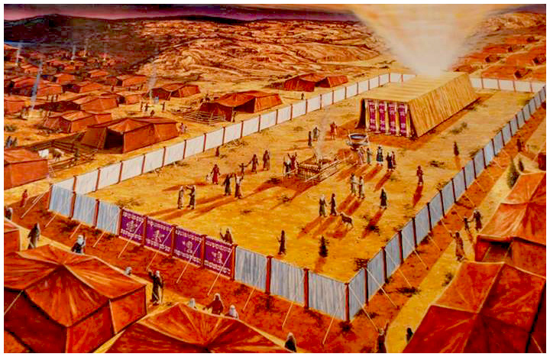
What Lessons Did it Teach?
Num. 29:12-16,32 “And on the fifteenth day of the seventh month ye shall have an holy convocation; ye shall do no servile work, and ye shall keep a feast unto the Lord seven days: And ye shall offer a burnt offering, a sacrifice made by fire, of a sweet savour unto the Lord; thirteen young bullocks, two rams, and fourteen lambs of the first year; they shall be without blemish: And their meat offering shall be of flour mingled with oil, three tenth deals unto every bullock of the thirteen bullocks, two tenth deals to each ram of the two rams, And a several tenth deal to each lamb of the fourteen lambs: And one kid of the goats for a sin offering; beside the continual burnt offering, his meat offering, and his drink offering. . . . And on the seventh day seven bullocks, two rams, and fourteen lambs of the first year without blemish”

Slide 12

Why Palm Trees?
1 Kings 6:29 “And he carved all the walls of the house round about with carved figures of cherubims and palm trees and open flowers, within and without.”
Ps. 92:12-13 “The righteous shall flourish like the palm tree: he shall grow like a cedar in Lebanon. Those that be planted in the house of the LORD shall flourish in the courts of our God.”
John 12:12-13 “On the next day much people that were come to the feast, when they heard that Jesus was coming to Jerusalem, Took branches of palm trees, and went forth to meet him, and cried, Hosanna: Blessed is the King of Israel that cometh in the name of the Lord.”

Slide 13
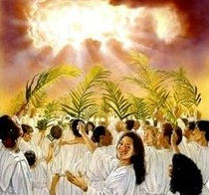
Palm Branches in Heaven?
Rev. 7:9-10, 13-14 “After this I beheld, and, lo, a great multitude, which no man could number, of all nations, and kindreds, and people, and tongues, stood before the throne, and before the Lamb, clothed with white robes, and palms in their hands; And cried with a loud voice, saying, Salvation to our God which sitteth upon the throne, and unto the Lamb. . . . And one of the elders answered, saying unto me, What are these which are arrayed in white robes? and whence came they? And I said unto him, Sir, thou knowest. And he said to me, These are they which came out of great tribulation, and have washed their robes, and made them white in the blood of the Lamb.”

Slide 14
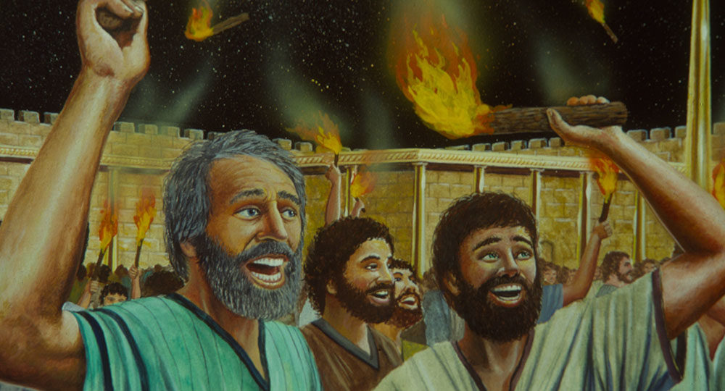
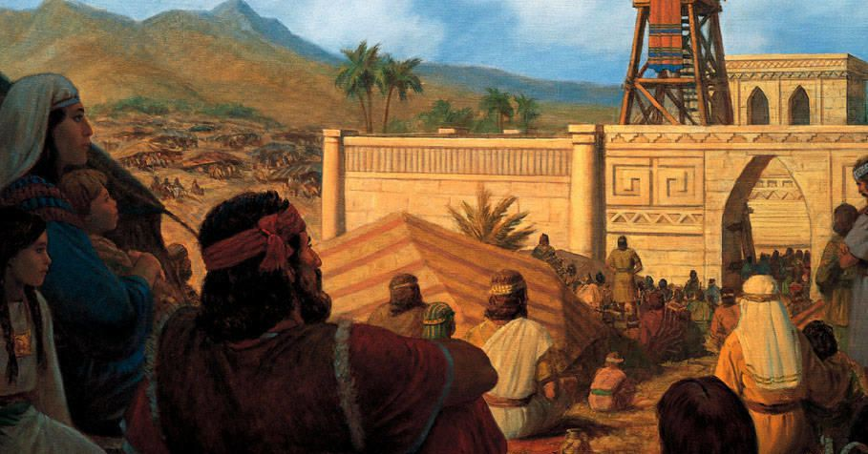
Vows, Freewill Offerings, Burnt Offerings
Num. 29:35-39 “On the eighth day ye shall have a solemn assembly: ye shall do no servile work therein: But ye shall offer a burnt offering, a sacrifice made by fire, of a sweet savour unto the Lord: one bullock, one ram, seven lambs of the first year without blemish: Their meat offering and their drink offerings for the bullock, for the ram, and for the lambs, shall be according to their number, after the manner: And one goat for a sin offering; beside the continual burnt offering, and his meat offering, and his drink offering. These things ye shall do unto the Lord in your set feasts, beside your vows, and your freewill offerings, for your burnt offerings, and for your meat offerings, and for your drink offerings, and for your peace offerings.”

Slide 15
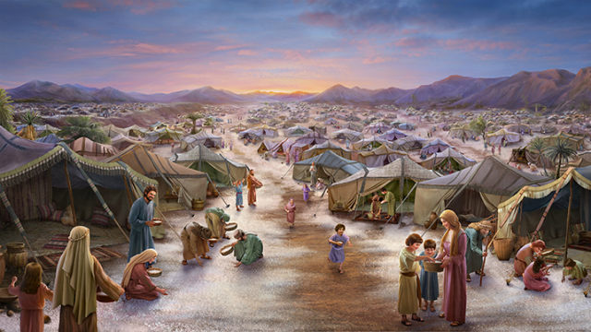
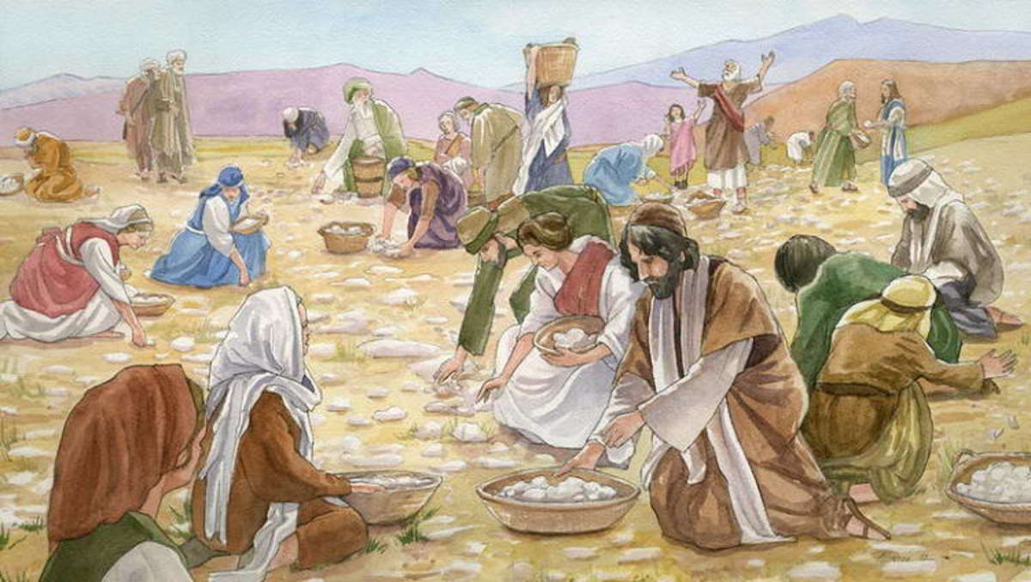
What Did the Feast of Tabernacles Memorialize?
“Like the Passover, the Feast of Tabernacles was commemorative. In memory of their pilgrim life in the wilderness the people were now to leave their houses and dwell in booths, or arbors, formed from the green branches “of goodly trees, branches of palm trees, and the boughs of thick trees, and willows of the brook.” Leviticus 23:40, 42, 43. The first day was a holy convocation, and to the seven days of the feast an eighth day was added, which was observed in like manner. At these yearly assemblies the hearts of old and young would be encouraged in the service of God, while the association of the people from the different quarters of the land would strengthen the ties that bound them to God and to one another.” PP, 540

Slide 16
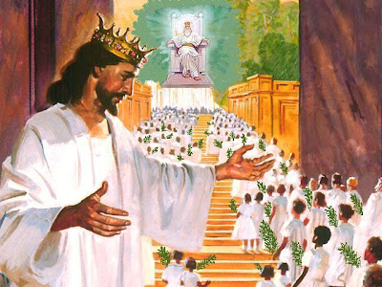
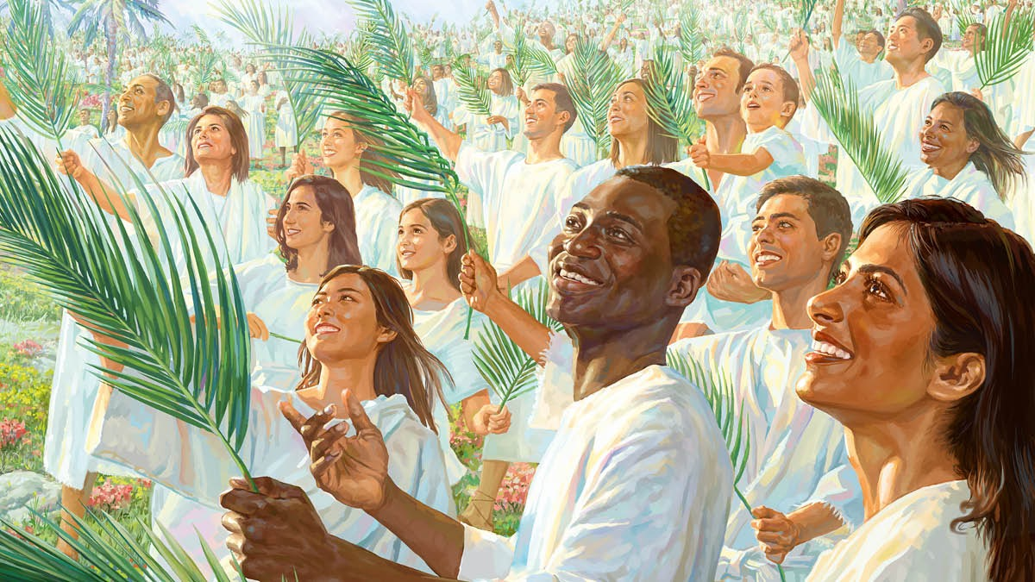
Encouraged to Reflect on God’s Love Today!
“Well would it be for the people of God at the present time to have a Feast of Tabernacles—a joyous commemoration of the blessings of God to them. As the children of Israel celebrated the deliverance that God had wrought for their fathers, and his miraculous preservation of them during their journeyings from Egypt, so should we gratefully call to mind the various ways he has devised for bringing us out from the world, and from the darkness of error, into the precious light of his grace and truth. With those who lived at a distance from the tabernacle, more than a month of every year must have been occupied in attendance upon the annual feasts. This example of devotion to God should emphasize the importance of religious worship and the necessity of subordinating our selfish, worldly interests to those that are spiritual and eternal. We sustain a loss when we neglect the privilege of associating together to strengthen and encourage one another in the service of God” PP, 540

Slide 17
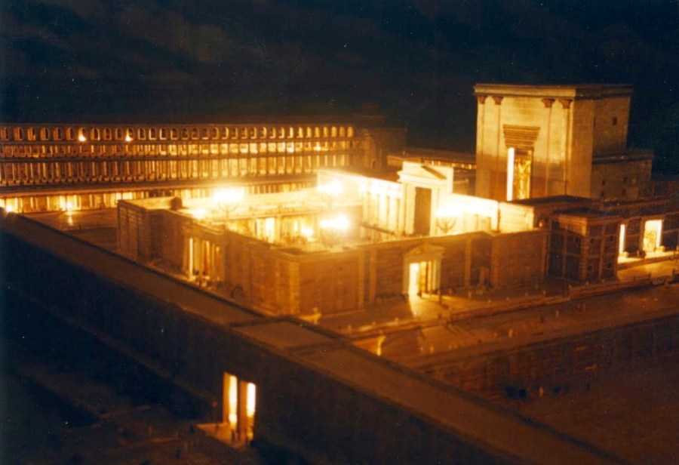
Memorial of God’s Protection!
“This feast was not only the harvest thanksgiving, but the memorial of God's protecting care over Israel in the wilderness. In commemoration of their tent life, the Israelites during the feast dwelt in booths or tabernacles of green boughs. These were erected in the streets, in the courts of the temple, or on the housetops. The hills and valleys surrounding Jerusalem were also dotted with these leafy dwellings, and seemed to be alive with people. With sacred song and thanksgiving the worshipers celebrated this occasion. A little before the feast was the Day of Atonement, when, after confession of their sins, the people were declared to be at peace with Heaven. Thus the way was prepared for the rejoicing of the feast. "O give thanks unto the Lord; for He is good: for His mercy endureth forever" (Psalm 106:1) rose triumphantly, while all kinds of music, mingled with shouts of hosanna, accompanied the united singing. The temple was the center of the universal joy. Here was the pomp of the sacrificial ceremonies. Here, ranged on either side of the white marble steps of the sacred building, the choir of Levites led the service of song. The multitude of worshipers, waving their branches of palm and myrtle, took up the strain, and echoed the chorus; and again the melody was caught up by voices near and afar off, till the encircling hills were vocal with praise.” DA, 448

Slide 18
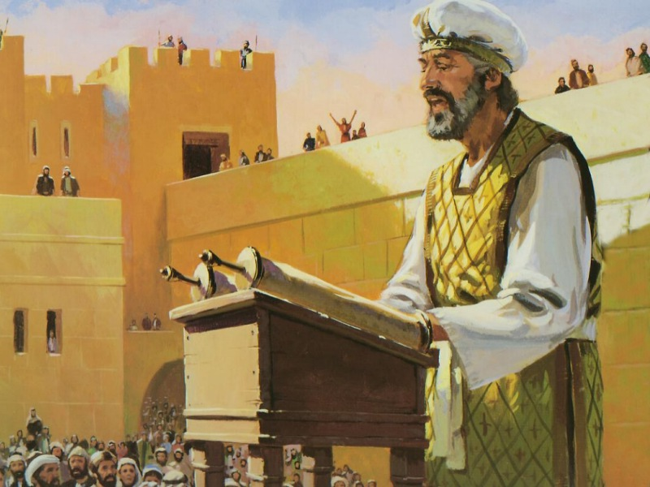
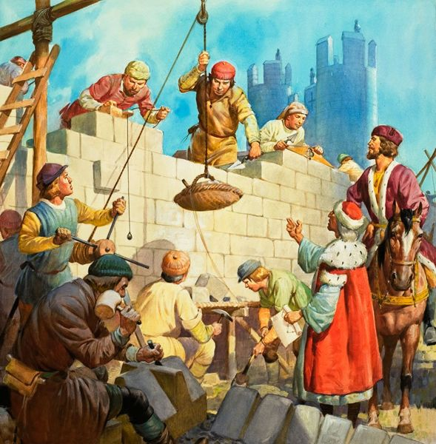
Old Testament Feast of Tabernacles
Neh. 8:14-18 “And they found written in the law which the Lord had commanded by Moses, that the children of Israel should dwell in booths in the feast of the seventh month: And that they should publish and proclaim in all their cities, and in Jerusalem, saying, Go forth unto the mount, and fetch olive branches, and pine branches, and myrtle branches, and palm branches, and branches of thick trees, to make booths, as it is written. So the people went forth, and brought them, and made themselves booths, every one upon the roof of his house, and in their courts, and in the courts of the house of God, and in the street of the water gate, and in the street of the gate of Ephraim. And all the congregation of them that were come again out of the captivity made booths, and sat under the booths: for since the days of Jeshua the son of Nun unto that day had not the children of Israel done so. And there was very great gladness. Also day by day, from the first day unto the last day, he read in the book of the law of God. And they kept the feast seven days; and on the eighth day was a solemn assembly, according unto the manner.”

Slide 19
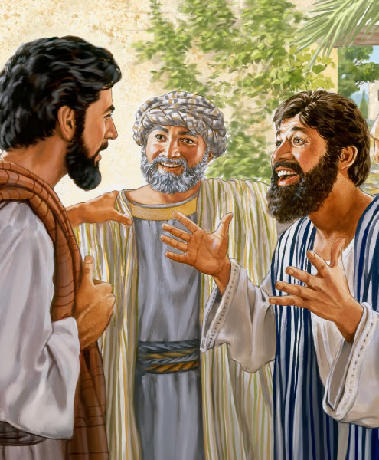
Jesus Goes to the Feast of Tabernacles?
John 7:1-9 “After these things Jesus walked in Galilee: for he would not walk in Jewry, because the Jews sought to kill him. Now the Jew's feast of tabernacles was at hand. His brethren therefore said unto him, Depart hence, and go into Judaea, that thy disciples also may see the works that thou doest. For there is no man that doeth any thing in secret, and he himself seeketh to be known openly. If thou do these things, shew thyself to the world. For neither did his brethren believe in him. Then Jesus said unto them, My time is not yet come: but your time is alway ready. The world cannot hate you; but me it hateth, because I testify of it, that the works thereof are evil. Go ye up unto this feast: I go not up yet unto this feast: for my time is not yet full come. When he had said these words unto them, he abode still in Galilee.”

Slide 20
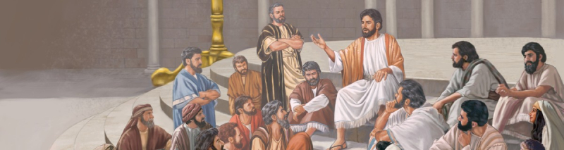
Arrives in Secret!
John 7:10-19 “But when his brethren were gone up, then went he also up unto the feast, not openly, but as it were in secret. Then the Jews sought him at the feast, and said, Where is he? And there was much murmuring among the people concerning him: for some said, He is a good man: others said, Nay; but he deceiveth the people. Howbeit no man spake openly of him for fear of the Jews. Now about the midst of the feast Jesus went up into the temple, and taught. And the Jews marvelled, saying, How knoweth this man letters, having never learned? Jesus answered them, and said, My doctrine is not mine, but his that sent me. If any man will do his will, he shall know of the doctrine, whether it be of God, or whether I speak of myself. He that speaketh of himself seeketh his own glory: but he that seeketh his glory that sent him, the same is true, and no unrighteousness is in him. Did not Moses give you the law, and yet none of you keepeth the law? Why go ye about to kill me?”

Slide 21
Ellen White Discusses this Feast Scenario
“At the first dawn of day, the priests sounded a long, shrill blast upon their silver trumpets, and the answering trumpets, and the glad shouts of the people from their booths, echoing over hill and valley, welcomed the festal day. Then the priest dipped from the flowing waters of the Kedron a flagon of water, and, lifting it on high, while the trumpets were sounding, he ascended the broad steps of the temple, keeping time with the music with slow and measured tread, chanting meanwhile, "Our feet shall stand within thy gates, O Jerusalem." Psalm 122:2. He bore the flagon to the altar, which occupied a central position in the court of the priests. Here were two silver basins, with a priest standing at each one. The flagon of water was poured into one, and a flagon of wine into the other; and the contents of both flowed into a pipe which communicated with the Kedron, and was conducted to the Dead Sea. This display of the consecrated water represented the fountain that at the command of God had gushed from the rock to quench the thirst of the children of Israel. Then the jubilant strains rang forth, "The Lord Jehovah is my strength and my song;" "therefore with joy shall ye draw water out of the wells of salvation." Isaiah 12:2, 3” DA, 448-449

Slide 22
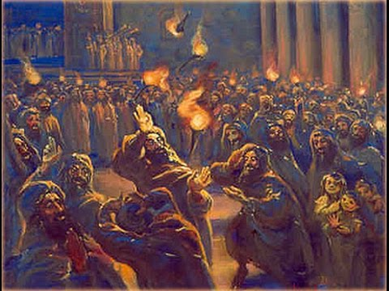
Facing the Wolves
“Meanwhile Jesus had quietly arrived at Jerusalem. He had chosen an unfrequented route by which to go, in order to avoid the travelers who were making their way to the city from all quarters. Had He joined any of the caravans that went up to the feast, public attention would have been attracted to Him on His entrance into the city, and a popular demonstration in His favor would have aroused the authorities against Him. It was to avoid this that He chose to make the journey alone. In the midst of the feast, when the excitement concerning Him was at its height, He entered the court of the temple in the presence of the multitude. Because of His absence from the feast, it had been urged that He dared not place Himself in the power of the priests and rulers. All were surprised at His presence. Every voice was hushed. All wondered at the dignity and courage of His bearing in the midst of powerful enemies who were thirsting for His life.” DA, 452

Slide 23
Spellbound at His Teaching!
“As Jesus spoke in the temple court, the people were held spellbound. The very men who were the most violent against Him felt themselves powerless to do Him harm. For the time, all other interests were forgotten. Day after day He taught the people, until the last, "that great day of the feast." The morning of this day found the people wearied from the long season of festivity. Suddenly Jesus lifted up His voice, in tones that rang through the courts of the temple: "If any man thirst, let him come unto Me, and drink. He that believeth on Me, as the scripture hath said, out of his belly shall flow rivers of living water." The condition of the people made this appeal very forcible. They had been engaged in a continued scene of pomp and festivity, their eyes had been dazzled with light and color, and their ears regaled with the richest music; but there had been nothing in all this round of ceremonies to meet the wants of the spirit, nothing to satisfy the thirst of the soul for that which perishes not. Jesus invited them to come and drink of the fountain of life, of that which would be in them a well of water, springing up unto everlasting life.” DA, 453-454

Slide 24
