Slide 1
What is in a Name?

Slide 2
East Different than West
In the Western world, names don’t mean very much. If searched out, one may find that their name has significance. This is not true in the culture of the Middle East. Names hold great significance. Names represent character. One small example would be Jacob.
Jacob meant deceiver/trickster.
Israel meant prince with God.

Slide 3
God’s many names are very significant
When Moses asked to see God’s glory, the Lord said He would make all His goodness pass before him, and would proclaim His name. (Exodus 33:18,19)
When the Lord passed before Moses, He proclaimed His name, and in His name was His character.
Exodus 34:5-7 “And the Lord descended in the

Slide 4
Names Represent Character
cloud, and stood with him there, and proclaimed the name of the Lord…The Lord, the Lord God, merciful and gracious, longsuffering, and abundant in goodness and in truth. Keeping mercy for thousands, forgiving iniquity and transgression and sin, and that will by no means clear the guilty”………………………………………………

Slide 5
God’s many names reveal this!
1. Elohim- God’s first name in Genesis 1 means ‘the mighty covenant maker, the One who always keeps His promises’. Elohim is plural! In KJV, Elohim is translated God.
2. Yahweh- God’s next name, found in Genesis 2, means ‘the Supreme Being, the I AM, the Sovereign of the Universe’. Found in Genesis 2:4. In KJV, it is translated LORD.
3. Adonai- God’s next name, found in Genesis 15 means ‘master, owner, or reverent lord’. IN KJV, it is translated Lord.

Slide 6
Name equals Character
4. El Ra’i, first mentioned in Genesis 16 in the story of Hagar, means ‘the mighty One who sees’.
5. El Shaddai, first mentioned in Genesis 17, and the fifth name for God, means ‘the mighty/ breasted One, depicting the amazing contrasts in Deity, showing His unstoppable power and His tender, gentle compassion’. It is translated in KJV as the Almighty. Guess which Old Testament character referred to El Shaddai more than any other?

Slide 7
Some Variations
In many cases, the names are used together. For example, Yahweh Elohim or Adonai Yahweh, are often seen together in Scripture.
In many cases, the name Yahweh is put together with another word. The two together have rich meaning. For example, when Abraham offered up Isaac at Mt. Moriah and the Lord provided a lamb in Isaac’s place, Abraham called the place, Yahweh Jireh, which means ‘the Sovereign provides’. After seeing the horrors of famine and sorrow, Ezekiel could triumphantly at the end of his book, ‘Yahweh Shammah’, which means ‘the Supreme One is there!’

Slide 8
I wanted a stronger name
1. A Catholic paper tells the Catholic League of New York to stop our work.
2. The Catholic churches of Orlando tell the central Florida postmaster to stop the mass mailings of Secret Terrorists/Enemy Unmasked.
3. ABC affiliate, channel 9 Eyewitness News, paints me as a monster who has no right to a bulk mailing permit.

Slide 9
Stronger, stronger, NAME!!
4. Priest and pastors in Southern Oregon speak out against mass mailings of Secret Terrorists, calling it hate literature.
5. Pseudo Adventist pastors denounce Secret Terrorists as ‘not in harmony with Adventist teachings’.
6. Historic Adventists disagree with Hughes, saying his sources are bad.
7. Others shred the books, write ‘You are next.’

Slide 10
What’s Next?
                8. A trucking company brings us some books from New York. At the Georgia/Florida border, the truck is stopped by local authorities. “We need to keep an eye on an extreme group in Florida that mails out hate literature”.
9. Tallahassee writes, saying that they have gotten complaints. I told them that I want people to be ready for Jesus when He comes!!!
10. One man wrote, “If you come to these meetings, you will go home in a box!” He failed in his mission!

Slide 11
The Name is Right here!!!
The name I needed was in the Bible all the time.
It was the name used to identify Joshua’s Visitor at Jericho.
It was Hannah’s encouragement in the face of her enemy.
It was the one David invoked as he faced the monster.
It was the one invoked by Zerubbabel as he sought to do the work of God.
It was cited by Luther as the Reformation was endangered.
It was cited by Ellen White as she saw the final battles of God’s people.

Slide 12
The name is Yahweh Tsabaoth
Yahweh Tsabaoth means the ‘Sovereign Commander of the armies of the Universe’.
It is translated into English as the LORD of hosts.
The first time it appears is in 1Samuel 1:11 when Hannah prayed for a son.
“And she vowed a vow, and said, O LORD of hosts, if thou wilt indeed look on the affliction of thine handmaid, but wilt give unto thine handmaid, and remember me………”

Slide 13
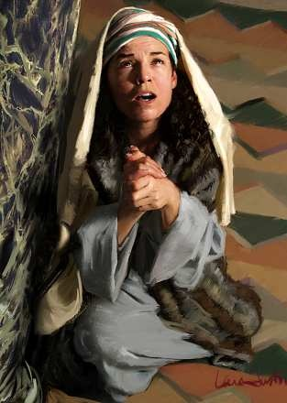
Yahweh Tsabaoth heard Hannah’s Prayer
God’s people were in complete disarray.
Eli’s sons were polluting the temple services.
It was hard to know anymore where God’s people were.
The Sovereign fought for His child. With God on our side, we are the majority, no matter what the odds.

Slide 14
The Battle of Jericho
This took place before Hannah’s plea. When Christ came to help Joshua, He referred to Himself as ‘tsaba Yahweh’. With Christ on our side, we can know no defeat.
Joshua 5:13-15 “…Joshua went unto Him, and said unto Him, ‘Art Thou for us, or for our adversaries?...As Captain of the host of the LORD am I now come.”

Slide 15
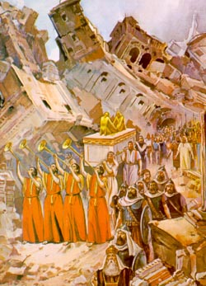
The walls Fell

Slide 16
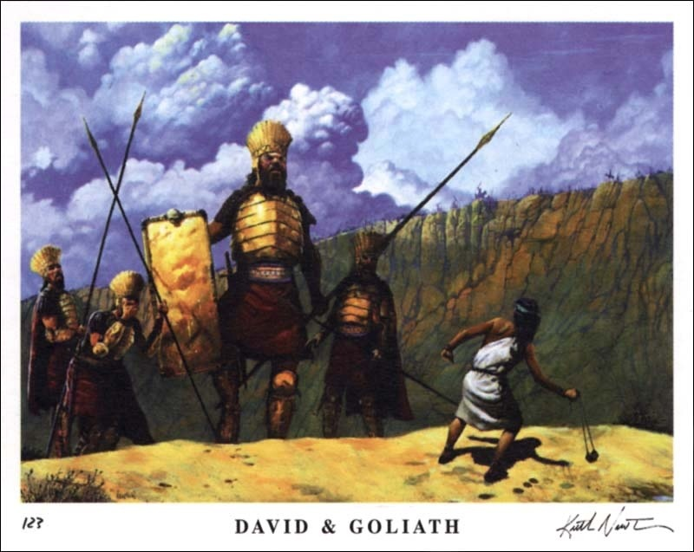
David and Goliath
1Samuel 17:45 “Thou comest to me with a sword, and with a spear, and with a shield; but I come to thee in the name of the LORD of hosts, the God of the armies of Israel, whom thou hast defied.”

Slide 17
Victory was Assured
David invoked the name of Yahweh Tsabaoth when he said that the LORD of hosts would fight for him that day. He fully understood that that name was a reference to the Sovereign Commander of the universe who has never lost a battle!!
David referred to the Lord thus throughout the Psalms. Psalm 46:11 says, “The LORD of hosts is with us; the God of Jacob is our refuge.”
Psalms 24:8,10 says, “Who is this King of glory? The LORD strong and mighty; the LORD mighty in battle…The LORD of hosts, He is the King of glory.”

Slide 18
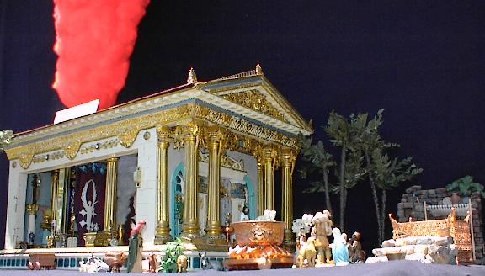
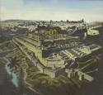
Zerubbabel and the temple

Slide 19
Zerubbabel’s Troubles
Zerubbabel faced manifold difficulties in rebuilding the temple after the Babylonian captivity. The Samaritans troubled the Jews all during the reconstruction. The Persians were influenced to halt the work, and apathy set in among God’s people. This was why it took three decrees to restore the city and the temple. Ezra, Nehemiah, Haggai, and Zechariah all played a part in the reconstruction of the 2nd temple.

Slide 20
Word’s of Encouragement
Zechariah invoked Yahweh Tsabaoth to fight for Zerubbabel. Notice: “Not by might, nor by power, but by My Spirit,” saith the LORD of hosts. “Who art thou, o great mountain? Before Zerubbabel, thou shalt become a plain and he shall bring forth the headstone thereof with shouting, crying grace, grace, unto it.” Zechariah 4:6
“Throughout the history of God's people great mountains of difficulty, apparently insurmountable, have loomed up before those who were trying to carry out the purposes of Heaven. Such obstacles are permitted by the Lord as a test of faith. When we are hedged about on every side, this is the time above all others to trust in God and in the power of His Spirit. The exercise of a living faith means an increase of spiritual strength and the development of an unfaltering trust. It is thus that the soul becomes a conquering power. Before the demand of faith, the obstacles placed by Satan across the pathway of the Christian will disappear; for the powers of heaven will come to his aid. "Nothing shall be impossible unto you." Matthew 17:20.” PK, pg. 594,595

Slide 21
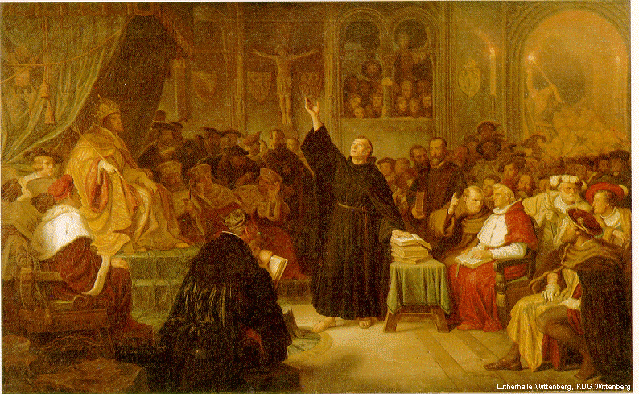
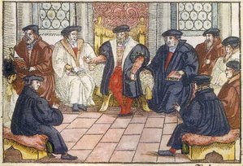
The 1500’s

Slide 22
Luther and the Protestant Princes
The Reformer answered: "Since your most serene majesty and your high mightinesses require from me a clear, simple, and precise answer, I will give you one, and it is this: I cannot submit my faith either to the pope or to the councils, because it is clear as the day that they have frequently erred and contradicted each other. Unless therefore I am convinced by the testimony of Scripture or by the clearest reasoning, unless I am persuaded by means of the passages I have quoted, and unless they thus render my conscience bound by the word of God, I cannot and I will not retract, for it is unsafe for a Christian to speak against his conscience. Here I stand, I can do no other; may God help me. Amen." --Ibid., b. 7, ch. 8.
Thus stood this righteous man upon the sure foundation of the word of God. The light of heaven illuminated his countenance. His greatness and purity of character, his peace and joy of heart, were manifest to all as he testified against the power of error and witnessed to the superiority of that faith that overcomes the world.
Great Controversy, page 160

Slide 23
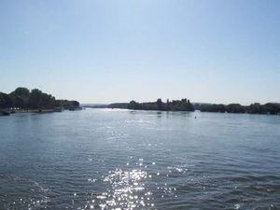
Augsburg 1530
The elector set out, with his retinue, for Augsburg. All were acquainted with the dangers that menaced him, and many went forward with gloomy countenance and troubled heart. But Luther, who accompanied them as far as Coburg, revived their sinking faith by singing the hymn, written on that journey, "A strong tower is our God." Many an anxious foreboding was banished, many a heavy heart lightened, at the sound of the inspiring strains.”
Great Controversy page 206

Slide 24
A Mighty Fortress
A mighty fortress is our God, a bulwark never failing;
Our helper He, amid the flood of mortal ills prevailing:
For still our ancient foe doth seek to work us woe;
His craft and power are great, and, armed with cruel hate,
On earth is not his equal.
Did we in our own strength confide, our striving would be losing;
Were not the right Man on our side, the Man of God’s own choosing:
Dost ask who that may be? Christ Jesus, it is He;
Lord Sabaoth, His Name, from age to age the same,
And He must win the battle.
And though this world, with devils filled, should threaten to undo us,
We will not fear, for God hath willed His truth to triumph through us:
The Prince of Darkness grim, we tremble not for him;
His rage we can endure, for lo, his doom is sure,
One little word shall fell him.
That word above all earthly powers, no thanks to them, abideth;
The Spirit and the gifts are ours through Him Who with us sideth:
Let goods and kindred go, this mortal life also;
The body they may kill: God’s truth abideth still,
His kingdom is forever.

Slide 25
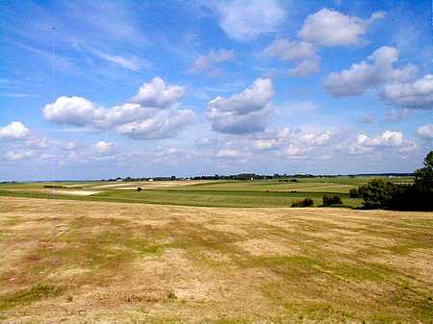
Ellen White Saw the battle
“His prophetic glance takes in the experience of His servants through all the ages till He shall come the second time. He shows His followers the conflicts they must meet; He reveals the character and plan of the battle. He lays open before them the perils they must encounter, the self-denial that will be required. He desires them to count the cost, that they may not be taken unawares by the enemy. Their warfare is not to be waged against flesh and blood, but "against the principalities, against the powers, against the world rulers of this darkness, against the spiritual hosts of wickedness in the heavenly places." Eph. 6:12, R. V. They are to contend with supernatural forces, but they are assured of supernatural help. All the intelligences of heaven are in this army. And more than angels are in the ranks. The Holy Spirit, the representative of the Captain of the Lord's host, comes down to direct the battle. Our infirmities may be many, our sins and mistakes grievous; but the grace of God is for all who seek it with contrition. The power of Omnipotence is enlisted in behalf of those who trust in God.” DA, 352

