Slide 1
Ezekiel, pt. 23
‘Measurements, Chambers, and Gates’

Slide 2
Very Controversial Chapters
Ezekiel, chapters 40-46, are highly controversial. It isn’t so much what they discuss, but rather when they occur. These chapters look in some detail at the restoration of the temple in Jerusalem and the various functions of each item in the temple. After the temple is rebuilt, in chapters 40-43, the Lord declares, “…Son of man, mark well, and behold with thine eyes, and hear with thine ears all that I say unto thee concerning all the ordinances of the house of the LORD, and all the laws thereof; and mark well the entering in of the house, with every going forth of the sanctuary.” Ezekiel 44:5

Slide 3
When Do these Verses apply?
These verses definitely apply to Ezekiel’s time. After the Babylonian captivity, the people of Israel returned to Jerusalem and rebuilt the temple and the city. This is the great focus of the Bible books of Ezra and Nehemiah. The glory of God, that had departed from Israel in Ezekiel 11:23 “And the glory of the LORD went up from the midst of the city, and stood upon the mountain which is on the east side of the city.”, has returned in Ezekiel 43:4 “And the glory of the LORD came into the house by the way of the gate whose prospect is toward the east.”

Slide 4
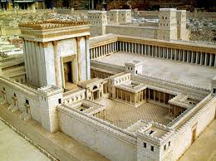
Other Speculative Interpretations
Since these chapters fall after the final battle of Rev. 20, it could be speculated that these verses are describing the heavenly temple in the New Jerusalem. However, so much in Ezekiel 40-43 would not be fitting in that Heavenly temple; sacrifices, sin offerings, etc. Another speculation pinpoints these chapters since 1948 and the restoration of the Jews to their homeland and the rebuilding of Solomon’s temple! We will now look at that speculation!

Slide 5
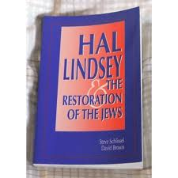
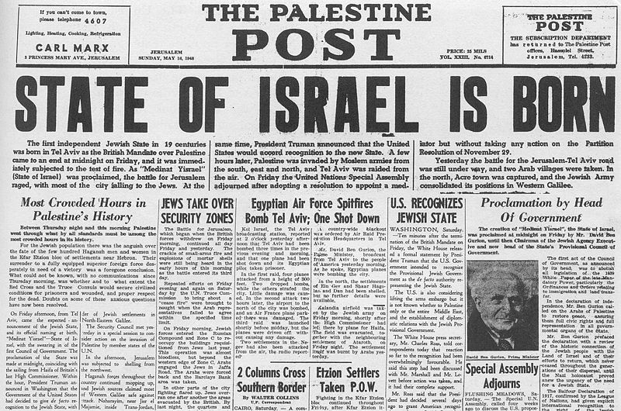
1948-Fulfillment?

Slide 6
No! A Thousand Times No!!
The time prophecy of Daniel 9:24-27 had designated “Seventy weeks are determined upon thy people and upon thy holy city, to finish the transgression, and to make an end of sins, and to make reconciliation for iniquity,…”. When that time period ended in 34 AD, at the stoning of Stephen, the Jewish nation ceased to be the people of God forever. Individual Jews could accept Christ. The nation divorced itself from Christ and God chose out the church to be the depositors of divine truth. Any work done in Jerusalem would be outside of Bible prophecy!!!

Slide 7
1948 God had Nothing to do with it!
In 1918, the Jesuits would cause their Zionists in England to issue the Balfour Declaration, declaring Palestine to be the new homeland for the wandering Jew. Could it be that after 1900 years of Rome’s crusades, inquisitions, and pogroms, the Jewish race would now have a place to call it’s own? Or was Zionism a set up for the greatest betrayal the Jewish race has ever known? World War I prepared the land for the people, WWII prepared the people for the land. “Instead of taking a public stand, he, Cardinal Spellman would operate behind the scenes by personally calling on ever South American country to cast their votes for Israel…There was little doubt that Spellman knew the UN delegates…After a bitter struggle, Israel was admitted to the UN by a vote of 37-12. The Israelis had turned to a number of men of prominence including John Foster Dulles to promote their cause. Many were convinced that Spellman had been the deciding factor.” John Cooney, The American Pope, pages 186-187.

Slide 8
Rome’s Plan to Destroy Them
“World War II was to be fomented through manipulation of the differences that existed between the German Nationalists and the Political Zionists. This was to result in an expansion of Russian influence and the establishment of a state of Israel in Palestine.” Albert Pike’s letter to Mazzini, 1871
“In Vatican eyes, therefore, the millenarian yearning for a global Hebrew theocracy, represents a deadly threat to the eschatological teachings of the Catholic church. When translated into concrete political terms, such a view spells not only rivalry, but implacable enmity. -- Avro Manhattan, The Vatican Moscow Washington Alliance, chick Publications, pp. 169, 170.

Slide 9
Explaining Scripture
“And when ye shall see Jerusalem compassed with armies, then know that the desolation thereof is nigh. Then let them which are in Judaea flee to the mountains; and let them which are in the midst of it depart out; and let not them that are in the countries enter there into. For these be the days of vengeance, that all things which are written may be fulfilled. But woe unto them that are with child, and to them that give suck, in those days! for there shall be great distress in the land, and wrath upon this people. And they shall fall by the edge of the sword, and shall be led away captive into all nations: and Jerusalem shall be trodden down of the Gentiles, until the times of the Gentiles be fulfilled.” Luke 21:20-24
1. 70 AD
2. led captive as slaves
3. Jerusalem trodden down by the Gentiles until the time of the Gentiles be fulfilled.
4. What is Jerusalem here, who are the Gentiles and what are the Gentiles times?
Revelation 11:2 “But the court which is without the temple leave out, and measure it not; for it is given unto the Gentiles: and the holy city shall they tread under foot forty and two months.”

Slide 10
Explanation
3. Jerusalem trodden down by the Gentiles until the time of the Gentiles be fulfilled.
4. What is Jerusalem here, who are the Gentiles and what are the Gentiles times? Revelation 11:2 “But the court which is without the temple leave out, and measure it not; for it is given unto the Gentiles: and the holy city shall they tread under foot forty and two months.”
Jerusalem is the holy city. The Gentiles are the papacy. The times of the Gentiles is 1260 years. What was the holy city tread down by Rome for 1260 years? Was it the city of Jerusalem or was it the church? THE CHURCH!!

Slide 11
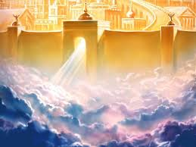
Heavenly Home!
1. Israel had their day in the sunshine.
2. By 34 AD, they ceased to be God’s people.
3. God’s blessing rested on the church.
4. Any attempts to restore Israel came from Rome with the desire to destroy the Jews.
5. The promises in Ezekiel 36 are for God’s children today to take us to the Heavenly promised land.

Slide 12
Summary of this false teaching
34 AD marked the end of Jewish importance in Bible prophecy.
1948 was Rome’s attempt to bring the Jews to Palestine in order to destroy them forever.
Albert Pike and his Jesuit cronies have longed for Jewish annihilation since 1871!
Without any Jews, or very few, the Messiah’s long reign would never happen and the Vatican’s goal to rule the world remains intact.

Slide 13
Ezekiel 40-46/ Significance
There are 3 concepts that are repeated over and over in these chapters. These 3 concepts are the major points we must not miss in this study. These are:
1. Measuring
2. Chambers/little chambers
3. Gates/doors

Slide 14
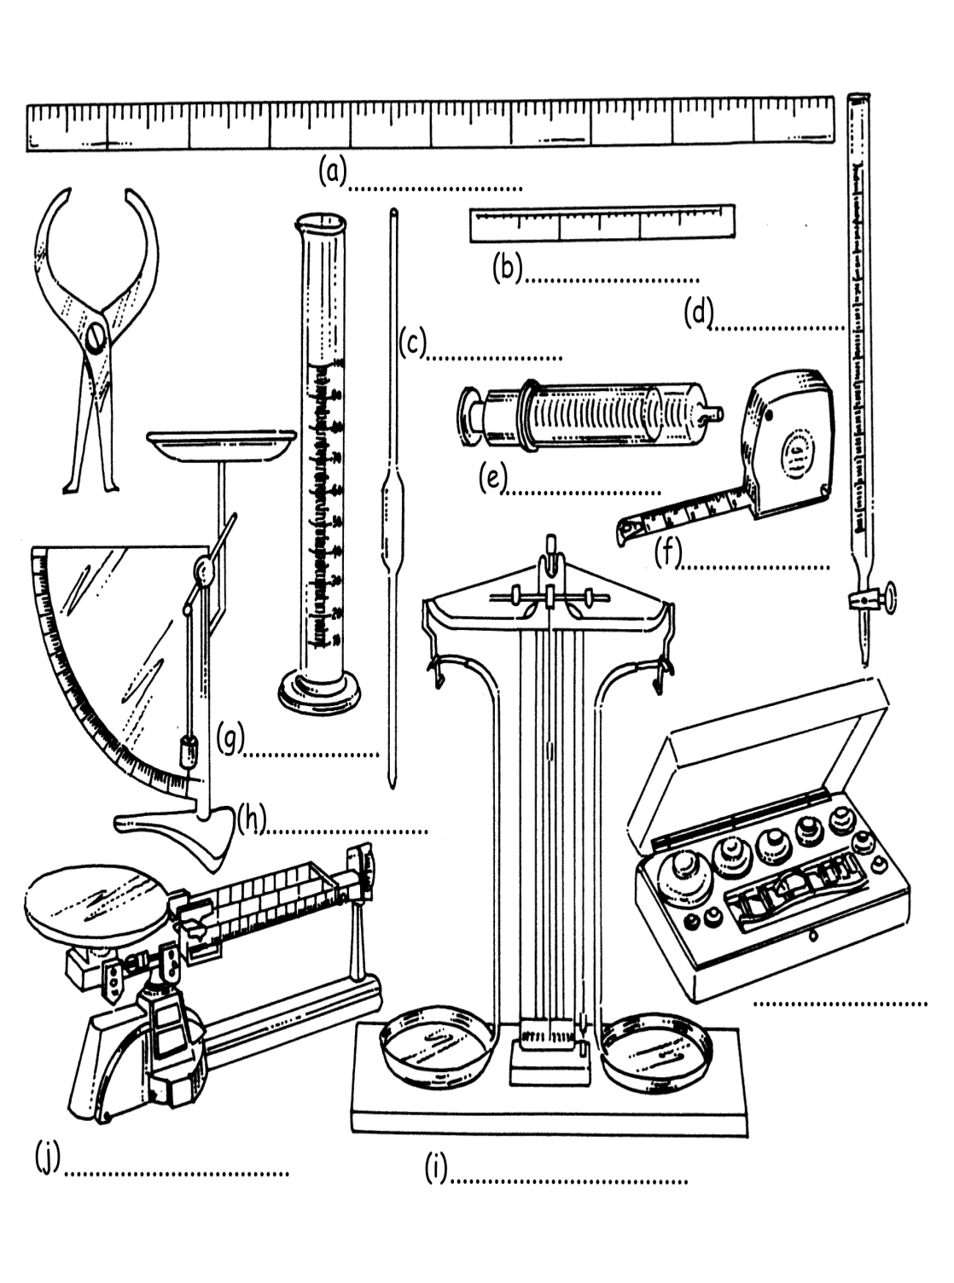
Measuring/JUDGMENT
In Ezekiel chaps. 40-43, there is reference made to measuring, measurements, etc. at least 40 times. The point being that judgment will take place for every being that has ever lived in the sanctuary. The 2 ideas of judgment/sanctuary bring our minds to 1844 and the beginning of the investigative judgment!! Rev. 14:7 ‘the hour of his judgment is come’!
“And there was given me a reed like unto a rod: and the angel stood, saying, Rise, and measure the temple of God, and the altar, and them that worship therein.” Rev. 11:1

Slide 15
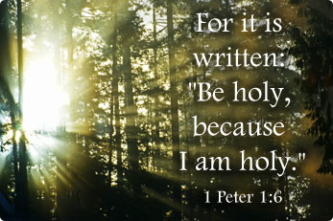
The Point
Judgment brings mankind face to face with a dilemma that, by himself, he cannot solve. “Thou son of man, shew the house to the house of Israel, that they may be ashamed of their iniquities: and let them measure the pattern.” Ezekiel 43:10
We have fallen short of the Pattern!

Slide 16
Chambers to our Souls!
Ezekiel 40-42 is also very interested in the chambers in the temple. Over 36 times, reference is made to the little chambers! Within our soul temple, the Lord emphasizes His interest in what goes on with us when no one else is around! When it is dark, when we are alone, and no one else sees, who are we then? The Lord is most interested in the little chambers of our minds!
“Behold, it is written before me: I will not keep silence, but will recompense, even recompense into their bosom, Your iniquities, and the iniquities of your fathers together, saith the LORD, which have burned incense upon the mountains, and blasphemed me upon the hills: therefore will I measure their former work into their bosom.” Isaiah 65:6,7

Slide 17
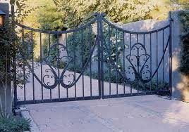
The Third Component
As we contemplate judgment in the light of Ezekiel’s vision of the sanctuary and the full revelation of our lives, we are met with at least 66 references to gates and doors throughout the temple. These gates/doors beckon us, telling us there is a way of hope.

Slide 18
The DOOR
“Then said Jesus unto them again, Verily, verily, I say unto you, I am the door of the sheep. All that ever came before me are thieves and robbers: but the sheep did not hear them. I am the door: by me if any man enter in, he shall be saved, and shall go in and out, and find pasture.” Jn. 10:7-9

Slide 19
Will We Open the Door?
“Christ is the door to the fold of God. Through this door all His children, from the earliest times, have found entrance. In Jesus, as shown in types, as shadowed in symbols, as manifested in the revelation of the prophets, as unveiled in the lessons given to His disciples, and in the miracles wrought for the sons of men, they have beheld "the Lamb of God, which taketh away the sin of the world" (John 1:29), and through Him they are brought within the fold of His grace. Many have come presenting other objects for the faith of the world; ceremonies and systems have been devised by which men hope to receive justification and peace with God, and thus find entrance to His fold. But the only door is Christ, and all who have interposed something to take the place of Christ, all who have tried to enter the fold in some other way, are thieves and robbers.” DA, pgs. 477,478

