Slide 1
What is the Difference Between Mormons, Jehovah’s Witnesses, and Seventh-day Adventists? pt 28

Slide 2
Amalgamation?
“But if there was one sin above another which called for the destruction of the race by the flood, it was the base crime of amalgamation of man and beast which defaced the image of God, and caused confusion everywhere. God purposed to destroy by a flood that powerful, long-lived race that had corrupted their ways before him.”–Spiritual Gifts, vol. 3, p. 64
“Every species of animal which God had created were preserved in the ark. The confused species which God did not create, which were the result of amalgamation, were destroyed by the Flood. Since the Flood there has been amalgamation of man and beast, as may be seen in the almost endless varieties of species of animals, and in certain races of men.”–Spiritual Gifts, vol. 3, p. 75

Slide 3
Charge 3: Rebuttal—They’re Still Doing it Today!!!
“Scientists in China have, for the first time, used cloning techniques to create hybrid embryos that contain a mix of DNA from both humans and rabbits, according to a report in a scientific journal that has reignited the smoldering ethics debate over cloning research. More than 100 of the hybrids, made by fusing human skin cells with rabbit eggs, were allowed to develop in laboratory dishes for several days before the scientists destroyed them to retrieve so-called embryonic stem cells from their interiors. Although scientists in Massachusetts had previously mixed human cells and cow eggs in a similar attempt to make hybrid embryos as a source of stem cells, those experiments were not successful.” The Washington Post, “Cloning Yields Human-Rabbit Hybrid Embryo Rick Weiss, Aug. 14, 2003

Slide 4
Human-Monkey Hybrids
“A team of scientists from the U.S., China, and Spain reported Thursday they have created the first embryos that were part human and part monkey and kept them alive for up to 20 days in laboratory dishes. The ethically controversial creation of chimeras — containing cells from multiple species — is part of a drive to make experimental models to help scientists better understand early development, devise new treatments for human disease, and possibly find methods to grow organs for transplant inside other animals, such as pigs or sheep” statnews.com, “International team creates first chimeric human-monkey embryos”, Usha Lee McFarling, April 15, 2021

Slide 5
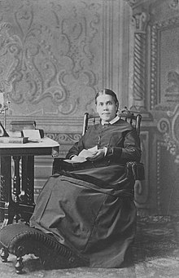
Charge 4: Hypocrite on Jewelry
“Those who have bracelets, and wear gold and ornaments, had better take these idols from their persons and sell them, even if it should be for much less than they gave for them, and thus practice self-denial. Time is too short to adorn the body with gold or silver or costly apparel. I know a good work can be done in this line. Jesus, the Commander in the heavenly courts, laid aside His crown of royalty and His royal robe and stepped down from His royal throne, and clothed His divinity with the habiliments of humanity, and for our sakes became poor, that we through His poverty might come into possession of eternal riches, and yet the very ones for whom Christ has done everything that was possible to do to save the perishing souls from eternal ruin feel so little disposition to deny themselves anything they have money to buy.” {9MR 117.1}

Slide 6
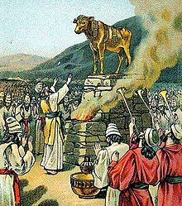
Is It Biblical?
Ex. 33:1-6 “And the Lord said unto Moses, Depart, and go up hence, thou and the people which thou hast brought up out of the land of Egypt, unto the land which I sware unto Abraham, to Isaac, and to Jacob, saying, Unto thy seed will I give it: And I will send an angel before thee; and I will drive out the Canaanite, the Amorite, and the Hittite, and the Perizzite, the Hivite, and the Jebusite: Unto a land flowing with milk and honey: for I will not go up in the midst of thee; for thou art a stiffnecked people: lest I consume thee in the way. And when the people heard these evil tidings, they mourned: and no man did put on him his ornaments. For the Lord had said unto Moses, Say unto the children of Israel, Ye are a stiffnecked people: I will come up into the midst of thee in a moment, and consume thee: therefore now put off thy ornaments from thee, that I may know what to do unto thee. And the children of Israel stripped themselves of their ornaments by the mount Horeb.”

Slide 7
New Testament Clarifies!
1 Pet. 3:3-5 “Whose adorning let it not be that outward adorning of plaiting the hair, and of wearing of gold, or of putting on of apparel; But let it be the hidden man of the heart, in that which is not corruptible, even the ornament of a meek and quiet spirit, which is in the sight of God of great price. For after this manner in the old time the holy women also, who trusted in God, adorned themselves, being in subjection unto their own husbands:”
1 Tim. 2:9-10 “In like manner also, that women adorn themselves in modest apparel, with shamefacedness and sobriety; not with broided hair, or gold, or pearls, or costly array; But (which becometh women professing godliness) with good works.”

Slide 8
Ellen White Comments on 1 Tim. 2:9
“Here the Lord, through His apostle, speaks expressly against the wearing of gold [1 Timothy 2:9-10]. Let those who have had experience see to it that they do not lead others astray on this point by their example. That ring encircling your finger may be very plain, but it is useless, and the wearing of it has a wrong influence upon others." Ellen G. White, Testimonies for the Church, vol. 4, p. 630

Slide 9
Facts on Jewelry in the Bible
Whenever people truly repent, the jewelry comes off (Ex. 33:1-5)
Whenever Jewelry is spoken of in an expressly positive light it is always an object lesson (Ez. 16:11-13; Prov. 25:12; Is. 61:10; Luke 22:15; Rev. 21:2)
When God is angry with His people or enemies, He constantly rebukes the wearing of jewelry (Is. 3:17-23; Hos. 2:13, Jer. 4:30: Rev. 17:4)
Other examples which were not positive or negative, simply express things that actually happened (Gen. 24)
Note: John Calvin, John Wesley, Charles Spurgeon, Charles Finney, the Puritans also condemned the use of Jewelry (http://www.puritans.net/news/attire040604.htm)

Slide 10
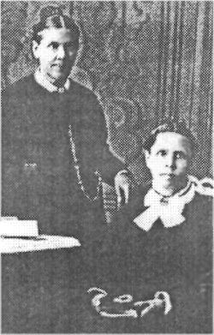
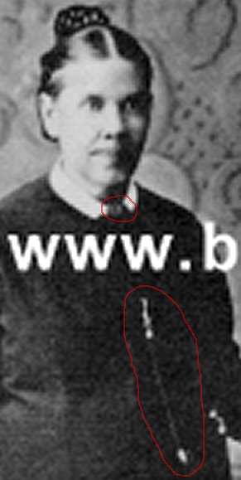
Photographic Proof!!!
“On the right is a picture of Ellen White with her twin sister Elizabeth at age 51. Notice that Ellen is wearing a decorative brooch and a gold chain. This photograph was taken 15 years after she condemned others for wearing similar jewelry:1
"To dress plainly, abstaining from display of jewelry and ornaments of every kind, is in keeping with our faith."2 . . .
1. Photograph on file at the James White Research Library, Andrews University. Digital images were taken from the book White-Washed by Sidney Cleveland. . . .
2. Ellen White, Testimonies, Vol. 3, p. 366.” Sydney Cleveland and Dirk Anderson, “Did Ellen White Wear Jewelry?”, https://www.nonsda.org/egw/contra7.shtml
Sydney Cleveland, White Washed, p. 203

Slide 11
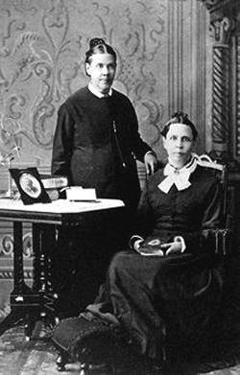
Who’s The Dishonest One Again?
"If I write one thing and act another, I am a hypocrite"
--Ellen White, Manuscript Releases Vol. 19, p. 31
The White Estate
Dirk Anderson’s nonsda.org

Slide 12
Rebuttal---Jewelry: A Freewill Offering
“Elder Simpson explains the prophecies by the means of charts, and makes it very plain that the end of all things is at hand. In some cases entire families have taken their stand to obey God, as in 1844. All are brought over the ground from the beginning, and many believe as the prophecies relating to the past, present, and future are explained. Jewelry which cost many hundreds of dollars has been given to Elder Simpson to be sold for the cause. There is no spirit of excitement in this movement. No fanaticism attends it. The truth takes hold of hearts; and men and women give their rings and bracelets although no call has been made for them to strip themselves of these idols. The work is earnest and quiet. The people take off their jewelry of their own freewill, and bring it to Elder Simpson as an offering up of their idols.” (14MR 250-251)

Slide 13
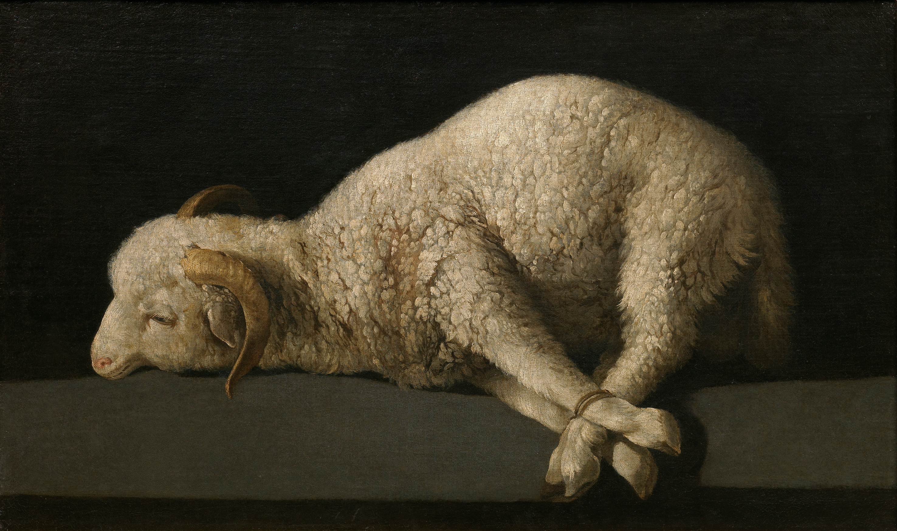
Charge 5: Contradiction in Writing
“In him dwelleth all the fulness of the Godhead bodily." Men need to understand that Deity suffered and sank under the agonies of Calvary. Yet Jesus Christ whom God gave for the ransom of the world purchased the church with His own blood. The Majesty of heaven was made to suffer at the hands of religious zealots, who claimed to be the most enlightened people upon the face of the earth” (MS 153, 1898)
“There is no one who can explain the mystery of the incarnation of Christ. Yet we know that He came to this earth and lived as a man among men. The man Christ Jesus was not the Lord God Almighty, yet Christ and the Father are one. The Deity did not sink under the agonizing torture of Calvary, yet it is nonetheless true that "God so loved the world, that he gave his only begotten Son, that whosoever believeth in him should not perish, but have everlasting life."—Letter 140, 1903

Slide 14
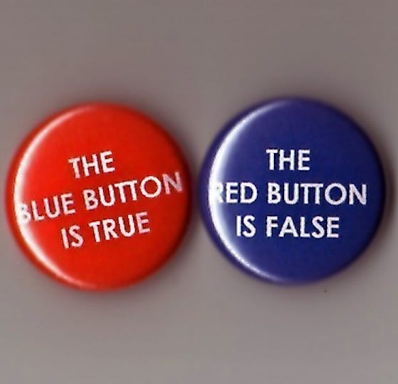
Charge 5 Rebuttal: Deity Was Emotionally Sunk but NOT Sunk in Reality
The Bible and the SOP are written in our way of speaking. We do this all the time. Pastor Bill says there are 2 storehouses, which is true—Kody Morey says there is only 1 storehouse, which is also true → Context Matters. If Paul Praino said Hitler lost WWII one week, then said Hitler won WWII another week, he would be correct both times depending on the context.
Bible example:
Matt. 5:48 “Be ye therefore perfect, even as your Father which is in heaven is perfect.”
Luke 6:36 “Be ye therefore merciful, as your Father also is merciful.”

Slide 15
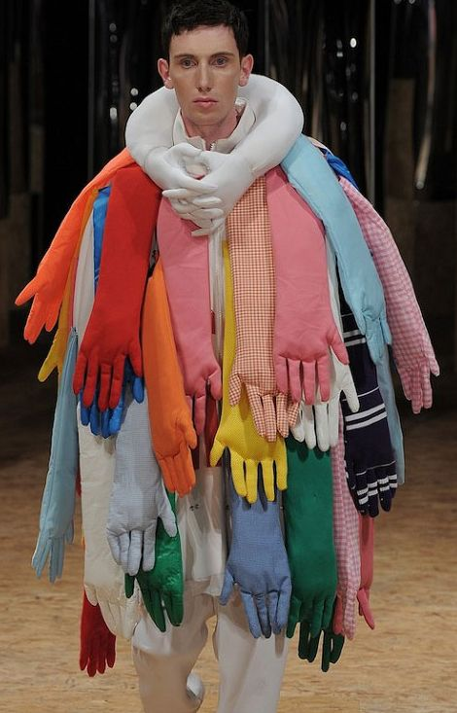
Charge 6: Ridiculous!!!
“There is perfect order and harmony in the Holy City. All the angels that are commissioned to visit the earth hold a golden card, which they present to the angels at the gates of the city as they pass in and out. Heaven is a good place. I long to be there and behold my lovely Jesus, who gave His life for me, and be changed into His glorious image. Oh, for language to express the glory of the bright world to come! I thirst for the living streams that make glad the city of our God” EW, p. 39

Slide 16
Charge 6: Rebuttal
The Rebuttal for this is two-fold:
This prophetic insight in no way, shape, or form proves Ellen White to be a false or a true prophet. You may think it’s ridiculous, but it’s certainly not disqualifying.
This prophetic insight leans toward proving her to be a true prophet given that cards were not a normal form of identification in the 1800s. There were no credit cards, debit cards, gift cards, or card licenses in her day. As technology has advanced, we now can visualize more clearly than in her day what the angel’s present to at the gates to the city. If it proves anything, it proves that Ellen White had amazing technological vision—where did she get it from?—combined with all the other tests of a prophet which she has passed, I think the answer to that question is clear.

