Slide 1
Francis I
In The Light of Prophecy

Slide 2
Listening to Francis before Congress/ 9/24/2015
He is so difficult to listen to as he spoke to Congress. He addressed many issues, reading from a prepared document.
1. Immigration
2. Economic equality.
3. Saving the planet. Sustainable development. (Diop said he also saw ways that the church and UN could cooperate, particularly in eradicating poverty and promoting education and healthcare.
“The impressive portfolio that the Seventh-day Adventist Church has developed for service to the whole human family remarkably resonates with the Millennium Development Goals and the Sustainable Development Goals of the UN,” he said in a statement. (Adventist Review, April 6, 2015) (no cars, no private property, etc.)
4. abortion

Slide 3
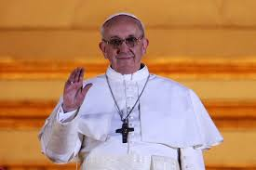
Modern Press
“Throughout his life, both as an individual and a religious leader, he has been known for his humility, his concern for the poor, and his commitment to dialogue as a way to build bridges between people of all backgrounds, beliefs, and faiths.” Wikipedia

Slide 4
Jesuit Provincial of Argentina
“ Throughout Christendom, Protestantism was menaced by formidable foes. The first triumphs of the Reformation past, Rome summoned new forces, hoping to accomplish its destruction. At this time the order of the Jesuits was created, the most cruel, unscrupulous, and powerful of all the champions of popery. Cut off from earthly ties and human interests, dead to the claims of natural affection, reason and conscience wholly silenced, they knew no rule, no tie, but that of their order, and no duty but to extend its power. (See Appendix.) The gospel of Christ had enabled its adherents to meet danger and endure suffering, undismayed by cold, hunger, toil, and poverty, to uphold the banner of truth in face of the rack, the dungeon, and the stake. To combat these forces, Jesuitism inspired its followers with a fanaticism that enabled them to endure like dangers, and to oppose to the power of truth all the weapons of deception. There was no crime too great for them to commit, no deception too base for them to practice, no disguise too difficult for them to assume. Vowed to perpetual poverty and humility, it was their studied aim to secure wealth and power, to be devoted to the overthrow of Protestantism, and the re-establishment of the papal supremacy. When appearing as members of their order, they wore a garb of sanctity, visiting prisons and hospitals, ministering to the sick and the poor, professing to have renounced the world, and bearing the sacred name of Jesus, who went about doing good. But under this blameless exterior the most criminal and deadly purposes were often concealed. It was a fundamental principle of the order that the end justifies the means. By this code, lying, theft, perjury, assassination, were not only pardonable but commendable, when they served the interests of the church. Under various disguises the Jesuits worked their way into offices of state, climbing up to be the counselors of kings, and shaping the policy of nations.” GC, pgs. 234,235

Slide 5
Media Controlled!
“There is no such thing, at this date of the world’s history, in America, as an independent press. You know it, and I know it. There is not one of you who dares to write your honest opinions, and if you did, you know beforehand that it would never appear in print. I am paid weekly for keeping my honest opinion out of the paper I am connected with. Others of you are paid similar salaries for similar things, and any of you who would be so foolish as to write honest opinions would be out on the streets looking for another job. If I allowed my honest opinions to appear in one issue of my newspaper, before twenty-four hours my occupation would be gone. The business of the journalists is to destroy the truth; to lie outright; to pervert; to vilify; to fawn at the feet of mammon, and to sell his country and his race for his daily bread. You know it, and I know it and what folly is this toasting an independent press? We are the tools and vassals of rich men behind the scenes. We are the jumping jacks, they pull the strings and we dance. Our talents, our possibilities and our lives are all the property of other men. We are intellectual prostitutes. — Multiple contributors, A U.S. Police Action: Operation Vampire Killer, The American Citizens and Laumen Association, pp. 18,19, (emphasis supplied).

Slide 6
Who Told You That?
CNN is owned by one of the wealthiest men in the world-Ted Turner. Ted Turner controls what goes out over CNN and his journalists say what he wants them to say!! Who controls Ted Turner?

Slide 7
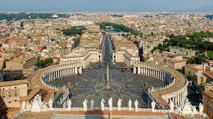
The Bible Says!
“ And the merchants of the earth shall weep and mourn over her; for no man buyeth their merchandise any more: The merchandise of gold, and silver, and precious stones, and of pearls, and fine linen, and purple, and silk, and scarlet, and all thyine wood, and all manner vessels of ivory, and all manner vessels of most precious wood, and of brass, and iron, and marble, And cinnamon, and odours, and ointments, and frankincense, and wine, and oil, and fine flour, and wheat, and beasts, and sheep, and horses, and chariots, and slaves, and souls of men. And the fruits that thy soul lusted after are departed from thee, and all things which were dainty and goodly are departed from thee, and thou shalt find them no more at all. The merchants of these things, which were made rich by her, shall stand afar off for the fear of her torment, weeping and wailing,” Rev. 18:11-15

Slide 8
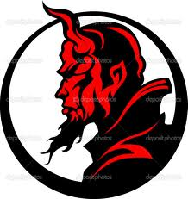
Who Controls the papacy?
“And the beast which I saw was like unto a leopard, and his feet were as the feet of a bear, and his mouth as the mouth of a lion: and the dragon gave him his power, and his seat, and great authority.” Rev. 13:2

Slide 9
Think!!!!!!!!!!!!!!!!!!!!!!!!!!!!
The devil controls the papacy.
The papacy controls the wealthy.
The wealthy control the media.
The media reports news to us.
We get only lies.
We were told that Islam was behind 9-11. Think again.
We were told of the evil of Osama bin Laden.
Think again.
We were told of Oswald killing Kennedy. Think again.
‘Take heed that no man deceive you.’ Matthew 24:4

Slide 10
Truth vs. Fiction
He is a Jesuit; the first Jesuit ever to become the white, or visible, pope. What oath does every Jesuit take? “I furthermore promise and declare that I will, when opportunity present, make and wage relentless war, secretly or openly, against all heretics, Protestants and Liberals, as I am directed to do, to extirpate and exterminate them from the face of the whole earth; and that I will spare neither age, sex or condition; and that I will hang, waste, boil, flay, strangle and bury alive these infamous heretics, rip up the stomachs and wombs of their women and crush their infants' heads against the walls, in order to annihilate forever their execrable race. That when the same cannot be done openly, I will secretly use the poisoned cup, the strangulating cord, the steel of the poniard or the leaden bullet, regardless of the honor, rank, dignity, or authority of the person or persons, whatever may be their condition in life, either public or private, as I at any time may be directed so to do by any agent of the Pope or Superior of the Brotherhood of the Holy Faith, of the Society of Jesus.” Nice to know that such a man is ruling the world!!! Sick!!!

Slide 11
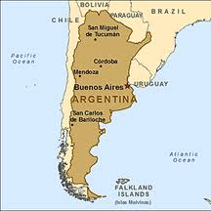
Ist non-European in 13 centuries
He must be good. He has proven to his superiors that he can be trusted to do whatever it takes to destroy Protestantism! Whatever he did in Argentina; now, he can do that on a world-wide scale! What did he do there?

Slide 12
Jesuit Provincial
For several years in Argentina, Bergoglio served as a Jesuit provincial. The provincials are the major subordinates of the black pope. There are around 83 provincials right now. As I understand it, the Jesuit Order has divided the world into 83 regions. For each region, there is a Jesuit provincial. There are 10 provincials in the United States. There is one for Central America. There is one for Ireland. They’ve divided up the world into these provinces. So it’s old Babylonian provincial government, centered in Nebuchadnezzar or the Jesuit General himself; so it’s strictly a Roman form of government where all the states or provinces are subordinate to this worldwide sovereign….

Slide 13
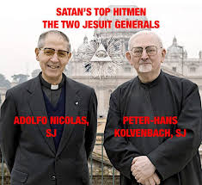
Information Gatherer/Planner
The Jesuit General exercises full and complete power over the Order. He meets with his provincials. When they decide to start a war or an agitation, he gets the information from the provincial of that country. The provincial gathers information over his locale from all his subordinates.

Slide 14
World-Wide!
The prophet of God declares, “The Roman Catholic Church, with all its ramifications throughout the world, forms one vast organization under the control, and designed to serve the interests, of the papal see. Its millions of communicants, in every country on the globe, are instructed to hold themselves as bound in allegiance to the pope. Whatever their nationality or their government, they are to regard the authority of the church as above all other. Though they may take the oath pledging their loyalty to the state, yet back of this lies the vow of obedience to Rome, absolving them from every pledge inimical to her interests.” GC, pg. 580 The Jesuit provincial utilizes all manner of information gathering to further the war on Protestantism around the world! This was Bergoglio’s purpose as Jesuit provincial in Argentina!

Slide 15
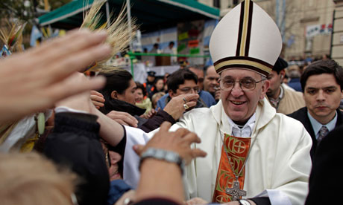
As a Provincial
Tragically, Bergoglio and Argentina didn’t get along very well. Thousands and thousands more died in a bloody war that raged while Bergoglio was there.

Slide 16
From an article by Michel Chossudovsky on the newly elected pope, we find that he was up to no good in Argentina. During the military rule by Jorge Videla, we read “In endorsing the military Junta, the Catholic hierarchy was complicit in torture and mass killings an estimated 22,000 dead and disappeared; from 1976 to 1978 … Thousands of additional victims were killed between 1978 and 1983 when the military was forced from power.” (National Security Archive, March 23, 2006). All of this occurred during Bergoglio’s time as provincial and bishop in Buenos Aires! Obviously, Bergoglio was so successful in fulfilling the Vatican’s purpose in Argentina; he has now been elevated to a higher position, to carry out these kinds of awful deeds on a worldwide scale!

Slide 17
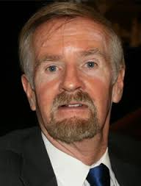
Operation Gladio by Catholic Paul L. Williams
In his classic book, Operation Gladio, Catholic author Williams declares that Francis was part of the disappearance and slaughter of thousands of Argentines during the Dirt War between 1976-1983. The Papal general, Jorge Videla, sought to create a Catholic holy state in Argentina. Francis was behind him 100%!

Slide 18
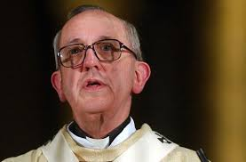
The man!
“Wall Street was firmly behind the military Junta which waged “The Dirty War” on its behalf. In turn, the Catholic Church hierarchy played a central role in sustaining the legitimacy of the military Junta.
The Order of Jesus –which represented the Conservative yet most influential faction within the Catholic Church, closely associated with Argentina’s economic elites– was firmly behind the military Junta, against so-called “Leftists” in the Peronista movement.”

Slide 19
A Typical Politician
“Bergoglio [Pope Francis I] twice invoked his right under Argentine law to refuse to appear in open court, and when he eventually did testify in 2010, his answers were evasive”: “At least two cases directly involved Bergoglio. One examined the torture of two of his Jesuit priests — Orlando Yorio and Francisco Jalics — who were kidnapped in 1976 from the slums where they advocated liberation theology. Yorio accused Bergoglio of effectively handing them over to the death squads… by declining to tell the regime that he endorsed their work. Jalics refused to discuss it after moving into seclusion in a German monastery.” (Los Angeles Times, April 1, 2005)

Slide 20
UN chief hails Pope Francis as a global spiritual leader
April 9, 2013 8:19pm VATICAN CITY - UN Secretary General Ban Ki-moon on Tuesday hailed Pope Francis as "a spiritual leader of the world" and emphasized goals of social justice shared between the Vatican and the United Nations. "It is very important to meet a spiritual leader of the world," Ban said at the start of his meeting with the Argentine pope, who last month became the first non-European leader of the world's Catholics in nearly 1,300 years. "The Holy See and the UN share common goals and ideas," said Ban—one of the first world leaders to be received at an audience by the new pontiff. Francis has called for the Roman Catholic Church to be closer to ordinary people and help the needy, as well as to reach out to people of different religions and non-believers. "We discussed the need to advance social justice and accelerate work to meet the Millenium Development Goals," Ban said after the meeting.

Slide 21
“The international community has undertaken to meet goals including eradicating extreme poverty and hunger and reducing child mortality by 2015. "Pope Francis is a man of peace and purpose. He is a voice for the voiceless," he said. Ban said he also invited the pope to visit the United Nations "at his earliest convenience.“ The UN leader also commented on the pope's choice to name himself after St Francis of Assisi, saying this was "a powerful message for the many goals shared by the United Nations.“ "It speaks loudly of his commitment to the poor, his acute sense of humility, his passion and compassion to improve the human condition," he said. Ban gave the pope a large book with the Charter of the United Nations in six languages. The pope, who only spoke in Italian, gave Ban a mosaic of Rome.”

Slide 22
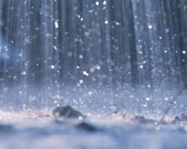
Rain is Coming
“And after these things I saw another angel come down from heaven, having great power; and the earth was lightened with his glory. And he cried mightily with a strong voice, saying, Babylon the great is fallen, is fallen, and is become the habitation of devils, and the hold of every foul spirit, and a cage of every unclean and hateful bird.” Rev. 18:1,2

Slide 23
Heaven’s Limitless Power
“I saw the latter rain is coming suddenly, as the midnight cry and with ten times the power.” Ellen White letter, Spalding-Megan Collection, pages 3,4
How powerful was the midnight cry?
“In the parable of Matthew 25 the time of waiting and slumber is followed by the coming of the bridegroom. This was in accordance with the arguments just presented, both from prophecy and from the types. They carried strong conviction of their truthfulness; and the "midnight cry" was heralded by thousands of believers.
Like a tidal wave the movement swept over the land. From city to city, from village to village, and into remote country places it went, until the waiting people of God were fully aroused.

Slide 24
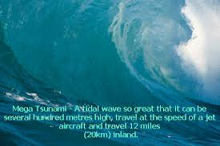
Unstoppable Force
“The angel who unites in the proclamation of the third angel's message is to lighten the whole earth with his glory. A work of world-wide extent and unwonted power is here foretold. The advent movement of 1840-44 was a glorious manifestation of the power of God; the first angel's message was carried to every missionary station in the world, and in some countries there was the greatest religious interest which has been witnessed in any land since the Reformation of the sixteenth century; but these are to be exceeded by the mighty movement under the last warning of the third angel.” GC, pg. 611

